Slide 1
Part-time Educator
Learn and Discover
Notes:
Welcome everyone, thank you for joining us. The time is , but we would like to wait a few more minutes to allow others to join we will be starting in just a few moments.
Welcome to the CalSTRS Part-time Educator: Learn and Discover webinar. My name is , and I am a benefits specialist at the __________ Member Service Center/ office.
**feel free to input a personalized introduction about yourself and your background**
Before we start, I’d like to address a couple items.
Today's presentation is packed with a lot of information and demonstrations of our online resources. Please be sure you have pen and paper available to take notes, I can give you a couple of minutes if you need to grab them.
Please do not submit any personal information OR request from us any information that is specific to your account. For your security we ask that if you do have any questions specific to your retirement account you email those through your secured myCalSTRS account or to call us at 1-800-228-5453 and speak with a CalSTRS representative.
If you find that you have questions after the webinar is complete, I urge you to log into your myCalSTRS account and send a secure online message. You can log onto myCalSTRS anytime.
Click.

Slide 2
Trust ®, not impersonators
CalSTRS authorized representatives:
Have an email address ending in @CalSTRS.com.
Can provide a CalSTRS ID badge or business card.
Do not provide refreshments at offsite events.
Will never meet at your home.
Do not sell insurance products.
Notes:
Before we start, we’ve been receiving constant reports from our members believing they’ve set up an appointment or spoken with a CalSTRS representative when they have not. Only CalSTRS employees can provide you with accurate information regarding your CalSTRS Defined Benefit and Pension2 accounts. We’ve developed a checklist for you to use to ensure the person with whom your speaking is a CalSTRS employee.
Companies or individuals not affiliated with CalSTRS cannot have the CalSTRS logo on their advertisements.
Only CalSTRS employees will have an @CalSTRS.com e-mail address on their business cards. Please double-check the spelling of CalSTRS.
CalSTRS does not provide any refreshments when we come to see you at events.
CalSTRS employees will never meet you at your home.
CalSTRS is not an insurance company, so we will never try to sell you on any insurance products.
Click.

Slide 3
Trust ®, not impersonators
CalSTRS authorized representatives:
Have access to your CalSTRS or Pension2® account information.
Some Voya Financial representatives work exclusively with Pension2. Their names and photos are listed at CalSTRS.com/Trust-CalSTRS.
To verify a CalSTRS representative, contact us at 888-394-2060 or RepCheck@CalSTRS.com.
Notes:
Only CalSTRS employees will have access to your CalSTRS or Pension2 account information. If you’re asked to provide a copy of your CalSTRS Retirement Progress Report or Pension2 account statement in order for someone to assess your CalSTRS accounts, they are not affiliated with CalSTRS.
CalSTRS has created a webpage at www.CalSTRS.com/Trust-CalSTRS with names and pictures of our member-facing Voya representatives. This webpage is kept up-to-date, so you can always ensure you’re speaking with a trusted person. These representatives from Voya Financial have an @Voya.com e-mail address and they work exclusively on the Pension2 program.
If you scheduled an appointment or already met with someone you think may not be a CalSTRS representative, contact us at 888-394-2060 or RepCheck@CalSTRS.com to verify they are a CalSTRS representative.
Please disseminate this information to any friends or colleagues who may need it.
Click.

Slide 4
Objectives
Explore the Part-time Educator webpage and your Retirement Progress Report.
Review part-time educator forms.
Learn about CalSTRS tools and financial education resources.
Notes:
The tools we are going to review today are available at your fingertips 24/7
Click.
In today’s webinar we will review the Part-Time Educator webpage and learn how to access your myCalSTRS account. While in myCalSTRS, I’ll show you how to download your Retirement Progress report and how you can use it to find some important information.
Click.
We will review some relevant forms that are more commonly used by part-time educators.
Click.
And throughout the presentation I’ll be showing you the CalSTRS tools and financial education resources our website has to offer.
Click.

Slide 5
CalSTRS.com
Notes:
Because we know it can be time-consuming to search through our website looking for information, we’ve created a webpage specific to our Part-Time Educators.
Click.

Slide 6
Part-time educator career webpage
Your “one stop shop” for retirement information.
Links resources associated with part-time employment.
Available to you 24 / 7 / 365.
Notes:
You will notice throughout today’s presentation that we are going to refer to the part-time webpage quite a bit:
Click.
The part-time page acts as a “one stop shop” for retirement information. We’ve collected links to all the pages we felt would be relevant for you.
Click.
This page houses links to all sorts of resources that will help you learn more about your retirement program with CalSTRS.
Click.
This information is available to you 24 hours a day, 7 days a week, 365 days a year.
Click.

Slide 7
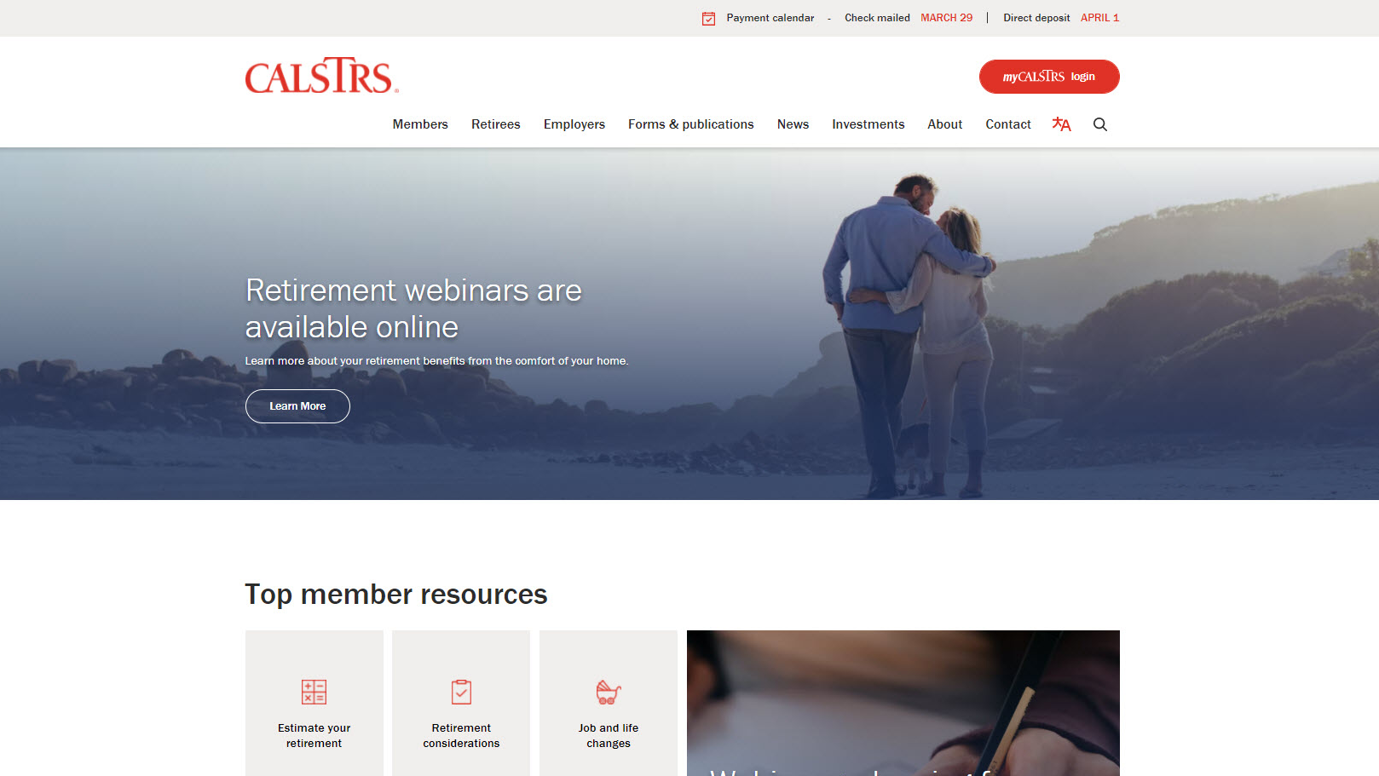
Notes:
Here’s how to get there.
From the top menu on our homepage CalSTRS.com, you’re going to want to hover your mouse over “Members” and a dropdown menu will appear.
Click.

Slide 8
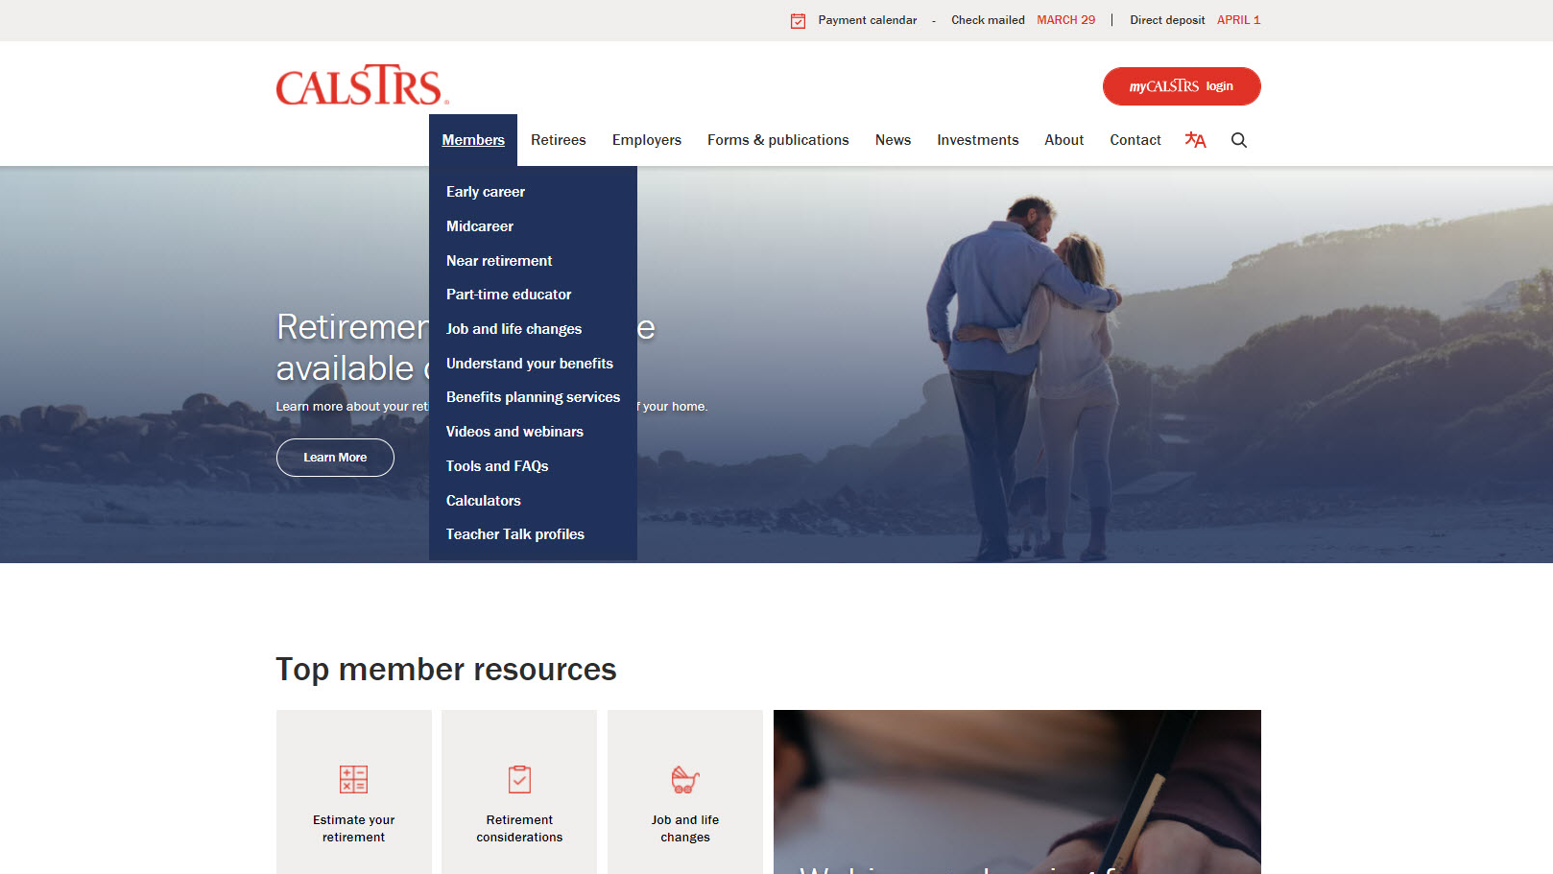
Notes:
From that menu, you’ll find and click “Part-time educator”
Click.

Slide 9
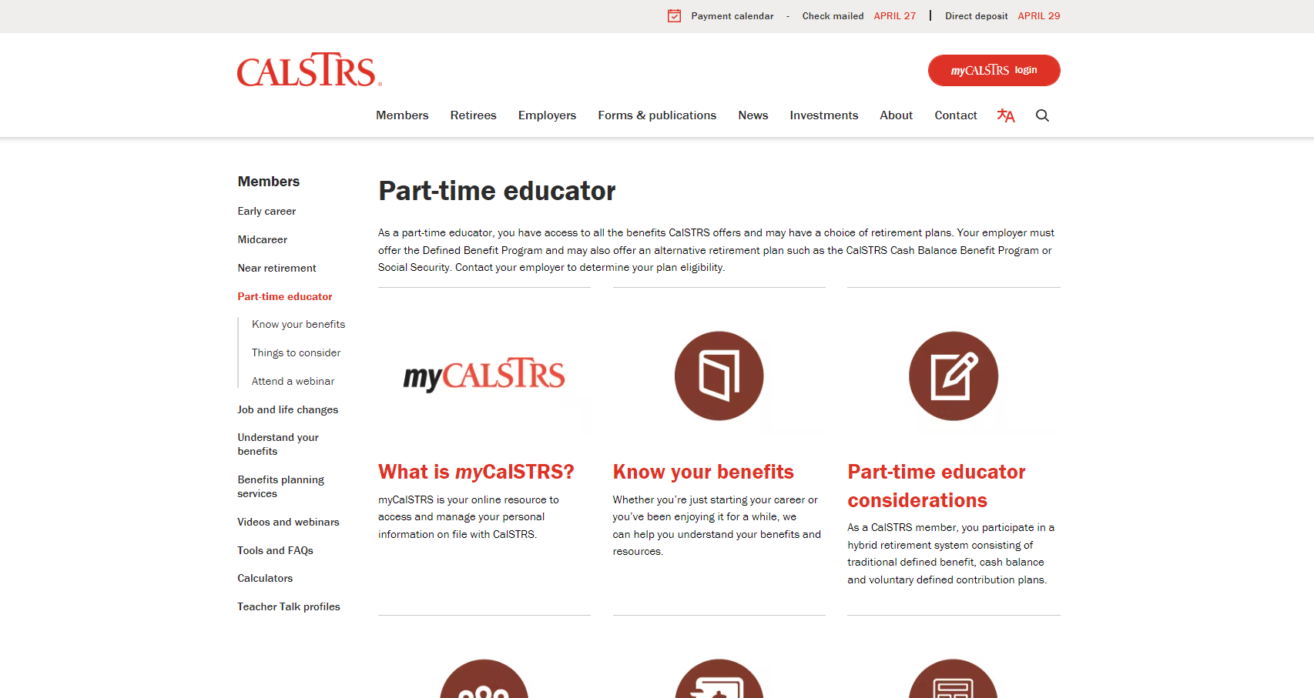
Notes:
Then you’re there! Scroll down to see all the resources.
Click.

Slide 10
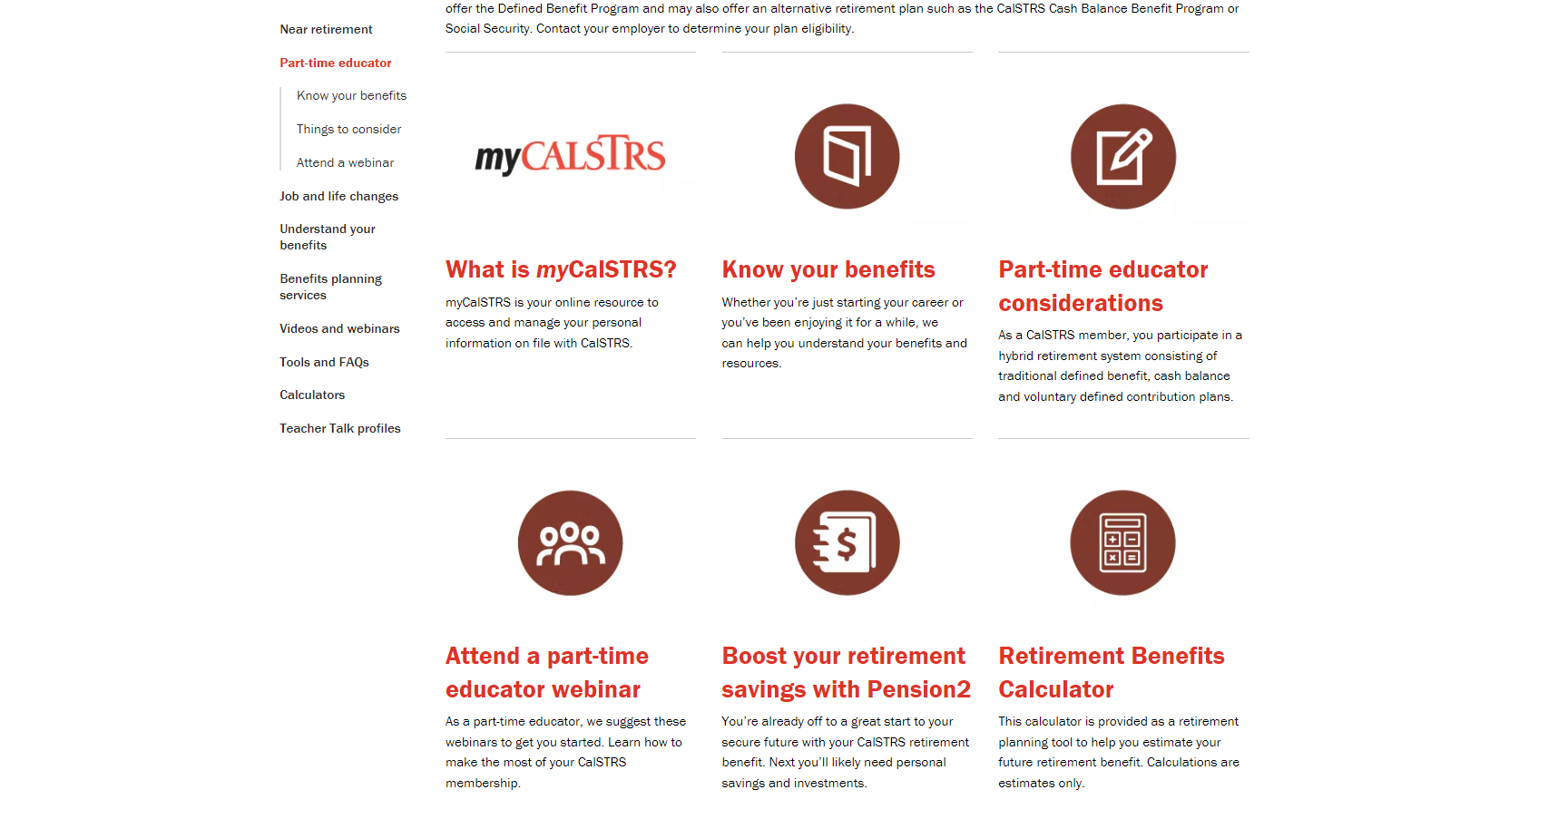
Notes:
Today I’m going to take you through all six of these links. They each offer valuable information so take note if something stands out to you as something you’ll want to come back to later. Most of what we talk about today will be very general, but we hope you’ll feel inspired to check out our other resources or webinars to continue your learning.
Click
First, and maybe the most important resources, is myCalSTRS.
Click.

Slide 11
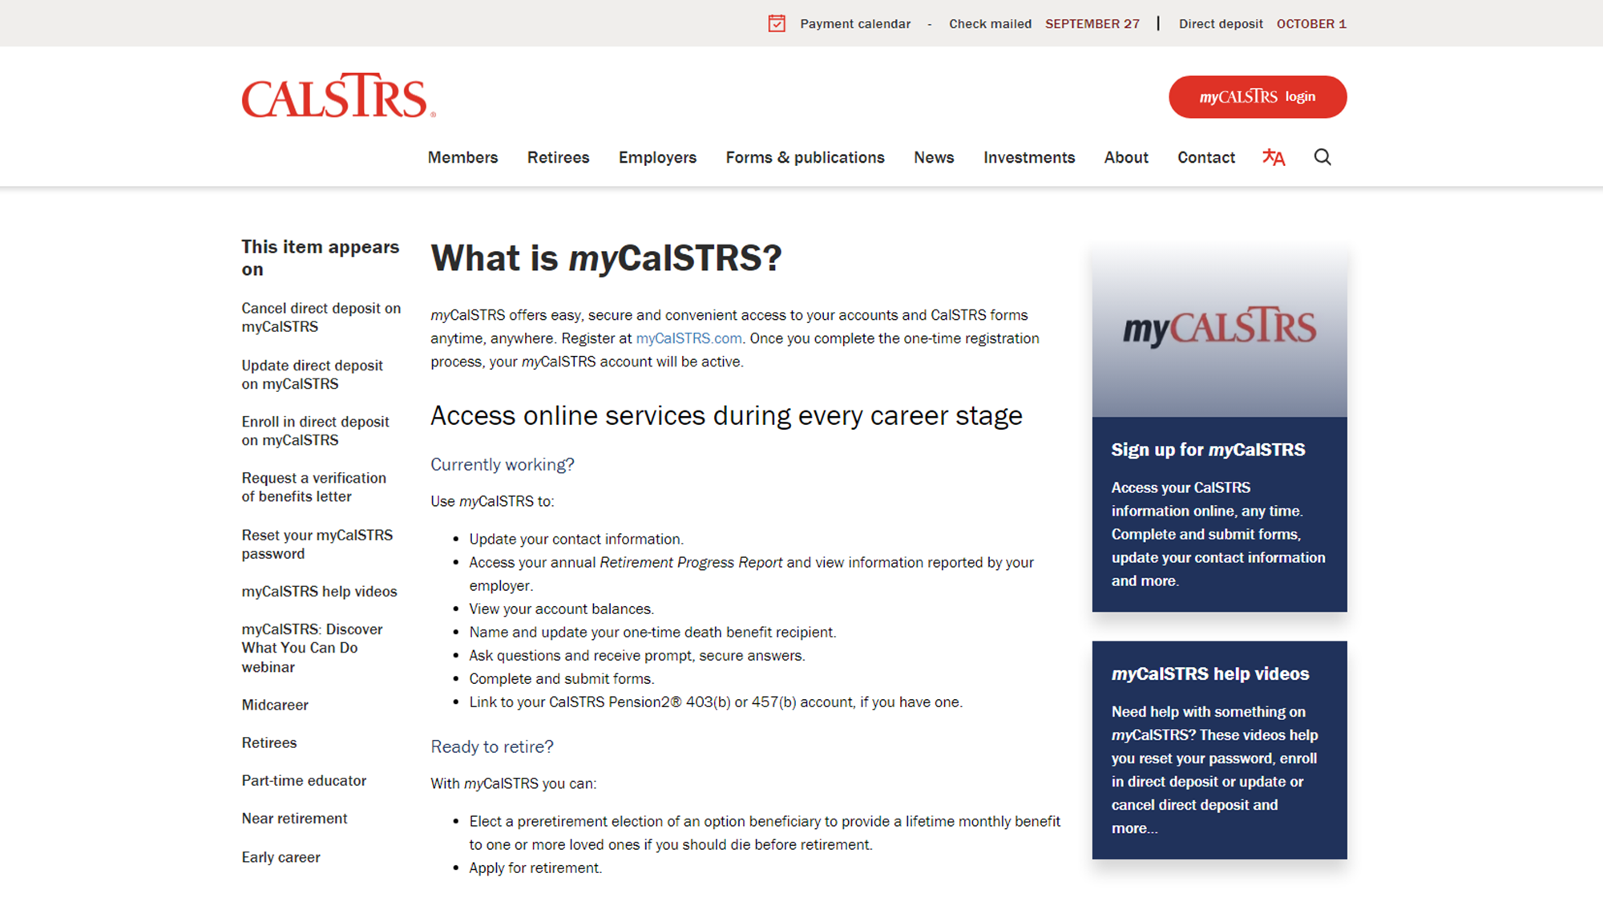
Notes:
What is myCalSTRS? If you haven’t checked out your myCalSTRS account before today, I encourage you to register and login as soon as you can.
Click.
This page has links for you to sign up or log in.
Click.
You can also see there are help videos if you are having trouble.
Click.

Slide 12
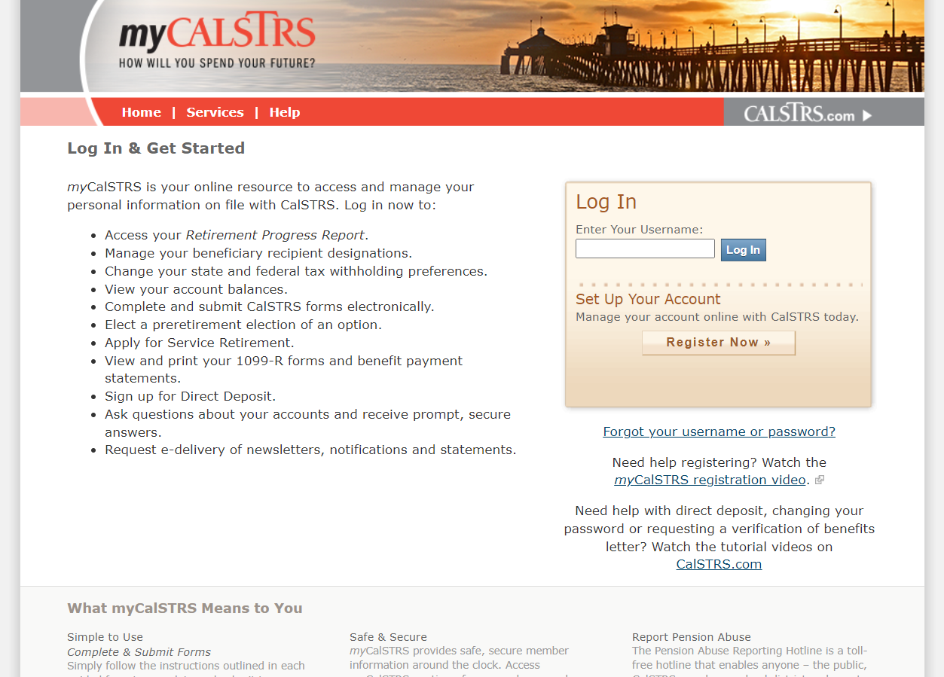
myCalSTRS
View and update your account information.
Verify and update your benefit recipient.
Review your Employer Details screen to check reporting.
Access your Retirement Progress Report.
Notes:
Again…..What is myCalSTRS?
A myCalSTRS account allows you access to all information pertaining to you and your membership.
You’re able to view and update your account information, maybe you’ve moved and need to change your address, this is where you can go to easily do that.
myCalSTRS is your resource for verifying and updating your benefit recipient information.
If you’re a Defined Benefit member, you’ll be able to see your employer’s reporting in the Employer Detail screen.
And you can access your annual Retirement Progress Report.
We will be talking more about these things throughout today’s presentation.

Slide 13
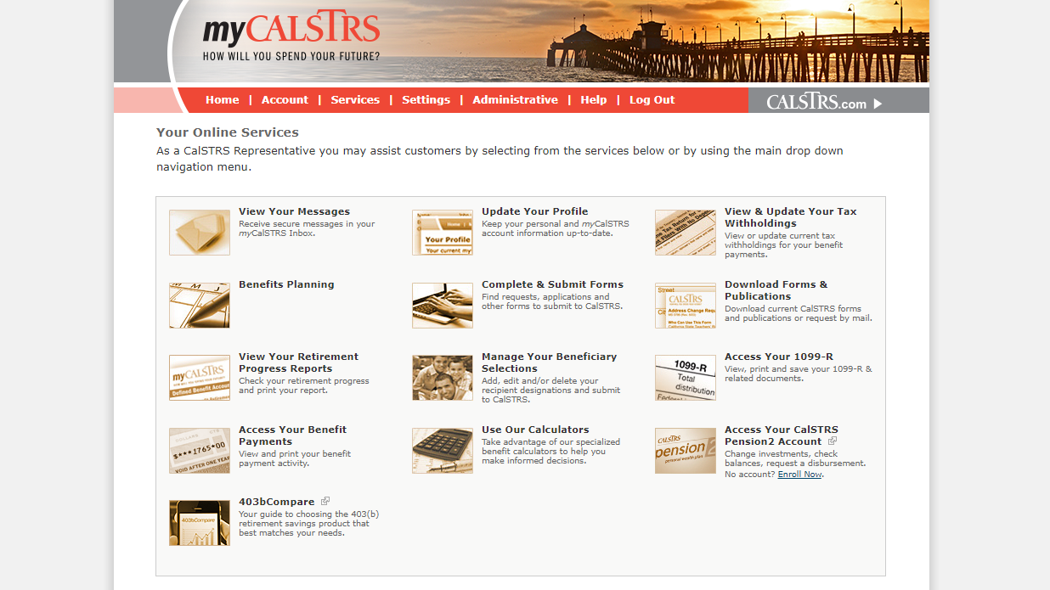
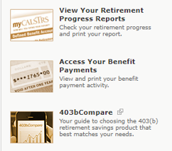
Notes:
So in September, when you’ll be looking for your Retirement Progress Report, you’ll first login to your myCalSTRS account.
This is a landing page similar to the one you’ll find when you log on. The tiles you see will vary depending on your membership status.
Click.
You’ll click “View Your Retirement Progress Reports”
Click.

Slide 14
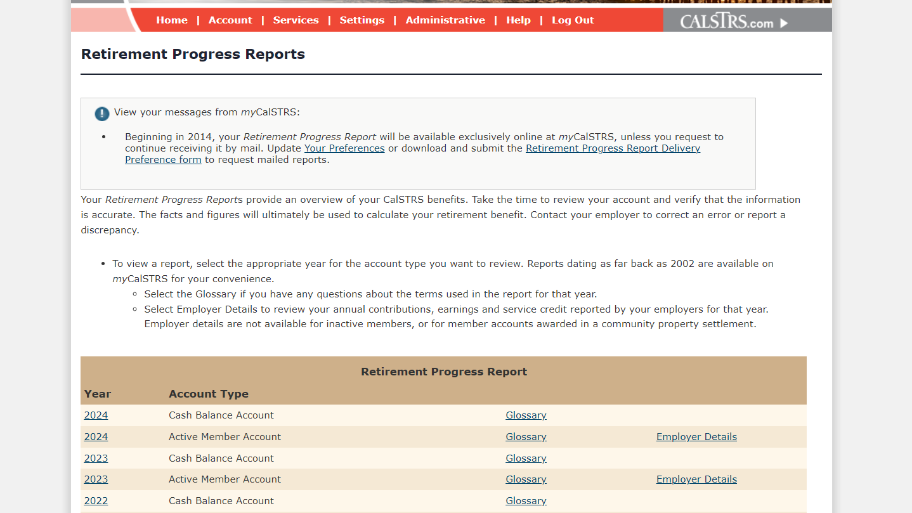
Retirement Progress Report
Notes:
A couple things to notice on this page.
This sample member is participating in both the Cash Balance Benefit Program and the Defined Benefit Account. Under ‘Account Type’ Defined Benefit is listed as “Active Member Account”
You can view your Retirement Progress Reports all the way back to 2002.
Click.
I had mentioned employer reporting. If you are a Defined Benefit member, you’ll see a link titled Employer Details”
Let’s look at what kind of reporting is shown
Click.

Slide 15
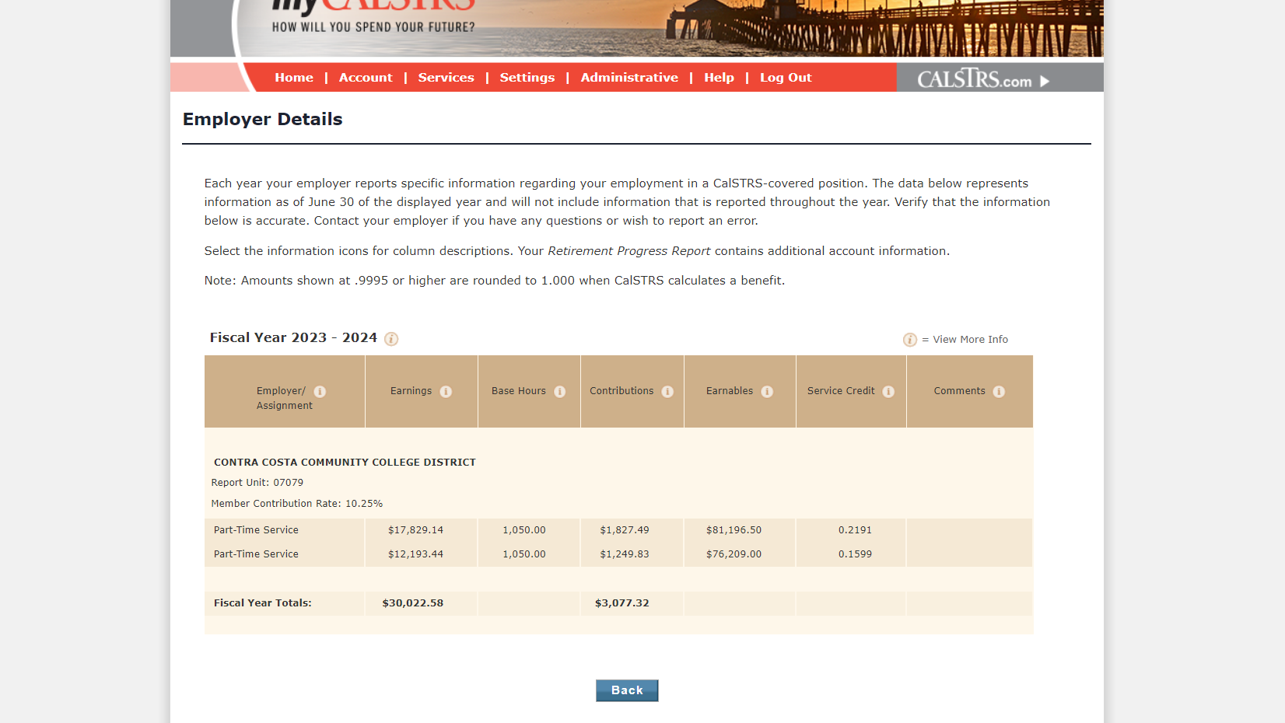
Notes:
Employer Details are listed by who your Employer is. If you have more than one employer, you’ll see separate lines for each.
You’ll see how much you earned during the school year, how much you contributed, and the service credit earned.
“Base Hours” and “Earnables” are both specific to your contract and reflect what you would work and earn if you were working that contract on a full-time basis.
While here, if you notice any discrepancies, please contact your employer to have them correct the reporting.
Click.

Slide 16
Retirement Progress Reports
Notes:
Back to the list of Retirement Progress Reports. You can view previous years while here, but today we will focus on 2023.
Note that this sample member is participating in both the Cash Balance and Defined Benefit program. “Active Member Account” actually refers to the Defined Benefit progress report.
Click.

Slide 17
Cash Balance Benefit Program
Defined Benefit Program
Notes:
Depending on your program, or which program report you pull up, these are the current covers.
If you’re a Cash Balance Benefit Program participant, this will be your cover on the left.
For Defined Benefit members, your cover will look like this on the right.
Click.

Slide 18
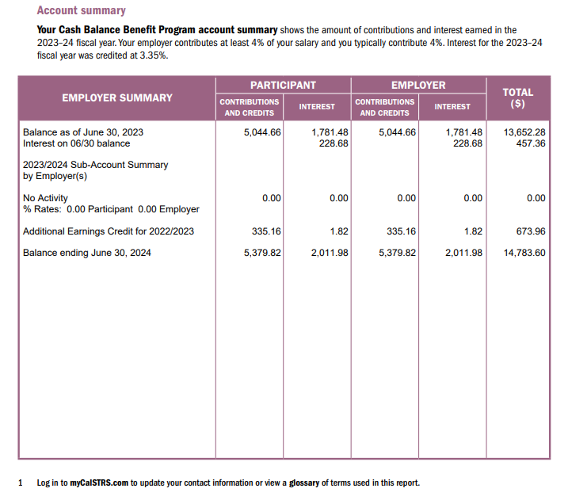
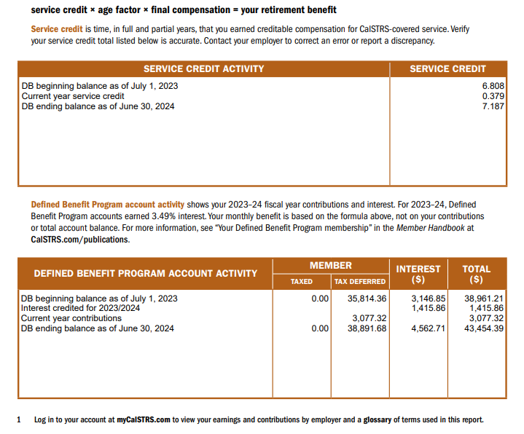
Cash Balance Benefit Program
Defined Benefit Program
Notes:
For Defined Benefit members, I showed where you can find the breakdown of employer reporting. If you’re a cash balance participant, you won’t be left in the dark!
Cash Balance reporting shows up in your Retirement Progress Reports. On page 1 you’ll find a detailed breakdown of your employer reporting. You’ll notice your contributions are listed as well as your employer’s contributions. Both go into your Cash balance account and an updated balance is calculated for you.
Defined Benefit members, you will NOT find specific employer reporting in your report. However, you will see your total year contributions and an updated balance including interest. Your employer’s contributions are not shown because they are not credited to your Defined Benefit account but are deposited into the Teachers’ Retirement Fund to help fund the benefits paid to all members and beneficiaries.
Either way, any discrepancies found, you need to go to your employer to have the reporting corrected.
We are going shift out of the retirement progress report now, but rest assured that we will be refrencing it a few more times.
Click.

Slide 19
Notes:
Back to the part-time educator page. The next tile here is “Know your benefits” and contains a wealth of information for you
Click.

Slide 20
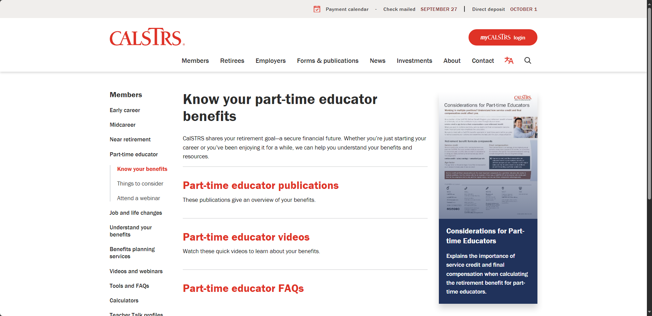
Notes:
We’ve broken this down into 3 parts. Depending on how you learn best, you might find different links useful. But I’ll give you an overview of each.
Click.

Slide 21
Part-time educator publications
Considerations for Part-time Educators
Member Handbook
Cash Balance Benefit brochure
Concurrent Retirement
Social Security, CalSTRS and You
Understanding the Formula
Notes:
CalSTRS has a lot of publications covering a variety of topics and scenarios you might find yourself in. However, on this page, we’ve linked those most applicable to a part-time educator.
On this slide we’ve listed some of those publications. These contain important information to keep in mind while you are working.
Considerations for part-time educators is our newest publication. This is all about what a part-time defined benefit member needs to keep in mind to maximize their benefit.
The member handbook and cash balance handbook are really good resources that give information about everything CalSTRS. Concurrent Retirement, Social Security, CalSTRS and You, and Understanding the Formula are factsheets that focus on a single part of your membership.
Click.

Slide 22
Part-time educator videos
Understanding the Formula
CalSTRS Pension2 – Plan Overview
Introduction to Social Security
Defined Benefit Supplement Program
Survivor Benefits
Refund: Consider the Consequences
Notes:
If you’d rather watch a video, we’ve linked those too. Each video is only a few minutes long but serves as a good first step or refresher for you to better understand your CalSTRS membership.
Click.

Slide 23
Part-time educator FAQ
Cash Balance Benefit Program
Consolidating program coverage
Address change
Notification of death
Retirement Progress Report
Purchasing service credit
Service retirement
Refunds
Notes:
And we have FAQs, or Frequently Asked Questions. This is probably the best place for you to go before calling our 800 number. CalSTRS has been here since 1913, we have a good idea of the most common concerns of our membership. I hope you will find answers to not only your questions, but also to questions you didn’t even know to ask.
Click.

Slide 24
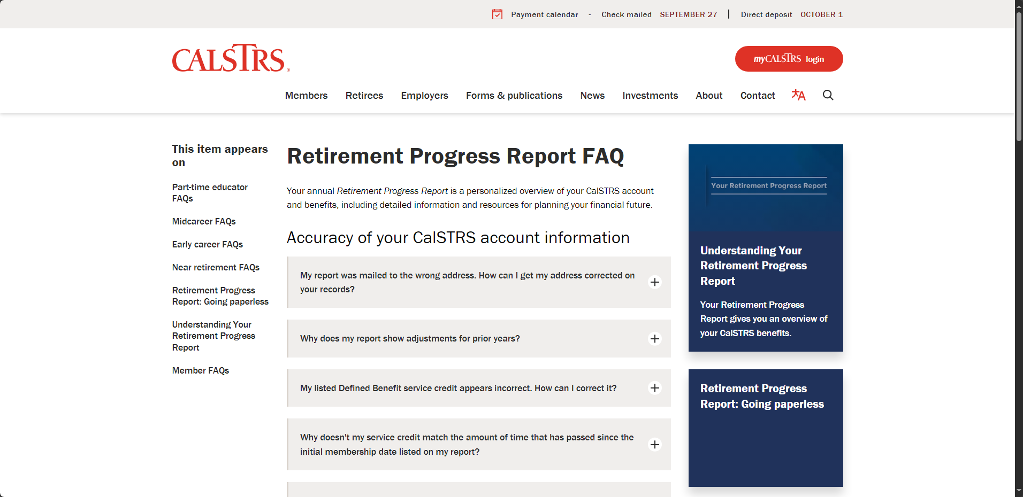
Notes:
To find the answer to that question, you’ll want to check out the Retirement Progress Report FAQ. There are multiple questions here about the accuracy of your CalSTRS account information.
The question we want answered is the third one down.
Click.

Slide 25
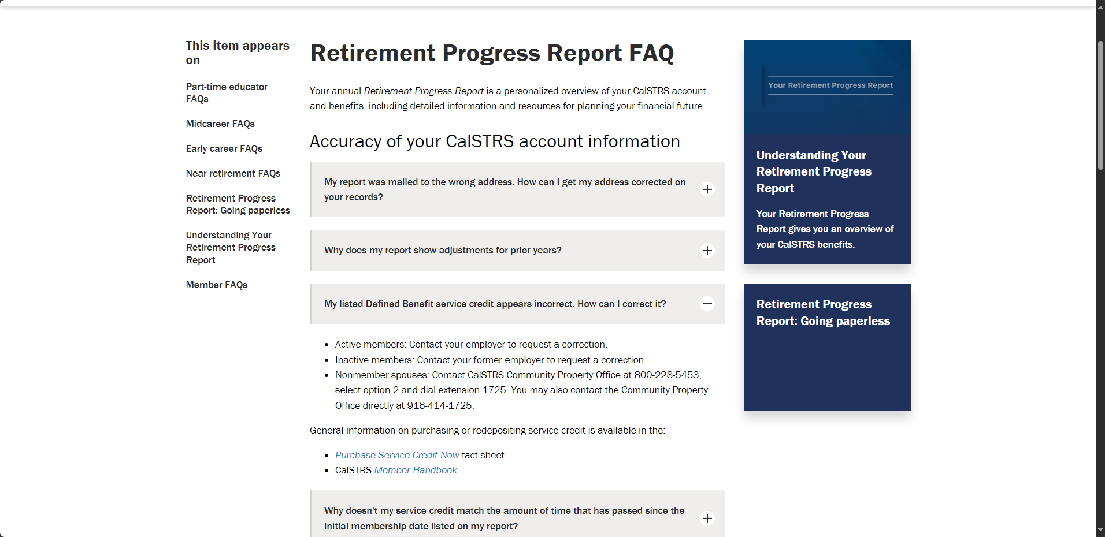
Notes:
If you click on the question, it will expand like this and you’ll find a detailed answer. There’s actually 3 ways for it to be corrected depending on your membership status. The question mentioned an active member, so as you can see by the first bullet, you will want to contact your employer.
A part of this that I find very beneficial, are the links to related publications. So if you want to do more research, we try to make it easier.
Other types of questions you can find on this page are….
Why should I read my Retirement Progress Report?
Why aren't my employer's contributions listed on my Retirement Progress Report?
What are the base hours displayed on the Employer Detail screen of my Retirement Progress Report on myCalSTRS?
Click.

Slide 26
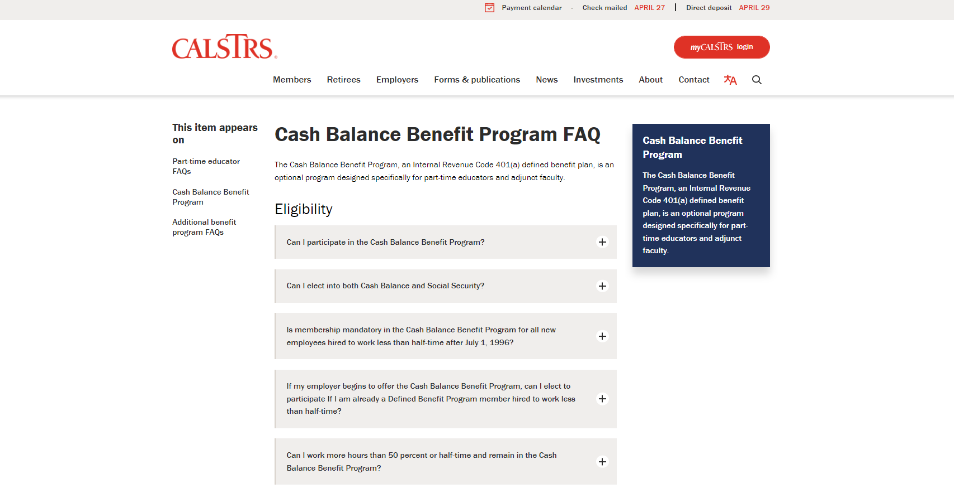
Notes:
The Cash Balance Benefit Program is an optional program designed specifically for part-time educators. Some of you attending today might be contributing into this program.
Some great questions on this page as well….
Can I elect into both Cash Balance and Social Security?
If my employer begins to offer the Cash Balance Benefit Program, can I elect to participate If I am already a Defined Benefit Program member hired to work less than half-time?
Can I roll over money from other retirement plans to the Cash Balance Benefit Program?
The answer is ‘Yes’ to each of these questions, but sometimes it’ll be a “yes, if…” or a “yes, but…” type of answer. When checking these out, do make sure you read the complete answer so you get all the details.
Click.

Slide 27
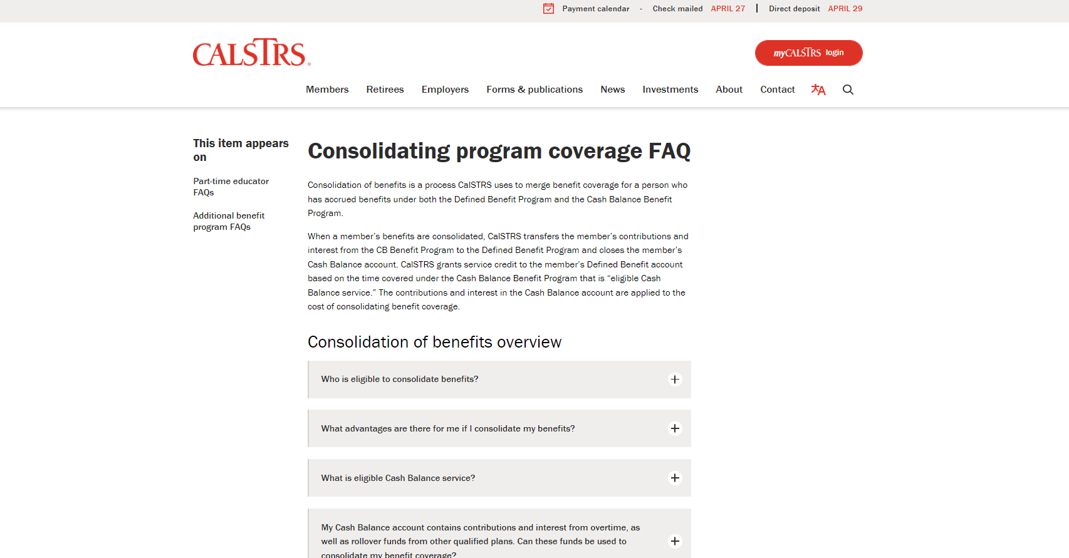
Notes:
If you are currently a participant of the cash balance program, or maybe you were in the past and still have an inactive account, then you might be interested in consolidating program coverage.
This is the consolidation of your Defined Benefit account and your Cash Balance account.
This page answers questions such as:
What advantages are there for me if I consolidate my benefits?
What will happen when my benefits are consolidated?
May I participate in the Cash Balance Benefit Program after consolidating my benefits? How do I make a request for consolidation of my benefits?
Definitely check this page out if these questions resonate with you at all.
Click.

Slide 28
Notes:
After ‘Know your benefits’, we have “Part-time educator considerations”
Click.

Slide 29
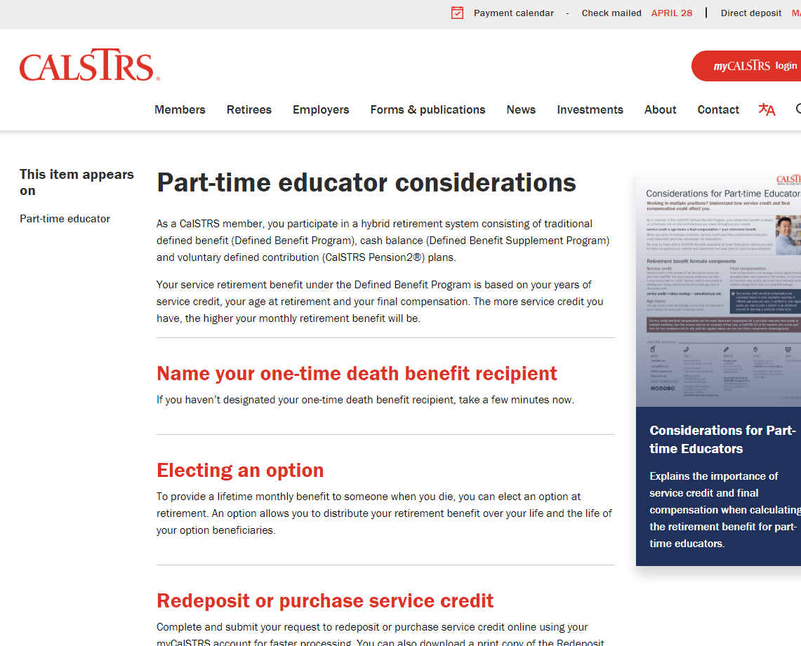
Defined Benefit
One-time death benefit recipient
Cash Balance
Lump-sum benefit recipient
Elect someone today!
Review every five years
Notes:
There are three considerations that we have listed on this page.
The first is “Name your one-time death benefit recipient”
If you haven’t done this yet, I recommend you do it as soon as you’re able.
Click.

Slide 30
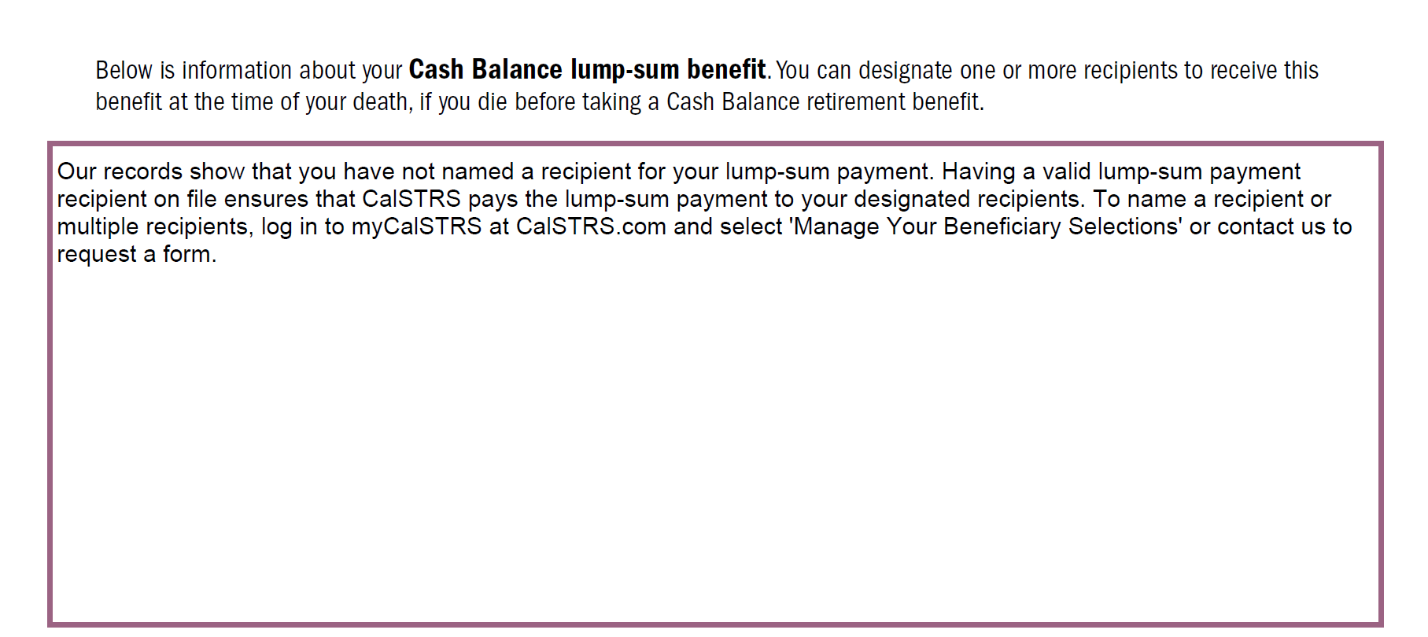
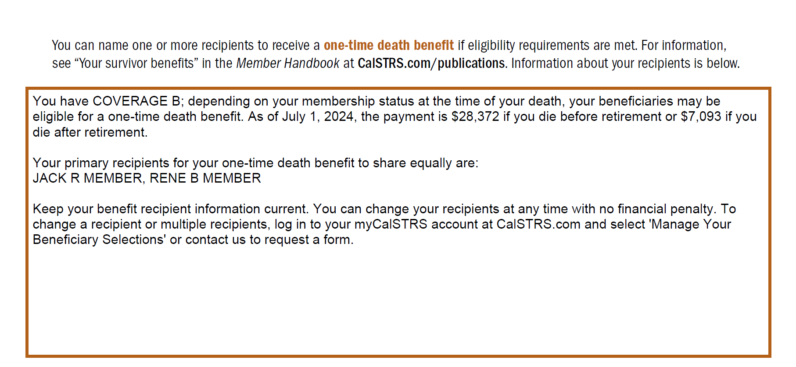
Verify your benefit recipient
Cash Balance Benefit Program
Defined Benefit Program
Notes:
Both programs need a recipient to be named. For Cash Balance, it’s a lump-sum benefit because there is no one-time death benefit with this program. For Defined Benefit, you can see your coverage type and benefit amounts in your RPR. If you have a recipient named, you will see them named on this portion of your Retirement Progress Report. If it looks like you see above, then you’ll want to sign on to myCalSTRS and get someone’s name on file.
Click.

Slide 31
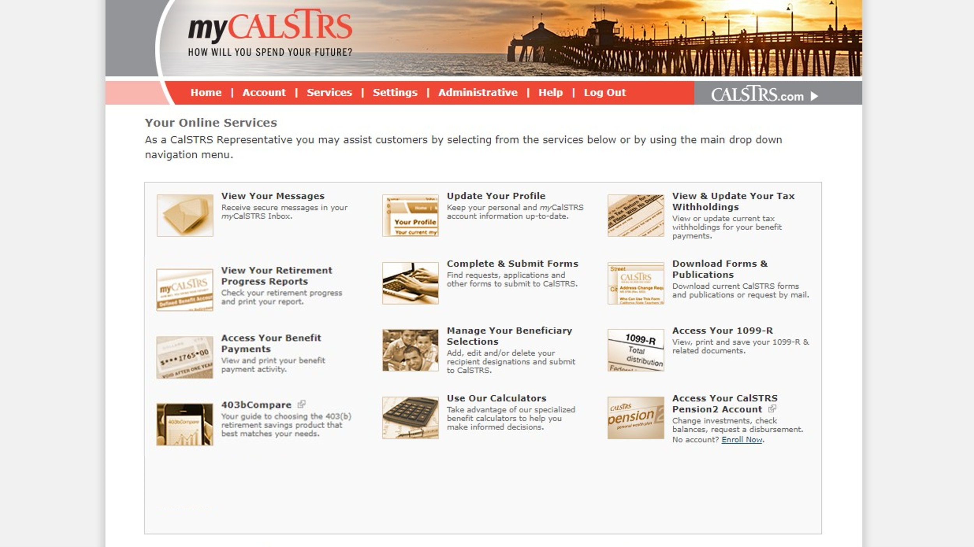
Manage your beneficiary selections
Notes:
In your myCalSTRS account you’ll want to go here, “Manage Your Beneficiary Selections”.
This will be your most up-to-date record of any beneficiary you may have on file. So if you have submit a request after the last Progress Report was issued, you can verify your selection here.
Click.

Slide 32
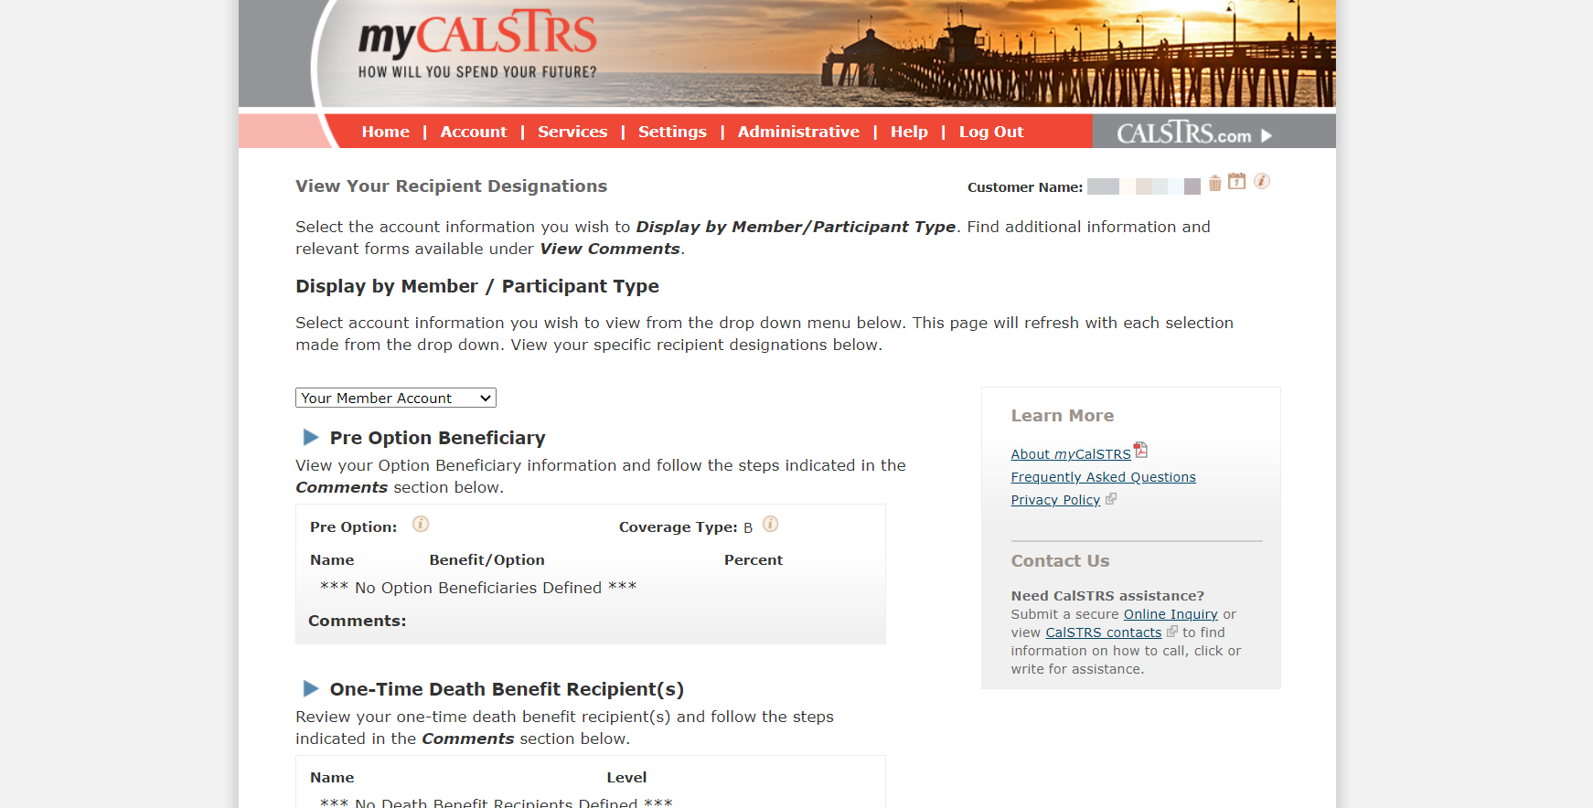
View your recipient designations
Notes:
If you have more than one account with CalSTRS, you can select it in the dropdown menu here. Once you verify you’re looking at the correct account, you can review, add, or update your beneficiary information.
Click.
We just saw on the Cash Balance RPR that the recipient is called a “lump-sum benefit recipient” but when you’re in myCalSTRS, you won’t see that title. You’ll want have your recipient added under the “one-time death benefit recipient”
Click.

Slide 33
Defined Benefit
Preretirement election as soon as you’re eligible to retire.
Elect an option at retirement.
Cash Balance
Name an annuity beneficiary at retirement.
Notes:
Next item on the considerations page is “Electing an option”.
For both the Defined Benefit program and Cash Balance program, you may have the opportunity to leave a lifetime payment for a loved one after your passing.
Under Defined Benefit, you can name this option beneficiary if eligible but not yet ready to retire. This is called a preretirement election of an option and will provide a lifetime benefit to a loved one if you were to pass away before you retire.
If you don’t elect an option while you’re working, you will still have the chance to do so on your Service Retirement application.
For Cash Balance, you also will have a chance to name a beneficiary at retirement given you meet the minimum qualifications for a lifetime annuity. That minimum requirement is to have at least a $3,500 balance at retirement.
Click.

Slide 34
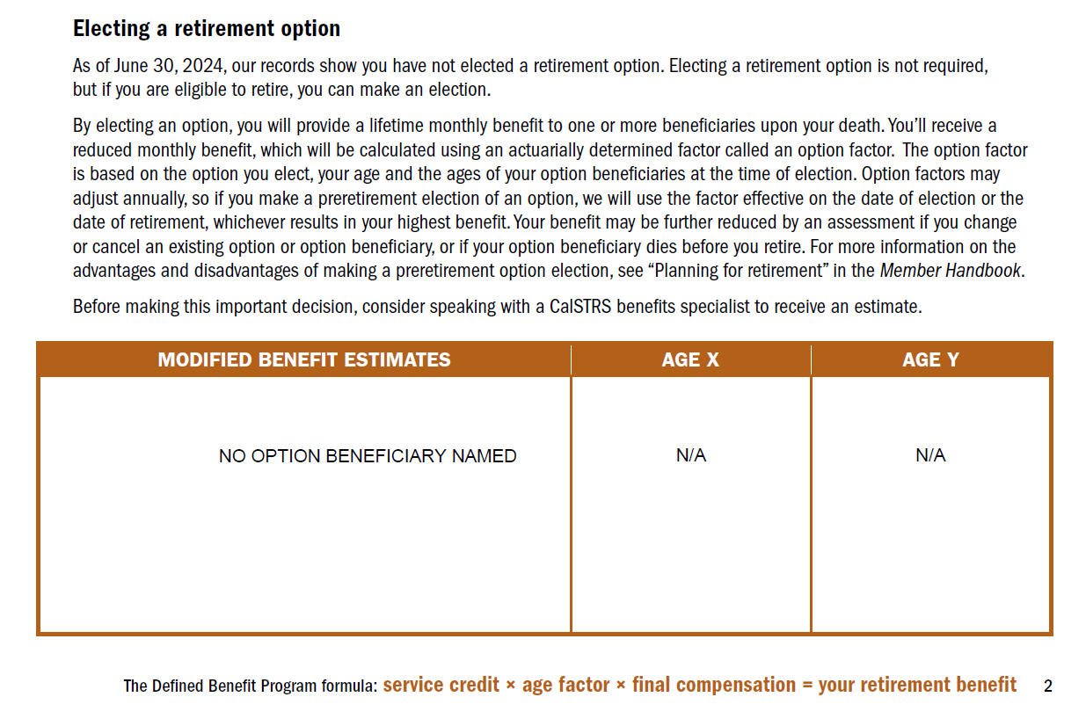
Verify your option beneficiary
Notes:
In the Defined Benefit RPR, there is a section dedicated to “Electing a retirement option”
You’ll see 1 of 3 things here… Either you aren’t eligible to elect an option, you haven’t elected an option yet, or if you have, you’ll see an estimate that shows a modified benefit.
This is the bottom of page 2.
Click.

Slide 35
Defined Benefit
Redeposit a prior refund
Purchase permissive service credit
Nonmember
Unpaid leave
Out-of-state
Cash Balance
Consolidation of benefits
Notes:
The third part-time consideration is “Redeposit or purchase service credit.”
For a Defined Benefit member, if you previously refunded your account, those funds can be put back in through a redeposit. Or if you worked in a CA public school prior to becoming a full time member, have taken an unpaid leave, such as FMLA, or if you worked out of state then that time may be purchasable.
As a Cash Balance participant, the only way you’d be able to purchase service credit is through the process of consolidating your benefits. This will set you up to purchase the eligible cash balance time to convert it into service credit under a Defined Benefit account.
If any of this sounds like it may apply to you, definitely go here to learn more.
Click.

Slide 36
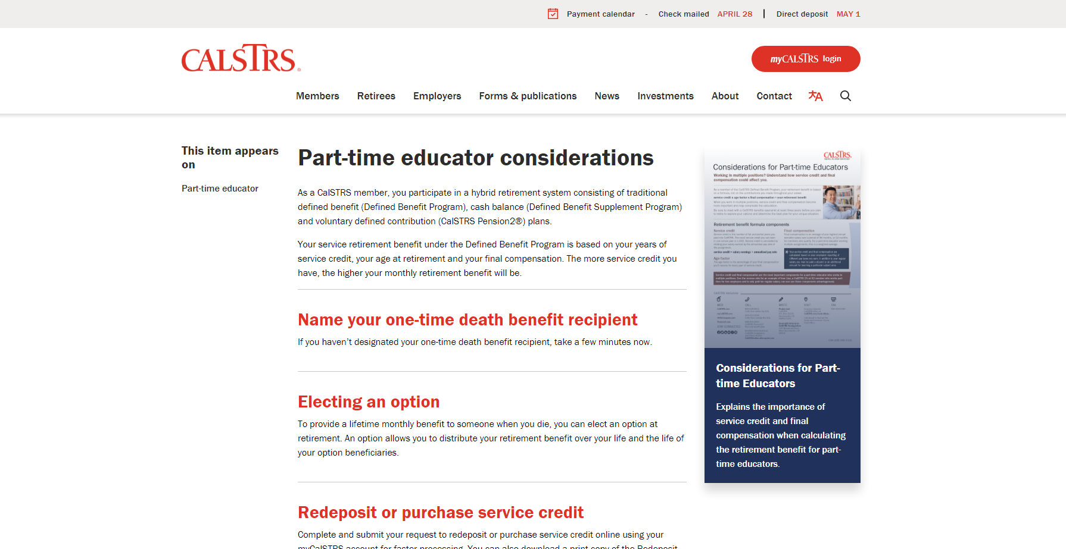
Notes:
The last thing I want to point out on the part-time educator considerations page is here on the right-hand side.
This is our newest factsheet for part-time educators.
Click.

Slide 37
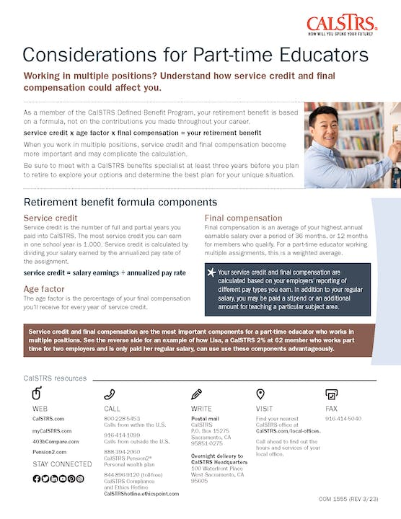
Considerations for Part-time Educators
Retirement benefit formula
Educators working multiple assignments
Determining service credit
Annualized pay rate
Final compensation considerations
Notes:
This fact sheet is for those of you in the Defined Benefit program or even if you’re considering joining the Defined Benefit program. Because many part-time educators are working multiple assignments, there are some things to consider that a full-time educator may not need to.
Download this factsheet to learn more about the retirement benefit formula and how your service credit, pay rate, and final compensation are calculated and factor in to your retirement benefit.
Click.

Slide 38
Notes:
Now on to the next tile of the part-time educator page………..webinars!
Click.

Slide 39
Part-time webinars
Part-time Educator
Start Saving Now for Part-time Educators
Consolidation of Benefits
Cash Balance
Additional Income Sources for Part-time Educators
Part-time Educator Working Multiple Assignments
Notes:
If you had checked out our website 2 years ago, you wouldn’t have found any webinars dedicated to part-time educators. Our team has been hard at work to create a group of webinars just for you! We started with the “part-time educator” to set a foundation for you. Through that webinar, we looked at the most commonly asked questions and created some topical-based webinars to further educate you on your retirement and how to make the most of it.
So if you haven’t already, I recommend you attend the “Part-time Educator” webinar first before you attend any of the others. I’ll go into more detail on these webinars later on in this presentation.
Click.

Slide 40
Notes:
Moving along, our next tile is labeled “Boost your retirement savings with Pension2”
This tile is especially important for part-time educators. Typically, part-time work means a part-time retirement benefit. While paying into CalSTRS, you aren’t paying into Social Security, it might be wise to instead invest the money you would be paying into social security in a supplemental savings plan to help set you up for a better retirement.
Click.

Slide 41
Pension2
Voluntary supplemental savings plan
Roll over money from other qualified retirement plans
Save on fees
Visit 403bCompare.com
Notes:
Pension2 is our voluntary supplemental savings plan. You don’t have to be a CalSTRS member to take advantage, you just have to be working somewhere in the California public school system.
If you already have retirement savings in another plan outside of CalSTRS, you do have the option of rolling money over into a Pension2 plan.
We might be able to help you save on fees!
On this webpage we also link you to 403bcompare.com to help in your research
Click.

Slide 42
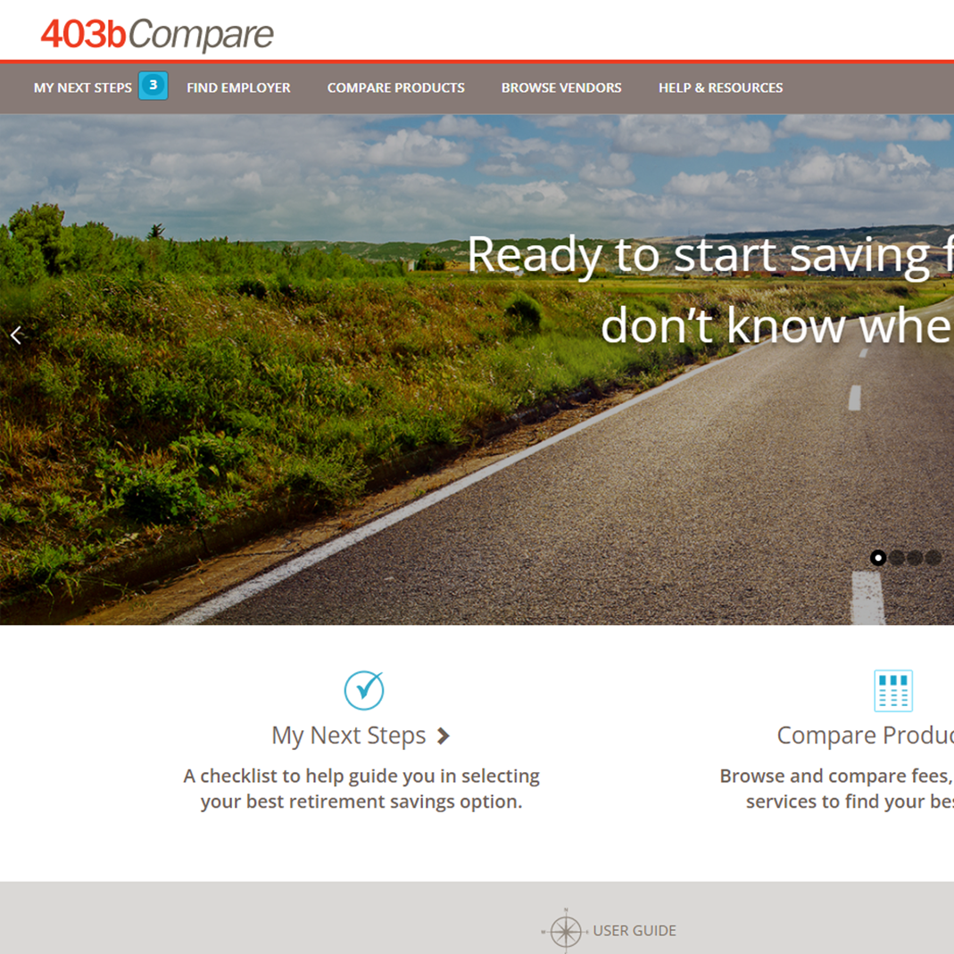
403bCompare.com
Easy access to products offered by your district.
Compare investment fees, performances and services.
Learn 403(b) & 457(b) plan fundamentals.
Notes:
403bCompare.com is a legally mandated website that lists all products offered by your district. On this website, you’ll easily be able to compare investment fees, performances, and services offered.
It also goes a step further and helps you understand what exactly a 403(b) and 457(b) are and how those plans can help you.
I hope you find these resources helpful as you research additional retirement accounts to invest in.
Click.

Slide 43
Notes:
Last, but definitely not least, we have our “Retirement Benefits Calculator”
Click.

Slide 44
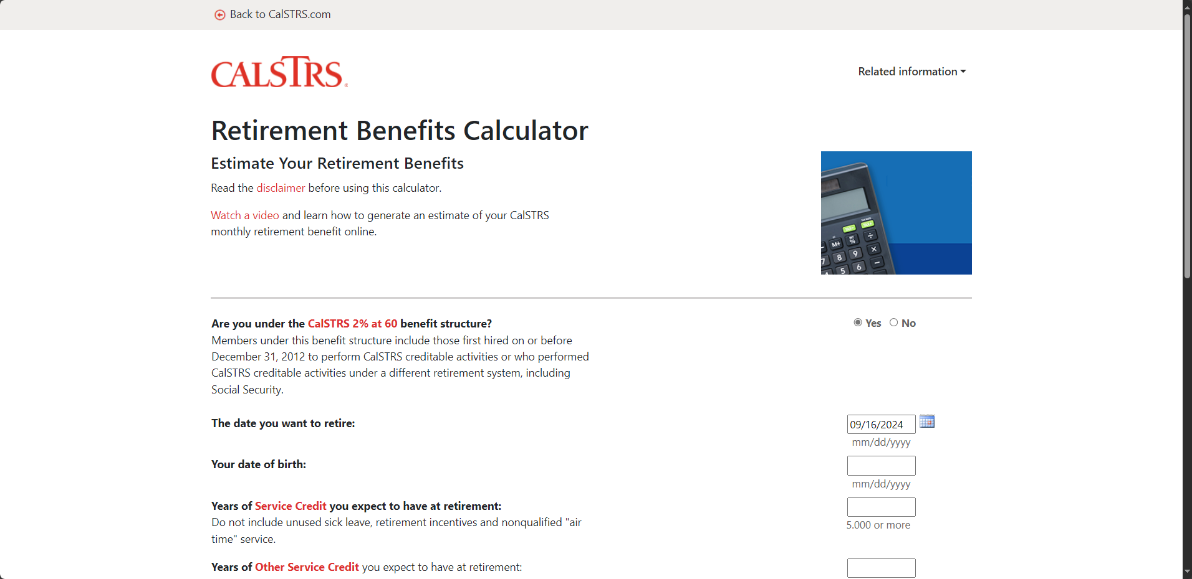
Retirement Benefits Calculator
Defined Benefit Only
Notes:
This calculator is solely for those of you planning to retire from the Defined Benefit Program. You’re able to input all the information to create a customized estimate for yourself. It’s really good for deciding how many more years you’ll have to work to reach the retirement benefit that is right for you.
Click.

Slide 45
CalSTRS.com/member-forms
Notes:
One thing we didn’t put on the part-time educator page is Forms.
The quick way to access forms is to go to this web address. Or if you’re on our homepage, you’ll click the link for “Forms & Publications”
Click.

Slide 46
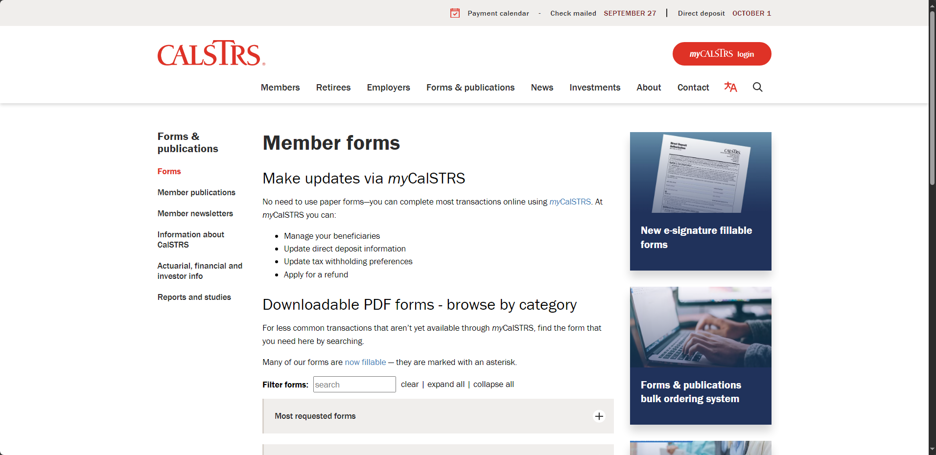
Notes:
Whether you go through the main page or type in the web address, you’ll come to this page. The first forms I’ll direct you to are near the bottom of the list.
Click.

Slide 47
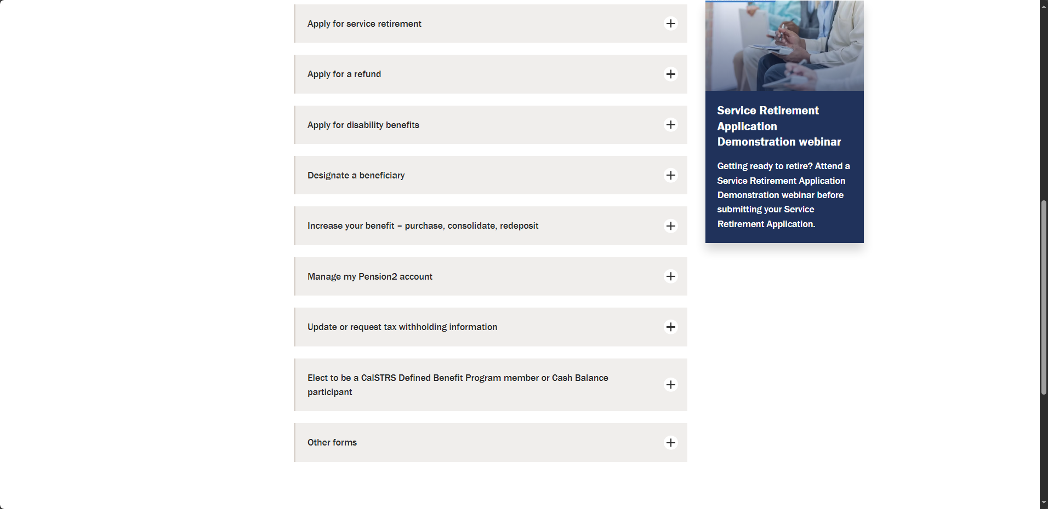
Notes:
The first category we will look at is “Elect to be a CalSTRS Defined Benefit Program member or Cash Balance participant”
Click.

Slide 48
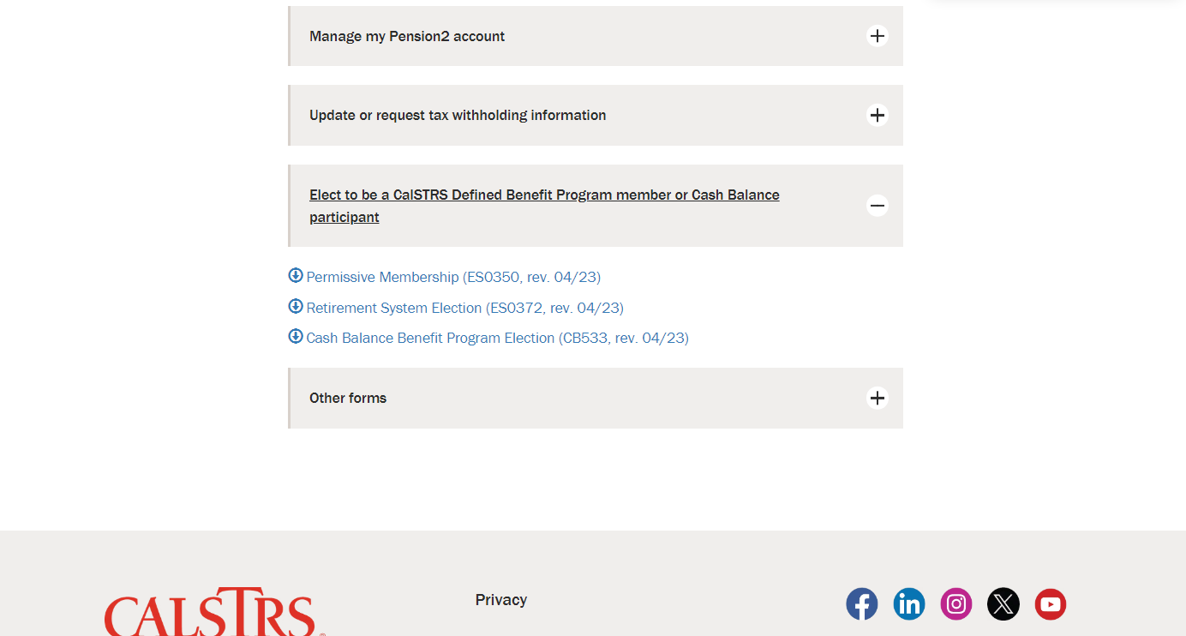
Notes:
This section is where you’ll find the forms to elect membership.
One reminder, once you permissively elect membership into the Defined Benefit Program, that decision is irrevocable.
Click.

Slide 49
Notes:
The next section I want to point out is “Increase your benefit – purchase, consolidate, redeposit.”
Click.

Slide 50
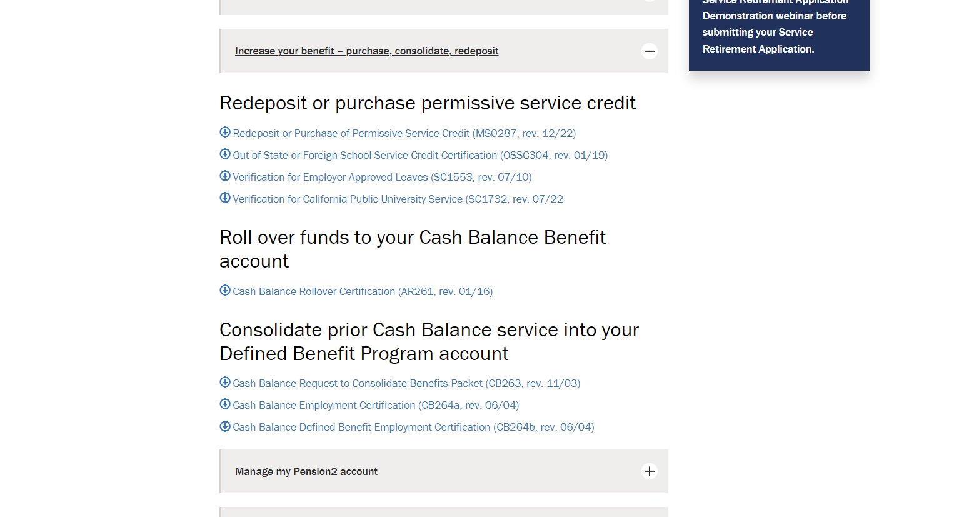
Notes:
Back in the section “Part-time considerations” I discussed purchasing service credit. Here are all the forms associated with purchasing service credit.
A note here, when requesting a billing statement, there is absolutely no obligation to purchase. You will have a due date, but you only need to reply if you’re interested in moving forward with the process.
Click.

Slide 51
Attend another part-time educator webinar
Notes:
Now I’d like to go into a little bit more detail about our suite of part-time webinars.
Click.

Slide 52
Part-Time Educator
Determine which retirement program you’re paying into.
Learn about CalSTRS programs.
Identify retirement considerations.
Who? All part-time educators.
Why? To gain a broad understanding of a CalSTRS retirement.
Notes:
Our “Part-Time Educator” webinar is a great webinar for all part-time educators looking to gain an understanding of a CalSTRS retirement. In this webinar we will help you determine which retirement program you’re paying into, it isn’t always so easy to figure out. We go into detail about both Defined Benefit and Cash Balance to help you decide which program might be best for you. Finally, we identify some retirement considerations that are specific to you, the part-time educator.
Click.

Slide 53
Cash Balance Benefit Program
Review the Cash Balance Benefit Program.
Understand the program’s benefits.
Explore additional resources and considerations.
Who? All part-time educators interested in this program.
Why? To get more details specific to the Cash Balance Benefit Program.
Notes:
Next, our Cash Balance Benefit Program webinar. While the Part-Time Educator webinar focuses on both defined benefit and cash balance, this webinar is specific to the Cash Balance program and goes into a lot more detail.
So if you’re a part-time educator and are interested in this program, definitely join us at one of our next offerings.
Click.

Slide 54
Consolidation of Benefits
Define consolidation and eligibility.
Explore the advantages of consolidating.
Learn the process of consolidation.
Who? All cash balance participants (active or inactive).
Why? Get all the facts about the consolidation process.
Notes:
A Consolidation of Benefits is the combining of your Cash Balance account and your Defined Benefit account. If you do now or have ever contributed into a Cash Balance Benefit Program account, you can join this webinar to get all the facts. The process can be both lengthy and costly, so whether you’re already in the process or just trying to learn more, this webinar contains a wealth of information for you.
Click.

Slide 55
Additional income sources
Determine your income needed in retirement.
Estimate CalSTRS benefit replacement.
Explore CalSTRS Pension2 and other income sources.
Who? All part-time educators.
Why? Start planning to maximize your retirement.
Notes:
As a part-time educator, you might have retirement income coming from multiple sources. This webinar will help you to determine what income you need and how all the different accounts you have can be pieced together to determine if you’ll have enough income in retirement.
This webinar is one of our only webinars that goes into a bit more detail on those Social Security offsets we often talk about. The Windfall Elimination Provision and the Government Pension Offset.
Join us in our next offering so we can help you get started on your journey towards retirement.
Click.

Slide 56
Working multiple assignments
Determine how working multiple assignments affects your retirement.
Review calculations to help you maximize your retirement benefit.
Identify resources for members working in multiple positions.
Who? Any part-time educator working multiple assignments.
Why? Start planning to maximize your retirement benefit.
Notes:
I mentioned the factsheet about considerations for part-time educators working multiple assignments and contributing to the Defined Benefit program, this is the webinar version. This webinar follows a sample member as they determine the best path towards maximizing their retirement benefit.
There are a lot of sample calculations, but we’ve done our best to ensure this webinar is clear and understandable.
Here at CalSTRS, we really care about our educators getting a retirement they deserve. This webinar is another tool with a goal of helping you to maximize your retirement benefit.
I hope to see you there!
Click.

Slide 57
Additional Income
403(b)
457(b)
Roth 403(b)
Roth 457(b)
☑
Visit Pension2.com for more information, educational videos and savings calculators.
☑
See your employer’s plans at 403bCompare.com
Notes:
Another way to increase your retirement income is to increase your additional retirement savings while you are working. While your contributions for the Defined Benefit are set you can always invest in other retirement accounts such as a 403(b) or a 457(b).
Pension2 offers 403(b), 457(b), Roth 403(b) and Roth 457(b) plans that often have lower fees and expenses compared to other plans.
They can provide no cost, no obligation statement comparisons between the costs you may pay elsewhere and pension2.
If you want to do some research on your own, you can visit 403bcompare.com to compare all 403b products offered in California.
If you are interested in opening a pension2 account, please reach out to Pension2 directly.
You can learn more, watch educational videos and use a personal wellness plan calculator to estimates your account balance based on various contribution amounts at Pension2.com.

Slide 58
Additional Income
Tax-deferred retirement savings
Low and transparent costs
No commissions, load fees or surrender charges
Flexible investment options
Visit Pension2.com or call 888-394-2060 for more information.
Notes:
Pension2 is a great way to save more for your future because you can contribute tax-deferred money, there are low and transparent costs, no commissions, load fees or surrender changes, because CalSTRS is a nonprofit organization, we want you to keep all your hard-earned money. There are also flexible investment options.
If you have additional questions about Pension2, you can visit Pension2.com or give them a call at 888-394-2060.
Click

Slide 59
What if I already have an account?
Other supplemental savings plan accounts can be rolled into Pension2
Your
Current
Account
CalSTRS
Pension2
LET US COMPARE!
Call 888-394-2060 for a statement comparison
Statement comparisons will be conducted by Voya Financial representatives working exclusively with Pension2®. Their names and photos are listed at CalSTRS.com/Trust-CalSTRS.
Notes:
If you already have a supplemental savings plan account, like another 403(b), 457(b), 401(k) or a traditional IRA, it’s possible to roll it over into the CalSTRS Pension2 program. And we can help you determine if it would be beneficial for you to do so.
CalSTRS has noncommissioned licensed advisors who are able to do a review of your current account and compare it to the CalSTRS Pension2 program to see if we’d be able to save you some more money. In order to do so, all we’d need is a copy of your latest account statement and that will help us begin the process of comparing. Since CalSTRS employees do not receive a commission, there is no incentive to get you to transfer your account, unless we’re able to help you save some more money.
If you’re interested in having your account reviewed and compared to Pension2, please call 888-394-2060.
Click.

Slide 60
Financial Awareness Series
Save for Your Future
Plan for Your Future
Protect Your Future
Learn about:
Budgeting
Short-term and long-term savings and investing goals
Credit and debt
Learn about:
Picturing your retirement lifestyle
Income and expenses
Creating an action plan
Learn about:
Retirement distributions
Maximizing income
Strategies to protect your income
Notes:
Another resource CalSTRS offers to help you plan for your retirement is our Financial Awareness Series. This series of webinars focuses on financial literacy rather than on the CalSTRS programs. This information can be helpful regardless of your employer or employment status.
These webinars can be attended at anytime during your career, but we do recommend you attend them in this order.
Save for Your Future is really helpful for those needing the basics. We help you set a budget for now and to determine some short-term and long-term goals. By setting up the budget, you’ll get a better idea about what you can afford.
Plan for Your Future is great for when your retirement day-dreaming has really begun. We’ll help you get on the right path and create an action plan to make those dreams a reality.
Protect Your Future is more about the money when you’re actually IN retirement. Attend this webinar before you retire to set yourself up for success!
Click.

Slide 61
Be your own advocate
Create your myCalSTRS account.
Review your CalSTRS Retirement Progress Report annually.
Subscribe to CalSTRS’ online newsletter.
Verify your one-time death benefit information is correct.
Notes:
As a CalSTRS member regardless of what stage of your career you are in, it is very important to be your own advocate.
Make sure you create a myCalSTRS account.
Review you Retirement Progress Reports annually.
You can subscribe to the CalSTRS’ online newsletter and stay in the know with us.
Lastly make sure your one-time death benefit information is correct.
Click.

Slide 62
For more information
Online resources
Benefits planning session
Attend a webinar
myCalSTRS
Retirement Progress Report
Educational videos
Benefits planning session over Zoom or in person
Part-time Educator
Additional Income Sources
Financial Awareness Series
calstrs.com/webinars
Notes:
If you need more information, we have several online resources. That we have reviewed today. Those include myCalSTRS, your Retirement Progress Report, and any educational videos on topics that you want to review.
You can schedule an individual or group benefits planning session currently we are offering sessions in person at you nearest member service center or over zoom.
We also have additional webinars that you can attend. Some that you might find informative are part-time educator, additional income sources, and any webinar that is a part of our 3–part financial awareness series.
Click.

Slide 63
Questions?
CalSTRS.com
myCalSTRS
800-228-5453
*Press 2 for Customer Service
Monday – ­Friday
8 a.m. – 5 p.m.

