Slide 1
Notes:
Welcome to the CalSTRS Retired Educator: Learn and Discover workshop. My name is , and I am a benefits specialist at the __________ Member Service Center/ office.
**feel free to input a personalized introduction about yourself and your background**
Today's presentation is packed with a lot of information and demonstrations of our online resources.
Please be sure you have pen and paper available to take notes.
Click.

Slide 2
Your Newly Retired Member Kit Available on CalSTRS.com
Notes:
If you still have questions after this presentation or want to know more about your CalSTRS benefits as a retired educator, we have created the Newly Retired Member Kit, which is available on CalSTRS.com.
Click.

Slide 3
Things to Do Now That You're Retired
Open
Open your Newly Retired Member Kit
Find out
Find out how myCalSTRS can help you
Get
Get information about working in retirement
Prepare
Prepare for the effect of inflation on your benefit
Consider
Get
Get the facts on Social Security
Understand
Understand how the federal required minimum distribution may affect you
Organize
Organize your important documents
Enjoy
Enjoy your retirement!
Consider health care coverage
Notes:
Here are some things you should be doing, now that you are retired.
(Read off the list)
Click.

Slide 4
Notes:
In your myCalSTRS account, you will be able to keep your retirement in order.
(Read off the list)
If you are not registered already, I suggest you do so ASAP. Keep in mind that we will ask for your social security number during the registration process.
Click.

Slide 5
The Benefit of a Lifetime
356
74
430
women
men
retired members over 100 years old
108
23.01
9,915
age of oldest retired member
average years of service credit
total years of service credit
Data current as of January 2024
Notes:
Updated: Jan 2024. Source: Actuarial Resources
Your relationship with CalSTRS will possibly be decades long.
Age of oldest Retiree: 108.67
Number of retirees over 100: 430
Number of female retires: 356
Number of male retirees: 74
Total service credit: 9,915
Average service credit: 23.01
Click.

Slide 6
Working After Retirement
Extra income for travel, luxuries or entertainment
To stay mentally active
To maintain social connections
To stay physically active
Necessary living expenses
Other
Notes:
If you are considering working after retirement, there are some benefits to doing so…
(Read off list)
Click.

Slide 7
Working After Retirement
Notes:
Working after retirement does have a few things to consider and learn about. If you plan on working after retirement in a non-CalSTRS covered position, you can start working immediately without any restrictions. If you want to come back to a CalSTRS- covered position there are a couple things to take note of such as if you’ve received an incentive, when you plan on returning, and the annual earning limitations.
Click.

Slide 8
Working After Retirement
2024−2025 fiscal year earnings limit = $74,733
For CalSTRS-covered employment, each fiscal year you are subject to an annual earnings limitation after the 180-day separation-from-service requirement

Slide 9
Protecting Against Inflation During Retirement
Annual Benefit Adjustment
2% increase to your initial benefit (not compounded)
Purchasing Power Protection
Measurement of how your benefit is keeping up with inflation
CalSTRS provides supplemental benefit payments to members whose purchasing power has dropped below 85%
Notes:
In retirement you will receive a 2% increase to your initial benefit every September, but you will see it in your October payment. This is not a compounded increase, so it will always be the same increase amount from your first increase.
You also have Purchasing Power Protection, this is a measurement of how your benefits is impacted by inflation. If the purchasing power of your monthly benefit ever decreases below 85%, CalSTRS will provide you a supplemental payment.
Click.

Slide 10
Health Insurance and Medicare Basics
CalSTRS does not provide any health benefits
Covered California
Medicare
For people age 65 or older.
Medicare helps with the cost of health care, but it doesn’t cover all medical expenses or the cost of most long-term care.
Notes:
For health insurance, this will come from your employer. CalSTRS does not provide any Health Benefits.
At age 65, you can sign up form Medicare, to help with the cost of health care.
Click.

Slide 11
Social Security Rules
Windfall Elimination Provision
May reduce but cannot eliminate your earned Social Security benefit
Government Pension Offset
Reduces and may eliminate your spousal or widow/widower Social Security benefit
Notes:
As a CalSTRS member, you do not contribute to Social Security for your CalSTRS-covered employment. If you anticipate receiving a Social Security benefit from other employment or from a spouse, there are two government rules that can reduce your benefit or leave you with no benefit at all.
Click.
The Windfall Elimination Provision impacts your earned Social Security benefit from employment outside of CalSTRS. The Social Security Administration uses an alternate formula to calculate your benefit. This can reduce your benefit but will not eliminate it.
Click.
The Government Pension Offset impacts your spousal, widow or widower benefit. The Social Security Administration reduces your benefit by two-thirds of your CalSTRS benefit which can eliminate your benefit all together.
It’s important to be aware of these rules and contact the Social Security Administration for more information since the estimates on your annual statement don’t reflect these reductions.
Your CalSTRS retirement benefit is not impacted by Social Security. However, your CalSTRS retirement benefit could be reduced if you return to work…
Click.

Slide 12
One Time Death Benefit Recipient
Name or update your one-time death benefit recipient at any time during retirement
myCalSTRS account
Recipient Designation form, available at CalSTRS.com
Can be a person, trust, charity, estate, parochial institution, corporation or public entity
Notes:
Make sure you have a One-Time Death Benefit Recipient in place. This will provide a survivor benefit of $7,093 to whomever you designate.
You can update this on your myCalSTRS account, or you can submit a Recipient Designation form which is available on CalSTRS.com
You can Designate a Person, Trust, charity, estate, parochial institution, corporation, or public entity.
Click.

Slide 13
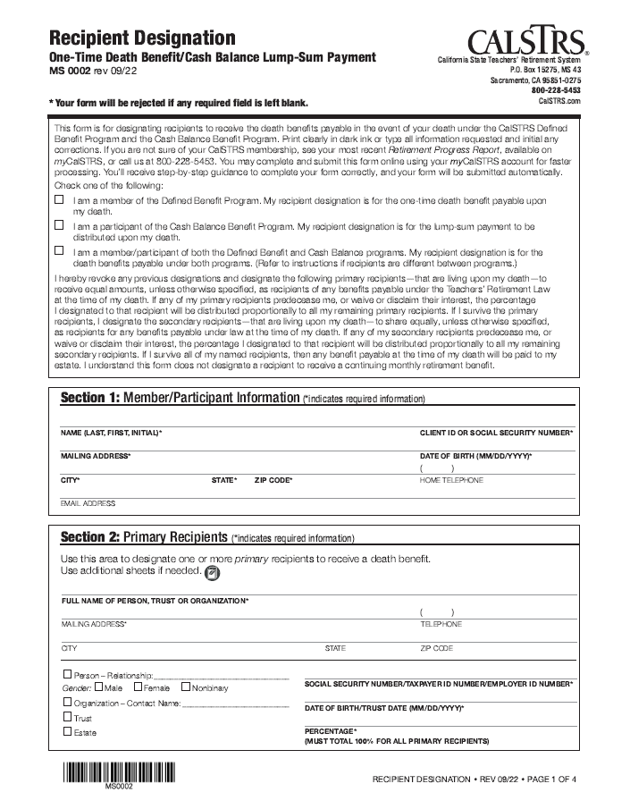
Reporting the Death of a Member or Beneficiary
Notes:
The Survivor Benefits booklet is available on CalSTRS.com and provides all the information about setting up your One-time death benefit recipient. On the right-hand side is a snapshot of the paper form to designate someone, which is also available on CalSTRS.com
In the event of your passing, someone will need to let CalSTRS know for the one-time death benefit to be paid out. A death certificate is required for this and instructions are in the Survivor Benefits booklet.
Click.

Slide 14
Reporting the Death of a Member or Beneficiary
Submit a Notification of Death form online or call 800-228-5453
You will need:
Full name
CalSTRS Client ID or Social Security number
Date of birth
Date of death
Notes:
In the event of your passing, someone will need to let CalSTRS know for the one-time death benefit to be paid out. A Notification of Death form is required and instructions are in the Survivor Benefits booklet. They can submit the Notification of Death form Online or call 800-228-5453 and one of our Contact Center representatives will help.
Click.

Slide 15
Sign up for Direct Deposit
myCalSTRS account
Download the Direct Deposit Authorization form at CalSTRS.com/forms
Notes:
On your myCalSTRS account you can sign up for Direct Deposit, instead of receiving paper check in the mail.
You can also submit a paper form as well which is available on CalSTRS.com/forms
Click.

Slide 16
Retired Educator Organizations
Association of California School Administrators
California Federation of Teachers
California Retired Teachers Association
California Teachers Association/ National Education Association-Retired
Faculty Association of California Community Colleges
United Educators of San Francisco-Retired Division
United Teachers Los Angeles-Retired
Notes:
As a retired educator there are other organization to help you out as well. Here are a few of the organization we partner with.
Click.

Slide 17
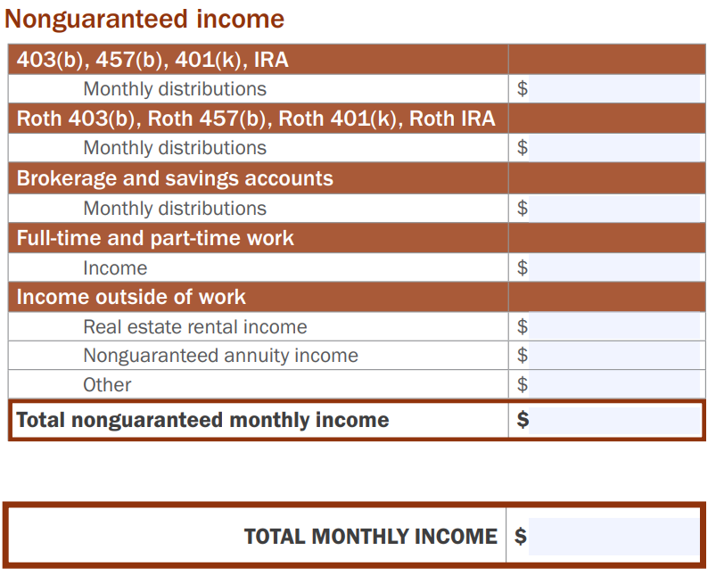
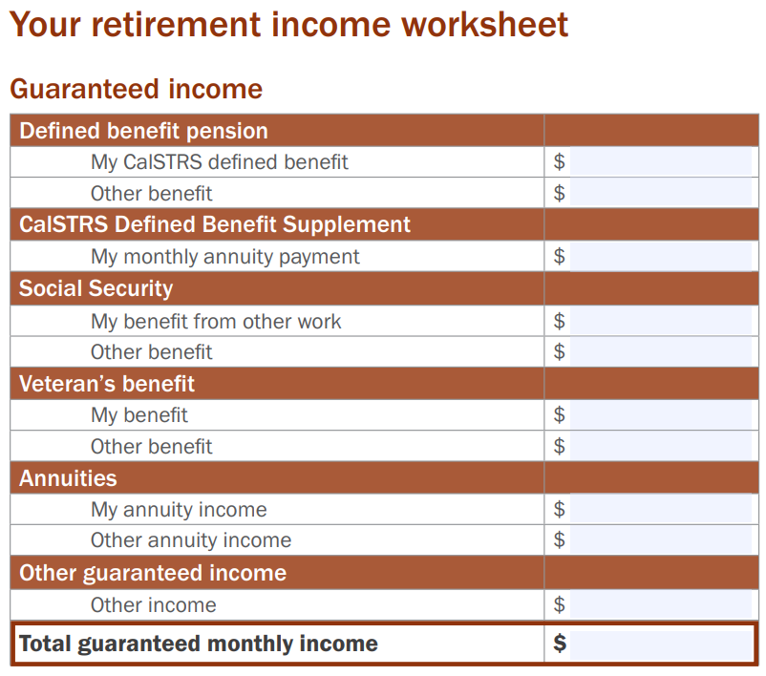
Create a Spending Plan Page 16
Notes:
In retirement it is important to create a spending plan, so you don’t run out of money. On page 16 in the Learn and Discover: Newly Retired publication is a worksheet to help you see how much you are bringing in each month.
Click.

Slide 18
Your Monthly Expenses Page 17
Notes:
On page 17 of the Learn and Discover: Newly Retired publication is and Expenses worksheet, so you can breakdown your monthly expenses to see where your money is going monthly.

Slide 19
Visit 403bCompare.com and consider consolidating your other retirement accounts into CalSTRS Pension2
Notes:
You may benefit by consolidating your other retirement accounts into Pension2. CalSTRS administers a purely informational site called 403bCompare that can help you compare the products your district offered when you retired.

Slide 20
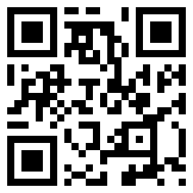
Tax-deferred retirement savings.
Low cost.
Flexible investment options.
Friendly support team.
888-394-2060
Pension2.com
Notes:
CalSTRS has our own 403(b) and 457(b) program called Pension2 - there are low and transparent costs, no commissions, load fees or surrender changes, because CalSTRS is a nonprofit organization, we want you to keep all your hard-earned money. There are also flexible investment options.
If you have additional questions about Pension2, you can visit Pension2.com or give them a call at 888-394-2060.
Also, if you aren’t quite ready and just want to learn more about the Pension2 program, we offer a webinar called Start Saving Now with Pension2. I encourage you to attend and receive some more in-depth information about the ways in which Pension2 can help you reach your retirement income goals.
Click.

Slide 21
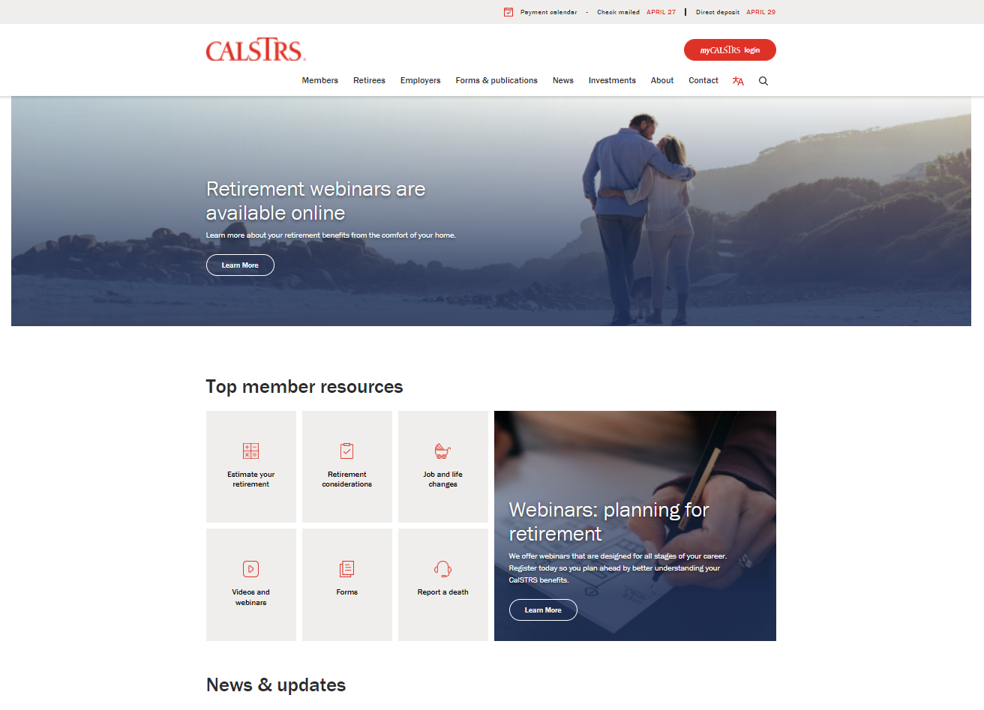
CalSTRS.com
View Pay Dates
Notes:
If you are wondering when CalSTRS is going to send you your monthly benefit, on CalSTRS.com you can view pay dates,
Click.
Just click on Payment Calendar at the top.
Click.

Slide 22
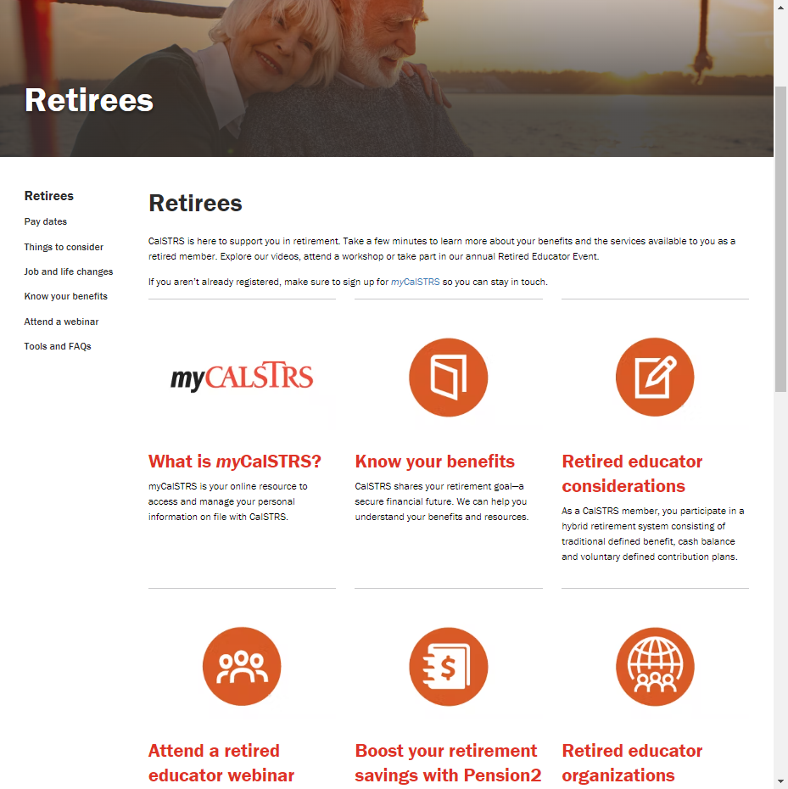
CalSTRS.com
Retirees Page
myCalSTRS
Know Your Benefits
Retired Educator Considerations
Notes:
We also created a page just for our retired members. This page allows you to quickly access your myCalSTRS account, other webinars that are available, forms you may need, information about your benefits, and all the Retired Organizations we partner with.

Slide 23
Your Opinion Matters
Feedback
Questions

