Slide 1


Part-time Educator
Notes:
Welcome everyone, thank you for joining us. The time is , but we would like to wait a few more minutes to allow others to join.
*Wait one minute.*
I see more people have joined us, welcome. We will be starting in 1 minute.
*Wait one minute or until incoming numbers seem to be steady.”
Welcome to the CalSTRS Part Time Educator webinar. My name is , and I am a benefits specialist at the __________ Member Service Center/ office.
**feel free to input a personalized introduction about yourself and your background**
Before we start, I’d like to address a couple items:
First, I’d like to thank you for joining us today! If you find today helpful, please tell your colleagues! We are constantly striving to educate as many educators as we can! So please, refer them to us!
Today’s presentation is packed with a lot of information and resources. Please be sure you have a pen and paper available to take notes as we move thorough the presentation.
We encourage you to use the Q&A function to submit any questions you may have.
Please do not submit any personal information OR request from us any information that is specific to your account. For your security we ask that if you do have any questions specific to your retirement account you email those through your secured myCalSTRS account or call us at 1-800-228-5453 and speak with a CalSTRS representative.
If you find that you have questions after the webinar is complete, I urge you to log into your myCalSTRS account and send a secure online message. You can log onto myCalSTRS anytime, 24/7. But, if you’d rather speak with a live person, you can reach a representative Monday – Friday from 8a.m. – 5p.m.
Click.

Slide 2

Trust CalSTRS, not impersonators.
CalSTRS authorized representatives:
Have an email address ending in @CalSTRS.com.
Can provide a CalSTRS ID badge or business card.
Do not provide refreshments at offsite events.
Will never meet at your home.
Do no sell insurance products.
Have access to your Pension2® account information.
Some Voya financial representatives work exclusively with Pension2.
Their names and photos are listed at
CalSTRS.com/trust-CalSTRS.
To verify a CalSTRS representative, contact us at 888-394-2060 or RepCheck@CalSTRS.com.
Notes:
Firstly, we’ve been receiving constant reports from our members believing they’ve set up an appointment or spoken with a CalSTRS representative when they have not. Only CalSTRS employees can provide you with accurate information regarding your CalSTRS Defined Benefit and Pension2 accounts. We’ve developed a checklist for you to use to ensure the person with whom your speaking is a CalSTRS employee.
Companies or individuals not affiliated with CalSTRS cannot have the CalSTRS logo on their advertisements.
Only CalSTRS employees will have an @CalSTRS.com e-mail address on their business cards. Please double-check the spelling of CalSTRS.
CalSTRS does not provide any refreshments when we come to see you at events.
CalSTRS employees will never meet you at your home.
CalSTRS is not an insurance company, so we will never try to sell you on any insurance products.
Only CalSTRS employees will have access to your CalSTRS or Pension2 account information. If you’re asked to provide a copy of your CalSTRS Retirement Progress Report or Pension2 account statement in order for someone to assess your CalSTRS accounts, they are not affiliated with CalSTRS.
CalSTRS has created a webpage at www.CalSTRS.com/Trust-CalSTRS with names and pictures of our member-facing Voya representatives. This webpage is kept up-to-date, so you can always ensure you’re speaking with a trusted person. These representatives from Voya Financial have an @Voya.com e-mail address and they work exclusively on the Pension2 program.
If you scheduled an appointment or already met with someone you think may not be a CalSTRS representative, contact us at 888-394-2060 or RepCheck@CalSTRS.com to verify they are a CalSTRS representative.
Please disseminate this information to any friends or colleagues who may need it.
Click.

Slide 3




Objectives
Determine which retirement program you’re paying into
Learn about CalSTRS programs
Identify retirement considerations
Notes:
We are going to cover a lot today, but the main three objectives are as follows:
Click.
We will talk about how to determine what retirement plan you are paying into. It is very common for an educator working part-time with either one employer or more to not know what retirement plan they are paying into. And our first goal is for all of you to be confident in figuring this out.
Click.
We are going to talk about the different CalSTRS programs that are offered to California’s educators. We will be comparing them side by side; I hope you find it informative.
Click.
Finally, I am going to point out additional retirement considerations that may pertain to your unique situation. So, you will want to take notes if you identify any considerations that apply to you.
So let’s get started…and again, thank you for joining us today.
Click.

Slide 4

What program are you paying into?
Notes:
You are here…we are a retirement system…so that tells me that you want to retire someday. Having confidence in your retirement plan might be one of your top priorities. But first, you’ll need to figure out exactly what kind of plan that is. Once you know where your money is going currently, then you can work on figuring out if it is the right plan for you and your future. OR maybe you need to find something more suitable.
Click.

Slide 5


What program are you paying into?
Defined Benefit Program
Cash Balance Program
CalSTRS Pension2
Social Security
Other
Alternative retirement plan
Notes:
Let’s look at the different places your retirement contributions could be going.
As a part-time educator your employer is required to provide, or make available to you, a retirement plan. However, this could be one of many different options. As you can see here, you might be paying into CalSTRS but even then CalSTRS offers 3 different plans.
If you are not paying into CalSTRS you could be paying into social security or some other program offered by your employer.
Please note that if you are a part-time educator working for multiple employers you may in fact be paying into more than 1 retirement plan.
Click.

Slide 6
Defined Benefit Program
Pension based on a formula. As a part-time educator, you may permissively elect membership at any time.
Cash Balance Program
Retirement program offered by participating districts to employees that work on a part-time, temporary basis.
CalSTRS Pension2
Voluntary defined contribution plan available to all members in participating districts.
Notes:
First let’s go over a quick preview of what those 3 CalSTRS programs are:
The Defined Benefit is a monthly retirement benefit paid over your lifetime. The amount is based on a formula, not on your savings. As a part-time educator you may not be required to be in the defined benefit program, but you can permissively elect membership at anytime. This is a decision you should not take lightly, because once you make that choice, it is irrevocable.
The Cash Balance Benefit program is a CalSTRS retirement program offered only by participating districts. Eligibility goes to employees that work on a part-time or temporary basis. CalSTRS created this program specifically for you, the part-time educator.
Pension2 is a voluntary defined contribution plan available to all public-school employees, but again it is only offered by participating districts. So even if you are not enrolled in either of our 2 main retirement programs, you can still invest with CalSTRS.
Click

Slide 7

Social Security
If you’re part-time, your district must offer Social Security or an alternative plan in addition to the Defined Benefit Program.
Other
Alternative program
Some districts may offer the Cash Balance Benefit Program, a TSA or a 403(b) plan as an alternative to Social Security.
Contact your district or check your pay statement.
Notes:
If you are a part time educator your district must offer either Social Security OR an alternative plan in addition to the CalSTRS Defined Benefit program.
Some districts may offer the CalSTRS Cash Balance Plan as an alternative to social security, or they may offer an alternative retirement plan such as: metlife, apple, Pars, Fica, or Pear.
It is very important to determine what plan you are paying into so that you can understand what retirement benefits will be available to you.
Now that you know what types of plans are out there, let’s talk about where to go to determine where your retirement savings are going.
Click.

Slide 8
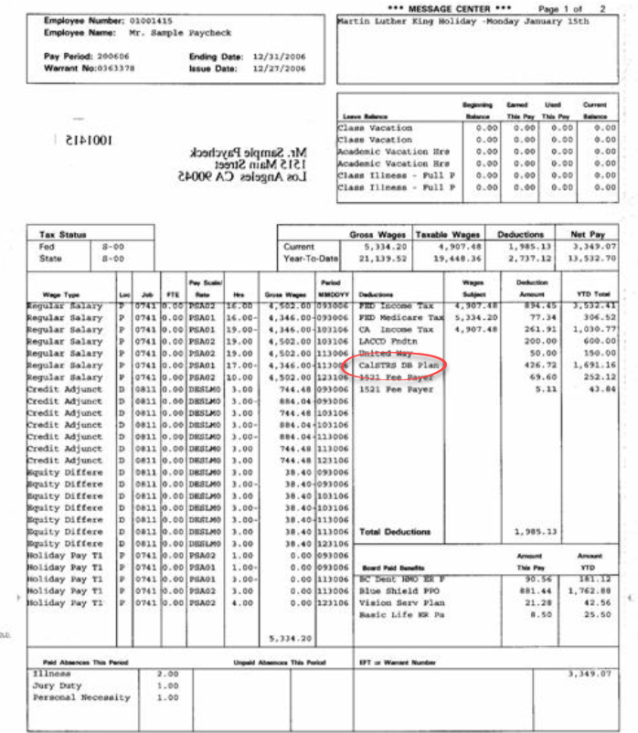
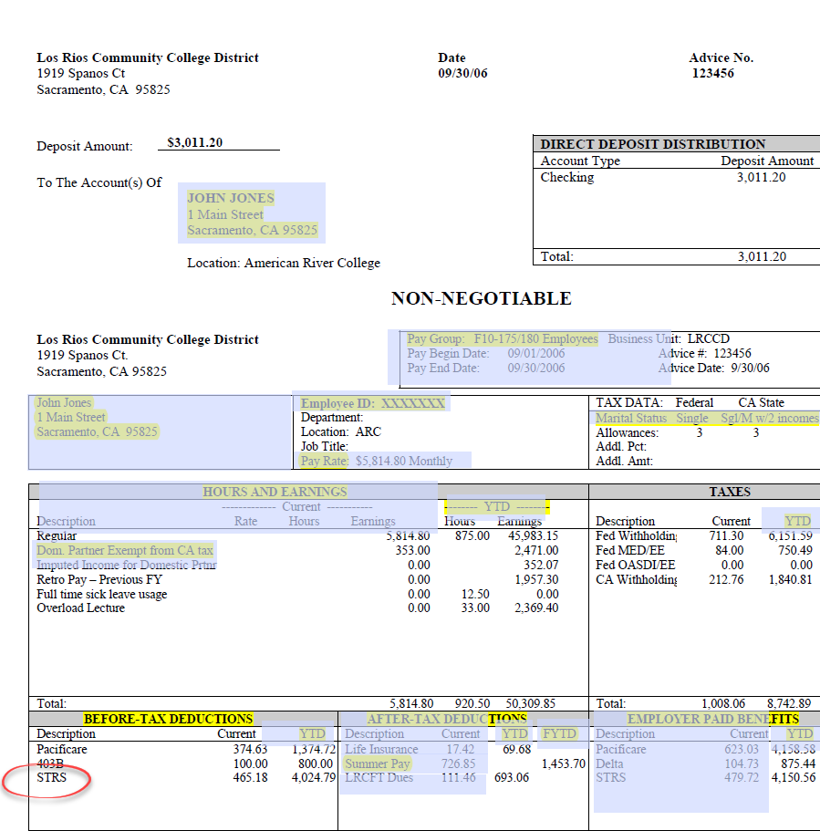


Pay statement examples
Notes:
One of the first places you should look to determine what program you are in is your pay stub. *Based on personal experience, I’ve noticed that no 2 pay stubs are identical, so that can make reading them even more complex. Members bring theirs in for sessions all the time and I still struggle figuring out some of them.* Here we have examples from 2 different employers. You will want to focus your attention to the deductions area of the statement
Click.
Not only do they all look different, but each employer also labels them differently. For instance, in this first example this member is paying into STRS. That’s good to know but it does not specify if they are paying into the defined benefit program, the cash balance program, or Pension2.
Click.
In this next example you can see that this deduction is very specific. This member is paying into the CalSTRS DB (or defined benefit) program.
If you are unable to decipher your own paystub, I’d recommend you go to your employer for clarification.
Click.

Slide 9

Log in at myCalSTRS.com
For assistance, call us at: 800-228-5453
*Press 2 for Customer Service.
Monday–Friday
8 a.m. to 5 p.m.
Notes:
If you are paying into CalSTRS a great resource for you to gain more insight into your retirement program is your myCalSTRS account.
You can log in by going to myCalSTRS.com. If you have not previously logged on, have no fear, registration is simple.
If you find you need assistance getting registered or logging in, please call our customer service line and they will help you log in after verifying your account. The number to customer service is 1(800)228-5453 and a representative will be available Monday -Friday 8am to 5pm.
Our customer service representatives can also tell you if you are paying into a CalSTRS program, which CalSTRS program you are paying into, and if you have multiple employers, we can identify which CalSTRS program each employer is paying into.
If CalSTRS does not have your information on file and you are not able to register for myCalSTRS remember that you could be paying into social security or an alternate plan.
Click.

Slide 10





View and update your
account information.
Send secure messages.
Access your Retirement
Progress Report.
Notes:
myCalSTRS is great for several reasons. You should log on to visit your account if you have not done so recently.
Click.
Here, you will be able to update your account information, including, but not limited to, your mailing address and beneficiary information.
Click
If you have a questions, you can send a secure online message to a CalSTRS representative and receive a secure response. This can be accessed 24/7 and you will receive a response during normal business hours.
Click.
You can also access your annual Retirement Progress Report which is important to download to view and track your retirement progress on a yearly basis.
These are only some of the more commonly used and most important features of myCalSTRS. Now hopefully I’ve encouraged you to explore your account.
Next, I’m going to show you what myCalSTRS looks like.
Click.

Slide 11

Account balance screen
Notes:
Once you have logged into to your personal myCalSTRS account you are going to see a landing page that looks similar to this.
Your icons may not be the same as mine because each person’s landing page is customized based on their situation.
From here you can access your account balance screen by selecting the services tab in the red banner and selecting View Your Account Balance.
Click.

Slide 12
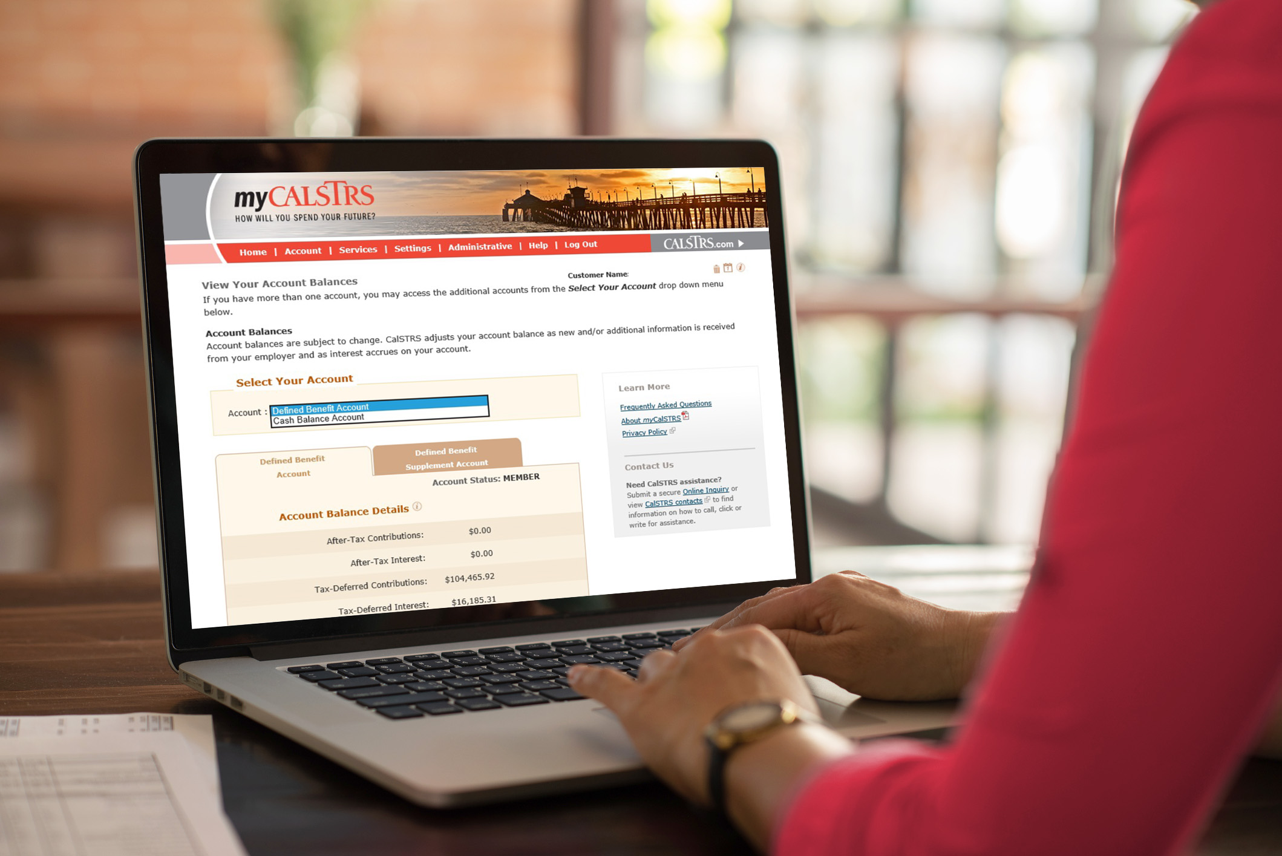
Defined Benefit, Cash Balance or both?
Notes:
If you have more than one account type, there will be a drop-down box as shown. You’ll be able to choose between the two. If only one type of account is showing, then your choice is easy! Choose the account and explore what you’ve accumulated.
On this screen you will see information for the defined benefit account, the cash balance account or both
Click.

Slide 13

Accessing your resources
Notes:
I previously mentioned that you can send a secure online message to a CalSTRS representative.
If you choose to do so, you can do that by selecting this ‘View Your Messages’ link.
Another area on this page that you should be checking every year is your retirement progress report.
From the landing page you will click the link labeled ‘View your Retirement Progress Reports’
Click.

Slide 14




Your Retirement Progress Report
Membership and benefit information
Contributions and account balances
Employer reporting
Current recipient information
Notes:
Your Retirement Progress Report is an annual report that comes out every September and tracks your Retirement progress.
The reports for a defined benefit member and a cash balance participant may look a little different but both will contain:
Click.
Your most current Membership and benefit information
Click.
Your contributions and account balances – for the defined benefit program this will include service credit and your supplement account if you have one.
Click.
You’ll be able to see the reporting we have received from your employer or employers. It has the information as reported through June 30 of the previous school year.
Click.
Also, important, you can check your current recipient information. Your recipient is an individual, trust, charity or an estate, that you have chosen to receive any death benefits that are payable upon your passing. If you don’t currently have a recipient designated, we strongly encourage you to do so at your earliest convenience.
Click.

Slide 15
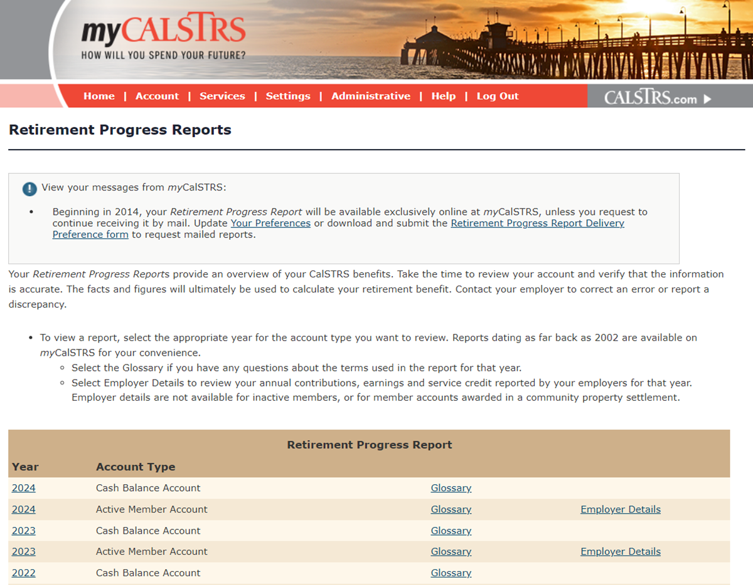
Notes:
Once you select the retirement progress report option this screen will open up. About halfway down you will see a beige bar that reads retirement progress report. You will see your reports listed here by year and account type.
This sample shows 2 account types because this member has money in both programs. If you only participate in one program, then you will only see that account listed here. When you see Active Member, Account know that it refers to the Defined Benefit account.
If you made it to this part of your myCalSTRS account, then you now know which CalSTRS program you are paying into. I encourage you to take the time to go through and really familiarize yourself with this website.
In addition to identifying what program, you are in, you should review the details of your Retirement Progress Report. You can do this by selecting the most current year on this page. While you are actively working it is very important that you check this report every year. If you notice any errors or discrepancies, you will need to speak with your employer right away so that the reporting can be corrected.
Click.
If you are a Defined Benefit member on the far right of the screen you will notice an option labeled employer details. This link can be very helpful for part-time educators to review, especially if you are working for multiple employers because you will be able to see what each employer reported to CalSTRS for each school year.
Click.

Slide 16
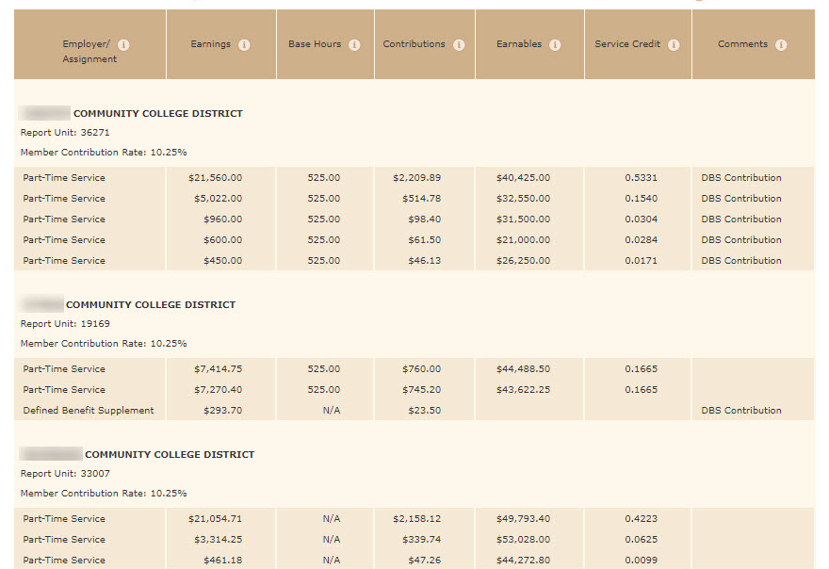
Notes:
When you select the employer details screen you will see exactly what each employer is reporting. For example, this member can see the 3 employers they are working for, a summary of their earnings and contributions, and their service credit earned.
It is so important to review this information annually so that any discrepancies can be settled with your employer.
Click.

Slide 17




Resources
CalSTRS
District
Local teacher association
Alternative retirement program
Notes:
If you still need help determining which program you are in:
Click.
Call us. You can call CalSTRS Monday – Friday 8am -5pm and we would be happy to help you determine if you are paying into a CalSTRS program.
Click.
Contact your district. They should definitely have some information available for you.
Click.
Or you can contact your local union. They may be able to help you identify what program you are paying into.
Click.
Finally, you should reach out to any other retirement program you believe you are paying into and try to verify your account with them.
Click.

Slide 18

Cash Balance Benefit Program
Notes:
We are now going to take an in-depth look at the 2 main programs that CalSTRS offers. Since you are here, I am assuming you either work part-time or work in multiple part-time positions, or you plan. So, we will first look at the program that was designed for part-timers……our Cash Balance Benefit Program.
Click.

Slide 19
Cash Balance Benefit Program enrollment
You sign up within the first 60 days of employment.
Permissive election
You can elect the Cash Balance Program at
any time.
Automatic election
If no program is selected within 60 days, you’re automatically enrolled,
if eligible.
Notes:
First, how to enroll in the Cash Balance program.
Click.
You might have turned in the paperwork and elected to be in the program within the first 60 days of being hired by your district.
If you did not originally choose to be in the Cash Balance program, but you know that your district offers it, you can change your mind and permissively elect to be in the Cash Balance program moving forward.
Click.
It is also possible that you did not select any program within the first 60 days of employment and your employer defaulted you into the Cash Balance program.
Click.

Slide 20

Cash Balance Benefit Program* eligibility
Adjunct or hourly faculty
Community college
Hired semester to semester
Adult education instructors
Employed less than 50% of full time
PreK–12
Signed a contract for less than 50%
Only available if district adopts a resolution to offer the Cash Balance Benefit Program.
Substitute employees
Notes:
Today is all about those that work part-time. But what does “part-time” mean to CalSTRS and why does that matter?
First, it is important because only part-time employees are eligible to participate in our Cash Balance Benefit Program. And it is only available if your district offers it.
Click.
At the Community College level, you are considered part-time if you are Adjunct or Hourly faculty employed to work less than 67% of full time.
Click.
If you are hired on a semester-to-semester contract
Click.
Or if you are an adult education instructor
Click.
At the Pre-K through 12 level or for those of you that work with the County Office of Education you are considered part-time if you are employed to work less than 50% of full time.
Click.
If you signed a contract for less than 50%
Click.
Or if you are a substitute employee.
Click.

Slide 21




Cash Balance Benefit Program advantages
No program fees
Immediate vesting
Lower contribution rates and employer matching
Guaranteed annual interest rate
Notes:
Some advantages of participating in the Cash Balance Benefit Program are:
Click.
No program fees
Click.
Immediate vesting
Click.
Lower contribution rate coming out of your paycheck than if you were in Defined Benefit. The percentage is set by your local bargaining unit, it is generally 4 percent and is matched by your employer.
Click.
There is a guaranteed annual interest rate – 4.19 percent 2024 -2025
Click.

Slide 22

Cash Balance retirement eligibility
Normal retirement age:
  Age 60 if hired on or before December 31, 2012.
  Age 62 if hired on or after January 1, 2013.
Early retirement at age 55.
Must terminate all creditable service.
Required minimum distribution at a specific age depending on your birthdate.
Notes:
Finally, let’s talk about what it takes to retire. There are not many requirements to be able to retire under the Cash Balance plan.
Click.
There is a normal retirement age depending on when you were hired. That age is 60 if hired on or before December 31, 2012 and 62 if you were hired on or after January 1, 2013. This age plays a role when your benefit amount is calculated.
Click.
The minimum age to retire is age 55.
Click.
In order to retire you must terminate ALL creditable service from all CalSTRS employers.
Click.
Lastly, if you are not working and have not started receiving your money there is a required minimum distribution set by the IRS at age 72.
Click.

Slide 23

Defined Benefit Program
Notes:
Next, let’s spend some time talking about the other main retirement program CalSTRS has to offer. The Defined Benefit Program.
Click.

Slide 24
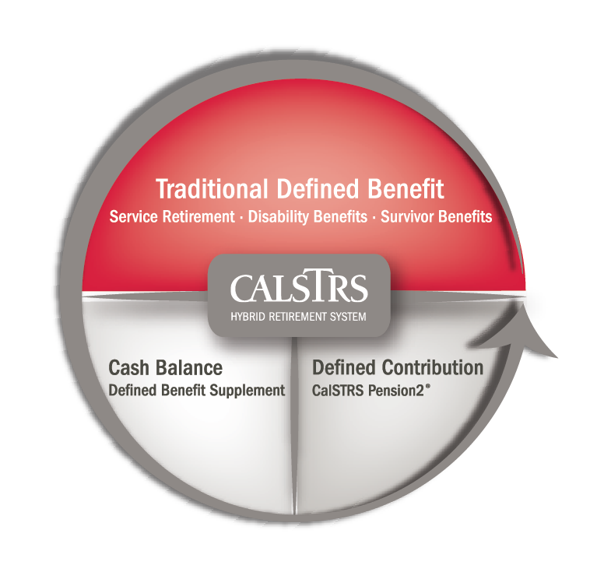
CalSTRS hybrid retirement system
Notes:
As a member of the CalSTRS Defined Benefit program, you have access to 3 types of CalSTRS accounts that make up our hybrid retirement system.
At the top, you’ll see the Traditional Defined Benefit, this is the lifetime benefit that’s based on a formula.
In the bottom half, you can see the Defined Benefit Supplement Account, which acts like a cash balance account and lastly there is CalSTRS Pension2.
We will talk about each of the three pieces of the hybrid during this next portion of the presentation.
Click.

Slide 25


Defined Benefit Program enrollment
Employed to work on a full-time or permanent basis.
Mandatory membership
Hiring basis changes from part-time to full-time or permanent.
Permissive election
Any part-time educator can elect the Defined Benefit Program.
See the CalSTRS Member Handbook for more information on Defined Benefit Program eligibility at CalSTRS.com/publications.
Notes:
Becoming a Defined Benefit Member occurs in one of two ways.
Click.
Membership is mandatory for employees hired to perform creditable service on a full-time or permanent basis.
You can be automatically enrolled into the Defined Benefit Program when your status changes from part time to full time.
Click.
Part-time, substitute, or temporary employees hired to perform creditable service in the California Public School system have the ability to permissively elect the Defined Benefit program at anytime while you’re working.
The appropriate forms to elect Defined Benefit membership can be found at CalSTRScom/Forms or might be provided by your employer. It is important to note membership must be elected during a pay period in which you are performing creditable service.
Click.
You can find more information about defined benefit eligibility in the CalSTRS member handbook.
Click.

Slide 26



Defined Benefit Program advantages
No program fees
Guaranteed lifetime monthly benefit based on a formula
Concurrent retirement and inflation protection
Unused sick leave converts to additional service credit at retirement
Notes:
Some advantages of participating in the Defined Benefit Program are:
Click.
There are no program fees. All your contributions will go back to you.
Click
There is a guaranteed lifetime monthly benefit when you retire, and that benefit is determined by a formula and not your account balance.
Click.
The Defined Benefit program allows for members to take advantage of the benefits of retiring from more than 1 California public retirement system through concurrent retirement.
It also provides inflation protection to your monthly benefit.
Click.
Additionally, any unused sick leave that you may have converts to additional service credit at retirement.
Click.

Slide 27
Defined Benefit Program benefit structures
CalSTRS
2% at 60
Members first employed to perform creditable service on or before December 31, 2012.
CalSTRS
2% at 62
Members first employed to perform creditable service on or after
January 1, 2013.
Notes:
As a Defined Benefit member, you will be under one of two benefit structures.
Your benefit structure is either CalSTRS 2% at 60 or 2% at 62.
Your benefit structure is determined by the date in which you were first hired to perform creditable service.
Click.
If you were first hired on or before December 31, 2012, you are under the CalSTRS 2% at 60 benefit structure.
Click.
If you were first hired on or after January 1, 2013, you are under the CalSTRS 2% at 62 benefit structure.
That 2% refers to the age factor you’ll receive if you retire at the normal retirement age associated with your benefit structure. 60 or 62.
Click.

Slide 28


Defined Benefit retirement eligibility
Minimum requirements:
  Age 55 with five years of service credit.
Early retirement:
  Age 50 with 30 years of service credit (CalSTRS 2% at 60 only).
Concurrent retirement:
  Age 55 with fewer than five years of service credit if retiring with a concurrent retirement system.
Notes:
There are a few ways to earn your eligibility to retire from the Defined Benefit Program. To be eligible to retire:
Click.
You must be at least age 55 with 5 service credits
Click.
There is an option for early retirement at age 50 if you have 30 service credits. But this is only for our members who fall under the 2% at 60 benefit structure.
Click.
You can also take advantage of concurrent retirement as early as age 55. If you qualify, you do not need to hit our 5 service credit requirement. You’ll need to contact your other retirement system for more details.
The most important thing I want to point out in regard to retirement on this slide is the vesting requirement. Remember that with Cash Balance program, there was no vesting requirement involved. In most cases here, you must earn at least 5 service credits. That’s definitely something to keep in mind.
Click.

Slide 29

Defined Benefit Program retirement formula
service credit $×$ age factor $×$ final compensation
$=$ monthly Member-Only Benefit
Service credit
Time worked and contributed
up to 1.000 per year.
Age factor
Percentage based on age at retirement with a maximum of 2.4%.
Final compensation
Highest average annual compensation earnable for
36 consecutive months.
Notes:
At this point, you have heard me mention that the benefit is based on a formula and not the amount of money in your account. But we haven’t talked about what that formula is. Let’s take a look at the multiple factors involved.
Click.
To calculate the monthly Member-Only Benefit, we multiply service credit times age factor times final compensation. But let’s go over each individually so you can better understand.
Click.
First, we look at service credit. Service credit is the time you work and contribute to the defined benefit program. You can earn up to 1.00 year per school year.
Click.
Next, we look at age factor. This is a percentage based on your age in years and months at retirement
Click.
Finally, we calculate your final compensation, which is your highest average annual compensation earnable for 36 consecutive months.
We then multiply all three components together to get your monthly member-only retirement benefit.
As a part-time educator, service credit and final compensation require some special considerations while planning for retirement. I’ll let you know why on these next 2 slides.
Click.

Slide 30

Determining service credit
earnings $÷$ annualized pay rate
$=$ service credit
Earnings
What you were actually paid.
Annualized pay rate
The amount you could have earned if you worked a full-time load.
Service credit
Time worked and contributed up to 1.000 per year.
Notes:
Your service credit depends partly on the amount you would have earned if you were working full time in your position.
Service credit is calculated by dividing your earnings by your annualized pay rate .
Earnings are what you actually earned and were paid.
Annualized pay rate is the amount you could earn if you worked a full-time load.
This gives us the service credit earned in that assignment. If you are working multiple assignments, you would calculate the service credit you earn from each and add them together to get your total service credit for the school year. Remember you can only earn up to 1.000 service credit in a school year.
Click.

Slide 31

Determining final compensation
highest average annual compensation earnable $÷$ 36 months
$=$ final compensation
Highest average annual compensation earnable
The amount you would have been paid if you worked on a full-time basis.
36 months
The number of consecutive months used for the calculation.
Final compensation
Highest average annual compensation earnable for
36 consecutive months.
Notes:
Like service credit, when calculating your final compensation, it partly depends on the amount you would have earned if you were working full time in your position.
Final Compensation is calculated by taking your highest average annual compensation earnable and dividing that by 36 months. The result gives us a monthly average to use when calculating your monthly retirement benefit.
CalSTRS will do the research for you to find the highest average 36 consecutive months. Our goal is to provide the best possible retirement benefit to you based on the hard work you’ve put in.
Now, if you are working multiple assignments, there is a bit of extra math to calculate your compensation earnable. We first take the weighted average of the amounts you would have been paid if had you worked full time in each of your assignments. If you have an assignment with a low annualized pay rate it might be worth considering dropping that contract near retirement in order to maximize your final compensation.
If you are working in multiple positions, be sure to meet with a CalSTRS benefits specialist at least three years before you plan to retire to explore your options and determine the best plan for your unique situation.
Click.

Slide 32




Final compensation
Based on what you would have earned if you worked in your position full time.
When working multiple assignments, a lower paying contract might bring your average compensation earnable down.
The higher your average compensation earnable, the higher your retirement benefit.
See the Considerations for Part-Time Educators fact sheet for a detailed example of service credit and final compensation.
Notes:
Because we feel this is often misunderstood and can be very impactful, I’m going to highlight some notes about final compensation.
Click.
Your final compensation is one of 3 components of the defined benefit formula. It is based on the amount you would have earned had you worked in your position on a full-time basis.
Click.
If you find yourself working multiple part-time contracts, remember that we use a weighted average. We use the amounts you would have earned had you worked full-time across all your assignments.
Click.
Finally, remember the higher your average compensation earnable the higher your benefit will be. This is something to pay attention to when looking for ways to increase your retirement benefit.
Click.
Like I mentioned at the start, if you look to the right side of your screen, you will see the document icon. You can use this icon to download the factsheet titled Considerations for Part-Time Educators. This factsheet will provide you with a more detailed example of how Service Credit and Final Compensation are calculated and how each can impact your final retirement benefit.
Click.

Slide 33



Considerations for Part-time Educators
For members of the Defined Benefit Program.
Understand service credit calculations.
Understand how final compensation is calculated
using a weighted average.
Scan the QR code to read Considerations for Part-time Educators.
Notes:
If you downloaded today’s attachment, then this should look familiar This is our brand-new factsheet designed for part-time workers in the defined benefit program.
We include descriptions and sample calculations for both service credit and final compensation. It should help you better understand how the amount of your contract may affect your benefit in retirement.
Click.

Slide 34
CalSTRS hybrid retirement system
Defined Benefit Supplement Program
Notes:
Let’s look at the CalSTRS Hybrid model again. We just finished talking about the Traditional Defined Benefit…remember, based on a formula.
The second account built into your membership is the Defined Benefit Supplement account.
We learned earlier that you can only earn up to 1.000 service credit per school year. So what happens to anything extra you might have worked?
Here is your answer. The Defined Benefit Supplement. All of your excess earnings are routed here at the end of each school year.
Click.

Slide 35





Build your Defined Benefit Supplement account
Earnings in excess of 1.000 years of service credit.
Contributions from both you and
your employer.
Guaranteed annual interest rate.
To watch the video series
and learn more, visit CalSTRS.com/videos.
Notes:
This account is a 2nd account you will draw from in retirement. It is supplemental to your defined benefit account. The Defined Benefit Supplement is very similar to the cash balance plan because your benefit in retirement depends on the ending balance of your account.
Click.
This account grows from contributions made on earnings in excess of 1.000 service credit. As a part time educator, if you are working multiple assignments then you may in fact be working more than the equivalent of 1.000 service credit.
Click.
When that happens, both you and your employer pay contributions into this account based on those excess earnings.
Click.
AND it earns guaranteed annual interest. Which means the account will continue to grow even if you are not working any extra assignments.
Again, we really encourage you to track the growth of this account in your annual Retirement Progress Report
For more information on this account, including the history, how it is funded, and distribution choices visit CalSTRS.com and watch a short 3-part series of videos about the Defined Benefit Supplement Program
Click.

Slide 36

CalSTRS hybrid retirement system
Notes:
Finally, the 3rd CalSTRS program in our hybrid is CalSTRS Pension2.
Though there are money companies offering these types of plans throughout California, most of them are offered by for-profit or insurance companies. Pension2 is designed as a revenue-neutral program, meaning CalSTRS is not profiting from it and there are no commissioned sales representatives. The goal of Pension2 is purely to help you save enough money to retire comfortably.
Just a reminder that participation in this program is completely voluntary but it is an opportunity for you to invest additional retirement savings.
Click.

Slide 37

Let’s compare
Notes:
That was a lot of information. So, in the next portion of this presentation, we are going to compare these programs side by side and point out some of the important features that set these two programs apart. I hope it helps clear up any questions you might have. If not, don’t forget that you can always send a secure online message through your myCalSTRS account or contact customer service and speak with CalSTRS representative.
Remember this information can be found in the Member Handbook and Cash Balance Benefit Program: A Retirement Plan for Part-time and Adjunct Educators publications located on calstrs.com.
Click.

Slide 38
Choose a plan that works for you
Cash Balance
Benefit Program
Defined
Benefit Program
After earning a cumulative total of 5.000 years of service credit
Vesting
Immediately
Payroll deductions
Pretax
Pretax
Benefit based on
Total balance of the account
A formula
CalSTRS 2% at 60: 10.25% of earnings
CalSTRS 2% at 62: 10.205% of earnings
Contribution rate
Typically 4% of earnings
Notes:
First, let's look at a summary of the vesting requirements for both. This determines the minimum number of service credits that are needed before you are eligible to receive retirement benefits. With the Cash balance program there is no vesting requirement. You are vested immediately. Let’s compare that to the Defined Benefit Program, you can see here that you must earn at least 5 service credits before you are eligible to retire.
Click.

Slide 39
Choose a plan that works for you
Cash Balance
Benefit Program
Defined
Benefit Program
After earning a cumulative total of 5.000 years of service credit
Vesting
Immediately
Payroll deductions
Pretax
Pretax
Benefit based on
Total balance of the account
A formula
CalSTRS 2% at 60: 10.25% of earnings
CalSTRS 2% at 62: 10.205% of earnings
Contribution rate
Typically 4% of earnings
Notes:
Your contributions are taken as payroll deductions. In both cases your contributions are coming out pre-tax. So, no difference there.
Click.

Slide 40
Choose a plan that works for you
Cash Balance
Benefit Program
Defined
Benefit Program
After earning a cumulative total of 5.000 years of service credit
Vesting
Immediately
Payroll deductions
Pretax
Pretax
Benefit based on
Total balance of the account
A formula
CalSTRS 2% at 60: 10.25% of earnings
CalSTRS 2% at 62: 10.205% of earnings
Contribution rate
Typically 4% of earnings
Notes:
This one can make a big difference. What is your benefit based on? … With the Cash Balance Program your distribution choices are calculated based on the balance you have in your account when you retire. With the Defined Benefit Program, that account balance plays no part in our calculation. Instead, remember, your benefit is based on the formula we previously discussed: Service Credit x Age Factor x Final Compensation.
Click.
.

Slide 41
Choose a plan that works for you
Cash Balance
Benefit Program
Defined
Benefit Program
After earning a cumulative total of 5.000 years of service credit
Vesting
Immediately
Payroll deductions
Pretax
Pretax
Benefit based on
Total balance of the account
A formula
CalSTRS 2% at 60: 10.25% of earnings
CalSTRS 2% at 62: 10.205% of earnings
Contribution rate
Typically 4% of earnings
Notes:
Finally, how much does each program cost you? We saw previously that the Defined Benefit Program is our more robust plan so it is more expensive and your contributions into this account are going to be higher than the contributions you would make into the Cash Balance plan.
In the Cash Balance plan, you typically contribute 4% of your earnings. We say ‘typically’ because it depends on your local bargaining agreement.
In the defined benefit program, your benefit structure determines how much you are contributing. Both are currently set just above 10%.
Click.

Slide 42

Candace
Teaching is a supplemental career choice for Candace. She is currently planning to teach only one to two classes each semester for the next 10 years.
This means it could take more than 10 years for her to earn the service credit needed to meet the vesting requirement for the Defined Benefit Program. She’d also like the option to retire early if the opportunity came along.
Notes:
We are going to meet 2 sample members today. The first is Candace.
Teaching is a supplemental career for Candace. She is currently planning to teach only 1-2 classes each semester for the next 10 years. This means it could take over 10 years to reach the vesting requirement of the Defined Benefit Program. She’d also like the option to retire early if the opportunity came along.
We point out that this is a supplemental career because she has savings for retirement from her previous employment. She is looking to CalSTRS to help fill that gap.
Click.

Slide 43
Best plan for Candace
Cash Balance
Benefit Program
Defined
Benefit Program
After earning a cumulative total of 5.000 years of service credit
Vesting
Immediately
Payroll deductions
Pretax
Pretax
Benefit based on
Total balance of the account
A formula
CalSTRS 2% at 60: 10.25% of earnings
CalSTRS 2% at 62: 10.205% of earnings
Contribution rate
Typically 4% of earnings
Notes:
Candace will be working part-time, so the vesting requirement of the Defined Benefit does not quite work in her favor when looking at her goal of retiring early. Plus, she already has a big portion of retirement savings taken care of. She may not need all that comes with that plan.
Click.
The Cash Balance Benefit Program may be her best option. The contribution rate allows her to retain more of her earning and regardless of the number of years of service she earns she could retire anytime after she meets the age requirement.
Click.

Slide 44

Jack
Although Jack works part time now, he does hope to find a full-time contract or teach more classes in the near future.
Between his and his spouse’s income, they make enough money for him to afford the Defined Benefit Program contribution rate. Being young, he still has time to earn his minimum 5.000 service credits to become vested.
Notes:
Let’s talk about Jack.
Although Jack works part-time now, he does hope to find a full-time contract or teach more classes in the near future. Between his and his spouse’s income, they make enough money for him to afford the 10% contribution rate. Being young, he still has time to earn the minimum 5.000 service credits required to become vested.
For Jack, the higher contribution rate is not an issue. He is also looking for full time position, so in theory reaching the vesting requirement shouldn’t be a challenge.
Click.

Slide 45
Choose a plan that works for you
Cash Balance
Benefit Program
Defined
Benefit Program
After earning a cumulative total of 5.000 years of service credit
Vesting
Immediately
Payroll deductions
Pretax
Pretax
Benefit based on
Total balance of the account
A formula
CalSTRS 2% at 60: 10.25% of earnings
CalSTRS 2% at 62: 10.205% of earnings
Contribution rate
Typically 4% of earnings
Notes:
The Defined Benefit Program might be the best choice for him.
Click.

Slide 46
Service credit
Cash Balance Benefit Program
Time worked is not used to calculate the benefit.
Time worked in which creditable compensation is earned and contributions are made.
Defined Benefit Program
Unused sick leave.
Defined Benefit Supplement account.
Notes:
Some reminders for Service Credit
Click.
Remember this is the time you put in working in education and paying into CalSTRS. The time you have worked is not considered when you retire with the Cash Balance Program. There is no vesting. And that number isn’t used when calculating your benefit.
Click.
However, in the Defined Benefit Program the time you put in directly impacts your retirement benefit. Your service credit is used in the retirement formula we previously discussed. This means any increase in service credit will increase your retirement benefit.
Click.
Working isn’t all we count for service credit. In the Defined Benefit program, it is also very important to note that if you have any unused sick leave at the end of your career, it will be converted to service credit at retirement. CalSTRS will accept your sick leave from any employer that you have had in your last 12 months of work. If you are changing employers throughout your career be sure to have any unused sick leave transferred to your new employer.
Click.
An added bonus here, if you do end up working more that 1.000 service credit, don’t forget about the Supplement account!
Click.

Slide 47
Age factor
Cash Balance Benefit Program
There is no age factor in the benefit calculation.
Percentage is based on age at retirement.
Defined Benefit Program
Maximum is 2.4% at:
Age 63 for CalSTRS 2% at 60 members.
Age 65 for CalSTRS 2% at 62 members.
Notes:
Next, the age factor.
Click.
The cash balance plan is based on your account balance at retirement. There is no age factor when calculating your retirement benefit.
Click.
With the Defined Benefit program, age factor is a percentage that is based on your age at retirement.
Click.
Depending on your benefit structure age factor will max out at either age 63 or 65. This percentage is a big part of the formula used to calculate your retirement benefit.
Click.

Slide 48
Final compensation
Your final compensation is not used in calculating your benefit.
Cash Balance Benefit Program
Your contributions are
a percentage of the compensation you
can earn.
Highest average compensation earnable for 36 consecutive months.
Defined Benefit Program
CalSTRS 2% at 60:
12 months with 25 years of service credit.
Notes:
Now, final compensation.
Click.
With the Cash Balance Program, we do not take your highest compensation earnable into account when determining your retirement benefit.
Click.
During your career you make contributions into your account and your account earns interest. The account balance is then used to determine your retirement benefit.
Click.
In the defined Benefit we are looking at your highest average compensation earnable over 36 months to determine your retirement benefit. The higher your final compensation, the higher your retirement benefit.
Click.
If you are in the 2% at 60 benefit structure, and you reach 25 service credits, CalSTRS will use 12 months instead of 36 to calculate your final compensation.
Click.

Slide 49
But what does that actually mean?
Cash Balance
Benefit Program
Defined
Benefit Program
10 years
Years worked
10 years
$20,000
Account balance
$25,500
Age 60
Age at retirement
Age 60
N/A
36-month average highest final compensation
$2,750
$134
Monthly benefit
$550
Notes:
That was a lot of words. So, what does this all mean in numbers?
In this example, let’s assume this is the same educator. Same contracts worked. One is in Cash Balance and the other in the Defined benefit.
Click.
Let’s assume this member works 10 years.
Click.
The account balance for the Cash Balance participant is $20,000. This is going to include the 4% of earnings the employee contributed, their employers matching contributions and all the interest that has accrued.
The account for the Defined benefit has $25,500 this only includes the members contributions into the account and any interest that has accrued. As a defined benefit member your employer does contribute to your retirement, but their contributions go directly into the Teachers’ Retirement Fund.
Click.
Both scenarios show a retirement age of 60.
Click.
Since they were working the same contracts at the same payrate they have the final compensation or 36-month average highest final compensation of $2,750. But, Cash Balance doesn’t use that, so it really isn’t applicable.
Click.
Now when we get down to the monthly benefit the figures are very different. For a Cash Balance Participant who chooses a lifetime monthly benefit based on their account balance they are going to receive $134 per month. A defined benefit member whose benefit is demined using the retirement formula is going to receive a monthly benefit of $550.
Click.

Slide 50
Distribution options
Lump-sum payment
Cash Balance Benefit Program
Annuity, if balance is $3,500+
Period-certain annuity of 3–10 years
Participant-Only Annuity*
100% Beneficiary Annuity*
75% Beneficiary Annuity*
50% Beneficiary Annuity*
Member-Only Benefit*
Defined Benefit Program
Modified Benefit*
100% Beneficiary Annuity
75% Beneficiary Annuity
50% Beneficiary Annuity
Lifetime monthly benefit
Notes:
In the previous example we compared the lifetime monthly benefits. The truth is, there is more than one distribution option for both programs.
Click.
Both the Cash Balance and Defined Benefit accounts have the option for a lifetime monthly benefit. You can also take a reduced monthly benefit to ensure that you can leave a lifetime monthly benefit for a loved one. You can see these option choices here on the screen. The 100% beneficiary option would provide your beneficiary with 100% of what you were receiving in retirement after your passing.
Click.
In the cash balance plan you can also choose to take a lump sum payment or a monthly period certain annuity if you account balance is $3500 or more.
Click.
In the Define Benefit program your only option is to take a lifetime monthly benefit or refund the balance of your account.
Click.

Slide 51
Candace
Candace has been paying into Social Security and contributing to a 401(k) for more than 30 years through other work. She wants to retire in 10 years or less and plans on CalSTRS being just a part of the money she will live on when she retires.
A smaller contribution to the Cash Balance Program while working means her benefit will be smaller than if she contributed to the Defined Benefit Program.
Notes:
Let’s look at Candace.
Candace has been paying into Social Security and contributing to a 401(k) for over 30 years through other work. She wants to retire in 10 years or less and plans on CalSTRS being just a part of the money she will live on when she retires.
A smaller contribution to the Cash Balance Program while working means her benefit will be smaller than if she contributed to the Defined Benefit program. Cash Balance still looks like it may be the best option for her.
Click.

Slide 52
Jack
Jack only worked a few years through college in a job that paid into Social Security. He has not earned enough credits yet to receive a benefit.
He knows he will rely on his CalSTRS pension to provide the bulk of his income in retirement. Jack and his spouse like the idea of having the security of a lifetime pension.
Notes:
Next, we’ll look at Jack.
Jack only worked a few years through college in a job that paid into Social Security. He has not earned enough credits yet to receive a benefit. He knows he will rely on his CalSTRS pension to provide the bulk of his income in retirement. Jack and his spouse like the idea of having the security of a lifetime pension.
Even if Jack does not obtain the fulltime position, he is looking for, he can always work multiple contracts to get as close to 1.000 service credit per school year as possible. So based on his goals, Defined Benefit still looks like it may be the best option for him.
Click.

Slide 53
Disability and survivor benefits
Cash Balance
Benefit Program
Defined
Benefit Program
Disability benefits
Survivor benefits
One-time death benefit
Notes:
Both programs provide disability and survivor benefits that are unique to each plan. Note that there is an additional one –time death benefit that comes with being a Defined Benefit member. Because of the complex variances between the two we won’t focus on the specifics today but remember that Defined Benefit members are contributing more of their salary each month to CalSTRS and therefore are entitled to more robust benefits.
Further details are available in multiple publications on calstrs.com
Click

Slide 54
Inflation protection in retirement
Cash Balance Benefit Program
N/A
Annual benefit adjustment:
Not tied to inflation.
Not compounded.
Defined Benefit Program
Purchasing power protection:
CalSTRS monitors this automatically.
Notes:
One of the last things I want to compare is inflation protection in retirement.
Click.
The cash balance plan does not have any built-in protections.
Click.
The Defined Benefit on the other hand has an annual benefit adjustment. The Annual Benefit Adjustment is a 2% increase to your initial benefit. You get this increase every year after you have been retired for a year. It is not tied to inflation and it is not compounded. This means you will get the same dollar amount increase to your benefit every year.
Click.
The Defined Benefit also has purchasing power protection. This inflation protection is tied to the California consumer price index and tends to go into effect well into your retirement. If/when the purchasing power of your benefit goes below 85% CalSTRS will start paying you quarterly payments to ensure your retirement benefit stays at 85% purchasing power.
As you can see with these comparisons that the Defined Benefit is our more robust plan. It will cost a member more with higher contributions but also comes with more protections. On the flip side you can see from our examples that although the Defined Benefit may be more robust it is not the ideal plan for everyone. This fact makes it very important that you choose the right plan for you.
Remember detailed information on both the Defined Benefit and Cash Balance plans can be found in the Member Handbook and Cash Balance Benefit Program: A Retirement Plan for Part-time and Adjunct Educators publications located on calstrs.com
Click.`

Slide 55

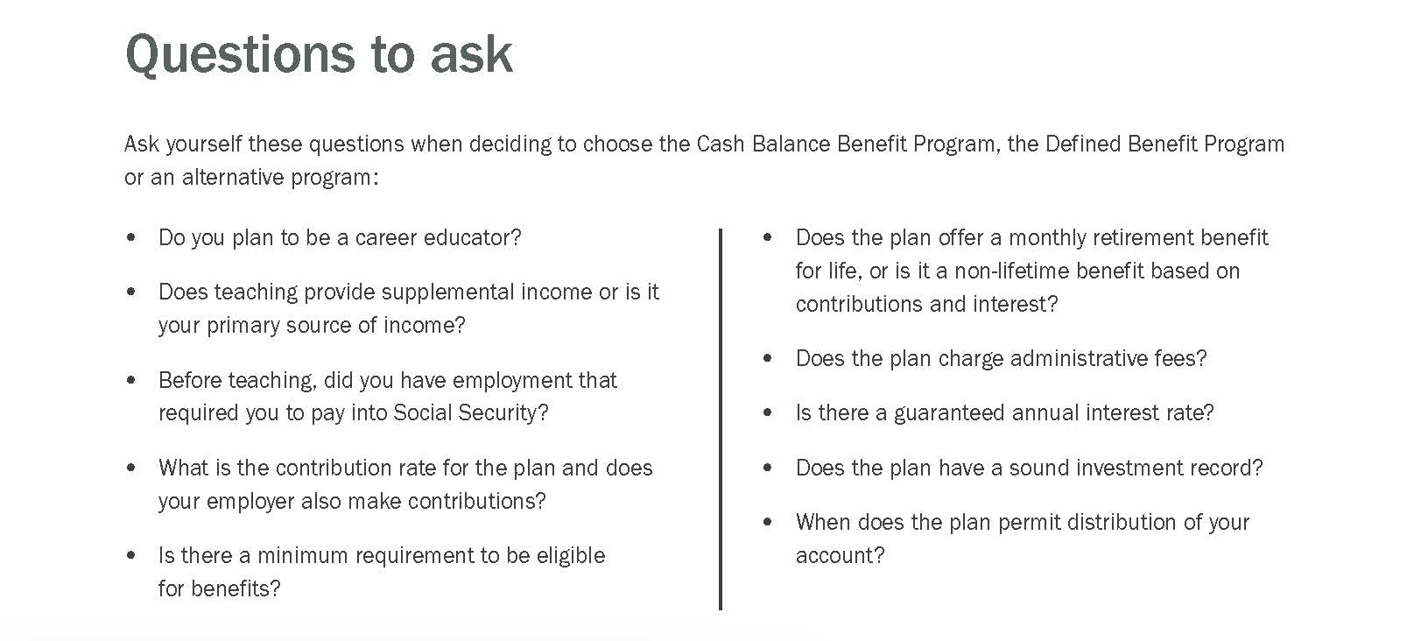

Choose the plan that works for you
Scan the QR code to read
Cash Balance Benefit Program.
Notes:
If you’re in a place to be deciding between these plans and any other alternative programs, I recommend checking out our Cash Balance Benefit Program booklet. Which can be found on calstrs.com under member publications or by scanning this QR code.
Click.
On page 6 of that booklet there is a list of questions to ask yourself when considering a plan outside of Cash Balance or even if you are trying to decide between Cash Balance or the CalSTRS Defined Benefit Plan. To highlight a few important ones….
Click.
Does teaching provide supplemental income or is it your primary source of income? The answer to this question may also be reflected in retirement. If teaching is a supplemental source of income, then your retirement savings from teaching may also be a supplement to your retirement savings from another career.
Click.
Is there a minimum requirement to be eligible for benefits? You don’t want to be committed to working when you are ready to retire just to meet the eligibility requirements.
Click.
Does the Plan offer a monthly retirement benefit for life like the CalSTRS Defined Benefit Plan or does it provide choices for payout like the CalSTRS Cash Balance Plan, or is it a non lifetime benefit based on contributions and interest?
Click.
Is there a guaranteed annual interest rate?
You might not know the answers to all these questions, so a financial advisor could be someone to talk to.
Click.

Slide 56

Other retirement considerations for part-time educators
Notes:
Next, we are going to go over some additional retirement considerations that you should be aware of regardless of the program you are in.
Click.

Slide 57




Consolidation of benefits
Converts Cash Balance Benefit Program account into service credit for the Defined Benefit Program.
Must be an active member of the Defined Benefit Program.
Must terminate all activity for the Cash Balance Benefit Program.
Consolidation process can be lengthy.
Notes:
If you are a Defined Benefit member but you have a Cash Balance account, you can consolidate your Cash Balance account into your Defined Benefit.
Click.
By doing this you would be converting your Cash Balance account into Defined Benefit service credit.
Click.
To do this you must be an active member of the Defined Benefit Program.
Click.
You must terminate all Cash Balance activity.
Click.
Also know that the consolidation process can be lengthy. So, if this is something you are interested in, it is better to research this sooner rather than later. For those of you who are interested in consolidating benefits you can review more information in the CalSTRS Member Handbook and our FAQs found on our Part-time Educator webpage. You may access the necessary forms on our website at CalSTRS.com/forms.
Click.

Slide 58
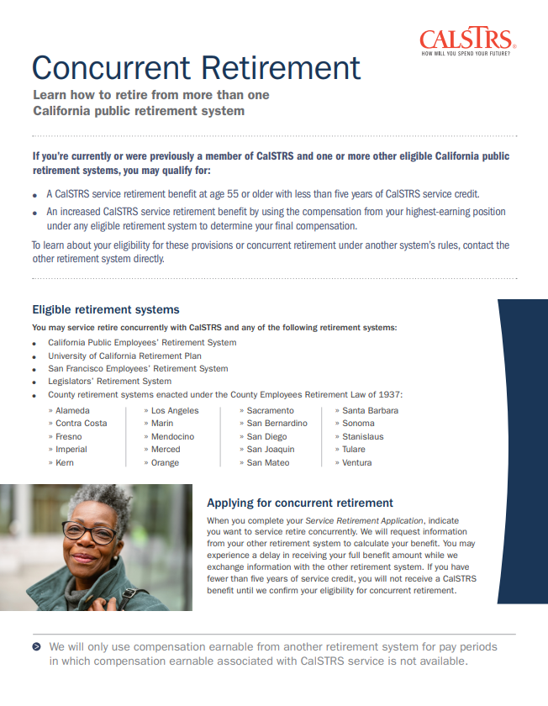



Concurrent Retirement*
Member of another eligible California public retirement system.
Retire on the same day.
Additional retirement benefits for applying together.
Scan the QR code to read Concurrent Retirement.
Defined Benefit Program only.
Notes:
Concurrent Retirement is a benefit for Defined Benefit members only. It can be applicable to many part-time educators, particularly if you have also worked at California universities in which you may have paid into PERS or UCRP. The availability of concurrent retirement may also influence which plan you choose.
If you are a member of another eligible California public retirement system, you may be eligible to take advantage of this feature. If you do decide to proceed with a concurrent retirement, you should retire on the same day in both systems. I already mentioned that this is one way to retire without our 5-year vesting requirement, but there are additional retirement benefits you should know about.
For more information about concurrent retirement, you can refer to the Concurrent Retirement factsheet you see here. It is available on our website at CalSTRS.com/publications. We also recommend you talk to your other retirement system for any requirements they may have.
Click.

Slide 59
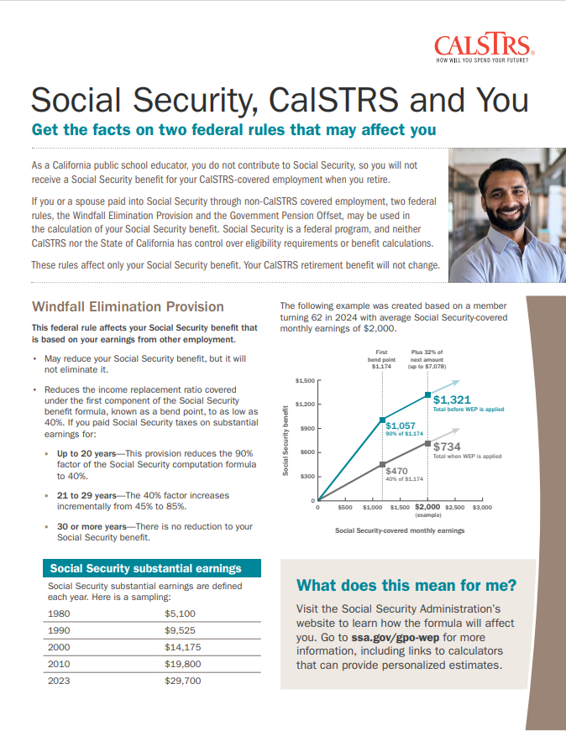

Social Security, CalSTRS and You
Windfall Elimination Provision
May reduce but cannot eliminate your Social Security benefit.
Government Pension Offset
Reduces and may eliminate your spousal, widow or widower Social Security benefit.
Contact the Social Security Administration for more information.
Scan the QR code to read Social Security, CalSTRS and You.
Notes:
You may have heard that CalSTRS members do not get social security. This is not true and requires further investigation/consideration for part-time educators. There are 2 social security offsets that you should know about that may impact your Social Security benefit should you qualify for one.
If you are expecting a social security benefit based on your own earnings, your social security benefit may be reduced but not eliminated. This offset considers how many substantial earnings years you paid into social security. If your career in California education has occurred after a full career paying into Social Security, you may not be impacted at all or the offset may be reduced.
If you are expecting a spousal or widow/widower benefit from social security, that benefit can be reduced or eliminated based on the amount of your CalSTRS benefit.
I encourage you to read more about these offsets on our fact sheet Social Security, CalSTRS and You found at CalSTRS.com/publications. We also have an educational video on this topic on our Part-time Educator webpage.
Click.

Slide 60
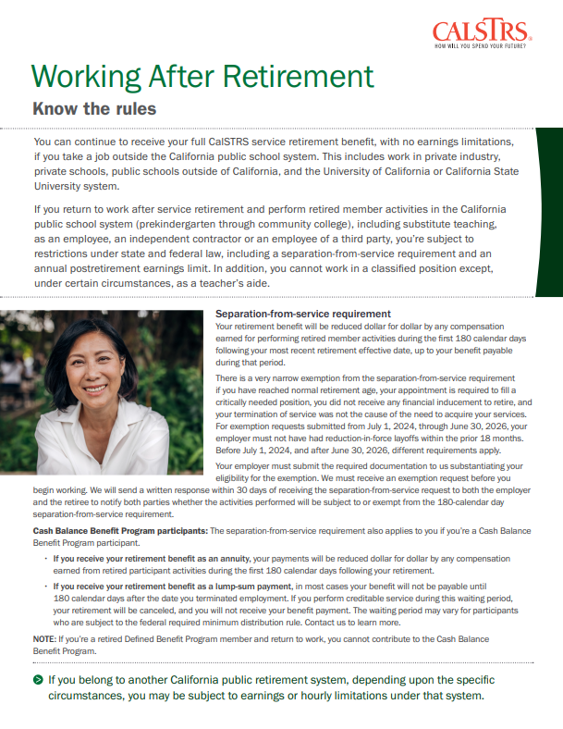

Working After Retirement
Separation-from-service requirement
Benefit reduced dollar for dollar by the amount you earn in CalSTRS-covered employment during the first 180 calendar days of retirement.
Annual postretirement earnings limit
Benefit reduced dollar for dollar for earnings in excess of the annual limit.
Earnings limit changes every
fiscal year.
Scan the QR code to read Working After Retirement.
Notes:
Many part-time educators consider working after retirement, if this is a consideration for you there are three things you need to know if you are planning to work in a California Public school. Please note that the rules for working after retirement only apply if you are going back to work in a California Public school.
There is a separation from service requirement. You cannot go back to work for a CalSTRS covered employer during the first 180 calendar days following retirement without penalty. Meaning if you do, your benefit will be reduced dollar for dollar by the amount you earn, up to your benefit amount for the first 180 days. We have worked with many part-time educators that have shared that they have to start working right away to stay on the substitute list or to remain as a preferred adjunct and chose to pay back the benefit amount during the separation of service requirement, don’t forget that during this time period you are still receiving your full district pay.
2. After the separation from service requirement, you are subject to an Annual post retirement earnings limit.
3. You cannot contribute to the Cash Balance program as a CalSTRS retiree.
If you are planning on working after retirement know the rules. You can get a copy of the Working after Retirement factsheet seen here at CalSTRS.com/publications.
Click.

Slide 61





Tax-deferred retirement savings.
Low cost.
Flexible investment options.
Friendly support team.
888-394-2060
Pension2.com
Notes:
We’ve already talked about the importance of supplementing your retirement income by contributing to the low-cost CalSTRS Pension2 program.
If you’re interested in starting your supplemental savings plan account today or if you already have a supplemental savings plan account through another company and are interested in our free, unbiased, statement comparison service, please give us a call at 888-394-2060. We want to help ensure you have enough money to meet your retirement income needs.
Also, if you aren’t quite ready and just want to learn more about the Pension2 program, we offer a webinar called Start Saving Now with Pension2. I encourage you to attend and receive some more in-depth information about the ways in which Pension2 can help you reach your retirement income goals.
Click.

Slide 62

Be your own advocate
Create your myCalSTRS account.
Review your CalSTRS Retirement Progress Report annually.
Subscribe to CalSTRS’ online newsletter.
Verify your one-time death benefit information is correct.
Notes:
As a part-time educator and CalSTRS member it is very important to be your own advocate.
Make sure you create a myCalSTRS account.
Review you Retirement Progress Reports annually. Especially, if you have multiple employers you want to keep track of each employers reporting.
You can subscribe to the CalSTRS’ online newsletter and stay in the know with us.
Lastly make sure your one-time death benefit information is correct.
Click.

Slide 63





Additional webinars for
part-time educators
Cash Balance Benefit Program
Explore the benefits of being a participant of the Cash Balance Benefit Program.
Consolidation of Benefits
Learn how to consolidate your Cash Balance Benefit Program account into service credit for the Defined Benefit Program.
Part-time Educator
Additional Income Sources
Discover all the different income sources that will contribute to your retirement income.
Sign up at CalSTRS.com/attend-a-part-time-educator-webinar.
Notes:
Recently, CalSTRS has prioritized the education for part-time educators. Today was the main event. We have also created 3 shorter webinars that focus on some of those topics we touched on today.
If Cash Balance seems like a good fit for you, the Cash Balance webinar will be a good opportunity to learn even more and get all of your CB questions answered.
Or if you already have a Cash Balance account and are looking to turn it into DB service credit, please join us for the Consolidation of Benefits webinar.
Finally, as a part-time educator, your retirement picture might be a bit more complex. Your retirement income might be coming from many different places. Join us for Additional Income sources and we can help you identify what those other sources might be.
Click

Slide 64


For more information
Online resources
Part-time Educator webpage
myCalSTRS
Retirement Progress Report
Benefits planning sessions
Schedule a benefits planning session
Attend a workshop or webinar
Consolidation of Benefits
Cash Balance Benefit Program
Part-time Educators Additional Income Sources
Notes:
If you need more information, we have several online resources. I want to highlight the Part-time educator webpage. This acts as you one stop shop for all resources such as forms, publications, videos and webinars that pertain to the part-time educator.
You can schedule a benefits planning sessions
There are also several webinars that were created specifically for you the pat-time educator.
Click.

Slide 65


Questions?
CalSTRS.com
myCalSTRS.com
800-228-5453
*Press 2 for Customer Service.
Monday–Friday
8 a.m. to 5 p.m.
Notes:
Questions?

