Slide 1
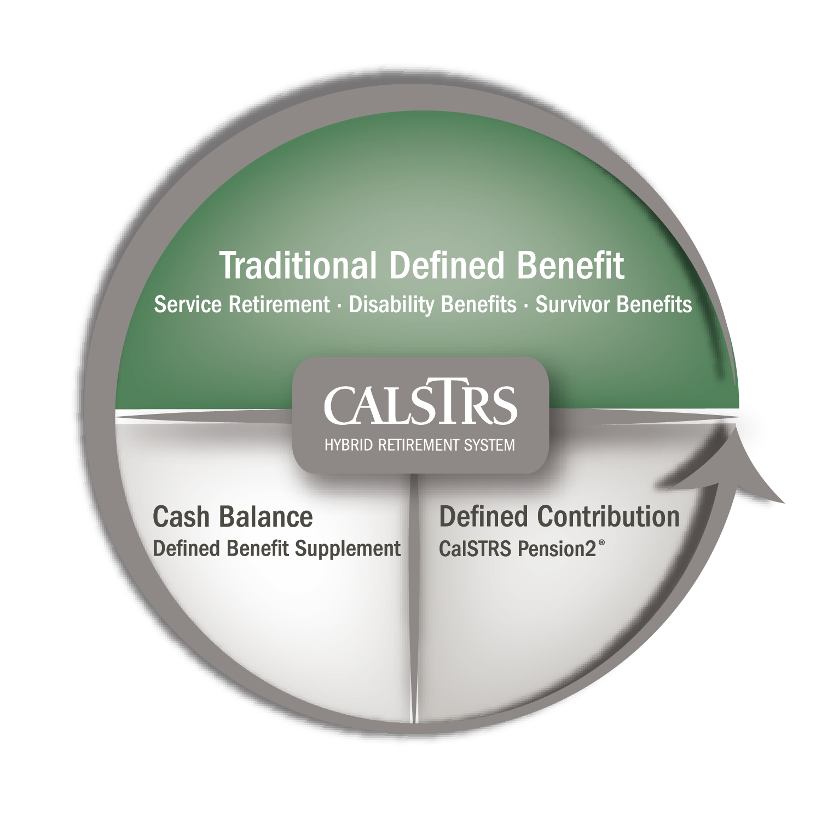
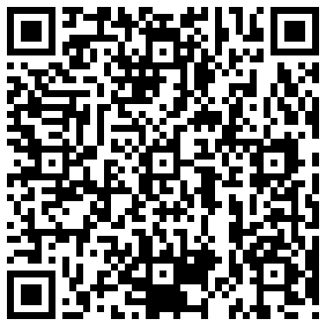
Did you know CalSTRS is a hybrid retirement system?
Thank you for your patience.
Your presentation will begin soon.
Scan the QR code to visit
CalSTRS.com/understand-your-benefits.
Notes:
IMPORTANT – When sharing your screen, be sure to share your sound as well.
RECOMMENDED – Have a browser window open behind your PowerPoint screen for ease of transition when showing the video and calculator.
TO BEGIN PRESENTATION – Click on “Your presentation will begin soon.” and the loop will end and you’ll be taken to the title slide.

Slide 2
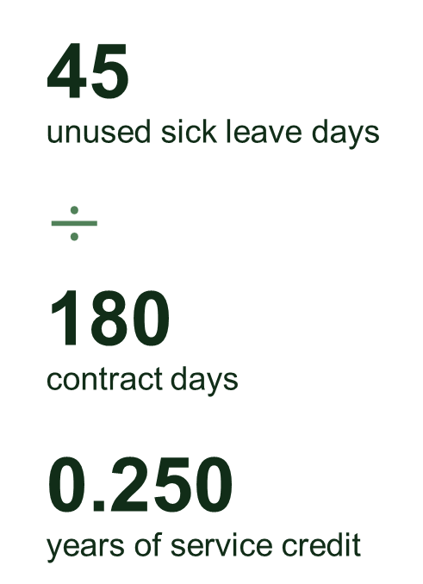
Did you know your unused sick leave is converted into service credit at retirement?
Thank you for your patience.
Your presentation will begin soon.
Example:
45
unused sick leave days
$÷$
180
contract days
0.250
years of service credit
Notes:
TO BEGIN PRESENTATION – Click on “Your presentation will begin soon.” and the loop will end and you’ll be taken to the title slide.

Slide 3

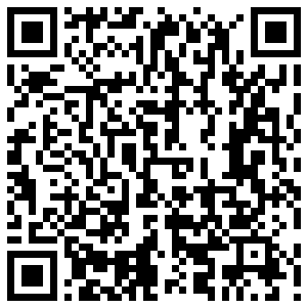
Did you know you have disability and survivor benefits as part of your CalSTRS membership?
Thank you for your patience.
Your presentation will begin soon.
Download the CalSTRS Member Handbook to learn more about these benefits and eligibility requirements.
Scan the QR code to visit
CalSTRS.com/member-handbook.
Notes:
TO BEGIN PRESENTATION – Click on “Your presentation will begin soon.” and the loop will end and you’ll be taken to the title slide.

Slide 4
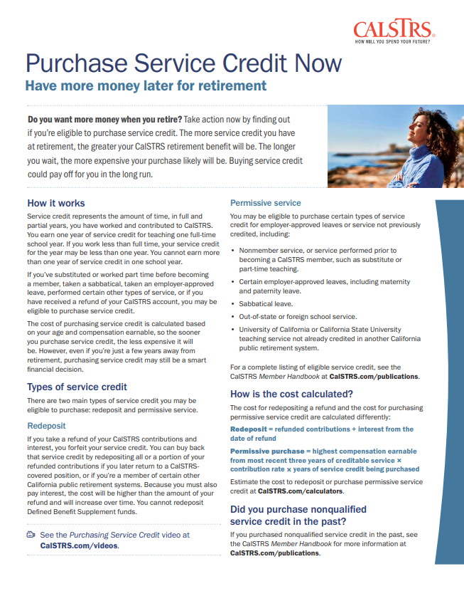
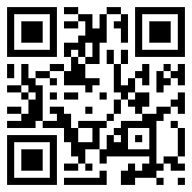
Did you know you may be eligible to purchase service credit?
Thank you for your patience.
Your presentation will begin soon.
Download the Purchase Service Credit Now fact sheet to learn more about purchases.
Scan the QR code to visit CalSTRS.com/
purchase-service-credit-now.
Notes:
TO BEGIN PRESENTATION – Click on “Your presentation will begin soon.” and the loop will end and you’ll be taken to the title slide.

Slide 5
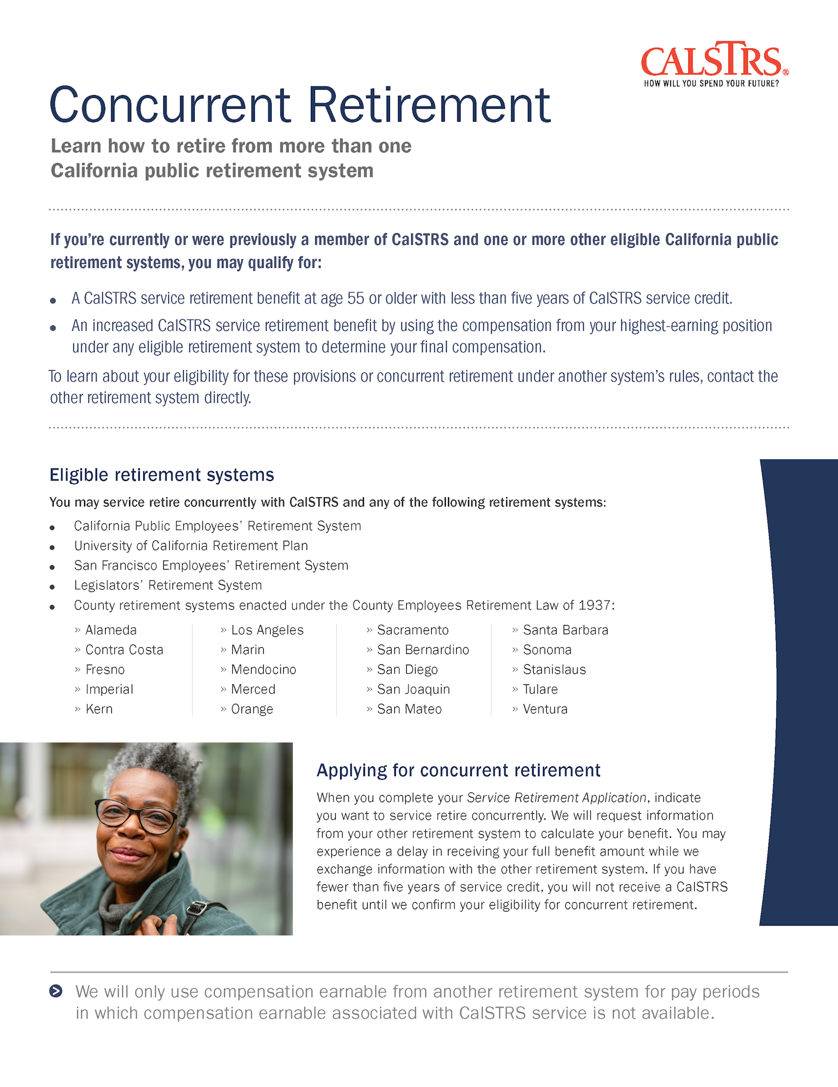

Did you know you may benefit from a concurrent retirement if you’re a member of another eligible California public retirement system?
Thank you for your patience.
Your presentation will begin soon.
Download the Concurrent Retirement fact sheet to learn more about how you may qualify.
Scan the QR code to visit
CalSTRS.com/concurrent-retirement.
Notes:
TO BEGIN PRESENTATION – Click on “Your presentation will begin soon.” and the loop will end and you’ll be taken to the title slide.

Slide 6
My First Steps
Understand what you have and determine what you’ll need.
Notes:
Welcome!
Introduce yourself.
Click.

Slide 7

Understand how teaching provides a pension for your retirement.
Recognize the importance of starting to save now.
Get the facts on Social Security.
Objectives
Notes:
We're going to cover a lot over the next 30 minutes.
Click.
We want to make sure that you understand your retirement benefit and what it is that you are getting from CalSTRS
We are going to talk about the contributions that you’re paying.
And you’ll get to see how your employer and the state of California are also helping to fund your retirement.
Click.
We’ll talk about setting goals for retirement
Why it is important to start saving now.
Click.
We are going to get into Social Security
Because there's a lot of misinformation out there.
Click.

Slide 8
1
What is a pension?
Notes:
Let’s look at the basics of a pension.
Click.

Slide 9


A pension is:
Monthly income paid to you in retirement.
Guaranteed for your lifetime.
Most common in the public sector.
Funded by contributions made by you and your employer.
Notes:
We’ll first look at some general facts about pensions before we look at some features that are specific to CalSTRS.
Click.
A pension is a monthly benefit that is paid to you in retirement.
Click.
A pension is guaranteed for your lifetime.
From when you stop working until your death, you will receive a pension check.
Click.
A pension is most found in the public sector and as teachers for the public school system, you are in the public sector.
Click.
And a pension is funded by contributions made by both you and your employer.
Click.

Slide 10
Your pension is initially paid from your Defined Benefit Program account.
Your retirement benefit is based on a formula.
You can provide a lifetime monthly benefit to someone after your death.
Contribution rates are set by law and the Teachers’ Retirement Board.
With CalSTRS:
Notes:
Let’s look at some details that are specific to CalSTRS.
Click.
With CalSTRS, your pension comes from your Defined Benefit Program account.
Whenever you see “Defined Benefit Program” on any CalSTRS materials, know that that's the account that your pension is coming from in retirement.
Click.
With CalSTRS your benefit is based on a formula.
Not based on how much you've contributed or how much your employer contributed.
We’ll look at that formula on the next slide so you can see the components of it.
Click.
With CalSTRS you get the opportunity to provide a lifetime monthly benefit to someone after your death.
You’ll receive a reduced pension for your lifetime.
After your passing, the person you’ve named will then receive a check for the remainder of their lifetime.
Click.
With CalSTRS, the amount you are contributing towards this retirement system set by law and by our Teachers Retirement board.
Click.

Slide 11



CalSTRS retirement formula
Service credit
Time worked and contributed. CalSTRS vesting requirement is a minimum of five years of service credit.
Age factor
Percentage based on age at retirement.
Final compensation
Highest average annual compensation earnable for 36 consecutive months.
service credit $×$ age factor $×$ final compensation $=$ monthly retirement benefit
Notes:
As I mentioned, your CalSTRS pension is based on a formula.
Click.
The first component of the formula is service credit.
Service credit is the time that you've worked and contributed into CalSTRS.
Additionally, to qualify for that lifetime pension, you do have to have a minimum of five years of service credit.
Click.
The second component is the age factor.
This is a percentage that's based on your age at retirement.
The older you are when you retire, the higher your percentage will be.
With our program, there is a cap at 2.4%.
Click.
The third component is final compensation.
We use the average of your highest 36 consecutive months.
It's important to know that this does not have to be the last three years of working.
It can be anywhere in your career, but it is the highest 36 consecutive months.
Click.
Multiply that all together and it equals your monthly retirement benefit amount.
The higher these numbers are, the higher your retirement benefit is going to be.
Click.

Slide 12

Contributions
You
Employer
State
CalSTRS 2% at 62: 10.205%
CalSTRS 2% at 60: 10.25%
Contribution rate
About 19%
About 8%
Deposited in
Personal Defined Benefit Program account
Teachers’
Retirement Fund
Teachers’
Retirement Fund
Scan the QR code to visit
CalSTRS.com/contributions.
Notes:
I mentioned that your CalSTRS contributions are set by law. The law also sets the amount your employer and the state are contributing. Let’s take a closer look at how much everyone is paying and where that money is going.
Click.
First, let's talk about you the member.
Depending on your benefit structure, you are contributing 10 point something percent of your compensation. If you’re not sure your benefit structure, that information can be found in your Retirement Progress Report.
If you look on your paycheck, you'll see that there’s pre-tax money being taken out and that money is then going directly into your own defined benefit account. Where it automatically accrues interest. That money that's coming out of your paycheck is always yours. Upon your death, any account balance will be paid out to any beneficiary you have on file.
Click.
Now, let’s look at your employer. They're are also paying to help fund your pension.
Your employer is currently contributing about 19% your compensation.
Their contributions are going into the Teachers Retirement fund.
Click.
Next, the state of California.
The state is currently contributing about 8% of your compensation.
Their contributions are also going into the Teachers Retirement fund.
Because these contributions are going directly into the Teachers’ Retirement Fund, you will only have access to this money in retirement. I’ll show you how that works in the next section.
Click.

Slide 13
Did you know?
Only 15% of private industry workers have a pension.
Around 66% of private employers offer defined contribution plans like a 401(k) or 403(b) instead of a pension.
The average contribution rate for private employers is only 4% to 6%.
Notes:
Click.
Did you know only 15% of private industry workers have access to a pension.
If you were to switch jobs and join the private sector, this includes private schools, you’ll find that a pension is rare.
Click.
Instead of a pension, 66% of workers are offered a defined contribution plan.
Something like a 401(k) or 403(b).
This is something you do have access to now, but it’s most likely not going to be your main source of income in retirement.
This will be an account you set up to supplement your pension.
We’ll look a little bit at how these types of accounts differ from a pension on the next slide.
Click.
According to the US Bureau of Labor Statistics, the average private employer is contributing only 4-6% of their employee’s compensation.
We just saw your employer is contributing about 19% of your earnings towards your retirement.
Click.
(source: www.bls.gov/opub/ted/2023/retirement-plans-for-workers-in-private-industry-and-state-and-local-government-in-2022.htm)

Slide 14


Pension vs. defined contribution
Pension
Defined benefit plan
401(k) or similar
Defined contribution plan
Make contributions.
Make contributions.
Benefit is determined by a formula.
Benefit reliant on investments and market activity.
Receive set monthly payment for life.
Receive payments until funds run out.
Notes:
Let’s look at some similarities and differences between a pension, also known as a defined benefit plan, and a defined contribution plan.
Both are employer sponsored.
Both provide income in retirement.
Click.
The next similarity is that you would be contributing to both to grow your account.
But what happens next is where the difference lies.
Click.
With the defined benefit plan,
The amount you're receiving in retirement is determined by a formula
Not dependent on investments you choose or how the stock market performs.
Compared to the defined contribution plan,
The money that will fund your retirement is dependent on your investment choices and how the stock market performs.
The money you’ll receive in retirement does depend on the account balance.
Click.
In retirement,
With the defined benefit, you’re going to receive a set amount for life regardless of regardless of your account balance.
With the defined contribution, depending on the contracts you’ve signed, you will just be withdrawing those funds until the money run out.
Click.

Slide 15
2
Benefits of a pension
Notes:
Section 2, let’s look at how a pension can benefit you.
Click.

Slide 16

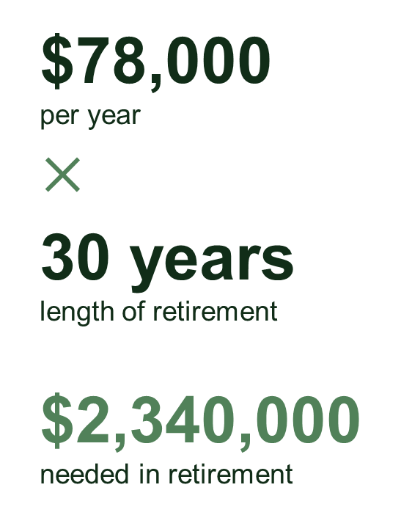
How much will you need in retirement?
Now, let’s say you’ll be retired 30 years and want to maintain your lifestyle in retirement. You’ll need:
Let’s say your current salary is:
$6,500
per month
$×$
12
months per year
$78,000
annual salary
$78,000
per year
$×$
30 years
length of retirement
$2,340,000
needed in retirement
Notes:
But before we do that, I want to walk you through a very general calculation for how much money you might need to fund your retirement.
Let's imagine that you currently make $6,500 per month.
If we multiply that by 12 months
That’s $78,000 per year.
Click.
Now imagine that’s the same income you’ll earn in retirement.
A lot of financial experts use 30 years to calculate the length of retirement, so we’ll do the same
We’ll multiply $78,000 by 30 years.
You would need to save over 2 million dollars to cover your retirement, which is a lot of money to save!
That's where your pension comes in, because it’s going help cover a big portion of that.
Click.

Slide 17


Let’s compare
Average career length
Working longer
Years of service credit
25
28
Total Defined Benefit
account contributions
$217,075
$257,569
Monthly pension amount
$5,044
$7,407
Length of retirement
30 years
30 years
Total paid
$1,815,669+
$2,666,536+
Note: Both examples are CalSTRS 2% at 62 members.
Notes:
Now we are going to take a look at 2 sample members and see how much money they have paid into CalSTRS and how much they might receive over their retirement.
On the left we have an average CalSTRS member and on the right we have a member that's going to work a little bit longer to increase their pension.
Click.
First, the average CalSTRS member.
She's retiring with 25 years of service credit and
Click.
throughout her career, she has contributed about $217,000.
Click.
Considering her service credit, age factor, and final compensation, her pension amount is going be about $5000 per month. .
Click.
We’ll assume her retirement is 30 years
She’s not leaving money for a loved one.
Click.
This member would be receiving over 1.8 million dollars over the span of her retirement.
Keep in mind that this is pre-tax and does not include the built-in inflation protection that CalSTRS offers.
Click.
Next, the CalSTRS member that works a few more years.
She's retiring with 28 years of service credit
Click.
Throughout her career, she has contributed about $258,000.
Click.
Considering her service credit, age factor, and final compensation, her pension amount is going be about $7,500 per month.
Click.
We’ll assume her retirement is 30 years.
She’s not leaving money for a loved one.
Click.
This member would be receiving over 2.7 million dollars over the span of her retirement.
Again, keep in mind that this is pre-tax and does not include the built-in inflation protection that CalSTRS offers.
Notice how much they’ve paid into CalSTRS versus what they are receiving!
Click.

Slide 18

How are your pension payments funded?
Estimated retirement timeline
First 3–5 years:
Paid from your contributions to your Defined Benefit Program account.
The rest of your and your beneficiary’s lifetimes:
Paid from the Teachers’ Retirement Fund
Scan the QR code to visit
CalSTRS.com/funding-plan.
Notes:
The last slide showed you how much money a member might pay into CalSTRS and how much they might get in retirement.
With this slide, I’m going to show you how that works.
Click.
When you first retire, your benefit checks are coming out of the money that you contributed throughout your career.
Money will continue to be drawn until that account reaches a zero-dollar balance.
On average, the account is depleted within the first 3-5 years of retirement.
But that doesn’t mean that your payments are going to stop.
Click.
You're still going to get paid for the remainder of your lifetime.
But once your account is at zero, the money is coming out of the Teachers’ Retirement Fund.
And if you were to leave money for a loved one, then their money is also coming from the Teachers’ Retirement Fund.
That's where you're benefiting from and receiving the money that your employer and that the state paid in on your behalf.
In 2013, legislative changes were made to ensure CalSTRS would have enough money to pay you for your entire retirement.
If you want to learn more about the funding plan, there's a QR code you can scan or visit calstrs.com/funding-plan.
Click.

Slide 19

Things to consider:
Your CalSTRS retirement benefit is considered taxable income.
If you choose to leave a lifetime benefit to a loved one, your benefit will be reduced.
Your needs in retirement may be greater than what your CalSTRS benefit will provide.
Notes:
I hope now you’ve seen that your CalSTRS benefit has big potential for you!
But it’s only part of your big retirement picture.
I want to go over some things to consider when imagining your future as a CalSTRS retiree.
Click.
First, your CalSTRS retirement benefit is considered taxable income.
The numbers we see today and numbers you’ll see on any estimates are always going to be gross numbers.
Your benefit will be taxed as normal income in retirement.
Click.
Next, if you choose to leave a lifetime benefit to a loved one, then your member benefit will be reduced.
It’s essentially like a life insurance policy where you are paying for the coverage.
Click.
Finally, your needs in retirement might be greater than what your CalSTRS benefit will provide.
Which leads us into the rest of this presentation.
Click.

Slide 20
3
Is your pension enough?
Notes:
Our next section we’ll talk about how to determine if your pension will be enough.
Click.

Slide 21
Did you know?
Financial advisors typically recommend replacing 80% to 90% of your working income in retirement to maintain the same standard of living.
Notes:
In order to determine if your pension will be enough, it’s a good idea to set a goal.
This is something we tell all of our members at every stage of retirement. If you’ve attended another webinar, this might look familiar.
Financial advisors typically recommend replacing 80 to 90% of your working income in retirement in order to maintain the same standard of living that you're living now while you're working.
You don’t necessarily need to replace 100%.
In retirement a lot of those deductions you have now, like your contributions to CalSTRS, will no longer be taken out of your paycheck.
Click.

Slide 22
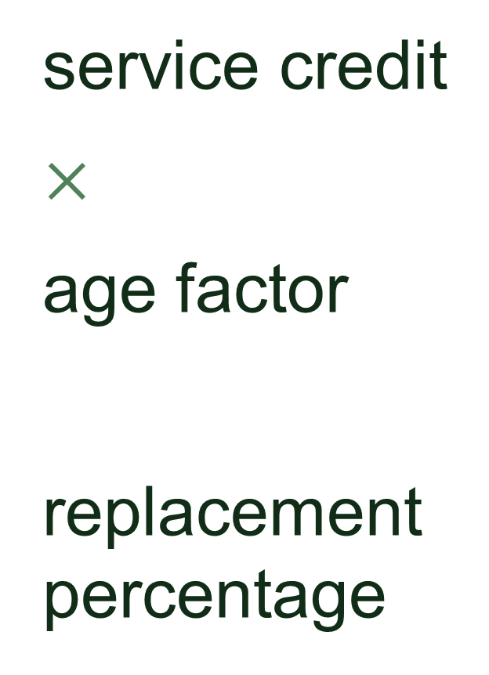
service credit
$×$
age factor
replacement percentage
What percentage does your CalSTRS benefit replace?
Notes:
You might have noticed that I spoke about goals with percentages rather than dollar amounts.
The actual dollar amount is hard to predict this early in your career.
Your final compensation is a third of the retirement formula and will definitely make a big difference.
It’s not realistic to try to figure out how much money you’ll be making in 15 or 20 years or however long you have until retirement.
To determine what percentage CalSTRS is replacing…
We take the retirement formula and remove the final compensation portion.
This leaves your service credit and age factor.
After multiplying these 2 factors, it gives you a replacement percentage.
We look at these factors because they are more within your control.
You can plan to work a certain number of years or to retire at a certain age.
You don’t really get to control what your salary will be.
Next, we’ll look at some examples.
Click.

Slide 23

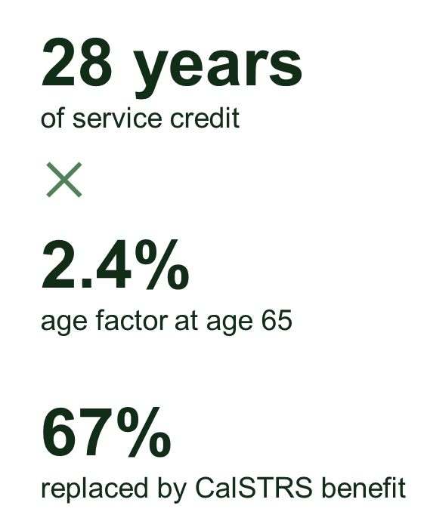
25 years
of service credit
$×$
2%
age factor at age 62
50%
replaced by CalSTRS benefit
28 years
of service credit
$×$
2.4%
age factor at age 65
67%
replaced by CalSTRS benefit
Notes:
Let’s revisit our sample members so you get an idea of what that replacement percentage can look like.
Click.
First, the average CalSTRS member retires with 25 years of service.
And if she retires at age 62, that's a 2% age factor.
When we multiply that, we see that CalSTRS is replacing 50% of her working income.
Click.
Next, we’ll look at the member who worked a little bit longer.
She’s retiring with 28 years of service.
She’s retiring at age 65, so she’s maxing out her age factor at 2.4%.
CalSTRS is going to be replacing 67% of her working income.
Click.

Slide 24
Retirement goal: 80%
Retirement goal: 80%
CalSTRS benefit replaces: 50%
CalSTRS benefit replaces: 67%
Gap: 30%
Gap: 13%
Notes:
Now we’re going to see how close these members are to reaching their retirement goal.
Click.
Both members have set a goal to replace 80% of their working income in retirement.
Click.
We saw on the last slide that CalSTRS is replacing 50% and 67% for each of our members.
Click.
For our first member, that leaves a gap of 30%.
And for our member on the right, a gap of 13%.
Both members will have to have some additional savings outside of their CalSTRS pension to retire more comfortably.
Click.

Slide 25
4
Additional savings
Notes:
That leads us to our next section, we’ll talk about additional savings.
Click.

Slide 26
Did you know?
Making pretax contributions to a retirement savings account reduces your taxable income.
The earlier you start saving, the less you need to contribute each month to reach your savings goals.
Notes:
Some facts about saving…
Click.
Did you know that contributing to a retirement savings account on a pre-tax basis will reduce your taxable income?
This means that it will reduce the taxes you owe in the year that those contributions are being made.
So, you get to benefit both now and in retirement!
Click.
Also, did you know that the earlier you start saving, the less you’ll need to contribute each month to reach your savings goals?
This is due to compound growth.
The more time you allow your money to grow, the greater compounding will benefit you.
Click.

Slide 27
Start saving now
$227,218
$123,309
Notes:
Here’s a graph to illustrate that last point.
We’ll look at 2 scenarios for the same member.
The black line shows what it looks like if that member started saving $200/month at age 30.
As you can see, that investment has the potential to grow to over $200,000
The green line shows that same member that didn’t start saving until age 45.
Maybe they were busy having babies or buying a house and didn’t have that extra income.
To try to catch up, they decided they’d save a bit more per month.
They started saving $300/month.
Although they were saving more per month, not having that extra time really impacted how much they could have at age 65.
Click.

Slide 28
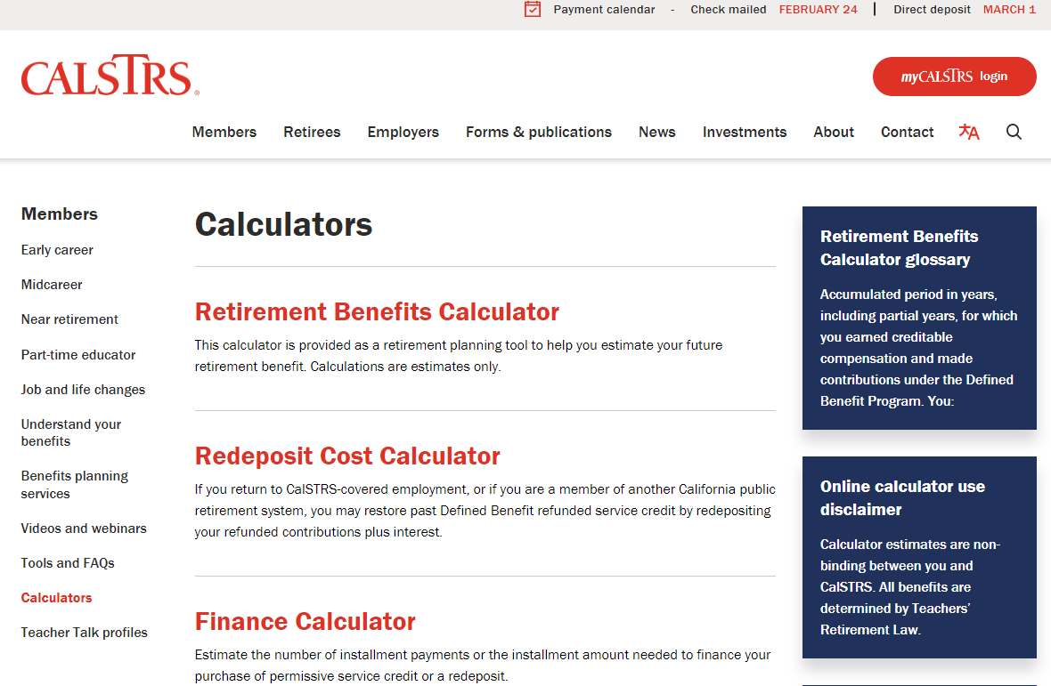
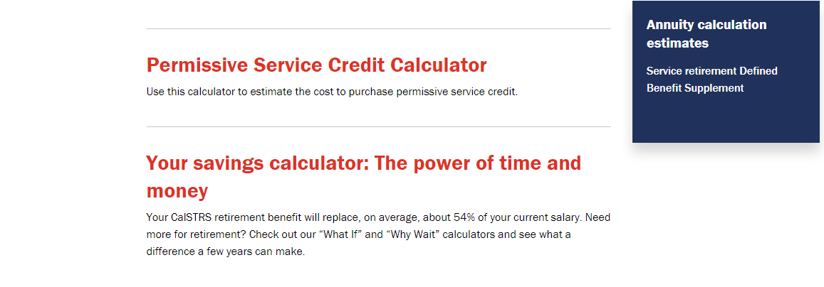

Benefits of
saving early
Scan the QR code to visit
CalSTRS.com/calculators.
Notes:
We got the numbers in that graph from this calculator we have on our website called “Your savings calculator: The power of time and money.”
I’m going to show you how the calculator works so you can use it to see the impact for you of saving now.
**Click the calculator link and it will open in your browser window. Demonstrate both parts of the calculator. For number of years of contributions, do 20-30 years. For current age, choose 35-45.**
**When demo is complete, minimize calculator window to show slide show again.**
Click.

Slide 29


403(b)
457(b)
Roth 403(b)
Roth 457(b)
Tax-deferred retirement savings.
Low and transparent costs.
No commissions, load fees or surrender charges.
Flexible investment options.
Scan the QR code to learn more at Pension2.com.
Notes:
To help you save now and to supplement your pension, CalSTRS has a Defined Contribution program.
We offer 403b and 457b and the Roth version of each.
As an employee in California’s public education system, you have access to Pension2. This is a great way of reaching that 80-90% goal.
Click.
Pension2 offers tax-deferred retirement savings.
If you want to make the pre-tax contributions, you can do so.
Click.
Pension2 has low and transparent costs.
CalSTRS only charges what it costs to run the program.
We want to make sure that you get as much of your money in your pocket in retirement.
Click.
No commissions, no load fees, no surrender charges.
We are all state employees, so we get paid whether you sign up or now. We just want you to have the best retirement possible.
Click.
Flexible investment options.
You can choose your own investments or let Pension2 do the work for you based on your risk tolerance and what stage of your career you are in
Scan the QR code to learn more at Pension2.com.
Click.

Slide 30


Do you want Pension2 to contact you?
Do you want Pension2 to contact you?
Scan the QR code to schedule an appointment.
Notes:
Do you want Pension2 to contact you?, We will call you.
Mark yes on this poll and you don’t have to add this to your to-do list.
Your answer is confidential - only we can see it internally.
If you have an account with someone else, we can run a free statement comparison for you.
Like I said, we don’t earn commissions, so we will be completely honest.
We just want you to have all the facts to have the best retirement possible.
Click.

Slide 31
5
Defined Benefit
Supplement Program
Notes:
We just looked at the importance of saving outside of your CalSTRS membership, now I want to show you an additional account you have that is part of your membership.
It’s called the Defined Benefit Supplement account.
Click.

Slide 32
Did you know?
You may be eligible to receive two benefits each month from CalSTRS when you retire.
You can build up this account by working extra-pay assignments like summer school or coaching.
You decide how to receive your Defined Benefit Supplement account funds at retirement.
Notes:
Click.
Did you know you have the potential to receive 2 checks each month from CalSTRS in retirement?
If you build up this Defined Benefit Supplement account, you may qualify to receive a lifetime annuity.
Click.
If you are working extra pay or outgrowth assignments and earning more than 1 year, those contributions are being redirected into your Defined Benefit Supplement account.
Click.
And when you retire, YOU get to decide how you receive these funds.
Unlike your pension which is a monthly benefit, you will have other options for this account.
Click.

Slide 33

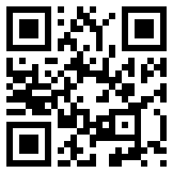
Defined Benefit Supplement video
Scan the QR code to visit CalSTRS.com/videos.
Notes:
On our website, you can find a 3-part video series that explains this account. I’m going to play part 1 for you now.
**Click on the video picture and it will open up in the browser. Make video full screen before hitting play. When done, minimize the browser window to return to the slideshow.**
**If time doesn’t allow for the video, give brief description of where to find the video. Add that this account is automatically a part of their CalSTRS membership.**
You can find the remaining videos in the series at calstrs.com/videos.
Click.

Slide 34
6
Social Security
Notes:
Social Security could be another source of income for you in retirement.
You’re eligible if you have paid into it in a job other than your current that you're working in the California Public School system and earned enough credits.
We’re going to briefly talk about some common misconceptions that we hear about from our members that are nearing retirement.
Click.

Slide 35
Do CalSTRS members pay into Social Security?
yes
no
no
Notes:
Let’s address a few common questions that we get from members now.
Do CalSTRS members pay into Social Security?
Click.
The answer is “no”.
The decision was made decades ago that CA teachers do not pay into Social Security from employment in the public school system.
Click.

Slide 36
Can a CalSTRS member still receive a benefit from Social Security?
yes
yes
no
Notes:
Can a CalSTRS member still receive a benefit from Social Security?
Click.
The answer is “yes”.
If you’ve earned enough credits from work outside of your CalSTRS-covered employment, then you still qualify to receive some money from Social Security once you’re eligible.
Click.

Slide 37
Will your Social Security benefit be affected by CalSTRS?
yes
yes
no
Notes:
Finally, Will my Social Security benefit be affected by CalSTRS?
Click.
The answer is “yes”.
Your CalSTRS benefit will not be affected by Social Security.
Your Social Security may be reduced or eliminated depending on which provisions apply to you.
Click.

Slide 38
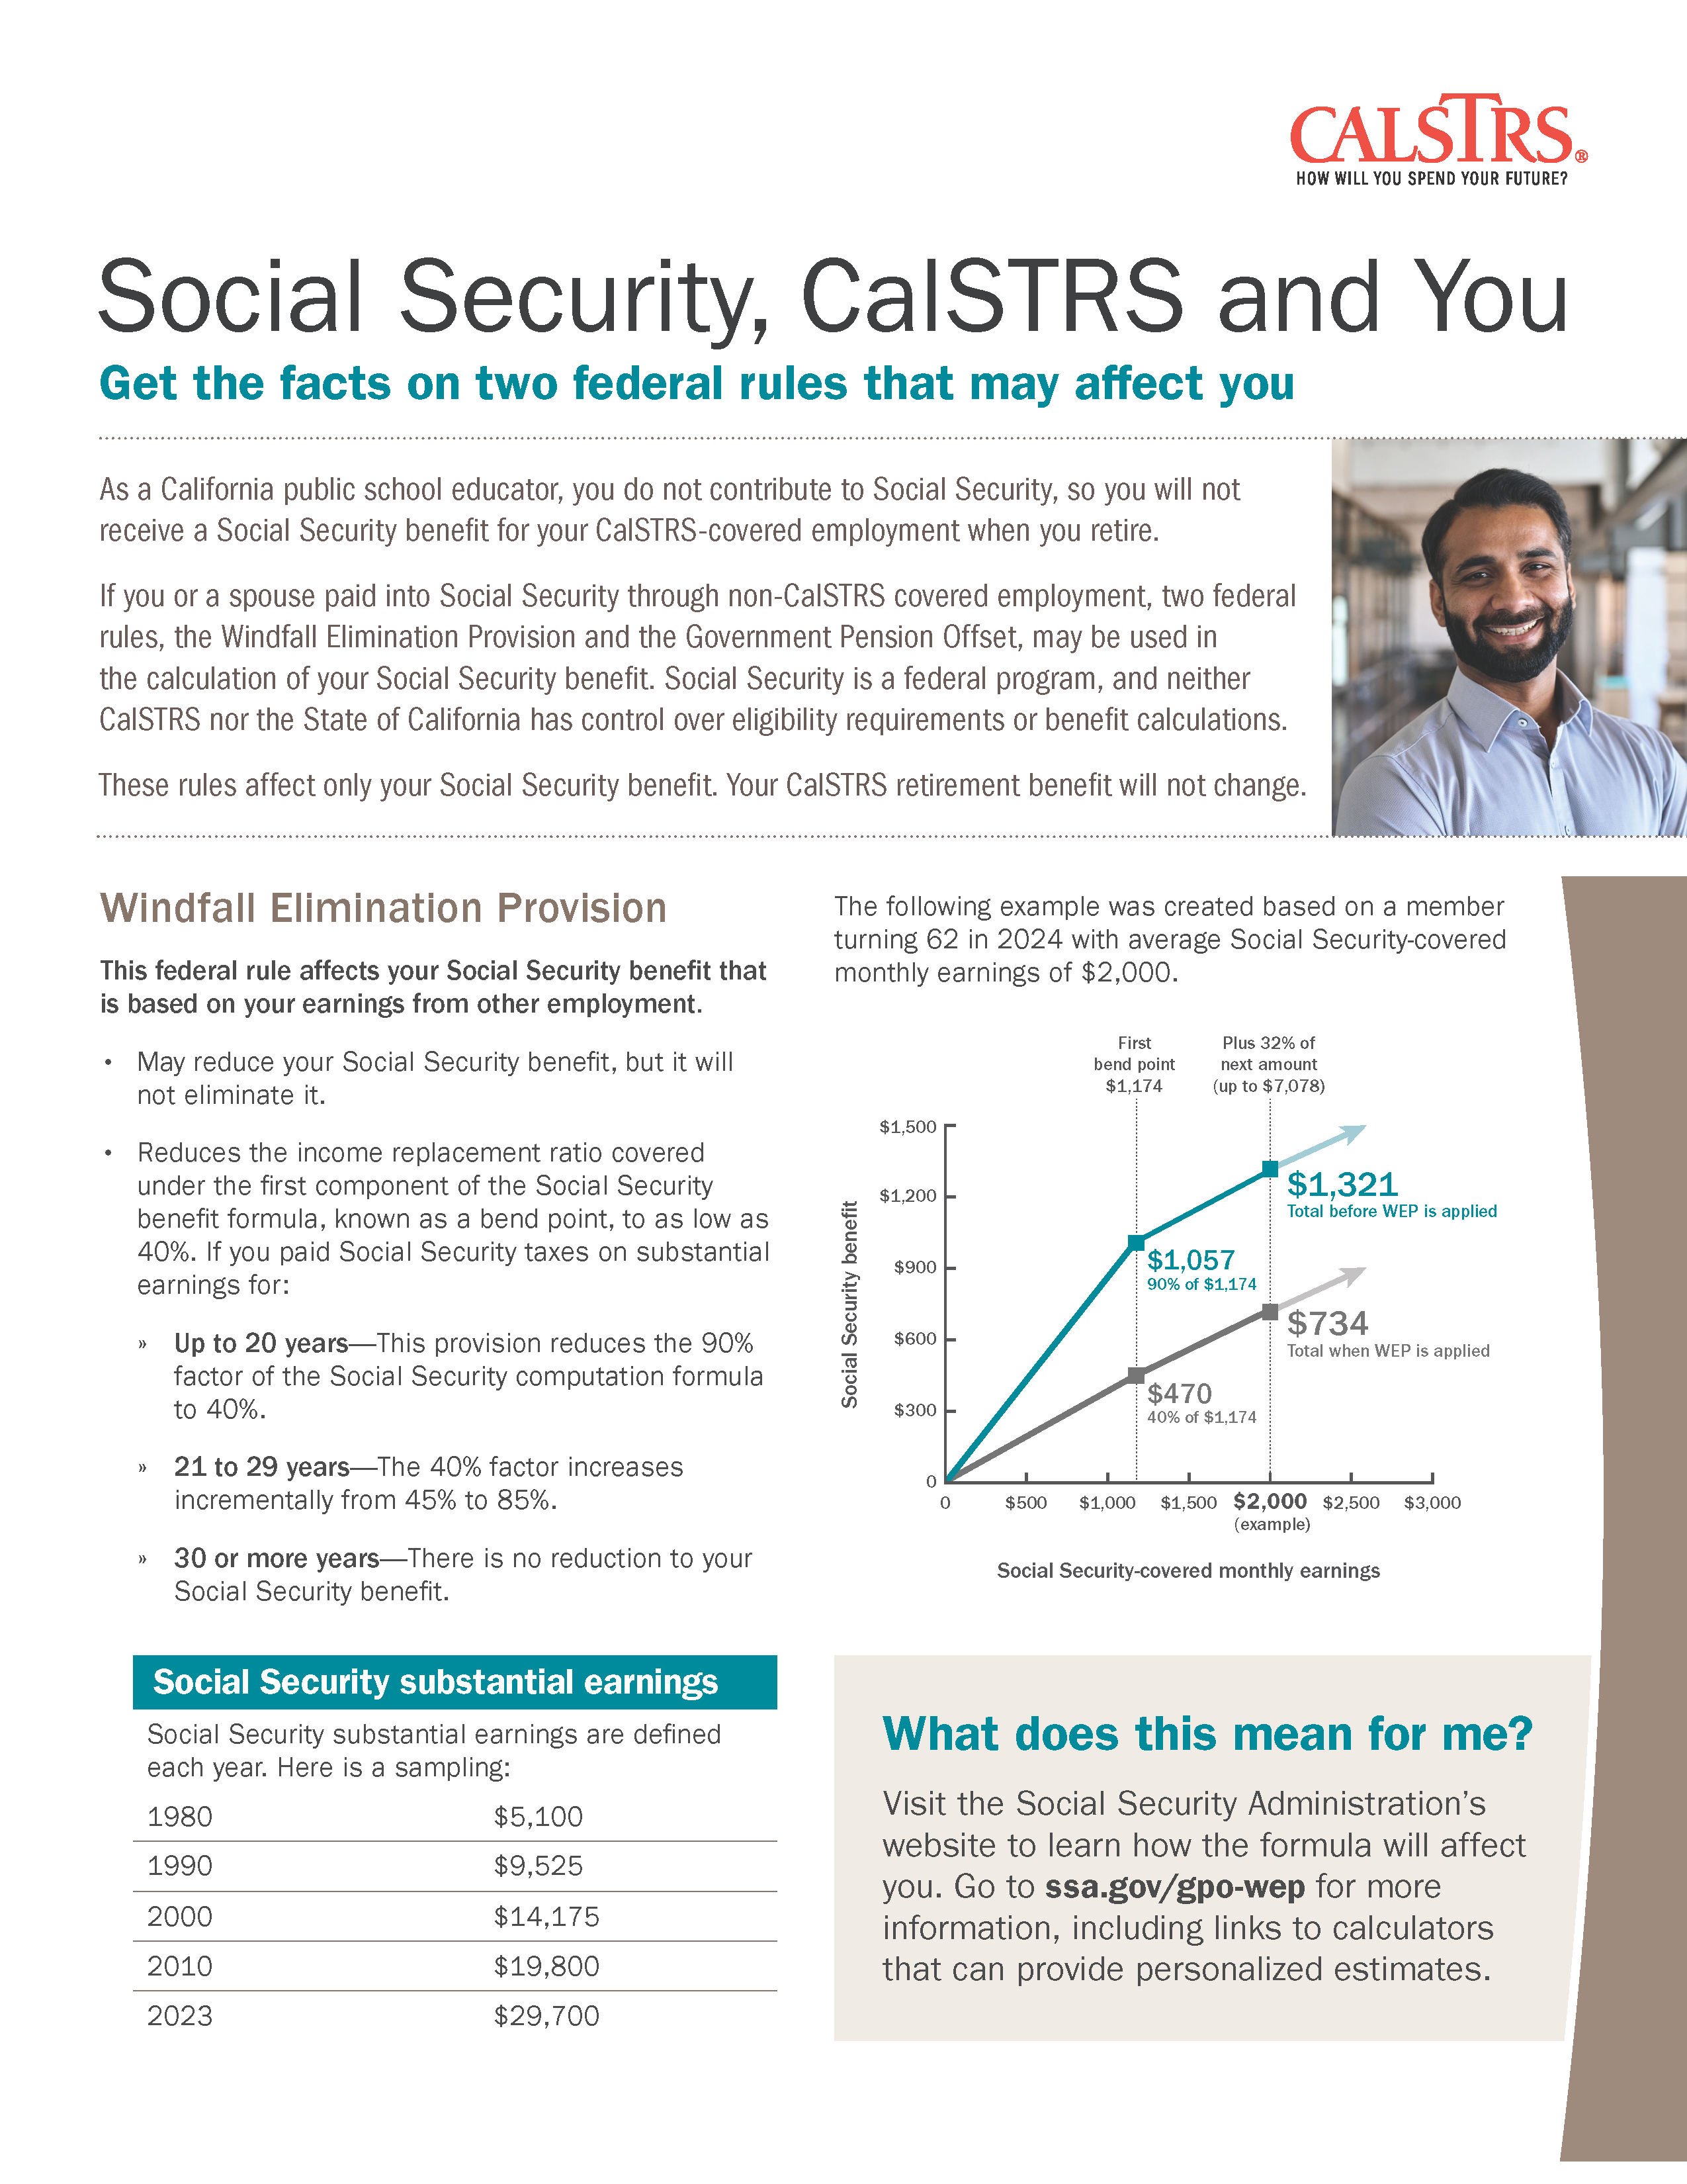
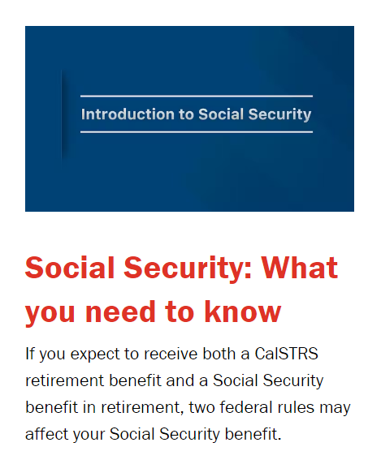


Social Security resources
Visit ssa.gov/retirement to learn more.
Notes:
If you do plan to receive a Social Security benefit, and if you want to learn more, we have some resources for you.
We have a fact sheet called Social Security, CalSTRS and You.
There's also a video that will go into detail the two federal rules that may affect your Social Security benefit.
Or you can go straight to the source and visit Social Security’s website at ssa.gov
Click.

Slide 39
7
CalSTRS resources
Notes:
We’ve talked about a few CalSTRS resources already, let’s look at some more.
Click.

Slide 40
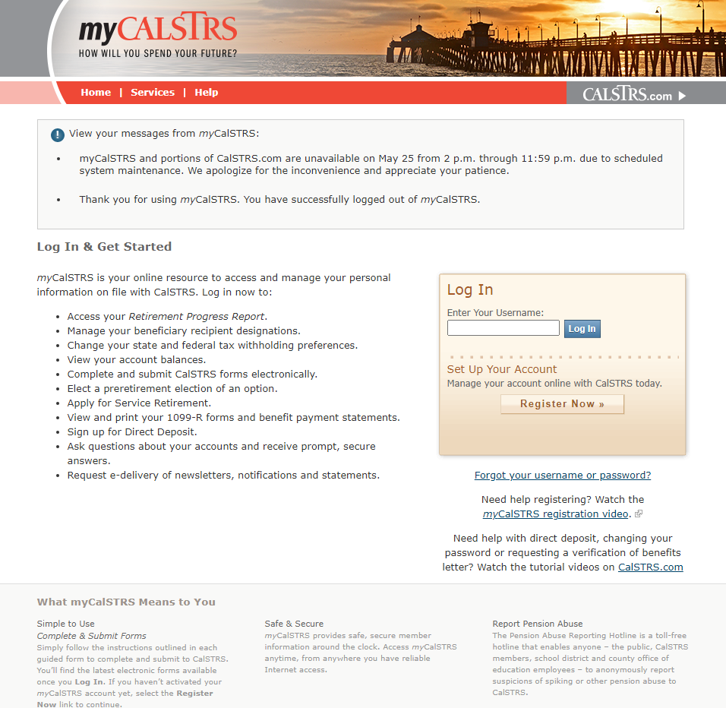

myCalSTRS.com
Scan the QR code to visit
myCalSTRS.com.
Notes:
A very important resource for you is your my CalSTRS account.
If you haven’t registered for your account yet, I suggest you do soon.
It’s easy to set up and then you’ll have access now and into retirement.
Click.

Slide 41
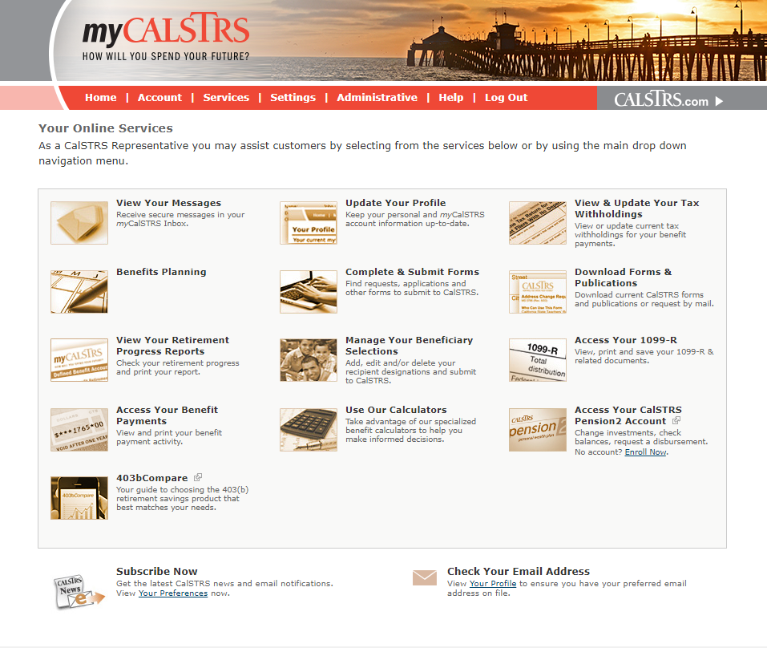
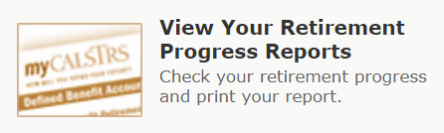
Retirement Progress Report
Check your Retirement Progress Report every fall to:
Verify what your employer reported.
See your account balances.
Review benefit estimates after age 45.
Scan the QR code to visit
myCalSTRS.com.
Notes:
One of the main reasons to log in to your account is to check your Retirement Progress Report.
This is released in September of every year. It has your balances that shows what your employers have been reporting.
It's important to check this now and throughout your career.
If you find any discrepancies, you can go to your employer and get that fixed right away.
It's a lot easier to do that now versus waiting until it's time to retire.
Once you turn age 45, your Progress Report will include estimates so you can get an idea of what your retirement benefit might look like at retirement.
Click.

Slide 42
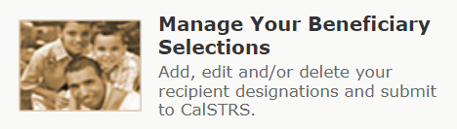
One-time death benefit
Update your one-time death benefit recipients in your myCalSTRS account.
Scan the QR code to visit
myCalSTRS.com.
Notes:
Another important part of myCalSTRS is the ability to manage your beneficiary selections.
When you die, a one-time death benefit is payable to your designated recipient if eligibility requirements are met.
The amount varies depending on whether you die while working or after retirement.
There is no cost to naming this beneficiary and it will not affect your retirement benefit.
Click.

Slide 43


Scan the QR code to read Learn and Discover at
CalSTRS.com/learn-and-discover-early-career.
Notes:
We have this Learn and Discover - Early Career publication.
You can read more about your CalSTRS membership
Find a checklist of things you should be doing to prepare for retirement
There’s even a budgeting tool to help plan your monthly spending.
Click.

Slide 44


CalSTRS
Learn more about CalSTRS and your benefits by attending a My Retirement Benefits webinar.
Pension2
Discover more about Pension2 and supplemental savings by attending a Start Saving Now webinar.
Financial literacy
Improve your financial literacy by attending a
Save for Your Future webinar.
Continue your education
Scan the QR code to register today at CalSTRS.com/webinars.
Notes:
Finally, we have some webinars you can attend to further your education.
If you want to learn more about CalSTRS
We have a webinar titled My Retirement Benefits
If you instead want to learn more about additional savings and pension2
We have webinar titled Start Saving Now
Finally, if you are looking at improving your financial literacy and want to learn more about money management
We have this webinar titled Save For Your Future.
You can find all these webinars on CalSTRS.com/webinars.
They are offered each month.
Hopefully you can find one that fits into your schedule and can continue learning and preparing for your future
Click.

Slide 45
Homework
Due now:
Due annually:
Sign up for myCalSTRS.
Elect your one-time death benefit recipient.
Review your Retirement Progress Report each fall.
Open a defined contribution account.
Notes:
Before I let you go, I do have some homework for you!
We have a few things we recommend you do now:
Sign up for myCalSTRS
To access your Retirement Progress Reports
Update your contact information
Send us a secure online message.
While you’re on myCalSTRS, you’ll want to name your one-time death benefit recipient.
Again, there is no cost to do this and it will have no impact on your retirement benefit, but it’s a good idea to have it in place now.
We talked a lot about the fact that your pension might not be enough income for you to retire comfortably, so my hope is you’ll leave today and open up a defined contribution account.
Maybe with our Pension2 program.
If you have an account, maybe consider how you can increase the amount you’re saving.
Next is something we hope you do annually.
Please log on to myCalSTRS each fall to review your Retirement Progress Report.
It’s a good idea to get into this habit so that you can check your employer’s reporting from the previous year.
If you do notice any discrepancies, you’ll want to go straight to your district to get things correct.
Click.

Slide 46
Contact us
CalSTRS.com
myCalSTRS
800-228-5453
*Press 2 for customer service.
Monday–Friday
8 a.m. – 5 p.m.
Notes:
As you continue researching your benefits and retirement decisions, questions may come up. Remember your resources!
CalSTRS.com offers forms, publications, educational videos, calculators and benefit information that may help answer your questions.
One of the most convenient features of myCalSTRS is our online messaging.
Submit your question in writing and a written response from a CalSTRS representative will be sent and archived in your myCalSTRS account for future reference.
And as always, our Contact Center agents are available to assist you by phone.
Click.

Slide 47
Thank you for attending!
Notes:
Thank you for attending!
Click.

