Slide 1
Midcareer Educator
Learn and Discover
Notes:
Welcome everyone, thank you for joining us. The time is , but we would like to wait a few more minutes to allow others to join we will be starting in just a few moments.
Welcome to the CalSTRS Midcareer Educator: Learn and Discover webinar. My name is , and I am a benefits specialist at the __________ Member Service Center/ office.
**feel free to input a personalized introduction about yourself and your background**
Before we start, I’d like to address a couple items.
Today's presentation is packed with a lot of information and demonstrations of our online resources. Please be sure you have pen and paper available to take notes, I can give you a couple of minutes if you need to grab them.
Please do not submit any personal information OR request from us any information that is specific to your account. For your security we ask that if you do have any questions specific to your retirement account you email those through your secured myCalSTRS account or to call us at 1-800-228-5453 and speak with a CalSTRS representative.
If you find that you have questions after the webinar is complete, I urge you to log into your myCalSTRS account and send a secure online message. You can log onto myCalSTRS anytime.
Click.

Slide 2
Trust CalSTR, not impersonators
CalSTRS authorized representatives:
Have an email address ending in @CalSTRS.com.
Can provide a CalSTRS ID badge or business card.
Do not provide refreshments at offsite events.
Will never meet at your home.
Do not sell insurance products.
Notes:
Before we start, we’ve been receiving constant reports from our members believing they’ve set up an appointment or spoken with a CalSTRS representative when they have not. Only CalSTRS employees can provide you with accurate information regarding your CalSTRS Defined Benefit and Pension2 accounts. We’ve developed a checklist for you to use to ensure the person with whom your speaking is a CalSTRS employee.
Companies or individuals not affiliated with CalSTRS cannot have the CalSTRS logo on their advertisements.
Only CalSTRS employees will have an @CalSTRS.com e-mail address on their business cards. Please double-check the spelling of CalSTRS.
CalSTRS does not provide any refreshments when we come to see you at events.
CalSTRS employees will never meet you at your home.
CalSTRS is not an insurance company, so we will never try to sell you on any insurance products.
Click.

Slide 3
Trust CalSTR, not impersonators
CalSTRS authorized representatives:
Have access to your CalSTRS or Pension2® account information.
Some Voya Financial representatives
work exclusively with Pension2. Their names and photos are listed at CalSTRS.com/trust-CalSTRS.
To verify a CalSTRS representative, contact us at 888-394-2060 or RepCheck@CalSTRS.com.
Notes:
Only CalSTRS employees will have access to your CalSTRS or Pension2 account information. If you’re asked to provide a copy of your CalSTRS Retirement Progress Report or Pension2 account statement in order for someone to assess your CalSTRS accounts, they are not affiliated with CalSTRS.
CalSTRS has created a webpage at www.CalSTRS.com/Trust-CalSTRS with names and pictures of our member-facing Voya representatives. This webpage is kept up-to-date, so you can always ensure you’re speaking with a trusted person. These representatives from Voya Financial have an @Voya.com e-mail address and they work exclusively on the Pension2 program.
If you scheduled an appointment or already met with someone you think may not be a CalSTRS representative, contact us at 888-394-2060 or RepCheck@CalSTRS.com to verify they are a CalSTRS representative.
Please disseminate this information to any friends or colleagues who may need it.
Click.

Slide 4
Objectives
Review the midcareer webpage and access myCalSTRS.
Read and understand your Retirement Progress Report.
Learn to use the Retirement Benefits Calculator.
Notes:
Today is all about discovering the tools you have access to at calstrs.com.
First, I’m going to show you the Midcareer webpage and briefly show you how to access your myCalSTRS account.
Hopefully, after today you will develop a better understanding of your Retirement Progress Report. This report has a lot of valuable information inside.
Using a sample Retirement Progress Report, I will show you how you can use the Retirement Benefits Calculator to better help you plan for retirement.
Click.

Slide 5
CalSTRS midcareer webpage
Your “one stop shop” for retirement information
Links to forms and publications for midcareer educators
Available 24 / 7 / 365
Notes:
You will notice throughout today’s presentation that we are going to refer to the midcareer webpage quite a bit:
The midcareer page acts as a “one stop shop” for retirement information. We’ve collected links to all the pages we felt would be relevant to an educator in the middle of their career.
This page houses links to forms and publications commonly used by midcareer educators.
This information is available to you 24 hours a day, 7 days a week, 365 days a year.
Click.

Slide 6
Notes:
You might have noticed that we have a brand new and refreshed website. CalSTRS had the goal of making this website easier to navigate for our members.
The first menu I want you to take a look at is “members.” If you want to follow along, please note that you don’t have to click on this menu. Just hover your mouse over it and a menu will drop down.
Click.

Slide 7
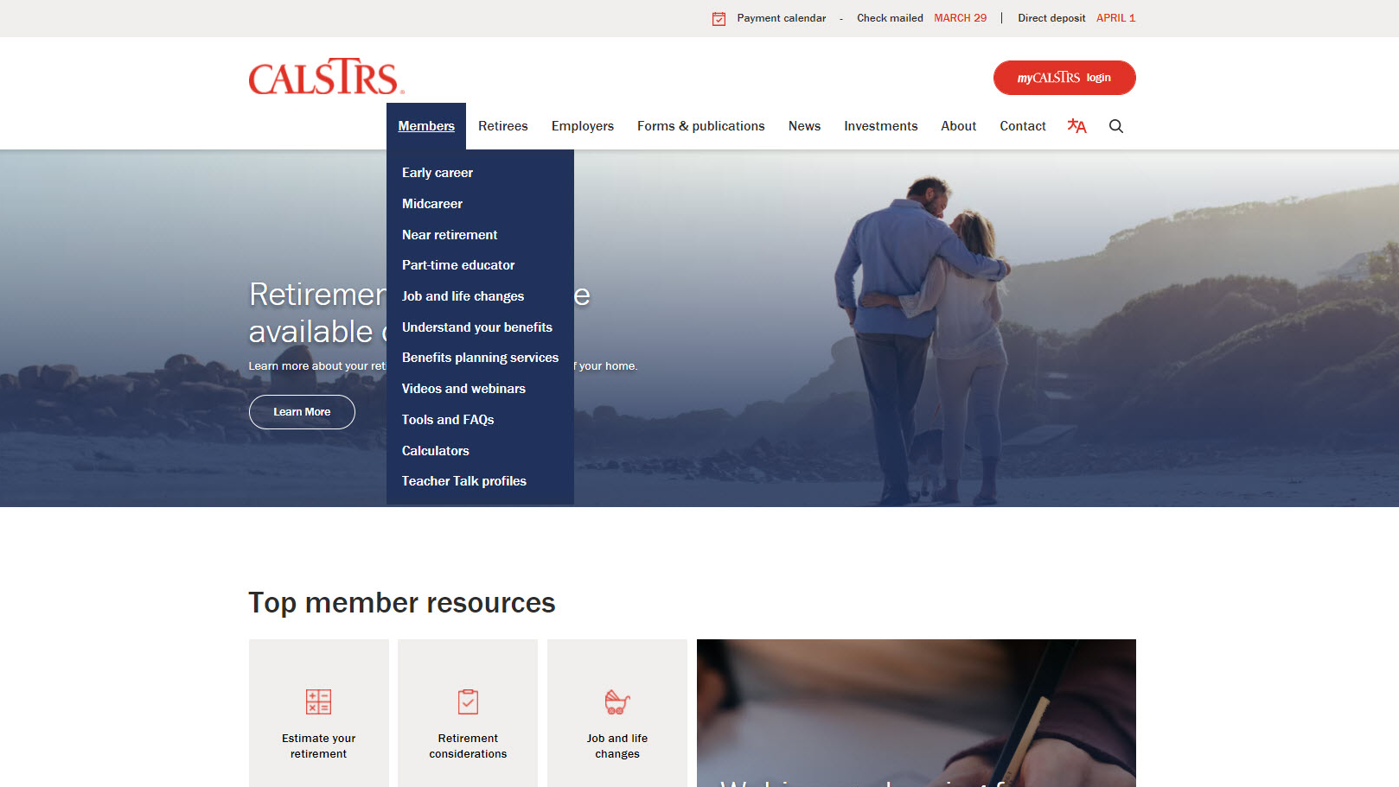
Notes:
After you click on members, this is what that drop down menu looks like.
You’ll see it’s simple to find the different pages we have dedicated to the 3 stages of your career.
Today, we will visit the Midcareer webpage. But the rest of these links are helpful too! I hope you’ll explore the Members section after today’s webinar.
Click.

Slide 8
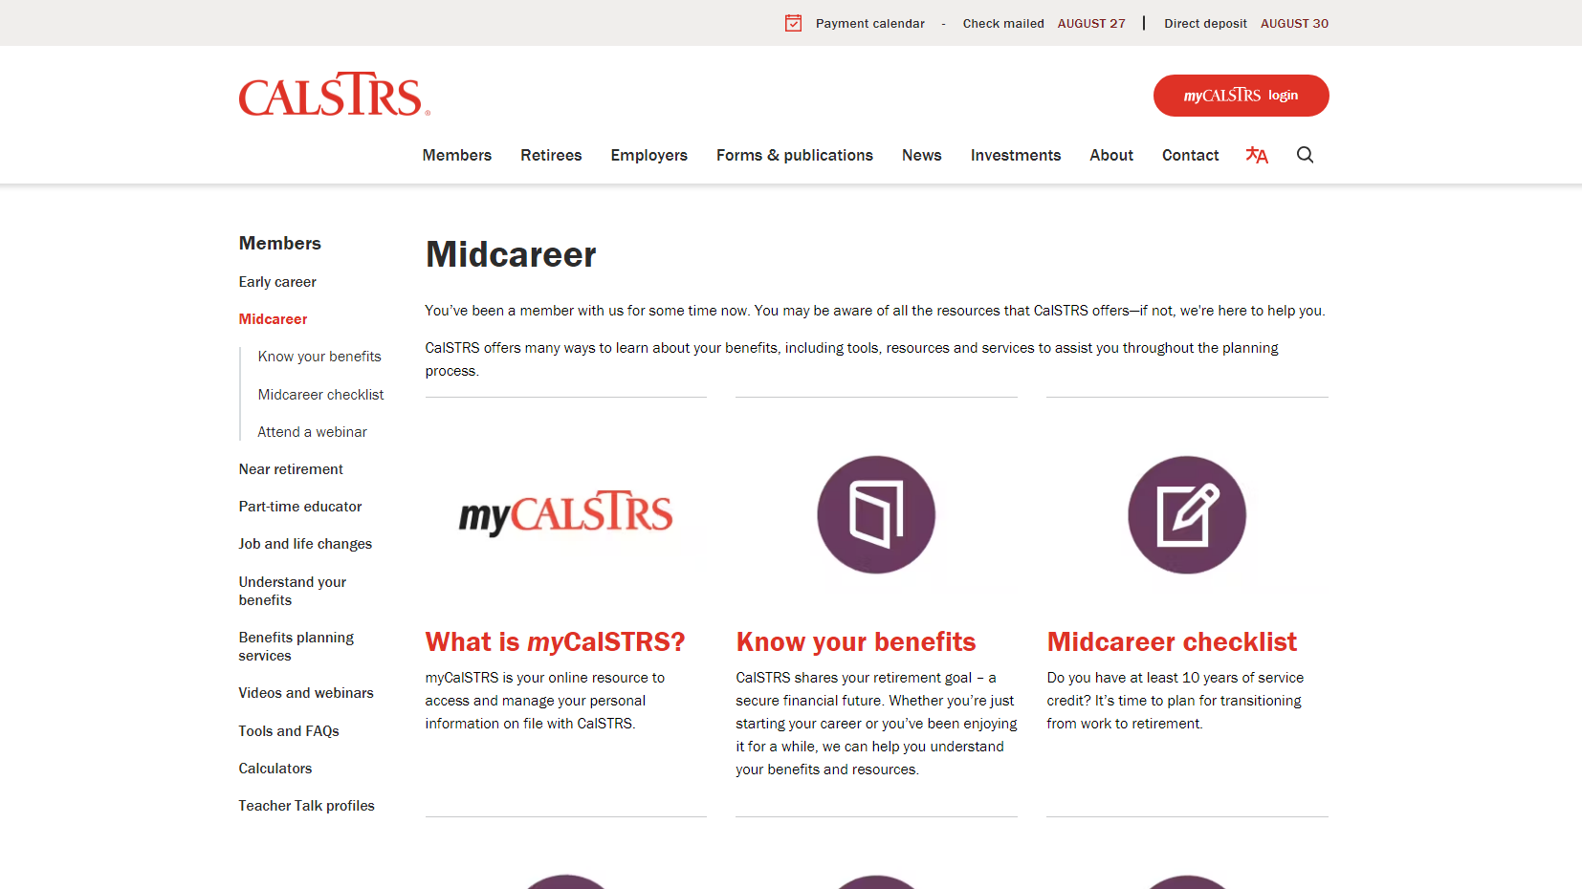
Notes:
When you click on Midcareer in the menu, it should bring you to this page. You’ll notice the purple throughout the presentation and the purple icons on this page. Each stage has its own color, midcareer is purple.
You’ll want to scroll down to see all the resources.
Click.

Slide 9
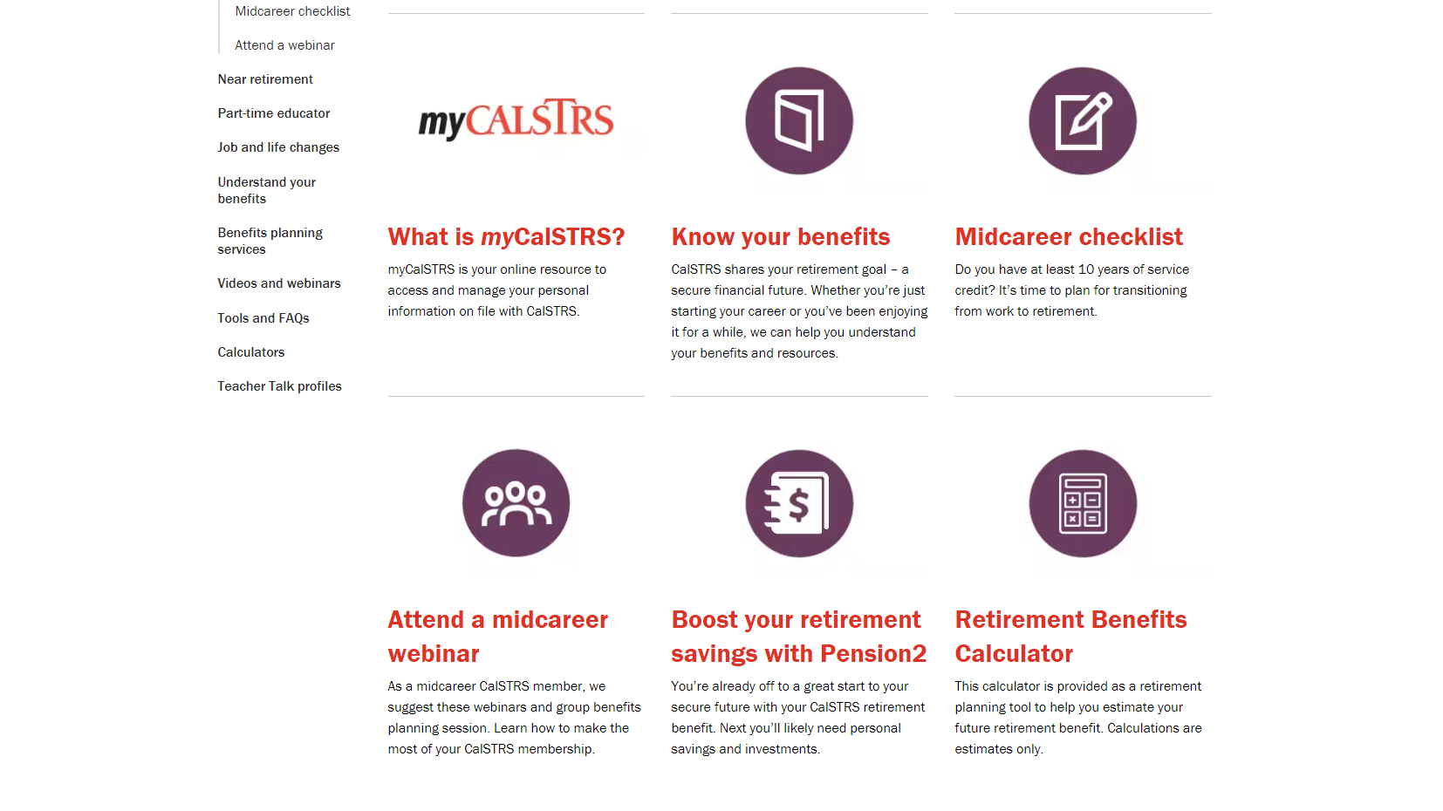
Notes:
Here we’ve scrolled down, now you can see there are 6 places to visit to learn more about your retirement.
The first on the list, and one of the most important to you, is myCalSTRS.
Click.

Slide 10
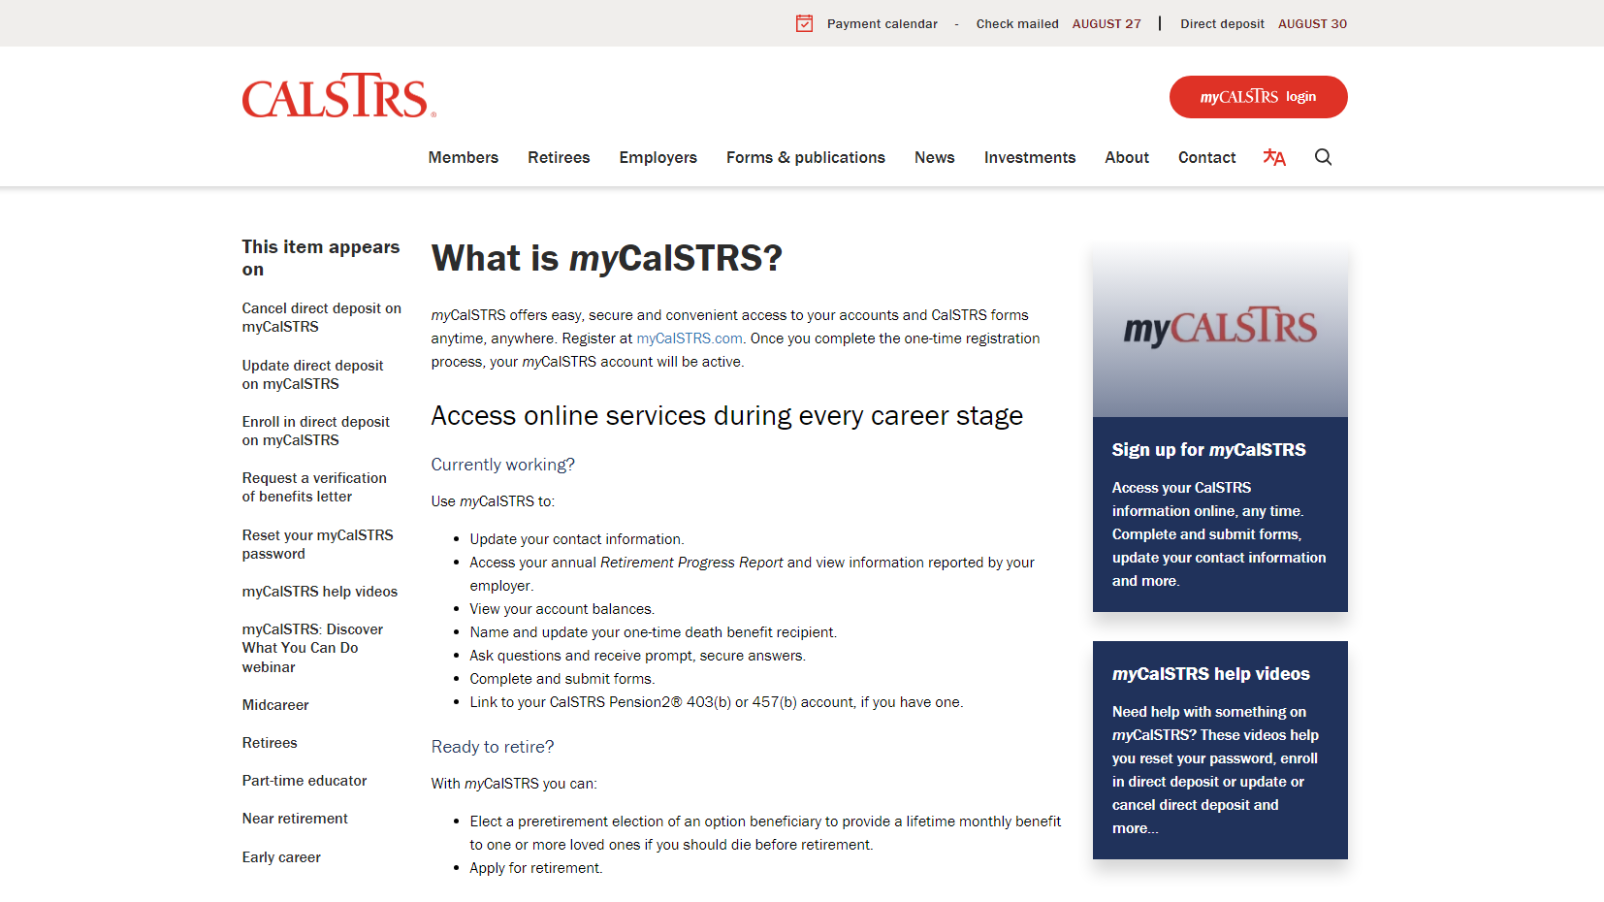
Notes:
What is myCalSTRS? This is your account that gives you access to manage your personal information.
Click.
To log in, you can click the link here in the text, or look for the big red button at the top right corner. Either way is fine and will take you to the same log in page.
Click.
Now, if you haven’t already done so, I encourage you to sign up to access your myCalSTRS account. You’ll just have to answer a few personal questions.
Click.
Finally, if you are having any issues with myCalSTRS, there are some videos to help with some of our common problems. Or you can always contact our customer service number.
Click.

Slide 11
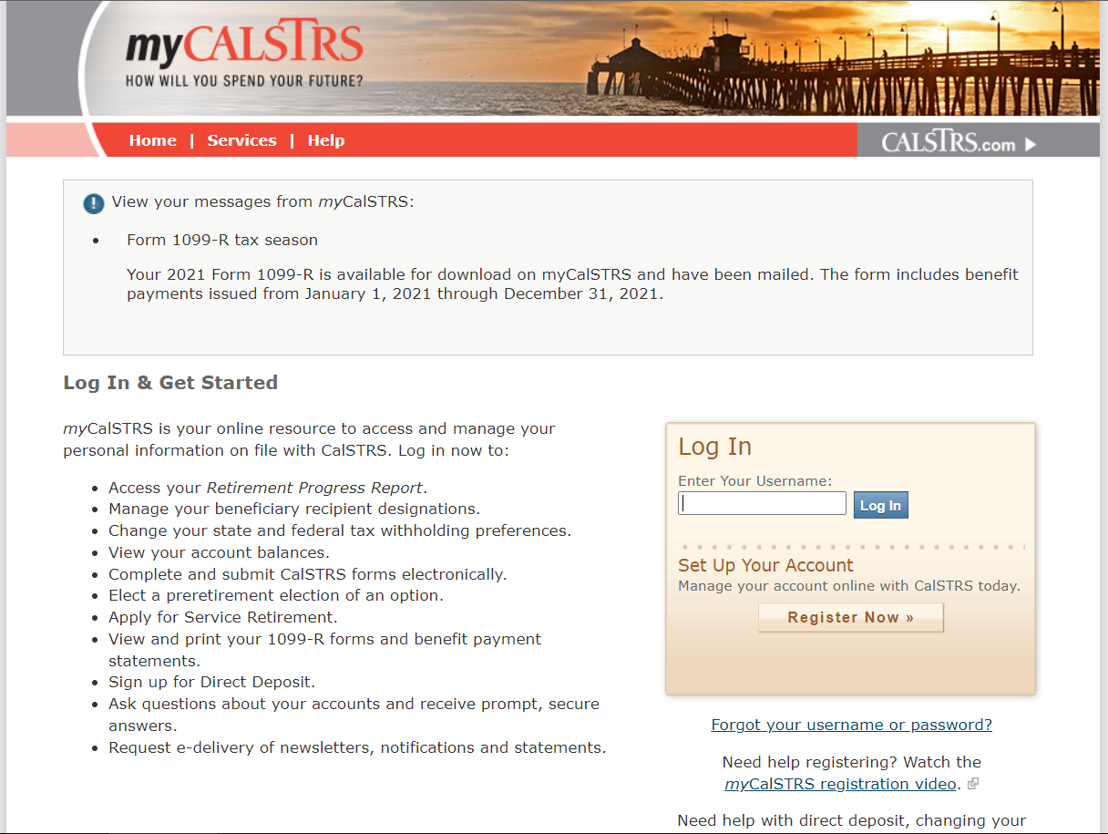
Your myCalSTRS account
View and update your account information
Submit forms and send secure online messages
Access your Retirement Progress Report
Notes:
This is the log in page for myCalSTRS.
Once logged in to your account, you will be able to view and update your account information. Using myCalSTRS you can ensure that we always have your up-to-date contact information.
You’ll be able to submit forms and send secure online messages.
And finally, access your Retirement Progress Report. This report comes out annually.
Click.

Slide 12
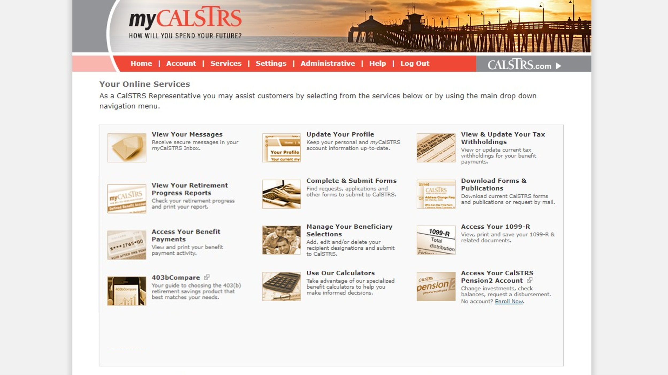
Notes:
Once you have logged into to your personal myCalSTRS account you are going to see a landing page that looks like this.
Your icons may not be the same as mine. Be aware that each person’s landing page is customized based on their situation.
Click.
By using the View Your Messages icon, you can send and receive secure online messages with a CalSTRS representative. This is where you’ll want to ask those questions you have that are specific to your account. And those messages are saved, so you’ll be able to go back in later and review at any time.
Click.
The Update Your Profile icon allows you to update personal information. So if you move or change phone numbers, please make sure all the contact information we have for you is correct. This includes your email address, too!
Click.
You can update your recipient information by selecting the Manage Your Beneficiary Selections icon. We recommend you review your beneficiary information at least once every 5 years.
Click.
This is where you’ll view your Retirement Progress Reports by selecting the View Your Retirement Progress Reports icon. A new report can be found every September while you are actively working.
Click.

Slide 13
Notes:
Next up is “Know your benefits”
Click.

Slide 14
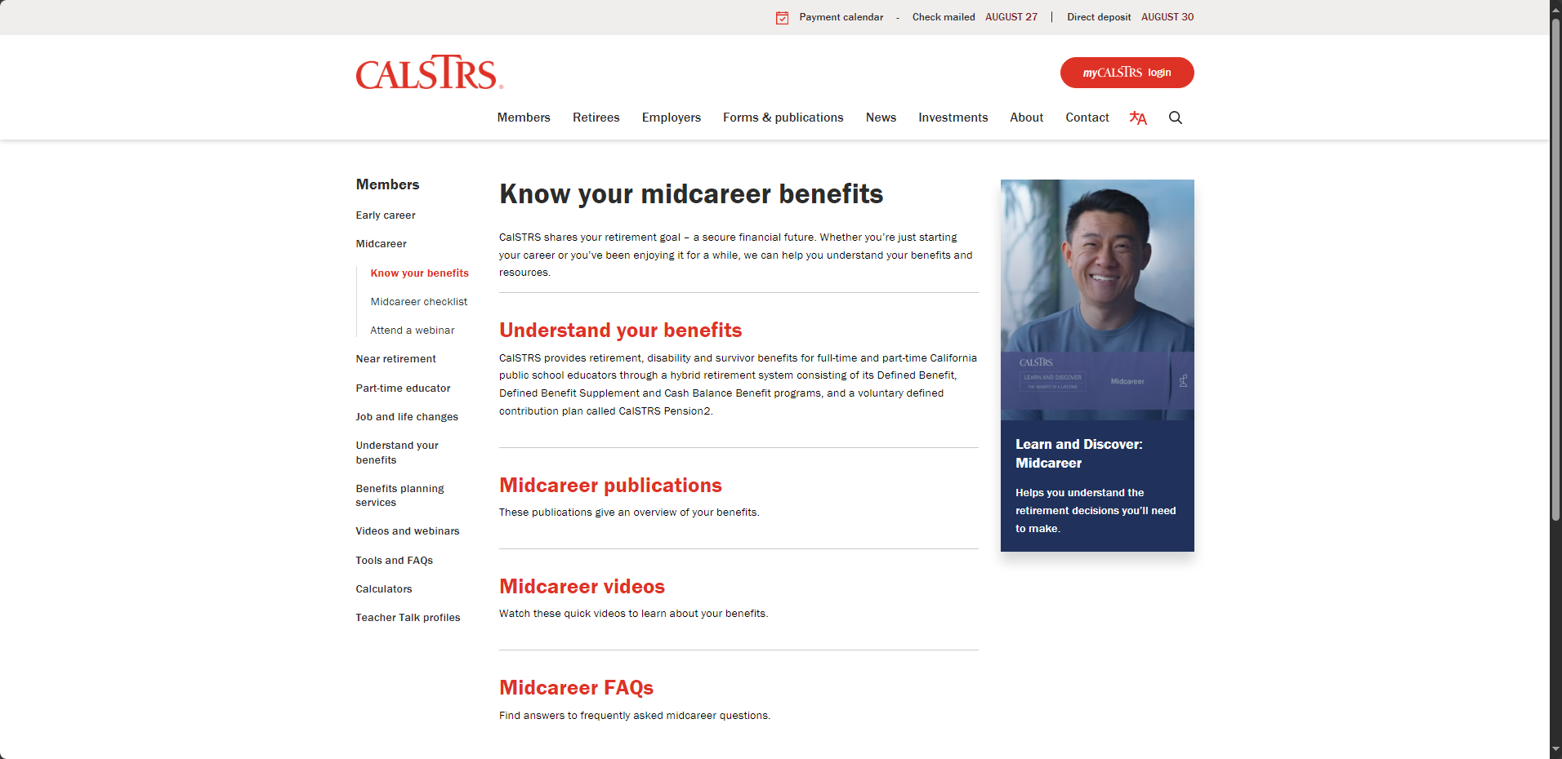
Know your midcareer benefits
Understand your benefits
Publications
Videos
FAQ
Notes:
This will bring you to a page where we’ve collected some of our resources that we feel are most applicable to you at this stage in your career.
If you want to read more about the program you’re in and what benefits are available to you, you’ll want to visit that first link “Understand your benefits”.
Our publications and videos are another great resource for you to gain more information. We’ve linked the publications and videos most commonly used by educators through the middle of their career.
And the Frequently Asked Questions. When you click on that link, it’s actually broken down into topics. It might be wise to check these questions out, you may find answers to your questions without needing to contact us.
Click.

Slide 15
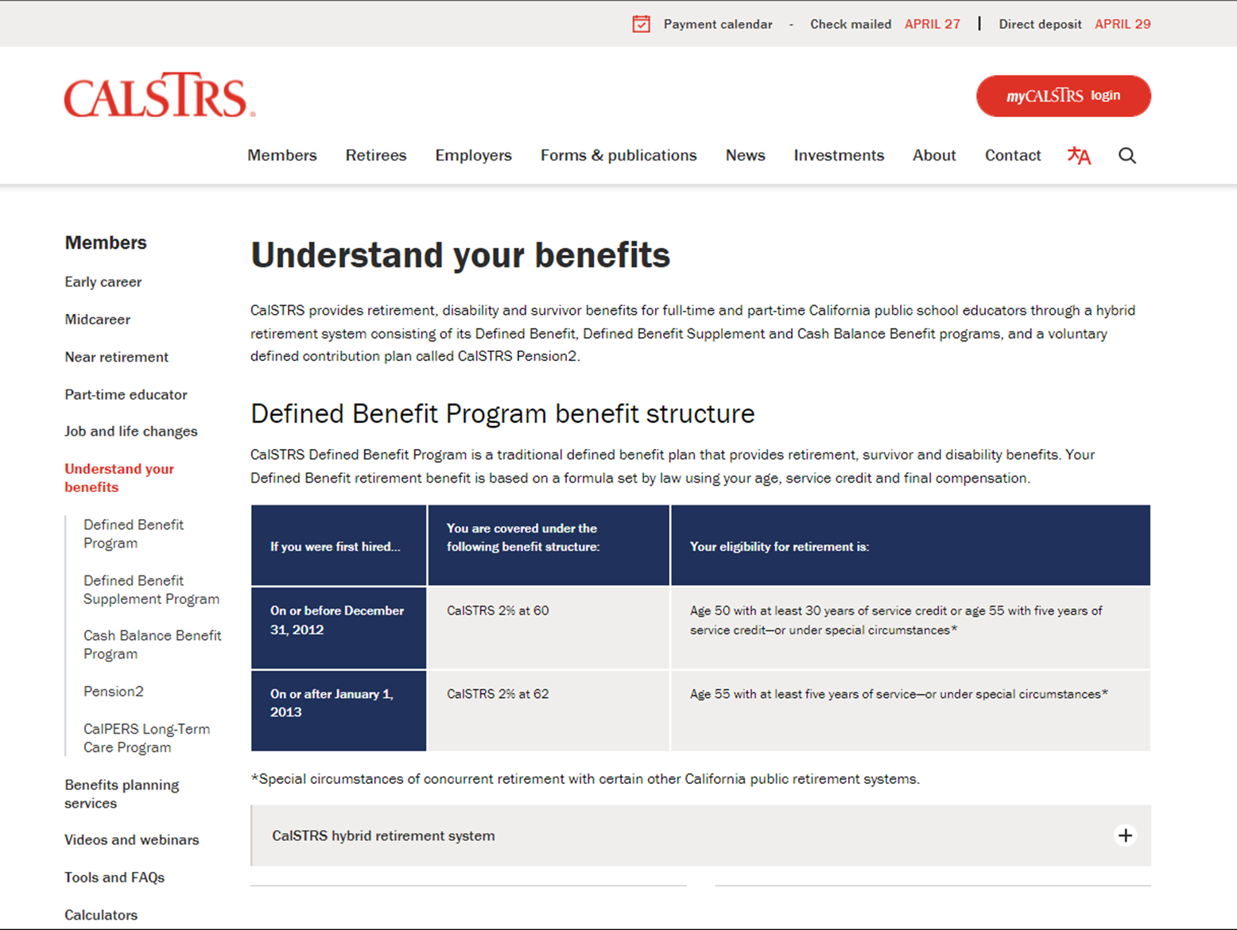
Understand your benefits
Defined Benefit Program benefit structure
CalSTRS hybrid retirement system
CalPERS Long-Term Care Program
Notes:
I want to expand a little bit on the “Understand your benefits” page that was linked on the previous slide we just saw.
This page will tell you more about the benefit structures and when you’ll be eligible to retire.
There is information about each part of the hybrid that CalSTRS administers. Defined Benefit, Defined Benefit Supplement, Cash Balance, and Pension2.
Finally, as a CalSTRS member, you and certain family members may be eligible for the CalPERS Long-Term Care Program. Visit this page for more details on that.
Click.

Slide 16
Notes:
Another important link on the “Know your midcareer benefits” page is here, the “Learn and Discover: Midcareer” publication
Click.

Slide 17
Learn and Discover: Midcareer
5 things to do at this stage of your career
Read about your CalSTRS benefits
Learn how to estimate and increase your retirement benefit
Start picturing what retirement will look like
Notes:
This resource is PACKED with information for you. We’ve really put a little bit of everything here.
You’ll find a list of 10 things to do at this stage of your career.
Again, this is another place to read about your CalSTRS benefits.
Learn how to estimate your retirement benefit. And if it isn’t quite as high as you need, it also talks about ways to increase that retirement benefit.
Finally, it’ll get you started on picturing what retirement could look like for you.
Click.

Slide 18
Notes:
Back to the midcareer page. Next is “Midcareer checklist”
Click.

Slide 19
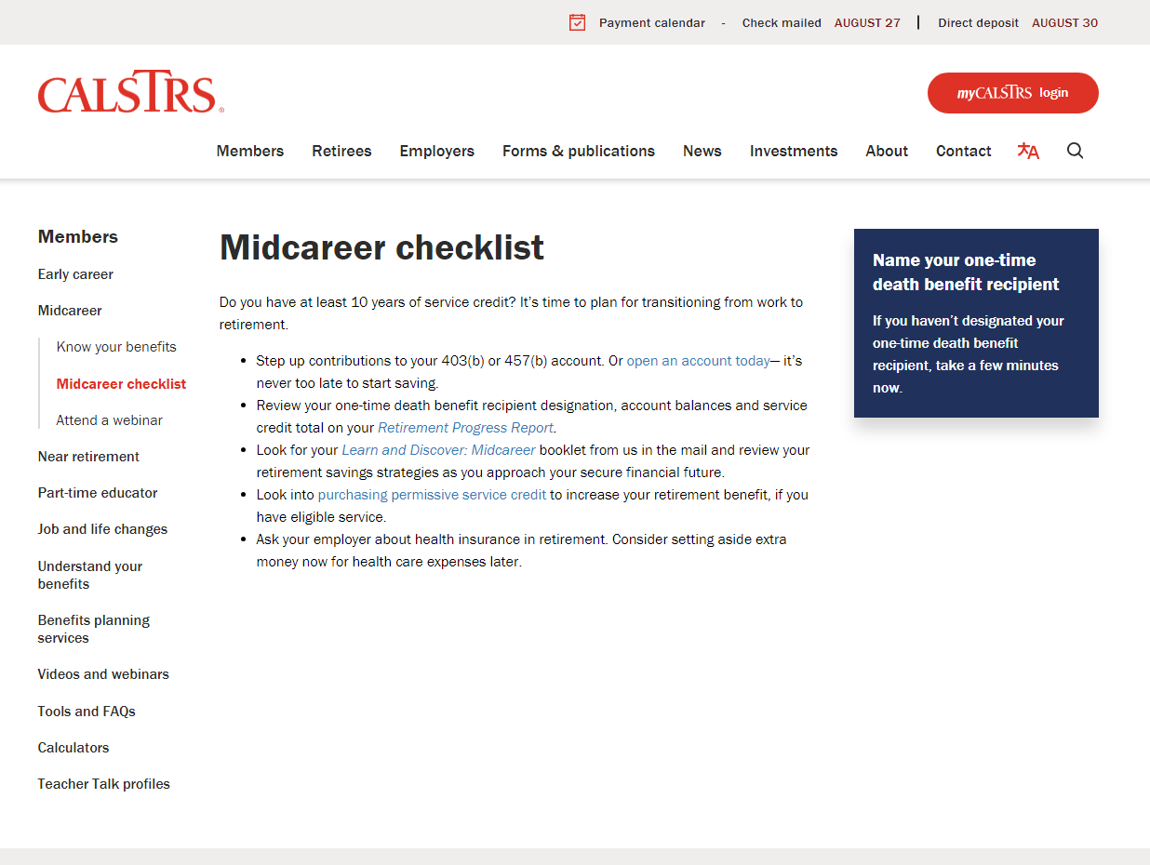
Midcareer checklist
Name your one-time death benefit recipient
Increase contributions to your 403(b) or 487(b) account.
Redeposit or purchase service credit
Notes:
Use this checklist to start to transition from work to retirement. Once you’re in the middle of your career it’s a great time to..
Name your one-time death benefit recipient if you haven’t done so already. If you have, it’s a good idea to check that the information is still up-to-date.
Make sure you are saving to supplement your CalSTRS retirement benefit. Consider increasing those contributions if you haven’t done so already.
Start researching if you’re eligible to purchase service credit. Or if you’ve previously refunded your account, you should look into redepositing those funds.
Click.

Slide 20
Notes:
You’re here, so you know about our webinars. If you’re interested in learning more, visit “Attend a midcareer webinar.”
Click.

Slide 21
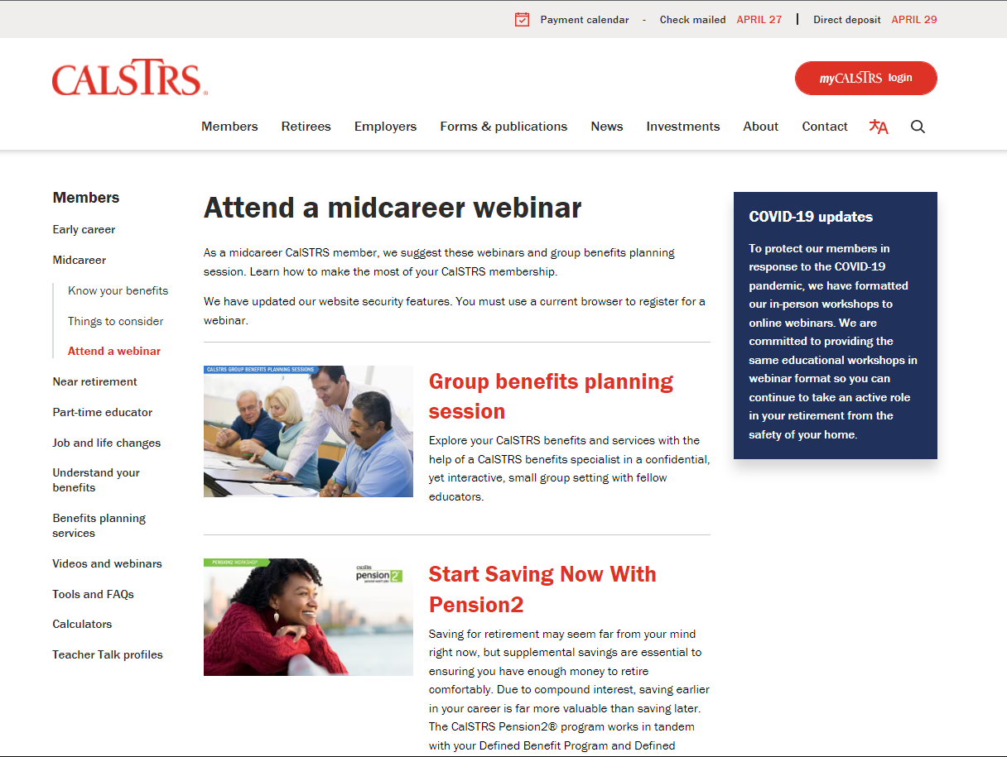
Attend a midcareer webinar
Group benefits planning session
Start Saving Now with Pension2
My Retirement Benefits
Plan for Your Future
Notes:
There are 4 webinars we recommend at this stage in your career.
The first is an interactive group benefits planning session.
We also have Start Saving Now with Pension2, My Retirement Benefits, and Plan for Your Future.
Click.

Slide 22
Notes:
To learn how to save even more for retirement, you’ll definitely want to check out Pension2.
Click.

Slide 23
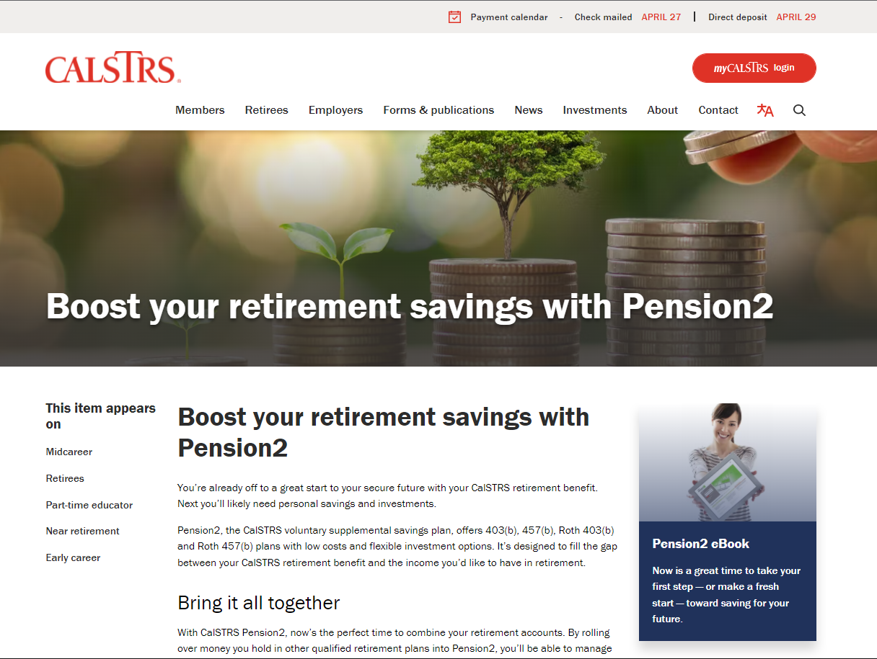
Boost your retirement savings with Pension2
Voluntary supplemental savings plan
Roll over money from other qualified retirement plans
Save on fees
Visit 403bCompare.com
Notes:
Pension2 is a voluntary supplemental savings plan offered to you by CalSTRS.
You can roll over money from other qualified plans to be able to manage your retirement savings in one place.
By joining Pension2, you might be able to save on fees.
If you want to compare fees, a good place to start is 403bcompare.com
Click.

Slide 24
Notes:
Last on the list is the Retirement Benefits Calculator. I’ll be walking through an example later to show you how you can utilize this tool to help you plan for your retirement.
Click.

Slide 25
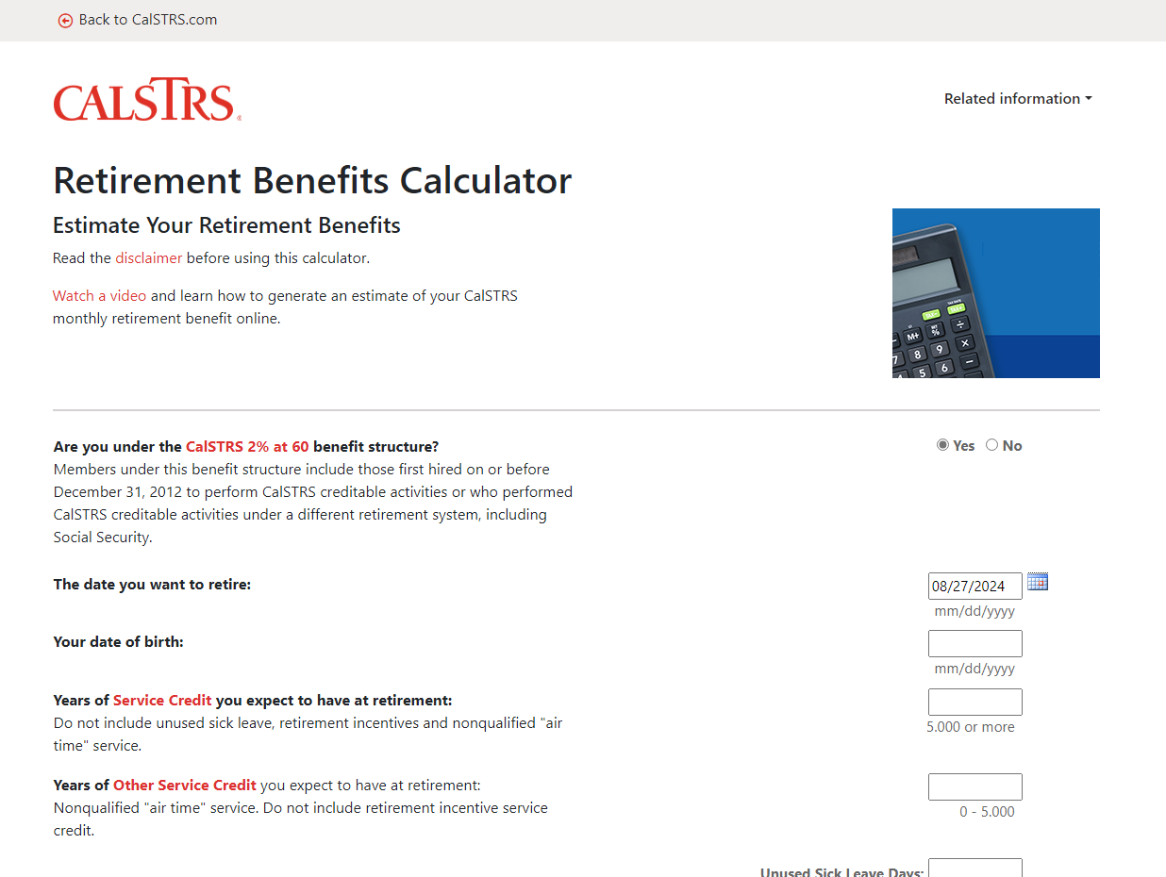
Retirement Benefits Calculator
Generate a retirement benefit estimate
Customize your estimate by adding sick leave credit
See how your benefit is impacted by working more or receiving a raise
Notes:
You’ll be able to generate your own retirement benefit estimate. So play around with the benefit effective dates to see what might work best for you.
If you have unused sick leave on the books, that will convert to extra service credit at retirement. This calculator has a place for you to add in what balances you have now or anticipate you’ll have at retirement.
Maybe there’s a raise in your future. You get to input whatever salary you want into this calculator, so you’ll be able to see how your benefit is impacted.
Click.

Slide 26
View your Retirement Progress Report in your myCalSTRS account.
Notes:
We are done looking at those 6 resources on the midcareer page. Next, we will look at a sample Retirement Progress Report and how you can best utilize it when trying to determine how much you’ll be earning in retirement.
Click.

Slide 27
Notes:
To show you again, once you’re logged on, you’ll want to click “View your retirement progress reports” from the landing page.
Click.

Slide 28
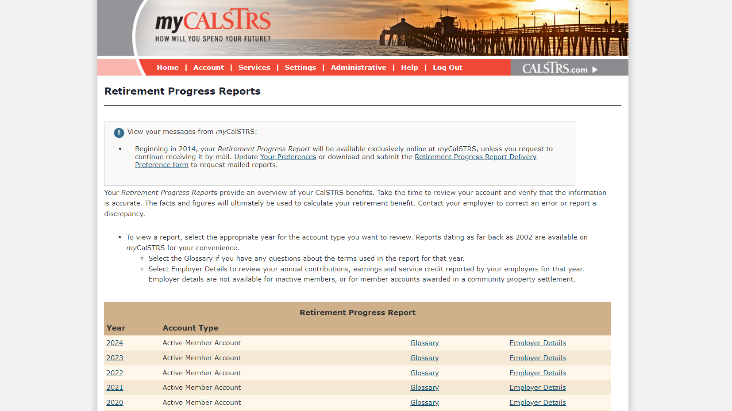
Notes:
You can view any year as far back as 2002.
Today we will look at a sample report from 2022. The most recent. Your 2023 report won’t be out until September of 2023.
Click.

Slide 29
Your Retirement Progress Report
Membership and benefit information
Service credit and account balances
Employer reporting
Notes:
Your Retirement Progress Report is an annual report that comes out every September and tracks your Retirement progress. It has the information as reported by your employer through June 30 of the previous school year.
Your Retirement Progress report has your most current Membership and benefit information.
Service credit totals and account balances
as well as the reporting we have received from your employer.
While you are still actively working it is very important that you check this report every year. If you notice any errors or discrepancies, we encourage you to talk with your employer right away so that the reporting can be corrected.
Let’s get into a sample Retirement Progress Report and I’ll show you in more detail.
Click.

Slide 30
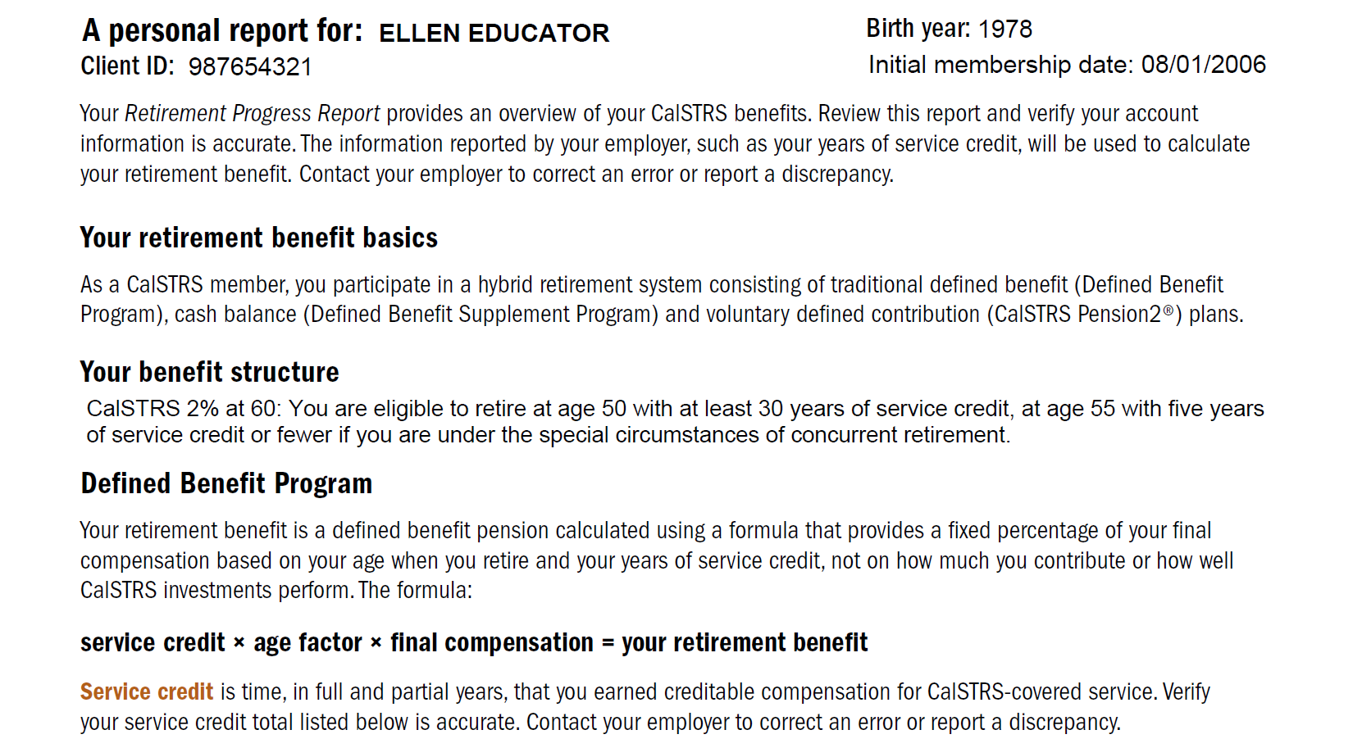
Page
1
Notes:
Now opening your Retirement Progress Report, first, you can find your personal information at the top of page 1.
Click.
Here you will see your CalSTRS client id. The CalSTRS client id is your CalSTRS specific identification number. When you submit any forms with CalSTRS you can use this number instead of your social security number for security purposes.
Click.
Next is your benefit structure. CalSTRS has 2 benefit structures 2%@60 and 2%@62. So check your progress report if you aren’t sure which you belong to.
Click.
Finally, this is the formula we use to calculate your retirement benefit. Your CalSTRS benefit is based on this formula and not the balance in your account. It reads: service credit x age factor x final compensation.
Click.

Slide 31
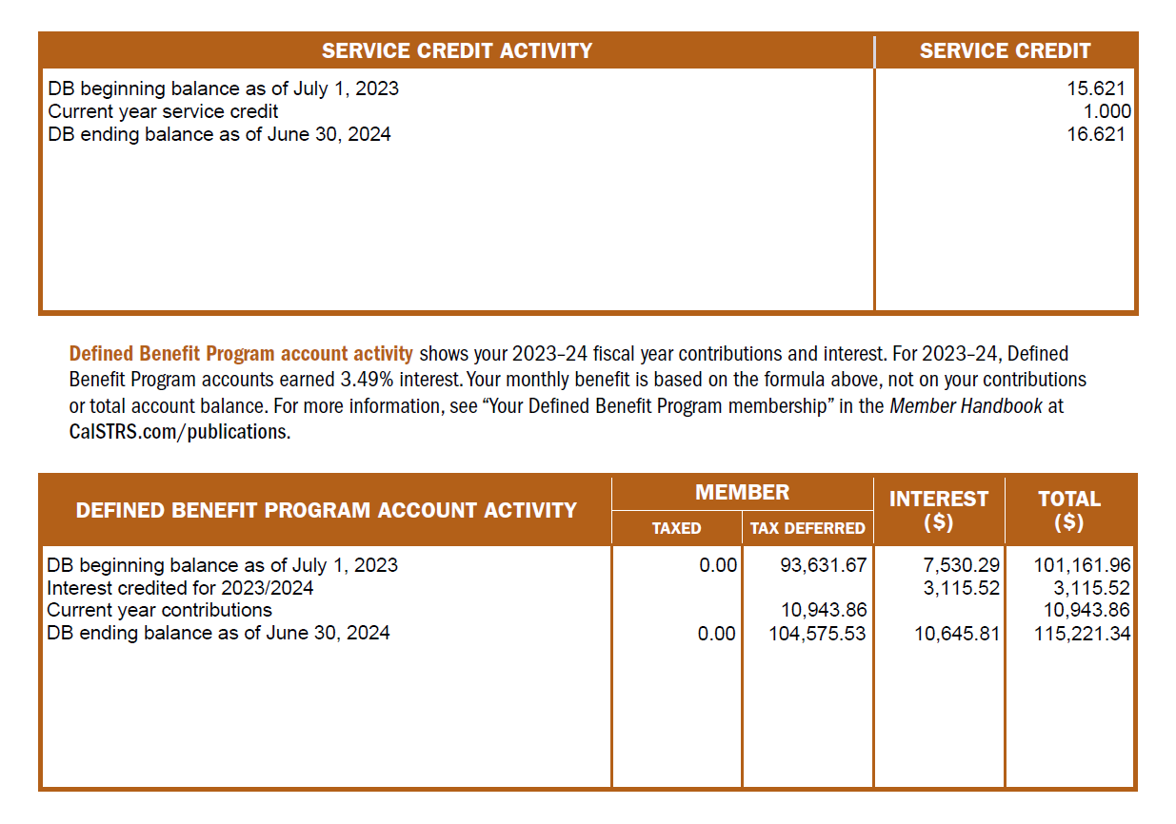
Page
1
Notes:
At the bottom of page 1, is where you’ll find your Service Credit balance.
Remember that this is as of the end of previous school year. You’ll want to verify that you are credited all the service credit that you earned. If you notice any discrepancy, please talk to your district to get it corrected.
Click.
Then at the very bottom, you will see your account activity.
Click.
You can see the contributions you made during the last school year as well as your account balance. Keep in mind your benefit is not based on this balance but the formula we just discussed.
Click.

Slide 32
Age 45
Earliest age an estimate will be included in your RPR
Notes:
Encourage those turning 45 this year to check their RPR in September.**
Click.

Slide 33
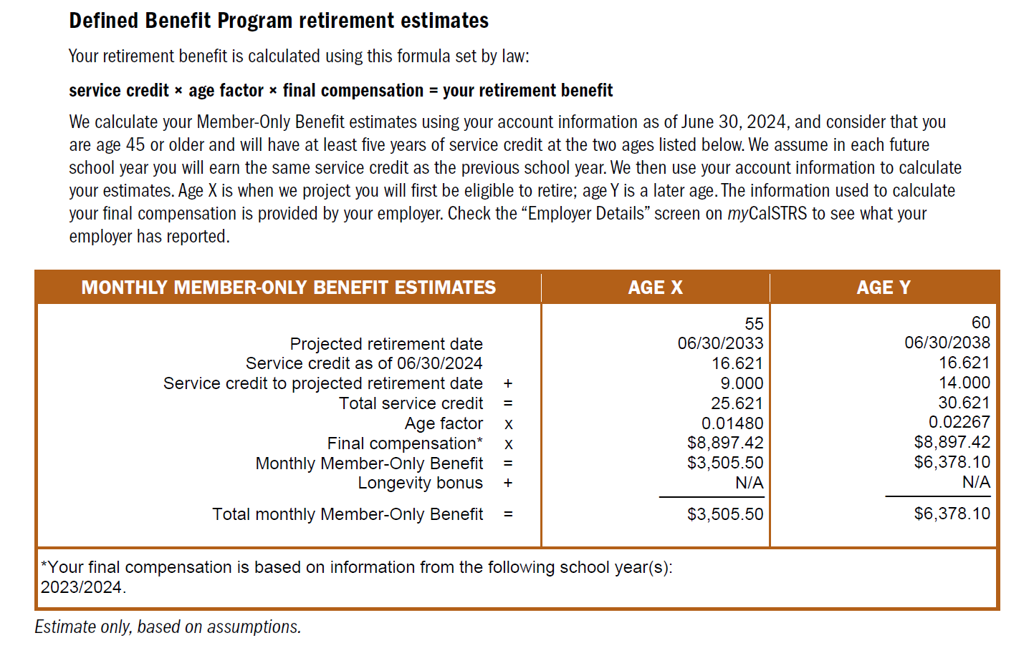
Page
2
Notes:
Speaking of retirement estimates….
Like we just saw in that polling question, when you are 45 years old and have 5 years of service credit you will see 2 side-by-side retirement estimates prepared for you by CalSTRS. You can find these on page 2 of your Retirement Progress Report.
If you do not see these retirement estimates in your report, it could be that you aren’t old enough or there is something else going on with your account. If you have any questions, please call our customer service line and we will get you answers.
Click.
CalSTRS puts together 2 estimates for you to review, one at age x and one at age y. In each column you’ll see a projected age at retirement and retirement date. Notice in this example, this member was provided estimates for age 55 and age 60.
Click.
The total service credit is your actual service credit from page 1 plus the service credit we assume you’ll earn until the projected retirement date.. CalSTRS projects service credit based on the service credit you earned last year.
Click.
Another number you should take note of is your final compensation.
Click.
At the bottom of the table, you will see what years CalSTRS used to calculate your final compensation. Final compensation is calculated by taking the average of your highest consecutive 36 months of earnings. For those of you that are under the CalSTRS 2% at 60 benefit structure and you have 25 years of service or more Final compensation is calculated by taking the average of your highest consecutive 12 months of earnings
Click.
Finally, at the bottom you will see your estimated monthly member-only benefit has been calculated for you.
Please note that these numbers are pulled from the system as of your most recent completed school year and really provide a good barometer when planning for your retirement.
Click.

Slide 34
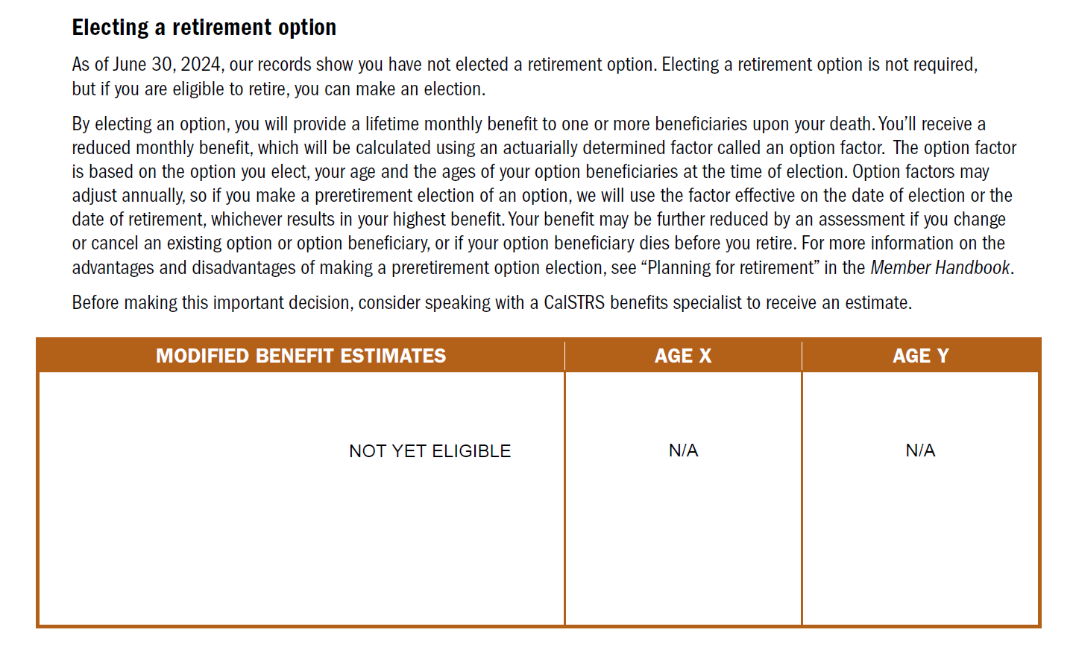
Page
2
Notes:
As we continue to look through the retirement progress report you will see a page titled Electing a retirement option.
For most of you, you will notice that the box is blank stating that you are not eligible yet.
A member becomes eligible to elect a preretirement election of an option once they are eligible to retire which in most cases is age 55 with at least 5 years of service. Electing a retirement option means that you are choosing to take a reduced or modified monthly retirement benefit to ensure that upon your passing you can leave a lifetime monthly benefit for a loved one.
For more information about electing an option including eligibility, advantages, disadvantages and how your benefit will be affected you can watch the Beneficiary Options video at CalSTRS.com
Click.

Slide 35
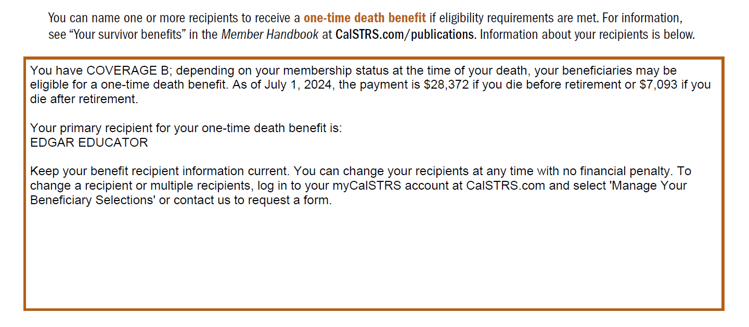
Page
3
Notes:
Next you will notice information about your one-time death benefit recipient.
Click.
The first thing that will be identified is your coverage. You will either be coverage A or coverage B. This coverage determines the amount that will be paid out upon your passing. Those amounts are named further in the paragraph.
Click.
If you have already named a recipient for this benefit, you’ll see the name listed here.
You should have a recipient designated for this benefit throughout your career and in retirement.
Click.

Slide 36
Protecting a loved one
Lifetime benefit
One-time death benefit
Provides a lifetime benefit to a loved one upon your passing
Pre-elect when you’re eligible to retire
OR
Elect at retirement
Provides a one-time payment to the recipient on file upon your passing
Designate a recipient today!
Update recipient information via myCalSTRS
Notes:
So just to recap. CalSTRS has 2 different benefits that can protect a loved one upon your passing.
Click.
A lifetime monthly benefit
Which you can elect once you are eligible to retire or at retirement
Click.
and one-time death benefit.
That you can elect at any stage of your career and should be kept current. It’s a good idea to designate both a primary and a secondary.
Click.

Slide 37
Notes:
To learn more about electing an option or naming a recipient, just a reminder that it can be found in the Midcareer checklist section of the career page.
Click.

Slide 38
Notes:
Or if you’re ready to add, update, or remove your beneficiary selections, you can do that here in your myCalSTRS account.
Click.

Slide 39
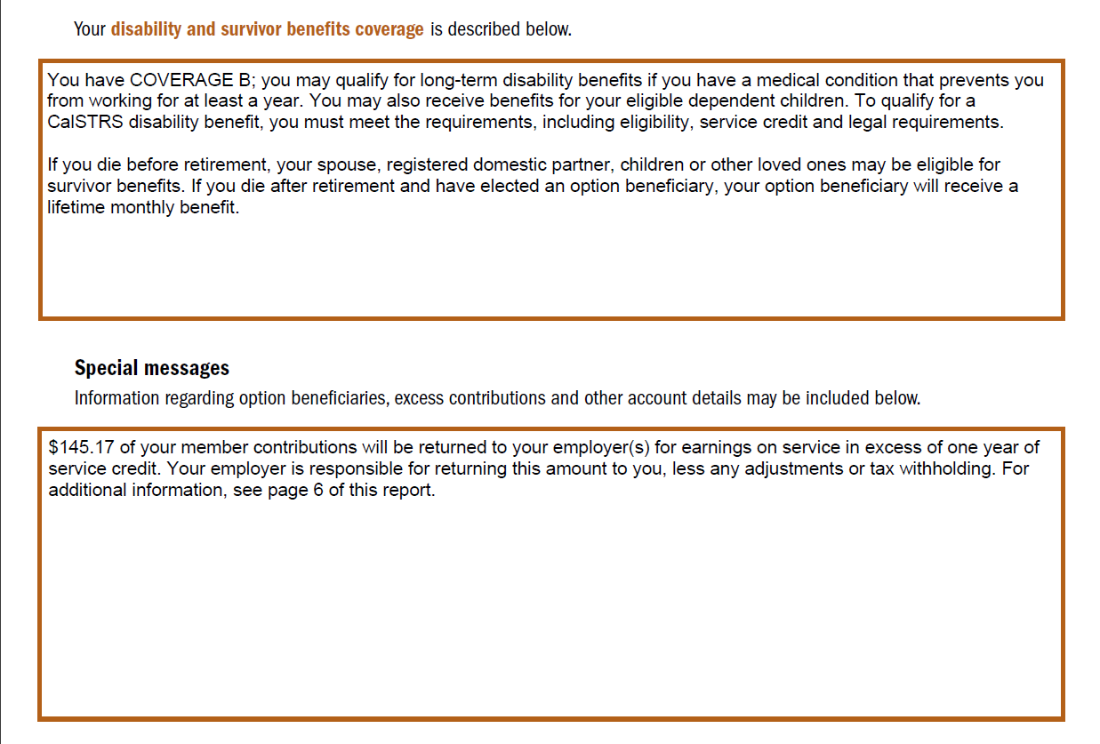
Page
3
Notes:
Back to the Retirement Progress Report. As you continue flipping or scrolling through your report, you’ll notice some additional information about your disability and survivor benefits. As you see here there is another mention of your coverage type. For additional information on Disability and Survivor benefits please refer to the midcareer member kit that is provided in today’s webinar.
Below that, you’ll want to pay special attention to Special Messages section. CalSTRS uses this space to note anything particular to the member's account. In this example our member made excess contributions which are being returned.
Click.

Slide 40
DBS
Contributions from any time worked in addition to your full-time contract will go into your Defined Benefit Supplement account.
Notes:
Up next is the Defined Benefit Supplement Account. The Defined Benefit Supplement account is an additional retirement account that is separate from the Defined Benefit Account. It is different from the Defined Benefit in that distribution from this account IS based on your account balance at retirement.
Let’s continue to look at our sample RPR as we talk more about the Defined Benefit Supplement Account.
Click.

Slide 41
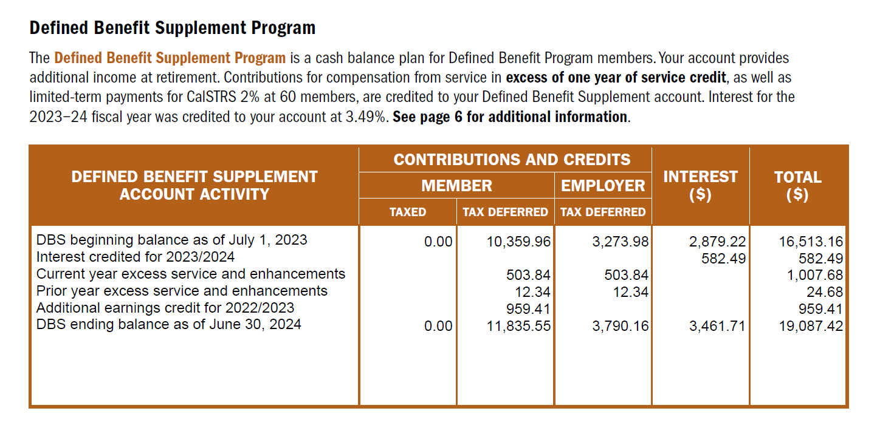
Page
4
Notes:
As you move through your report you might notice a section dedicated to the Defined Benefit Supplement Program. Here you’ll find the interest rate from last fiscal year and a summary of your account activity.
Click.
This will give you your account balance as of the end of the previous school year. Unlike the balance of your Defined Benefit account, this number here does determine how much you’ll receive in retirement.
Click.

Slide 42
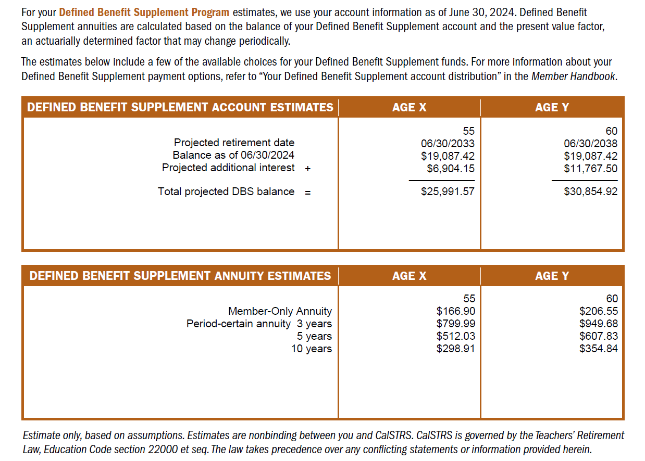
Page
4
Notes:
If your RPR has estimates for the Defined Benefit account, you will also have estimates for the Defined Benefit Supplement account. On this page you will see the same projected ages x and y. For the Defined Benefit Supplement CalSTRS will project the estimated interest your account will accrue from the end of the previous school year until your projected retirement date. If you plan to continue working those extra duties, keep in mind that these numbers do not include an estimate for that work.
Click.
I previously mentioned that distributions from this account is contingent upon your account balance. So, what you will see here is an estimate of your total DBS account balance with that interest added in.
Click.
The next estimates you will notice are annuity amounts. The RPR shows estimates for a lifetime Member-only annuity and for a period certain annuity of 3, 5, or 10 years. Keep in mind that at retirement, you’d be allowed to choose anywhere from 3 to 10 years.
To learn more about the Defined Benefit Supplement account including it history, how its funded, and a full range of the distribution choices you can watch those videos we saw in our website tour.
Click.

Slide 43
Notes:
You can access that DBS video series here, use the Know Your Benefits tile.
Click.

Slide 44
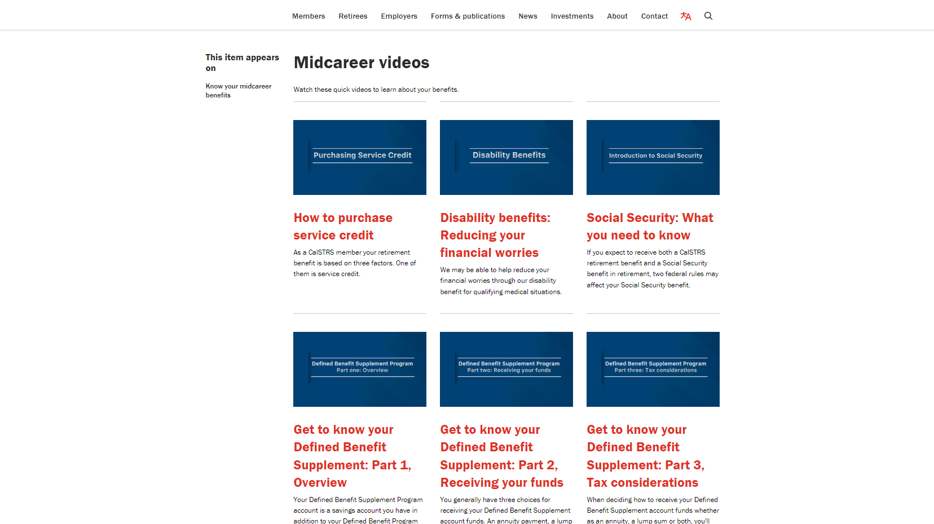
Notes:
Scroll down and you’ll see the trilogy at the bottom.
Click.

Slide 45
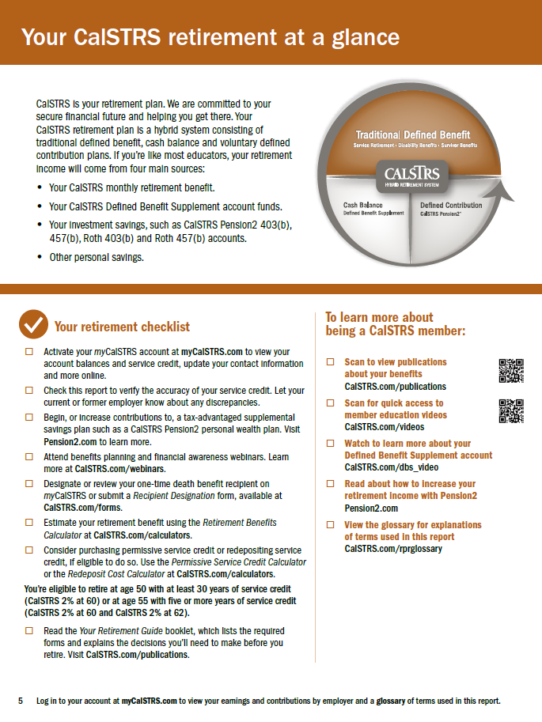
Page
5
Your retirement checklist
Notes:
On the final pages of the RPR you will find additional reading that will tell you more about CalSTRS and your retirement program. There is also a checklist of action items that you might find helpful if you don’t know what to do next.
Click.

Slide 46
What’s not included in your RPR?
Incomplete service credit purchase
Unused sick leave credit
Current year salary
Retirement incentives
Notes:
Having estimates provided to you by CalSTRS can be very helpful when trying to prepare for retirement. As you look at your own estimates know that there are some factors that are not included.
Click.
The first is any service credit purchases that you are in the process of making or plan to make. If you have eligible service to purchase and plan to do so your service credit total will be higher than what was projected in your RPR. Once that service credit is completely paid, it will then be included in your service credit total for all future RPRs.
Click.
CalSTRS does not track sick leave during your career, so will not be found in your RPR. Any unused sick leave that you have at retirement will be converted to service credit which would then increase that total.
Click.
Remember, the estimates in your RPR use information that is reported to CalSTRS as of the previous school year and we do not project working salaries, therefore your current year salary or any raises you expect to get in the future are not included in the estimates you see in your RPR.
Click.
And last, any retirement incentive that your employer may offer as you near retirement also, cannot be projected by CalSTRS.
Thankfully, CalSTRS has an online calculator that will allow you to incorporate these missing factors and generate a more accurate retirement estimate.
Click.

Slide 47
Notes:
Just a reminder: click here to access the Retirement Benefits calculator from the midcareer webpage.
Click.

Slide 48
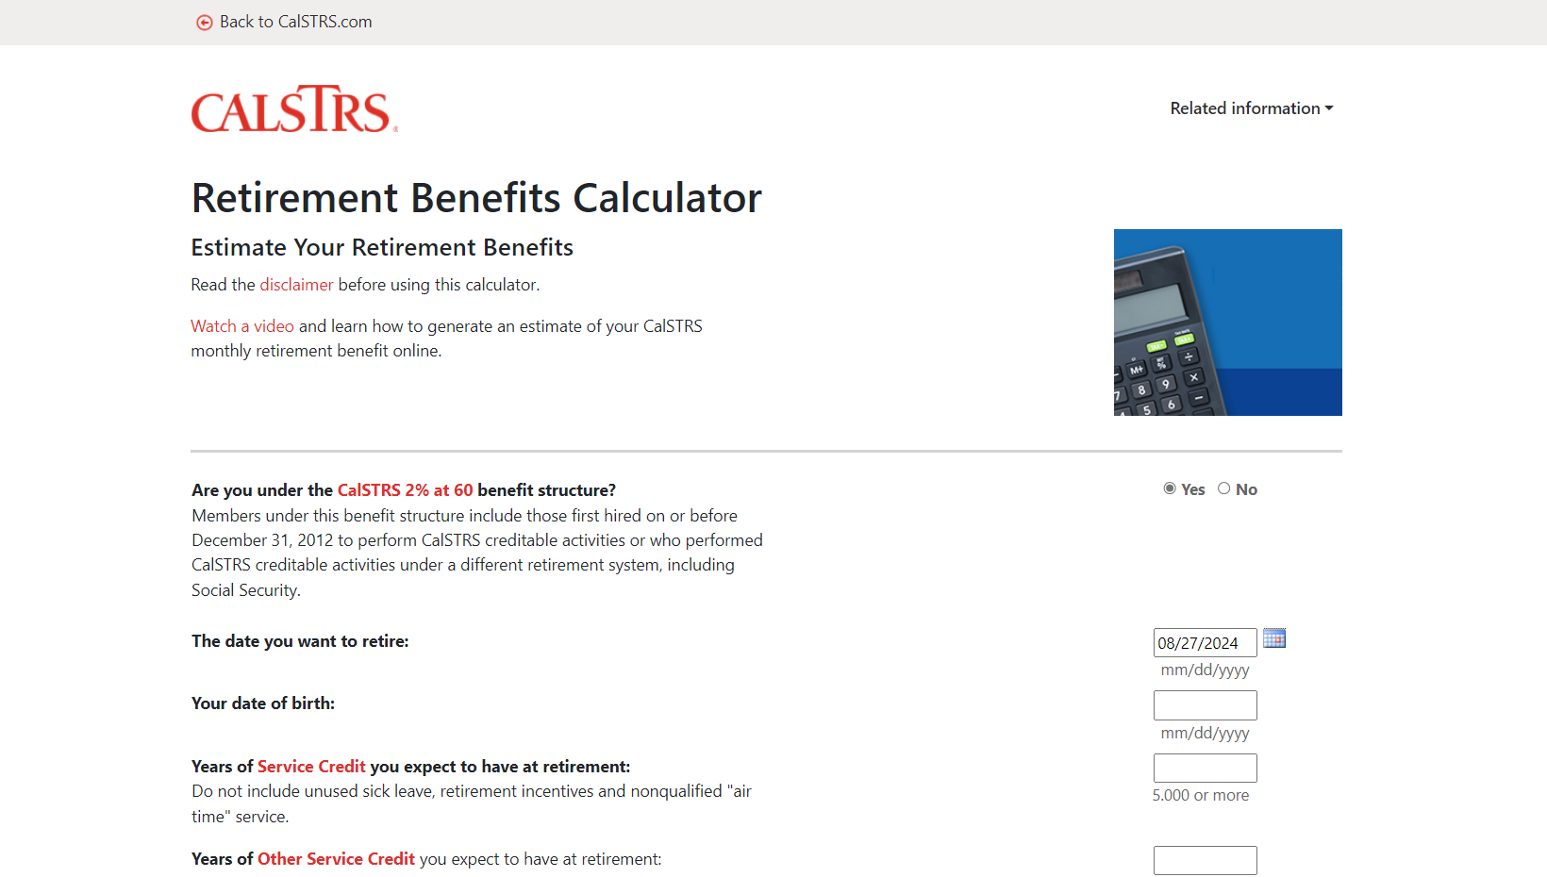
Notes:
This is the CalSTRS Retirement Benefits Calculator.
This first question you will see is about your benefit structure.
Click.

Slide 49
Page
1
Notes:
If you are unsure what benefit structure you are under, you can check your Retirement Progress report. Your benefit structure will be listed on page 1.
Click.

Slide 50
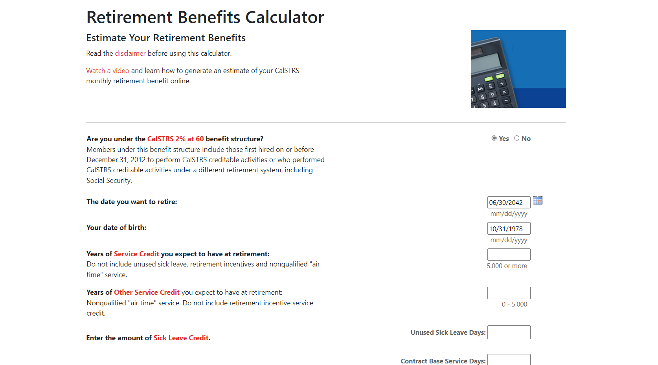
Notes:
If you are under the CalSTRS 2% at 60 benefit structure you will select yes. If you are under the CalSTRS 2% at 62 benefit structure, select no. Melinda Member’s RPR stated she is under the CalSTRS 2% at 60 benefit structure. We can leave this as yes.
Click.
Next you want to put in the date you want to retire or your projected/ target retirement date. The specific date isn’t as important as the month and year.
Melinda’s RPR provided estimates for age 55 and age 60. Let’s generate an estimate if Melinda wants to retire at age 59 instead. This would make her projected retirement date 06/30/2036. Remember to save time it is easiest not to click on the calendar icon but type in your projected retirement date.
Click.
And your date of birth. We input the member’s date of birth here.
Click.

Slide 51
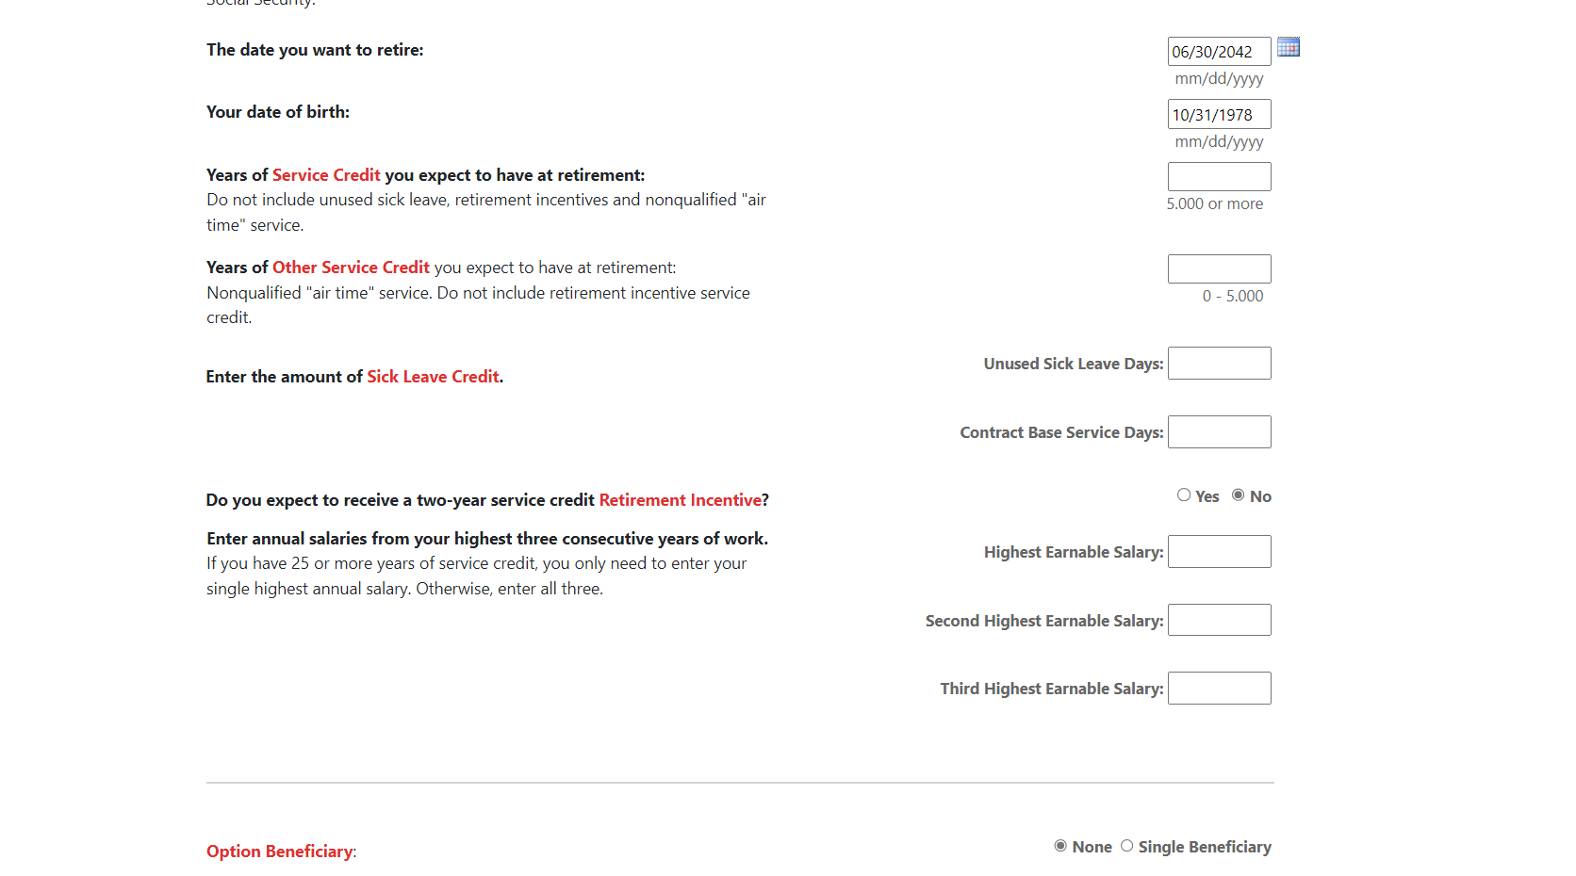
Notes:
Next is the years of service you expect to have at retirement.
Click.

Slide 52
Page
1
balance + projected
16.621 + 18.000
Notes:
If you remember on your Retirement Progress Report, it lists the service credit you have on file with CalSTRS as of the end of the previous school year.
To determine the years of service you will have at retirement add any service credit you plan to earn or purchase by your projected retirement date.
In this example the member is projecting that she will earn 1 year of service every school year starting after what was reported at the end of the previous school year until her projected retirement date in 2041. That’s an extra 18 years she will add to her balance. She is 45 now, that brings her retirement to her age of 63.
Click.

Slide 53
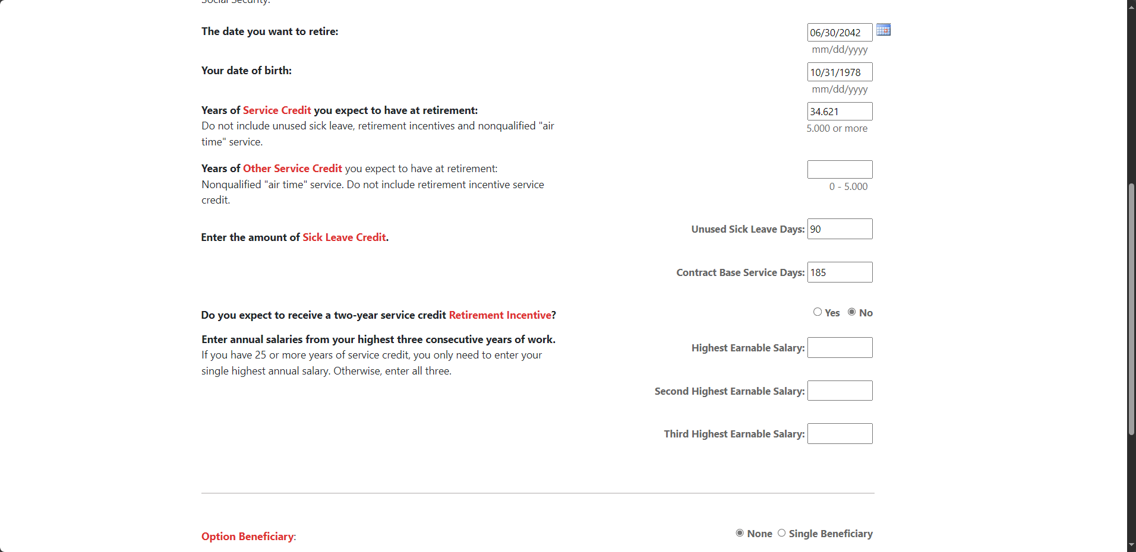
balance + projected
16.621 + 18.000
Notes:
Click.
16.621+18=34.621, so we will put that number here.
Remember this is also where you add any additional service credit you are purchasing or plan to purchase before your retirement date.
Click.
Years of other Service Credit you expect to have at retirement is referring to nonqualified time or what we call airtime. If you purchased airtime, you would have needed to submit your request prior to January 1, 2012. For those of you that made this purchase you will enter the amount of service credit you purchased here. Please be aware if you included those years in the total above you will need to subtract them out.
In my example my member did not request to purchase this time. I’ll leave it blank.
Click.
Here you can enter the number of unused sick leave days you have. (remember this must be in days and not hours). Next you will input the contract base service days. This is how many days you are contracted to work in a school year.
In this example. Ellen expects that she will have 90 unused days of sick leave and she is contracted to work 185 days a school year.
Click.

Slide 54
Notes:
Your employer may be offering a 2-year service credit incentive. If you know that this is something your employer is offering or plans to offer you can select yes.
My member is going to select NO.
Click.
Next, you want to enter your 3 highest consecutive annual salaries. By using the online calculator, you can project any future salaries you plan to earn.
Click.

Slide 55
Page
2
Multiply by 12
$8,897.42 x 12
Notes:
If you need help determining your annual salary you can refer back to your progress report. Your RPR lists your final compensation as a monthly average. To use the calculator, convert your monthly average to an annual amount by multiplying by 12.

Slide 56
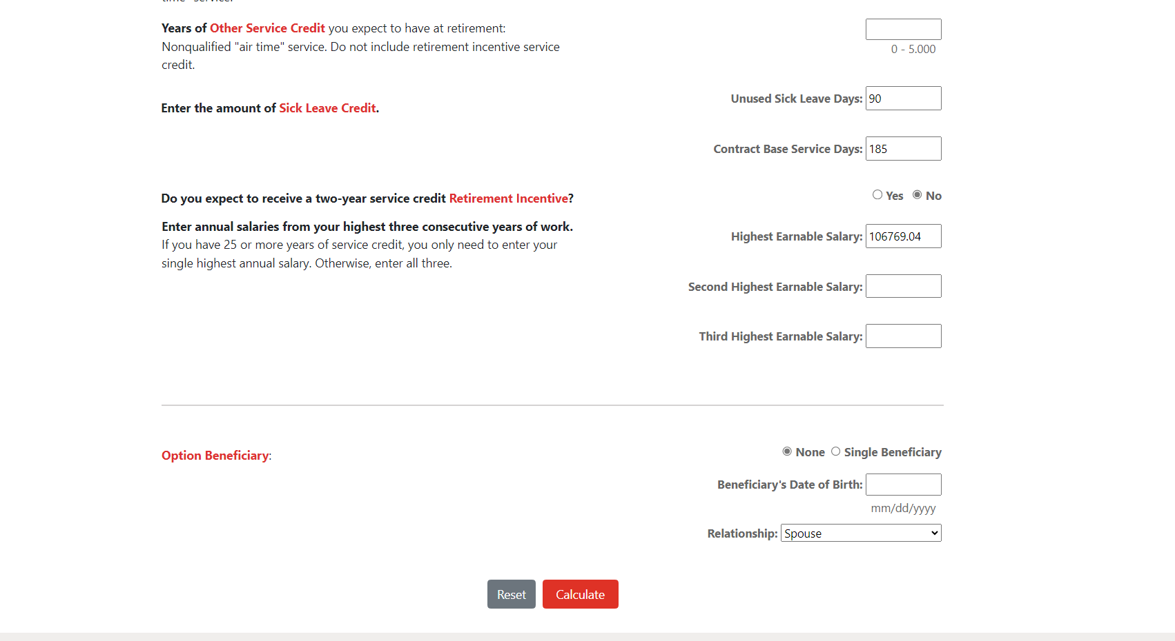
Multiply by 12
$8,897.42 x 12
Notes:
In this example, Melinda is unsure of what her future salaries may be. For the sake of a conservative estimate, she decided to use the final compensation provided on her RPR and multiplies by 12.
If you are under the CalSTRS 2 % at 60 benefit structure and you have 25 years of service credit or more you only need to enter your single highest annual salary.
You can enter this estimated annual salary into the calculator.
If you have less than 25 years of service, you will enter your estimated annual salary 3 times.
Click.
If you want to see how your benefit will be affected by adding an option beneficiary, you can select that here and provide your beneficiary date of birth here as well as their relationship to you.
For this example, we are not going to add an option beneficiary.
Click.
Once you have entered all required fields click calculate.
Click.

Slide 57
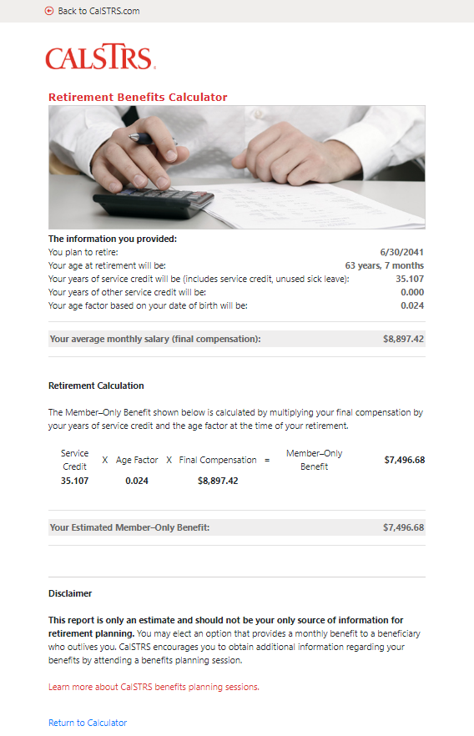
Your
retirement
estimate
Notes:
The system will take all your entries into account and generate a retirement estimate for you. At the top is a summary of the information you put into the calculator.
Your estimated monthly retirement benefit can be found at the bottom of the estimate.
Click.

Slide 58
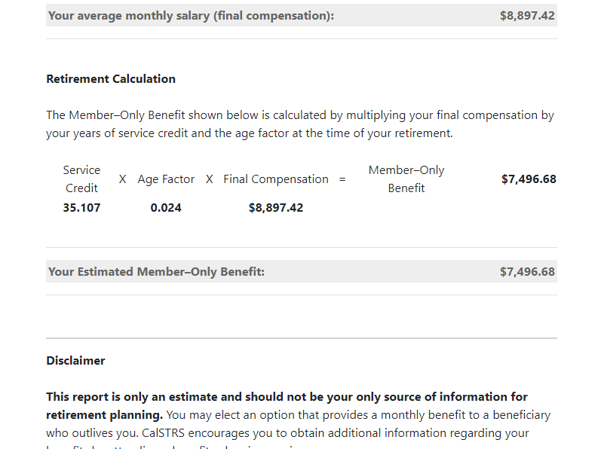
Notes:
A close-up of the retirement calculation and estimated benefit.
The estimated benefit is a gross amount. This will be taxable income in retirement.
Point out age factor and how maxing that out can increase their benefit.
Click.

Slide 59
Increasing your monthly benefit
Service credit
Age factor
Final compensation
Work longer
Purchase service credit
Work longer
Retire later
Work at higher pay rates
Notes:
If you generate an estimate and realize it’s not quite what you were hoping for, keep in mind that there are a few things you can do to increase your monthly benefit. You can increase any component of the retirement formula to get a higher benefit
Click.
You can increase service credit by working longer or purchasing service if you are eligible. Our sample member might go back into the calculator and estimate she’s going to work 14 years instead of 12. This number might prove to be worth working those extra 2 years.
Click.
You can increase your age factor by working longer or retiring later. Age factor is a percentage based on your age in years and months at the time of your retirement. The maximum age factor is 2.4%. In most cases, a member under the CalSTRS 2% at 60 benefit structure will reach their maximum age factor at age 63 and a member under the CalSTRS 2% at 62 benefit structure will reach the maximum benefit at age 65.
Click.
You can increase your final compensation by working at higher payrates. This can be done by regular step increases or by seeking out higher paying contracts.
Click.

Slide 60
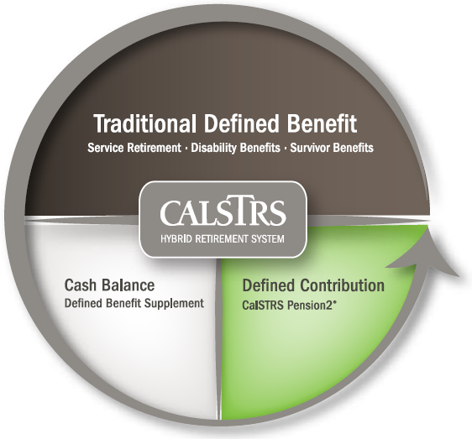
403(b)
Roth
403(b)
457(b)
Roth
457(b)
Notes:
Another way to increase your retirement income is to increase your additional retirement savings while you are still working. While your contributions for the Defined Benefit are set you can always invest in other retirement accounts if you aren’t already.
Pension2 is the third part of the CalSTRS hybrid that is completely voluntary. It offers 403b, 457b, Roth 403b, and Roth 457b.
Depending on how many years you have left in your career, you might be able to sign up and start a payroll deduction to start saving now.
Click.

Slide 61
What if I already have an account?
Other supplemental savings plan accounts can be rolled into Pension2.
Your
current
account
CalSTRS
Pension2
Let us compare!
Call 888-394-2060 for a statement comparison.
Statement comparisons will be conducted by Voya Financial representatives working exclusively with Pension2. Their names and photos are listed at CalSTRS.com/Trust-CalSTRS.
Notes:
If you’re nearing the end of your career, you might not have time to make contributions to build up a healthy amount. Instead, you can look at rolling other supplemental savings plan accounts into Pension2.
Call 888-394-2060 for a statement comparison.
Click.

Slide 62
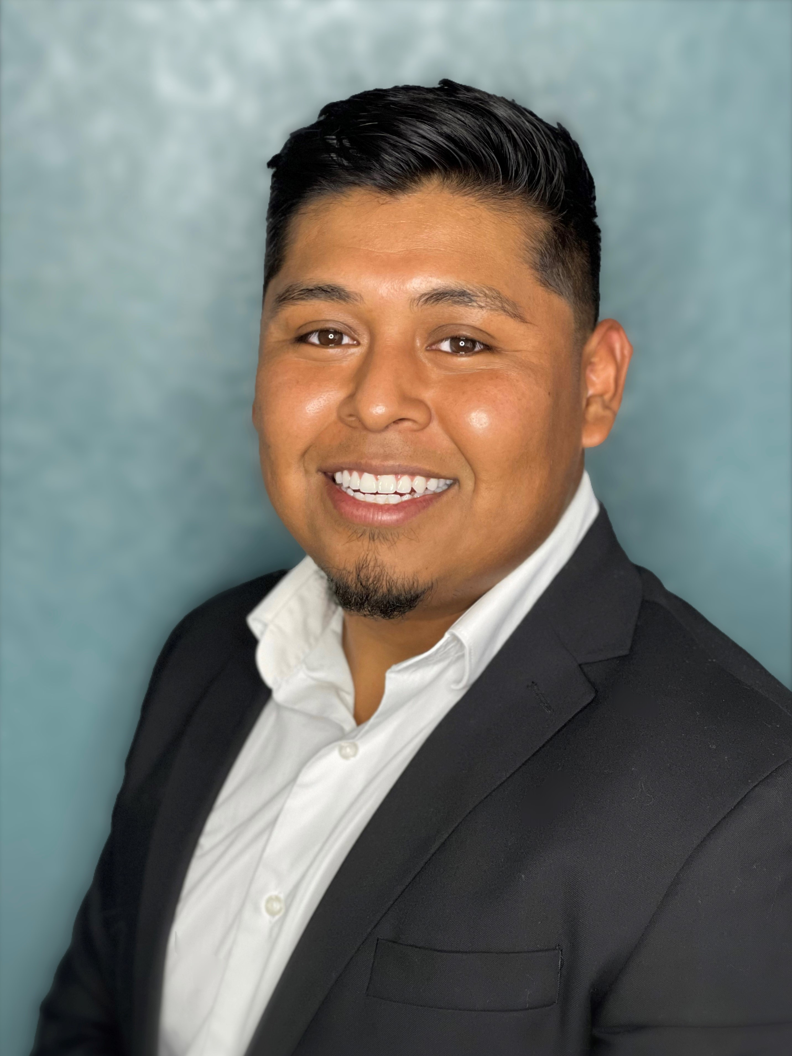
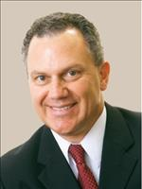
Voya Representatives for CalSTRS Pension2
Stephanie Henry
Stephanie.Henry@voya.com
Central Valley:
Fresno, Kern, Kings, Madera, Tulare, San Luis Obispo, Inyo
Aaron Ivey
Aaron.Ivey@voya.com
Sacramento Region, Northern California
Santiago Gonzalez
Santiago.Gonzalez@voya.com
San Diego, Imperial, Riverside
Aren Yarian
Aren.Yarian@voya.com
Los Angeles, Ventura, Santa Barbara, San Luis Obispo, Orange County
Jeff Kissiar
Jeff.Kissiar@voya.com
Sacramento Region,
Northern California
Verify your CalSTRS Representative at:
www.calstrs.com/verify-your-calstrs-representative
Notes:
HYBRID
Hi (______), thank you for joining us today. I’d like to give you the opportunity to introduce yourself and how you serve our members.
VOYA REP introduces themselves….
I am very happy to be speaking with all of you today and having this opportunity to introduce not only myself, but also the team I work with.
1. Provide overview of your background and how long you’ve been in the financial services industry.
2. Discuss why you starting working w/VOYA and have a passion for finance.
3. Provide a brief explanation of what you do for our members:
Statement comparison (what it is and why it’s a good idea to have one)
Rollover Assistance
Enrollment Contributions
4. Discuss One on One Meetings
In Person, Phone, and Zoom
Meeting before (territory driven - meeting one on one at MSCs or via telephone)
During (meeting w/all areas via zoom or telephone)
After pandemic (possible mixture or return to territory?)
HYBRID
Thank you for sharing that with us and supporting members throughout California.
We will have a polling question near the end of this webinar for those who would like take part in Pension2 or request a statement comparison.
CLICK.

Slide 63
Notes:
You can also access more information about pension2 from the midcareer webpage.
Click.

Slide 64
Be your own advocate
Create your myCalSTRS account
Review your Retirement Progress Report annually
Research supplemental savings plans like Pension2
Verify your one-time death benefit information is correct
Notes:
As a CalSTRS member regardless of what stage of your career you are in, it is very important to be your own advocate.
Make sure you create a myCalSTRS account.
Review you Retirement Progress Reports annually.
It is a good idea to begin researching supplemental savings plans, like Pension2, to begin some extra savings if you haven’t already.
Lastly make sure your one-time death benefit information is correct. CalSTRS recommends you keep this updated throughout your career and into retirement.
Click.

Slide 65
Notes:
Remember, any of those publications or videos we’ve referred to can be found on the midcareer page.

Slide 66
As you near retirement
Continue to educate yourself on retirement
Participate in additional webinars about benefits
Attend a group benefits planning session
Graduate from midcareer to near retirement webpage
Notes:
As you near retirement…
Click.
Continue to educate yourself on retirement
Click.
Participate in additional webinars about your benefits
Click.
Attend a group benefits planning session
Click.
Graduate yourself from the midcareer webpage to the near retirement webpage.
Click.

Slide 67
For more information
Online resources
Benefits planning
Webinars
myCalSTRS
Retirement Progress Report
Educational videos
My Retirement Benefits
Financial Awareness Series
Group benefits planning session webinar
Notes:
If you need more information, we have several online resources that I have mentioned today. Those include myCalSTRS, your Retirement Progress Report, and any educational videos on topics that you want to review.
Click.
You can schedule a group benefits planning session that we are currently doing over zoom.
Click.
We also have additional webinars that you can attend. Some that you might find informative are My Retirement Benefits, My Retirement Decisions and any webinar that is a part of our 3–part financial awareness series that really focuses on financial literacy at different stages of your career.
Click.

Slide 68
Notes:
To register for another webinar, use the Attend a Midcareer Webinar tile on the midcareer webpage.
Click.

Slide 69
888-394-2060
Pension2.com
Notes:
If you have any other questions or want to learn more about Pension2, call 888-394-2060 or visit pension2.com
Click.

Slide 70
CalSTRS.com myCalSTRS
800-228-5453 *Press 2 for Customer Service. Monday – Friday 8 a.m. – 5 p.m.
Notes:
Questions?

