Slide 1
Cash Balance Benefit Program
Notes:
Welcome everyone, thank you for joining us. The time is , but we would like to wait a few more minutes to allow others to join we will be starting in just a few moments.
Welcome to the CalSTRS Cash Balance Benefit Program webinar. My name is , and I am a benefits specialist at the __________ Member Service Center/ office.
**feel free to input a personalized introduction about yourself and your background**
Before we start, I’d like to address a couple items.
Today's presentation is packed with a lot of information and resources. Please be sure you have pen and paper available to take notes, I can give you a couple of minutes if you need to grab them.
If you have any questions during today’s webinar you can submit them using the Q&A tab. Please do not submit any personal information OR request from us any information that is specific to your account. For your security we ask that if you do have any questions specific to your retirement account you email those through your secured myCalSTRS account or to call us at 1-800-228-5453 and speak with a CalSTRS representative.
If you find that you have questions after the webinar is complete, I urge you to log into your myCalSTRS account and send a secure online message. You can log onto myCalSTRS anytime. For your convenience you can also reach a representative Monday – Friday from 8a.m. – 5p.m.
Click.

Slide 2
Objectives
Review the Cash Balance Benefit Program
Understand the program’s benefits
Explore additional resources and considerations
Notes:
The objectives of today’s presentation are:
Click.
To review the Cash Balance Benefit Program.
Click.
To understand the benefits offered under the Cash Balance Program
Click.
And to explore any additional resources and considerations available to you as a cash balance participant.
Click.

Slide 3
Cash Balance Benefit Program
Notes:
As the webinar is titled, we are here today to talk about the Cash Balance Benefit Program. It’s important to note that this program is specifically for part-time educators.
Click.

Slide 4
CalSTRS programs
Cash Balance Benefit
Retirement program offered by participating districts to employees that work on a part-time or temporary basis.
Defined Benefit
Pension based on a formula. As a part-time educator,
you may permissively elect membership at any time.
Pension2®
Voluntary defined contribution plan available to all members in participating districts.
Notes:
The Cash Balance plan is just a portion of what CalSTRS has to offer.
CalSTRS offers 3 different programs.
Click.
The Cash Balance Benefit program, which we will talk about at length today.
is a CalSTRS retirement program offered only by participating districts to employees that work on a part-time or temporary basis. CalSTRS created this program as an alternative to social security. This program is often confused with the Defined Benefit Supplement account that is included in the Defined Benefit Program.
Click.
The Defined Benefit program is a pension based on a formula. As a member of the Defined Benefit, you also have the additional account I just mentioned called the Defined Benefit Supplement that contributions from extra duties such as summer school are invested. As a part-time educator you may not be required to be in the defined benefit program, but you may permissively elect membership at anytime. This is something you want to carefully consider and make sure is right for you as this decision is irrevocable.
Click.
CalSTRS Pension2 is a voluntary defined contribution plan available to all public-school employees by any district that offers the Pension2 program. Both members of the Defined Benefit program and participants of the Cash Balance program have access to CalSTRS Pension2.
click

Slide 5
Cash Balance plans
Cash Balance Benefit Program
Defined Benefit Supplement
vs
Part-time educator
Defined Benefit member
Alternative to Social Security
Service in excess of 1.000
Retirement savings
Additional retirement savings
Notes:
As I just mentioned it is very common for the Cash Balance Benefit Program to be confused with the Defined benefit Supplement account. The Cash Balance Benefit account and the Defined Benefit Supplement account are both considered cash balance plans from an IRS perspective. They have similar distribution rules but their contributions come from different circumstances.
Let’s look at Cash Balance first,
Click.
This program is ONLY for part-time educators. If you’re working a full-time contract, you are not eligible to participate in this program.
Click.
If it is offered by your district and you choose to participate, it is an alternative to social security. Meaning you will see no withholding going to the social security administration for your service.
Click.
Finally, this program was created to provide part-time educators a secure choice for retirement savings with employer matching, a guaranteed interest rate and no plan costs.
If you want to confirm that you are a Cash Balance participant, you can do so through your myCalSTRS account, You can call CalSTRS directly and speak with a customer service representative, or you can reach out to your employer.
Click.
Only Defined Benefit members will have a Defined Benefit Supplement account.
Click.
Contributions come from any duties performed above and beyond a full-time contract or 1.000 service credit. Or if you are working multiple contracts, it would be any amount of service credit earned over the 1.000 maximum per school year.
Click.
This is not the main account for the program, instead it provides you with additional retirement savings. Any distribution coming from this account will be paid separately from the retirement benefit coming out of the Defined Benefit account and will be based upon the account balance upon retirement.
Now that we have identified the differences between the two know that today we are only going to be focusing on the Cash Balance Benefit program.
Click.

Slide 6
Cash Balance Benefit Program enrollment
Participant election
You signed up within the first 60 days of being employed.
You can elect Cash Balance Benefit at
any time.
Automatic enrollment
If no program was selected within 60 days, if eligible.
Notes:
Once you have confirmed that you are in fact a Cash Balance Participant, you may be wondering how you got into the Cash Balance program.
Click.
You could have elected to be in the program if you signed up within the first 60 days of being employed
Click.
Or if you were placed in social security or any other alternative retirement programs you can always make an election to be in Cash Balance.
Click.
It is also possible that you did not make a selection within the first 60 days of employment and your employer defaulted you into the Cash Balance program.
Click.

Slide 7
Cash Balance Benefit Program eligibility
Pre-K through 12
Employed less than 50% of full time
Signed a contract for less than 50%
Substitute employees
Notes:
If you remember at the beginning of this presentation, I mentioned that the Cash Balance Program was developed specifically for Part-time educators. Let’s take a look at what “Part-time” means, keeping in mind that the Cash Balance Program is only available at participating districts.
At the Pre-K through 12 level you are eligible for the Cash Balance Program if you are:
Click.
Employed less than 50% of full time.
Click.
Signed a contract to work less than 50%
Click.
Or if you are a substitute employee.
Click.

Slide 8
Cash Balance Benefit Program eligibility
County Office of Education
Employed less than 50% of full time
Signed a contract for less than 50%
Notes:
For those of you that work with the County Office of Education you are eligible for the Cash Balance Program if you are:
Click.
Employed less than 50% of full time.
Click.
Signed a contract to work less than 50%
Click.

Slide 9
Cash Balance Benefit Program eligibility
Community college
Adjunct or hourly faculty
Hired semester to semester
Adult education instructors
Only available if district adopts a resolution to offer the Cash Balance Benefit Plan.
Notes:
If you are employed at the community college level, you are eligible for the Cash Balance Program if you are:
Click.
Employed as adjunct or hourly faculty.
Click.
Hired semester to semester on a part-time or temporary basis
Click.
Or if you are an adult education instructor.
In any event the Cash Balance Benefit Program is only available if your district offers it.
Click

Slide 10
Cash Balance Benefit Program features
No program fees
Immediate vesting
Assets managed by CalSTRS
Portability
Notes:
There are a lot of benefits for those who choose to be a Cash Balance Participant.
Click.
As with all programs CalSTRS offers, the Cash Balance Benefit Program, does not have any program fees. This may not be the case with other retirement programs offered by your employer.
Click.
The Cash Balance Plan offers immediate vesting. This means the only eligibility requirement to retire is that you reach retirement age. There is no account balance requirement and there is no requirement to work for a certain number of years.
Click.
Some individuals are not comfortable with finance and the world of investing those individuals can rest assured knowing that the Cash Balance account is a risk-free investment, and its assets are managed by CalSTRS.
Click.
This account was created to be portable. You can continue to participate in Cash Balance if you move to another employer that offers Cash Balance. You can roll funds into the Cash Balance Plan from other outside retirement accounts and if you become a member of the Defined Benefit Program and stop contributing to Cash Balance you can consolidate your benefits and receive Defined Benefit service credit for your eligible Cash Balance service.
Click.

Slide 11
Cash Balance Benefit Program features
Low contribution rates
Employer matching
Guaranteed annual interest rate
Flexibility at retirement
Notes:
With the Cash Balance Benefit program contribution rates are fairly low. In most cases you contribute 4%.
Click.
Your contributions are matched by your employer.
Click.
This account has a guaranteed interest rate, which is compounded. For the 2024-2025 school year this interest rate is 4.19%
Click.
And the last benefit I want to highlight is the payment flexibility at retirement. It is important to note that all payment choices are based on your account balance, but you have the option to take a lump sum payment, a lifetime or period certain annuity. We will talk about distribution choices in a little more detail in a few slides.
Click.

Slide 12
Cash Balance Benefit Program
Specifically for educators who work part-time or temporarily
Offered as an alternative to Social Security
Only in participating districts
Details about Cash Balance can be found in the Cash Balance Benefit Program booklet.
Notes:
For more information, you can find the details about this program in the Cash Balance Benefit Program booklet. A couple highlights for you to know are:
Click.
Cash Balance is specifically for educators who work part-time or temporarily.
Click.
As a part-time educator your employer is required to offer Social Security or make another alternative retirement plan available to you. The CalSTRS Cash Balance Benefit Program was created to be a secure and portable retirement income account for part-time educator as an alternative to paying into social security.
Click.
Cash Balance is only offered at participating districts. If a district offers the Cash Balance Program, it becomes the default choice if the educator does not choose a plan when hired.
Click.

Slide 13
Cash Balance Benefit Program funding
%
Employer Contribution 4%
Guaranteed interest
Employee contribution
4%
CB
Consider a rollover from other qualified retirement plans.
Notes:
So now that we have reviewed what the Cash Balance Benefit Program is let's talk about how you can get funds into this account. There are several ways that you can get funds into your Cash Balance Account.
Click.
I previously mentioned that the Cash Balance plan has a low contribution rate… that rate is typically 4%. I say typically because alternative contribution rates can be bargained.
Click.
That 4% is matched by your employer who also contributes at least 4% into the account. In the event that you negotiate different contribution rates just know that the combined employee and employer contribution rates must be at least 8%
Click.
The Cash Balance account earns an annual interest rate that is compounded. The Teacher’s Retirement Board sets the interest rate each fiscal year and it mirrors the treasury rate. For the current year 2022-2023 that interest rate is 2.09% but historically it has been as high as 6.75%.
Click.
This program is unique in that unlike other CalSTRS programs - If you have outside investments or accounts, the Cash balance account does allow for you to roll funds into it.
Click.

Slide 14
Cash Balance Benefit account distributions
Lump sum
Lifetime annuity
Period-certain annuity
Review your choices and tax considerations with a tax professional.
Notes:
I mentioned that there are flexible choices for payout and distribution in retirement
You have three choices.
Click
You can take your entire balance as a lump sum.
Click.
You can annuitize your account balance in a lifetime annuity
Click.
Or you can do a period certain annuity.
Let’s look at these payment choices in a little more detail.
Click.

Slide 15
Lump-sum payment
Direct payment
Account balance
Rollover
Take your entire account balance at retirement
Notes:
A lump-sum payment is essentially a return of your account balance.
Click.
You can take this as a direct payment and receive a check for the balance. If you do this there is a 20% mandatory federal tax withholding and an optional 2% state tax withholding.
Keep in mind this is just a tax withholding and you may owe more or receive a refund when you file your taxes depending on your situation.
Click.
You can delay paying taxes on your lump sum by rolling the funds into a qualified plan such as a 403(b), 457 or 401(k).
You can also annuitize your account balance…
Click.

Slide 16
Lifetime annuity
Receive a separate monthly payment for your lifetime.
Account balance
Participant-Only Annuity
100% Beneficiary Annuity
Your annuity beneficiary will receive a lifetime monthly payment upon your passing.
Account balance
75% Beneficiary Annuity
50% Beneficiary Annuity
Notes:
A lifetime annuity would offer a separate monthly payment each month for the rest of your life.
The lifetime annuity depends on whether or not you elect a participant-only annuity or beneficiary annuity .
Click.
If you elect the participant-Only Annuity you could receive a monthly Annuity which would stop when you die.
CalSTRS will actuarially determine a monthly payment amount that we will pay you. If there are any funds remaining in your account when the you die the remaining balance will be paid to the recipient, you have designated. If you do not have a recipient designated the remaining balance will be paid to your estate. There is no situation where CalSTRS keeps your remaining funds.
Click.
If you elect the Beneficiary annuity, you could choose between a 100%, 75% or 50% beneficiary annuity. You would be electing to reduce your Participant-Only Annuity in exchange for providing 100%, 75% or 50% of your reduced annuity to your beneficiary. Your Beneficiary would then receive a lifetime monthly payment upon your passing.
All of the lifetime annuities are taxed like regular income meaning you will tell us your tax withholding preferences.
Another way to annuitize your account balance is over a specific period…
Click.

Slide 17
Period-certain annuity
Account balance
Annuitize account balance and receive a monthly benefit for a specified number of years.
3 year
4 year
5 year
6 year
7 year
8 year
9 year
Notes:
A period-certain annuity is a separate monthly payment that stops after a designated number of years. The shorter the period, the larger the monthly benefit payment. The longer the period, the smaller payment.
Click.
A period-certain annuity between three and nine years can be rolled over to a qualified plan. If you have the annuity paid directly to you, there is a 20% mandatory federal tax withholding and an optional 2% state tax withholding similar to the lump-sum payment.
Click.

Slide 18
Period-certain annuity
Account balance
Annuitize account balance and receive a monthly benefit for a specified number of years.
10
year
Notes:
You can also choose to receive a 10-year annuity. The 10-year annuity is taxed like regular income and cannot be rolled over.
Like the lifetime annuity if you pass away before you have been paid all the funds in your account the remaining balance will be paid to your designated recipient. If you do not have a recipient, the remaining funds will be paid to your estate.
As you can see there are lots of decisions and tax considerations for your Cash Balance Benefit account. You can review the information we covered, including some examples by reading the Cash Balance Benefit Program booklet on CalSTRS.com. You may also want to discuss this account with your financial representative or tax advisor.
Click.

Slide 19
Benefits of Cash Balance Benefit Program
Notes:
The Cash Balance account offers Retirement Benefits, Disability Benefits, Death Benefits and even termination benefits lets look at what each of those benefits look like.
Click.

Slide 20
Cash Balance retirement benefit
Normal retirement age (60 or 62)
Early retirement at age 55
Must terminate all creditable service
Required minimum distribution at age 73
Notes:
Retirement eligibility is very straight forward.
Click.
There is a normal retirement age of 60 or 62 depending on when you were hired. For those hired on or before December 31, 2012, their retirement age is 60. For those hired on or after January 1, 2013, retirement age is at 62.
Click.
There is an option of early retirement at age 55
Click.
In order to retire you must terminate ALL creditable service
Click.
Lastly, if you are not working and have not started receiving your money there is a required minimum distribution set by the IRS at age 73.
Click.

Slide 21
Meet Jemma Simmons
Jemma is 62 years old
Married to Leopold, her husband
of 30 years
Contributing to Cash Balance Benefit Program for 10 years
Interested in retiring and taking a distribution from her account
Notes:
Let’s go ahead and run through an example that will illustrate the retirement distribution choices.
This is Jemma Simmons. She is 62 years old and is married to her husband Leopold who she has also designated as her recipient should anything happen to her.
Jemma has been teaching part-time and contributing to the Cash Balance Program for 10 years and is interested in retiring at the end of this semester.
She meets with a CalSTRS benefit specialist and is given the following distribution choices…
Click.

Slide 22
Lump-sum payment
Direct payment*
$48,801
Rollover
*Mandatory 20% federal withholding and optional 2% state tax withholding
Notes:
On Jemma’s estimate it shows that she will have approximately
Click.
$48,801 in her account at the end of the semester.
Her first option would be to take a lump-sum payment or a return of her account balance.
Click.
She can take this as a direct payment and receive a check for the balance of her account.
With a direct payment there is a 20% mandatory federal tax withholding and an optional 2% state tax withholding.
Click.
She can also roll the funds into a qualified plan such as a 403(b), 457 or 401(k). If she chooses to roll the funds over into a qualified retirement account, she will delay the taxes until she withdrawals the money from that account.
Click.

Slide 23
Lifetime annuity
Participant-Only Annuity
$48,801
$312
100% Beneficiary Annuity
$291
75% Beneficiary Annuity
$48,801
$299
50% Beneficiary Annuity
$306
Notes:
Jemma can take a lifetime annuity, and this would provide her with a monthly payment for the rest of her life.
The amount of lifetime annuity depends on whether or not she elects a participant-only annuity or beneficiary annuity .
Click.
If she elects the participant-Only Annuity she will receive a monthly Annuity which will stop when she dies. As you can see here for an account balance of $48,801 her monthly payment is $312.
If there are any funds remaining in Jemma’s account when she dies the remaining balance will be paid to her husband Leopold, since that is the recipient, she has designated.
Click.
If Jemma elects the Beneficiary annuity, she can choose between a 100%, 75% or 50% beneficiary annuity. She would be electing to reduce her Participant-Only Annuity in exchange for providing 100%, 75% or 50% of your reduced annuity to her beneficiary.
In this case, Jemma has asked to see an estimate of her monthly benefit if she were to also name her husband as her beneficiary. As you can see here if she were to elect the 100% beneficiary then her monthly benefit would be reduced to $291. Upon her passing Jemma’s husband Leopold would receive 100% of what she was receiving every month for the rest of his life.
Remember all of the lifetime annuities are taxed like regular income meaning Jemma will tell us her tax withholding preferences.
Click.

Slide 24
Period-certain annuity
$1,492
3 year*
$1,153
4 year*
$950
5 year*
$48,801
$816
6 year*
$720
7 year*
$649
8 year*
$594
9 year*
*Mandatory 20% federal withholding and optional 2% state tax withholding
Notes:
Jemma can also choose a period-certain annuity or a separate monthly payment that stops after a designated number of years.
Click.
With an account balance of $48,801
Click.
She is looking at the following distribution choices. If she were to choose a 3-year annuity she would receive $1,492 every month for 3 years and then the benefit would stop. The longer the period she selects the smaller the monthly payment. For instance, if she chooses the 8-year annuity then her monthly payments would be $649.
You will notice that if you multiply the monthly payment amount by the number of months you will be receiving the payments the balance you will receive will be higher than your account balance at retirement. This is because your account balance is always earning interest.
Click.
A period-certain annuity between three and nine years can be rolled over to a qualified plan. If Jemma has the annuity paid directly to her, there is a 20% mandatory federal tax withholding and an optional 2% state tax withholding similar to the lump-sum payment.
Click.

Slide 25
Period-certain annuity
$48,801
$550
10 year
Be mindful of the different tax considerations
Notes:
Jemma can also choose to receive a 10-year annuity.
Click.
With an account balance of $48,801
Click.
Jemma’s monthly payment for 10 years would be $550.
Remember the 10-year annuity is taxed like regular income and cannot be rolled over.
Click.
As you can see Jemma has a lot of decisions and tax considerations for her Cash Balance Benefit account. She may also want to discuss this account with her financial representative or tax advisor.
Click.

Slide 26
Cash Balance disability benefit
Apply any time
Terminate all creditable service
Medical documentation
Disability must be total and permanent
Notes:
If you find that you become disabled with a physical or mental impairment
that is expected to prohibit you from working for at least 1 year you may
want to apply for disability. Before you apply for disability, know that:
Click.
You can apply at any time.
Click.
You must terminate all creditable service
Click.
CalSTRS will require medical documentations to substantiate your disability.
Click.
And like I mentioned previously your disability must prevent you from
working.
Click.

Slide 27
Retirement or disability distribution options
Lifetime benefit options
Participant-Only Annuity 75% Beneficiary Option
100% Beneficiary Option 50% Beneficiary Option
Period-certain annuity
3-10 years
Direct payment
Rollover
Lump sum
Direct payment
Rollover
Notes:
In the cash balance program, the disability benefit amount is equal to your account balance. So, the distribution choices for disability are the same as the distribution choices for a cash balance retirement benefit. Keep this in my mind if you are considering applying for disability, this is only necessary if you become disabled prior to age 55. If you become disabled after age 55 you can simply apply for a retirement.
Click
If the you have $3500 or more in your account, you can choose a lifetime annuity. Remember this can either be a participant-only annuity or a beneficiary annuity.
Click.
You can choose a period certain annuity for a period of 3-10 years.
Click.
Or you can choose to take your benefit as a lump sum payment. Remember if you do not have at least $3500 in your account, your only option is a lump sum benefit.
Click.
typically 4% determined by your local bargaining agreement

Slide 28
Cash Balance death benefits
Before retirement
Lump-sum payment
Period-certain annuity
After retirement
Choice elected at retirement by participant
Have you filled out your Recipient Designation form?
Notes:
This program also has death benefits built into it. The amount of this benefit is equal to your account balance.
As a Cash Balance participant if you die before retirement, your named recipient will have the option of a lump –sum payment or an annuity if your account balance is more that $3500
Click.
If you die in retirement your recipient will be paid based on the choice you elect at retirement
In any case if you do not name a recipient a lump-sum of your account balance will be paid to your estate.
Click.
You can name or update a recipient by filling out the recipient designation form on myCalSTRS or download the form from CalSTRS.com/forms.
Click.
typically 4% determined by your local bargaining agreement

Slide 29
Cash Balance termination benefit
Lump-sum payment
Six months following termination
Once every five years
Notes:
Upon termination of all creditable service subject to coverage by the plan, for any reason other than death, disability, or retirement, you may apply for a termination benefit.
Click.
This would be paid out as a lump sum. The benefit amount is equal to the sum of the you and your employers' contributions, plus compounded interest as of the date the benefit is paid.
Click.
The termination benefit is payable after six months has elapsed following the date of termination of employment.
The application for the termination benefit will be automatically canceled if you perform creditable service within six months following the date of termination of employment.
Click.
You may not apply for a termination benefit, if less than five years has elapsed since your most recent termination benefit was distributed.
Click.

Slide 30
Additional Cash Balance Benefit Program considerations
Notes:
Next, we are going to go over some additional considerations that you should be aware of as a Cash Balance participant.
Click.

Slide 31
Your goal
- 40%
Your gap
80-90%
40%
Notes:
Because your retirement income might be coming from multiple sources, it can be helpful to look at your retirement plan as a puzzle. And ask yourself: Do you have all the pieces of the puzzle you’ll need? Maybe after calculating your gap, you find that you need to add a piece or 2.
To help paint a better picture, let’s talk numbers.
Click.
The average CalSTRS part-time educator will earn almost 40% of their final compensation in retirement. This is the average so depending on how much you work, that percentage might be higher or lower.
Click.
Financial Advisors say in order to maintain your standard of living in retirement you should plan to replace 80-90 percent of your final compensation.
Click.
You will have to decide what your goal for retirement income is. Then you’ll subtract the benefit from CalSTRS. That leaves a gap in your retirement puzzle.
Additional savings and investments can help complete your puzzle to reach your retirement goals.
Many Part-time educators have retirement accounts from previous employment or careers – don’t forget to research those accounts and factor in those income sources.
Click.
Our CalSTRS Pension2 program provides an opportunity for members to save additional retirement income to help fill that gap. Though there are many companies offering these types of plans throughout California, most of them are offered by for-profit or insurance companies. Pension2 is designed as a revenue-neutral program, meaning CalSTRS is not profiting from it and there are no commissioned sales representatives. The goal of Pension2 is purely to help you save enough money to retire comfortably. You might even be able to roll over other qualified retirement plans so that you’ll be able to manage your retirement savings in one place.
Click.

Slide 32
Tax-deferred retirement savings.
Low cost.
Flexible investment options
Friendly support team.
888-394-2060
Pension2.com
Notes:
For those of you who are interested in saving more for retirement know that CalSTRS Pension2 offers accounts such as a 403(b), roth 403(b), 457(b) and roth 457(b).
These accounts offer additional low cost, tax deferred retirement savings.
There are no hidden costs, and you are never locked into this program
Please take note of their phone number here or their web address. If you want more information on the Pension2 program, you can sign up for a Pension2 webinar or give them a call and a representative will assist you.
Click.

Slide 33
Consolidation of benefits
Converts Cash Balance service into Defined Benefit
service credit
Must terminate all Cash Balance Benefit Program activity
Must be an active member of the Defined Benefit Program
Consolidation process can be lengthy
Notes:
If you are also a member of the Defined Benefit, one of the other retirement income plans offered by CalSTRS or you are considering becoming a Defined benefit member, you can consolidate your Cash Balance account into your Defined Benefit.
Click.
By doing this you would be converting your Cash Balance account into Defined Benefit service credit.
Click.
You must terminate all Cash Balance activity. This means you will no longer be a Cash Balance participant. This does not mean that you must quit your job it just means that instead of contributing to Cash Balance you will be contributing to the Defined Benefit.
Click.
To do this you must be an active member of the Defined Benefit Program. There are several reasons why someone would choose to consolidate. You may find that your employment status has changed, and you now fall under mandatory membership for the Defined Benefit. If this happens your Cash Balance account will be inactive, and consolidation might be a good idea for you.
Click.
Also know that the consolidation process can be lengthy. So, if this is something you are interested in, it is better to look into this soon rather than later. For those of you who are interested in consolidating benefits you can get the forms on our website at CalSTRS.com/forms.
To learn more, you can also sign up for the Consolidation of Benefits webinar at CalSTRS.com/webinars
Click.

Slide 34
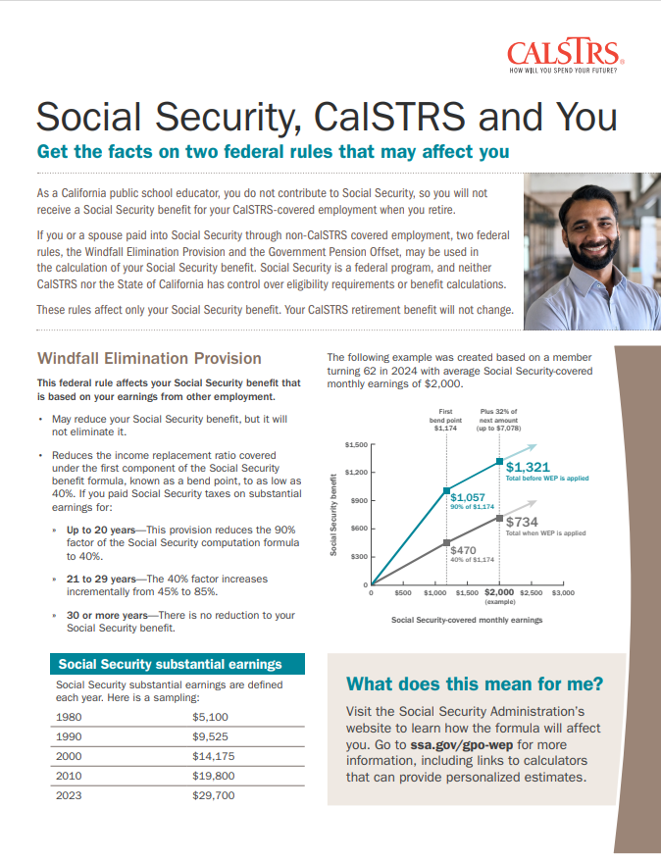
Social Security
Windfall Elimination Provision
May reduce but cannot eliminate your Social Security benefit.
Government Pension Offset
Reduces and may eliminate your spousal, widow or widower Social Security benefit.
Contact the Social Security Administration for more information.
Notes:
You may have heard that CalSTRS members do not get social security. This is not true. However, there are 2 social security offsets that you should know about.
First is the WEP If you are expecting a social security benefit based on your own earnings, your social security benefit may be reduced but not eliminated. As a part–time educator you may have had other employment that paid into social security. If this is the case, the reduction to your social security benefit may not be as large depending on how many years of substantial earnings you put into social security. For those of you that have over 30 years of contributing to social security you may not be affected by this offset.
The other offset is the GPO. If you are expecting a spousal or widow/widower benefit from social security, that benefit can be reduced or eliminated.
If you want to read more about these offsets you can find the Social Security, CalSTRS and You factsheet at CalSTRS.com/publications.
Click.

Slide 35
Do Social Security offsets apply?
Cash Balance account
Defined Benefit account
Consolidated account
Refunded account
Contact Social Security for information regarding offsets pertaining to your specific situation.
Notes:
A very common question asked by Part-time educator’s is if the Social Security offsets will apply to different scenarios. Let’s look at some different scenarios to help determine the potential impact to Social Security .
Click.
Cash Balance program was created specifically as a social security alternative for part-time educators to establish retirement savings, this program features immediate vesting and is subject to the offsets…
Click.
The Defined Benefit account is a public pension as an alternative to Social Security, makes you automatically subject to the offsets.
Click.
Consolidation is combining two accounts that are both subject to the offsets – you are simply combining them into one.
Click.
we are often asked, “So what if I refund both?” – The short answer is, Refunding your account won’t stop those offsets from taking effect.
I have provided you a high level overview on this, which I hope is helpful. It is important to contact Social Security directly to discuss their offsets and how they pertain specifically to your situation.
Click.

Slide 36
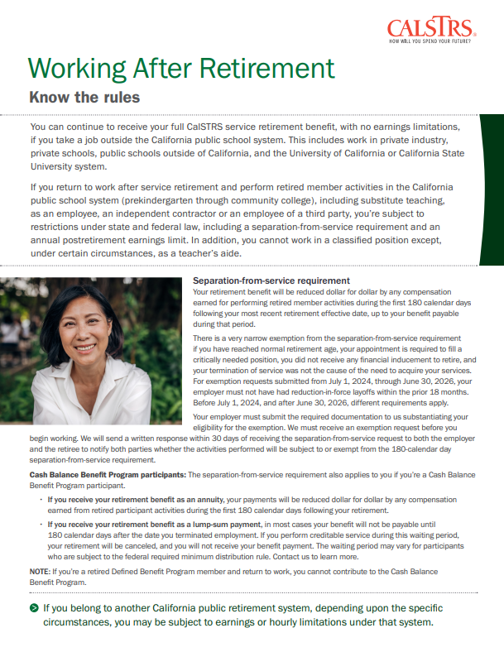
Working after retirement
Separation-from-service requirement
Benefit reduced dollar for dollar by the amount you earn in CalSTRS-covered employment during your first 180 calendar days of retirement.
Defined Benefit Program members
If you return to work, you cannot contribute to the Cash Balance Benefit Program.
Notes:
If you were considering working after retirement, there is a separation from service requirement. Earning pay from a CalSTRS covered employer during the first 180 calendar days following retirement can affect your retirement benefits.
If you receive your retirement benefit as an annuity your benefit will be reduced dollar for dollar by any earnings from retired participant activities.
If you receive your retirement benefit as a lump sum your benefit will not be payable until 180 days after you terminate employment.
Even after you have met the separation from service requirements if you decide to return to work you cannot contribute to the Cash Balance Program.
If you are planning on working after retirement know the rules. You can get a copy of the Working after Retirement factsheet seen here at CalSTRS.com/publications.
Click.

Slide 37
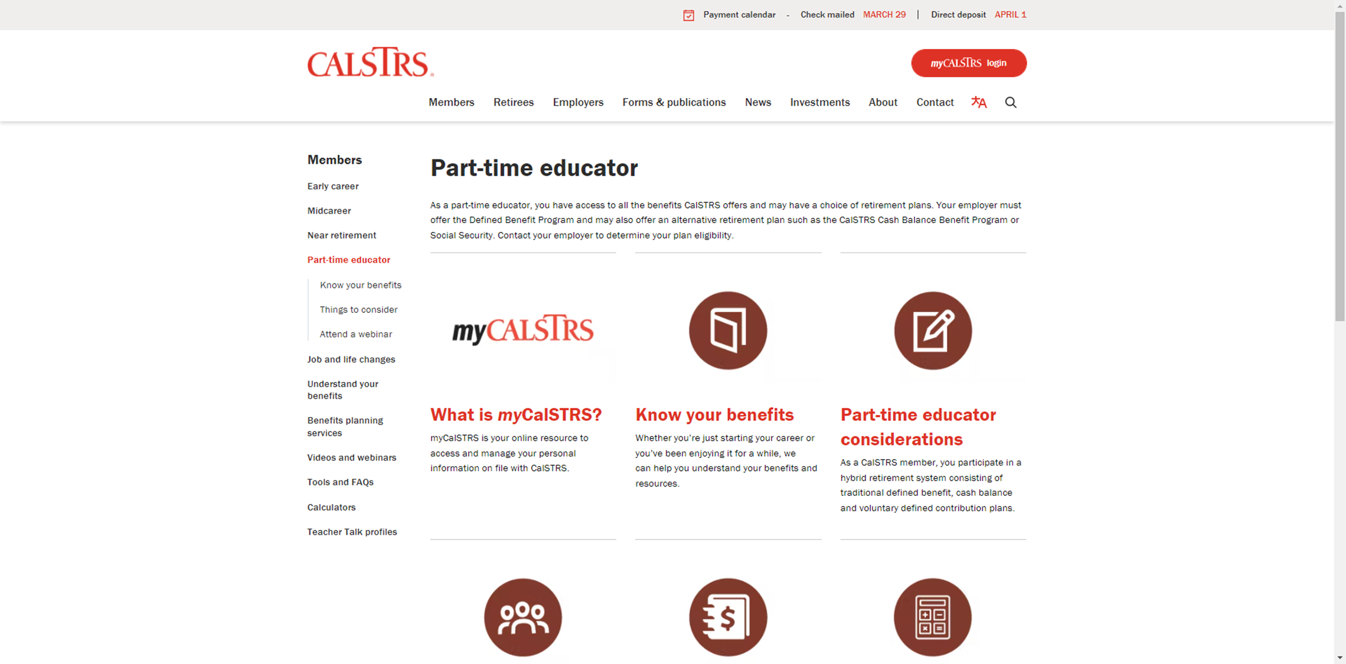
Part-time educator webpage
Notes:
You can visit the Part-time educator webpage which acts as a one stop shop for all things a part-time educator may need.
From this webpage you can access all the publications and forms that were referenced in todays webinar. At the end of this webinar, I will quickly show you how to navigate to this webpage
From this page you can also access myCalSTRS
Click.

Slide 38
myCalSTRS
View and update your account information
Send secure messages
Access your Retirement Progress Report
Notes:
myCalSTRS provides online access to your CalSTRS accounts. Once you register for an account you can log in 24 hours a day 7 days a week. Using myCalSTRS you can:
Click.
View and update your account information
Click
Send a secure online message to a CalSTRS representative and receive a secure response.
Click.
You can also access your annual Retirement Progress Report which is important to view and track your retirement progress on a yearly basis.
Click.

Slide 39
Your Retirement Progress Report
Participant and program benefit information
Contributions and account balances
Employer reporting
Current recipient information
Notes:
Your Retirement Progress Report is an annual report that comes out every September and tracks your Retirement progress. It has the information as reported by your employer through June 30 of the previous school year.
The report for a cash balance participant will include:
Click.
Your most current participant and program benefit information
Click.
Your contributions and account balances
Click.
The reporting we have received from your employer
Click.
As well as current recipient information.
Click.

Slide 40
Log in to myCalSTRS.com
For assistance, call us at
1-800-228-5453
Monday-Friday 8 a.m. - 5 p.m.
Notes:
You log in by going to myCalSTRS.com. If you have not previously registered for an account registration is easy.
If you ever forget your password there is a forgot password link. If you ever need more assistance, you can call our customer service line and they will help you log in after verifying your account. The number to customer service is 1(800)228-5453 and a representative will be available Monday - Friday 8am to 5pm.
Click.

Slide 41
For more information
Online resources
Benefits planning session
Attend a workshop or webinar
Part-time educator webpage
myCalSTRS
Retirement Progress Report
Individual benefits planning session
Part-time Educator
Consolidation of Benefits
Additional Income Sources for Part-time Educators
calstrs.com/webinars
Notes:
If you need more information, we have several online resources. I specifically want to point out the Part-time Educator webpage. This webpage is really the “one-stop shop” for all things a part-time educator might need.
Before I show you how to navigate to this page, I want to remind you that myCalSTRS and your annual retirement progress report are both going to be excellent online resources for you.
You can schedule a benefits planning session
There is also several webinars that were created specifically for you the part-time educator.
Click.

Slide 42
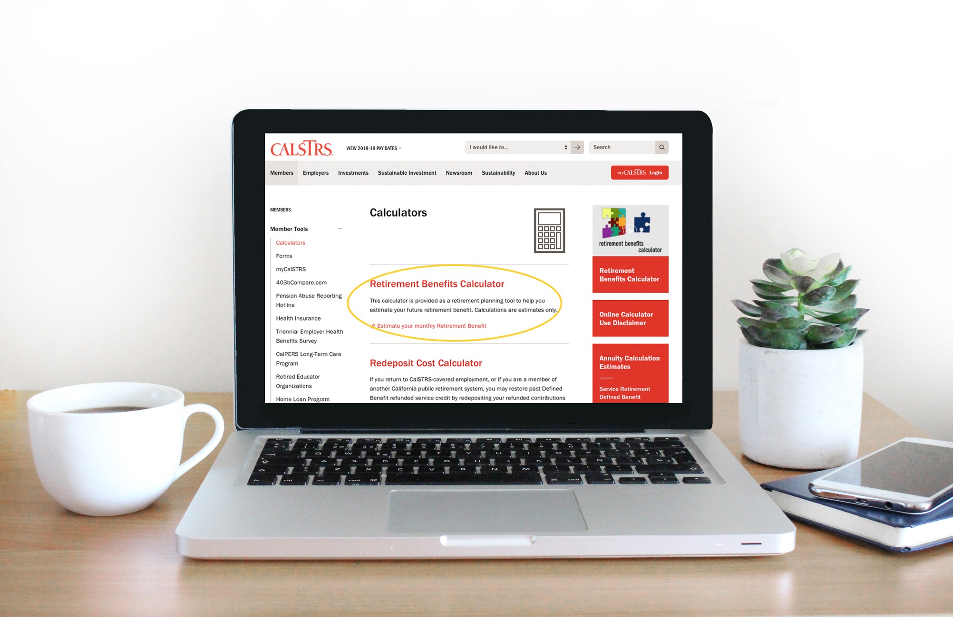
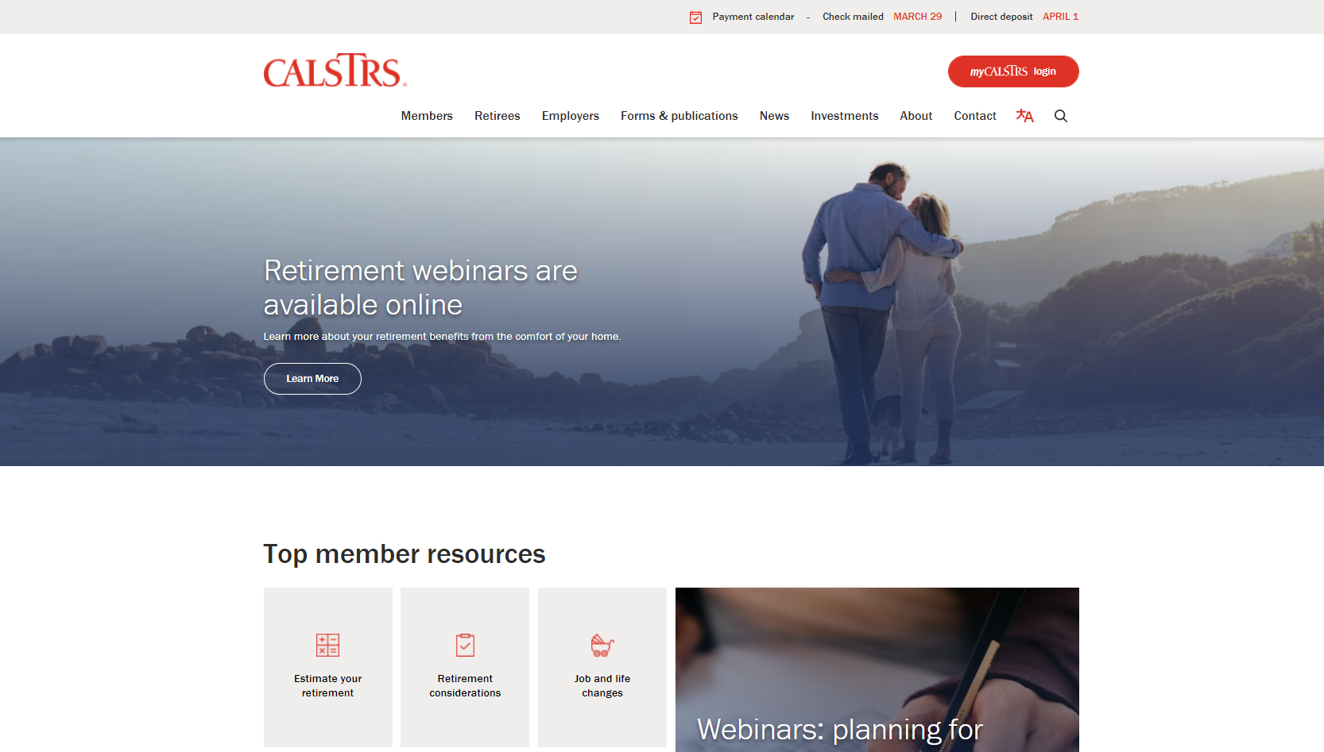
Part-time educator webpage
Notes:
Like I said I want to go ahead and show you how you can get to the Part-time Educator webpage.
Click.
From the CalSTRS.com landing page hover your mouse over “Members” from the top menu.
Click.

Slide 43
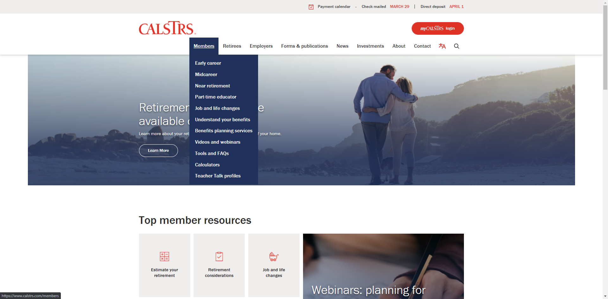
Getting Started
Notes:
From the menu that drops down,
Click.
you will select “Part-time educator”
Click.

Slide 44
PTE page
Notes:
This will bring you to the part-time educator webpage where you can access all things part-time.
Click.

Slide 45
Questions?
CalSTRS.com
myCalSTRS
800-228-5453
*Press 2 for Customer Service.
Monday – ­Friday
8 a.m. – 5 p.m.
Notes:
Questions?

