Slide 1
Near Retirement Educator Learn and Discover
Notes:
Welcome to the CalSTRS Near Retirement Educator: Learn and Discover webinar. My name is , and I am a benefits specialist at the __________ Member Service Center/ office.
**feel free to input a personalized introduction about yourself and your background**
Before we start, I’d like to address a couple items.
Today's presentation is packed with a lot of information and demonstrations of our online resources. Please be sure you have pen and paper available to take notes, I can give you a couple of minutes if you need to grab them.
If you have any questions during today’s webinar you can submit them using the Q&A tab. Please do not submit any personal information OR request from us any information that is specific to your account. For your security we ask that if you do have any questions specific to your retirement account you email those through your secured myCalSTRS account or to call us at 1-800-228-5453 and speak with a CalSTRS representative.
If you find that you have questions after the webinar is complete, I urge you to log into your myCalSTRS account and send a secure online message. You can log onto myCalSTRS anytime. For your convenience you can also reach a representative Monday – Friday from 8a.m. – 5p.m.
Click.

Slide 2
Trust , not impersonators
CalSTRS authorized representatives:
Have an email address ending in @CalSTRS.com.
Can provide a CalSTRS ID badge or business card.
Do not provide refreshments at offsite events.
Will never meet at your home.
Do not sell insurance products.
Notes:
Before we start, we’ve been receiving constant reports from our members believing they’ve set up an appointment or spoken with a CalSTRS representative when they have not. Only CalSTRS employees can provide you with accurate information regarding your CalSTRS Defined Benefit and Pension2 accounts. We’ve developed a checklist for you to use to ensure the person with whom your speaking is a CalSTRS employee.
Companies or individuals not affiliated with CalSTRS cannot have the CalSTRS logo on their advertisements.
Only CalSTRS employees will have an @CalSTRS.com e-mail address on their business cards. Please double-check the spelling of CalSTRS.
CalSTRS does not provide any refreshments when we come to see you at events.
CalSTRS employees will never meet you at your home.
CalSTRS is not an insurance company, so we will never try to sell you on any insurance products.
Click.

Slide 3
Trust , not impersonators
CalSTRS authorized representatives:
Have access to your CalSTRS or Pension2® account information.
Some Voya Financial representatives work exclusively with Pension2. Their names and photos are listed at CalSTRS.com/Trust-CalSTRS.
To verify a CalSTRS representative, contact us at
888-394-2060 or RepCheck@CalSTRS.com.
Notes:
Only CalSTRS employees will have access to your CalSTRS or Pension2 account information. If you’re asked to provide a copy of your CalSTRS Retirement Progress Report or Pension2 account statement in order for someone to assess your CalSTRS accounts, they are not affiliated with CalSTRS.
CalSTRS has created a webpage at www.CalSTRS.com/Trust-CalSTRS with names and pictures of our member-facing Voya representatives. This webpage is kept up-to-date, so you can always ensure you’re speaking with a trusted person. These representatives from Voya Financial have an @Voya.com e-mail address and they work exclusively on the Pension2 program.
If you scheduled an appointment or already met with someone you think may not be a CalSTRS representative, contact us at 888-394-2060 or RepCheck@CalSTRS.com to verify they are a CalSTRS representative.
Please disseminate this information to any friends or colleagues who may need it.
Click.

Slide 4
Objectives
Tour myCalSTRS and the Retirement Progress Report.
Explore the Near Retirement webpage.
Identify CalSTRS’ resources and tools that support your coming retirement journey.
Notes:
Today we are going to briefly touch on a lot of topics. I hope to introduce you to the tools CalSTRS has to offer to help you on your retirement journey.
Click.
First, we’ll explore the calstrs.com Near Retirement webpage. It’s set up just for you to help find any resource you might need at this stage in your career.
Click.
Next, I’ll give you a short tour of myCalSTRS and we’ll look at the different parts of the Retirement Progress Report.
Click.
While we are going through the Retirement Progress Report, I’ll be identifying and talking about the different resources and tools that CalSTRS offers to support your retirement planning.
Click.

Slide 5
Near Retirement webpage on CalSTRS.com
Notes:
Let's begin with introducing the Near Retirement career webpage that we’ve put together for you.
Click.

Slide 6
Near Retirement webpage
Your “one-stop-shop” for retirement information.
Links to forms and publications associated with nearing retirement.
Available 24 / 7 / 365.
Notes:
We created different pages for different stages in your career. Today we are looking at the Near Retirement webpage
The near retirement page acts as a “one stop shop” for retirement information. We’ve collected links to all the pages we felt would be relevant to an educator nearing the end of their career.
This page houses links to forms and publications commonly used by those educators near to retirement.
This information is available to you 24 hours a day, 7 days a week, 365 days a year. Unless of course the site is down for maintenance.
Click.

Slide 7
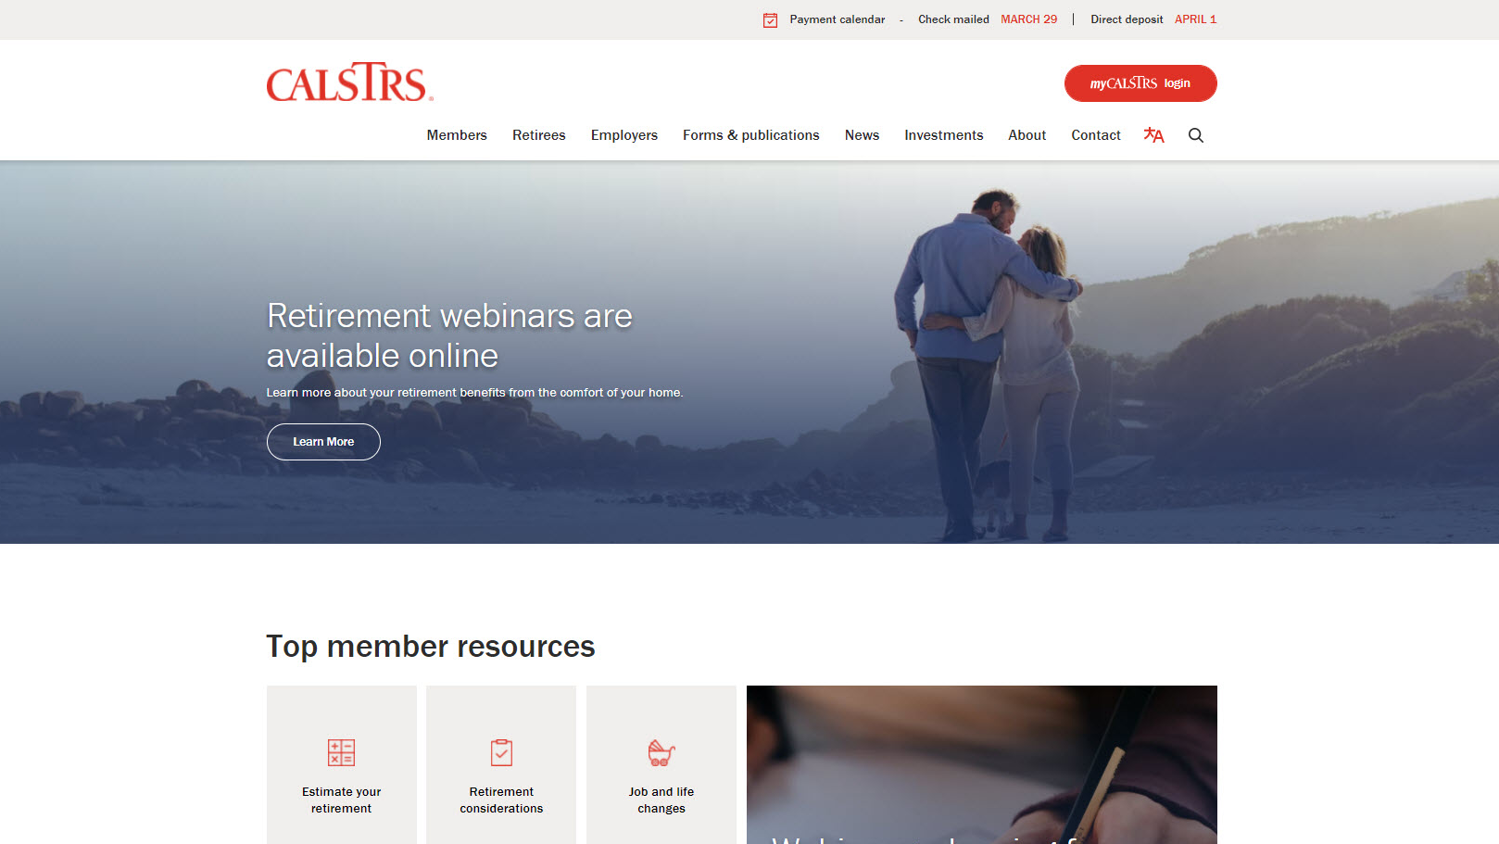
Notes:
You might have noticed that we have a brand new and refreshed website. CalSTRS had the goal of making this website easier to navigate for our members.
The first menu I want you to take a look at is “Members.” If you want to follow along, please note that you don’t have to click on this menu. Just hover your mouse over it and a menu will drop down.
Click.

Slide 8
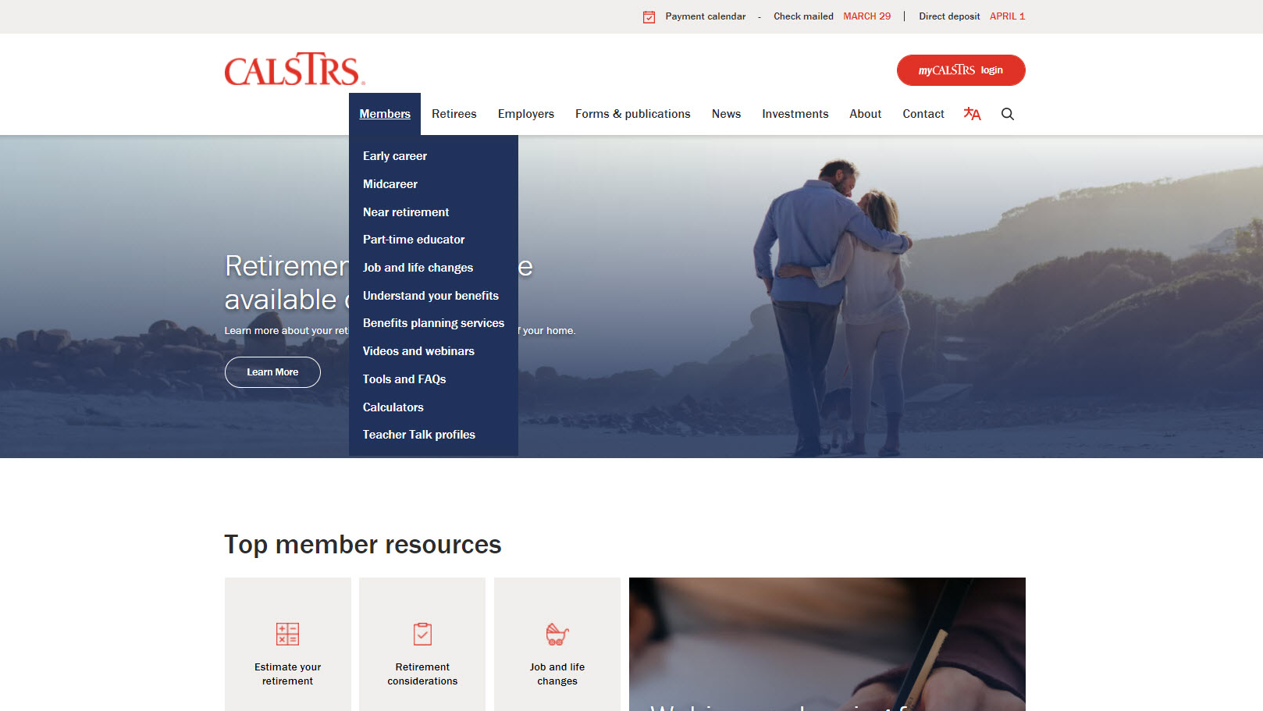
Notes:
After you click on members, this is what that drop down menu looks like.
You’ll see it’s simple to find the different pages we have dedicated to the 3 stages of your career.
Today, we will visit the Near career webpage. But the rest of these links are helpful too! I hope you’ll explore the Members section after today’s webinar.
Click.

Slide 9
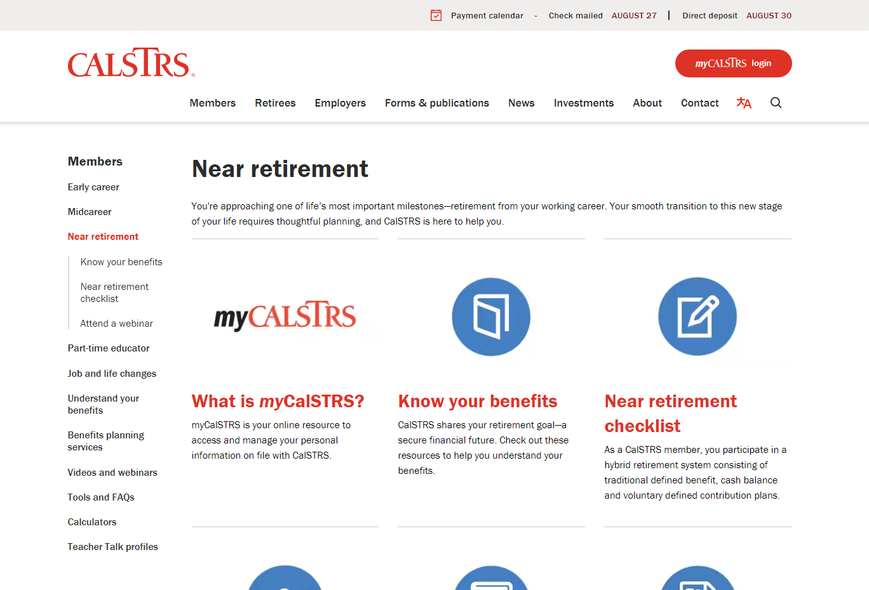
Notes:
When you click on Near career in the menu, it should bring you to this page. You’ll notice the blue throughout the presentation and the blue icons on this page. Each stage has its own color, Near career is blue!
You’ll want to scroll down to see all the resources.
Click.

Slide 10
Notes:
This is the near retirement page.
If you have checked out any other career page, you’ll notice we kept the same 6 basic categories to choose from.
Click.
We’ll go in order and first look at myCalSTRS.
Click.

Slide 11
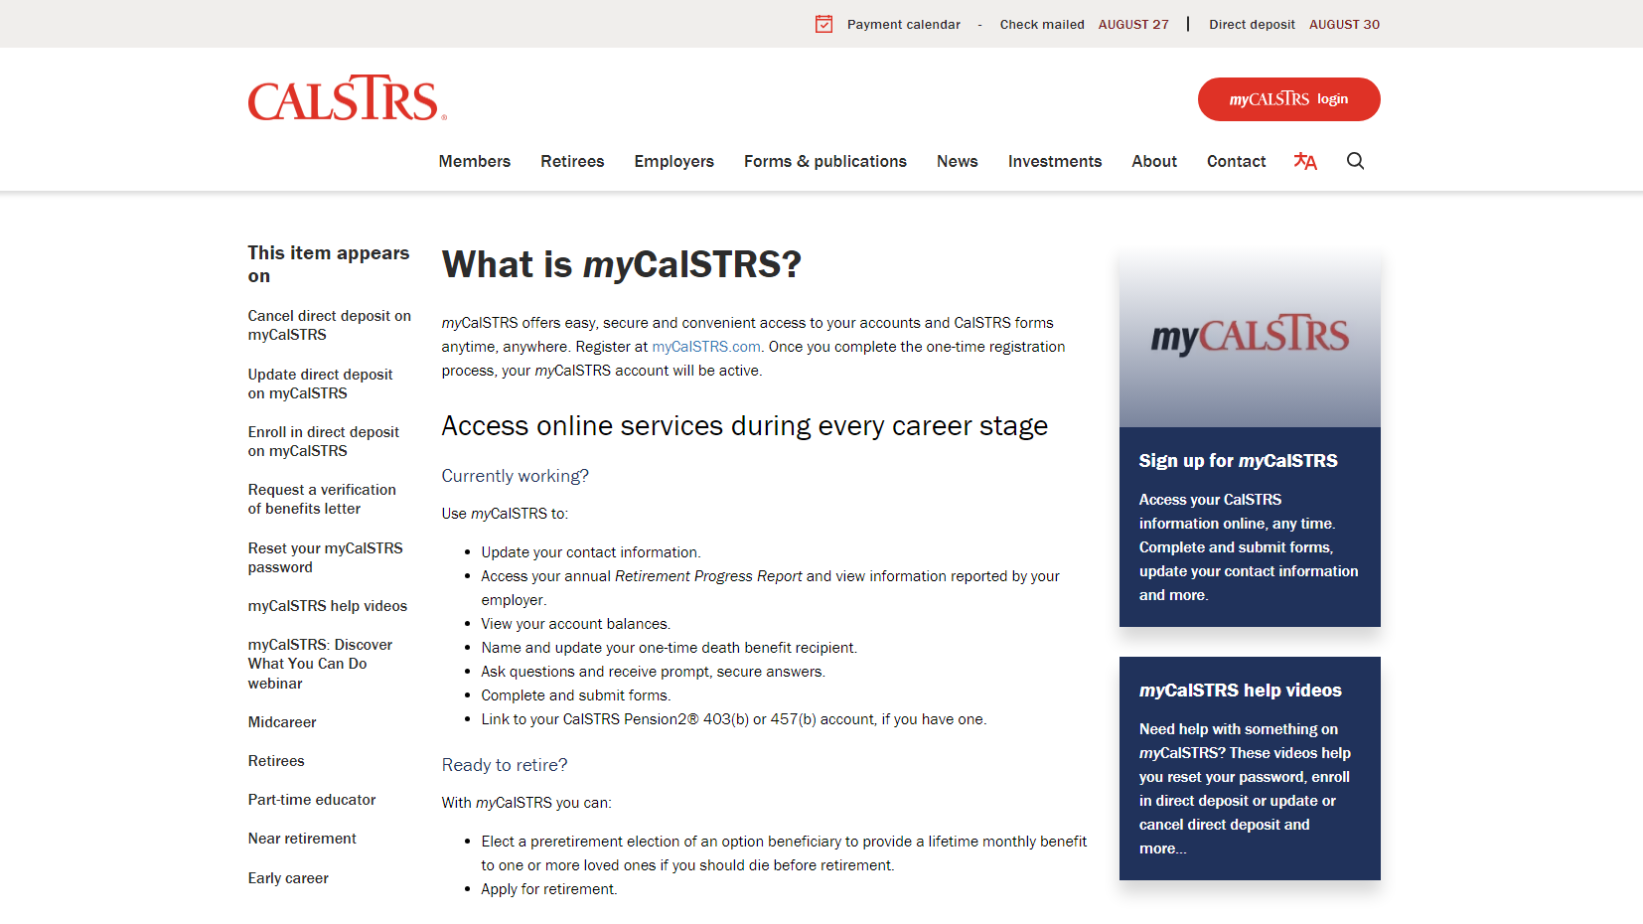
Notes:
What is myCalSTRS? This is your account that gives you access to manage your personal information.
Click.
To log in, you can click the link here in the text, or look for the big red button at the top right corner. Either way is fine and will take you to the same log in page.
Click.
Now, if you haven’t already done so, I encourage you to sign up to access your myCalSTRS account. You’ll just have to answer a few personal questions.
Click.
Finally, if you are having any issues with myCalSTRS, there are some videos to help with some of our common problems. Or you can always contact our customer service number.
Click.

Slide 12
Your myCalSTRS account
View and update your account information.
Submit forms and send secure online messages.
Access your Retirement Progress Report.
Notes:
This is the myCalSTRS log in page. In the next section of today’s webinar, I’ll show you the landing page after you log on and some commonly used features.
MyCalSTRS is a great resource for you to access all things related to CalSTRS. If you haven’t registered, I suggest you do so asap. Keep in mind that we will ask for your social security number during the registration process.
Click.

Slide 13
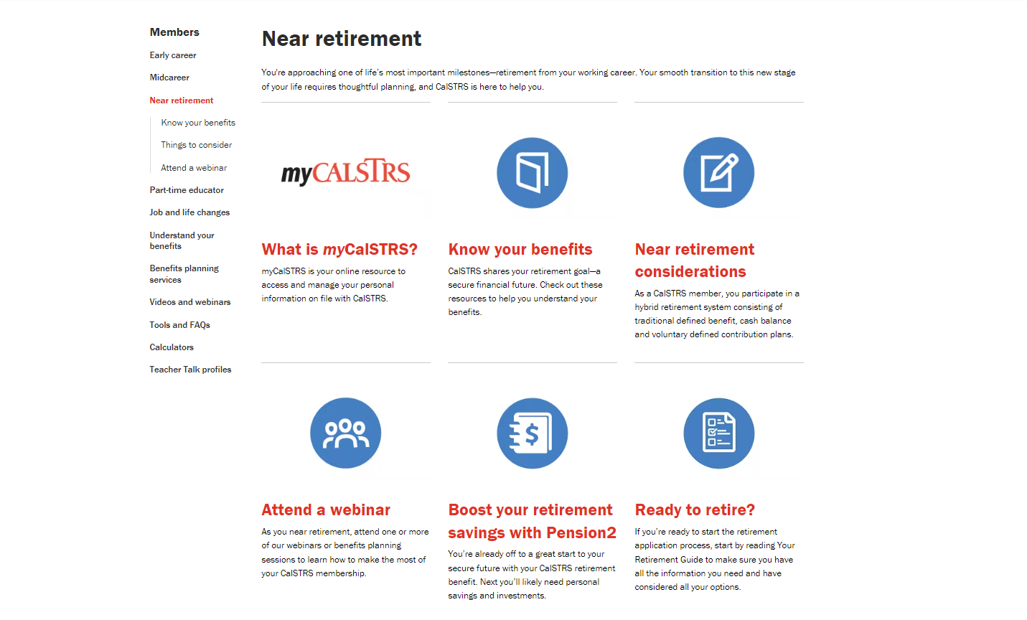
Notes:
Next, we’ll look at “Know your benefits”
Click.

Slide 14
Know your near retirement benefits
Understand your benefits
Publications
Videos
FAQs
Notes:
This will bring you to a page where we’ve collected some of our resources that we feel are most applicable to you at this stage in your career.
If you want to read more about the program, you’re in and what benefits are available to you, you’ll want to visit that first link “Understand your benefits”.
Our publications and videos are another great resource for you to gain more information. We’ve linked the publications and videos most commonly used by educators through the early stages of their career.
And the Frequently Asked Questions. When you click on that link, it’s actually broken down into topics. It might be wise to check these questions out, you may find answers to your questions without needing to contact us.
Click.

Slide 15
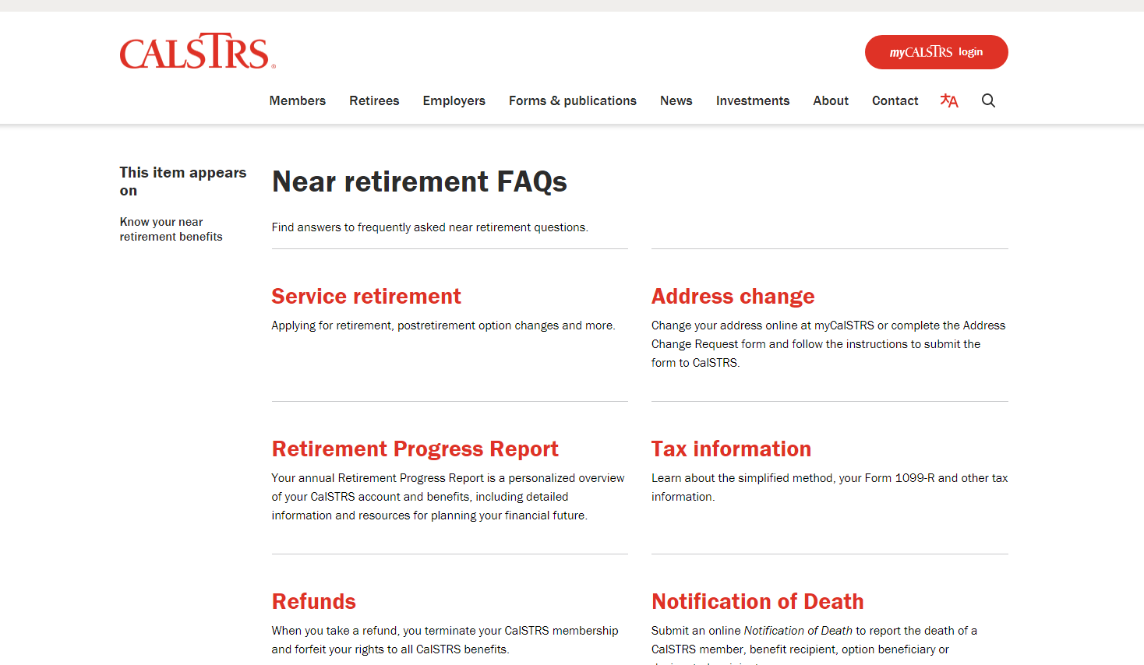
Frequently asked questions
Notes:
Let’s take a quick look at the Frequently asked questions
Click.

Slide 16
Learn and Discover: Near Retirement
Understand your CalSTRS benefits
Timeline for the year before retirement
10 things to do now checklist
Retirement income and expense worksheets
Notes:
Going back to the “Know your near retirement benefits page” you might have noticed we linked some publications directly on this page. I want to point out this highlighted link.
As you may notice, the title, Learn and Discover: Near Retirement, matches the webinar we are in right now. This publication is a great resource to get to know your benefits and for planning in the last year of your career. I recommend you check this out and see how it can help you.
Click.

Slide 17
Notes:
Next, Near Retirement checklist
Click.

Slide 18
Near retirement checklist
What to consider before retirement
Electing an option
Name your one-time death benefit
Complete your Service Retirement Application
Notes:
We have 2 checklists on this page. The first is for you if you’re eligible but not yet ready to retire. This means you’re at least 55 years with 5 years of service credit.
The second checklist is for you once you’re ready to retire.
Check these out to make sure you’re on the right track!
Click.

Slide 19
Notes:
We have many webinars we are offering every week, in this section, we’ve listed the ones that best pertain to you.
Click.

Slide 20
Attend a near retirement webinar
Service Retirement Application Demonstration
Start Saving Now with Pension2
Protect Your Future
My Retirement Decisions
Retire Now or Later
Notes:
Rather than scrolling, here is a list of the webinars we’ve put on that page for you to access.
Service Retirement Application Demonstration - Get hands-on assistance with your CalSTRS Service Retirement Application in an interactive, small group setting with other CalSTRS members.
Start Saving Now with Pension 2 to see why saving now with Pension2 is important.
Protect Your Future to learn how to identify your income sources, ways to reduce the risks of underestimating your expenses and strategies for withdrawing your invested dollars. You’ll also get a step-by-step guide to choosing a financial professional.
My Retirement Decisions - You’ll learn how to calculate your retirement benefit and how to choose your retirement date. You’ll also find out about beneficiary options, service retirement forms, your Defined Benefit Supplement account and working after retirement parameters.
Retire Now or Later to Use the CalSTRS Retirement Benefits Calculator to generate retirement estimates and determine if you can retire now or later.
**Specialist to explain further as necessary.**
For a complete listing of our webinars, visit calstrs.com/webinars
Click.

Slide 21
Notes:
Next up, Learn about Pension2.
Click.

Slide 22
Boost your retirement savings with Pension2
Voluntary supplemental savings plan
Roll over your DBS account at retirement
Save on fees
Visit 403bCompare.com
Notes:
I’ll talk a little bit more about Pension2 later in today’s presentation, but this page is a great resource if you’re looking to educate yourself on Pension2.
**Specialist to explain further as necessary.**
Click.

Slide 23
Notes:
And finally….Ready to retire?
Once you’ve made your decision and are ready to start the retirement application process be sure to check this page out.
Click.

Slide 24
Ready to Retire
Get help completing your service retirement application
Read Your Retirement Guide before you retire
Access the forms needed to apply for retirement
Notes:
The Ready to Retire page has 3 categories
You can register for an application demonstration webinar; a specialist will walk you through your service retirement application in a small group setting
Your Retirement Guide – Read this guide for timelines, checklists & examples to help you plan for retirement
Apply for retirement – which we will look at on the next slide
Click.

Slide 25
Apply for retirement
Service Retirement application
Express Benefit Report
Direct Deposit Authorization
Notes:
Apply for retirement – this page lists out the forms you need to submit to apply for retirement from CalSTRS.
Service Retirement application
Express Benefit Report – so your employer can report your last day of work and any unused sick leave
and direct deposit (optional). You can also apply for retirement online through your myCalSTRS
Click.

Slide 26
Notes:
Finally, Below the 6 tiles you’ll find this link to the Retirement Benefits Calculator.
Click.

Slide 27
Retirement Benefits Calculator
Generate a retirement benefit estimate.
Customize your estimate by adding sick leave credit.
See how your benefit is impacted by working more or receiving a raise
Notes:
This calculator is a great way for you to figure out what your benefit could look like in retirement. You can customize your estimate by inputting any unused sick leave or an upcoming raise.
To quickly visit the calculators we have, visit calstrs.com/calculators
Click.

Slide 28
my
Notes:
myCalSTRS really is a great resource for you to track and manage your CalSTRS account.
Click.

Slide 29
my
View and update your account information.
Access your Retirement Progress Report.
Submit forms and send secure online messages.
Notes:
As a reminder myCalSTRS is good for many reasons. myCalSTRS is a place for you to:
View and update your account information.
Submit forms and send a secure online message to CalSTRS representatives and receive a secure response.
You can also access your annual Retirement Progress Report.
Click.

Slide 30
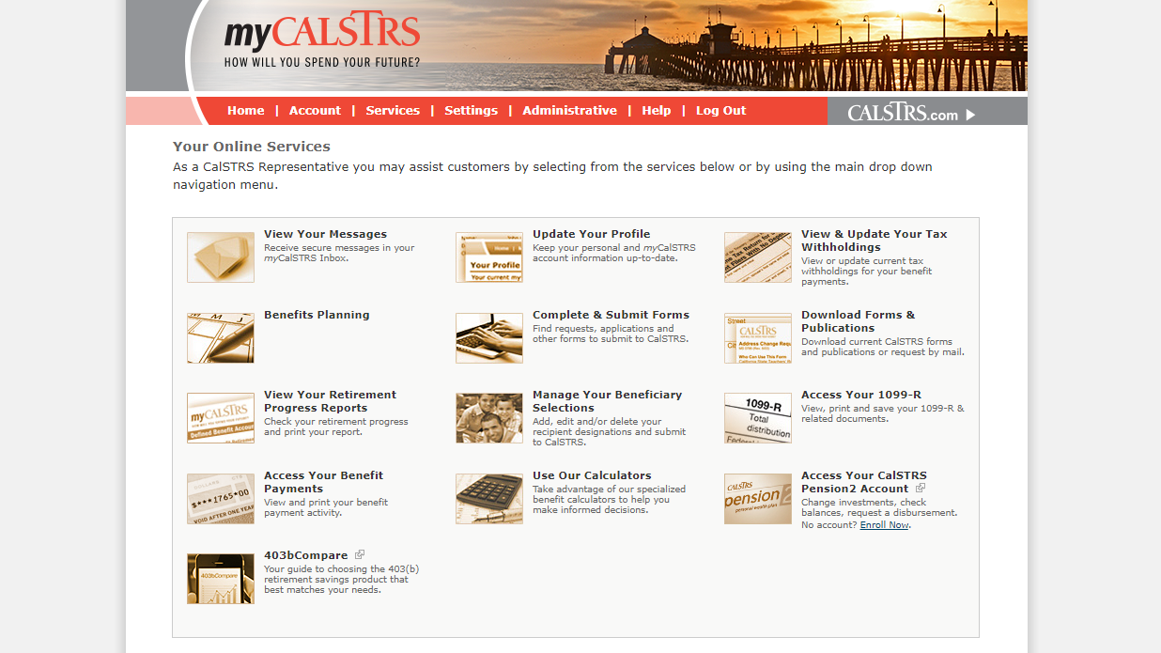
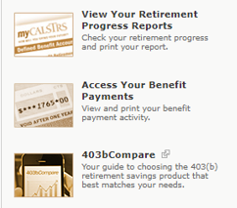
Notes:
Once you have logged into to your personal myCalSTRS account you are going to see a landing page that looks like this. Your icons may not be the same as mine. Be aware that each person’s landing page is customized based on their situation.
Click.
By using the View Your Messages icon, you can send and receive secure online messages with a CalSTRS representative. This is where you’ll want to ask those questions you have that are specific to your account. And those messages are saved, so you’ll be able to go back in later and review an older message.
Click.
The Update Your Profile icon allows you to update personal information. So, if you move or change phone numbers, please make sure all the contact information we have for you is correct. This includes your email address, too!
Click.
You can update your recipient information by selecting the Manage Your Beneficiary Selections icon. We recommend you review your beneficiary information at least once every 5 years.
Click.
You can also view your Retirement Progress Reports by selecting the View Your Retirement Progress Reports icon. A new report can be found every September while you are actively working.
Click.

Slide 31
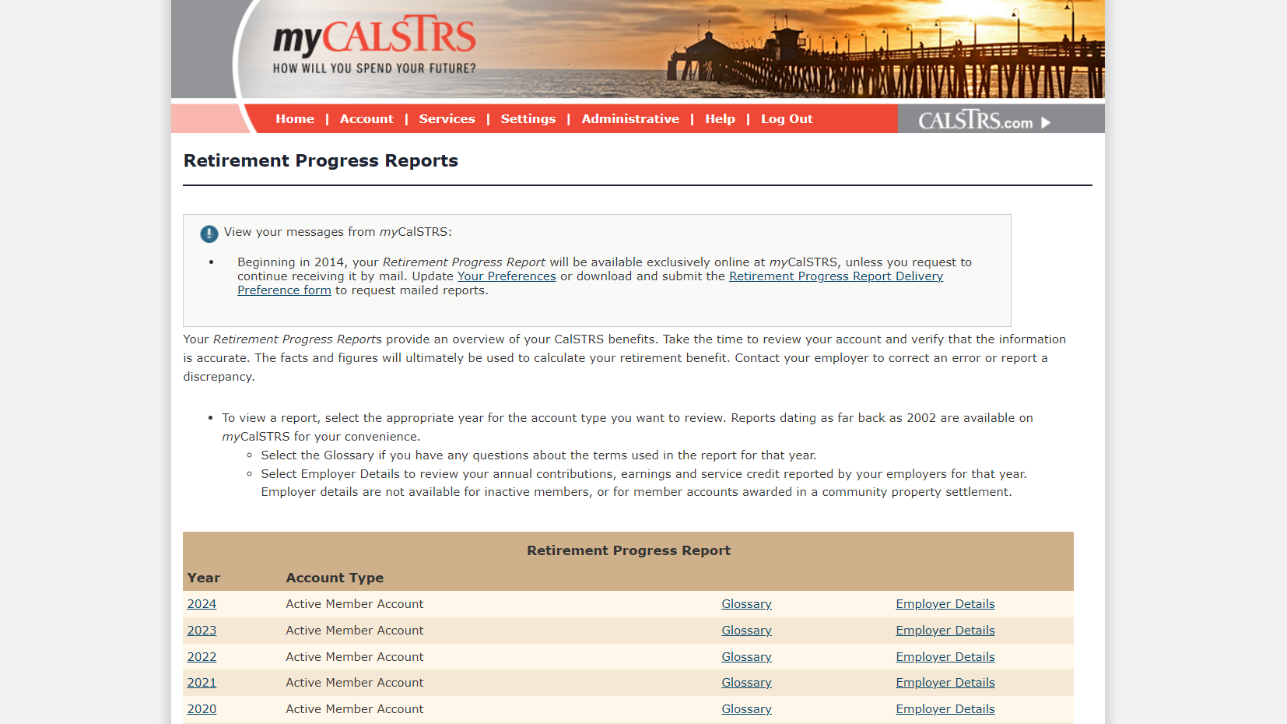
Retirement Progress Report
Notes:
Once you selected view your retirement progress reports from the myCalSTRS landing page you will see this next screen.
About halfway down you will see a beige bar that reads retirement progress report. You will see your RPR’s listed here by year and account type.
For those of you that have a cash balance account in addition to a defined benefit account, we will only be focusing on the defined benefit account today.
For those of you who are not aware of what a cash balance account is, it is an alternative retirement program for part-time educators.
If you do have a cash balance account, please note that this is another potential retirement income source for you. If you want more information about your cash balance account CalSTRS offers a very informative webinar for Part-time educators that will help you with that account.
For the most current information when reviewing your retirement progress report select the most current year for your active member account.
Click.

Slide 32
Your Retirement Progress Report
Membership and benefit information.
Service credit and account balances.
Retirement estimates.
Notes:
Your Retirement Progress Report should look similar to this.
Your personal copy may look a little different from mine here on the screen as everyone’s individual RPR is specific to their personal and unique situation.
Your Retirement Progress Report is an annual report that comes out every September and tracks your Retirement progress. It has the information as reported by your employer through June 30 of the previous school year.
Your Retirement Progress report has your most current Membership and benefit information.
You’ll be able to check your latest service credit and account balances.
Finally, your RPR will contain 2 retirement estimates to help you plan for retirement. As we look through this sample RPR, I’ll show you how this tool can be useful for you.
Now as we explore the Retirement Progress Report, I am going to show you the tools and resources to help with each section we talk about.
Click.

Slide 33
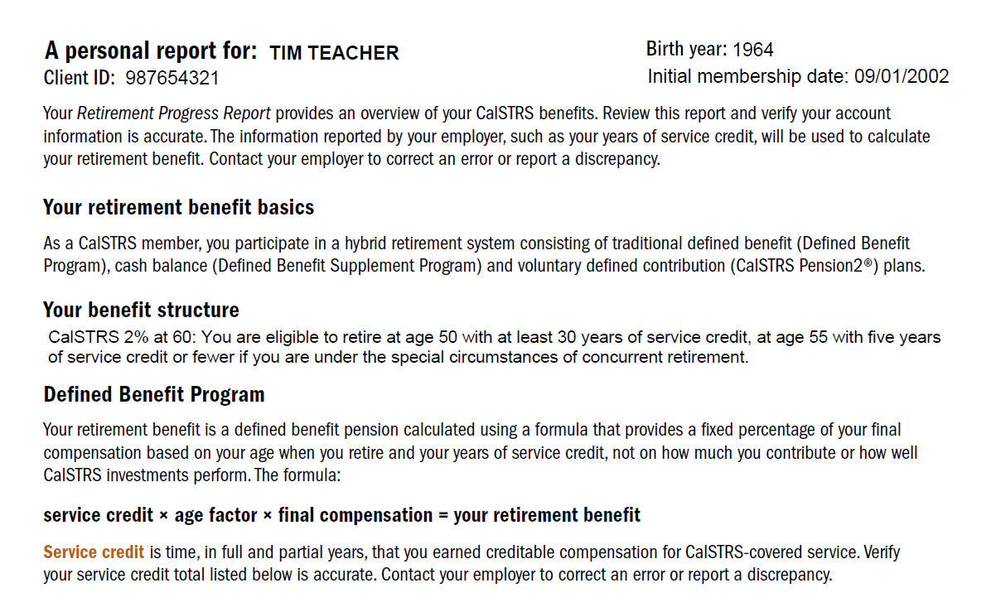
Page 1
Retirement Progress Report
Notes:
First, you can find your personal information at the top of page 1.
Click.
Here you will see your CalSTRS client id. The CalSTRS client id is your CalSTRS specific identification number. When you submit any forms with CalSTRS you can use this number instead of your social security number for security purposes.
Click.
Next is your benefit structure. CalSTRS has 2 benefit structures 2%@60 and 2%@62. So, check your progress report if you aren’t sure which you belong to.
Click.
Finally, this is the formula we use to calculate your retirement benefit. Your CalSTRS benefit is based on this formula and not the balance in your account. It reads: service credit x age factor x final compensation.
Click.

Slide 34
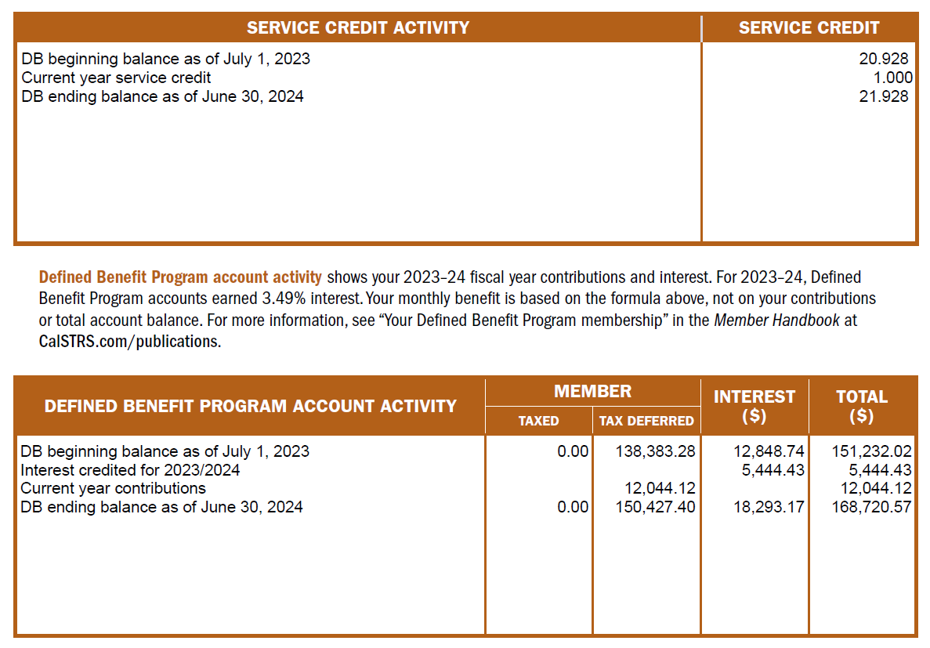
Page 1
Retirement Progress Report
Notes:
Near the bottom of page 1, is where you’ll find your Service Credit balance. Remember that this is as of the end of previous school year. You’ll want to verify that you are credited all the service credit that you earned. If you notice any discrepancy, please talk to your district to get it corrected.
Click.
Then at the very bottom, you will see your account activity.
Click.
You can see the contributions you made during the last school year as well as your account balance. Keep in mind your benefit is not based on this balance but the formula we just discussed.
Click.

Slide 35
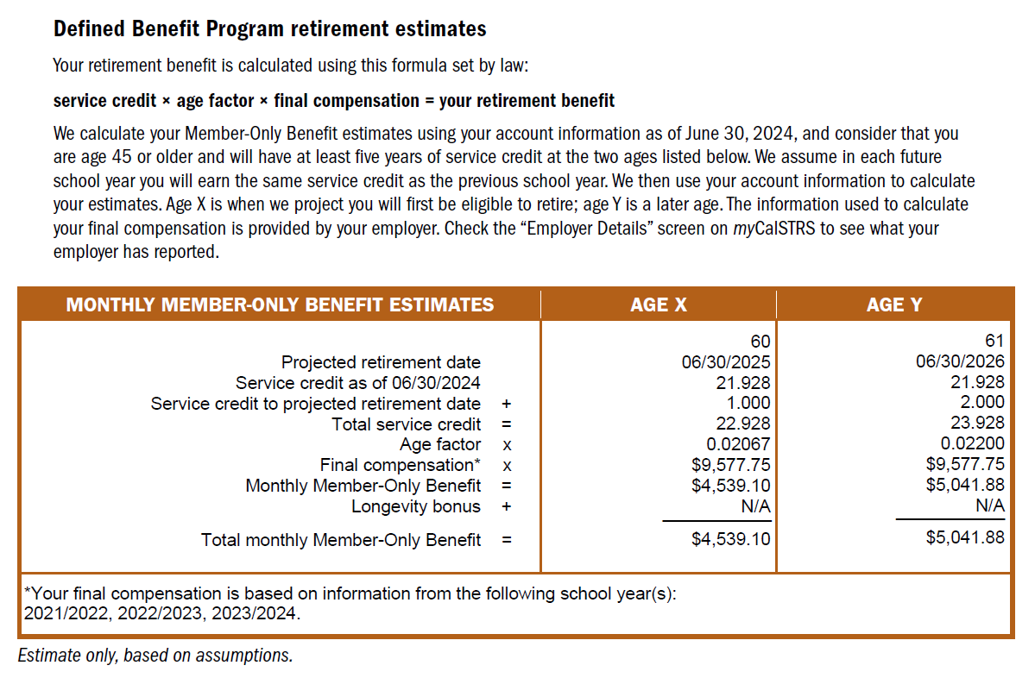
Page 2
Retirement Progress Report
Notes:
CalSTRS puts together 2 estimates for you to review, one at age x and one at age y. In each column you’ll see a projected age at retirement and retirement date. Notice in this example, this member was provided estimates for age 61 and age 62.
Click.
The total service credit is your actual service credit from page 1 plus the service credit we assume you’ll earn until the projected retirement date.. CalSTRS projects service credit based on the service credit you earned last year.
Click.
Note your Age factor, it will grow as you age until the maximum of 2.4%
Click.
Another number you should take note of is your final compensation.
Click.
At the bottom of the table, you will see what years CalSTRS used to calculate your final compensation. Final compensation is calculated by taking the average of your highest consecutive 36 months of earnings. For those of you that are under the CalSTRS 2% at 60 benefit structure, and you have 25 years of service or more Final compensation is calculated by taking the average of your highest consecutive 12 months of earnings
Click.
Finally, at the bottom you will see your estimated monthly member-only benefit has been calculated for you.
The average CalSTRS member replaces about 50 percent of their working income in retirement. Wanting to find your percentage? Multiply your service credit by your age factor. The result is the percentage of your working income that you’d be replacing.
Please note that these numbers are pulled from the system as of your most recent completed school year and really provide a good barometer when planning for your retirement.
Click.

Slide 36
What’s not included in your RPR?
Incomplete service credit purchase.
Unused sick leave.
Current or future salary information.
Retirement incentive.
Notes:
Having estimates provided to you by CalSTRS can be very helpful when trying to prepare for retirement. As you look at your own estimates know that there are some factors that are not included.
Click.
The first is any service credit purchases that you are in the process of making or plan to make. If you have eligible service to purchase and plan to do so your service credit total will be higher than what was projected in your RPR. Once that service credit is completely paid, it will then be included in your service credit total for all future RPRs.
Click.
CalSTRS does not track sick leave during your career, so will not be found in your RPR. Any unused sick leave that you have at retirement will be converted to service credit which would then increase that total.
Click.
Remember, the estimates in your RPR use information that is reported to CalSTRS as of the previous school year and we do not project working salaries, therefore your current year salary or any raises you expect to get in the future are not included in the estimates you see in your RPR.
Click.
And last, any retirement incentive that your employer may offer as you near retirement also, cannot be projected by CalSTRS.
Thankfully, CalSTRS has an online calculator that will allow you to incorporate these missing factors and generate a more accurate retirement estimate.
Click.

Slide 37
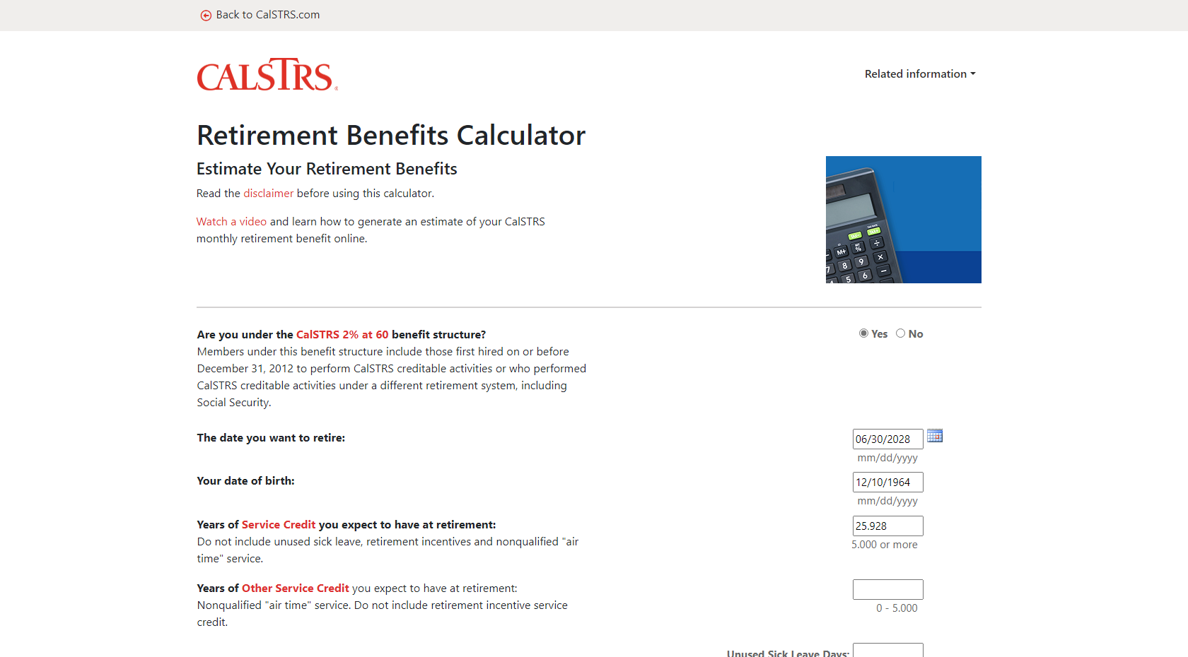
Notes:
This is the Retirement Benefits Calculator we saw earlier. I’d like to run through an example to briefly show you how you can use the numbers from your retirement progress report and plug them into our online calculator. This will allow you to better customize your estimates to fit your realistic scenario.
Click.
The first question you want to answer is for your benefit structure. Most educators retiring now are under the 2% at 60 benefit structure, if you are unsure, please check your Retirement Progress Report page 1. For our sample member today, we are going to select “yes”
Click.
Next section asks for the date you want to retire. For this member, they are looking to retire at the end of the 2024-2025 school year.
Click.
So, I’ll type 6/30/2025.
Click.
Next section is your date of birth….self explanatory, I hope.
Click.
Click.
Next, you’ll see 2 boxes for service credit. The first is for all the service credit you’ve earned or purchased in your career. Plus any years you plan to earn until your retirement date.
Click.
This member plans to work 4 more years, including the current year.
The 2nd question is asking for any “air time” you might have purchased earlier in your career. You could have purchased up to 5 years, if you didn’t, unfortunately that window of opportunity has closed.
Click.

Slide 38
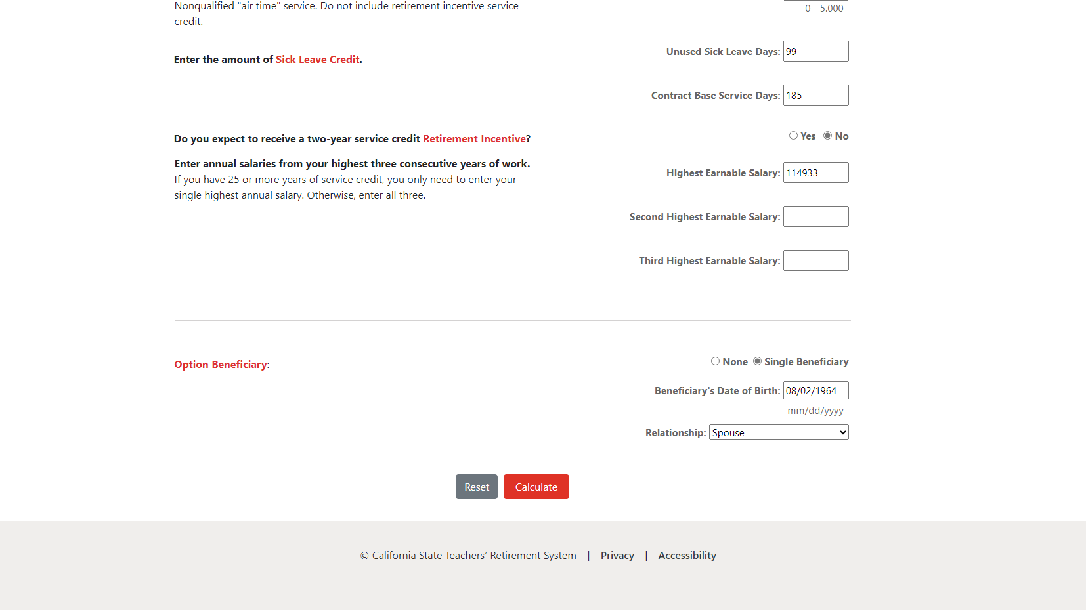
Notes:
As we move further down on the calculator…
Click.
The next question is asking for any unused sick leave you might have with your current employer.
Click.
Our sample member has 99 DAYS of unused sick leave
Click.
And that is out of their total contract DAYS of 185. It’s important these numbers are listed as days and not hours.
Click.
Do you expect to receive a two-year service credit retirement incentive? This member does not.
Click.
For this section you can grab the final compensation from your retirement progress report or your latest contract.
Click.
For our sample member, I’m going to grab the final compensation from the RPR and multiply by 12. Let’s assume the member has no raises coming that he’s aware of so I’m going to enter the same for all three year’s salary.
Click.
Note that if you have more than 25 years of service credit at retirement, you will only need to enter your single highest annual salary.
Click.
Finally, the online calculator gives you the option to estimate a modified benefit you would receive if you decide to name an option beneficiary.
Click. Click.
This sample member is marking Single Beneficiary and entered their spouse’s date of birth. If you aren’t naming your spouse, you can choose another relationship type.
Click.
Finally, click Calculate.
Click.

Slide 39
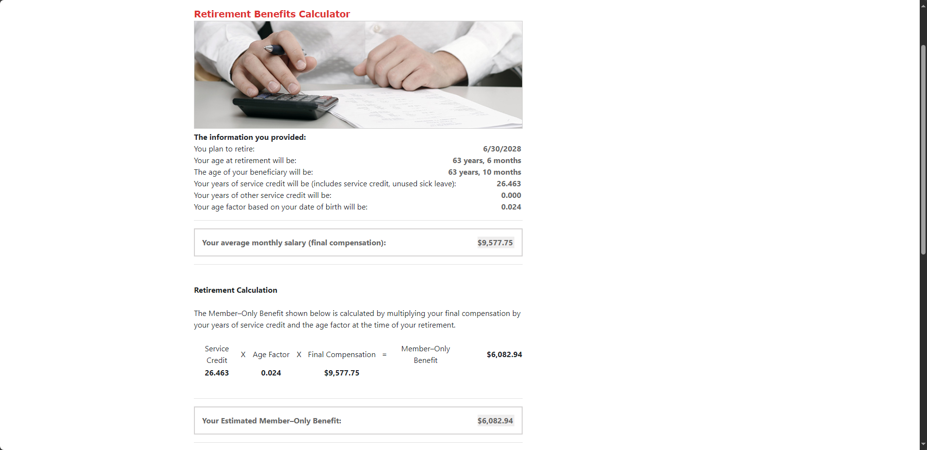
Notes:
After clicking calculate, your results will be calculated and displayed.
Click.
You’ll first notice a summary of the information you provided on the previous screen.
Click.
Next, you’ll see how your numbers fit into CalSTRS’ retirement formula. Service Credit x Age Factor x Final Compensation
Click.
When multiplied out, it provides your estimated member-only benefit.
Click.

Slide 40
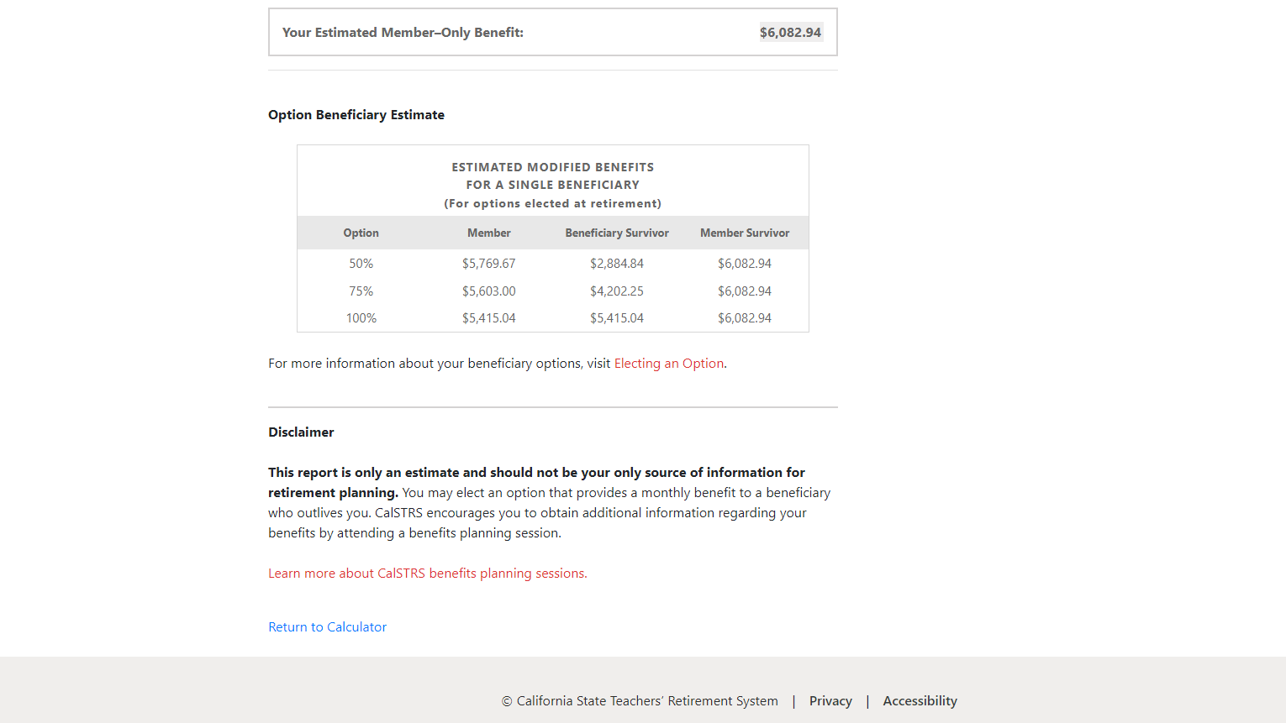
Notes:
Scrolling down on that page
Click.
Below that estimated member-only benefit you see the option beneficiary estimate if you chose to calculate it. Remember that the member-only benefit is the highest amount you could receive and your benefit is modified after naming an option beneficiary.
Not sure if you’ve named an option beneficiary already? I’ll show you in a moment where you can find that information in the Retirement Progress Report.
Click.
If leaving money for a beneficiary, you’ll have the 3 choices shown here. The table lists the option choice, the amount you would receive in retirement and the amount your beneficiary will receive upon your passing. In that last column “Member Survivor”, we are indicating that if your beneficiary were to pass away before you, your benefit will pop up to the member-only amount because you will no longer be required to pay for the coverage of having a beneficiary on file.
Be aware that all these amounts are gross, pre-tax amounts. And these are purely an estimate.
Click.

Slide 41
Increase your monthly benefit
Work longer
Purchase service credit
Service credit
Work longer
Retire later
Age factor
Final compensation
Work at higher pay rates
Notes:
If you generate an estimate and realize it’s not quite what you were hoping for, keep in mind that there are a few things you can do to increase your monthly benefit. You can increase any component of the retirement formula to get a higher benefit
You can increase service credit by working longer or purchasing service if you are eligible. Our sample member might go back into the calculator and estimate she’s going to work 5 years instead of 4. This number might prove to be worth working that extra year.
You can increase your age factor by working longer or retiring later. Age factor is a percentage based on your age in years and months at the time of your retirement. The maximum age factor is 2.4%. In most cases, a member under the CalSTRS 2% at 60 benefit structure will reach their maximum age factor at age 63 and a member under the CalSTRS 2% at 62 benefit structure will reach the maximum benefit at age 65.
You can increase your final compensation by working at higher payrates. This can be done by regular step increases or by seeking out higher paying contracts.
Click.

Slide 42
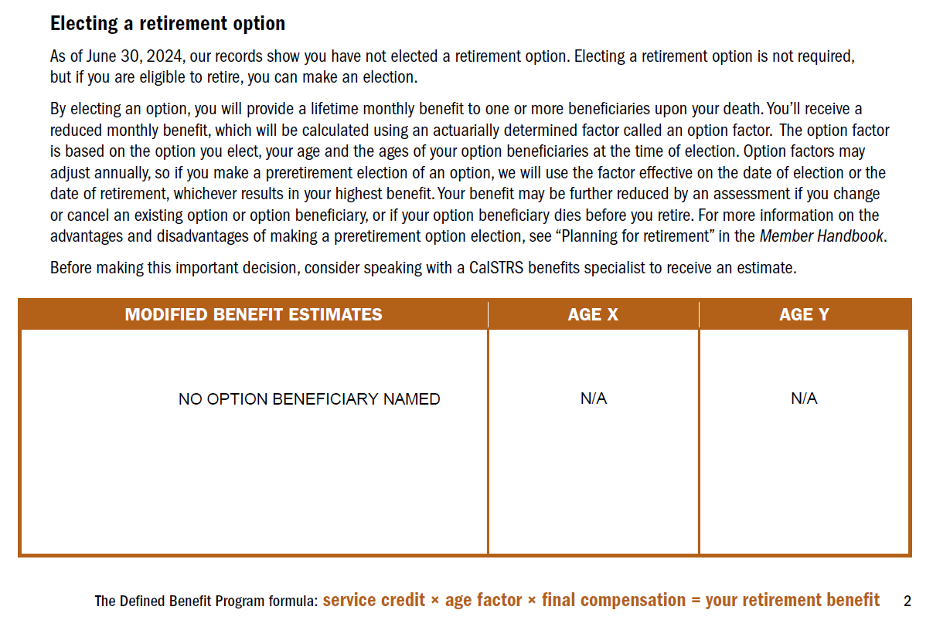
Page 2
Retirement Progress Report
Notes:
As we continue to look through the retirement progress report you will see a page titled Electing a retirement option. If you have an option already on file, you will see an additional estimate in this section. If not, your report should like this and state “no option beneficiary named”
If you are unsure what an option beneficiary is, your RPR gives a brief explanation on page 2. I’ll also talk about a couple things on the next few slides.
Click.

Slide 43
Preretirement election of an option
Advantages
Disadvantages
Protect your survivor with a lifetime benefit (Modified Benefit).
You’ll be subject to an assessment if you change or cancel your option or if your beneficiary dies before you retire.
The assessment may reduce your future benefit.
%
Option factor may be higher the earlier you elect an option.
Notes:
As your RPR states, you do not have to wait until retirement to elect an option, you can pre-elect at anytime once you are eligible to retire. Generally, your final opportunity to make this election is at retirement.
However, there are advantages and disadvantages to pre-electing an option.
If you die before retirement and you made a preretirement election of an option, your beneficiary will receive a lifetime monthly retirement benefit. The benefit begins immediately after your death, regardless of the ages of your beneficiaries.
In most cases, the benefit will be higher than if you elected an option at the time of retirement.
If you cancel or change your preretirement election of an option before retiring, or if your option beneficiary dies before you retire, your retirement benefit will be subject to an assessment and may be reduced for life.
Click.

Slide 44
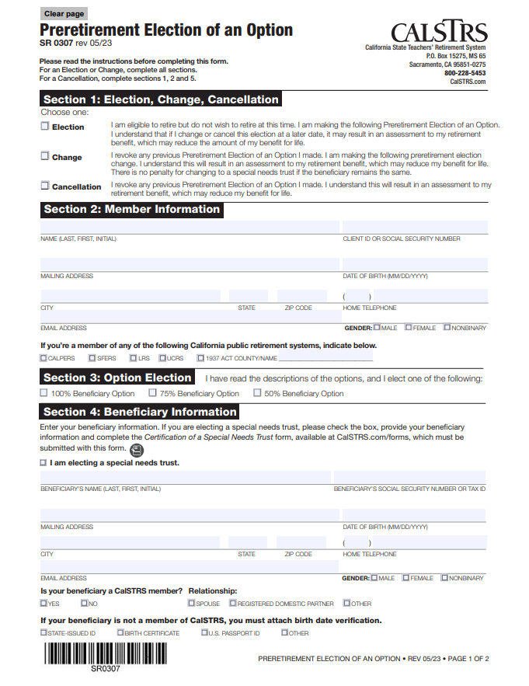
Preretirement election of an option
Must be eligible to retire from CalSTRS.
Your spouse or registered domestic partner must also sign this form.
Date of birth verification may be required for beneficiary.
Notes:
To elect this beneficiary prior to retirement, you’ll want to log on to your myCalSTRS account. And go to “Complete and Submit Forms.”
You must be eligible to retire from CalSTRS before you are eligible to submit this form.
If applicable, your spouse or registered domestic partner must also sign this form for it to be valid.
If CalSTRS doesn’t already have the information, your date of birth and that of your beneficiary will need to be verified.
Please note that if you are wanting to election a compound option, that will require a separate form. Look for that on calstrs.com/forms or contact our customer service if you have questions.
Click.

Slide 45
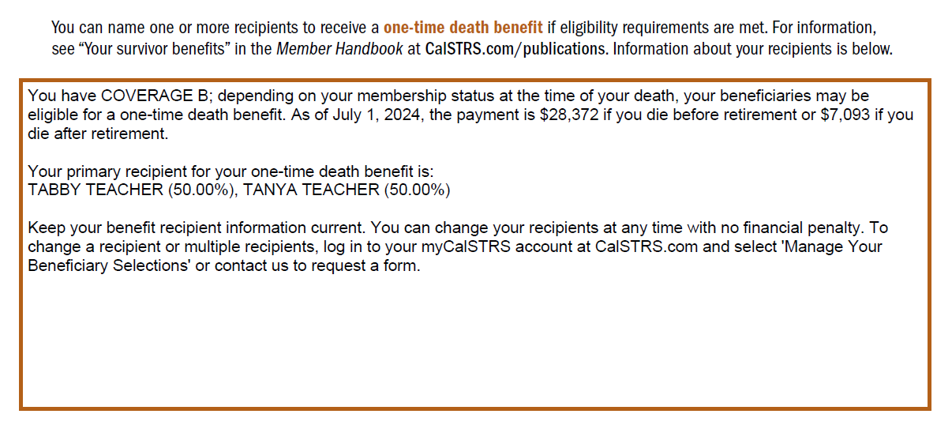
Page 3
Retirement Progress Report
Notes:
Continuing to the top of page 3, you will notice information about your one-time death benefit recipient.
Click.
The first thing that will be identified is your coverage. You will either be coverage A or coverage B. This coverage determines the amount that will be paid out upon your passing. Those amounts are named further down in the paragraph.
Click.
If you have already named a recipient for this benefit, you’ll see the name listed here. If not, a message appears to help you get a recipient on file.
You should have a recipient designated for this benefit throughout your career and in retirement. Unlike the option beneficiary, this can be changed at anytime with no cost to you.
Click.

Slide 46
One-time death benefit
Coverage A
Coverage B
$7,093
Before or after retirement
$28,372
Before retirement
$7,093
After retirement
All dollar amounts are subject to change by the Teachers’ Retirement Board.
Notes:
When you die, a one-time death benefit is payable to your designated recipient if eligibility requirements are met. The one-time death benefit amount varies depending on whether you have disability and survivor benefits under Coverage A or B and whether you die while working or after retirement.
Click.
If you have Coverage A, your benefit is $7,093 before or after retirement.
Click.
If you have Coverage B, your benefit is $28,372 before retirement and $7,093 after retirement.
We will pay this amount to your estate upon your death if you have no recipient on file. You can designate one or multiple primary and secondary recipients to receive this benefit by completing the Recipient Designation form on myCalSTRS or via the paper document.
*Please note: If you are married, your spouse must sign this form as well.
We recommend you review your recipient designation every five years or after any major life events such as marriage, divorce, or the birth or death of a loved one.
These amounts are subject to change by the Teacher’s retirement board.
Click.

Slide 47
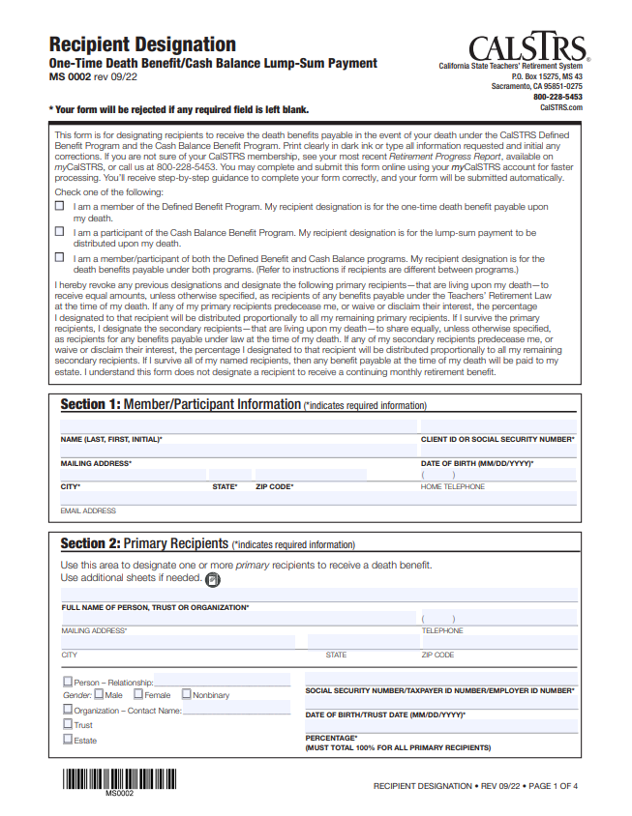
Recipient designation
Name one or more recipients.
Person, organization, trust or estate.
Update every five years throughout career.
Notes:
To designate the recipient of the one-time death benefit, you’ll want to log on to your myCalSTRS account. And go to “Complete and Submit Forms.”
You can name one or more recipients, and a primary and secondary recipient should your primary recipient predecease you.
Unlike naming an option beneficiary, you can name a person, organization, trust, or estate to receive this benefit.
We recommend verifying and updating your recipient designation at least every 5 years throughout your career.
Click.

Slide 48
Protecting a loved one Recap
Option beneficiary (voluntary)
The person or persons or special needs trust you name to receive a lifetime monthly benefit after your death.
One-time death benefit recipient (recommended)
The beneficiary you name to receive your one-time death benefit.
Notes:
That was a lot of information in a very short time. Hopefully at this point, you all have at least heard of these two types of beneficiaries.
For a recap….
The option beneficiary is the person you name to receive a lifetime monthly benefit after your death. This will then modify your benefit in retirement. Naming this beneficiary is completely voluntary. We know that everybody’s situation is different, so we are not able to recommend one way or the other.
The one-time death benefit recipient is the person you name to receive the one-time payment after your death. Naming this recipient has no effect on your benefit. In fact, CalSTRS recommends you get this recipient on file asap if you haven’t done so already. We also recommend that you check and update this information about every 5 years.
Click.

Slide 49
Page 3
Retirement Progress Report: Protecting a Loved One
Notes:
As you continue flipping or scrolling through your report, you’ll notice some additional information about your disability and survivor benefits. As you see here there is another mention of your coverage type.
Click.

Slide 50
Survivor Benefits brochure
Learn about Defined Benefit Supplement distribution.
Explore all benefits available to your survivors.
Share this brochure with your beneficiary.
Notes:
To learn about the survivor benefits available from CalSTRS, please download the Survivor Benefits brochure from calstrs.com/publications.
In this brochure you will be able to read and learn more about all the benefits available to your survivors.
We haven’t talked about it yet, but you can also learn how your Defined Benefit Supplement account is distributed upon your passing.
Finally, we recommend you keep this brochure with your important documents and share with your beneficiary.
Click.

Slide 51
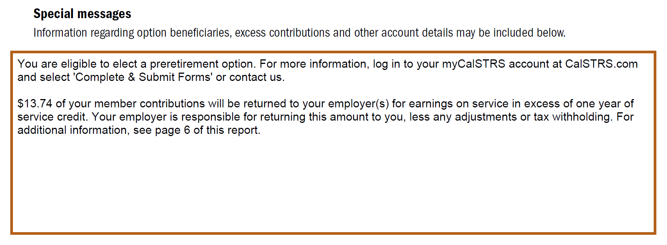
Page 3
Retirement Progress Report: Protecting a Loved One
Notes:
Further down on page 3, you’ll want to pay special attention to Special Messages section. CalSTRS uses this space to note anything particular to the member's account. In this example our member is being reminded that a. they are eligible to elect a preretirement option and b. they made excess contributions which are being returned.
Click.

Slide 52
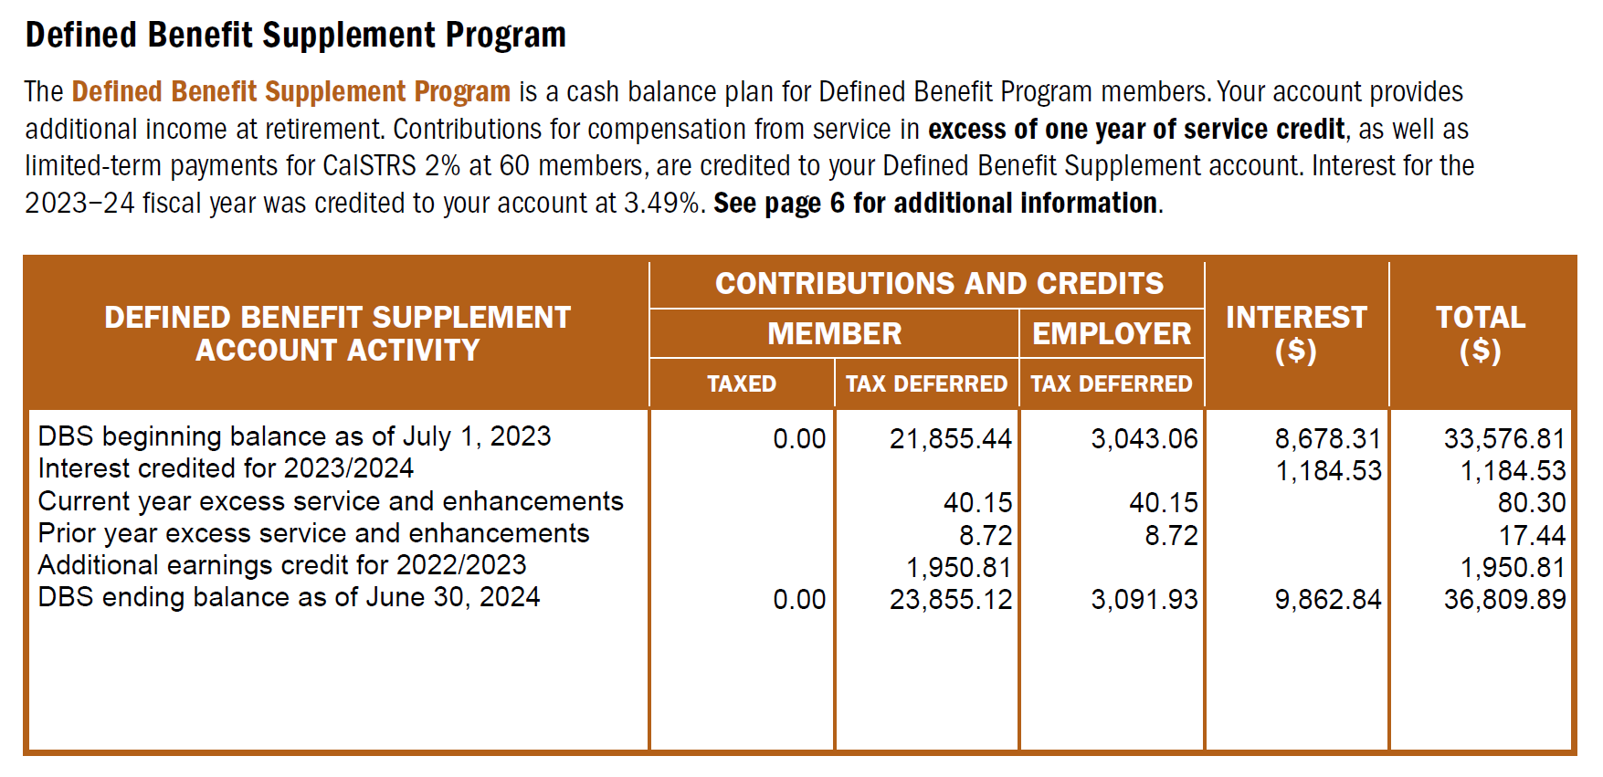
Page 4
Retirement Progress Report
Notes:
As you scroll through your report you might notice a section dedicated to the Defined Benefit Supplement Program. Here you’ll find the interest rate from last fiscal year and a summary of your account activity.
This will give you your account balance as of the end of the previous school year. Unlike the balance of your Defined Benefit account, this number here does determine how much you’ll receive in retirement.
Click.

Slide 53
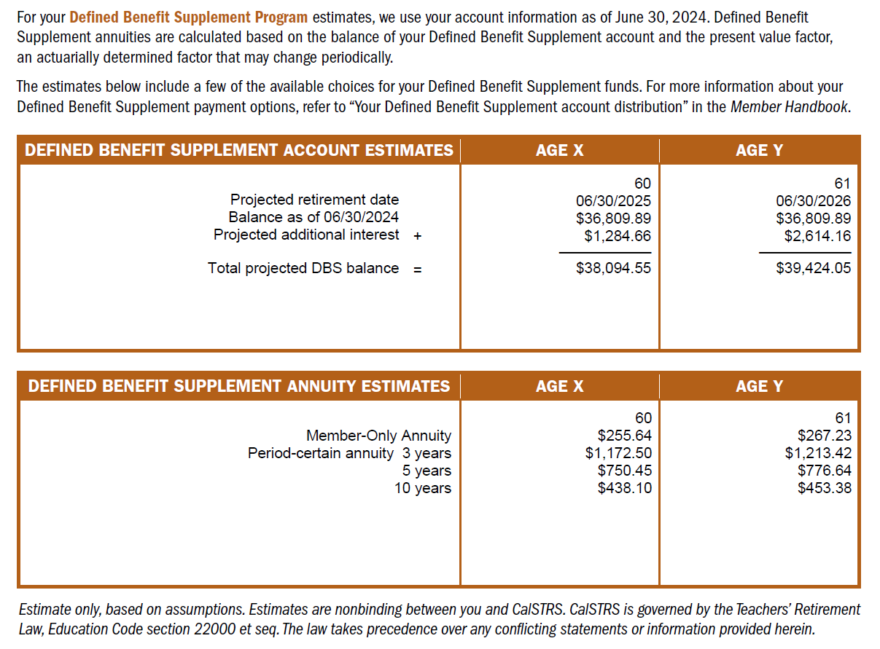
Page 4
Retirement Progress Report
Notes:
Next, we have estimates for the Defined Benefit Supplement account. On this page you will see the same projected ages x and y. For the Defined Benefit Supplement CalSTRS will project the estimated interest your account will accrue from the end of the previous school year until your projected retirement date. If plan to continue working those extra duties, keep in mind that these numbers do not include an estimate for that work.
Click.
I previously mentioned that distributions from this account is contingent upon your account balance. So, what you will see here is an estimate of your total DBS account balance with that interest added in.
Click.
The next estimates you will notice are annuity amounts. The RPR shows estimates for a lifetime Member-only annuity and for a period certain annuity of 3, 5, or 10 years. Keep in mind that at retirement, you’d be allowed to choose anywhere from 3 to 10 years.
To learn more about the Defined Benefit Supplement account including it history, how its funded, and a full range of the distribution choices you can watch those videos we saw in our website tour.
Click.

Slide 54
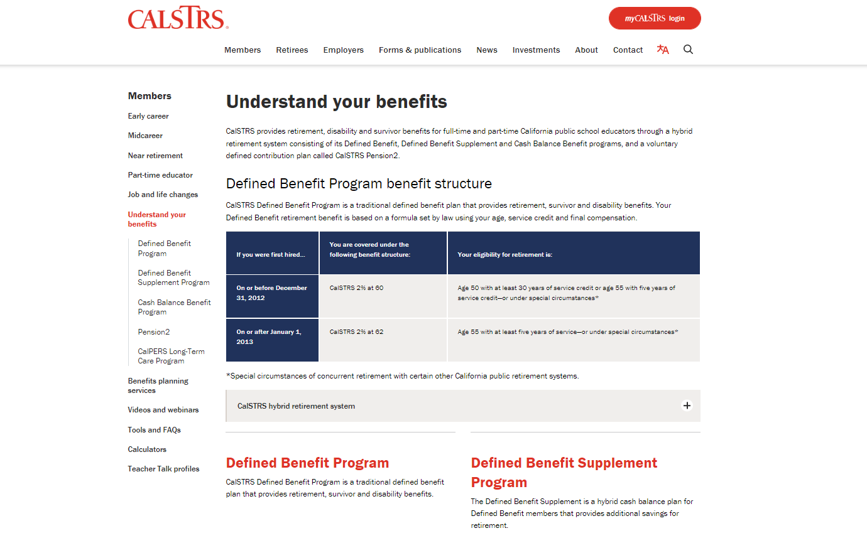
Notes:
To learn more about accessing your DBS funds, you can lots of information here on our Defined Benefit Supplement Program page on calstrs.com under the Members menu and in the Understand Your Benefits section.
Click.

Slide 55
Additional resources to prepare for retirement
Notes:
We’ve already discussed some resources available to you. I’d now like to go more in-depth with some of those resources.
Click.

Slide 56
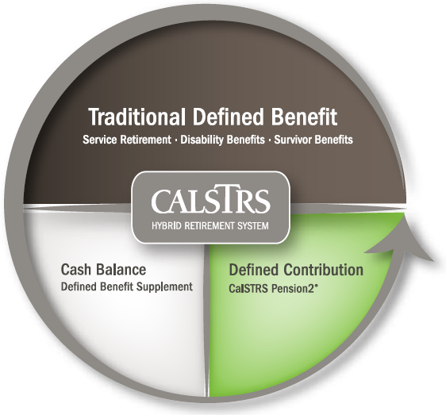
403(b)
Roth
403(b)
457(b)
Roth
457(b)
Notes:
Another way to increase your retirement income is to increase your additional retirement savings while you are still working. While your contributions for the Defined Benefit are set you can always invest in other retirement accounts if you aren’t already.
Pension2 is the third part of the CalSTRS hybrid that is completely voluntary. It offers 403b, 457b, Roth 403b, and Roth 457b.
Depending on how many years you have left in your career, you might be able to sign up and start a payroll deduction to start saving now.
Click.

Slide 57
What if I already have an account?
Other supplemental savings plan accounts can be rolled into Pension2.
Your
current
account
CalSTRS
Pension2
Let us compare!
Call 888-394-2060 for a statement comparison.
Statement comparisons will be conducted by Voya Financial representatives working exclusively with Pension2. Their names and photos are listed at CalSTRS.com/Trust-CalSTRS.
Notes:
If you’re nearing the end of your career, you might not have time to make contributions to build up a healthy amount. Instead, you can look at rolling other supplemental savings plan accounts into Pension2.
Call 888-394-2060 for a statement comparison.
Click.

Slide 58
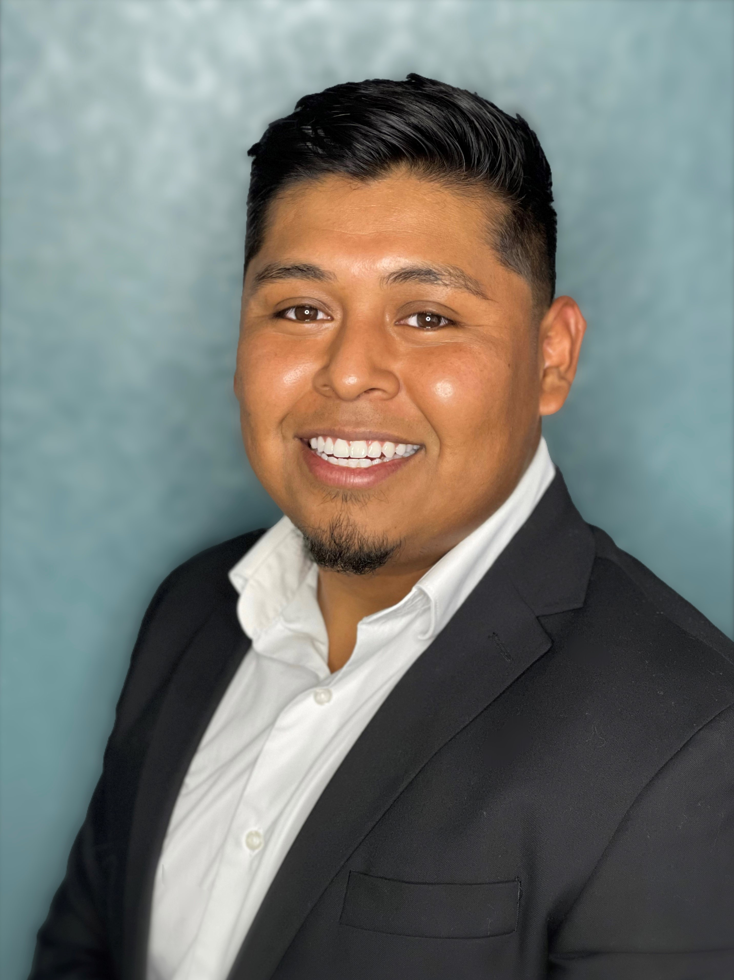
Voya Representatives for CalSTRS Pension2
Stephanie Henry
559-720-5388
Stephanie.Henry@voya.com
Central Valley:
Fresno, Kern, Kings, Madera, Tulare, San Luis Obispo, Inyo
Santiago Gonzalez
760-500-9398
Santiago.Gonzalez@voya.com
San Diego, Imperial, Riverside
Aaron Ivey
916-520-4839
Aaron.ivey@voya.com
Sacramento Region, Northern California
Ruben Rivera Jr.
425-599-1428
Ruben.riverajr@voya.com
Los Angeles, San Bernardino, Orange
Aren Yarian
818-478-0467
Aren.yarian@voya.com
Los Angeles, Ventura, Santa Barbara, San Luis Obispo
Walter Ruczynski
925-451-3079
Walter.ruczynski@voya.com
Alameda, Contra Costa, Marin, Monterey, San Benito, Santa Clara, Santa Cruz, San Francisco, San Mateo
Notes:
HYBRID
Hi (______), thank you for joining us today. I’d like to give you the opportunity to introduce yourself and how you serve our members.
VOYA REP introduces themselves….
I am very happy to be speaking with all of you today and having this opportunity to introduce not only myself, but also the team I work with.
1. Provide overview of your background and how long you’ve been in the financial services industry.
2. Discuss why you starting working w/VOYA and have a passion for finance.
3. Provide a brief explanation of what you do for our members:
Statement comparison (what it is and why it’s a good idea to have one)
Rollover Assistance
Enrollment Contributions
4. Discuss One on One Meetings
In Person, Phone, and Zoom
Meeting before (territory driven - meeting one on one at MSCs or via telephone)
During (meeting w/all areas via zoom or telephone)
After pandemic (possible mixture or return to territory?)
HYBRID
Thank you for sharing that with us and supporting members throughout California.
We will have a polling question near the end of this webinar for those who would like take part in Pension2 or request a statement comparison.
CLICK.

Slide 59
Be your own advocate
Review your CalSTRS Retirement Progress Report.
Verify your one-time death benefit information is correct.
Calculate your retirement benefit using our online calculators.
Research your options for taking distributions from your investment accounts.
Notes:
As a CalSTRS member regardless of what stage of your career you are in, it is very important to be your own advocate. You are your greatest resource!
Review you Retirement Progress Reports annually. Hopefully after today you’re better able to read your RPR and use it as a tool in planning.
Make sure your one-time death benefit information is correct.
Get comfortable with our online calculators. Play around with the numbers to find out what options you might have.
Lastly begin researching your options for taking distributions from your investment accounts. This will help you get a more wholistic picture of your income in retirement.
Click.

Slide 60
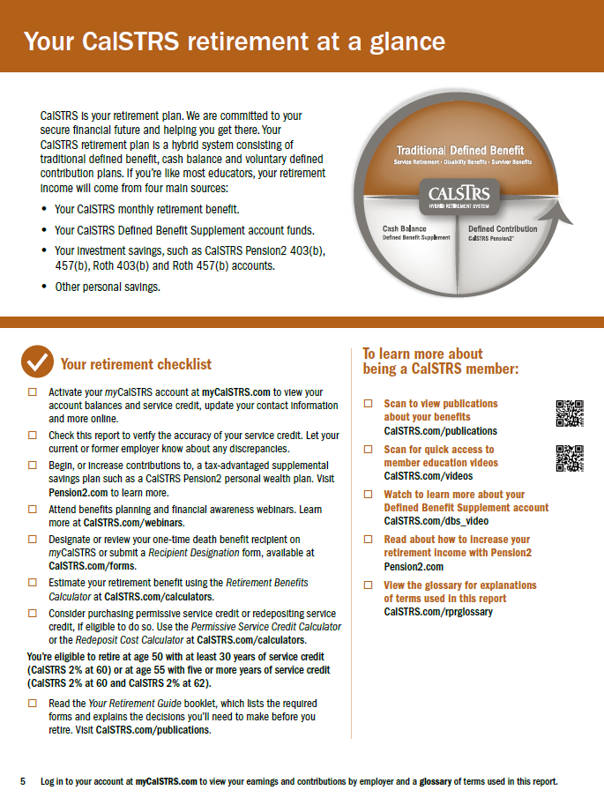
Page 5
Retirement Progress Report
Your retirement checklist
Notes:
On the final pages of the RPR you will find additional reading that will tell you more about CalSTRS and your retirement program. There is also a checklist of action items that you might find helpful if you don’t know what to do next.
Click.

Slide 61
For more information
Online resources
Benefits planning
Webinars
Near Retirement webpage
Retirement Progress Report
Videos and calculators
My Retirement Decisions
Protect Your Future
Retire Now or Later
Group or individual benefits planning session webinar
Notes:
If you need more information, we have several online resources. That we have reviewed today. Those include the near-retirement page, your Retirement Progress Report, and please check out our online videos and calculators.
You can schedule a group or individual benefits planning session.
We also have webinars that you can attend. Some that you might find informative are My Retirement Decisions, Protect Your Future, the third webinar in a part of our 3–part financial awareness series that really focuses on financial literacy. Finally we have Retire Now or Later to help you decide when the right time to retire might be.
Click.

Slide 62
888-394-2060
Pension2.com
Notes:
If you have any other questions or want to learn more about Pension2, call 888-394-2060 or visit pension2.com
Click.

Slide 63
CalSTRS.com myCalSTRS
800-228-5453 *Press 2 for Customer Service. Monday – Friday 8 a.m. – 5 p.m.
Notes:
Questions? If you find you have questions after today’s webinar, please contact us. You can log on to your myCalSTRS account and send us a secure message 24/7. Or call us m-f, 8-5. We are here to help you get to retirement.
Click.

