Slide 1

My Retirement System
Notes:
Introduction:
Hello and welcome to the “My Retirement System” presentation.
My name is (Full Name). I am a (Position) and have been working at CalSTRS for (# Years). I will be your host/presenter for today.
The My Retirement System is the first of a three part My Retirement Series.
Let’s go ahead and cover some general housekeeping……***give any necessary information***
I know we are all eager to get started. Let’s dive right in!
Click.

Slide 2

Trust CalSTRS, not impersonators
CalSTRS authorized representatives:
Have an email address ending in @CalSTRS.com.
Can provide a CalSTRS ID badge or business card.
Do not provide refreshments at offsite events.
Will never meet at your home.
Do no sell insurance products.
Have access to your Pension2® account information.
Some Voya financial representatives work exclusively with Pension2.
Their names and photos are listed at
CalSTRS.com/trust-CalSTRS.
To verify a CalSTRS representative, contact us at 888-394-2060 or RepCheck@CalSTRS.com.
Notes:
Firstly, we’ve been receiving reports from our members believing they’ve set up an appointment or spoken with a CalSTRS representative when they have not. Only CalSTRS employees can provide you with accurate information regarding your CalSTRS Defined Benefit and Pension2 accounts. We’ve developed a checklist for you to use to ensure the person with whom your speaking is a CalSTRS employee.
Companies or individuals not affiliated with CalSTRS cannot have the CalSTRS logo on their advertisements.
Only CalSTRS employees will have an @CalSTRS.com e-mail address on their business cards. Please double-check the spelling of CalSTRS.
CalSTRS does not provide any refreshments when we come to see you at events.
CalSTRS employees will never meet you at your home.
CalSTRS is not an insurance company, so we will never try to sell you on any insurance products.
Only CalSTRS employees will have access to your CalSTRS or Pension2 account information. If you’re asked to provide a copy of your CalSTRS Retirement Progress Report or Pension2 account statement in order for someone to assess your CalSTRS accounts, they are not affiliated with CalSTRS.
CalSTRS has created a webpage at www.CalSTRS.com/Trust-CalSTRS with names and pictures of all our member-facing employees. This webpage is kept up-to-date, so you can always ensure you’re speaking with a CalSTRS employee. There are some representatives from Voya Financial with an @Voya.com e-mail address who work exclusively on the Pension2 program. Their names and photos will also be found on the CalSTRS Outreach Page.
If you scheduled an appointment or already met with someone you think may not be a CalSTRS representative, contact us at 888-394-2060 or RepCheck@CalSTRS.com to verify they are a CalSTRS representative.
Please disseminate this information to any friends or colleagues who may need it.
Click.

Slide 3

Objectives
01
Understand the CalSTRS hybrid system.
02
Know what benefits CalSTRS offers.
03
Realize the importance of supplemental savings.
04
Take advantage of CalSTRS resources.
Notes:
Today we’ll cover the basics of your CalSTRS membership:
Click.
CalSTRS is a hybrid retirement system, we’ll talk about the different parts that make up our system.
Click.
We’ll go through the various benefits that CalSTRS offers besides your retirement benefit.
Click.
We’ll cover the importance of supplemental savings plans and how they can fill in your financial gap.
Click.
And lastly I’ll show you additional resources that we have made available to you.
Click.

Slide 4
When was CalSTRS established?
1850
1913
1913
1932
1935
The California State Teachers’ Retirement System has been serving California’s educators for more than 100 years!
Notes:
When was CalSTRS established?
Some of these dates may look familiar to you and might have caused some confusion.
The state of California was established in 1850.
The California Public Employees’ Retirement System, or CalPERS, was created in 1932.
And the Social Security Administration was established in 1935.
Click.
As for us, we were established back in 1913 and have been serving California’s educators for over 100 years. CalSTRS stands for the California State Teachers' Retirement System. Fun Fact: Back in 1913, the pension was $500 per year paid in quarterly installments of $125 and teachers were required to have 30 years service. I don't know how that money compares to today's money, but I'm just thinking about having to budget for only 4 checks a year!
Click.

Slide 5
01
Section one
About CalSTRS
Notes:
So we know CalSTRS is older than all of us, in fact our state was only 63 years old when CalSTRS was established.
But who exactly is CalSTRS? What does CalSTRS offer you?
Let's take a look.
Click

Slide 6

What is CalSTRS?
01
Our mission
Securing the financial future and sustaining the trust of California’s educators
Our vision
Your reward–
A secure retirement
Our reward–
Getting you there
Notes:
Today, CalSTRS is the largest educator-only pension fund in the world, and the second largest pension fund in the U.S.
Our membership consists of California's prekindergarten through community college educators and other certificated employees like school counselors, nurses, psychologists and administrators. This means that through your career, if you're moving districts/schools/positions - as long as the position is CalSTRS covered, then you'll still be contributing to the same account.
Our Mission: Securing the financial future and sustaining the trust of California’s educators.
Our Vision: Your Reward - a secure retirement. Our reward - getting you there.
Now let's take a look at how someone becomes a CalSTRS member...
Click.

Slide 7

CalSTRS membership
01
Full-time employee
Part-time employee
Mandatory CalSTRS membership
CalSTRS
Alternate program
Learn more about membership and programs in the CalSTRS Member Handbook at CalSTRS.com/publications.
Notes:
Click.
Membership is mandated by law for full‐time employees. (So, if you’re working full time you didn't get a choice)
Click.
Conversely, Part‐time employees can choose between participating in CalSTRS or another program offered by their employer.
You can learn more about membership and our programs in the Member Handbook available on CalSTRS.com…
You'll notice on the bottom of the slide is a check box. This is a signal to you to mark your worksheet under Action Items if this is something you'd like to research more on your own. Throughout this presentation you'll hear me reminding you to mark your worksheet.
We mentioned CalSTRS.com, let's take a look at why you should visit our website.
Click.

Slide 8


CalSTRS.com
01
Learn about CalSTRS and your benefits.
Download forms and publications.
Access calculators and watch videos.
Explore CalSTRS.com.
Notes:
CalSTRS.com is our public website where you can learn more about us and your benefits.
Under the “About Us” tab, there is a glossary to help you understand all of the terms you may hear and not understand. The retirement and investments world has a lot of terminology that you may not hear elsewhere.
You can download forms and publications. We have publications for easy reading for pretty much anything you'd like to know about CalSTRS and your membership.
You can also access retirement benefit calculators and watch short educational videos to recap the information we will be covering today. Your learning doesn't have to stop when this presentation ends.
Notice the check-box in that green box to remind you to mark your worksheet if this is something you want to check out after we're done.
When you visit calstrs.com, you’ll use the white banner at the top of the page to easily navigate to your various resources.
There is a red button at the top right for myCalSTRS. This is one of your most important resources as you continue your career as a California educator. If you haven't checked it out, let's look at what myCalSTRS has to offer.
Click.

Slide 9

myCalSTRS
01
Register at myCalSTRS.com and update your contact information and communication preferences.
View and update account information.
Submit forms and send messages.
Access your Retirement Progress Report.
Notes:
myCalSTRS provides online access to your CalSTRS accounts and information 24/7. If you haven't done so already, you'll need to register for an account and update your preferences for receiving information from us.
With the environment in mind, we default to electronic communication, but you can always request to receive hard copies of information by mail.
With myCalSTRS you can also submit forms (such as naming a recipient for your one-time death benefit) and you can send and receive online messages with a CalSTRS representative. The nice thing about this feature is that the electronic copies are archived in your account for future reference if you need them.
You can also access your Annual Retirement Progress Report (RPR) each September on myCalSTRS…
Click.

Slide 10
Retirement Progress Report
01
Use your Retirement Progress Report to review:
Membership and benefit information.
Service credit and account balances.
Employer reporting.
Review your report each fall and contact your employer regarding any discrepancies.
Notes:
Hopefully you all have seen your most recent Retirement Progress Report. It is your annual statement that summarizes your information for the prior school year.
Each report has all information as of June 30th of the previous school year. It includes information about your membership and benefits, service credit and account balances and even information reported by your employer.
Once you are age 45, the RPR will also start giving you estimates of what your benefit could look like at your normal retirement age.
It’s important to review your report each year and contact your employer directly regarding any discrepancies so they can be corrected. There’s a reminder under the action items on your worksheet.
Now that we’ve covered the basics, let’s get a bit more technical and look at different types of retirement plans…
Click.

Slide 11
What type of retirement plan is CalSTRS?
01
Defined benefit
Guaranteed benefit based on a formula, not on contributions.
Cash balance
Guaranteed benefit based on contributions and credits.
Defined contribution
Benefit based on account balance after any investment gains or losses.
Notes:
What type of retirement plan is CalSTRS?
Let's look at the most common types of plans out there.
Click.
A defined benefit plan offers a guaranteed life-time benefit based on a formula. It is not based on the contributions you or your employer make each year.
Click.
A cash balance plan offers a guaranteed benefit based on contributions and interest gained. There is the potential for a lifetime annuity to come out of this type of plan.
Click.
A defined contribution plan is a plan in which the employee makes regular contributions. The benefits are not guaranteed and are based on the amounts credited to the account plus any investment gains or minus any losses.
Click.

Slide 12
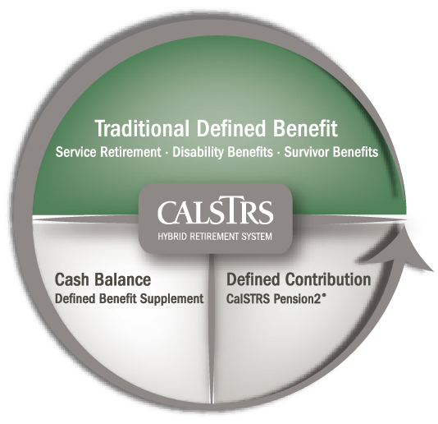
CalSTRS hybrid system
01
Membership includes:
Defined Benefit Program
Defined Benefit Supplement Program
Optional:
CalSTRS Pension2®
Notes:
CalSTRS administers a hybrid retirement system that offers all three plans we just went over.
The biggest section you see at the top is our traditional defined benefit plan which you probably know as your pension. The bulk of your retirement income from CalSTRS comes out of this account.
Going in a counterclockwise direction, next you'll see the Cash Balance plan, as a full time educator this is called the Defined Benefit Supplement account (Later you may hear me refer to this account as DBS or Supplement account). Remember that is a second account you may have and can draw from in retirement. Any benefit you receive from this account is based on the account balance when you retire.
Finally, as we continue our circle, the third section is our Pension2 program. This is a voluntary program you can join to set aside additional income for retirement. To learn more, you can visit CalSTRS.com/Pension2 or call them at 888.394.2060. Also keep a lookout for emails from us to join their Start Saving Now with Pension2 webinars that are being offered.
We will talk more about this hybrid system as we move on.
But first, let’s look at your membership and how it works.
Click.

Slide 13
02
Section two
Contributions and service
Notes:
This section we will look at how your contributions are determined and how service credit is calculated.
Click.

Slide 14
Two benefit structures
02
CalSTRS
2% at 60
First hired before January 1, 2013.
CalSTRS
2% at 62
First hired on or after January 1, 2013.
Find your benefit structure on your Retirement Progress Report or your myCalSTRS account.
Notes:
As a result of the California Public Employees' Pension Reform Act of 2013, CalSTRS has 2 benefit structures.
Your benefit structure is based on the date your were first hired in a CalSTRS‐covered position and it determines how your retirement benefit benefits are calculated.
There is a space for you to note your benefit structure under the Contributions and Service section of your handout:
You are a CalSTRS 2% at 60 member if you were first hired before January 1, 2013.
You are a CalSTRS 2% at 62 member if you were first hired on or after January 1, 2013.
However, please note this isn't as black and white as it may look:
If you were hired after January 2013 but were a member of certain other public retirement systems within six months of becoming a CalSTRS member, you might be a CalSTRS 2% at 60 member.
If you aren’t sure of your hire date you can verify your benefit structure on your Retirement Progress Report or on the home page of your myCalSTRS account.
Click.

Slide 15
Contributions
02
Member
Employer
and state
Defined Benefit Program account
Teachers’ Retirement Fund
View your Defined Benefit Program account balance on myCalSTRS.
Notes:
CalSTRS contributions are paid by 3 parties:
You, your employer and the state all contribute a percentage of your earnings to CalSTRS. There is a space for your to write in your contribution rate for the current year
in the Contributions and Service section of your handout.
If you’re a CalSTRS 2% at 60 member your contribution rate for the current school year is 10.25%.
If you’re a CalSTRS 2% at 62 member your contribution rate for the current school year is 10.205%.
Click.
Your member contributions go straight to your Defined Benefit account. This is that primary account that your have with CalSTRS, a summary can be found in your RPR.
Click.
Contributions from your employer and the state go to the Teachers’ Retirement Fund to cover all CalSTRS benefits.
It’s important to remember that your defined benefit is guaranteed. When you first retire, your benefit payments are being drawn from your own account that holds the contributions you've made. Once that account runs out (typically in 3-5 years), then your payments start drawing from the Teachers' Retirement Fund.
As you work and contribute to CalSTRS you are also earning service credit.
Click.

Slide 16

Service credit
02
Work
Contribute
Accrue
Track your service credit balance each year on your Retirement Progress Report.
Notes:
Click.
You earn service credit based on the percentage of a full‐time contract you work.
Click.
For each dollar you earn, you contribute about 10%.
Click.
All the time that you’ve worked and contributed get turned into service credit that you accrue throughout your career.
Click.

Slide 17
Service credit
02
Percentage of contract worked
Service
credit
Full time
75% time
50% time
1.000
0.750
0.500
Track your service credit balance each year on your Retirement Progress Report.
Notes:
Full‐time employees typically earn one year of service credit in a school year.
If you’re working 75 percent of a contract you would earn .750 years of service credit.
If you’re working half‐time you would earn .500 years of service credit and so on.
You can track your service credit balance on your annual Retirement Progress Report.
You can earn a maximum of one year of service credit in a school year. So even if you are working more than your full-time contract, you will never be able to earn more than 1 year per year.
But working those additional assignments or even working more than one contract can still have a positive impact on your retirement. Let's take a look at what happens to that extra time.
Click.

Slide 18

Extra-pay assignments
02
View your Defined Benefit Supplement account balance on myCalSTRS.
Watch the Defined Benefit Supplement video series at CalSTRS.com/videos.
Defined Benefit Supplement account
Member contribution rate:
  8% for CalSTRS 2% at 60 members.
  9% for CalSTRS 2% at 62 members.
Employer contribution rate is 8%.
Consider working extra-pay assignments to increase your account balance.
Notes:
As a Defined Benefit member, you have a Defined Benefit Supplement (DBS) account. Your Defined Benefit Supplement account is a cash balance retirement plan that provides additional guaranteed income for retirement.
2%@60-Eight percent (2%@62 nine percent)of your contributions for service in excess of one year go into your Defined Benefit Supplement account. Your employer contributes 8% regardless of your benefit structure. Unlike the Defined Benefit program, these employer contributions do go directly into your account instead of the CalSTRS fund.
Click.
This is the secondary cash balance account included with your membership. The funds in your DBS account are yours at retirement. Build this account by taking on outgrowth, or extra-pay, assignments. If you are already working a full-time contract, anything extra you do will generate some additional funds for this account. This could include things like yearbook advisor, soccer coach, or band director.
You might also have noticed that the contribution rate for this account is lower than your normal contribution rate. This does lead to some excess contributions that are returned to your employer in September. Your employer will take out any deductions and return the remaining money to you. If you aren't sure if you should be expecting this money, there will be a note at the bottom of page 3 in your Retirement Progress Report under Special Messages.
You can view and track your account balance on myCalSTRS.
There is a three‐part video series about this account on CalSTRS.com that covers the funding history, distribution choices and tax considerations.
While on the topic of contributions, let's talk about Social Security.
Click.

Slide 19
03
Section three
Social Security rules
Notes:
Section three, social security rules.
Click.

Slide 20
True or false?
03
I contribute to Social Security for
my CalSTRS-covered employment.
True
False
False
Consider investing the 6.2% you would have contributed to Social Security to CalSTRS Pension2 or another supplemental savings account.
Notes:
True or False? You contribute to Social Security for your CalSTRS-covered employment?
Click.
The correct answer is False. As a CalSTRS member you do not contribute to Social Security for your CalSTRS‐covered service.
You may want to consider investing the 6.2 percent of your income that would have gone to Social Security to a supplemental savings plan instead in order to build additional income for retirement.
Now, although you don’t currently contribute to Social Security, you may still qualify for a benefit. If you plan on receiving a Social Security benefit there are two rules you need to be aware of and I'd like to address because I know there is a lot of misinformation out there.
Click.

Slide 21
Social Security rules
03
Windfall Elimination Provision
May reduce but cannot eliminate your earned Social Security benefit.
Government Pension Offset
Reduces and may eliminate your spousal or widow/widower Social Security benefit.
Contact the Social Security Administration for more information.
Notes:
When we talk about Social Security at CalSTRS, we have to talk about these 2 Social Security Rules that will impact you and your Social Security benefit.
Click.
The Windfall Elimination Provision impacts your earned Social Security benefit from employment outside of CalSTRS-covered employment.
The Social Security Administration uses an alternate formula to calculate your benefit. This can reduce your benefit but will not eliminate it. If you paid Social Security taxes on substantial earnings for more than 20 years, then the impact isn't as great. Please remember that this provision will have no impact on your CalSTRS benefit at all.
I've heard rumors that the Windfall will completely eliminate your social security benefit, be confident that this is untrue. If you've earned a benefit then there will be some money available to you.
Click.
The Government Pension Offset impacts you if you were to become eligible for a spousal, widow or widower benefit. The Social Security Administration reduces your
benefit by two‐thirds of your CalSTRS benefit which can eliminate your benefit all together if your CalSTRS benefit is high enough. Again this will not affect your CalSTRS benefit at all. Your spouse is not affected by this, only when you, as a member, start receiving the Social Security benefit.
It’s important to be aware of these rules and contact the Social Security Administration for more information since the estimates on your annual statement don’t reflect these
reductions. Once you are closer to retirement, they should be able to tell you exactly how your Social Security Benefit will be impacted.
Now let's move back to talking about CalSTRS and the benefits we offer.
Click.

Slide 22
04
Section four
Retirement benefits
Notes:
In addition to retirement benefits, CalSTRS does have more to offer.
Click.

Slide 23
What types of benefits are offered by CalSTRS?
Retirement benefits
Retirement benefits
Disability benefits
Disability benefits
Survivor benefits
Survivor benefits
Health benefits
Check with your employer about health benefit coverage in retirement.
Notes:
Before we dive in, do you know which types of benefits are offered by CalSTRS? And what isn’t?
Click.
(health benefits disappears)
We offer retirement, disability and survivor benefits. CalSTRS does not offer health benefits.
As an active employee, your health benefits are covered through your employer. In retirement, you can continue on your employer’s plan at your own cost or seek your own coverage.
Either way, this is something you will want to plan ahead for. This can be a very big expense, especially if retiring before Medicare age.
Some employers might offer special healthcare packages to retirees. Check with your employer to see what health care benefit coverage is available to you in retirement.
We won’t be covering disability and survivor benefits in this workshop but if you want to learn more, attend the My Retirement Benefits workshop or view the educational videos at CalSTRS.com.
Let’s look at your retirement benefits…
Click.

Slide 24
Service retirement eligibility
04
Minimum requirements
Age 55 with five years of service credit.
Early
retirement
Age 50 with 30 years of service credit.
(CalSTRS 2% at 60 only)
Concurrent retirement
Age 55 with fewer than five years of service credit if retiring concurrently from certain other retirement systems.
See the Member Handbook for more information.
Notes:
Click.
The minimum requirements to retire are age 55 with at least five years of service credit.
Click.
If you’re a CalSTRS 2% at 60 member, you can retire as early as age 50 with 30 years of service credit.
Click.
Regardless of your benefit structure, you can retire with fewer than five years of service credit once you reach age 55 if you concurrently retire for service with certain other public retirement systems in California, such as CalPERS.
You can read more about concurrent retirement and service retirement eligibility in the Member Handbook. . . . . .
A cool thing about a defined benefit plan is that your monthly retirement benefit is based on a formula not based on your contributions or how well our investments perform…
Click.

Slide 25

Service retirement formula
04
service credit $×$ age factor $×$ final compensation
$=$ monthly retirement benefit
Service credit:
Time worked and contributed.
Use the Retirement Benefit Calculator at CalSTRS.com/calculators.
Review the Understanding the Formula fact sheet and video at CalSTRS.com.
Notes:
The formula is service credit x age factor x final compensation.
Service credit is the time you’ve worked and contributed to CalSTRS.
Click.

Slide 26
Service retirement formula
04
service credit $×$ age factor $×$ final compensation
$=$ monthly retirement benefit
Service credit:
Time worked and contributed.
Age factor:
Percentage based on age at retirement.
Use the Retirement Benefit Calculator at CalSTRS.com/calculators.
Review the Understanding the Formula fact sheet and video at CalSTRS.com.
Notes:
Your age factor is a percentage based on your age in years and months at retirement.
Click.

Slide 27
Service retirement formula
04
service credit $×$ age factor $×$ final compensation
$=$ monthly retirement benefit
Service credit:
Time worked and contributed.
Age factor:
Percentage based on age at retirement.
Final compensation:
Highest average annual compensation earnable for 36 consecutive months.
Use the Retirement Benefit Calculator at CalSTRS.com/calculators.
Review the Understanding the Formula fact sheet and video at CalSTRS.com.
Notes:
And final compensation is your highest average annual compensation earnable for 36 consecutive months. If you’re a CalSTRS 2% at 60 member, CalSTRS will calculate your
final compensation over a 12 month period if you retire with more than 25 years of service credit.
You might notice I said "compensation earnable." This means that if you are a part-time educator, you might be confused by the way we calculate your benefit. We base your benefit off how much could have been earned had you been working a full time contract. If you remember from before, a part-time education only earns partial service credit, so when doing the math, it all works out.
We multiple these three figures together to get your monthly retirement benefit. Like I mentioned early, your Annual Retirement Progress Report will include estimates beginning at age 45.
In the meantime, you can generate your own estimates using the Retirement Benefits Calculator on CalSTRS.com.
Click.

Slide 28
05
Section five
Supplemental savings and CalSTRS Pension 2
Notes:
Let's take a look at how CalSTRS can help you with supplemental savings.
Click.

Slide 29
Supplemental savings
05
On average, the CalSTRS retirement benefit replaces about half of a new teacher’s salary.
You’ll need to close any gap between your retirement income goal and your retirement benefit with savings and investments.
Notes:
On average, the CalSTRS retirement benefit replaces about 50 percent of a member’s working income.
Working with members and creating estimates I've seen some average the 50% and I've seen benefits higher and lower. Maybe teaching is your 2nd career. Then you won't have the years of service that someone may have who has been an educator since right after college. Don't be discouraged. Maybe you have been teaching since right after college. If you do continue your career and retire as an educator, you could easily have over 30 years of service and a benefit that far exceeds the average 50%.
This means there may be a gap between your retirement income goal and your CalSTRS retirement benefit. You’ll need to close that gap with other savings and investments.
For additional information, watch our educational video titled “How to fill the gap” on CALSTRS.com/videos.
Click.

Slide 30

Supplemental savings
05
Estimate your expenses in retirement.
Research supplemental savings plans like Pension2 and other income sources.
Visit 403bCompare.com to compare the plans offered by your district.
Notes:
To start planning, estimate your expenses in retirement. Start thinking about what kind of lifestyle you want to live in retirement.
Start researching the supplemental savings plans and other income sources available to you. Do you have the funds to start saving extra now? Can you make some changes to make that a possibility for you? Retirement may seem far off, but from what I've heard, time flies and it'll be here before you know it.
Visit 403bCompare.com and you can filter by School District or Employer and compare the different 403b plans offered.
Click .

Slide 31

Supplemental savings
05
403(b)
Roth 403(b)
457(b)
Roth 457(b)
Notes:
As you’re doing your research, you will come across CalSTRS Pension2 as an option for your supplemental savings.
Pension2 is the third piece of our hybrid system and is completely voluntary.
Click.
Pension2 offers 403(b) and 457(b) plans and the Roth versions of each.
Click.

Slide 32


CalSTRS Pension2
05
Pension2 can take you where you want to go
Tax-deferred retirement savings.
Low and transparent costs.
No commissions, load fees or surrender charges.
Flexible investment options.
Visit Pension2.com or call 888-394-2060 for more information.
Research your employer’s plans at 403bCompare.com.
Scan the QR code to visit Pension2.com.
Notes:
Pension2 offers the opportunity to invest your money through pre-tax payroll deductions. The tax you aren't paying then is deferred until you start making withdrawals from that account. Or you can invest post-tax money in a Roth account. Pension2 is a revenue-neutral program, so we offer low and transparent fees.
Remember in the beginning we talked about the CalSTRS vision to get you a secure retirement? With that in mind, there are no commissions, no load fees, and no surrender charges.
Pension2 offers flexible investment options. Your choice depends on your comfort in managing your retirement portfolio. Or if you have no comfort at all, we do have ready- made portfolios that you can choose from.
If you have additional questions about Pension2, you can visit Pension2.com or give them a call at 888‐394‐2060. You can also register to attend a Start Saving Now with Pension2 webinar. The dates and times are listed at CalSTRS.com/webinars.
Click.

Slide 33
06
Section six
Learn more
Notes:
I hoped you've learned a lot about the basics of your membership. We've now just barely scratched the surface of what there is to know about CalSTRS. I'd like to share more of what we offer to help you become as educated as possible.
Click.

Slide 34



Financial Awareness webinars
06
Save for Your Future
Plan for Your Future
Budgeting basics, savings and investing, credit and debit.
Retirement lifestyle, expenses, income and obstacles.
Protect Your Future
Retirement distributions, maximizing and protecting income.
View the webinar schedule and register at CalSTRS.com/webinars.
Notes:
First, we have our financial awareness workshop series.
This isn't necessarily CalSTRS specific, but they provide good financial planning and money management strategies.
The first webinar in the series is Save for Your Future focuses on creating budgets, saving and investing, and managing credit and debt.
Plan for Your Future focuses on reaching the retirement lifestyle you want by planning your expenses and income and how to overcome obstacles.
Protect your Future focuses on retirement distributions and maximizing and protecting your additional income sources.
You can learn more at CalSTRS.com/webinars.
Click.

Slide 35
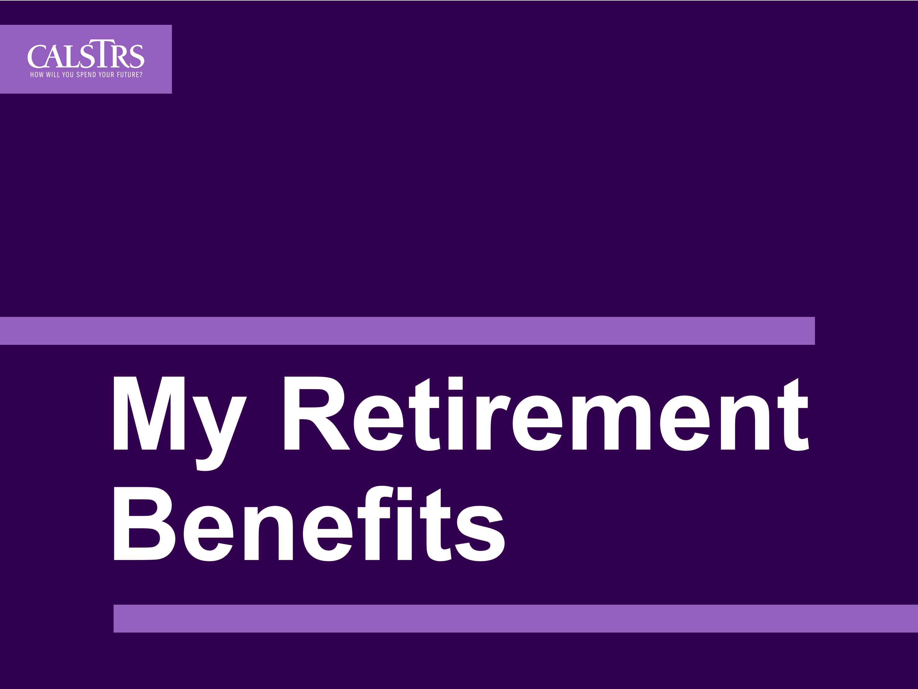
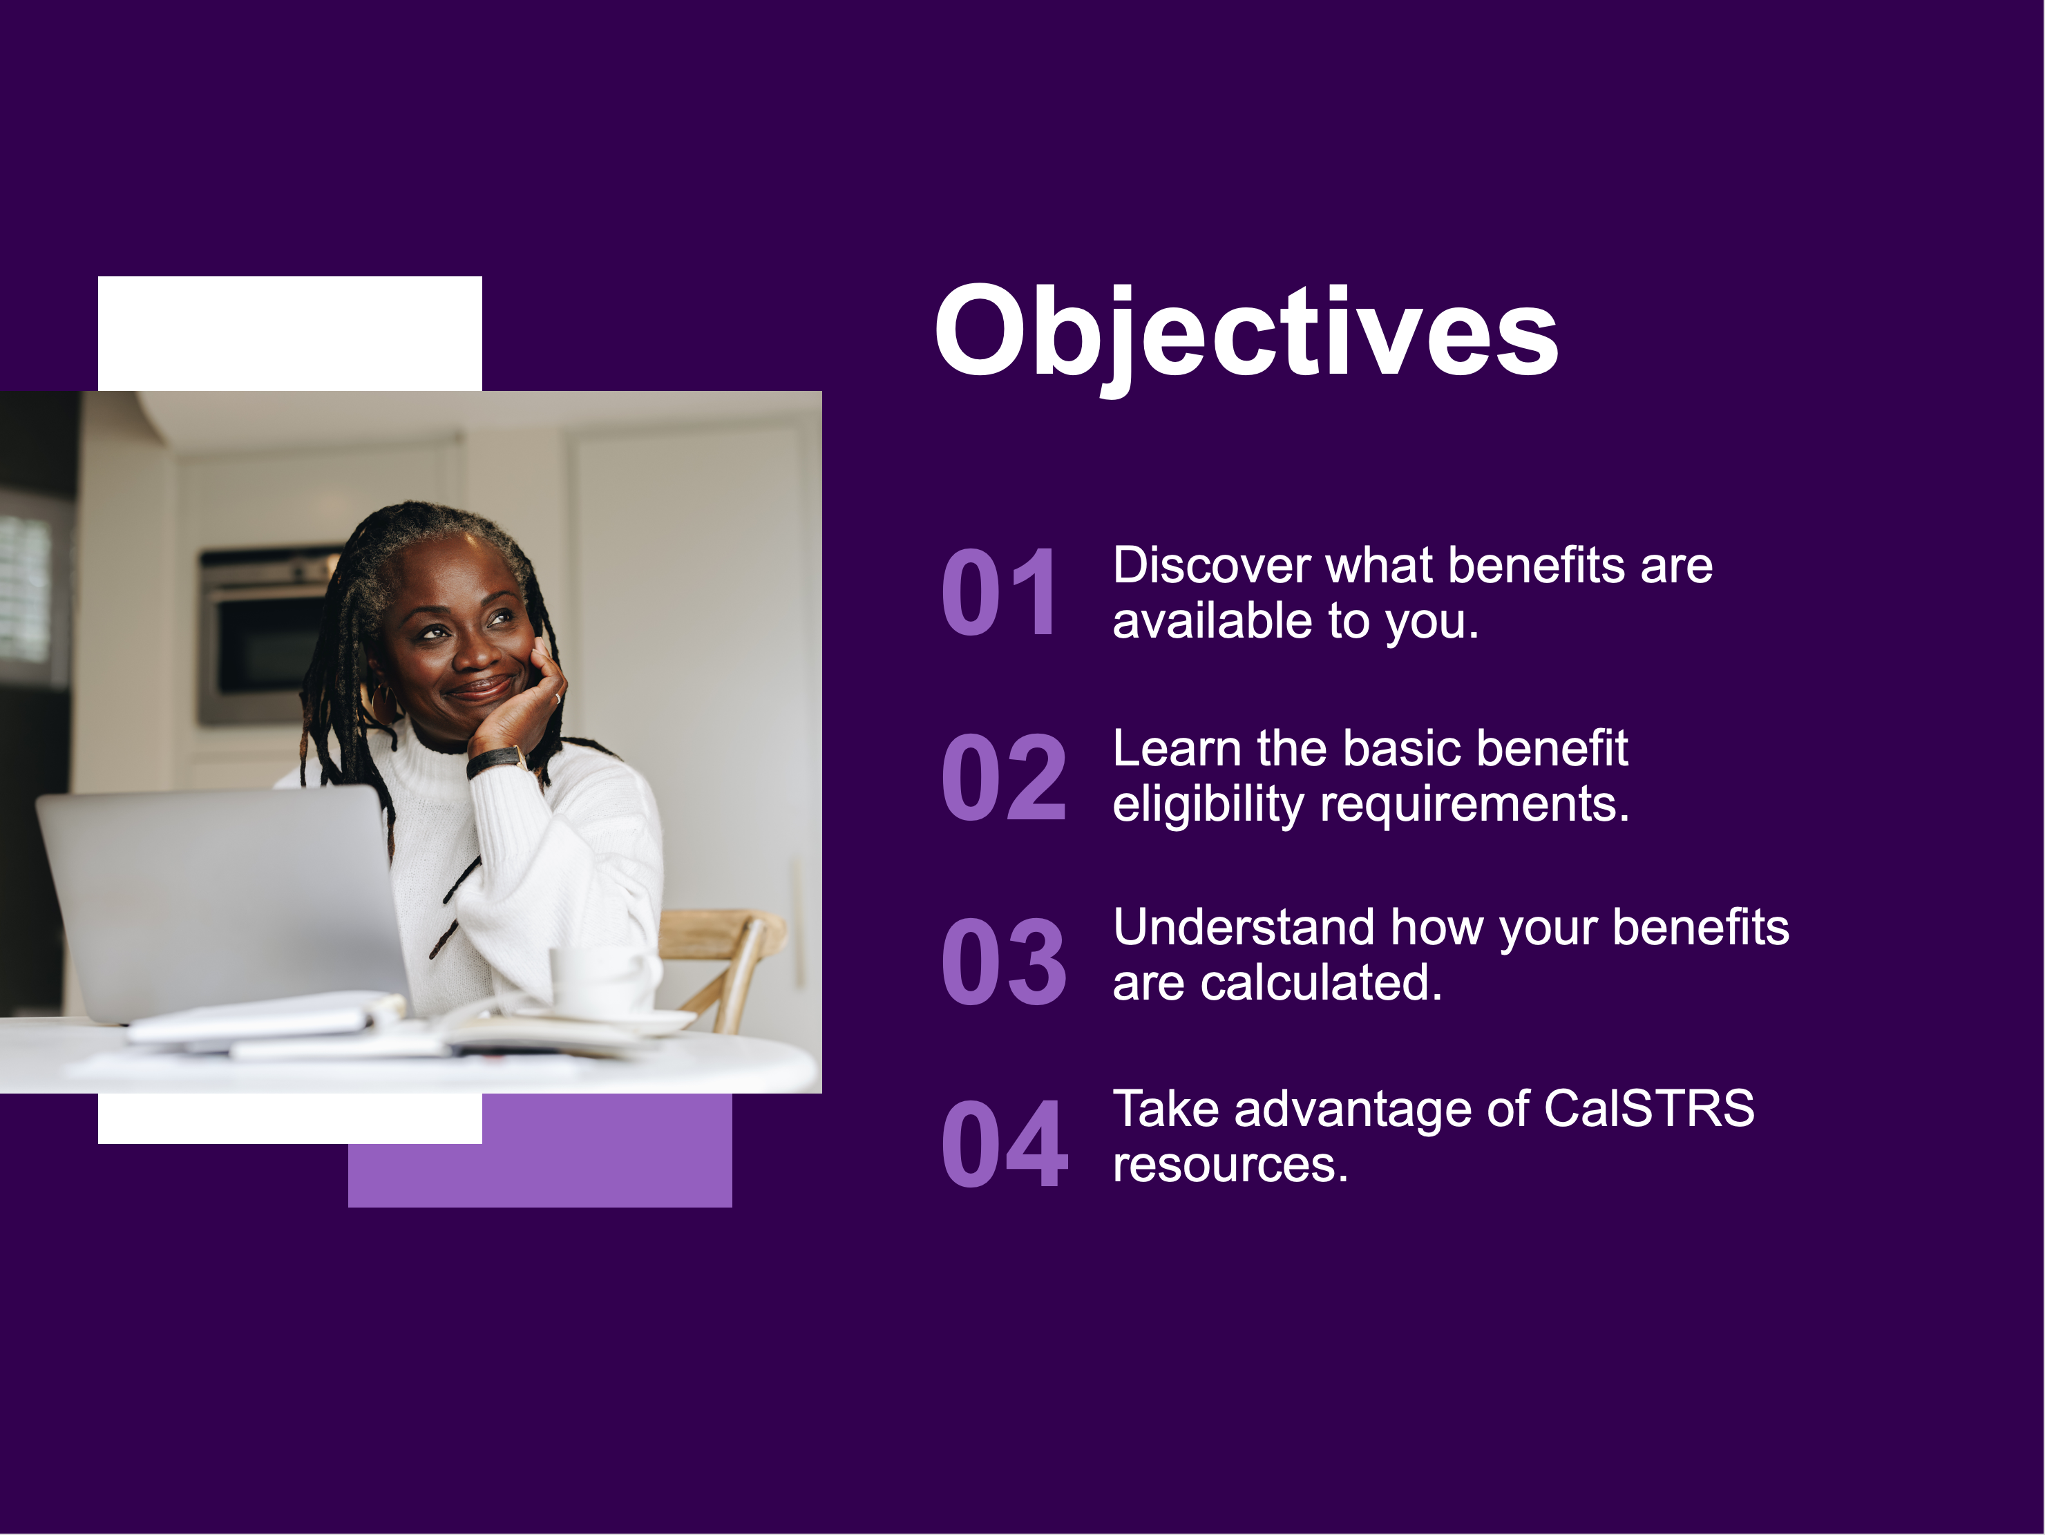
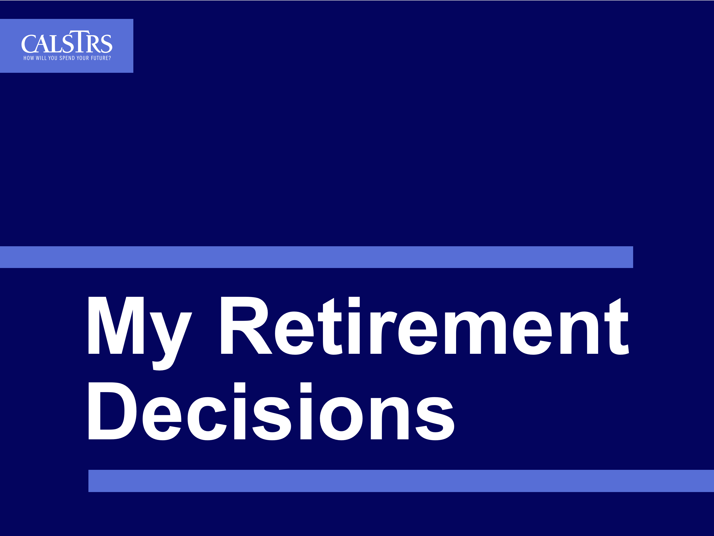
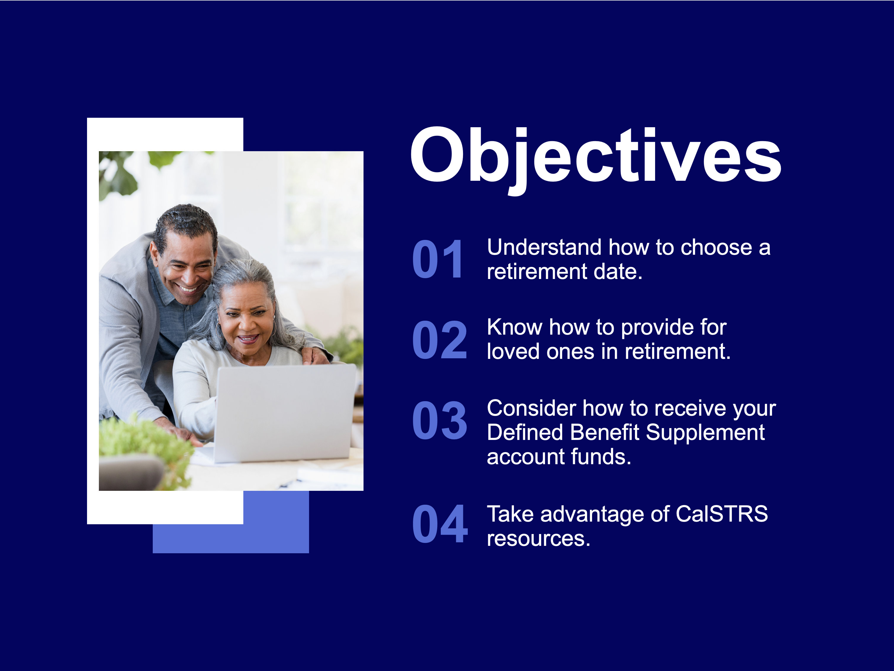
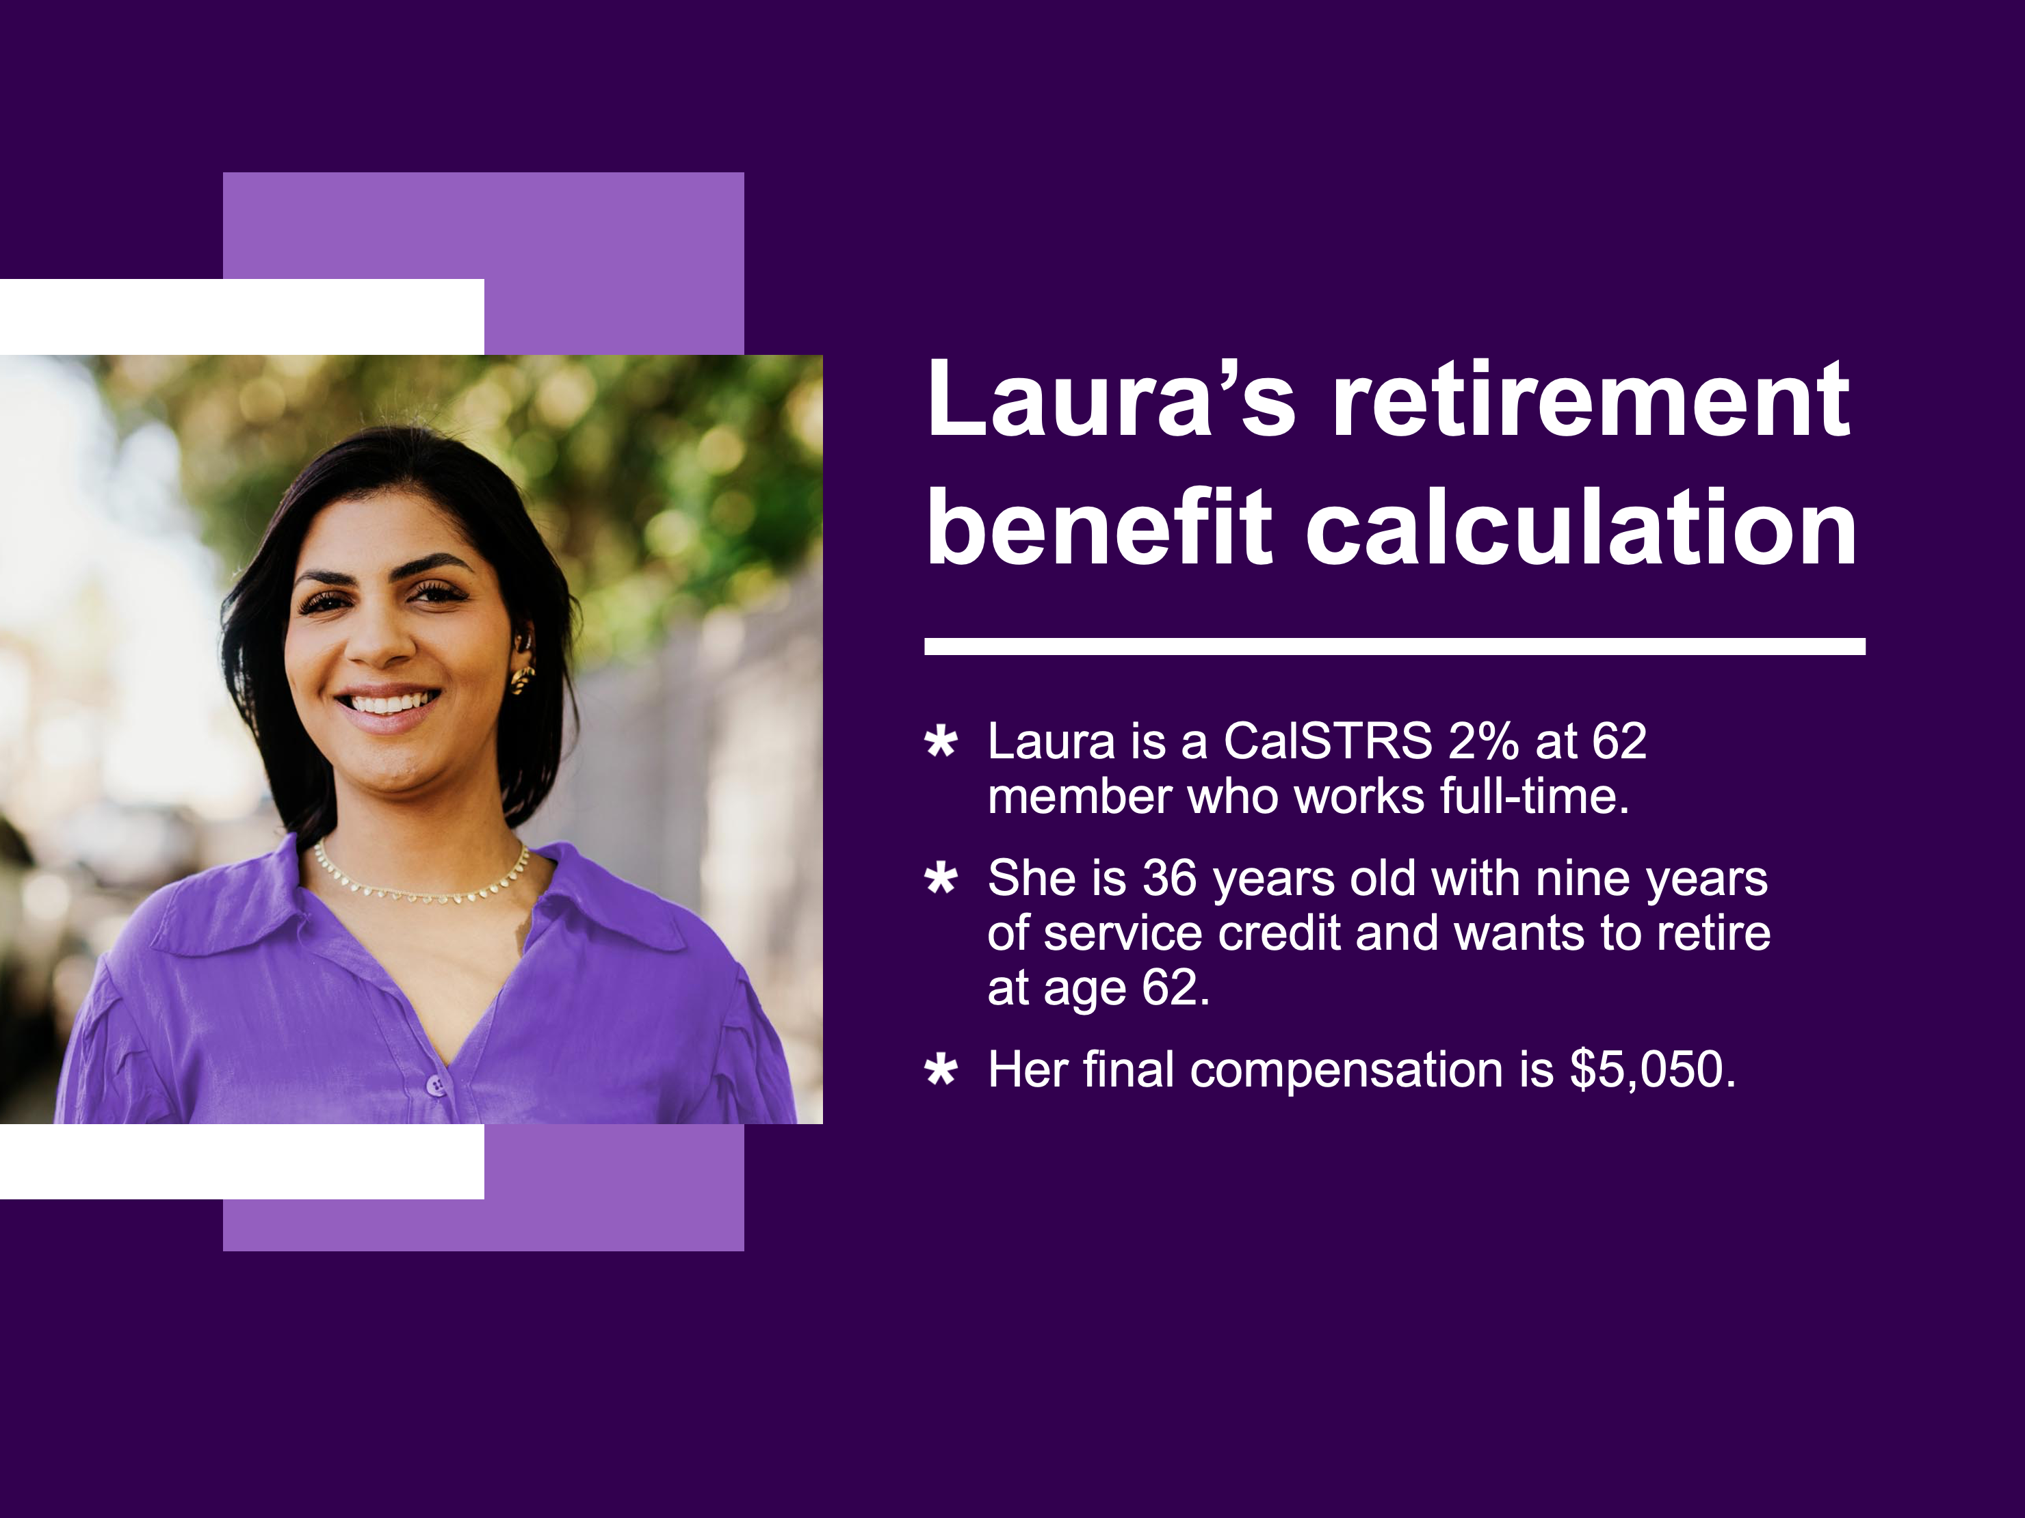
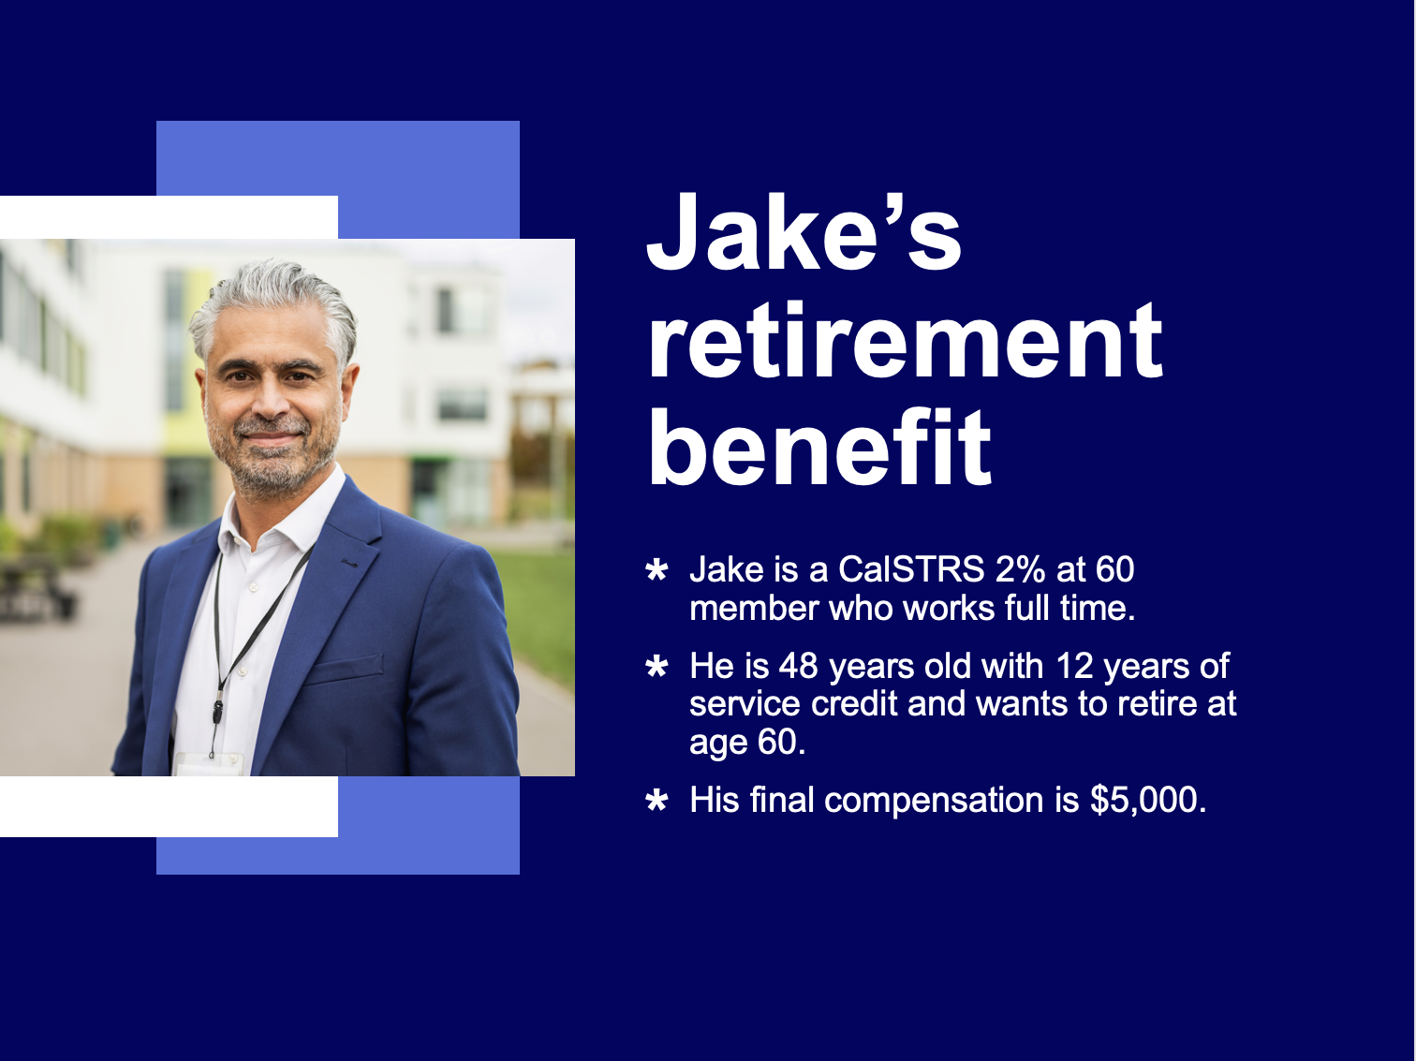
My Retirement webinars
06
Understand your benefits and the importance of supplemental savings.
Understand your retirement options and timelines.
View the webinar schedule and register at CalSTRS.com/webinars.
Notes:
The My Retirement Series has two other presentations we recommend.
My Retirement Benefits covers your disability and survivor benefits in addition to more information about your retirement benefits.
My Retirement Decisions focuses on the three decisions you’ll face as you near retirement, such as:
When should I retire?
Do I want to leave a lifetime monthly benefit to a loved one?
And what should I do with my Defined Benefit Supplement funds?
You can register for a webinar at CalSTRS.com/webinars. These webinars are available year-round.
Click.

Slide 36


Questions?
CalSTRS.com
myCalSTRS.com
Send us a secure online message using your myCalSTRS account.
800-228-5453
*Press 2 for Customer Service.
Monday–Friday
8 a.m. to 5 p.m.
Notes:
Well this concludes our presentation for today. I’d like to take some of your questions at this time. Keep in mind that I will only be able to answer some general questions, so if you have a question related to your personal account, please call customer service or log on to your myCalSTRS account and send us a secure message.
*****CLOSING
For those of you still have questions or want to learn more please visit us at CalSTRS.com. You can send also send and receive online messages with us on myCalSTRS or call us at 800‐228‐5453 weekdays from 8 a.m. to 5 p.m.
Thanks for attending the CalSTRS My Retirement System workshop. We look forward to having you join us on future educational webinars.
I hope you all have a great rest of your day!
Click.

Slide 37
Thank you for attending!

