Slide 1
My Retirement Benefits

Slide 2
Today’s Objectives
Know the basic benefit eligibility requirements
Understand how your benefits are calculated
Take steps to increase your income in retirement
Take advantage of CalSTRS resources

Slide 3
Section 1: Important Considerations

Slide 4
CalSTRS Benefits
Section 1
Retirement
Survivor
Disability
☑
Check with your employer about health benefit coverage in retirement.
Notes:
Retirement benefits.
Survivor benefits.
And disability benefits.
It’s important to keep in mind that CalSTRS does not offer health benefits. As an active member, your health benefits are offered through your employer. In retirement, you will be responsible for your own coverage.
Your employer is required to let you stay on their plan at your own cost but some employers offer special benefit packages to retirees. Check with your employer about what health benefit coverage is available to you in retirement so you can plan ahead for any additional costs.
Some benefit packages for retirees might be contingent on how long you’ve been with the district – this is something you might want to consider if you’re looking at changing employers throughout your career.
Another thing you will want to plan ahead for are potential reductions to any Social Security benefits you might receive….
Click.

Slide 5
Social Security Rules
Section 1
Windfall Elimination Provision
☑
Contact the Social Security Administration for more information.
May reduce but cannot eliminate your earned Social Security benefit
Government Pension Offset
☑
Review the CalSTRS, Social Security and You fact sheet.
Reduces and may eliminate your spousal or widow/widower Social Security benefit
Notes:
As a CalSTRS member, you do not contribute to Social Security for your CalSTRS-covered employment. If you anticipate receiving a Social Security benefit from other employment or from a spouse, there are two government rules that can reduce your benefit or leave you with no benefit at all.
Click.
The Windfall Elimination Provision impacts your earned Social Security benefit from employment outside of CalSTRS. The Social Security Administration uses an alternate formula to calculate your benefit. This can reduce your benefit but will not eliminate it.
Click.
The Government Pension Offset impacts your spousal, widow or widower benefit. The Social Security Administration reduces your benefit by two-thirds of your CalSTRS benefit which can eliminate your benefit all together.
It’s important to be aware of these rules and contact the Social Security Administration for more information since the estimates on your annual statement don’t reflect these reductions.
You can also read learn more by reviewing the CalSTRS, Social Security and You fact sheet on CalSTRS.com…
Click.

Slide 6
Section 2: Online Resources

Slide 7
CalSTRS.com
Section 2
Learn about us and benefits
Download forms and publications
Access calculators and watch videos
Notes:
CalSTRS.com is our public website where you can learn more about us and your benefits.
You can download forms and publications, access retirement benefit calculators and even watch short educational videos to recap the information we will be covering today.
Click.

Slide 8
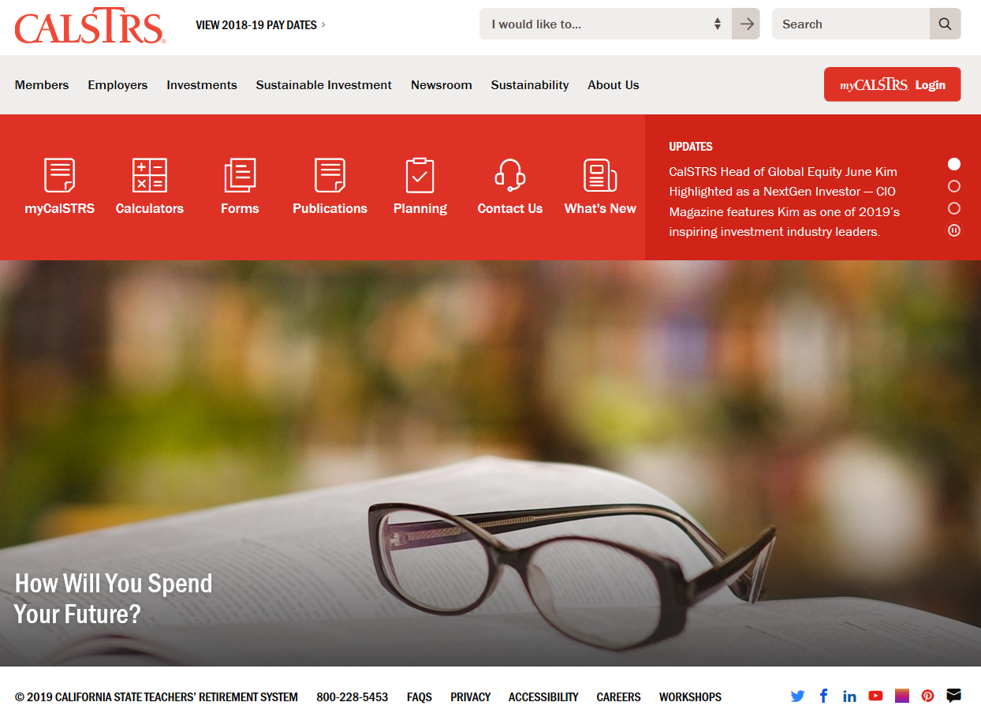
CalSTRS.com
Section 2
☑
Read the Member Handbook and browse the Members tab.
Notes:
Use the red Quick Links at the top of the page to easily navigate to your various resources.
You can use the publications Quick Link to download or request a copy of the Member Handbook. The Member Handbook provides detailed information about the benefits we will be discussing today.
You can use the myCalSTRS Quick Link to register for a myCalSTRS account…
Click.

Slide 9
myCalSTRS
Section 2
View and update account information
Submit forms and messages
Access your Retirement Progress Report
☑
Register at myCalSTRS.com and update your communication preferences.
Notes:
myCalSTRS provides online access to your CalSTRS accounts and information 24/7.
Register for an account and update your preferences for receiving information from us if you haven’t done so already. With the environment in mind, we default to electronic communication but you can always request to receive hard copies of information by mail.
With myCalSTRS you can also submit forms and send and receive online messages with a CalSTRS representative. The nice thing about this feature is that the electronic copies are archived in your account for future reference if you need them.
You can access your annual Retirement Progress Report each September on myCalSTRS…
Click.

Slide 10
Your Retirement Progress Report
Section 2
Membership and Benefit Information
Service Credit and Account Balances
Employer Reporting
☑
Review your report each fall. Contact your employer regarding any discrepancies.
Notes:
Your Retirement Progress Report is your annual statement that summarizes your information for the prior school year.
It includes information about your membership and benefits, service credit and account balances and even information reported by your employer.
Since we use information reported by your employer to calculate your benefit, it’s important to review your report each year and contact your employer directly regarding any discrepancies so they can be corrected.
You can find your benefit structure on your Retirement Progress Report…
Click.

Slide 11
Section 3: Membership Information

Slide 12
Benefit Structures
Section 3
CalSTRS 2% at 60
First hired before January 1, 2013
CalSTRS 2% at 62
First hired on or after January 1, 2013

Fill in your benefit structure on page 1.
☑
Verify your benefit structure on your Retirement Progress Report.
Notes:
Your benefit structure is based on the date your were first hired in a CalSTRS-covered position and determines how your retirement benefits are calculated.
There is a space for you to note your benefit structure at the bottom of page 1 of your handout. After the California Public Employees’ Pension Reform Act of 2013, there are two different benefit structures:
You are a CalSTRS 2% at 60 member if you were first hired before January 1, 2013.
You are a CalSTRS 2% at 62 member if you were first hired on or after January 1, 2013.
However, please note: If you were hired after January 2013 but were a member of certain other public retirement systems within six months of becoming a CalSTRS member, you might be a CalSTRS 2% at 60 member.
If you aren’t sure of your hire date you can verify your benefit structure on your Retirement Progress Report or on the home page of your myCalSTRS account.
Next, let’s discuss eligibility requirements for Service Retirement…
Click.

Slide 13
Section 4: Retirement Benefits

Slide 14
Service Retirement Eligibility
Section 4
Minimum Requirements
☑
See the Member Handbook for more information.
Age 55 with five years of service credit
Early Retirement
Age 50 with 30 years of service credit (CalSTRS 2% at 60 only)
Concurrent Retirement
Age 55 with fewer than five years of service credit if retiring concurrently from certain other retirement systems
Notes:
The minimum requirements for a service retirement benefit are age 55 with five years of service credit.
Click.
If you’re a CalSTRS 2% at 60 member, you can retire as early as age 50 with 30 years of service credit.
Click.
If you have fewer than five years of service credit you can retire at age 55 if you retire concurrently with certain other public retirement systems in California such as CalPERS.
You can read more about concurrent retirement and eligibility in the Member Handbook.
Your retirement benefit is based on a formula…
Click.

Slide 15
The Retirement Formula
Section 4
Service Credit
Time worked and contributed
On CalSTRS.com
☑
Review the Understanding the Formula fact sheet and video.
Age Factor
Final Compensation
☑
Use the Retirement Benefit Calculator
Monthly Retirement Benefit
Notes:
The formula is based on three figures – service credit, age factor and final compensation.
Click.
Service credit is the time you’ve worked and contributed to CalSTRS.
You accrue service credit based on the percentage of a full-time contract you work…
Click.

Slide 16
Service Credit
Section 4
Full Time
☑
Track your service credit balance on your Retirement Progress Report each year.
1.000
75% Time
0.750
50% Time
0.500
Notes:
If you’re working full time you should earn one year of service credit, half-time you would earn a half year and so on.
You can earn up to one year of service credit in a school year. We’ll talk about what happens to contributions in excess of one year a little later.
You can also receive service credit for any unused sick leave you have at retirement.
Click.

Slide 17
Service Credit
Section 4
Unused Sick Leave Days
Number of Contract Days
Additional Service Credit
Notes:
We calculate the service credit increase by dividing the number of unused sick leave days you have at retirement by the number of days in your annual contract.
Click.

Slide 18
Service Credit
Section 4
100
180
0.556
Notes:
For example, if you have 100 unused sick leave days at retirement and a 180-day contract, you would receive an additional .556 years of service credit in your retirement benefit. It’s important that you transfer your unused sick leave balances to your current employer if you change positions throughout your career.
Also, remember to track your service credit balance on your annual Retirement Progress Report each year and contact your employer regarding any discrepancies…. (Please note: Unused sick leave time is not reflected on the RPR—that information will be certified during the retirement process.)
Click.

Slide 19
The Retirement Formula
Section 4
Service Credit
Time worked and contributed
Age Factor
Percentage based on age at retirement
Final Compensation
Monthly Retirement Benefit
Notes:
Now let’s discuss the age factor portion of the retirement formula
Click. Your age factor is a percentage based on your age at retirement.
Click.

Slide 20
Age Factor
Section 4
Age at Retirement | CalSTRS 2% at 60 | CalSTRS 2% at 62
55 | 1.40% | 1.16%
56 | 1.52% | 1.28%
57 | 1.64% | 1.40%
58 | 1.76% | 1.52%
59 | 1.88% | 1.64%
60 | 2.00% | 1.76%
61 | 2.13% | 1.88%
62 | 2.27% | 2.00%
63 | 2.40% | 2.13%
64 | 2.40% | 2.27%
65 | 2.40% | 2.40%
☑
View the complete age factor table in the Member Handbook.
Career Factor
0.20 percent increase for CalSTRS 2% at 60 members with 30 or more years of service credit
Notes:
The standard age factor for CalSTRS 2% at 60 members is 2% at 60. The age factor gradually decreases if you retire before age 60 and gradually increases to a maximum age factor of 2.4% at age 63.
The standard age factor for CalSTRS 2% at 62 members is 2% at 62. The age factor gradually decreases if you retire before 62 and gradually increases to a maximum age factor of 2.4% at age 65.
The age factor is based on your age in years and months at retirement. You can view the complete age factor table in the Member Handbook…
Click.
If you’re a CalSTRS 2% at 60 member with 30 or more years of service credit at retirement, CalSTRS will increase your age factor by .200 percent up to the maximum of 2.4 percent. This is known as the career factor.
Click.

Slide 21
The Retirement Formula
Section 4
Service Credit
Time worked and contributed
Age Factor
Percentage based on age at retirement
Final Compensation
Highest average annual compensation earnable for 36 consecutive months
Monthly Retirement Benefit
Notes:
Now we will discuss final compensation.
Click.
Final compensation is the highest average annual compensation earnable for 36 consecutive months.
Click.

Slide 22
Final Compensation
Section 4
School Year | Compensation Earnable | Number of Months
Year A | $62,500 | 12
Year B | $60,000 | 12
Year C | $57,500 | 12
One-Year Final Compensation
12 consecutive months for CalSTRS 2% at 60 members with 25 or more years of service credit
$180,000
36
Months
$5,000
Notes:
In other words, final compensation is based on the weighted average of the various pay rates you work at rather than your earnings.
For example, let’s assume your highest compensation earnable amounts occurred during the last 36 months, or three school years, and are $57,500, $60,000 and $62,500.
Click.
We add these figures together and divide by 36 months to get a final compensation of $5,000.
Click.
If you’re a CalSTRS 2% at 60 member with 25 or more years of service credit, we will use a period of 12 consecutive months to calculate your final compensation.
Click.

Slide 23
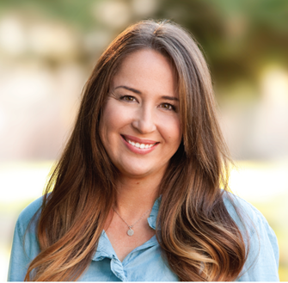
Laura’s Final Compensation
Section 4

Calculate Laura’s final compensation on page 2.
School Year | Compensation Earnable | Number of Months
Year A | $61,800 | 12
Year B | $60,600 | 12
Year C | $59,400 | 12
Year D | $58,300 | 12
Year E | $57,200 | 12
$181,800
36
Months
$5,050
Notes:
Now, let’s work through an example. Go ahead and calculate Laura’s final compensation at the bottom of page 2 of your handout. Assume Laura has a three-year final compensation.
(5 minute wait for attendees to work on calculation)
OK, let’s walk through Laura’s final compensation together.
Click.
Based on the information you were provided, what are Laura’s highest 36 months of compensation earnable?
Click.
Her highest consecutive 36 months occurred during school years A, B and C.
Click.
We add these figures together and divide by 36 to get a final compensation of $5,050.
Now let’s review the complete retirement formula.
Click...

Slide 24
The Retirement Formula
Section 4
☑
Review the Understanding the Formula fact sheet and video at CalSTRS.com.
Service Credit
Time worked and contributed
Age Factor
Percentage based on age at retirement
Final Compensation
Highest average annual compensation earnable for 36 consecutive months
Monthly Retirement Benefit
Notes:
Keep in mind your retirement benefit is a guaranteed lifetime monthly benefit based on this formula not what you contributed or how well our investments perform.
You can recap this information including benefit enhancements by reviewing the Understanding the Formula fact sheet or video on CalSTRS.com...
Click.

Slide 25
Laura’s Retirement Benefit
Section 4
An example calculation
Notes:
Now that we’ve reviewed the entire formula, let’s walk through an example together.
Click.

Slide 26
Laura’s Retirement Benefit
Section 4
35
☑
Use the Retirement Benefits Calculator at CalSTRS.com to estimate your benefit.
Service Credit
3 years + 32 more by retirement
Time worked and contributed
Age Factor
.0200
Percentage based on age at retirement
2% at 62
$5,050
Final Compensation
($61,800 + $60,600 + $59,400) / 36
Highest average annual compensation earnable for 36 consecutive months
$3,535
Monthly Retirement Benefit
Monthly Retirement Benefit
Notes:
So here we have the formula.
Click.
For the sake of this example, we know Laura has 3 years of service credit. Since she is working full-time we can assume she will earn 32 more years of service credit by retirement for a total of 35 years.
Click.
Laura is a CalSTRS 2% at 62 member, her age factor would be 2 percent when she retires at age 62.
Click.
Using the figure we calculated earlier, we’ll use a final compensation of $5,050.
Click.
When we plug these figures into the formula, we get a retirement benefit of $3,535.
Your Retirement Progress Report will contain estimates based on information we have on file once you reach age 45. If you want to calculate your benefit in the interim or look at different retirement scenarios, you can use the Retirement Benefits Calculator on CalSTRS.com…
Click.

Slide 27
Section 5: Additional Income Sources

Slide 28
Increase Your Monthly Benefit
Section 5
☑
Read the Purchase Additional Service Credit booklet and use the service credit purchase calculators at CalSTRS.com.
Service Credit
Work longer
Purchase service credit
Age Factor
Retire later
Final Compensation
Work at higher pay rates
Monthly Retirement Benefit
Notes:
You can increase your monthly benefit by increasing any part of the formula
– Your service credit, your age factor or your final compensation.
Click.
You can increase your service credit by working longer, purchasing permissive service credit such as unpaid medical or family leaves, sabbatical or time from an out-state-system you wont receive a benefit from. You can also redeposit or buy back service you lost when you took a refund of your contributions.
If you’re interested in purchasing service credit, read the Purchase Additional Service Credit booklet and use the calculators on CalSTRS.com to estimate the cost of your purchase and the increase to your benefit.
Click.
You can increase your age factor by working longer or, if you stop working and don’t need to collect your benefit right away, wait to retire until you reach the maximum age factor.
Click.
Finally, you can increase your final compensation by working at higher pay rates. If you’re working in multiple positions it can be advantageous to stop working in your lower paying positions as you approach retirement in order to increase your final compensation.
Click.

Slide 29
Replacement Ratio
Section 5
My
CalSTRS
benefit
Notes:
On average, the CalSTRS retirement benefit replaces about 50 percent of a members final compensation.
Click.

Slide 30
Replacement Ratio
Section 5
Service Credit
Time worked and contributed
Age Factor
Percentage based on age at retirement
Notes:
You can calculate your own replacement ratio by multiplying your service credit by your age factor.
Click.

Slide 31
Replacement Ratio
Section 5
35
3 years + 32 more by retirement
.0200
2% at 62
Notes:
In Laura’s case, her service credit at retirement would be 35 and her age factor would be 2%
Click.

Slide 32
Replacement Ratio
Section 5
Laura’s Retirement Benefit = 70%
of Final Compensation
Notes:
This gives her a replacement ratio of 70%. In other words, her retirement benefit will replace about 70% of her final compensation.
Click.

Slide 33
Replacement Ratio
Section 5
My
CalSTRS
benefit
☑
Estimate your expenses in retirement and research supplemental savings plans and other income sources.
My
savings and investments
Notes:
Financial experts recommend replacing about 80-90 percent of your income to maintain your current standard of living. You will need to rely on your savings and investments to fill the gap between your monthly retirement benefit and your retirement income goals. Start planning ahead by estimating your expenses in retirement and researching the supplemental plans and income sources available to you.
Keep in mind CalSTRS is a hybrid system with three different programs…
Click.

Slide 34
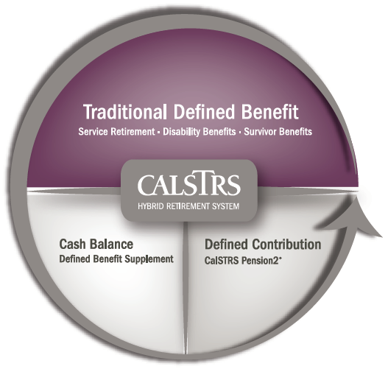
CalSTRS Hybrid System
Section 5
Membership includes:
Defined Benefit Program
Defined Benefit Supplement Program
Optional:
CalSTRS Pension2
Notes:
Up to this point, everything we’ve talked about is only the Defined Benefit Program.
Click.
Your membership also includes a Defined Benefit Supplement account…
Click.

Slide 35
Extra-Pay Assignments
Section 5
8% Member
Contribution
☑
Find your Defined Benefit Supplement account balance on myCalSTRS or your Retirement Progress Report.
8% Employer
Contribution
Defined Benefit Supplement Account
*9% for 2% at 62 members
Notes:
The Defined Benefit Supplement account is a cash balance account that offers guaranteed benefits based on your contributions and credits.
The Defined Benefit Supplement Program was created back in 2001. Between 2001 and 2010 we redirected a quarter of your monthly contribution to this account to give you additional income in retirement.
Click.
You also contribute to this account by working anything above one year of service credit (such as summer school, coaching, yearbook, etc.). 8 percent of your and your employers contributions for service in excess of one year go into your Defined Benefit Supplement account. Your account also gains a guaranteed interest rate each year.
Click.

Slide 36
Defined Benefit Supplement Account
Section 5
☑
Watch the Defined Benefit Supplement video series at CalSTRS.com.
Annuity
Lump Sum
Combo
Choices
Notes:
At retirement, you will have to decide how you want to receive these funds.
You can take them in a lump-sum, annuitize them or do a combination of the two.
There are several tax considerations for this account so it’s a good idea to review the Defined Benefit Supplement video series on CalSTRS.com and discuss your choices for this account with your financial representative as you near retirement.
You may want to consider rolling the Defined Benefit Supplement account funds into a qualified plan...
Click.

Slide 37
Supplemental Savings
Section 5
Notes:
This brings up the third part of the CalSTRS hybrid. You can roll your Defined Benefit Supplement funds into a CalSTRS Pension2 account, or you can also roll over funds from an existing plan you might have. Our Pension2 representatives are not paid on commission and can offer you nonbiased advice on what accounts may be a good fit for you and if rolling funds over is in your best interest.
Click.

Slide 38
Supplemental Savings
Section 5
403(b)
457(b)
Roth 403(b)
Roth 457(b)
☑
Visit Pension2.com for more information, educational videos and savings calculators.
☑
See your employer’s plans at 403bCompare.com
Notes:
Pension2 offers 403(b), 457(b), Roth 403(b) and Roth 457(b) plans that often have lower fees and expenses compared to other plans.
There are a variety of investment options – you can chose your own investments or let us do the work for you based on your anticipated distribution date and risk tolerance.
You can learn more, watch educational videos and use a personal wellness plan calculator to estimates your account balance based on various contribution amounts at Pension2.com.
You can also research the fees and expenses of other plans offered by your employer at 403bCompare.com.
If you’re interested in learning more about investing or money management, check out our Financial Awareness workshops series, which we will discuss more in a moment.
Click.

Slide 39
CalSTRS Pension2
Section 5
Tax-deferred retirement savings
Low and transparent costs
No commissions, load fees or surrender charges
Flexible investment options
Visit Pension2.com or call 888-394-2060 for more information.
Notes:
Pension2 is a great way to save more for your future because you can contribute tax-deferred money, there are low and transparent costs, no commissions, load fees or surrender changes, because CalSTRS is a nonprofit organization, we want you to keep all of your hard earned money. There are also flexible investment options.
If you have additional questions about Pension2, you can visit Pension2.com or give them a call at 888-394-2060.
Click

Slide 40
Section 6: Coverage Types

Slide 41
Coverage Types
Section 6
Coverage A

Fill in your coverage type on page 3.
Member prior to October 15, 1992
☑
Verify your coverage type on your Retirement Progress Report.
Coverage B
Member on or after October 15, 1992
Chose coverage during special election period
Notes:
Now, just as I’ve reviewed the different benefit structures today, I also want to discuss coverage types—there are two of them…
Your coverage type determines how your disability and survivor benefits are calculated.
Fill in your Coverage Type on the bottom of page 3, section 6 of your handout.
If you became a CalSTRS member prior to October 15, 1992, you have Coverage A.
If you became a member of CalSTRS on or after October 15, 1992, or elected the coverage during a special window period, you have Coverage B.
Your coverage type also determines the amount of your one-time death benefit….
Click.

Slide 42
Section 7: One-Time Death Benefit

Slide 43
One-Time Death Benefit
Section 7
$6,372
Before or after retirement

Fill in your one-time death benefit amount on page 3.
Coverage A
$25,488
Before retirement
☑
Complete the Recipient Designation form to name or update recipients.
Coverage B
$6,372
After retirement
Notes:
This is a one-time, lump-sum payment paid to a recipient or recipients of your choosing upon your death.
There is a spot to note your benefit amount before and after retirement on the top of page 3 of your handout.
Click.
If you have Coverage A, your benefit is $6,163 before or after retirement.
Click.
If you have Coverage B, your benefit is $24,652 before retirement and $6,163 after retirement.
We will pay this amount to your estate upon your death if you have no recipient on file. You can designate one or multiple primary and secondary recipients to receive this benefit by completing the Recipient Designation form on myCalSTRS or via the paper document. *Please note: If you are married, your spouse must sign this form as well.
We recommend you review your recipient designation every five years or after any major life events such as marriage, divorce, or the birth or death of a loved one.
Another benefit that may be payable upon your death is a survivor benefit…
Click.

Slide 44
Section 8: Survivor Benefits

Slide 45
Survivor Benefit Eligibility
Section 8
Membership

Fill in the age for eligible dependent children on page 4.
One year of service credit
Actively contributing at time of death
Survivor
☑
Read more about eligibility in the Member Handbook.
Spouse or registered domestic partner
Financially dependent children
Coverage A – under 22
Coverage B – under 21
Notes:
Survivor Benefits are payable if you have one year of service credit and pass away while an active member.
Your eligible survivors include your spouse or registered domestic partner and financially dependent children.
Fill in the dependent child age limit on page 4, section 8 of your handout.
For Coverage A, eligible survivors include financially dependent children under age 22.
For Coverage B, eligible survivors include financially dependent children under age 21.
In some circumstances, dependent parents may qualify for a survivor benefit if you have Coverage A.
You can find more details about eligibility in the Member Handbook.
You can also view the Survivor Benefits video at CalSTRS.com to recap information we’re going over and different benefit scenarios…
Click.

Slide 46
If There Are No Eligible Survivors
Section 8
No Eligible Survivors
☑
View the Survivor Benefits video at CalSTRS.com.
Account Balance
One-Time Death Benefit Recipient
Notes:
If you don’t have any eligible survivors or are otherwise not eligible for a benefit, your account balance will be paid to your one-time death benefit recipient.
Keep in mind you can track your account balances on myCalSTRS.
It’s important that your eligible survivors know to notify CalSTRS of your passing as soon as possible so we can initiate their benefits…
Click.

Slide 47
Survivor Benefit Payments
Section 8
Monthly Benefit
☑
Be sure your loved ones know to notify CalSTRS of your passing.
Surviving Spouse
Return of Account Balance
10% Final Compensation per child up to 50%
Surviving Children
Notes:
Your surviving spouse’s available choices depend on your coverage type and whether you have eligible children , but your spouse may be able to chose between receiving a monthly benefit or a return of your account balance.
Additionally, and in some case depending on the choice your spouse makes, your surviving dependent children can each receive 10% of your final compensation up to a combined total of 50%.
Read The Member Handbook for further Coverage A and B survivor benefit considerations.
Let’s take a look at a survivor benefits example.
Click.

Slide 48
Laura’s Survivor Benefits
Section 8
Let’s assume:
Laura is an active member
Laura has no children
Her fiancé Raymond is her one-time death benefit recipient
Laura dies before retirement
Notes:
Let’s assume:
Laura is an active member with no children, her fiancé Raymond is her one-time death benefit recipient and she dies before retirement. What would happen?
(pause for response)
Click.

Slide 49
Laura’s Survivor Benefits
Section 8
No Eligible Survivors
Account Balance
One-Time Death Benefit Recipient
Notes:
In this case, Laura doesn’t have any eligible survivors so her one-time death benefit recipient, Raymond, would receive a return of her account balance
Click.

Slide 50
Laura’s Survivor Benefits
Section 8
Let’s assume:
Laura is an active member
Laura has no children
Her fiancé husband Raymond is her one-time death benefit recipient
Laura dies before retirement
Notes:
Now lets make all the same assumptions but assume Raymond and Laura were married when she died. What would happen?
(pause for response)
Click.

Slide 51
Laura’s Survivor Benefits
Section 8
Monthly Benefit
Surviving Spouse
Return of Account Balance
Notes:
In this case, Raymond would be considered a surviving spouse and could chose to receive a monthly benefit or a return of Laura’s account balance.
Are there any questions about survivor benefits?
(provide time for questions)
Now let’s look at the disability benefits you have with CalSTRS…
Click.

Slide 52
Section 9: Disability Benefits

Slide 53
Disability Eligibility Basics
Section 9
Service Credit
☑
Schedule a disability benefits planning session if needed.
Five years or
One year if disability is due to unlawful act while working
Medical
Permanent or continuous impairment
Prevents you from performing usual duties or those of a comparable position
Notes:
The basic eligibility requirements for a disability benefit are five years of service credit or one year of service credit if your impairment was due to an unlawful act of bodily injury while teaching.
Your impairment must be permanent or expected to last more than 12 continuous months. It must also prevent you from performing your usual duties or those of a comparable level position.
If you should suffer an impairment and believe you may qualify for a disability benefit, contact CalSTRS as soon as possible to schedule a disability benefits planning session. A benefits specialist can prepare estimates and walk you through the application process.
Your eligibility and benefits can depend on when you apply so it’s important not to delay in initiating the process.
Click.

Slide 54
Disability Benefit Formula
Section 9
50%
Final compensation
☑
Read Your Disability Benefits Guide for more about alternate calculations.
10%
Final compensation per eligible dependent child
Disability Benefit
Notes:
The basic disability benefit is 50% of your final compensation plus an additional 10% per dependent child up to a combined total of 40% for your children.
Your disability benefit might be calculated differently if you work part time or if you’re a Coverage A member over age 45 with fewer than 10 years of service credit.
The Your Disability Benefits Guide provides comprehensive information on benefits for both coverage types and includes the forms you will need to apply. It’s important to read the guide and contact us if you believe you may qualify for a benefit.
Are there any questions about disability benefits?
(provide time for questions)
Click.

Slide 55
Section 10: Learn More

Slide 56
My Retirement Decisions Workshop
Section 10
☑
View schedule and register at
CalSTRS.com/workshops.
Notes:
I want to let you know more about our other workshops….
In My Retirement Decisions, our third workshop in this series, you will learn more about your retirement timeline and the decisions you will face as you near the end of your career such as:
When should I retire?
Do I want to leave a lifetime monthly benefit to a loved one?
And what should I do with my Defined Benefit Supplement funds?
We also offer the Financial Awareness Series I mentioned earlier…
Click.

Slide 57
Financial Awareness Workshops
Section 10
Save for Your Future
☑
Visit CalSTRS.com/ financial-awareness.
Budgeting basics, savings and investing, credit and debt
Plan for Your Future
Retirement lifestyle, expenses, income and obstacles
Protect Your Future
Retirement distributions, maximizing and protecting income
Notes:
There are three separate workshops that can be beneficial at any time throughout your career.
Click.
Save for Your Future focuses on creating budgets, saving and investing, and managing credit and debt.
Click.
Plan for Your Future focuses on reaching the retirement lifestyle you want by planning your expenses and income and how to overcome obstacles.
Click.
Protect your Future focuses on retirement distributions and maximizing and protecting your additional income sources.
You can learn more at CalSTRS.com/financialawareness
Are there any questions?
Click.

Slide 58
Questions?
☑
CalSTRS.com
myCalSTRS
800-228-5453
Monday – Friday
7 a.m. to 6 p.m.
Send us an online message using myCalSTRS or give us a call.
Notes:
(Provide time for questions)
If you have additional questions check out the variety of resources at CalSTRS.com. You can send and receive online messages with us on myCalSTRS or call us at 800-228-5453 weekdays from 7 a.m. to 6 p.m.
Thanks for attending! We welcome your feedback. Please look for a short survey in your email inbox about today’s session in the next few weeks.

Slide 59
Thank You For Attending

