Slide 1
Early Career Educator
Learn and Discover
Notes:
Welcome everyone, thank you for joining us. The time is , but we would like to wait a few more minutes to allow others to join we will be starting in just a few moments.
Welcome to the CalSTRS Early Career Educator: Learn and Discover webinar. My name is , and I am a benefits specialist at the __________ Member Service Center/ office.
**feel free to input a personalized introduction about yourself and your background**
Before we start, I’d like to address a couple items.
Today's presentation is packed with a lot of information and demonstrations of our online resources. Please be sure you have pen and paper available to take notes, I can give you a couple of minutes if you need to grab them. As we move thorough the presentation, we encourage you to submit any questions you may have. On the right-hand side of your screen, you will see a Question Mark. Click on it to type in your question and then hit send.
Also, on the right-hand side you will notice the document icon. If you select this icon, you can view and download any materials associated with this webinar. For today’s webinar you can download the early career educator member kit. This member kit is a publication put together specifically for educators that are about midway into their career. It explains the CalSTRS benefits as well as topics such as social security and other policies that can affect your retirement.
Please do not submit any personal information OR request from us any information that is specific to your account. For your security we ask that if you do have any questions specific to your retirement account you email those through your secured myCalSTRS account or to call us at 1-800-228-5453 and speak with a CalSTRS representative.
If you find that you have questions after the webinar is complete, I urge you to log into your myCalSTRS account and send a secure online message. You can log onto myCalSTRS anytime.
Click.

Slide 2
Trust , not impersonators
CalSTRS authorized representatives:
Have an email address ending in @CalSTRS.com.
Can provide a CalSTRS ID badge or business card.
Do not provide refreshments at offsite events.
Will never meet at your home.
Do not sell insurance products.
Notes:
Before we start, we’ve been receiving constant reports from our members believing they’ve set up an appointment or spoken with a CalSTRS representative when they have not. Only CalSTRS employees can provide you with accurate information regarding your CalSTRS Defined Benefit and Pension2 accounts. We’ve developed a checklist for you to use to ensure the person with whom your speaking is a CalSTRS employee.
Companies or individuals not affiliated with CalSTRS cannot have the CalSTRS logo on their advertisements.
Only CalSTRS employees will have an @CalSTRS.com e-mail address on their business cards. Please double-check the spelling of CalSTRS.
CalSTRS does not provide any refreshments when we come to see you at events.
CalSTRS employees will never meet you at your home.
CalSTRS is not an insurance company, so we will never try to sell you on any insurance products.
Click.

Slide 3
Trust , not impersonators
CalSTRS authorized representatives:
Have access to your CalSTRS or Pension2® account information.
Some Voya Financial representatives work exclusively with Pension2®. Their names and photos are listed at CalSTRS.com/Trust-CalSTRS.
To verify a CalSTRS representative, contact us at 888-394-2060 or RepCheck@CalSTRS.com.
Notes:
Only CalSTRS employees will have access to your CalSTRS or Pension2 account information. If you’re asked to provide a copy of your CalSTRS Retirement Progress Report or Pension2 account statement in order for someone to assess your CalSTRS accounts, they are not affiliated with CalSTRS.
CalSTRS has created a webpage at www.CalSTRS.com/Trust-CalSTRS with names and pictures of all our member-facing employees. This webpage is kept up-to-date, so you can always ensure you’re speaking with a CalSTRS employee. There are some representatives from Voya Financial with an @Voya.com e-mail address who work exclusively on the Pension2 program. Their names and photos will also be found on the CalSTRS Outreach Page.
If you scheduled an appointment or already met with someone you think may not be a CalSTRS representative, contact us at 888-394-2060 or RepCheck@CalSTRS.com to verify they are a CalSTRS representative.
Please disseminate this information to any friends or colleagues who may need it.
Click.

Slide 4
Objectives
Review the early career webpage and your Retirement Progress Report.
Explore disability and survivor benefits.
Discuss the purchasing or redepositing of service credit.
Notes:
The tools we are going to review today are available at your fingertips 24/7
In today’s webinar you will review the Early Career webpage and learn how to access your myCalSTRS account.
We will explore the disability and survivor benefits available to you as a calstrs member
We will also talk about purchasing service credit. The earlier in your career you purchase time, the cheaper it may be.
Click.

Slide 5
CalSTRS.com
Notes:
Intro to calstrs.com

Slide 6
Early career webpage
Your “one stop shop” for retirement information.
Links to forms and publications associated with early career.
This information is available to you 24 / 7 / 365.
Notes:
You will notice throughout today’s presentation that we are going to refer to the early career webpage quite a bit:
The early career webpage acts as a “one stop shop” for retirement information. We’ve collected links to all the pages we felt would be relevant to an educator in the middle of their career.
This page houses links to forms and publications commonly used by early career educators.
This information is available to you 24 hours a day, 7 days a week, 365 days a year. Unless of course the site is down for maintenance.
Click.

Slide 7
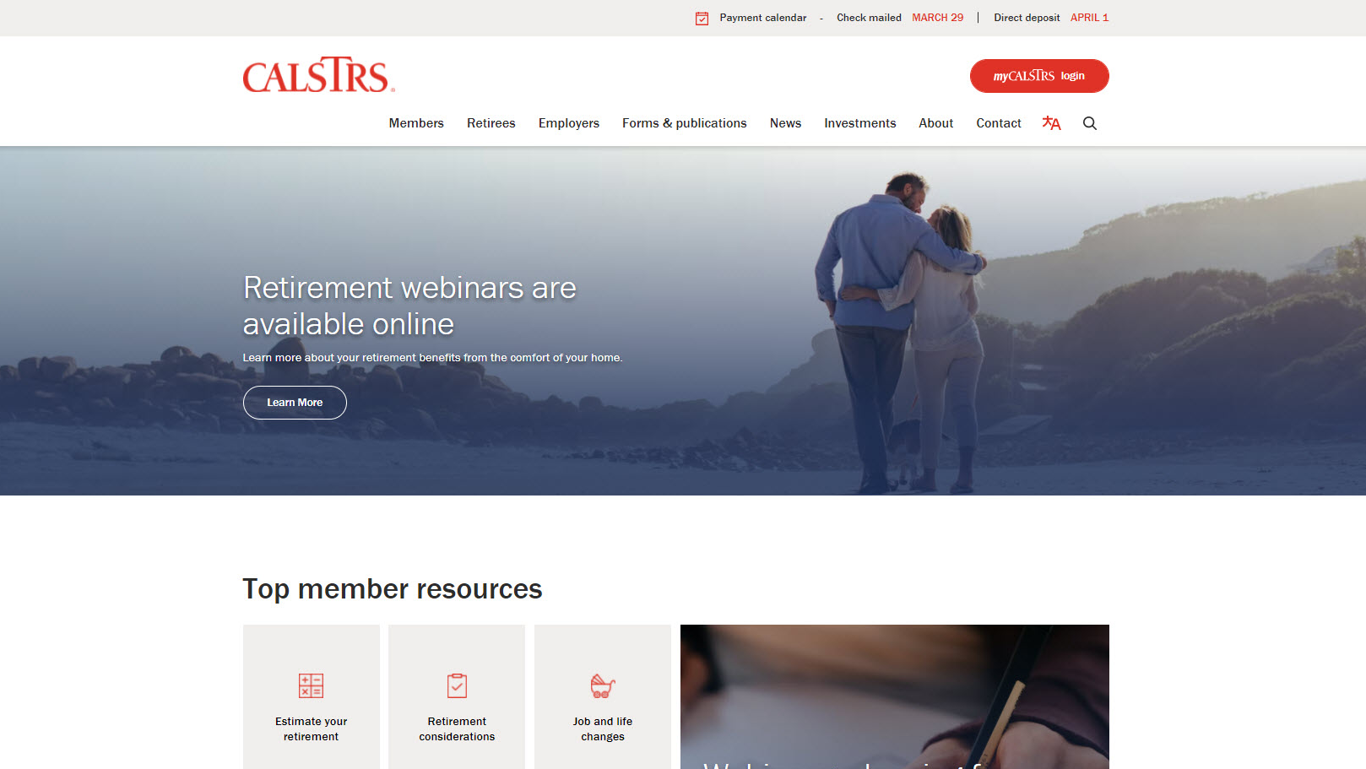
Notes:
You might have noticed that we have a brand new and refreshed website. CalSTRS had the goal of making this website easier to navigate for our members.
The first menu I want you to take a look at is “Members.” If you want to follow along, please note that you don’t have to click on this menu. Just hover your mouse over it and a menu will drop down.
Click.

Slide 8
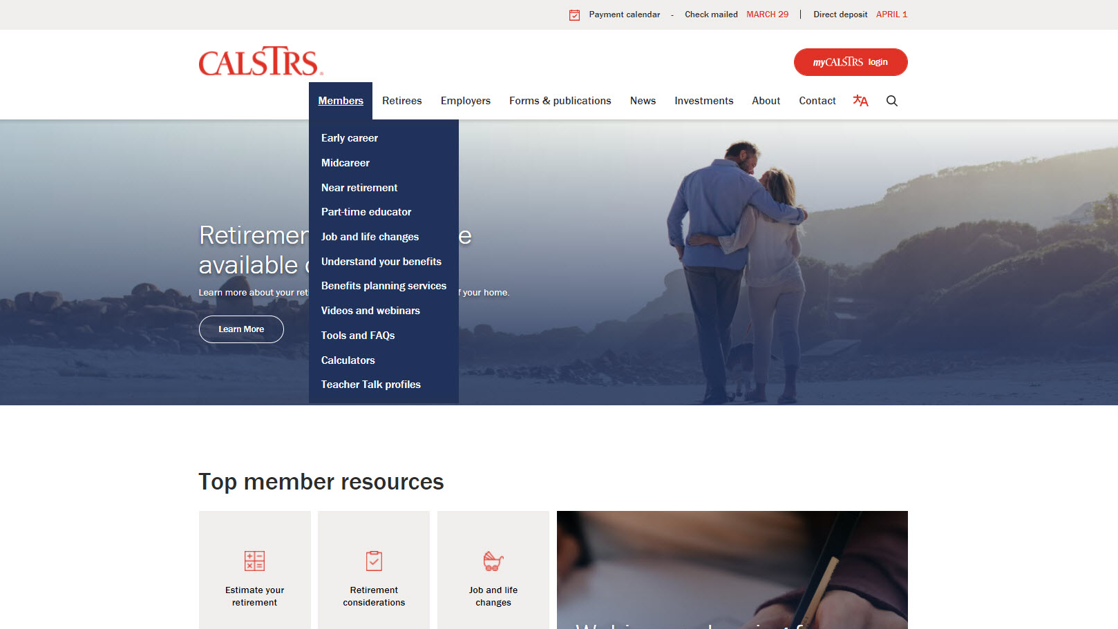
Notes:
After you click on members, this is what that drop down menu looks like.
You’ll see it’s simple to find the different pages we have dedicated to the 3 stages of your career.
Today, we will visit the Early career webpage. But the rest of these links are helpful too! I hope you’ll explore the Members section after today’s webinar.
Click.

Slide 9
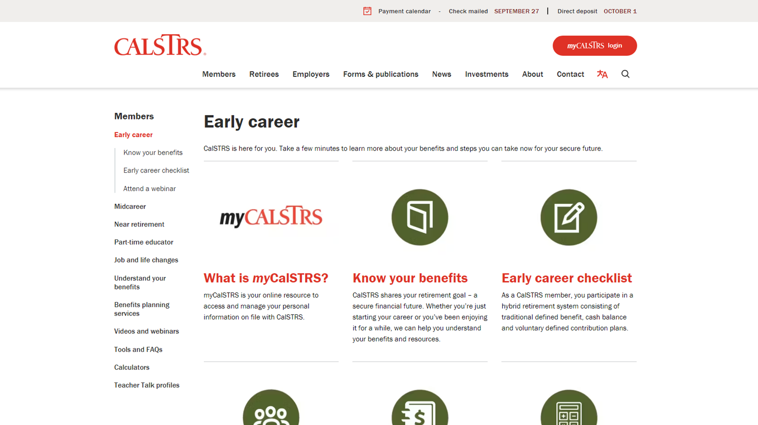
Notes:
When you click on Early career in the menu, it should bring you to this page. You’ll notice the green throughout the presentation and the green icons on this page. Each stage has its own color, Early career is green!
You’ll want to scroll down to see all the resources.
Click.

Slide 10
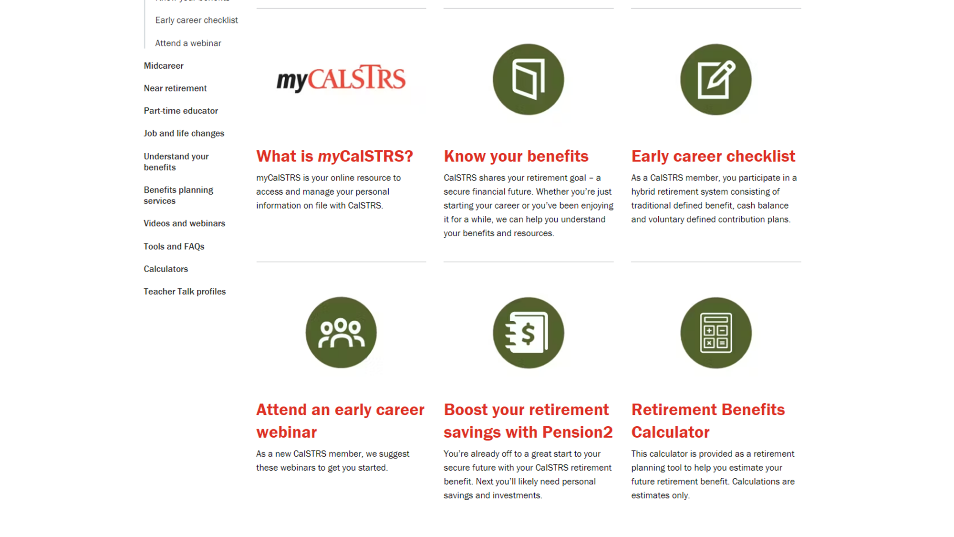
Notes:
Here we’ve scrolled down, now you can see there are 6 places to visit to learn more about your retirement.
The first on the list, and one of the most important to you, is myCalSTRS.
Click.

Slide 11
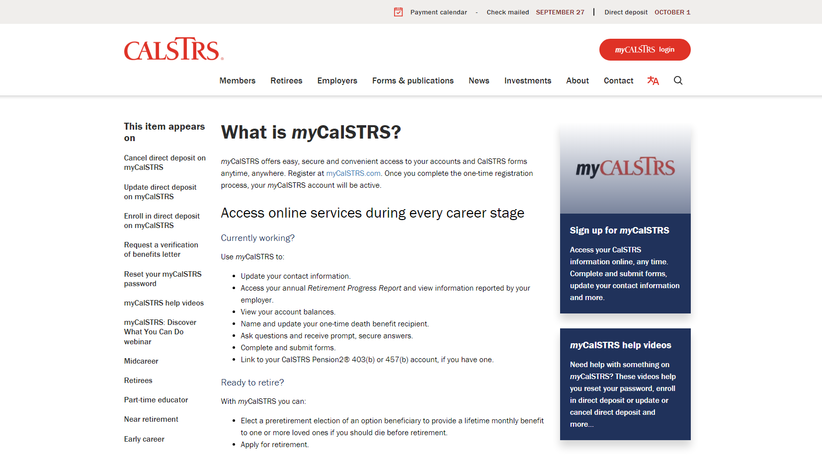
Notes:
What is myCalSTRS? This is your account that gives you access to manage your personal information.
Click.
To log in, you can click the link here in the text, or look for the big red button at the top right corner. Either way is fine and will take you to the same log in page.
Click.
Now, if you haven’t already done so, I encourage you to sign up to access your myCalSTRS account. You’ll just have to answer a few personal questions.
Click.
Finally, if you are having any issues with myCalSTRS, there are some videos to help with some of our common problems. Or you can always contact our customer service number.
Click.

Slide 12
Your myCalSTRS account
View and update your account information.
Submit forms and send secure online messages.
Access your Retirement Progress Report.
Notes:
This is the log in page for myCalSTRS.
Once logged in to your account, you will be able to view and update your account information. Using myCalSTRS you can ensure that we always have your up-to-date contact information.
You’ll be able to submit forms and send secure online messages.
And finally, access your Retirement Progress Report. This report comes out annually.
Click.

Slide 13
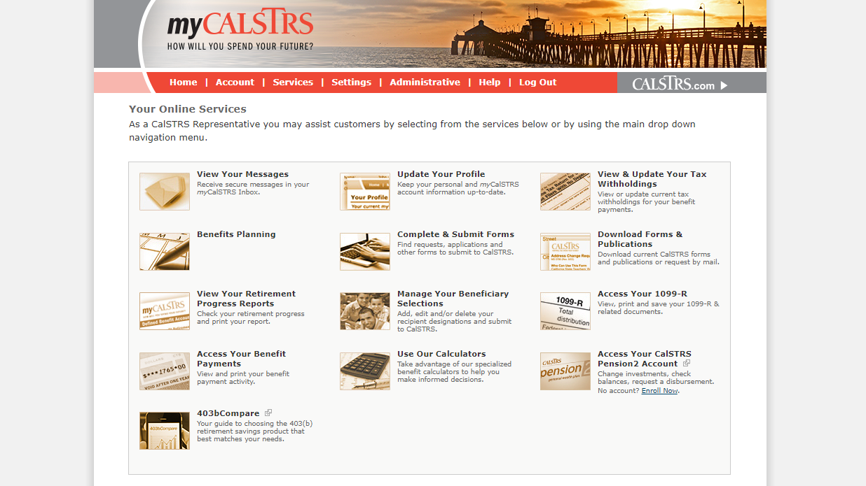
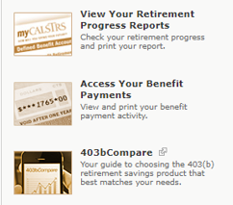
Notes:
Once you have logged into to your personal myCalSTRS account you are going to see a landing page that looks like this.
Your icons may not be the same as mine. Be aware that each person’s landing page is customized based on their situation.
Click.
By using the View Your Messages icon, you can send and receive secure online messages with a CalSTRS representative. This is where you’ll want to ask those questions you have that are specific to your account. And those messages are saved, so you’ll be able to go back in later and review at any time.
Click.
The Update Your Profile icon allows you to update personal information. So if you move or change phone numbers, please make sure all the contact information we have for you is correct. This includes your email address, too!
Click.
You can update your recipient information by selecting the Manage Your Beneficiary Selections icon. We recommend you review your beneficiary information at least once every 5 years.
Click.
This is where you’ll view your Retirement Progress Reports by selecting the View Your Retirement Progress Reports icon. A new report can be found every September while you are actively working.
Click.

Slide 14
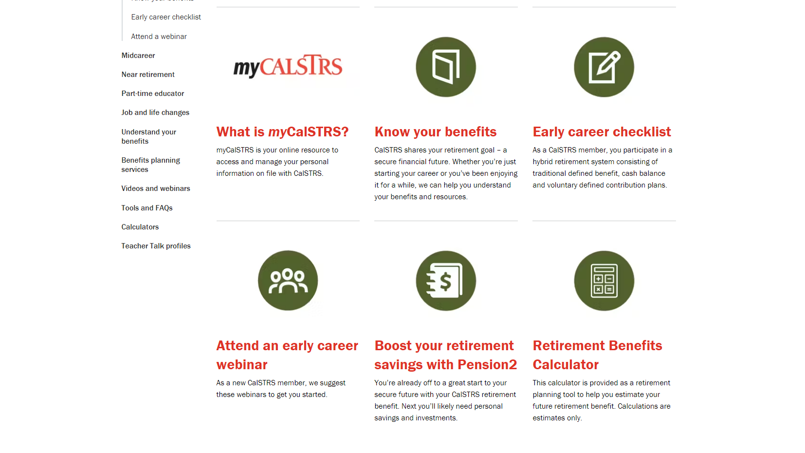
Notes:
Next up is “Know your benefits”
Click.

Slide 15
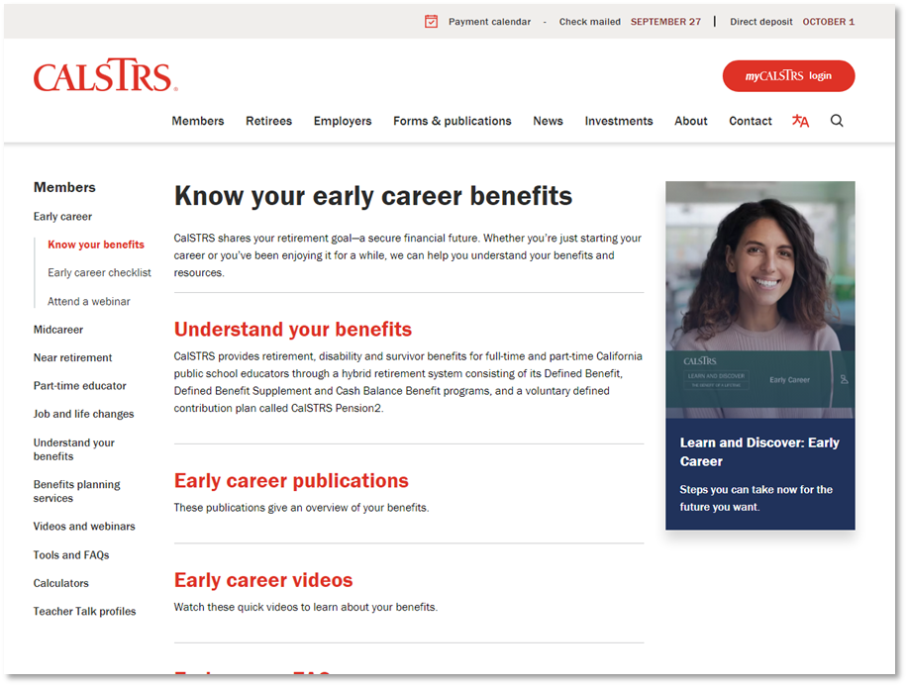
Know your early career benefits
Understand your benefits
Publications
Videos
FAQ
Notes:
This will bring you to a page where we’ve collected some of our resources that we feel are most applicable to you at this stage in your career.
If you want to read more about the program you’re in and what benefits are available to you, you’ll want to visit that first link “Understand your benefits”.
Our publications and videos are another great resource for you to gain more information. We’ve linked the publications and videos most commonly used by educators through the early stages of their career.
And the Frequently Asked Questions. When you click on that link, it’s actually broken down into topics. It might be wise to check these questions out, you may find answers to your questions without needing to contact us.
Click.

Slide 16
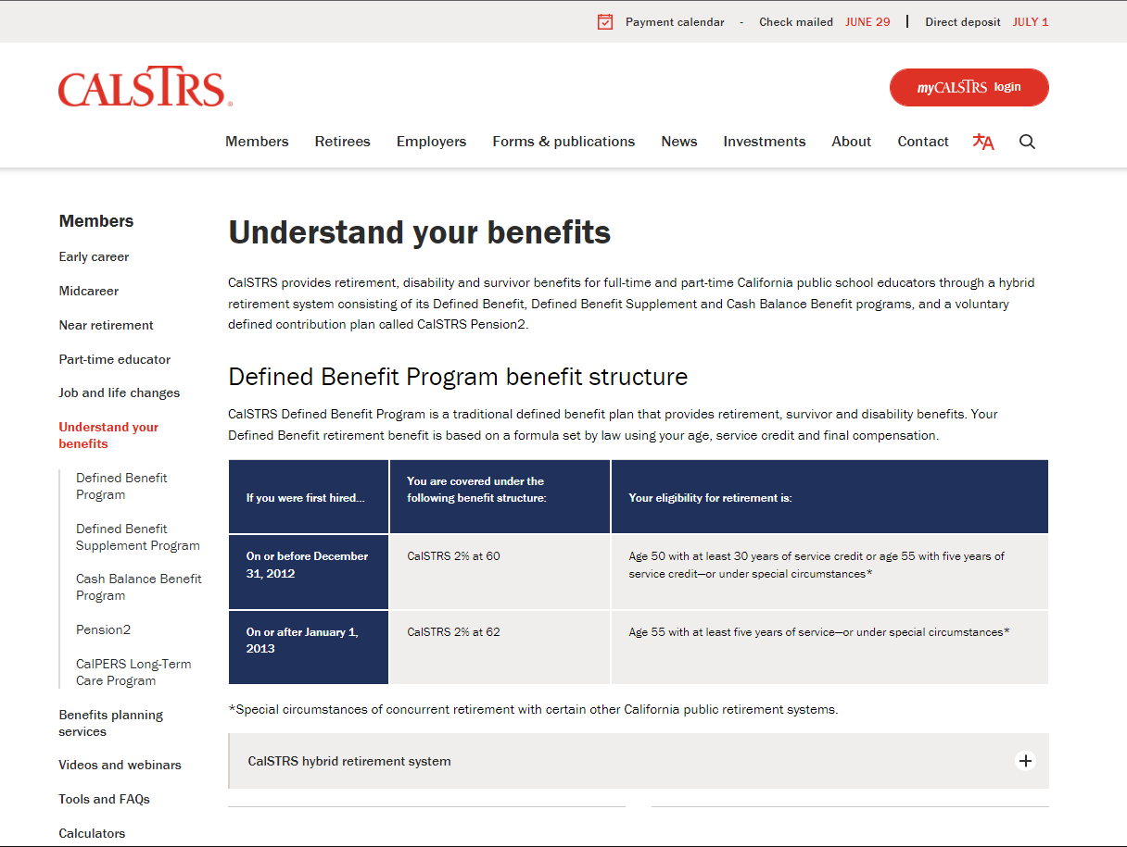
Understand your benefits
Defined Benefit Program benefit structure
CalSTRS hybrid retirement system
Information about Social Security
Notes:
I want to expand a little bit on the “Understand your benefits” page that was linked on the previous slide we just saw.
This page will tell you more about the benefit structures and when you’ll be eligible to retire.
There is information about each part of the hybrid that CalSTRS administers. Defined Benefit, Defined Benefit Supplement, Cash Balance, and Pension2.
Finally, as you scroll to the bottom of the page, you’ll see a blue box that links to some useful information about your Social Security benefit
Click.

Slide 17
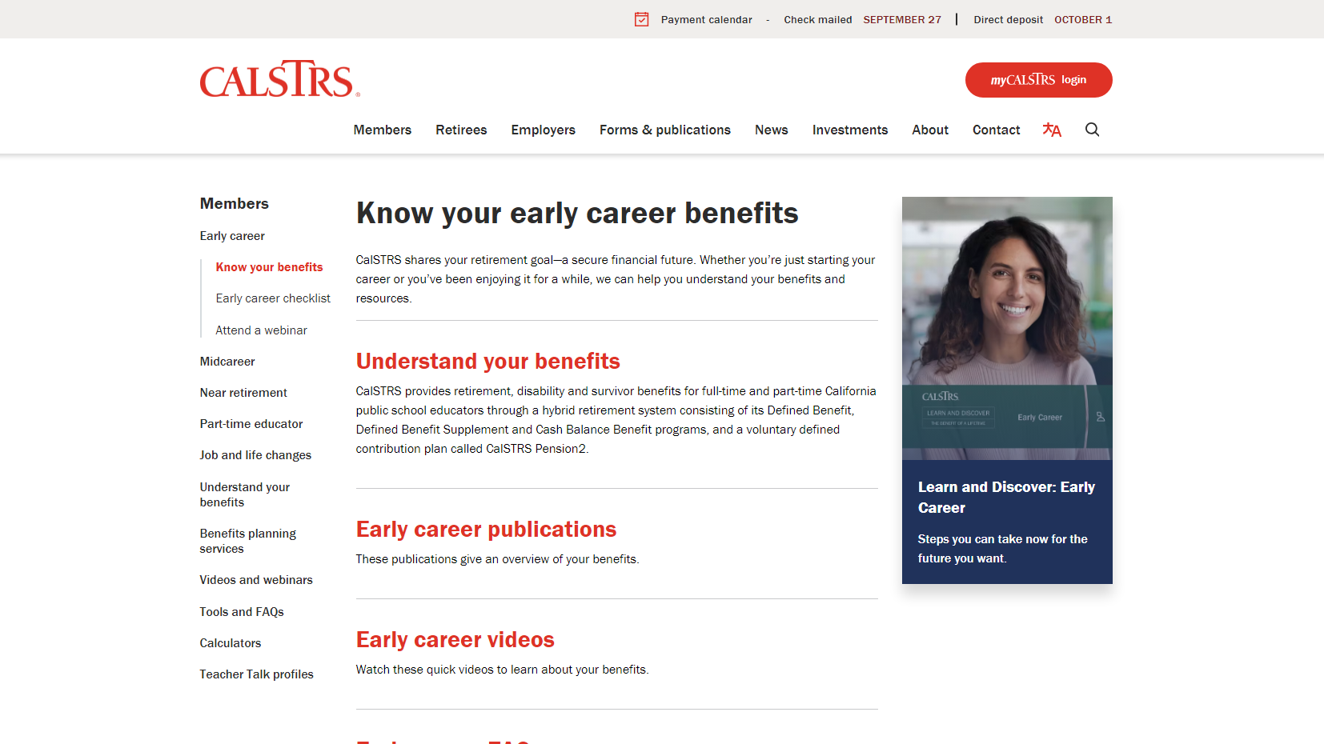
Notes:
Another important link on the “Know your early career benefits” page is here, “Your Smart Target Member Kit”
Click.

Slide 18
Learn and Discover: Early Career
Five reasons to start a 403(b) or 457(b) account today.
Read about your CalSTRS benefits.
Learn how to estimate and increase your retirement benefit.
Start picturing what retirement will look like.
Notes:
This resource is PACKED with information for you. We’ve really put a little bit of everything here.
You’ll find a list of 10 things to do at this stage of your career.
Again, this is another place to read about your CalSTRS benefits.
Learn how to estimate your retirement benefit. And if it isn’t quite as high as you need, it also talks about ways to increase that retirement benefit.
Finally, it’ll get you started on picturing what retirement could look like for you.
Click.

Slide 19
Notes:
Back to the early career page. Next is “early career checklist”
Click.

Slide 20
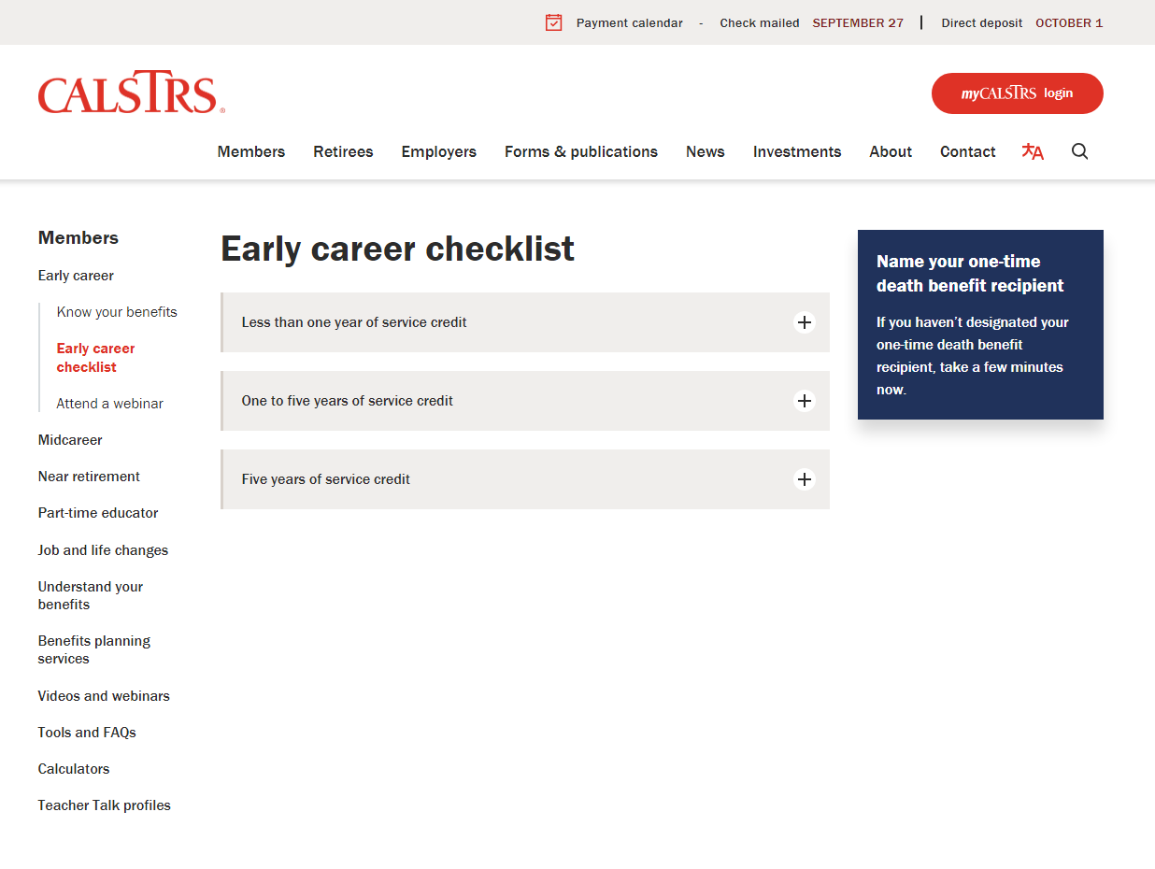
Early career checklist
Activate your myCalSTRS account.
Designate a one-time death benefit recipient.
Start a 403(b) or 457(b) retirement savings account.
Notes:
These checklists can help you ensure you’re doing the right things during this stage of your career. Depending on how many years you’ve been teaching, there are different things you should focus on.
The most important things you should be doing are:
Active your myCalSTRS account to view your account balances and service credit, update your contact information, or update your beneficiary.
Designate a one-time death benefit recipient. CalSTRS pays out a one-time payment upon your death to a person or entity of your choosing.
Start saving now! Your pension might not be enough to cover all your expenses in retirement. You’ll need an extra savings account to help you save and retire when you’re ready.
Click.

Slide 21
Notes:
CalSTRS has a library of webinars to choose from. We’ve tried to make this process easier by picking the webinars that are mostly related to early career educators.
Click.

Slide 22
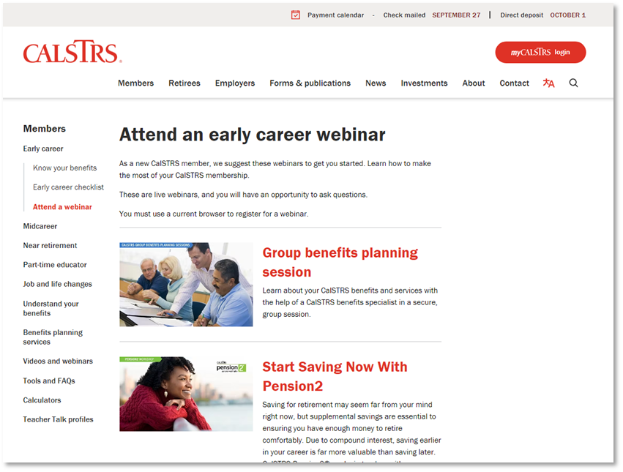
Attend an early career webinar
Start Saving Now with Pension2
My Retirement System
Save for Your Future
Notes:
We’ve listed 3 webinars. **Feel free to give brief overview of each webinar**
Pension 2
My Retirement System
and Save for Your Future. Which is actually the first of a 3 part Financial Awareness series.
Click.

Slide 23
Notes:
To learn how to save even more for retirement, you’ll definitely want to check out Pension2.
Click.

Slide 24
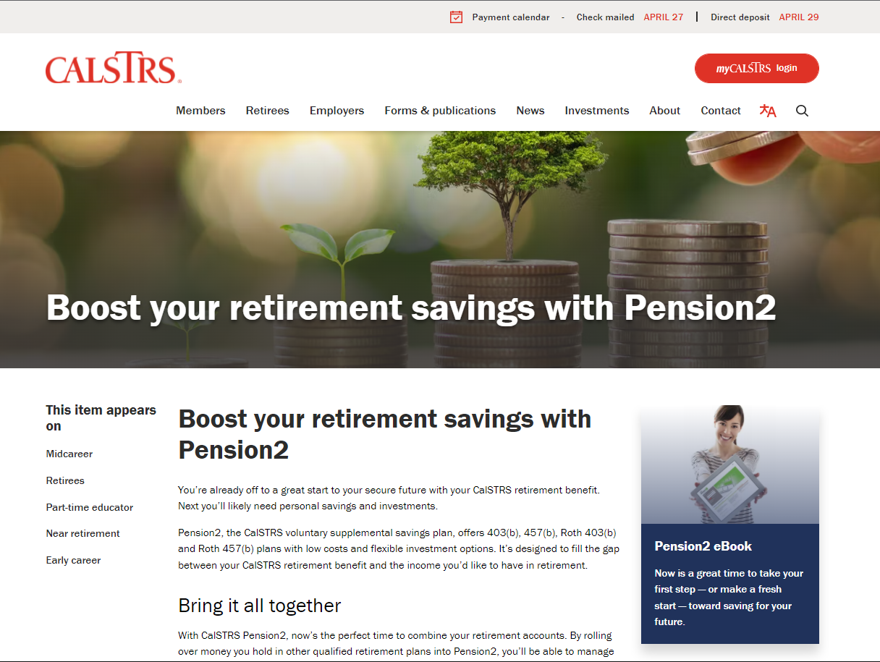
Boost your retirement savings with Pension2
Voluntary supplemental savings plan.
Roll over money from other qualified retirement plans.
Save on fees.
Visit 403bCompare.com.
Notes:
Pension2 is a voluntary supplemental savings plan offered to you by CalSTRS.
You can roll over money from other qualified plans to be able to manage your retirement savings in one place.
By joining Pension2, you might be able to save on fees.
If you want to compare fees, a good place to start is 403bcompare.com
Click.

Slide 25
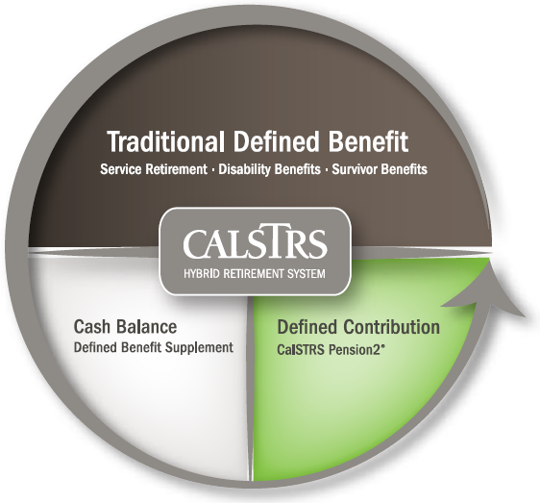
403(b)
Roth
403(b)
457(b)
Roth
457(b)
Notes:
Pension2 is the third part of the CalSTRS hybrid that is completely voluntary. It offers 403b, 457b, Roth 403b, and Roth 457b.
Click.

Slide 26
What if I already have an account?
Other supplemental savings plan accounts can be rolled into Pension2.
Your
current
account
CalSTRS
Pension2
Let us compare!
Call 888-394-2060 for a statement comparison.
Statement comparisons will be conducted by Voya Financial representatives working exclusively with Pension2. Their names and photos are listed at CalSTRS.com/Trust-CalSTRS.
Notes:
If you’ve already opened another supplemental savings account with another financial institution, you can look at rolling over that other supplemental savings plan account into Pension2 with a free statement comparison.
Call 888-394-2060 for a statement comparison.
Click.

Slide 27
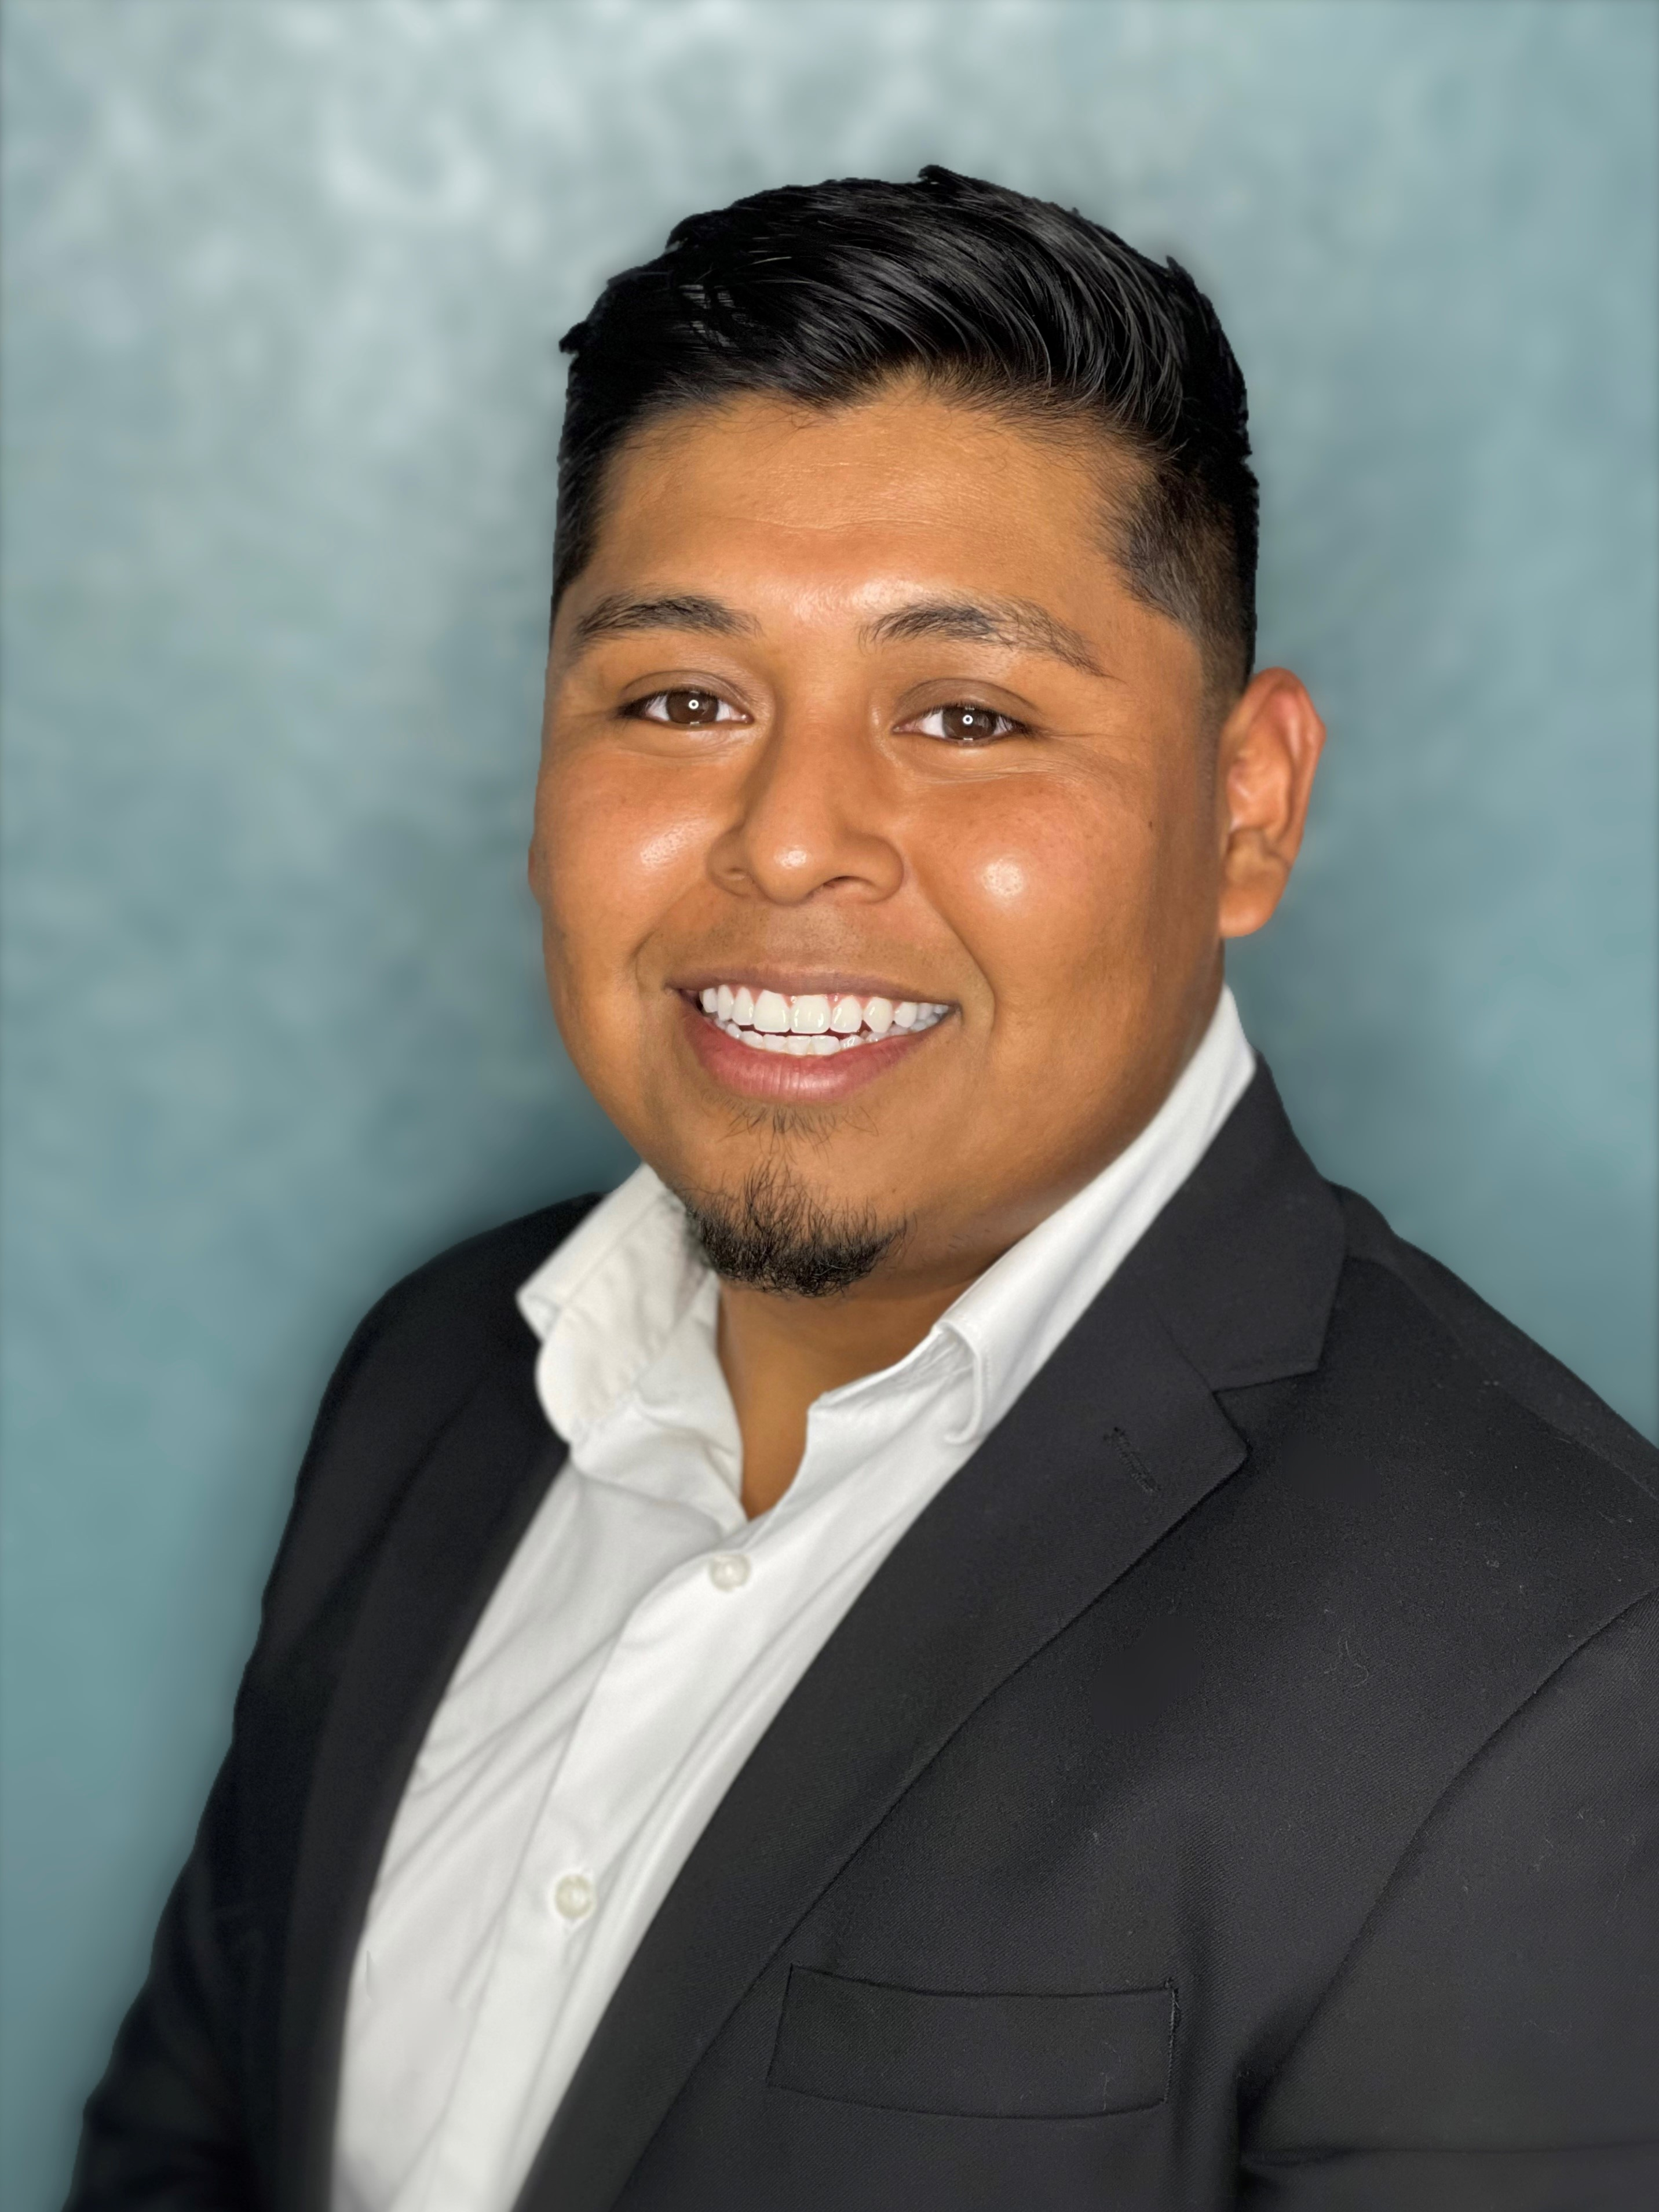
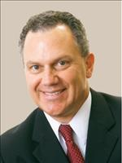
Voya Representatives for CalSTRS Pension2
Stephanie Henry
Stephanie.Henry@voya.com
Central Valley:
Fresno, Kern, Kings, Madera, Tulare, San Luis Obispo, Inyo
Aaron Ivey
Aaron.Ivey@voya.com
Sacramento Region, Northern California
Santiago Gonzalez
Santiago.Gonzalez@voya.com
San Diego, Imperial, Riverside
Aren Yarian
Aren.Yarian@voya.com
Los Angeles, Ventura, Santa Barbara, San Luis Obispo, Orange County
Jeff Kissiar
Jeff.Kissiar@voya.com
Sacramento Region,
Northern California
Verify your CalSTRS Representative at:
www.calstrs.com/verify-your-calstrs-representative
Notes:
HYBRID
Hi (______), thank you for joining us today. I’d like to give you the opportunity to introduce yourself and how you serve our members.
VOYA REP introduces themselves….
I am very happy to be speaking with all of you today and having this opportunity to introduce not only myself, but also the team I work with.
1. Provide overview of your background and how long you’ve been in the financial services industry.
2. Discuss why you starting working w/VOYA and have a passion for finance.
3. Provide a brief explanation of what you do for our members:
Statement comparison (what it is and why it’s a good idea to have one)
Rollover Assistance
Enrollment Contributions
4. Discuss One on One Meetings
In Person, Phone, and Zoom
Meeting before (territory driven - meeting one on one at MSCs or via telephone)
During (meeting w/all areas via zoom or telephone)
After pandemic (possible mixture or return to territory?)
HYBRID
Thank you for sharing that with us and supporting members throughout California.
We will have a polling question near the end of this webinar for those who would like take part in Pension2 or request a statement comparison.
CLICK.

Slide 28
Notes:
Finally, Estimate your retirement benefit.
Click.

Slide 29
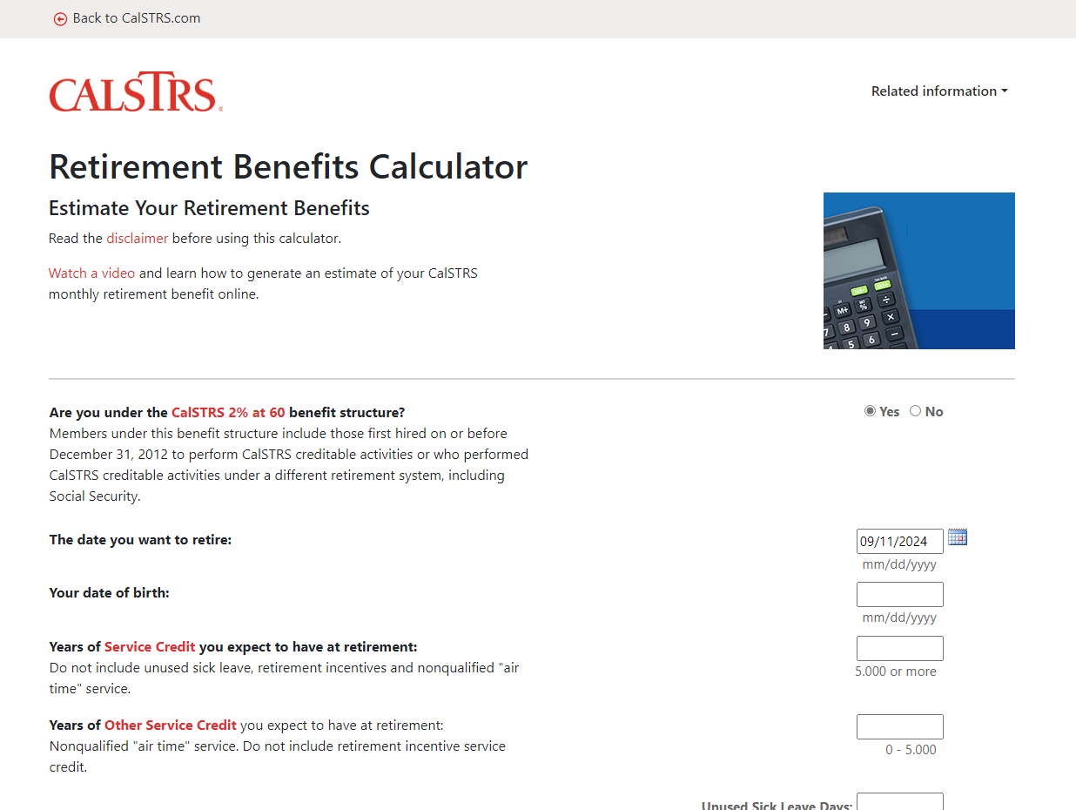
Retirement Benefits Calculator
Generate a retirement benefit estimate.
Customize your estimate by adding sick leave credit.
See how your benefit is impacted by working more or receiving a raise.
Notes:
You’ll be able to generate your own retirement benefit estimate. So play around with the benefit effective dates to see what might work best for you.
If you have unused sick leave on the books, that will convert to extra service credit at retirement. This calculator has a place for you to add in what balances you have now or anticipate you’ll have at retirement.
Maybe there’s a raise in your future. You get to input whatever salary you want into this calculator, so you’ll be able to see how your benefit is impacted.
Click.

Slide 30
View your Retirement Progress Report in your myCalSTRS account.
Notes:
We are done looking at those 6 resources on the early career page. Next, we will look at a sample Retirement Progress Report and how you can best utilize it when trying to determine how much you’ll be earning in retirement.
Click.

Slide 31
Notes:
To show you again, once you’re logged on, you’ll want to click “View your retirement progress reports” from the landing page.
Click.

Slide 32
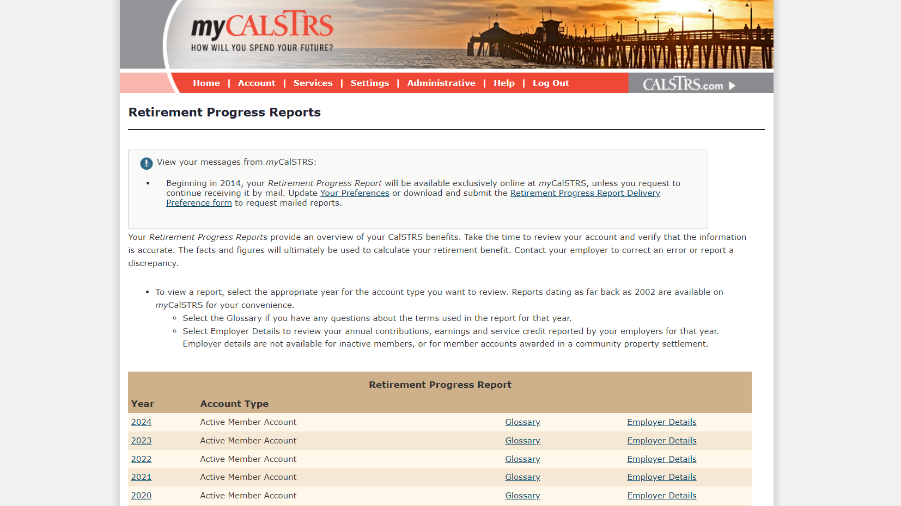
Notes:
You can view any year as far back as 2002.
Today we will look at a sample report from 2021. The most recent. Your 2022 report won’t be out until September.
Click.

Slide 33
Your Retirement Progress Report
Membership and benefit information.
Service credit and account balances.
Employer reporting.
Notes:
Your Retirement Progress Report is an annual report that comes out every September and tracks your Retirement progress. It has the information as reported by your employer through June 30 of the previous school year.
Your Retirement Progress report has your most current Membership and benefit information.
Service credit totals and account balances as well as the reporting we have received from your employer.
While you are still actively working it is very important that you check this report every year. If you notice any errors or discrepancies, we encourage you to talk with your employer right away so that the reporting can be corrected.
Let’s get into a sample Retirement Progress Report and I’ll show you in more detail.
Click.

Slide 34
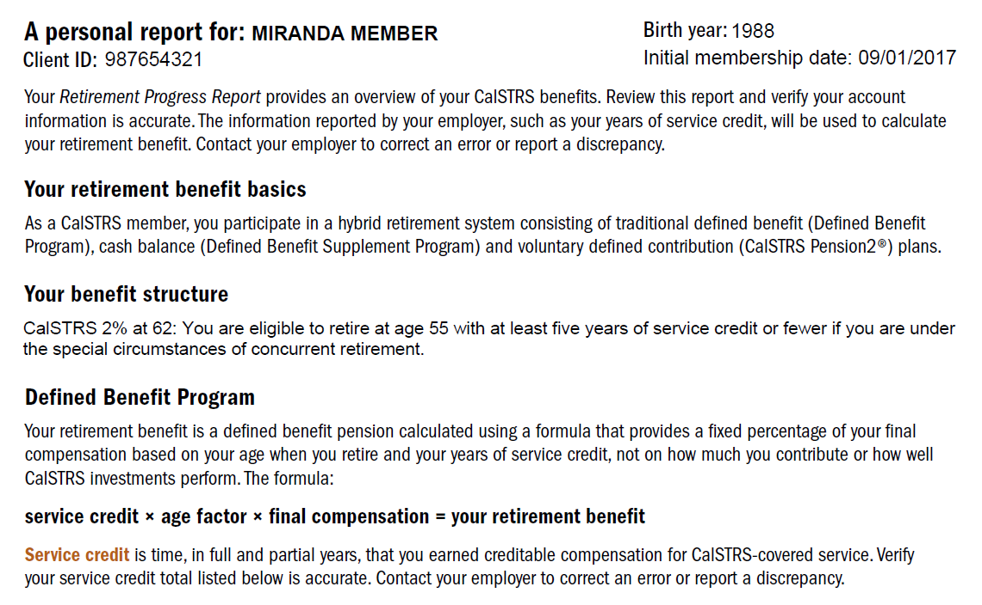
Page
1
Notes:
First, you can find your personal information at the top of page 1.
Click.
Here you will see your CalSTRS client id. The CalSTRS client id is your CalSTRS specific identification number. When you submit any forms with CalSTRS you can use this number instead of your social security number for security purposes.
Click.
Next is your benefit structure. CalSTRS has 2 benefit structures 2%@60 and 2%@62. So check your progress report if you aren’t sure which you belong to.
Click.
Finally, this is the formula we use to calculate your retirement benefit. Your CalSTRS benefit is based on this formula and not the balance in your account. It reads: service credit x age factor x final compensation.
Click.

Slide 35
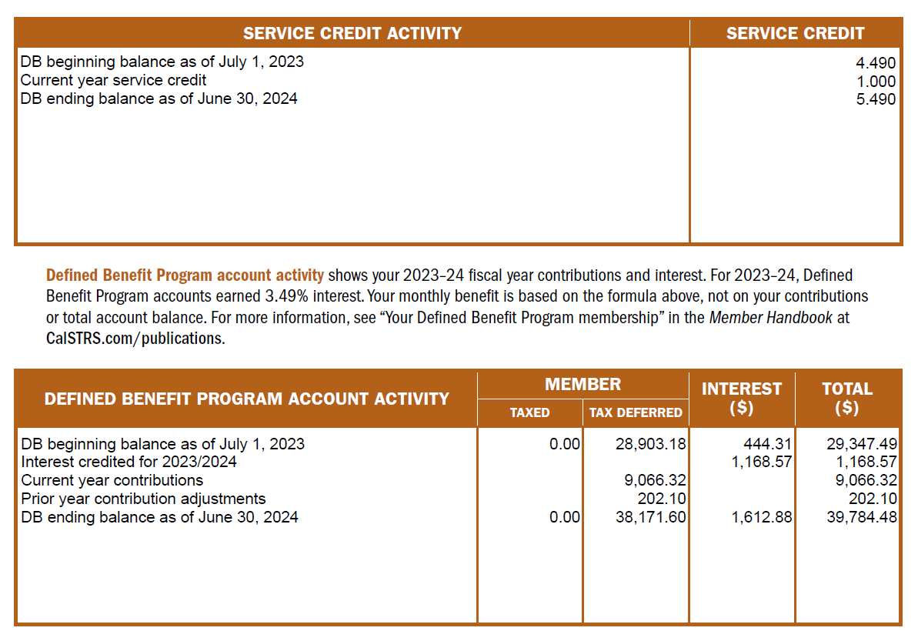
Page
1
Notes:
At the bottom of page 1, is where you’ll find your Service Credit balance. Remember that this is as of the end of previous school year.
Click.
You’ll want to verify that you are credited all the service credit that you earned. If you notice any discrepancy, please talk to your district to get it corrected. Then at the very bottom, you will see your account activity.
Click.
You can see the contributions you made during the last school year as well as your account balance. Keep in mind your benefit is not based on this balance but the formula we just discussed.
Click.

Slide 36
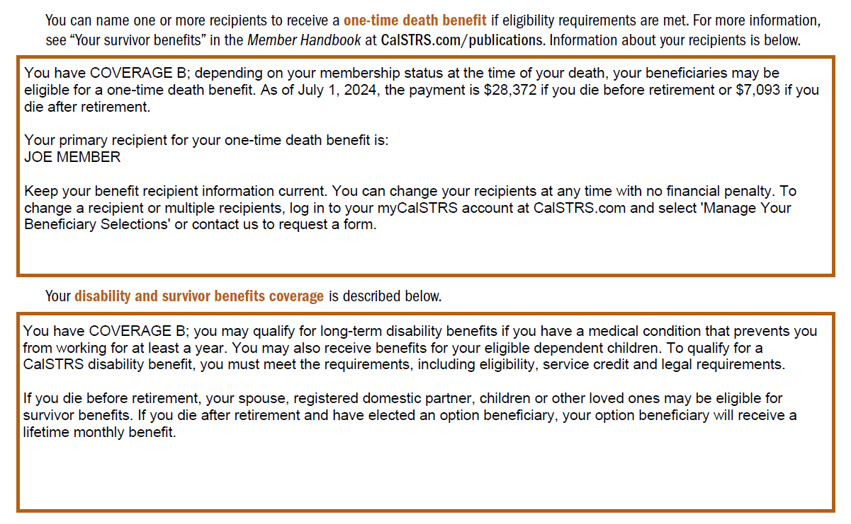
Page
2
Notes:
On page 2 of your RPR you can learn if you are Coverage A or B. Most of you in here will be covered under Coverage B.
Click.
If you’ve named your one-time death benefit recipient, you’ll find the name listed here.
Click.

Slide 37
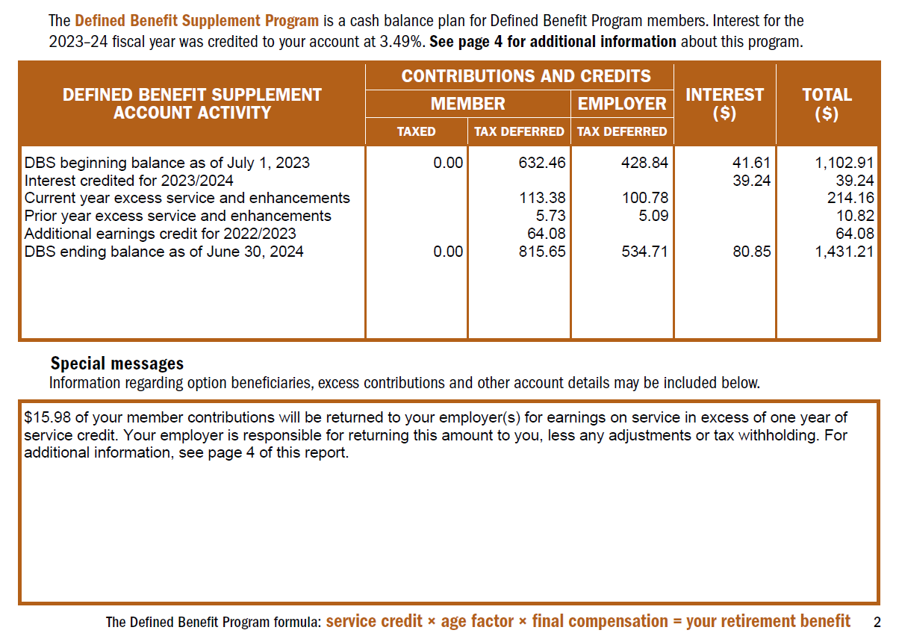
Page
2
Notes:
This top portion shows your account activity. You’ll find interested credited and current year excess service and enhancements. If your account had any reporting updated, that activity will also show up here. You can see this member had some credit added from the previous school year, 2022/2023.
Click.
This member did work extra assignments and therefore contributed to their DBS account.. And because DBS contributions are less than DB contributions, they will be receiving some money back.
Click.

Slide 38
Page
3
Notes:
Page 3 of your Retirement Progress Report has a checklist for you. These are action items that are appropriate for those members in the earlier stages of their career. You being here today is already great news!!
Click.

Slide 39
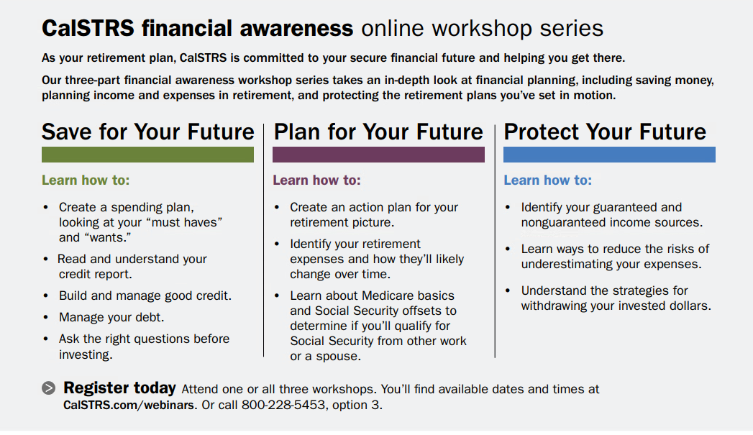
Page
3
Notes:
The bottom of page 3 has some extra information about our Financial awareness online workshop series. These webinars go above and beyond your CalSTRS membership and will help you gain some financial literacy. Some new information that can help you now where you are in life.
You’ll notice the green bar under Save for Your Future. If you haven’t checked out this webinar, I highly recommend it.
Click.

Slide 40
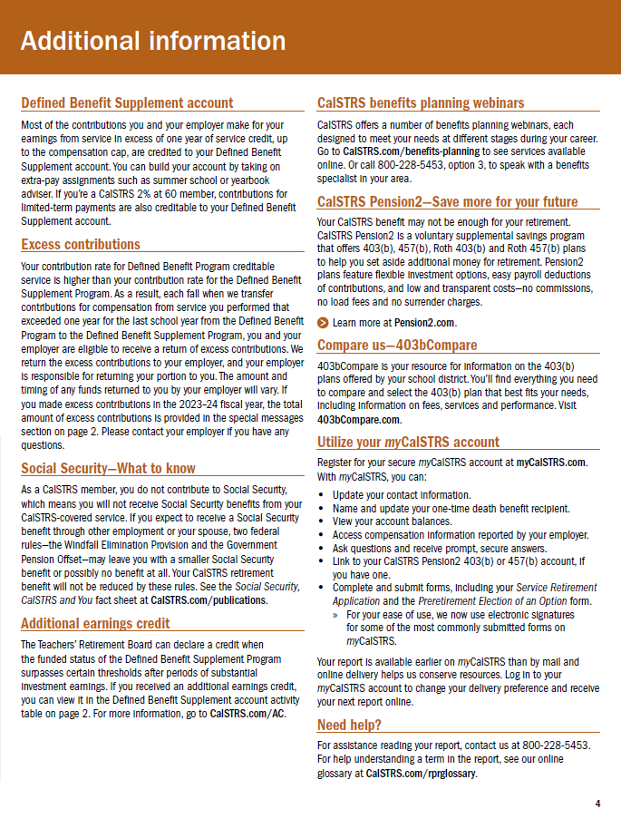
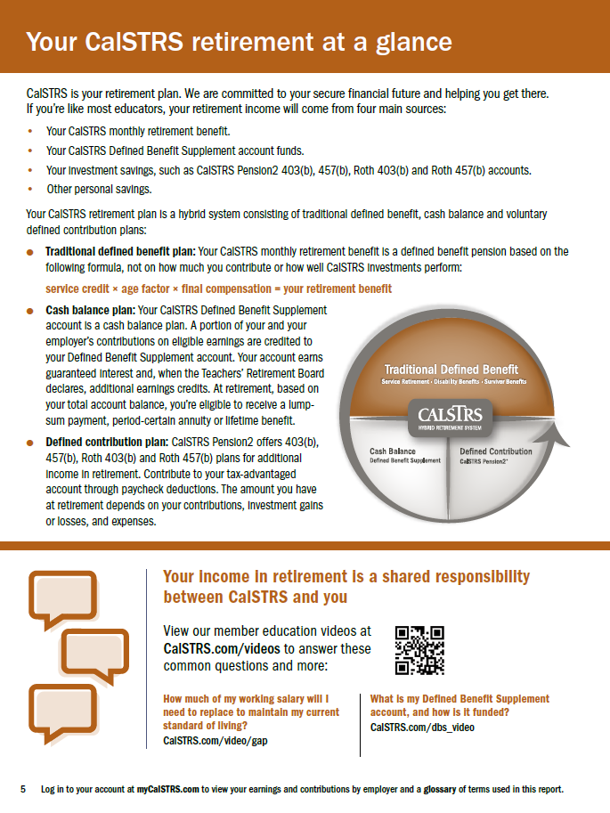
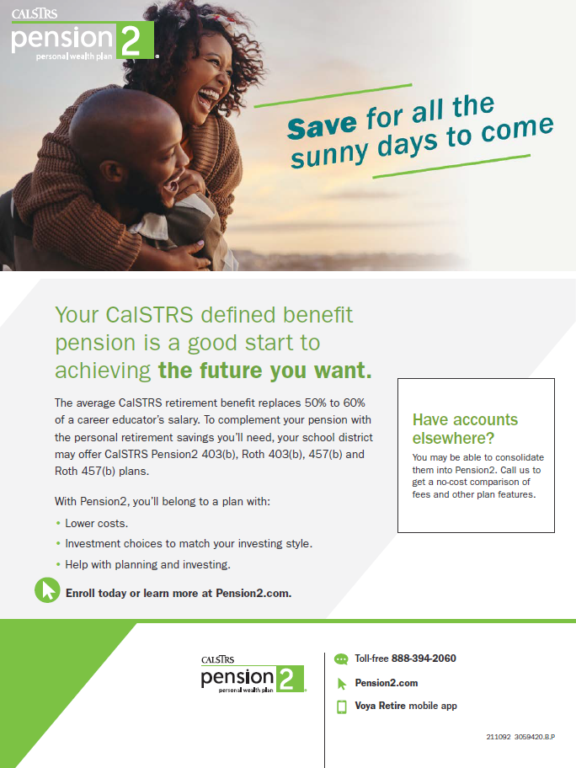
Pages 4-6
Notes:
Pages 4-6 has some really good information for you to learn more about CalSTRS and how you can create a secure future for yourself and your loved ones.
Click.

Slide 41
Disability benefits

Slide 42
Check your coverage type
Page
2
Notes:
Let’s go back to page 2 of the Retirement Progress Report. We looked at this previously to verify your one-time death benefit recipient.
We are looking at this page again to verify the type of coverage you have for disability and survivor benefits. Most, if not all of you, will be under Coverage B.
Click.

Slide 43
Disability benefits
Included with Defined Benefit Program membership.
Benefits for eligible dependent children.
Age, service credit and timeline requirements.
No health benefit coverage by CalSTRS.
Notes:
We saw in the RPR that long term disability benefits are available to those that qualify:
This is automatically included with your membership. This is not a separate program to be enrolled in. If you become disabled and unable to work, please contact us and we will help you figure out if a disability retirement is right for you.
Any disability benefit you qualify for will also include an extra 10 percent for any eligible dependent children (up to 4).
There are age, service credit, and timeline requirements. Again, if you become disabled, contact us and we will go over all of these requirements with you.
Reminder: CalSTRS does not offer any health benefit coverage. This will have to come from your employer or another 3rd party provider.
Click.

Slide 44
Your Disability Benefits Guide
Plan and research your decision.
Complete and submit your forms.
Understand CalSTRS’ role in the process.
Notes:
Everything you need to know is contained in this guide
Everything you need to plan and research before making a decision to claim a disability benefit
Instructions to complete and submit your forms
Learn about CalSTRS’ role in the process
Click.

Slide 45
Survivor benefits

Slide 46
Survivor benefits
Benefits depend on membership status at time of death.
Defined Benefit Program account
Defined Benefit Supplement account
One-time death benefit.
Notes:
In addition to disability benefits, there are also survivor benefits included in your CalSTRS membership.
There is a difference in benefits that is dependent upon your status at the time of death. Active, inactive, or retired….
Depending on that difference, your beneficiaries may be eligible for several benefits.
They could be eligible to receive a Defined Benefit Program account distribution.
OR a distribution from your Defined Benefit Supplement account.
And finally, that one-time death benefit you’ve heard me mention several times already today.
Click.

Slide 47
Survivor Benefits guide
Name a one-time death benefit recipient.
Monthly benefits vs. lump sum.
Electing an option beneficiary.
Notes:
We’re only briefly touching on the details of survivor benefits. For more information, this publication will go into much greater detail.
You’ll find instructions to name a one-time death benefit recipient. We encourage you name a recipient if you haven’t done so already.
You can read about the options for your survivors if you were to die while still an active member. There are situations that your survivor can choose between receiving a monthly benefit or a lump sum.
There is also information about election an option beneficiary. The beneficiary you name here will receive a lifetime benefit after your passing in exchange you’ll receive a modified benefit in retirement.
Click.

Slide 48
Name a one-time death benefit recipient
Notes:
To name a one-time death benefit recipient, you’ll go to Early Career Checklist on the early career webpage.
Click.

Slide 49
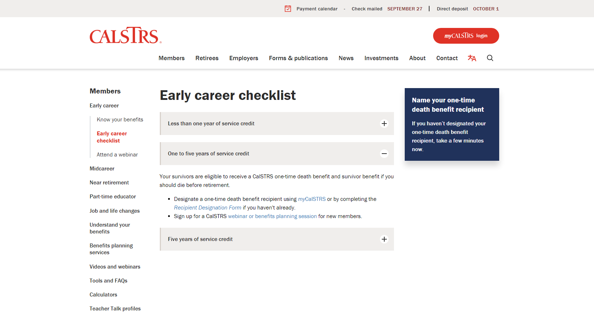
Notes:
If you open the “One to five years of service credit” menu, you’ll see the first bullet is reminding you to designate a one-time death benefit using either myCalSTRS or completing the Recipient Designation Form. This is a good place to get a link directly to either method.
Or you can click that blue box on the right.
Click.

Slide 50
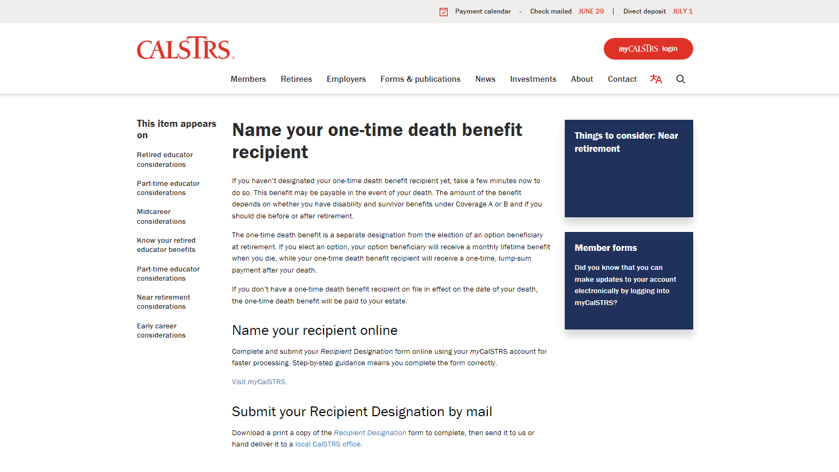
Notes:
This page contains all you’ll need to know to get that recipient on to your account.
Click.

Slide 51
Notes:
If you don’t want to use the paper form, you can submit this form online in your myCalSTRS account.
Click.

Slide 52
Recipient Designation form
Name one or more recipients.
Person, organization, trust or estate.
Update every five years throughout your career.
Notes:
Designation a recipient can be done using this form or online in your myCalSTRS account.
A few tips: you are able to name one or more recipients. Also, we allow a primary and secondary recipient to be named.
This recipient can be a person, organization, trust, or estate.
Life happens, things change. So we recommend you update your designation at least every five years.
Click.

Slide 53
Purchasing service credit
Notes:
We are talking about purchasing service credit now, in the early career webinar, because many educators have stated they wished they knew this information earlier in their career.
Click.

Slide 54
Purchasing service credit
The earlier in your career, the less expensive the purchase.
Increase your retirement benefit.
Redeposit a refund.
Purchase permissive service credit.
Notes:
This first bullet is the reason a lot of members wished they had knows about purchasing service credit earlier in their career. The earlier you purchase it, the less expensive it will be. Also, this must be paid off before you retire, so the earlier you can start the easier that is.
When you purchase service credit, you are adding to your service credit total. This in turn will increase your retirement benefit when you retire.
One way to purchase service credit is to redeposit the funds if you previously refunded your account.
Another is to purchase permissive service credit. This could be time you worked before becoming a calstrs member. Or if you ever taught out of state or went out on unpaid leave, etc.
Click.

Slide 55
Purchase Service Credit Now fact sheet
Common types of service credit.
Calculating the cost to purchase.
The impact on your retirement benefit.
Notes:
If any of that piqued your interest, you’ll want to check out this factsheet.
It’ll have a list of common types of service credit to purchase.
You can learn how we calculate the cost to purchase that service credit.
You’ll also get more information about the impact this additional service credit will have on your retirement benefit.
Click.

Slide 56
Redeposit or Purchase of Permissive Service Credit form
May require employer verification.
CalSTRS will send a billing statement.
Creates no obligation to purchase.
Notes:
Additional forms may be required, depending on the type of service. For example, if you’re looking to purchase service credit from the time you took on maternity leave, you’ll also have to submit the Verification of Employer-Approved Leaves form. Or if you taught out of state, an extra form is required to be completed by the state you taught in.
Your request will be verified. CalSTRS will send you a billing statement and you’ll have 35 days to accept the costs and make your first payment.
It’s important to remember that simply requesting the billing statement does not create an obligation for you to purchase any service credit. If the costs don’t work for you then you do not need to respond to the bill.
Click.

Slide 57
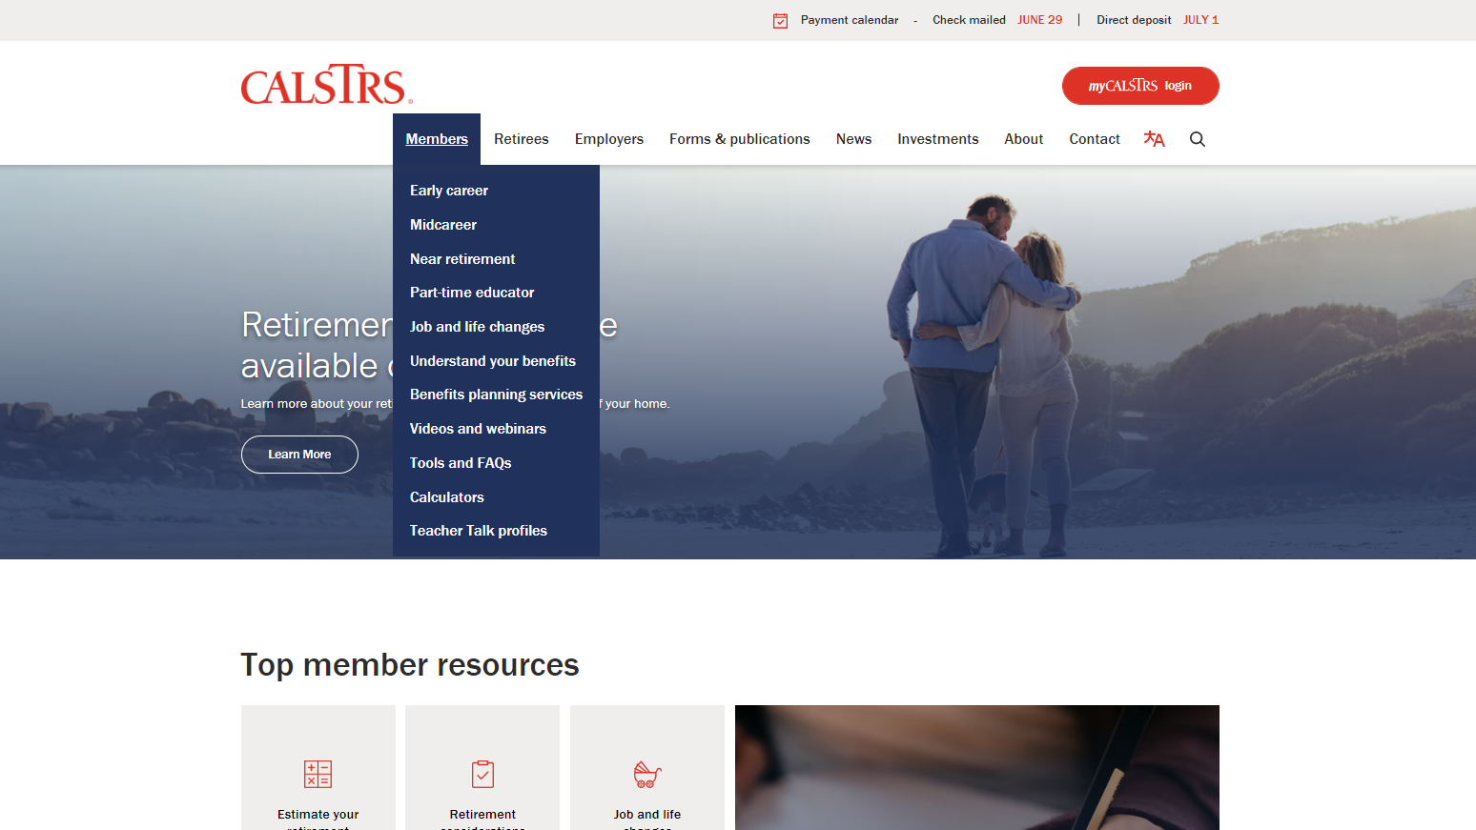
Notes:
Our calculators are an excellent help when trying to decide if purchasing service is right for you. Those calculators can be found here.
Click.

Slide 58
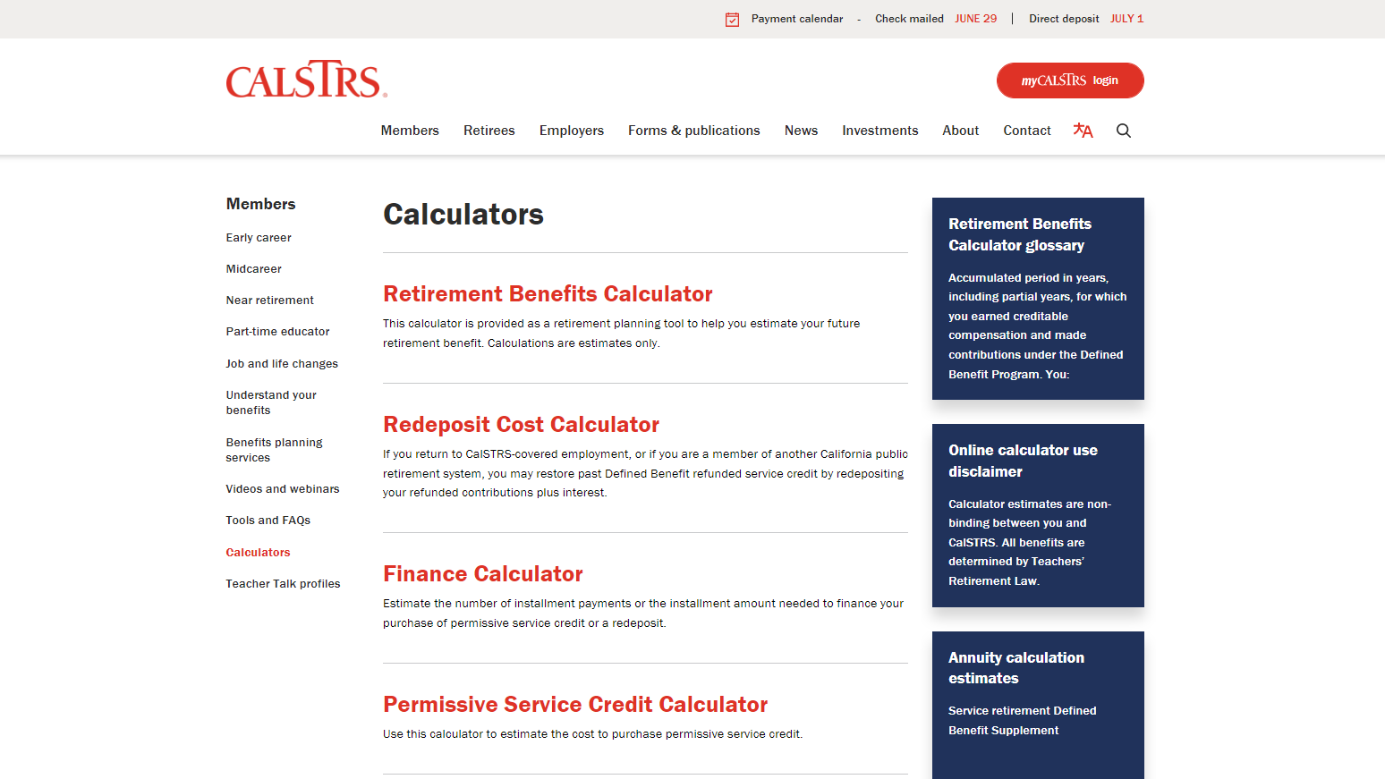
Notes:
There are a few calculators on this page.
The first is the Redeposit Cost Calculator. You’d use this if you previously refunded your contributions and interest.
Click.
The finance calculator will help you calculate possible installment payments that will be made to purchase the service credit.
Click.
And finally, the Permissive Service calculator. This includes time such as nonmember, out-of-state, unpaid medical leave, etc.
Click.

Slide 59
Be your own advocate
Create your myCalSTRS account.
Review your Retirement Progress Report annually.
Research supplemental savings plans like Pension2.
Verify your one-time death benefit information is correct.
Notes:
As a CalSTRS member regardless of what stage of your career you are in, it is very important to be your own advocate.
Make sure you create a myCalSTRS account.
Review you Retirement Progress Reports annually.
Research supplemental savings plans like Pension2
Lastly make sure your one-time death benefit information is correct.
Click.

Slide 60
For more information
Online resources
Benefits planning
Webinars
myCalSTRS
Retirement Progress Report
Educational videos
My Retirement Benefits
Financial Awareness Series
Group benefits planning session webinar
Notes:
Click.
If you need more information, we have several online resources that I have mentioned today.
Those include myCalSTRS, your Retirement Progress Report, and any educational videos on topics that you want to review.
Click.
You can schedule a group benefits planning session that we are currently doing over zoom.
Click.
We also have additional webinars that you can attend. Some that you might find informative are My Retirement Benefits, My Retirement Decisions and any webinar that is a part of our 3–part financial awareness series that really focuses on financial literacy at different stages of your career.
Click.

Slide 61
888-394-2060
Pension2.com
Notes:
If you’d like to set up more savings with us, CalSTRS has a great program called CalSTRS Pension2 that offers both Roth and regular 403(b)s as well as both Roth and regular 457(b)s.
For more information on the pension2 account you can reach out to them directly using the contact information on the screen.,
Click.

Slide 62
800-228-5453 *Press 2 for Customer Service. Monday – Friday 8 a.m. – 5 p.m.
CalSTRS.com myCalSTRS
Notes:
Questions?
Click.

