Slide 1
Protecting Your Loved Ones
Notes:
Welcome everyone, thank you for joining us. The time is , but we would like to wait a few more minutes to allow others to join.
*Wait one minute or until incoming numbers seem to be steady.”
Welcome to the CalSTRS Protecting Your Loved Ones webinar. My name is , and I am a benefits specialist at the __________ Member Service Center/ office.
**feel free to input a personalized introduction about yourself and your background**
Before we start, I’d like to address a couple items:
First, I’d like to thank you for joining us today! If you find today helpful, please tell your colleagues! We are constantly striving to educate as many educators as we can! So please, refer them to us!
Today’s presentation is packed with a lot of information and resources. Please be sure you have a pen and paper available to take notes as we move thorough the presentation, we encourage you to submit any questions you may have.
When asking your questions, please do not submit any personal information OR request from us any information that is specific to your account. For your security we ask that if you do have any questions specific to your retirement account you email those through your secured myCalSTRS account or call us at 1-800-228-5453 and speak with a CalSTRS representative.
If you find that you have questions after the webinar is complete, I urge you to log into your myCalSTRS account and send a secure online message. You can log onto myCalSTRS anytime, 24/7. But, if you’d rather speak with a live person, you can reach a representative Monday – Friday from 8a.m. – 5p.m.
Click.

Slide 2
Today’s topics
Survivor benefits
One-time death benefit
Defined Benefit and Defined Benefit Supplement options
Notes:
This webinar is called “Protecting Your Loved Ones” and my goal today is to ensure you are aware of the different benefits available to your loved ones upon your passing. The benefits we talk about today are going to be specific to the Defined Benefit Program.
Today’s topics.
Click.
First, we will look at the Survivor Benefits that are included with your CalSTRS membership. This protection is in place in the event your death occurs before retirement. We will look at the ways your loved ones may qualify.
Click.
One of those built-in benefits is the one-time death benefit. , we will discuss the one-time death benefit – a one time benefit paid to a recipient of your choosing after your death. I will show you why this recipient designation is so important.
Click.
Finally, you do have the opportunity to leave a lifetime benefit to a loved one after your passing. We will look at the Defined Benefit and Defined Benefit Supplement options that you may elect to take precedence over the default benefits. Naming an option beneficiary gives you some control over how your account balances will be distributed.
Click.

Slide 3
Defined Benefit Program
Notes:
I mentioned that we were going to focus on the benefits that come with your membership in the Defined Benefit program. If you are a part-time employee, you’ll want to check your Retirement Progress Report to verify you are in this program.

Slide 4
Defined Benefit Program membership
Lifetime retirement benefit
Benefit is based on a retirement formula
Survivor and disability benefits
Possible lifetime benefit for a loved one
Notes:
Click.
One way to protect your loved ones is to build your guaranteed lifetime retirement benefit. The more you earn in retirement the more you may be able to leave for your loved one.
Click.
The benefit you receive from CalSTRS is based on a formula and not on the balance in your account. To learn more about the defined benefit formula you can attend the My Retirement Benefits Webinar or watch our Understanding the Formula video. Today we will focus more on your loved ones
Click.
Your membership has built in survivor and disability benefits should the need arise during your career. Today we will only be talking about the survivor benefits. If downloaded the Coverage A or B sheet from the resources for this webinar, then you’ll be able to see a summary of disability benefits on the opposite side of the survivor benefits. We will be looking at the coverage types more in-depth so if you aren’t sure what type you’re under, we’ll discuss that shortly.
Click.
You have the opportunity to leave a lifetime benefit for a loved one upon your passing. You’ll get to see a few sample scenarios to better understand how this works.
Click.

Slide 5
Retirement formula
service credit
age factor
final compensation
your retirement benefit
Notes:
Really quickly, let’s take a look at the retirement formula.
Click.
First is Service Credit. This is credit earned for every year you work as a public educator and contribute into your CalSTRS account. Every year you work, your retirement benefit is increasing. CalSTRS has no limit on service credit you can earn in your career.
Click.
Next is your Age Factor. This is a percentage determined by your age at retirement. There is a maximum age factor you can earn of 2.4%.
Click.
Last is Final Compensation. We will take your highest 36 consecutive months and average them out. The higher your salary while working, the higher your retirement benefit can be. If you are 2% at 60, you might qualify for 12 months if you reach 25 service credits.
Click.
When those 3 numbers are multiplied, the product is your retirement benefit. The more you are receiving in retirement, the more you can possibly leave for a loved one. Increasing either service credit or age factor or final compensation will result in increasing your benefit in retirement. This is taxable income so keep that in mind when looking at your numbers.
Click.

Slide 6
Survivor benefits
if death occurs prior to retirement
Notes:
Like I said, CalSTRS does have built-in protections for your loved ones in place if you were to die before retirement. These benefits your survivors may be eligible for are based upon your coverage type.
Click.

Slide 7
Determine your coverage type
Coverage A
Member on or before October 15, 1992
Coverage B
Member after October 15, 1992
Elected Coverage B before March 1993
See your Retirement Progress Report for more details.
Notes:
The coverage type you are under mainly depends on the date you became a member.
Click.
We have 2 types of coverages, the first is Coverage A
If you became a member on or before October 15, 1992, then you were automatically given this coverage. At the time, it was all CalSTRS had to offer.
For more information, we have attached information sheets for both types of coverage on the page where you registered for this webinar.
Click.
Then in 1992, we introduced our 2nd coverage, Coverage B.
If you became a member after October 15, 1992, you were automatically given Coverage B.
When Coverage B was introduced, all existing members were given a one-time opportunity, until March 1993, to elect to change from Coverage A to Coverage B. If no response was received, you were left under Coverage A.
If you aren’t sure which coverage you have, you can always log on to your myCalSTRS account and check on your Retirement Progress Report. Not only does it give you your coverage type, it also gives a brief summary of the benefits.
Also, now that you know your Coverage type, you can be sure to download the correct coverage sheet from the webinar’s webpage on calstrs.com
Click.

Slide 8
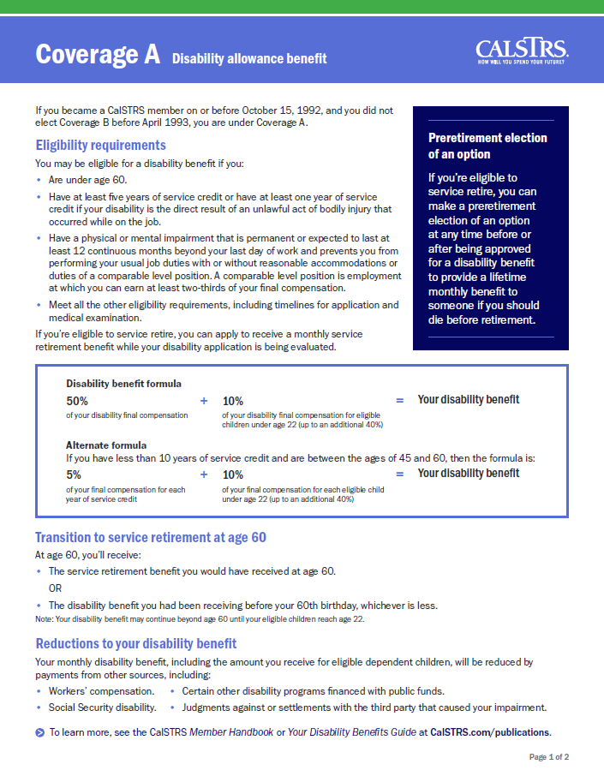
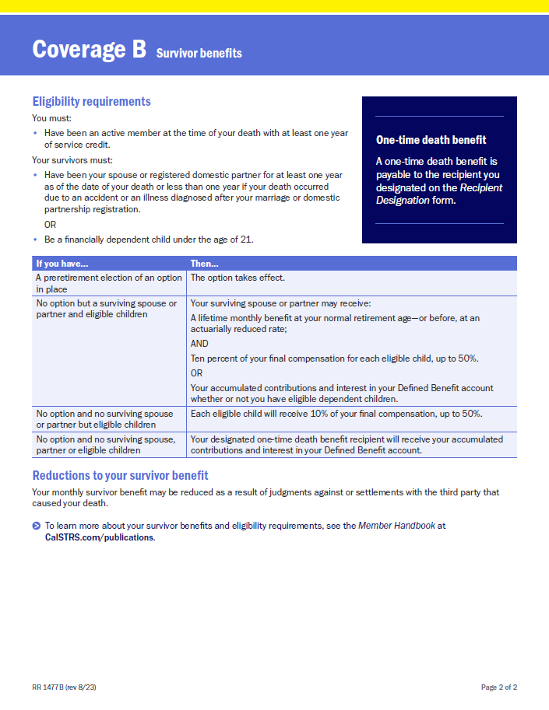
CalSTRS.com/protecting-your-loved-ones
Notes:
If you didn’t download this yet, remember to grab the coverage sheet that corresponds with YOUR coverage.
This is the coverage sheet I referred to earlier, you can find a summary of disability benefits on page 1 of the document.

Slide 9
Survivor benefit eligibility
Member
At least one year of service credit
Actively performing creditable CalSTRS service at time of death
Survivor
Spouse or registered domestic partner
Financially dependent children (Cov. A under 22; Cov. B under 21)
Financially dependent parents (Coverage A only)
Notes:
In order for a benefit to be payable, both you and your survivor have to meet certain criteria.
Click.
For CalSTRS to pay this benefit, you, the member, must have earned at least one year of service credit, and your death must have occurred while performing creditable service. There are other time periods considered eligible, please check our member handbook for more information.
Click.
For your survivor to be eligible to receive a survivor benefit, they must either be your spouse or registered domestic partner OR a financially dependent child. As you can see, the age limit is different depending on which coverage you have. Also, if you have financially dependent parents, they would be protected under coverage A only.
Click.

Slide 10
Survivor benefit payments
Surviving spouse
Surviving children
Lifetime monthly benefit
Return of account balance
10% of final compensation per child up to 50%
Notes:
Click.
If you have a surviving spouse their available choices depend on your coverage type and whether you have eligible children. Your spouse may be able to choose between receiving a monthly benefit or a return of your account balance. The amount of the lifetime monthly benefit would be equivalent to the 50% option choice and does depend on your spouse’s age.
Click.
In some cases, depending on the choice your spouse makes, your surviving dependent children can each receive 10% of your final compensation up to a combined total of 50%.
Read The Member Handbook for further Coverage A and B survivor benefit considerations.
Let’s look at a survivor benefits example.
Click.

Slide 11
If no eligible survivors
No eligible survivors
Account balance
One-time death benefit recipient
Member’s estate
OR
Notes:
Click.
If you don’t have any eligible survivors or are otherwise not eligible for a benefit, your account balance will instead be paid to your one-time death benefit recipient. If you have not named this recipient, the balance will be paid to your estate.
It’s important that your survivors know to notify CalSTRS of your passing as soon as possible so we can initiate this payment…
Click.

Slide 12
Edwin’s survivor benefits
Let’s assume:
Edwin is an active member
Edwin has no children
His fiancée, Rosa, is his one-time death benefit recipient
Edwin dies before retirement with no option in effect
Notes:
Click.
Let’s assume:
Edwin is an active member with no children, he is engaged to his fiancée Rosa, and she is his one-time death benefit recipient. In this scenario he dies before retirement.
Click.

Slide 13
Edwin’s survivor benefits
No eligible survivors
Account balance
One-time death benefit recipient (Rosa)
Notes:
Click.
Rosa is his fiancée so is not considered an eligible survivor.
Click.
But she is his one-time death benefit recipient so will qualify to receive is account balance.
Click.

Slide 14
Edwin’s survivor benefits
Let’s make one change and assume:
Edwin is an active member
Edwin has no children
His fiancée wife, Rosa, is his
one-time death benefit recipient
Edwin dies before retirement
Notes:
Click.
Now let’s make one change and assume:
Edwin is an active member with no children. His fiancé, Rosa is now his wife and his one-time death benefit recipient, and he dies before retirement.
Click.

Slide 15
Edwin’s survivor benefits
Surviving spouse
(Rosa)
Lifetime monthly benefit
Return of account balance
Notes:
Click.
Rosa is now Edwin’s wife and is considered an eligible survivor.
Click.
As Edwin’s surviving spouse now has a choice and she can choose between a lifetime monthly benefit or a return of Edwin’s account balance.
Click.

Slide 16
One-time death benefit
Notes:
Next, the One-Time Death Benefit.
Click.

Slide 17
One-time death benefit recipient
Name one or more recipients to receive this benefit:
Person
Estate
Trust
Parochial institution
Charity
Corporation
Public entity
Notes:
We’ll start this section with an introduction to who or what you can leave this benefit to.
Click.
It can be a person or persons, but it doesn’t have to be. As you can see you can name a trust, charity, your estate, a parochial institution, a corporation, or any other public entity.

Slide 18
One-time death benefit eligibility
Paid to your designated recipient if your death occurs:
While performing creditable service with at least one year of service credit
While receiving a service retirement benefit
While receiving a CalSTRS disability benefit
See the CalSTRS Member Handbook for more details.
Notes:
The one-time death benefit is a one-time, lump-sum payment paid to a designated recipient upon your death if eligibility requirements are met.
The amount of the benefit varies based on your membership status when you die.
Click.
Your loved one will be eligible for this one-time death benefit…
Click.
If your death occurs during active service. Meaning you were performing creditable service at the time of your death. Eligibility also requires that you performed at least one year of service credit.
Click.
If your death occurs in service retirement, meaning you are done working and have applied for a retirement benefit from CalSTRS.
Click.
If you die while receiving, or are qualified for, a CalSTRS disability benefit. This is a benefit you would have applied for after becoming unable to perform your normal job duties.
More eligibility scenarios and timeframes can be found in our Member Handbook.
Click.

Slide 19
One-time death benefit amount
Coverage A
Coverage B
Before or after retirement
$7,093
Before retirement
$28,372
After retirement
$7,093
Notes:
Not only does your membership status affect the benefit amount, your coverage type also has an impact. We determined your coverage type when we looked at Survivor benefits.
Click.
If you have Coverage A, the benefit is $7,093, regardless if your death occurs before or after retirement.
Click.
If you have Coverage B it is a little different. The benefit is $28,372 if your death occurs before retirement and $7,093 if it is after.
We will pay this amount to your estate upon your death if you have not designated a recipient. You can designate one or multiple primary and secondary recipients to receive this benefit. We will go over the process next.
Click.

Slide 20
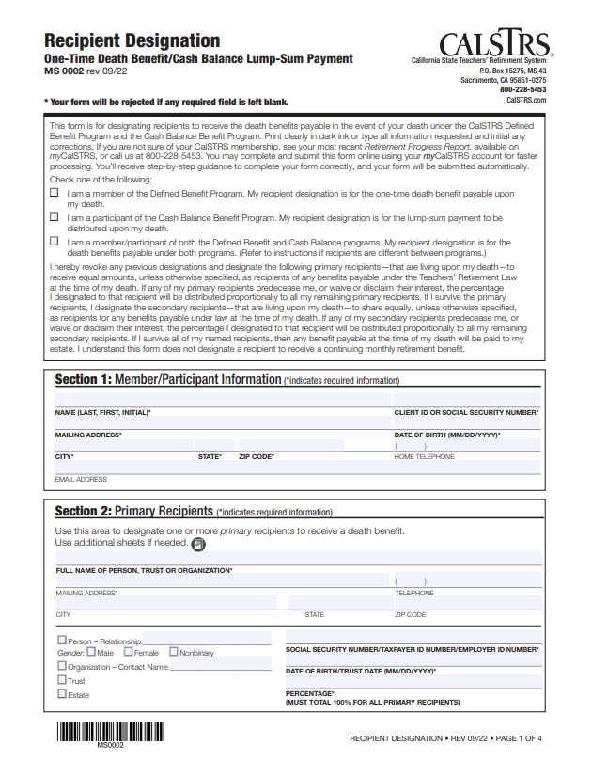
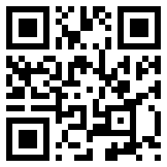
Recipient designation
One or more recipients allowed
Person, charity, trust, estate, etc.
Primary and secondary designations
Update through myCalSTRS
CalSTRS.com/forms
Notes:
This is the paper form that is used to name a recipient for the one-time death benefit. Recipient Designation form MS 0002. It can be found in myCalSTRS or calstrs.com/forms
Click.
To review what we’ve talked about already: You are allowed to name one recipient to receive the lump-sum of the benefit, or you can name multiple recipients to split it.
Click.
The recipient you name doesn’t have to be human! It can be, or it can be a charity, trust, estate, parochial institution, corporation, or public entity.
Click.
CalSTRS gives you the opportunity to elect both a primary and secondary recipient for the one-time benefit.
Click.
You can name a recipient by completing this form on myCalSTRS or via the paper document.
*Please note: If you are married, your spouse must sign this form as well.
If you are not sure of who you have designated, you can view your current recipients on your Retirement Progress Report or in your myCalSTRS account.
We recommend you review your recipient designation every five years or after any major life events such as marriage, divorce, or the birth or death of a loved one.
A separate form should also be completed if you also participate in the Cash Balance Benefit Program. See Cash Balance Benefit program booklet for more information.
Click.

Slide 21
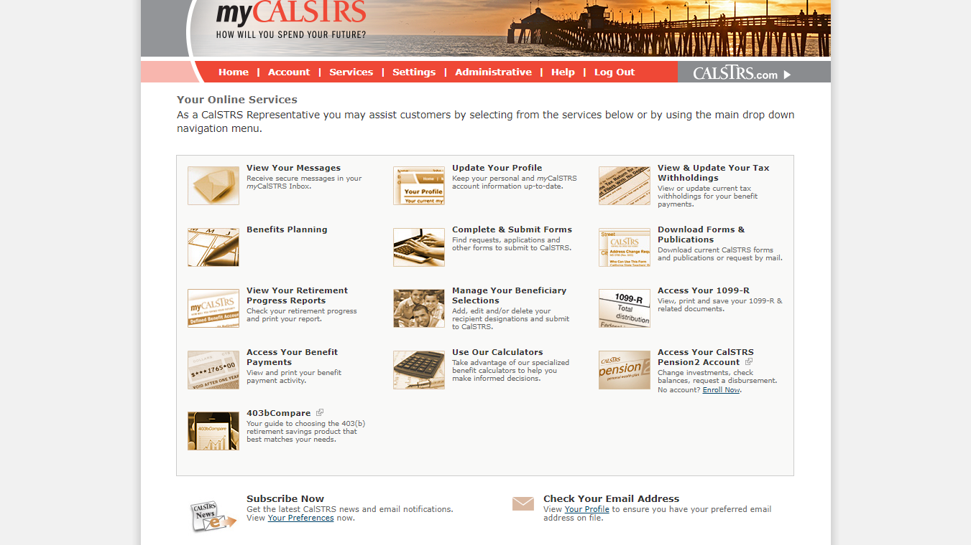
Notes:
Click.
When you log on to your myCalSTRS account, you can go through either of these menu items to access and update your recipient designations.
Click.

Slide 22
A lifetime benefit for your survivors
Notes:
We’ve looked at the default benefits that are available to you as a fulltime CalSTRS member.
Next we will look at an optional opportunity for you to leave a lifetime benefit for a loved one after your passing. This is a great opportunity for you to protect your loved ones and I hope you come away from today with a greater understanding of your choices.

Slide 23
Elect an option benefit
What?
Distribute your benefit over your lifetime and the lifetime of your option beneficiaries
When?
As soon as you’re eligible to retire (preretirement election)
At retirement on your Service Retirement Application
Notes:
In order to leave a lifetime benefit after your passing, you’ll have to elect an option benefit
Click.
Making this election means you’ll be distributing your benefit over your lifetime, then over the lifetime of your loved ones you choose as your option beneficiaries.
Click.
You are able to put this option in place as soon as your eligible to retire even if you aren’t ready to actually retire from CalSTRS. We call this a preretirement election.
The last opportunity you’ll have to name an option beneficiary is at retirement on your service retirement application.

Slide 24
Option choices
100% Beneficiary Option
75% Beneficiary Option
50% Beneficiary Option
Compound Option
Any option you choose will result in a decrease to the amount
of your monthly benefit (Modified Benefit)
Notes:
If you make the decision to leave a lifetime benefit for your loved one, you may have up to 4 Option types to choose from. These are available both before and at retirement.
Click.
You can provide your option beneficiary with 100% of the amount you were receiving upon your death. Choosing this option results in the largest reduction to your monthly benefit, while you and your option beneficiary are living.
Click.
The 75% option provides your option beneficiary with 75% of the amount you were receiving upon your death.
Click.
The 50% option will provide your option beneficiary with 50% of the amount you were receiving upon your death. Choosing this option results in the smallest reduction to your monthly benefit while still providing a monthly benefit for someone after your death.
Click.
The compound option allows for various choices. You may name one or more option beneficiaries and retain a portion of your benefit as a Member-Only Benefit. Or you might name two or more option beneficiaries, with an option choice for each, and not retain any of your benefit as a Member-Only Benefit.
We will be looking at an example so you can see how this might look in a real-life scenario.
Click.
Finally, I’d like to point out that any option you choose will result in a decrease to the amount of your monthly retirement benefit. We call this a modified benefit. If you choose not to elect an option, then you will be receiving a member-only benefit and that payment stops on the date of your passing.
Click.

Slide 25
Option factor
Percentage used to calculate the modified benefit
Option factor is based on:
Your age
Age of your option beneficiary
Option you elect
Date of election
Notes:
I’m sure you’re probably wondering how much naming an option beneficiary is going to cost you. To determine this, we calculate your modified benefit using an option factor.
Click.
This factor is actuarily determined and may differ depending on when you elect your option beneficiary. The percentage tells you how much of your member-only benefit that you will retain.
Click.
The option factor is based on
Click.
your age ;
and the age of your option beneficiary on the effective date of your retirement or when you make a preretirement election of an option;
the option you elect;
And the date you put the option in place.
Usually, the earlier you elect your beneficiary, the higher your modified benefit will be at retirement.
To see Service Retirement Option Factor tables, see Member Handbook.
Click.

Slide 26
Edwin’s option beneficiary
Let’s assume:
Edwin plans to retire at age 61
He plans to name his wife, Rosa, as his option beneficiary
Rosa will be 59 when he retires
He wants to name her on his retirement application
Notes:
Let’s revisit Edwin’s example.
Edwin is an active member and currently working fulltime. He recently attended a group benefit planning session and received an estimate to see how naming a beneficiary would affect his benefit.
Click.
Let’s assume:
Edwin hopes to retire at age 61
He wants to name his wife, Rosa, as an option beneficiary. He’s unsure which option is best for them
When Edwin retires, Rosa will be age 59
Right now, he is looking to add her at retirement on his retirement application because the default benefits satisfy his needs.
As we look through the following examples, keep in mind that these numbers are specific to Edwin. Your numbers will be unique to you. Check your Retirement Progress Report for your account balances.
Click.

Slide 27
Edwin’s beneficiary option estimate
Edwin’s Modified Benefit
Rosa’s lifetime benefit
upon Edwin’s death
$7,131
Edwin’s Member-Only Benefit
$7,131
Edwin’s benefit
if his option beneficiary
dies after
he retires
$6,740
$6,532
$6,291
$6,291
$4,899
$3,370
100%
Beneficiary Option
75%
Beneficiary Option
50%
Beneficiary Option
Notes:
For a visual representation of how those option choices will affect his benefit and the benefit he will be leaving for Rosa.
Click.
The Member-Only Benefit is the highest monthly benefit available when you retire. It provides a monthly benefit for your lifetime, but the benefit stops when you die. For Edwin, this would be a gross amount of $7,131.
Click.
The key above will help us read the graph, Light gray represents Edwin’s benefit. The dark gray represents Rosa’s benefit upon Edwin’s death.
We’ll start with the 100% Beneficiary Option. The beneficiary will receive 100% of the amount the member was receiving upon his death. Edwin’s benefit in retirement will be reduced from $7,131 to $6,291 His beneficiary, Rosa, would receive that same amount. As you’ll see on this chart, as we go through the remaining option choices, this will be the lowest modified benefit for the member, but the largest beneficiary benefit.
Click.
Next option provides the option beneficiary with 75% of the amount Edwin was receiving upon his death. The modified amount is greater than choosing 100% but the beneficiary benefit is lower. Edwin would receive $6,532 in retirement. After his passing, Rosa would receive 75% of that amount, so $4,899.
Click.
The final option will provide Rosa with 50% of the amount Edwin was receiving upon his death. Choosing this option means he’ll be receiving the highest modified benefit, but his beneficiary’s benefit is the smallest of the 3 beneficiary choices. Edwin’s modified benefit here is $6,740. His beneficiary would receive half after his passing, in this case $3,370.
Click.
And regardless of the option chosen, if in retirement, Edwin’s option beneficiary dies before him, his benefit will rise up to the Member-Only Benefit of $7,131.
Click.

Slide 28
Edwin’s beneficiary option estimate
Beneficiary option
100%
50%
Modified Benefit
$6,291
$6,532
$6,291
$4,899
75%
$3,370
Member-Only Benefit
$7,131
Option factor
0.8822
0.9160
0.9451
$6,740
Beneficiary benefit
Notes:
For a better breakdown on Edwin’s Option choices, let’s look at this table. This is closer to what you’d see on a CalSTRS generated estimate.
Click.
As we saw on that bar graph, Edwin’s member only amount would be $7,131. This is the amount he’d receive if he did not name an Option Beneficiary. It’s his highest possible benefit but there would be no lifetime benefit that carries on after his passing.
Click.
This column shows the 3 option choices available. 100%. 75%. And 50%.
Click.
The option factor, remember this is an actuarially determined number based on the chosen option and the age of our member and his beneficiary at the time of election.
Click.
The modified benefit is the amount that Edwin, the member, would receive in retirement. It is calculated by taking the member-only amount and multiplying it by the option factor. These numbers are gross and are taxable in retirement.
Click.
The beneficiary benefit is the gross amount that Edwin’s designated beneficiary, Rosa, will receive upon his passing. This is calculated by taking the modified amount and multiplying it by the option percentage chosen.
I want to remind you that all dollar amounts shown are the gross amount and are considered taxable income.
Click.

Slide 29
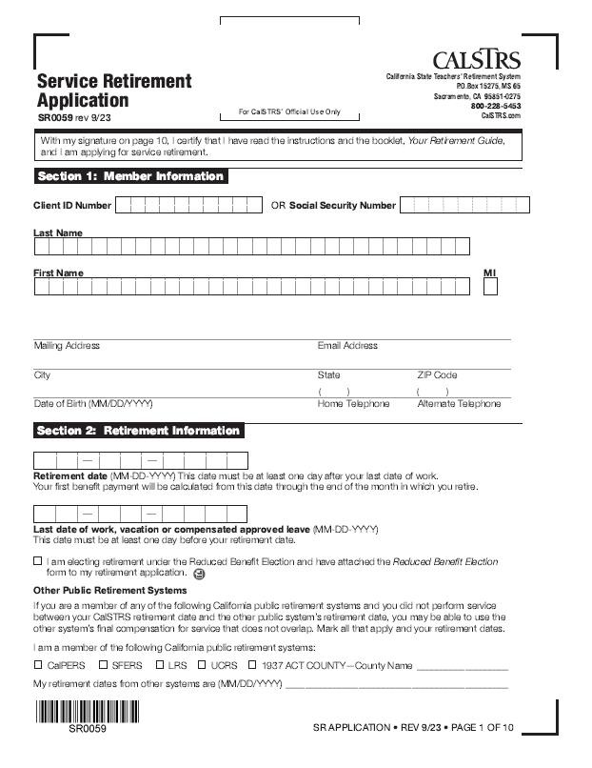
Electing an option at retirement
Elect on Service Retirement Application
Can name a special needs trust
Choose from 100%, 75%, 50% or Compound Option
Can be completed in myCalSTRS
CalSTRS.com/forms
Notes:
Once you’ve decided it is time to retire, you’ll arrive at your last opportunity to name an option beneficiary.
Click.
This can be done on the service retirement application.
The deadline to change or cancel an option election made on your Service Retirement Application is 30 days from the date your first benefit payment is issued. Once this deadline passes, your option election is irrevocable, except under certain limited circumstances.
Click.
Your option beneficiary can be a person or special needs trust— you cannot designate another type of trust, charity, estate, organization or other entity.
Click.
All the same option choices are available.
Click.
The image here is the paper format of the application to retire. This can also be completed through your myCalSTRS account. It is much easier for both you and CalSTRS if you do it online.
Click.

Slide 30
Preretirement election of an option
Notes:
Remember I said you can elect an option as soon as you’re eligible to retire even if you aren’t yet ready to retire.

Slide 31
Eligibility to retire
Minimum requirements
Age 55 with five years of service credit
Early retirement
Age 50 with 30 years of service credit (CalSTRS 2% at 60 only)
Concurrent retirement
Age 55 with fewer than five years of service credit if retiring for service with a concurrent retirement system
Notes:
First, let’s look at when you’re eligible to retire. This is the soonest that you can elect to have an option beneficiary on file.
The minimum requirements for a service retirement benefit are age 55 with five years of service credit.
Click.
If you’re a CalSTRS 2% at 60 member, you can retire as early as age 50 with 30 years of service credit.
Click.
If you have fewer than five years of service credit you can retire at age 55 if you retire concurrently with certain other public retirement systems in California such as CalPERS.
You can read more about concurrent retirement and eligibility in the Member Handbook
Click.

Slide 32
Advantages and disadvantages
Advantages
Secure coverage for beneficiary if you should die before retirement
Option factor tends to be higher the earlier you elect an option
Disadvantages
Subject to an assessment if you change or cancel your option
or if your beneficiary dies before you retire
Assessment can reduce your future monthly benefit
Notes:
As with most things in life, there are advantages and disadvantages of a preretirement election of an option.
Click.
The benefit of electing your option prior to retirement is that you’re putting protection in place and securing the lifetime benefit for your beneficiary if you pass away before retirement.
Click.
Another advantage is that the option factor could be more favorable the earlier you elect the option. Let’s say the actuarial tables change enough that the option factor is higher when you retire, then we will use the greatest of the 2 to give you the best benefit possible.
Click.
The disadvantage to electing an option before retirement is if your change or cancel your option, then you will be subject to an assessment that can reduce your future benefit. If your pre-elected option beneficiary dies before you retire, that is considered a cancelation and an assessment would still apply. The assessment is based on the coverage you chose and how long it was in place.
We highly recommend attending a benefits planning session or obtaining an estimate prior to electing an option so that you are aware of the impacts to your benefit and can fully understand the coverage.
Click.

Slide 33
Beneficiary option estimate with preretirement election of an option (PRE)
Beneficiary option
100%
50%
Modified Benefit
$6,291
$6,532
$6,291
$4,899
75%
$3,370
Member-Only Benefit
$7,131
$6,740
Beneficiary benefit
Modified Benefit with PRE*
$6,446
$6,645
$6,816
Beneficiary benefit with PRE*
$6,446
$4,984
$3,408
*Assumes Edwin will elect an option 5 years prior to retirement
Notes:
Like I said, the option factor tends to be higher the earlier you elect an option. Let’s compare what Edwin’s benefit would look like depending on when he elected his option beneficiary. We’ve updated the previous table to now show the changes to both Edwin’s modified benefit and the changes to his beneficiary’s benefit.
Click.
If Edwin were to elect his wife 5 years prior to retirement, he would be ensuring that both he and his spouse get a higher benefit than if he waited to add her on his retirement application. After attending a group benefits planning session and seeing this difference, Edwin might change his mind and decide to submit the Preretirement election of an option. Remember this is a 5 year difference between estimates and your numbers will be different. Again, I encourage you to schedule a benefits planning session or check out our online calculator at calstrs.com/calculators to see how a preretirement election of an option can benefit you.
Click.
His Member-Only benefit is the same, if he chooses not to elect an option, he will receive his highest possible benefit.
Click.
The beneficiary options are the same regardless of when an option is elected.
Click.
This modified benefit column is the same that we saw with the previous estimate.
Click.
This modified benefit with PRE column shows that if Edwin were to pre-elect the option, he will receive a higher benefit in retirement.
Click.
This beneficiary benefit is from the previous estimate.
Click.
Because Edwin will receive a higher benefit if electing his option before retirement, his beneficiary will receive a higher benefit as well.
Click.

Slide 34
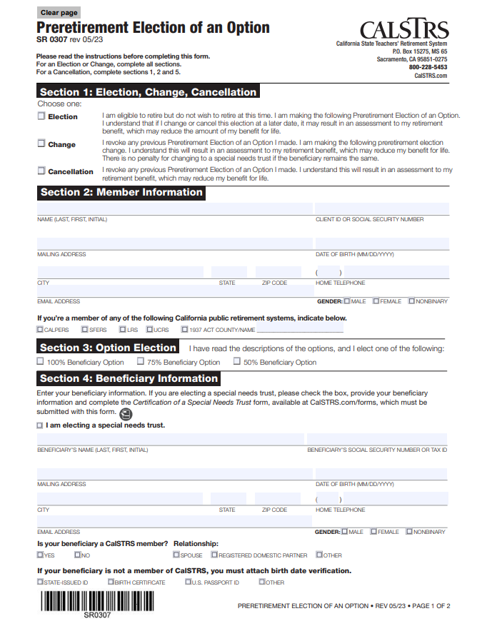
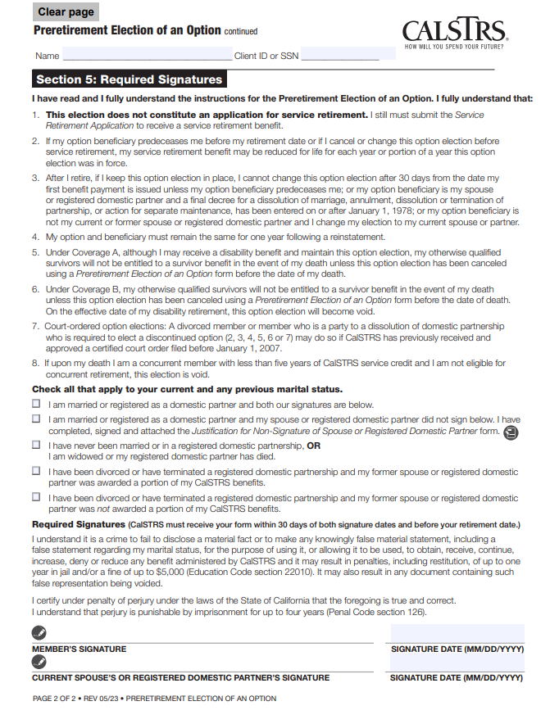
Preretirement election of an option
CalSTRS.com/forms
Notes:
This is the form for a preretirement election of an option. Can be used to elect, change, or cancel.
If electing a special needs trust, there is an additional form you’ll have to submit, “Certification of Special Needs Trust”
Birth date verification.
Signature of spouse/rdp.
Not an application to retire.

Slide 35
Compound Option
Notes:
The estimates we looked at for Edwin only showed the 100, 75, and 50 percent Options. But there is a 4th type, the compound option.

Slide 36
Preretirement Compound Option election
Provides various choices to meet your needs:
Member-Only
Beneficiary Option
Member-Only
Beneficiary Option
Beneficiary Option
Beneficiary Option
Beneficiary Option
Notes:
The options we looked at with Edwin were naming only one beneficiary and he was looking at leaving a portion of his entire benefit to his wife. A compound option utilizes the same 100, 75, or 50 option choices but with an additional step of dividing up your benefit between more than one person. We will look at Janice next and see how she plans to elect a compound option.
Click.
Naming a compound option has a few choices to really customize your benefit.
Name one option beneficiary, with an option choice, and retain a portion of your benefit as the Member-Only Benefit. The portion retained as Member-Only will not be impacted by the Option Factor and you receive 100% of that portion. Upon your death, your beneficiary will receive a percentage only of the portion named for the Beneficiary Option.
Click.
Name two or more option beneficiaries, with an option choice for each, and retain a portion of your benefit as the Member-Only Benefit.
Click.
Name two or more option beneficiaries, with an option choice for each, and not retain any of your benefit as the Member-Only Benefit.
Let’s look at an example.
Click.

Slide 37
Janice’s option beneficiaries
Let’s assume:
Janice is retiring in June
She has two adult children
Janice wants to leave money for both daughters after passing
Janice will elect a Compound Option
Notes:
Click.
Let’s assume:
Janice is retiring this June. She has 2 adult daughters and wants to leave a little money for each of them after her passing.
Janice knows that she must elect a compound option in order to name more than 1 beneficiary
Click.

Slide 38
Janice’s option beneficiaries
Let’s assume:
Janice will be 67 at retirement
Her daughters will be 42 and 40
Janice plans to elect the compound option before she retires
Federal age restrictions will apply
Notes:
Click.
A few more facts to help us talk about Janice. Let’s also assume:
She will be 67 at retirement while her daughters will be 40 and 42.
Janice has heard the benefits of a preretirement election and decides that is what she will do.
When Janice comes to us for a benefits planning session, we will let her know about the federal age restrictions and how they affect her.
Click.

Slide 39
Federal age restrictions
75% Beneficiary Option
Beneficiary can’t be more than exactly 19 years younger than you
100% Beneficiary Option
Beneficiary can’t be more than exactly 10 years younger than you (Compound Option only)
Restrictions do not apply to spouse or former spouse
Notes:
There are actually 2 age restrictions that we will look at:
These age restrictions only apply to someone other than your spouse or a former spouse. They apply to registered domestic partners too.
The age restriction depends on both your age and your beneficiary’s age.
If electing the 75% Beneficiary Option, your nonspouse option beneficiary cannot be more than exactly 19 years younger than you.
Under the Compound Option, that 75% rule applies, as well as another for the 100% Beneficiary Option. To elect 100%, your nonspouse option beneficiary more than exactly 10 years younger than you.
Janice’s daughters are 25 and 27 years younger than their mother. This restricts Janice from choosing anything other than the 50% beneficiary option.
Click.

Slide 40
Janice’s Compound Option estimate
Member-Only Benefit
Beneficiary name
Option
Percentage of benefit
Modified Benefit
Beneficiary benefit
$6,205
Sara
Age 40
50%
50%
$2,656
$1,328
Kelley
Age 42
50%
50%
$2,665
$1,332
Estimated amount Janice will receive in retirement:
$5,321
Notes:
Click.
This is an estimate for the benefit Janice would receive if she were to name her daughters as beneficiaries at retirement on her Service Retirement application. We start with the Member-Only amount. This is the amount she would receive if she chose not to name any beneficiary.
Click.
From here, we will split into 2 rows and have an estimated benefit for both daughters, Sara and Kelley.
Click.
We saw on the previous slide that Janice can ONLY choose the 50% option.
Click.
Percent of Benefit is not to be confused with the option. What this is actually doing is splitting up the member-only benefit. In this case, half will be calculated for Sara and half will be calculated for Kelley.
Click.
Now we’ve taken half of the member-only benefit and multiplied it by the option factor for each beneficiary. Kelly is older, so her option factor was a little bit greater than Sara’s. Now this isn’t what the daughters will be receiving as their benefit, this is still Janice’s benefit, but its calculation is split. So, we must add both parts and we see Janice’s total estimated Modified Benefit.
Click.
Now this is the amount each daughter will receive after their mom’s passing. Kelley will receive just a little more because she is 2 years older than Sara, so it’s assumed she will be paid for a shorter length of time than her younger sister.
Click.

Slide 41
Compound Option election
Member-Only
Beneficiary Option
Member-Only
Beneficiary Option
Beneficiary Option
Beneficiary Option
Beneficiary Option
Notes:
That compound option estimate was an example of this style. The entire benefit split between 2 beneficiaries.
Click.
We saw Janice’s modified estimate was going to be $5,321. Let’s say that Janice really can’t afford to live off this amount. The modified benefit is almost $900 less than the member-only benefit. She is still very much interested in leaving money for both of her daughters. She might instead look at this next style of compound option.
Click.
In this case, she will keep a portion for herself. That portion will not be reduced by an option factor, so it would help to increase her modified benefit.
The possibilities really are endless for how Janice could split this up for her and her daughters. She could keep half as member-only and split the other half between the daughters. They’d each get 25%. Or she could keep a greater portion like 90% and each daughter get 5%. In this case, Janice needs enough to live on. She doesn’t have any minimum requirements for how much she wants to leave behind. That isn’t always the case as some members decide how much they want to leave for the beneficiary, and we have to then calculate towards that goal.
Click.

Slide 42
Janice’s Compound Option estimate
Member-Only Benefit
Beneficiary name
Option
Percentage of benefit
Modified Benefit
Beneficiary benefit
$6,205
Member
80%
$4,964
$0
Sara
Age 40
50%
10%
$531
$266
Kelley
Age 42
50%
10%
$533
$266
Estimated amount Janice will receive in retirement:
$6,028
Notes:
As we saw in the previous estimate, Janice’s member-only benefit is $6,205.
Click.
Now you see “member” in this section. Before, only Sara and Kelley were listed. Member is the row that will show Janice’s member-only section that she is retaining. We are still looking at an estimate for naming her daughters at retirement.
Click.
Same age restrictions apply to this compound option. Janice can only choose 50%.
Click.
We can see here that Janice has chosen to retain 80% of her benefit and her daughters would split the remaining 20%. Janice’s portion will NOT be modified.
Click.
After multiplying Sara’s and Kelley’s portion by an option factor, we see that Janice now has a modified benefit of $6,028. That is about $700 more than the previous estimate.
Click.
Finally we see the Beneficiary benefit amounts. That top is a $0 because that portion ends when Janice dies. The daughters are each estimated to receive $266. Over $1000 less than the previous estimate. Janice is happy to learn there is a way for her to retain enough of her benefit to live on and still be able to leave a little money for her loved ones.
Click.

Slide 43
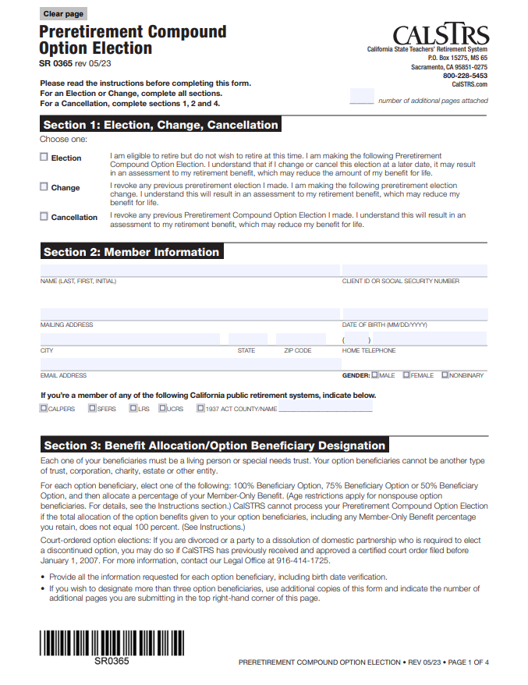
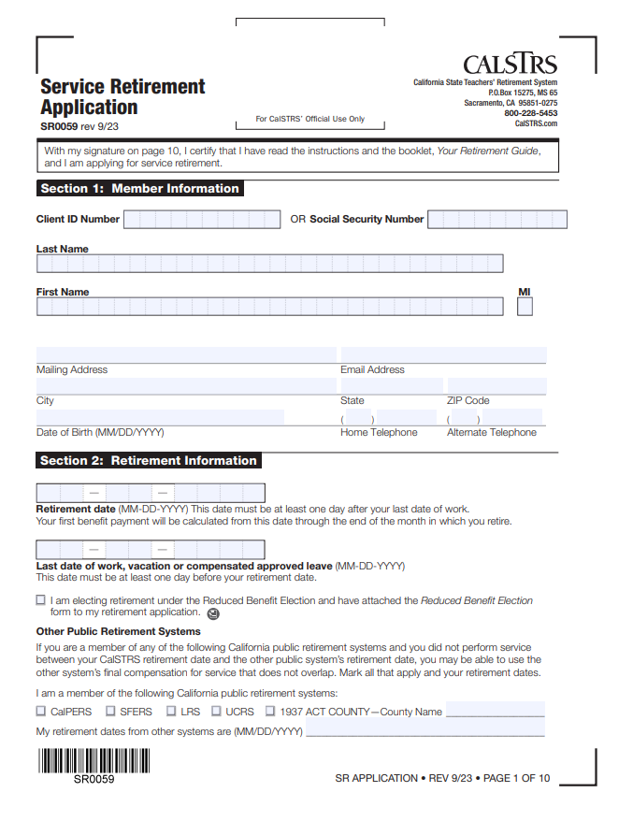
Electing a Compound Option
CalSTRS.com/forms
Notes:
A compound option can be named as a preretirement election or at retirement.

Slide 44
Let’s review

Slide 45
Monthly survivor benefit If death occurs before retirement
With preretirement election of an option:
Beneficiary will receive a lifetime monthly benefit
Paid as if you retired on the date of death
Without preretirement election of an option:
Survivors may be eligible for a lifetime monthly benefit
Notes:
To summarize. If you die BEFORE retirement….
Click.
And you completed the paperwork to elect an option prior to retirement.
Click.
Then the beneficiary that you named will receive a lifetime monthly benefit. And we will begin paying that benefit as if you retired on the date of your death. Meaning they will begin receiving that benefit the day after your death.
Click.
However, if you did not elect an option prior to retirement…
Click.
Then your survivors MAY be eligible for a lifetime monthly benefit. But they must meet certain qualifications first.
Click.

Slide 46
Monthly survivor benefit If death occurs after retirement
If you elect an option:
Monthly retirement benefit will be reduced
Option beneficiary will receive a lifetime monthly benefit after your death
Reduction is eliminated if beneficiary dies first
Notes:
Now that we’ve seen what happens when death occurs before retirement. We will now look at what happens when the member dies in retirement.
Click.
If you elected an option, either at retirement or as a preretirement election…
Click.
your service retirement benefit will be reduced.
Click.
Your option beneficiaries will receive a lifetime monthly benefit after your death.
Click.
If your option beneficiary dies before you, your benefit will rise to the Member-Only Benefit.
Click.

Slide 47
Monthly survivor benefit If death occurs after retirement
If you do NOT elect an option:
Full retirement benefit
Lifetime benefit ends with your death
Recipient or estate will receive remaining balance of contributions and interest as a lump-sum payment
Notes:
Click.
If you do not elect an option at the time you retire…
Click.
you will receive your full service retirement retirement benefit.
Click.
When you die, your lifetime benefit will end
Click.
and any remaining contributions and interest in your Defined Benefit account will be paid to your one-time death benefit recipient in a lump-sum distribution. If you did not name a one-time death benefit recipient, we will make the payment to your estate.

Slide 48
Defined Benefit Supplement
Notes:
Let’s now look at the Defined Benefit Supplement account.
This is separate from your Defined Benefit account.
A 2nd account to draw from in retirement.
Earnings in excess of 1 year
8% for 2%@60; 9% for 2%@62
8% employer contributions
Guaranteed interest
Click.

Slide 49
Defined Benefit Supplement before retirement
If one-time death benefit recipient is named:
Account balance is distributed to one-time death benefit recipient
If one-time death benefit recipient is not named:
Account balance will go to estate
Notes:
Unlike the Defined Benefit account, you can not elect anything for this account before retirement. This is another reason for you to designate your OTDB recipient. If your death were to occur before retirement..
Click.
Your Defined Benefit Supplement account balance will be distributed to your one-time death benefit recipient.
Click.
If you did not name a one-time death benefit recipient, we will make the payment to your estate. Your family will have to go through the probate process to access the funds.
Click.

Slide 50
Defined Benefit Supplement at retirement
Defined Benefit Supplement account balance at retirement
Less than $3,500
$3,500 or more
You must receive the account balance as a lump-sum payment
You can choose how
to receive your distribution
Notes:
Click
If you have less than $3,500 in your account at the time you retire, you must elect to receive the account balance as a lump-sum payment. Your lump-sum distribution may be paid directly to you or rolled over to a qualified plan such as CalSTRS Pension2.
Click
If your account balance is $3,500 or more, you have choices for electing how to receive your distribution, depending on whether you elect the Member-Only Benefit or the Modified Benefit.
Your most recent Retirement Progress Report shows the total balance in your Defined Benefit Supplement account at the end of the last school year.
Click.

Slide 51
Defined Benefit Supplement account distribution
Defined Benefit Supplement account balance of $3,500 or more
Defined Benefit: Member-Only Benefit
Defined Benefit: Modified Benefit
2
Lump-sum payment
Lifetime Member-Only Annuity
Lump-sum payment
Lifetime Beneficiary Annuity
Period-certain annuity
Combination lump sum and annuity
Period-certain annuity
Combination lump sum and annuity
Notes:
Click
If you elect a Member-Only Benefit for your Defined Benefit account and have $3,500 or more in your Defined Benefit Supplement account, you have the following payment choices:
Lump-sum payment, Member-Only Annuity, Period-certain annuity, Combination of lump-sum payment and annuity.
Click
If you elect a Modified Benefit for your Defined Benefit account and have $3,500 or more in your Defined Benefit Supplement account, you have the following payment choices:
Lump-sum payment, 100% Beneficiary Annuity, 75% Beneficiary Annuity, 50% Beneficiary Annuity, Period-certain annuity, Combination of lump-sum payment and annuity.
Click.

Slide 52
Defined Benefit Supplement lifetime annuity
Defined Benefit: Modified Benefit
Defined Benefit Supplement: Modified Annuity
2
Beneficiary named
Must match
Beneficiary named
Option selected
Can differ
Option selected
Compound Option
Allocation must match
Compound Option
Notes:
If you decide you want to receive a lifetime annuity from your supplement account, there are a few things to keep in mind.
Click.
The beneficiary or beneficiaries you name must remain the same.
Click.
You may be able to choose a different Option, for example maybe you choose 50% for your spouse in your Defined Benefit account but choose 100% in your Supplement account.
Click.
If you are electing a compound option, the allocation must match. Meaning if you split your benefit 50/50 between 2 people, you can’t change it to an 80/20 split in your supplement account.
When you’re getting ready to elect an option beneficiary, it’s a good idea to meet with us either in a group or individual setting to ensure you have a proper understanding of how your benefit will be impacted and what your choices will be.

Slide 53
Defined Benefit Supplement account distribution If death occurs after retirement
If you elect a beneficiary annuity:
Your option beneficiary will receive a lifetime monthly annuity
If you elect a period-certain annuity:
Remaining annuity will continue to be paid to your one-time death benefit recipient
Or a lump sum will be paid to your estate
Notes:
If you die after retirement, you will have already made your Defined Benefit Supplement election. An ongoing monthly annuity may be paid depending on your election at retirement.
Click.
If you elect a 100%, 75% or 50% Beneficiary Annuity for your Defined Benefit Supplement account and die after retirement, your option beneficiary will receive a lifetime monthly annuity after your death.
Click.
If you elect a Period-Certain Annuity of three to 10 years for your Defined Benefit Supplement account and die after retirement,
Click.
any remaining annuity will continue to be paid to your one-time death benefit recipient. If you did not name a one-time death benefit recipient, any remaining balance in this account will be paid in a lump-sum distribution to your estate.
Click.

Slide 54
Defined Benefit Supplement account distribution If death occurs after retirement
If you do not elect an annuity:
There is no balance to be paid to your one-time death benefit recipient or estate
Notes:
If you do not elect an annuity for your Defined Benefit Supplement account at the time you retire,
Click.
any remaining balance in this account will be distributed to your one-time death benefit recipient. If you did not name a one-time death benefit recipient, we will make the payment to your estate.
Click.

Slide 55
Edwin’s Defined Benefit Supplement account distribution
Scenario 1
Edwin named his wife, Rosa, as an option beneficiary for his Defined Benefit account
He qualifies to elect a modified benefit
Edwin chooses the 50% Beneficiary Annuity
After Edwin’s death, Rosa will collect a benefit from both the Defined Benefit and Defined Benefit Supplement
Notes:
Let’s travel forward in time and look at Edwin’s example one more time as he is applying for retirement and deciding what to do with his DBS account balance
Click.
We will look at 2 scenarios. Here is the first:
Click.
For his Defined Balance account, he chose to leave money for his wife and elected a modified benefit.
Because he named Rosa on his Defined Benefit account, he now qualifies to elect a modified benefit for his DBS account too.
Edwin decides to choose the 50% beneficiary annuity, he likes the idea of having 2 checks for his lifetime and that of his wife.
After Edwin’s death, Rosa can collect a benefit from both DB and DBS. Alternatively, if Rosa were to die first, Edwin’s benefits would both pop up to the member-only amount.
Click.

Slide 56
Edwin’s Defined Benefit Supplement account distribution
Scenario 2
Edwin elected to receive the Member-Only Benefit for his Defined Benefit account
He qualifies to elect a Member-Only Benefit
Edwin chooses the Member-Only Annuity
After Edwin’s death, Rosa will collect any remaining account balance
Notes:
Let’s look at another scenario that Edwin could be facing:
Click.
In this scenario, Edwin did not leave a lifetime benefit for his wife. He instead elected the Member-Only benefit.
Because he elected the member-only benefit, he now qualifies to elect a member-only benefit from his DBS account too. He NO LONGER qualifies to elect a modified benefit for this account.
Edwin choose the member-only lifetime annuity.
After Edwin’s death, Rosa will be able to collect any remaining account balance as she is named as his recipient. There is no lifetime benefit left for Rosa.
Click.

Slide 57
Resources

Slide 58
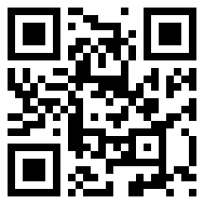
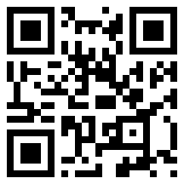
CalSTRS.com/publications
Member Handbook
Survivor Benefits
Notes:
If you visit calstrs.com/publications, you’ll find these 2 great resources. If you would like any more information on anything we’ve talked about today, you’ll be able to find answers in either of these books.
Click.

Slide 59
Tax-deferred retirement savings
Low cost
Flexible investment options
Friendly support team
888-394-2060
Pension2.com
Notes:
Another way to protect your loved ones is by growing your supplemental savings. If you have any accounts outside of your CalSTRS Defined Benefit Program, you’ll want to make sure that your beneficiary is named there as well.
If you’re interested in starting your supplemental savings plan account today or if you already have a supplemental savings plan account through another company and are interested in our free, unbiased, statement comparison service, please give us a call at 888-394-2060. We want to help ensure you have enough money to meet your retirement income needs.
Also, if you aren’t quite ready and just want to learn more about the Pension2 program, we offer a webinar called Start Saving Now with Pension2. I encourage you to attend and receive some more in-depth information about the ways in which Pension2 can help you reach your retirement income goals.
Click.

Slide 60
Be your own advocate
Create your myCalSTRS account
Review your CalSTRS Retirement Progress Report annually
Subscribe to CalSTRS’ online newsletter
Verify your one-time death benefit information is current
Notes:
As a CalSTRS member it is very important to be your own advocate.
Make sure you create a myCalSTRS account.
Review you Retirement Progress Reports annually. Especially, if you have multiple employers you want to keep track of each employers reporting.
You can subscribe to the CalSTRS’ online newsletter and stay in the know with us.
Lastly make sure your one-time death benefit information is correct.
Click.

Slide 61
Next steps
Visit CalSTRS.com/calculators to estimate your benefit
Talk to a financial advisor
Submit the forms to elect an option
Review and update your one-time death benefit recipient
Notes:
We’ve gone through a lot of information today. Here are some steps you can take after attending today’s webinar.
You can log on to calstrs.com/calculators. You have the ability to create an estimate that shows the impact of electing an option.
Talk to a financial advisor. Get help looking at your retirement income wholistically to decide if electing an option is right for you.
Once you’ve decided to take that step, you can log on to your myCalSTRS account and submit the required forms.
Finally, if you haven’t done so recently, we recommend you review and update your one-time death benefit recipient. This can also be done in your myCalSTRS account.
Click.

Slide 62
For more information
Online resources
Benefits planning session
Attend a workshop or webinar
CalSTRS.com
myCalSTRS
Retirement Progress Report
Attend a group session
Financial Awareness Series
Save for Your Future
Plan for Your Future
Protect Your Future
CalSTRS.com/workshops
CalSTRS.com/webinars
Notes:
If you need more information, we have several online resources.
You can schedule a benefits planning sessions
We also have a 3–part workshop or webinar financial awareness series that really focuses on financial literacy at different stages of your career.
Click.

Slide 63
Questions?
CalSTRS.com
myCalSTRS
800-228-5453
*Press 2 for Customer Service.
Monday – ­Friday
8 a.m. – 5 p.m.
Notes:
Questions?

