Slide 1
Consolidation of Benefits
Notes:
Welcome to the CalSTRS Consolidation of Benefits webinar. My name is , and I work out of the Member Service Center. I hope you’re all safe and healthy out there.
Before we start today, I’d like to address a couple housekeeping items:
Thank you
Lots of information and resources, be ready to take notes.
We will have strategic stopping points to answer questions throughout today’s session, please jot down your questions on the material covered as we go. Use the Q&A function to submit your questions during the designated stopping points.
No personal information. Nothing specific to your account.
If you find you have questions after the webinar is over.
myCalSTRS
Call us at 1-800-228-5453 and speak with a CalSTRS representative
Click.

Slide 2
Objectives
Determine if this webinar pertains to you
Define consolidation and eligibility
Explore the advantages of consolidating
Learn the process of consolidation
Notes:
our four main objectives are as follows:
Click.
Help you determine if this webinar is for you
Click.
We will look at an actual definition
What service is eligible
Why consolidation is important?
Reasons to consolidate
Program features and resources for the Defined Benefit program
Click.
advantages of consolidating.
process can be lengthy,
Help decide if it’s worth your time and effort.
Click.
Walk through the process of consolidating
your role in the process
CalSTRS role
your employer(s)’ role
Click.

Slide 3
CalSTRS Programs
Defined Benefit Program
Defined Benefit Account
Defined Benefit Supplement
Cash Balance Benefit Program
Cash Balance Plan
Completely voluntary
Defined Contribution
Pension2
403b and Roth 403b
457 and Roth 457
Notes:
CalSTRS is a hybrid retirement system.
Our main program is the Defined Benefit Program. The Defined Benefit Program consists of the Defined Benefit Account and Defined Benefit Supplement account. If you’re a member of this program, all of your service up to 1.000 service credit is applied to your defined benefit account. When you retire, the benefit is calculated with a formula.
If you happen to work any extra duties or multiple contracts, then you might actually be working more than 1.000 of service credit. Any extra service over 1.000 is credited to the Defined Benefit Supplement account. At retirement, the benefit you receive is based on the balance of the account. This is a 2nd account to draw from in the Defined Benefit Program upon retirement.
We also have the Cash Balance Benefit Program. This program was created specifically for part-time educators to establish retirement savings. This is a cash balance plan (as defined by IRS) which basically means, the retirement benefit depends on the account balance at retirement. If you are participating in this program, then you are working 1 or more part-time contracts.
Finally, there is the Defined Contribution program we call Pension2. This is an opportunity for you as a California educator to invest and save more money for retirement. This program is completely voluntary, separate, and in addition to both the Defined Benefit and Cash Balance programs.
Click.

Slide 4
Cash Balance plans
Cash Balance Benefit Program
Defined Benefit S upplement
vs
Part-time educator
Defined Benefit member
Alternative to Social Security
Service in excess of 1.000
Retirement savings
Additional retirement savings
Notes:
The Cash Balance Benefit account and the Defined Benefit Supplement account are both considered cash balance plans from an IRS perspective. They have similar distribution rules but their contributions come from different circumstances.
Let’s look at Cash Balance first,
Click.
This program is ONLY for part-time educators. If you’re working a full-time contract, you are not eligible to participate in this program.
Click.
If it is offered by your district and you choose to participate, it is an alternative to social security. Meaning you will see no withholding going to the social security administration for your service.
Click.
Finally, this program was created to provide part-time educators a secure choice for retirement savings with employer matching, a guaranteed interest rate and no plan costs.
Click.
Only Defined Benefit members will have a Defined Benefit Supplement account.
Click.
Contributions come from any duties performed above and beyond a full-time contract or 1.000 service credit. Or if you are working multiple contracts, it would be any amount of service credit earned over the 1.000 maximum per school year.
Click.
This is not the main account for the program, instead it provides you with additional retirement savings. Any distribution coming from this account will be paid separately from the retirement benefit coming out of the Defined Benefit account and will be based upon the account balance upon retirement.
Click.

Slide 5
What is your current situation?
Active
Cash Balance Benefit participant
Active Defined Benefit member with an inactive Cash Balance Benefit account
Actively contributing to both the Defined Benefit and Cash Balance Benefit programs
Notes:
When we created this webinar, we had to figure out who our audience would be.
Different scenarios you might find yourself in now.
Click.
part-time and actively paying into the Cash Balance program.
bits of this presentation are specific to you.
brief description
stop your current contributions
switch to the Defined Benefit program
advantages of making that switch
Part-Time Educator webinar
More information
in-depth comparison
Click.
already made that switch into the Defined Benefit program
inactive Cash Balance account
advantages of consolidating the two programs
or what it could look like if you don’t.
Since your Cash Balance account is already inactive, some of the steps we cover will no longer apply to you.
Click.
multiple employers
actively contributing to both
or not eligible to consolidate as long as you’re making contributions into that Cash Balance account.
Click.

Slide 6
Consolidating program coverage
Notes:
Merriam-Webster
to consolidate
‘to join together into one whole’
‘to make firm or secure.’
Click.

Slide 7
What is consolidation of benefits?
Defined Benefit Program
Cash Balance Benefit Program
Defined Benefit Program
A process to receive Defined Benefit service credit for prior eligible Cash Balance service
Notes:
CalSTRS definition
a process to receive Defined Benefit service credit for prior eligible Cash Balance service.
Click.
It is the merging of your Cash Balance account
Click.
into your Defined Benefit account.
Click.
you’re left with your membership in the Defined Benefit Program.
Click.

Slide 8
Consolidation is not the combining of…
All outside investments into one place
Speak with Pension2 or a financial advisor
Defined Benefit and Defined Benefit Supplement
These accounts remain separate through retirement
Pension2 and Defined Benefit
Speak with Pension2 about other options
Notes:
To further clear up any confusion, when we are talking about consolidation today, we are only talking about the CB and DB programs.
Click.
We will not be discussing the consolidation of outside investments into one place.
Click.
If this is something you’re interested in doing, we will provide some potential resources and may recommend that you speak with financial advisor.
Click.
Furthermore, we will not be discussing how to combine the defined benefit with the defined benefit supplement account,
Click.
as you just learned, those accounts remain separate.
Click.
Finally, we are not talking about combining your Pension2 account with your Defined Benefit account.
Click.
If you are interested in ways to grow your Pension2 account, we recommend you speak with Pension2 about other options that may be available to you.
Click.

Slide 9
How can I combine Outside investments?
403(b)
Roth 403(b)
457(b)
Roth 457(b)
Never locked in
No hidden costs
Notes:
Although we aren’t talking about it today, the combining of outside accounts is a possibility with our voluntary Pension2 program. Our Pension2 representatives can answer questions, provide unbiased information and resources and even assist you in comparing plans.
Click.

Slide 10
Is Pension2 right for you?
Your
Current
Accounts
CalSTRS
Pension2
LET US COMPARE!
Call 888-394-2060 for a statement comparison
Statement comparisons will be conducted by Voya Financial representatives working exclusively with Pension2®. Their names and photos are listed at CalSTRS.com/Trust-CalSTRS.
Notes:
If you are interested in Pension2 and how we can help you, please call 888-394-2060. A representative will be happy to schedule you for a statement comparison.
Click.

Slide 11
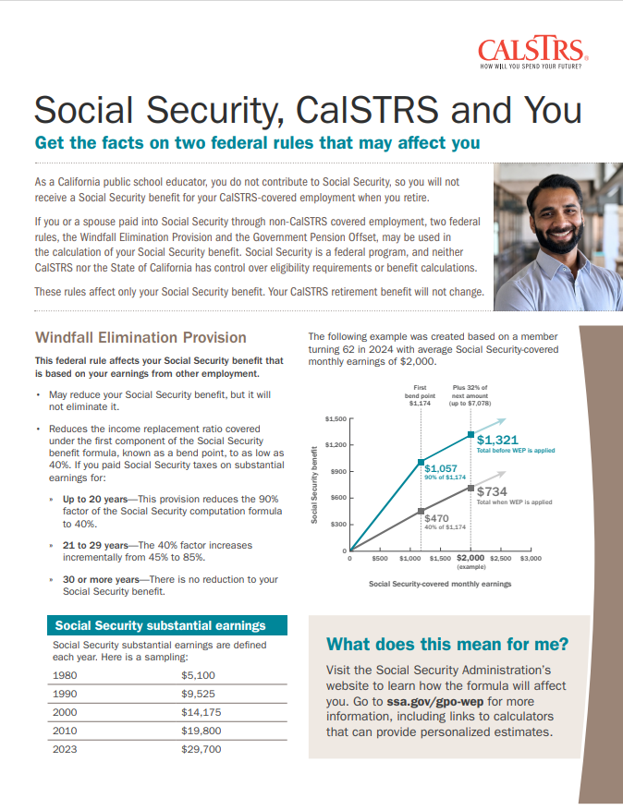
Social Security, CalSTRS and You
Windfall Elimination Provision
May reduce but cannot eliminate
your Social Security benefit.
Government Pension Offset
Reduces and may eliminate your spousal,
widow or widower Social Security benefit.
Contact the Social Security Administration for more information.
Notes:
One of the most common questions we receive from all educators, but especially part-time educators are pertaining to the Social Security offsets. In this particular webinar the question is, “How will consolidation impact Social Security?”
You can also review more information on these offsets if you download this factsheet from our website.
Click.

Slide 12
Do Social Security offsets apply?
Defined Benefit account
Cash Balance account
Consolidated account
Refunded account
Contact Social Security for information regarding offsets pertaining to your specific situation.
Notes:
Let’s look at some different scenarios to help determine the potential impact to Social Security .
Click.
The Defined Benefit account is a public pension as an alternative to Social Security, makes you automatically subject to the offsets.
Click.
Cash Balance program was created specifically as a social security alternative for part-time educators to establish retirement savings, this program features immediate vesting and is also subject to the offsets…
Click.
Consolidation is combining two accounts that are both subject to the offsets – you are simply combining them into one.
Click.
we are often asked, “So what if I refund both?” – The short answer is, Refunding your account won’t stop those offsets from taking effect.
I have provided you a high level overview on this, which I hope is helpful. It is important to contact Social Security directly to discuss their offsets and how they pertain specifically to your situation.
Click.

Slide 13
Eligible Cash Balance Benefit service
Service covered under the Cash Balance Benefit Program is eligible
Overtime service is not eligible
Rollover funds cannot be turned into service credit
All money can be used for purchasing service credit
Notes:
Let’s discuss what CalSTRS considers eligible service to consolidate.
Click.
part-time employment covered under the Cash Balance Benefit Program is considered eligible
Click.
Prior to July 1, 2002
overtime was covered under the Cash Balance Benefit Program
not eligible to consolidate into DB service credit.
Click.
rollover funds cannot be converted into service credit
Click.
all funds can be used to purchase service credit.

Slide 14
Reasons to consolidate
Increase my service credit
Take advantage of concurrent retirement
Meet the 5.000 service credit vesting requirement
Less than $3,500 in Cash Balance Benefit account
Notes:
Consolidation can be a lengthy and often expensive process. There might be many reasons you’re interested in consolidating benefits; we are going to look at 4 possible reasons today.
Click.
Service credit is one of the 3 parts of our benefit formula in the Defined Benefit program. When you consolidate benefits, your years of service credit will increase which will have a positive impact on that formula.
Click.
Maybe some of the service you’ve performed is covered under another California public retirement system. If that’s the case, while a Defined Benefit member, you can take advantage of what we call concurrent retirement. You may be entitled to these advantages even if you don’t meet the vesting requirements of one of those other systems.
Click.
Speaking of vesting, consolidating benefits might provide you the crucial service credit years you need to reach our 5.000 service credit vesting requirement in the Defined Benefit Program.
Click.
Finally, if your Cash Balance account has less than $3,500 and you don’t anticipate it will reach that threshold, consolidation might help you get the most out of the service in that account. I mention $3,500 because that is the minimum amount needed to qualify to annuitize your Cash Balance account.
Click.

Slide 15
CalSTRS program features
Defined Benefit Program | Cash Balance Program
CalSTRS 2% at 60 → 10.25%
CalSTRS 2% at 62 → 10.205%
Typically 4%
Contribution rates
Concurrent retirement
Notes:
In the beginning I mentioned that we would have a brief overview of our two programs here at CalSTRS.
These next few slides are for those of you not yet paying into the Defined Benefit program.
Key features to consider.
Click.
contribution rate
2 benefit structures
CalSTRS 2% at 60
CalSTRS 2% at 62
rate is just over 10%
Cash Balance program
rate is generally 4%.
Defined Benefit Program is our more robust retirement program.
Click.
concurrent retirement.
may be some advantages from retiring from both systems at the same time.
Click.

Slide 16
Concurrent retirement
Defined Benefit Program only
Retire with less than 5.000 service credits
Retire on the same day
CalSTRS.com/publications
Notes:
For more information on Concurrent Retirement, please download this factsheet
A few quick reminders:
Concurrent Retirement is a benefit for Defined Benefit members only.
If you are a member of another eligible California public retirement system, you may be eligible to retire without meeting our 5.000 service credit vesting requirement.
It’s also good to note that when taking advantage of this feature, you will be retiring from both systems on the same day.
If Concurrent Retirement sounds like something you might be interested in or eligible for, we recommend you download this factsheet you see here. It is available on our website at CalSTRS.com/publications.
We also recommend you talk to your other retirement system for any requirements they may have.
Click.

Slide 17
CalSTRS program features
Defined Benefit Program | Cash Balance Program
CalSTRS 2% at 60 → 10.25%
CalSTRS 2% at 62 → 10.205%
Typically 4%
Contribution rates
Concurrent retirement
Disability benefits
Survivor benefits
Notes:
Click.
Both programs provide disability and survivor benefits that are unique to each plan.
Again DB has more involved benefits.
We will look at some resources to learn more
Click.

Slide 18
Survivor and disability benefits
Benefits offered under both plans
Defined Benefit offers greater benefits
One-time death benefit recipient designation
CalSTRS.com/publications
Notes:
A reminder: each program provides unique disability and survivor benefits. As you research, you’ll notice that the Defined Benefit program has a lot more to offer One of those benefits that is offered only under Defined Benefit is the one-time death benefit that is paid out to a recipient of your choosing. Further details on disability and survivor benefits are available in multiple publications on calstrs.com/publications.
Click.

Slide 19
CalSTRS program features
Defined Benefit Program | Cash Balance Program
One-time death benefit
Annual benefit adjustment
Purchasing power protection
Notes:
Click.
The Defined Benefit program has an additional survivor benefit called the one-time death benefit built into it. This is a one-time lump sum paid out to the recipient of your choice upon your passing.
Click.
Lastly, the Defined Benefit program also has built in inflation protection that the Cash Balance program does not have. There is an annual benefit adjustment and additional Purchasing Power protection to keep your benefit safe.
Click.

Slide 20
Built-in inflation protection (DB only)
Annual benefit adjustment
An increase equal to 2% of your initial retirement benefit
Purchasing power protection
Currently set at 85% of your initial benefit
Defined Benefit Program only. See the Member Handbook for more details.
Notes:
I mentioned the inflation protection offered by the Defined Benefit program.
The annual benefit adjustment is a 2% increase to your initial benefit
not compounded
not directly tied to inflation
Yearly
Click.
Purchasing Power Protection does not kick in until well into retirement.
CalSTRS will monitor the purchasing power of your benefit
if/when the purchasing power of your benefit goes below 85%
CalSTRS will start paying you quarterly supplemental payments to support your retirement benefit’s purchasing power.
For more information on these protections please refer to the Member Handbook that can also be found at CalSTRS.com/publications.
Click.

Slide 21
Advantages of consolidation
Notes:
If you still aren’t sure if Consolidation is right for you, we will now look at a few advantages of doing so.
Click.

Slide 22
Reach the 5.000 service credit vesting requirement
Take advantage of Defined Benefit Program features
Notes:
As a member of the Defined Benefit program, you are subject to a 5.000 service credit vesting requirement. If you joined or are joining the Defined Benefit program late in your career, reaching five service credits might be a real concern for you. Consolidating your benefits could help to reach that requirement quicker and retire sooner.
Click.

Slide 23
Cash Balance Benefit Program
Defined Benefit Program
vs.
A retirement benefit based on a formula
A retirement benefit based on your account balance
Notes:
Although both programs offer lifetime retirement benefits, they are each calculated differently.
Under the Defined Benefit program, your benefit is calculated using a formula versus the Cash Balance program, which calculates your benefit based on the balance of your account. This can lead to a significant difference in the amount you receive in retirement. This is something to consider when deciding if you want to consolidate.
I’ll show you the formula in just a moment.
Click.

Slide 24
Increases the amount of Defined Benefit service credit
Increases monthly retirement benefit
Notes:
Speaking of the formula for Defined Benefit. One of the components we use is your service credit. When consolidating, you will be building your service credit, which leads to a higher monthly benefit in retirement.
Click.

Slide 25
Defined Benefit formula
Service credit
Age
factor
Final
compensation
Percentage based on age at retirement, with a maximum of 2.4%
Highest average annual compensation earnable for 36 consecutive months
Time worked and contributed up to 1.000 per year
= Monthly Member-Only retirement benefit
Notes:
Let’s briefly look at the formula used in the Defined Benefit program. There are 3 components that contribute to the calculation.
Click.
First, we look at service credit. Service credit is the time you work and contribute to the defined benefit program. You can earn up to 1.00 year per school year.
Click.
Next, we look at age factor. This is a percentage based on your age in years and months at retirement
Click.
Finally, we calculate your final compensation, which is your highest average annual compensation earnable for 36 consecutive months.
Click.
We then multiply all three components together to get your monthly member-only retirement benefit.
As a part-time educator, contributing to the Defined Benefit program service credit and final compensation require some special considerations while planning for retirement. For more information about these 2 considerations please review the Considerations for Part-time Educators factsheet.
Click.

Slide 26
Consolidation process
Notes:
Next, we are going to discuss the steps of the consolidation process.
Click.

Slide 27
Eligibility to participate
Contributing to the Defined Benefit Program
No longer contributing to your Cash Balance Benefit account
Eligible Cash Balance Benefit service to convert
Cash Balance Benefit funds in your account
Notes:
There are four conditions you must meet in order to be eligible for consolidation.
Click.
You must be actively contributing to the Defined Benefit Program. So, if you haven’t established membership yet, this will be your first step.
Click.
Your Cash Balance should be inactive, meaning you are no longer making contributions into that account.
Click.
We already looked at the service that is considered eligible. You must have performed eligible service under the Cash Balance Benefit Program.
Click.
Finally, you must still have funds in your Cash Balance account. If you previously refunded this account, you are no longer eligible for consolidation.
Click.

Slide 28
Switching from Cash Balance to Defined Benefit
Permissively elect Defined Benefit Program membership
Stop contributions to Cash Balance Program account
Cash Balance Benefit account becomes inactive
Contribute to Defined Benefit account
Notes:
There is a common misconception that we require you to quit any job that is contributing into Cash Balance. This is not true; you can remain in your current position during and beyond the consolidation process. It simply means you switch retirement programs and begin making contributions to the Defined Benefit for that position.
Click.
The first thing you’ll want to do is complete the required paperwork to permissively elect membership into the Defined Benefit program. This can be done at anytime during your career. This election is irrevocable.
Click.
Now that you’ve decided to open a Defined Benefit account, you will no longer be making contributions into Cash Balance.
Click.
If you’re working for multiple employers, you’ll want to ensure this switch is made for each one. This will effectively make your Cash Balance account inactive.
Click.
You will notice a change in your pay deductions. Your contribution rate will go up and those contributions will be directed to your new Defined Benefit account. After the appropriate forms are completed, your employer will be able to do this in their payroll system.
Click.

Slide 29
Permissively electing membership
Permissive Membership – Page 1
Section 1: Employee Information
Client ID
Physical address
Section 2: Employee Election
First day of pay period
or
First day of employment
X
Notes:
There is a single, 2-sided form to permissively elect membership. Remember that this choice is irrevocable.
On page 1 of 2, you’ll want to complete all of section 1 with your information. For section 2 you will check that you are electing membership and you can state the first day that you’d like to begin those contributions. The earliest you can backdate it is the first day of the pay period in which you are making the election, or the first day of employment, whichever is later.
Click.

Slide 30
Permissively electing membership
Permissive Membership – Page 2
Don’t forget to sign and date
Section 3: Required Signature
Sections 4 and 5 are to be completed by your employer
Once completed, this form will be sent to CalSTRS by your employer
X
Notes:
On the backside of that form, page 2 of 2, your signature is required in Section 3.
Your employer will complete sections 4 and 5. It is then your employer’s responsibility to send the form to CalSTRS.
Click.

Slide 31
The process begins with YOU
Notes:
You meet all 4 requirements
Once you are ready to take the next step, the consolidation process begins with you.
It is up to you to download the forms and get them completed by all appropriate parties. We will go into more detail on those forms next. In the event that you cannot download and print the forms don’t hesitate to call our customer service line at (800)228-5453 Monday – Friday 8am -5pm and a CalSTRS representative can mail you the appropriate forms.
Click.
istockphoto-949435100-2048x2048

Slide 32
Forms
Request to Consolidate Benefits
Cash Balance Employment Certification
SUBMIT
Cash Balance Request to Consolidate Benefits packet
Defined Benefit Employment Certification
Notes:
The required forms to consolidate benefits can be found in the Cash Balance Request to Consolidate Benefits packet. The packet consists of three forms: Request to Consolidate Benefits, Cash Balance Employment Certification and Defined Benefit Employment certification.
At the beginning of the packet there is a letter to the applicant that will detail the process and the requirements for completing this request. Each form will also have an accompanying detailed instructions page.
Let’s take the next few slides to look at each form you are required to submit.
Click.

Slide 33
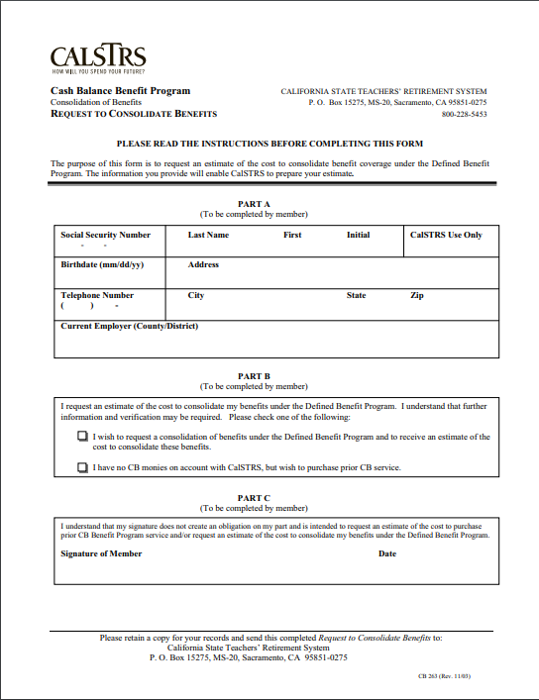
Request to Consolidate Benefits
Request to Consolidate Benefits
Member’s personal information
Specify the type of request
Member’s signature and date
X
Don’t forget to sign and date
Notes:
The first form in the packet is the Request to Consolidate Benefits.
Regardless of how many employers you have or have had you will only need to fill out one copy of this form. Sections A, B, and C are all to be completed by you, the CalSTRS member.
This form identifies your personal information, the type of consolidation request and a signature. Completing the form is certifying with CalSTRS that you are requesting an estimate of the cost to consolidate.
Click.

Slide 34
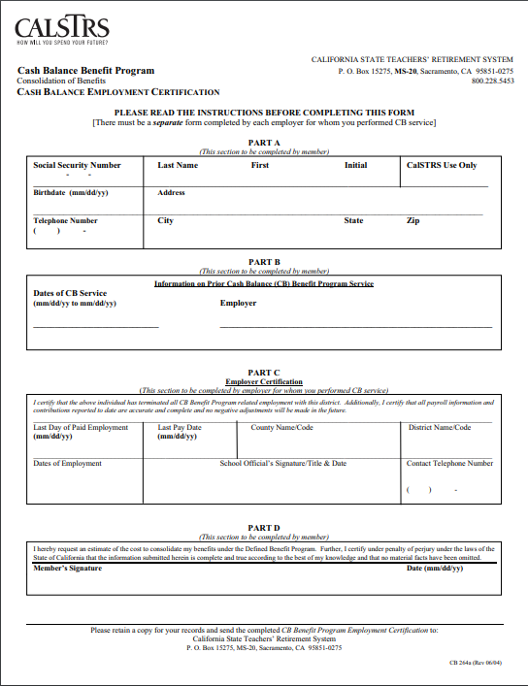
Cash Balance Employment Certification
Cash Balance Employment Certification
Separate form for each Cash Balance employer
Member: Part A, B & D
Member’s personal information
Prior Cash Balance Program service
Member’s signature and date
Employer: Part C
Employment verification
Completed by employer
X
Don’t forget to sign and date
Notes:
The next form to fill out is the Cash Balance Employment Certification.
You will need a separate form to be completed by each Cash Balance employer you have ever performed CB service with.
Parts A, B, and D will need to be completed by you, the CalSTRS member
Part C needs to be completed by the Cash Balance employer.
Your employer is certifying that you have terminated all Cash Balance service with them.

Slide 35
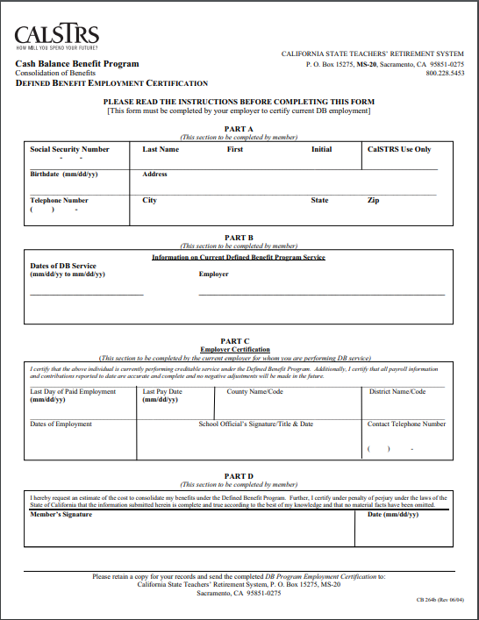
Defined Benefit Employment Certification
Defined Benefit Employment Certification
Member: Part A, B & D
Member’s personal information
Current Defined Benefit Service
Member’s signature and date
Employer: Part C
Employment verification
Completed by employer
X
Don’t forget to sign and date
Notes:
The last form that needs to be completed in the packet is the Defined Benefit Employment certification.
This form needs to be completed by your current Defined Benefit employer in which you are actively performing creditable DB service
Parts A, B, and D will need to be completed by you, the CalSTRS member
Part C needs to be completed by your current Defined Benefit employer.
Your employer is certifying that you are making contributions into the Defined Benefit program. They are also certifying that all reporting is up-to-date.
Click.

Slide 36
CalSTRS will do the research
Can be a lengthy process
Reporting errors may slow the process
Notes:
Once all the required information is received, CalSTRS will do the research. It can take up to 6 months to receive a billing statement detailing the available service to consolidate.
Most requests will be completed within this 6-month period. However, it is possible for a request to go over this time frame. For example, any reporting errors that may need to be corrected can increase the time it takes CalSTRS to generate a billing statement.
If you find that you are affected by reporting errors and delayed processing times you can be proactive and speak with the employer whose reporting needs to be corrected. You can also work with your local teacher's union to work with you on making sure reporting errors are corrected.
Click.

Slide 37
The research
CalSTRS determines eligible service credit
Cash balance covered service
All of your reported service will be researched and sorted.
Defined Benefit Nonmember Service
Overtime Service
Notes:
We mentioned CalSTRS will need to research your account.
Click.
Through research, CalSTRS will determine what service reported to your Cash Balance account is considered eligible service credit.
Click.
When we dive into your account, we might find a few types of service reported in your account. There is the Cash balance covered service that we already know is eligible. There could be some Defined Benefit Nonmember service, this would be service performed in a CalSTRS covered position, but contributions were not paid to CalSTRS, they may have been paid to another retirement program instead. Finally, overtime service could be there which does not qualify.
Click.
Once the eligible service is identified we will calculate the total number of service credit years available to consolidate and provide you with a billing statement that breaks down the cost.
Click.

Slide 38
The research
Your Cash Balance Program account balance:
Contributions
and interest
Funds used to purchase a portion of eligible service credit
Overtime
Rollover funds
Notes:
We will also be looking at the funds available in your account.
Click.
When we dive into your account, we might find contributions and interest, contributions from overtime, or rollover funds.
Click.
We will provide you with your account balance at the time of our research. This amount is subject to change due to a constant earning of interest. If you choose to move forward with the consolidation all funds in your account will be used to purchase a portion of the eligible service.
Click.

Slide 39
Jack permissively elects Defined Benefit
Program membership
His contributions to his Cash Balance Benefit account stop
Jack submits the Request to Consolidate Benefits packet
CalSTRS sends Jack a billing statement
Notes:
If you have attended our main Part-Time webinar, you’ll recognize Jack.
Jack began his career as a participant in the Cash Balance Benefit Program. He has decided that he wants to move forward with the Consolidation process.
Click.
The first step Jack will make is to permissively elect membership into the Defined Benefit Program.
Click.
As we noted before, once he has elected membership in DB, his contributions into Cash Balance will cease. That account is inactive and ready to consolidate.
Click.
Jack then goes online, downloads the Request to Consolidate Benefits packet. He and his employer complete the forms before sending them to CalSTRS for processing.
Click.
After processing the request, CalSTRS will send Jack a billing statement.
Click.

Slide 40
Billing statement
School years under Cash Balance Benefit Program
Available to purchase | Cash Balance Benefit account includes
Service credit for
school years under
Cash Balance Benefit
Prorated service credit based on Cash Balance Benefit account balance
Total cost to consolidate
benefit coverage
Cash Balance Benefit
account balance
Notes:
When you receive the billing statement from CalSTRS, you’ll notice a table to breakdown the findings of our research.
Click.
First you’ll notice the timeframe that you were enrolled in and contributing to the Cash Balance Benefit Program.
Click.
CalSTRS will give you the total amount of eligible service credit that was reported under the Cash Balance Program.
Click.
As we continue counterclockwise.
CalSTRS will also calculate the total cost to consolidate all of that service credit into your defined benefit account.
Click.
You’ll be given your account balance at the time of processing. This will usually be less than the total cost of all the service.
Click.
Because the balance is less, we will give you the prorated amount of service credit purchasable with the amount of funds in the account.
Click.

Slide 41
Billing statement
School years under Cash Balance Benefit Program
2015-2018
Available to purchase | Cash Balance Benefit account includes
School years the work was performed
Service credit for
school years under
Cash Balance Benefit
Prorated service credit based on Cash Balance Benefit account balance
Total cost to consolidate
benefit coverage
Cash Balance Benefit
account balance
Notes:
When you receive the billing statement from CalSTRS, you’ll notice a table to breakdown the findings of our research. The table won’t look exactly like this, but it will have the same 5 components.
Click.
The first thing to note will be the school years you were contributing to the Cash Balance Program.
These are the actual school years the work was performed. Even if 3 school years are listed, it does not mean you’ll be eligible for 3 years of service credit. For our example, Jack worked from 2015 to 2018.
Click.

Slide 42
Billing statement
School years under Cash Balance Benefit Program
2015-2018
Available to purchase | Cash Balance Benefit account includes
1.9000
Total service credit available to purchase
Prorated service credit based on Cash Balance Benefit account balance
Service credit for
school years under
Cash Balance Benefit
Total cost to consolidate
benefit coverage
Cash Balance Benefit
account balance
Notes:
For this example, our research showed that Jack is eligible to purchase 1.9 years of service credit. This covers the total of eligible service covered under the Cash Balance Benefit Program.
Click.

Slide 43
Billing statement
School years under Cash Balance Benefit Program
2015-2018
Available to purchase | Cash Balance Benefit account includes
1.9000
Prorated service credit based on Cash Balance Benefit account balance
Service credit for
school years under
Cash Balance Benefit
Total cost to consolidate
$17,860.00
Cash Balance Benefit
account balance
Total cost to consolidate benefit coverage
Notes:
Below that, we can see that the total cost to purchase Jack’s 1.9 years of service credit is $17,860.00.
Click.

Slide 44
Billing statement
School years under Cash Balance Benefit Program
2015-2018
Available to purchase | Cash Balance Benefit account includes
1.9000
Prorated service credit based on Cash Balance Benefit account balance
Service credit for
school years under
Cash Balance Benefit
$17,860.00
$3,678.54
The sum of your and your employer’s contributions, and interest gained
Total cost to consolidate benefit coverage
Cash Balance Benefit Program account balance
Notes:
Our billing statement will give you the total account balance of contributions and interest gained.
Because your account is continuously accruing interest, these numbers are subject to change from the time you receive the billing statement to the time your accounts are consolidated.
Click.

Slide 45
Billing statement
School years under Cash Balance Benefit Program
2015-2018
Available to purchase | Cash Balance Benefit account includes
1.9000
0.4406
Amount of service credit your Cash Balance Benefit account can buy
Service credit for
school years under
Cash Balance Benefit
Prorated service credit based on Cash Balance Program account balance
$17,860.00
$3,678.54
Total cost to consolidate benefit coverage
Cash Balance Benefit Program account balance
Notes:
In most cases, the cost to purchase the service credit will far outweigh the total balance of your Cash Balance account.
If Jack were to only purchase the service credit afforded him by the amount in his cash balance account, he would see 0.4406 years of service credit added to his Defined Benefit account. For your convenience, we will calculate the prorated amount for you.
Click.

Slide 46
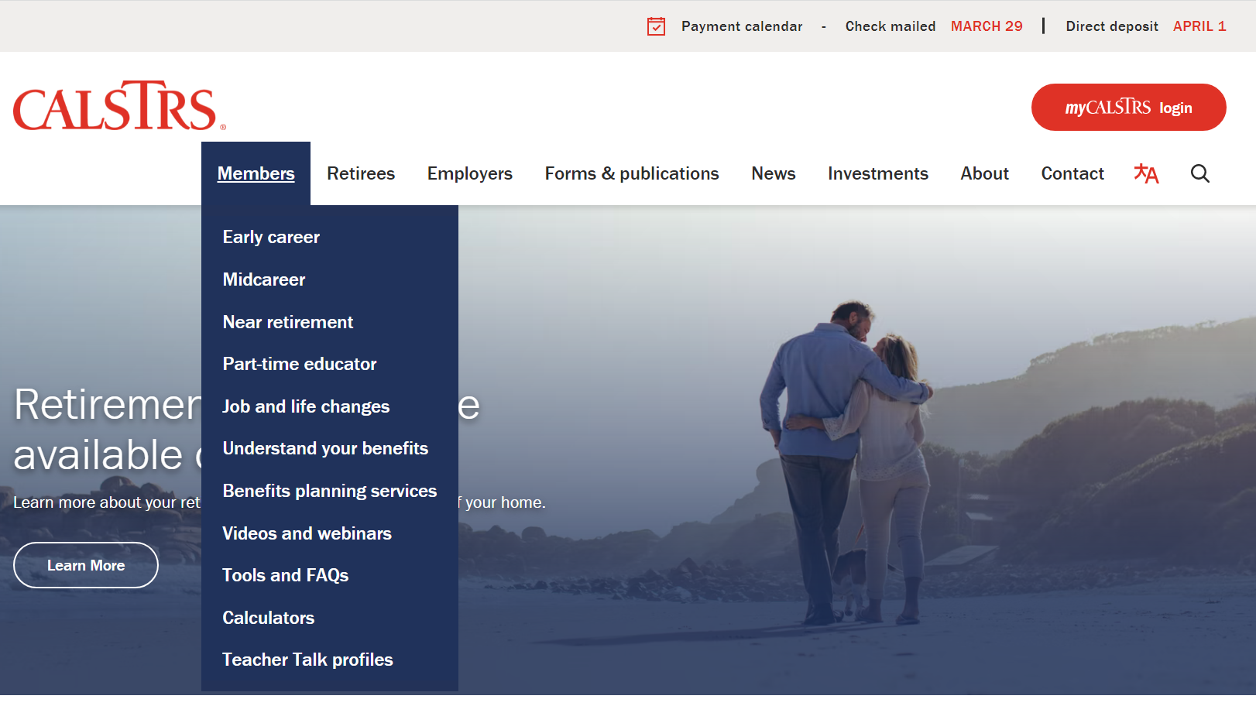
Notes:
If you’re curious as to how much that extra service credit can add to your retirement benefit, we recommend you use the calculators available on calstrs.com. Hover over the members tab at the top of the page
Click.
Click Calculators from the drop-down menu.
Click.

Slide 47
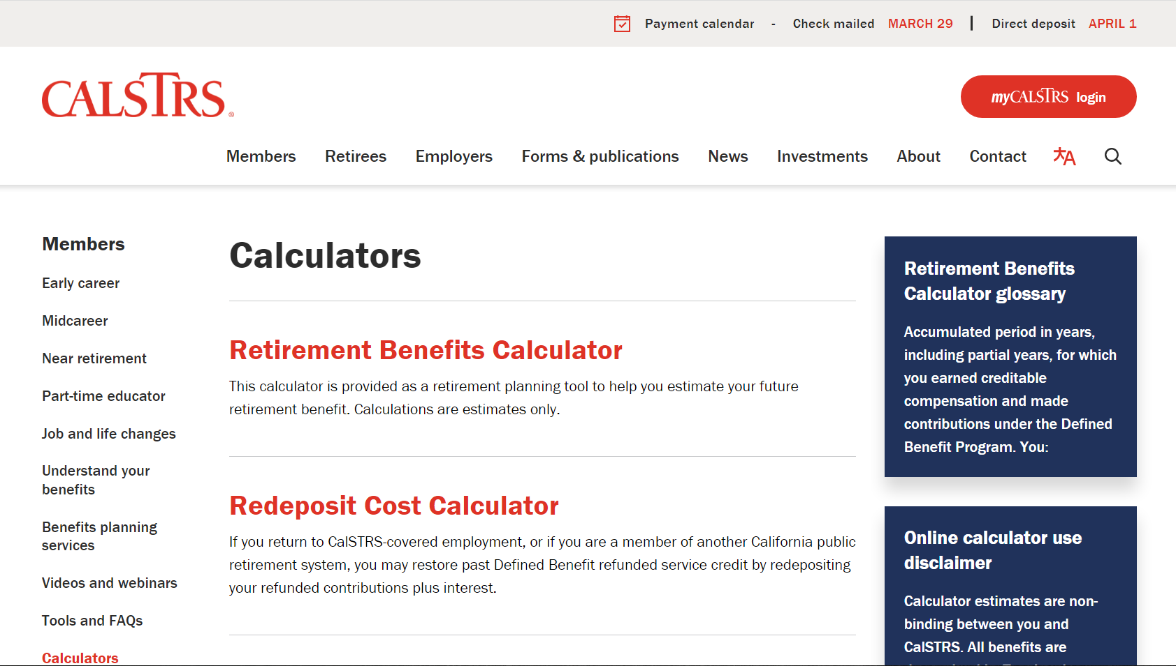
Retirement Benefits Calculator
Notes:
Click.
You’ll want to use the Retirement Benefits Calculator
Click.

Slide 48
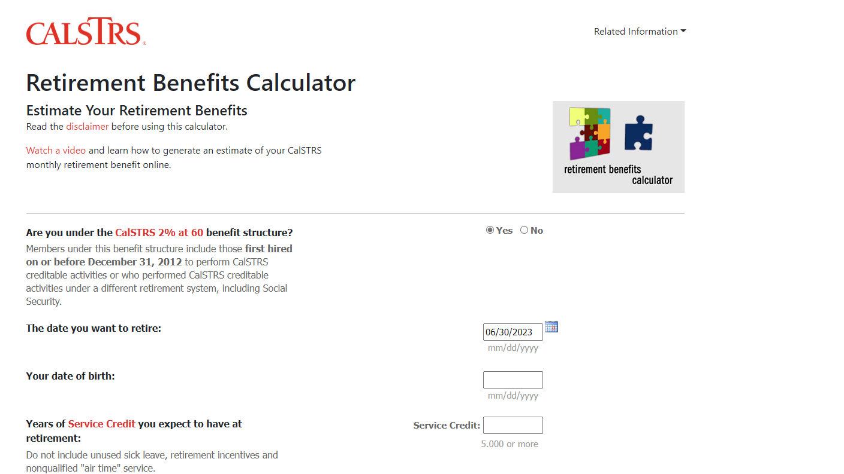
Notes:
I’m not going to go through this today, but this is what your screen should look like when you go into the calculator. If you have any questions, please call our 800 number.

Slide 49
Jack has three options
C
Consolidate the prorated service credit
Option A
AND
purchase remaining service credit
Do nothing
A
B
Notes:
At this point, Jack has three options to choose from.
Click.
Jack can choose to have CalSTRS apply his entire CB account balance to the cost of consolidating benefits. He will receive a proportionate share of the service credit that was covered under the Cash Balance Benefit Program.
Click.
Or Jack can choose to not only receive the proportionate share mentioned in Option A, but he will also request a billing statement of the cost to purchase the remaining eligible Cash Balance time. When he receives this 2nd billing statement, information will be included regarding payment options.
Regardless if Jack chooses A or B, it is important to note that an election to consolidate benefits is irrevocable.
Click.
Finally, Jack can decide to not respond to the letter at this time. There is no obligation for him to consolidate his accounts after requesting the consolidation estimate. He still has a right to elect a consolidation of benefits at a future time.
However, please note that as a general rule cost will increase as time passes due to age and salary increases.
Click.

Slide 50
Billing statement
School years under Cash Balance Benefit Program
2015-2018
Service credit available to purchase
1.9000
Total cost to consolidate
$17,860.00
Notes:
Looking at Jack’s numbers again, he has a total of 1.9 years of service credit that are available for purchase. The total estimated cost is $17,860.00.
Click.

Slide 51
Billing statement
School years under Cash Balance Benefit Program
2015-2018
What your Cash Balance Benefit account covers
0.4406
Cost
$3,678.54
Cash Balance Benefit Program
account balance
Notes:
If Jack chooses option A, he will only receive this orange slice of the pie. It is only a portion, but it means he has no additional money coming out of pocket for this consolidation.
Click.

Slide 52
Billing statement
School years under Cash Balance Benefit Program
2015-2018
Service credit available to purchase | What your Cash Balance Program account covers | What’s available left to purchase
1.9000
0.4406
1.4594
Prorated service credit
$17,860.00
$3,678.54
$14,181.46
Cash Balance Benefit Program account balance
Out-of-pocket cost
Total cost to consolidate benefit coverage
Notes:
If Jack chooses option B, he will receive that orange slice of the pie, but he will also be given options to purchase what is remaining.
Based on the numbers from his estimate, he is still eligible to purchase 1.4594 years of service credit. The estimated cost would be $14,181.46. Again, this number is subject to change through the process based on accruing interest in the cash balance account.
Click.

Slide 53
Jack has four payment options
1
2
3
4
Pay cash
Rollover from a qualifying account
Pre-tax payroll deduction
Do nothing
Or a combination of these payment options.
Notes:
At the end of Option B Jack receives the new Billing Statement. Now, Jack has four options to choose from.
Click.
Jack can elect to pay cash. Either as a lump sum or through monthly payments. If doing monthly payments, he will have up to 120 months to pay the balance. These funds are post-tax and will not be taxed again in retirement.
Click.
Or, if Jack has an outside investment account, he can choose to rollover those funds to purchase his service credit. With a rollover, taxes are not withheld during the transaction. Taxes will instead be paid in retirement.
Click.
Another option, Jack can elect to have pre-tax payroll deductions taken from his paycheck. The longest he’ll have to pay off the bill is 120 months.
Click.
Jack can choose a combination of payment options 1 2 and 3
Click.
Finally, and like before, Jack can choose to do nothing. If he doesn’t respond by the due date, we will assume he is not purchasing and close out accounts receivable for the request. Jack can request to purchase that time at a later date if he chooses, at a potentially higher cost.

Slide 54
The effect of doing nothing
You continue contributing to your Defined Benefit account
Your inactive Cash Balance Benefit account will continue to collect interest
You collect from both the Defined Benefit and Cash Balance Benefit accounts at retirement
If you decide to consolidate later, the cost will be greater.
Notes:
Finally, Jack could choose to Do nothing. So, what will happen to his CalSTRS accounts?
Click.
Jack has permissively elected membership into the Defined Benefit program, so he will continue making contributions into that account.
Click.
His cash balance account will remain inactive. Once he elects Defined Benefit, that election is irrevocable.
Click.
Although Jack won’t be contributing to his cash balance account, that balance will continue to grow by collecting interest.
Click.
At retirement, Jack can choose to collect from both accounts. We saw that his Cash Balance account is above $3,500, so he would be eligible to choose a lifetime or period-certain annuity when retiring.
I also want to remind you that in this scenario, just because Jack decides not to move forward, he is still eligible to request another consolidation estimate in the future, keeping in mind that the cost may be even substantially higher depending on how long .

Slide 55
Notes:
If you choose to consolidate your Cash Balance account into your Define Benefit account, Remember the process starts with you.
I am going to show you where on our website you can go to download the forms you will need.
From The CalSTRS.com landing page hover over Forms and publications
Click.
select forms from the drop-down menu.
Click.

Slide 56
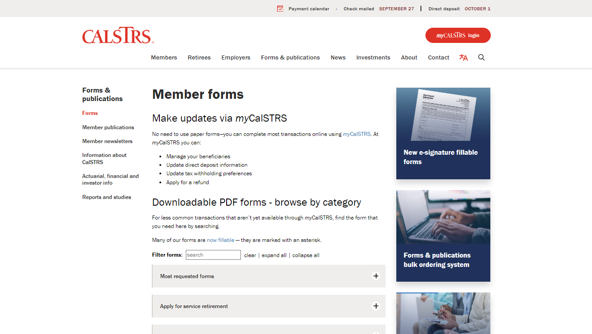
Notes:
All CalSTRS forms are separated here by relevant topic
Click.

Slide 57
Notes:
Select the option Increase your benefit- purchase, consolidate, redeposit.
Click.

Slide 58
Notes:
We are looking to select the Cash Balance Request to Consolidate Benefits Packet.
Click.

Slide 59
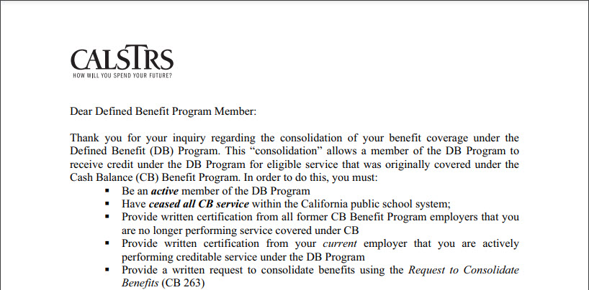
This does not mean you should quit your job
Notes:
When you access the packet you will notice it begins with a letter to the applicant that looks like this. This letter details the process and requirements to complete this request. I want to point out a very important bullet in this letter.
Click.
This bullet says you must cease all CB service… this does not mean you should quit your job. It just means that you should be contributing to the Defined Benefit Program and your CB account will need to be inactive.
Click.

Slide 60
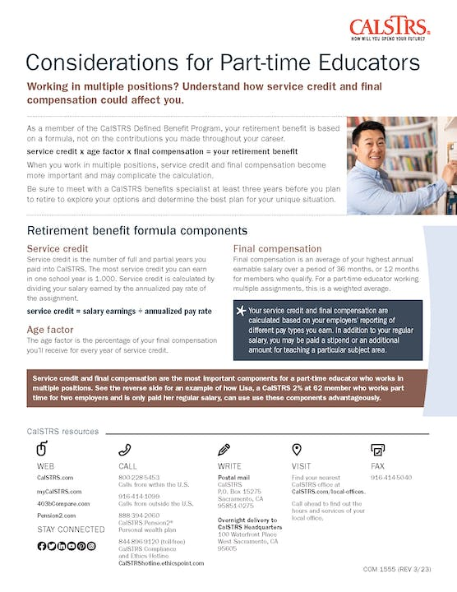
Considerations for part-time educators
Members of the Defined Benefit Program
Understand service credit calculations
Understand how final compensation is calculated using a weighted average
Notes:
I previously mentioned that there may be some additional considerations for part-time educators working in the Defined Benefit Plan. If you are a part-time educator who is a member of the Defined Benefit program, I encourage you to download and review this factsheet that can be found at CalSTRS.com/publications.
Click.

Slide 61
For more information
Online resources
Benefits planning session
Attend a workshop or webinar
Part-time educator webpage
myCalSTRS
Retirement Progress Report
Individual benefits planning session
Part-time Educator
Cash Balance Benefit Program
Additional Income Sources for Part-time Educators
calstrs.com/webinars
Notes:
If you need more information, we have several online resources. I specifically want to point out the Part-time Educator webpage. This webpage is really the “one-stop shop” for all things a part-time educator might need.
Before I show you how to navigate to this page, I want to remind you that myCalSTRS and your annual retirement progress report are both going to be excellent online resources for you.
You can schedule a benefits planning session
There is also several webinars that were created specifically for you the part-time educator .
Click.

Slide 62
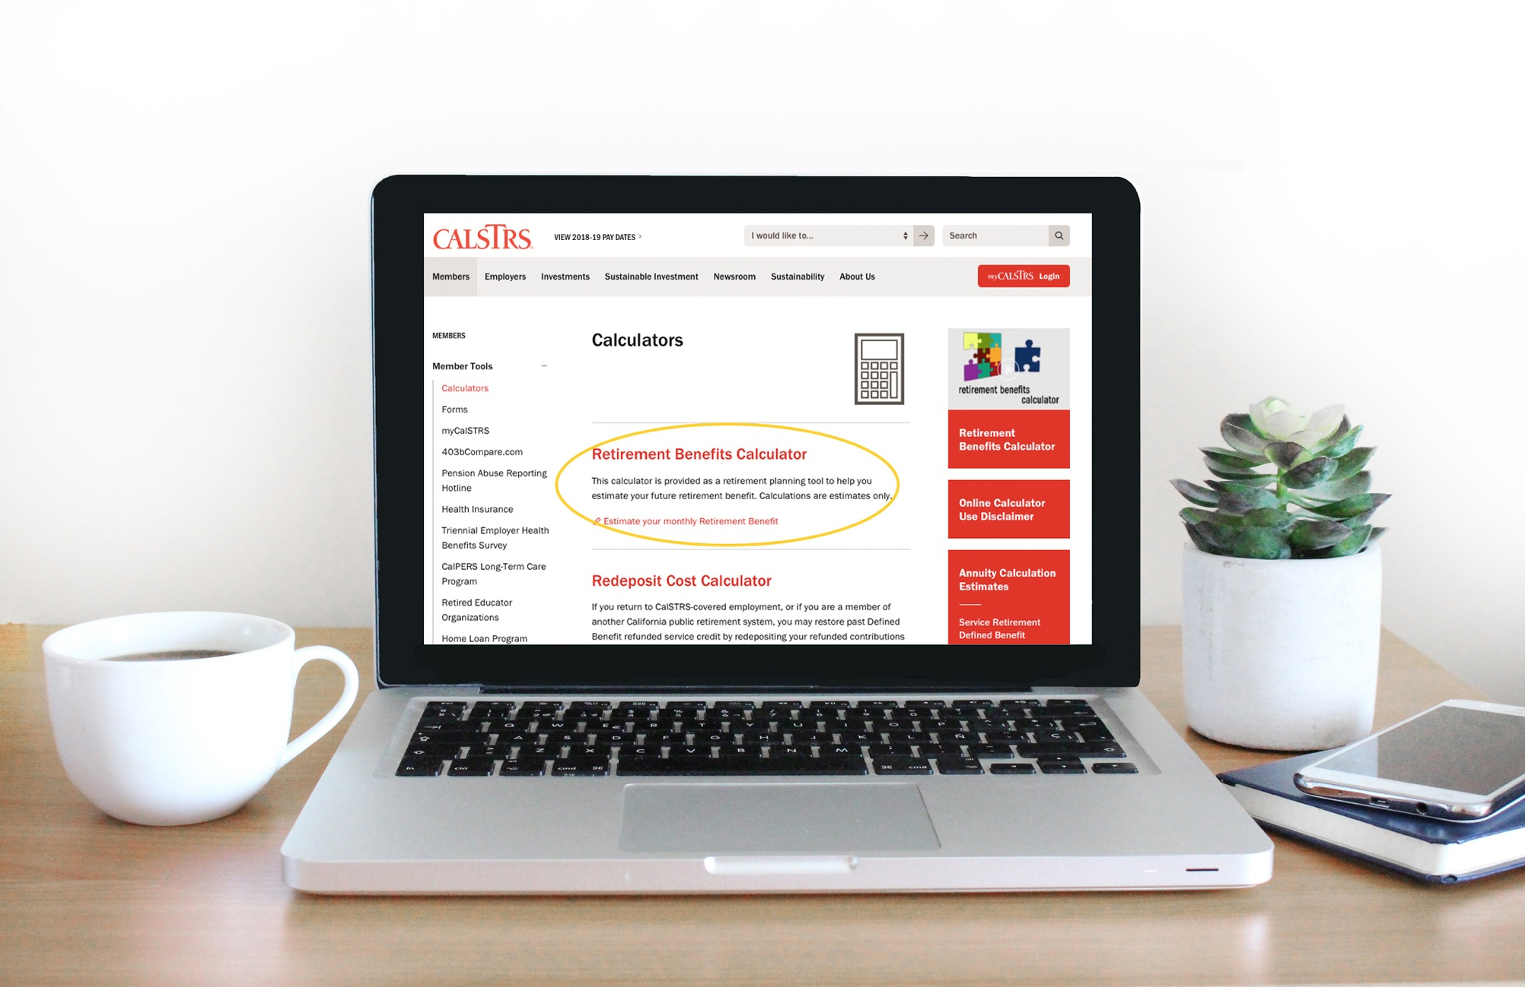
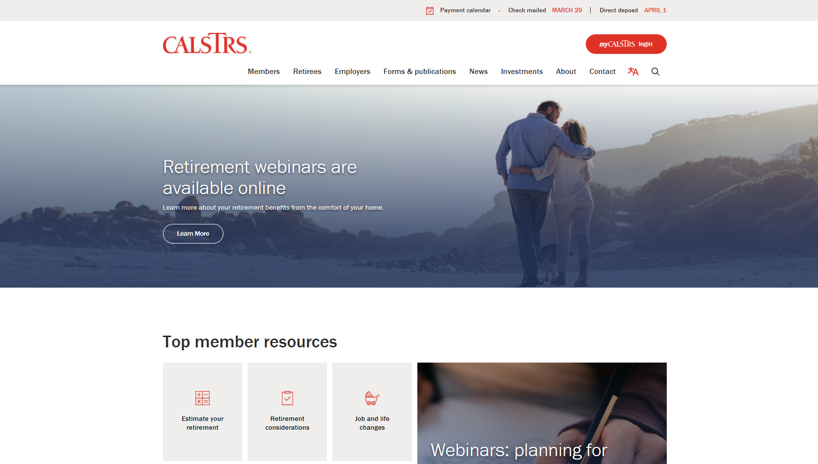
Part-time educator webpage
Notes:
Like I said I want to go ahead and show you how you can get to the Part-time Educator webpage.
Click.
From the CalSTRS.com landing page hover your mouse over “Members” from the top menu.
Click.

Slide 63
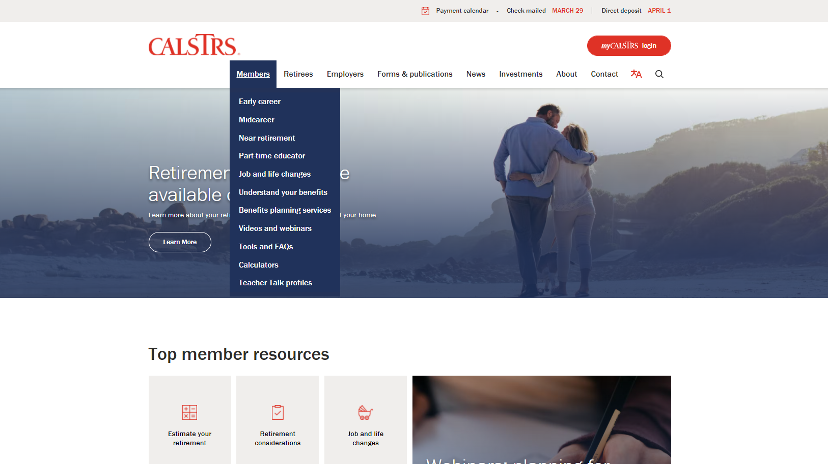
Getting Started
Notes:
From the menu that drops down,
Click.
you will select “Part-time educator”
Click.

Slide 64
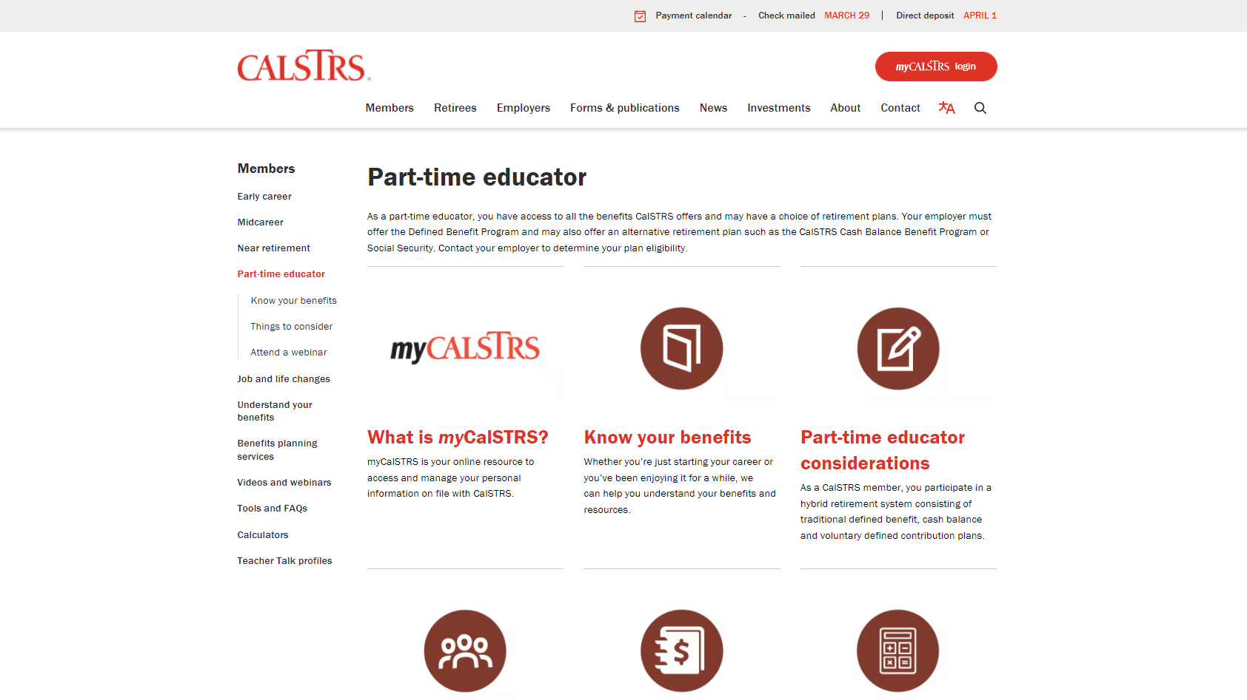
PTE page
Notes:
This will bring you to the part-time educator webpage where you can access all things part-time.
Click.

Slide 65
Questions?
CalSTRS.com
myCalSTRS
800-228-5453
*Press 2 for Customer Service.
Monday – ­Friday
8 a.m. – 5 p.m.
Notes:
Questions?

