Slide 1

My Retirement Benefits
Notes:
Introduction:
Hello Everyone, Welcome to the “My Retirement Benefits” workshop. Today’s workshop is focused around your retirement, but more specifically it’s a breakdown of all the benefits that CalSTRS provides. My name is , and I am a benefits specialist here at CalSTRS.
**Feel free to give a brief introduction about yourself.**
Click.

Slide 2

Trust CalSTRS, not impersonators
CalSTRS authorized representatives:
Have an email address ending in @CalSTRS.com.
Can provide a CalSTRS ID badge or business card.
Do not provide refreshments at offsite events.
Will never meet at your home.
Do no sell insurance products.
Have access to your Pension2® account information.
Some Voya financial representatives work exclusively with Pension2.
Their names and photos are listed at
CalSTRS.com/trust-CalSTRS.
To verify a CalSTRS representative, contact us at 888-394-2060 or RepCheck@CalSTRS.com.
Notes:
Firstly, we’ve been receiving constant reports from our members believing they’ve set up an appointment or spoken with a CalSTRS representative when they have not. Only CalSTRS employees can provide you with accurate information regarding your CalSTRS Defined Benefit and Pension2 accounts. We’ve developed a checklist for you to use to ensure the person with whom your speaking is a CalSTRS employee.
Companies or individuals not affiliated with CalSTRS cannot have the CalSTRS logo on their advertisements.
Only CalSTRS employees will have an @CalSTRS.com e-mail address on their business cards. Please double-check the spelling of CalSTRS.
CalSTRS does not provide any refreshments when we come to see you at events.
CalSTRS employees will never meet you at your home.
CalSTRS is not an insurance company, so we will never try to sell you on any insurance products.
Only CalSTRS employees will have access to your CalSTRS or Pension2 account information. If you’re asked to provide a copy of your CalSTRS Retirement Progress Report or Pension2 account statement in order for someone to assess your CalSTRS accounts, they are not affiliated with CalSTRS.
CalSTRS has created a webpage at www.CalSTRS.com/Trust-CalSTRS with names and pictures of all our member-facing employees. This webpage is kept up-to-date, so you can always ensure you’re speaking with a CalSTRS employee. There are some representatives from Voya Financial with an @Voya.com e-mail address who work exclusively on the Pension2 program. Their names and photos will also be found on the CalSTRS Outreach Page.
If you scheduled an appointment or already met with someone you think may not be a CalSTRS representative, contact us at 888-394-2060 or RepCheck@CalSTRS.com to verify they are a CalSTRS representative.
Please disseminate this information to any friends or colleagues who may need it.
Click.

Slide 3

Objectives
01
Discover what benefits are available to you.
02
Learn the basic benefit eligibility requirements.
03
Understand how your benefits are calculated.
04
Take advantage of CalSTRS resources.
Notes:
In today’s presentation we will discuss…
Click.
The benefits that CalSTRS provides to its members
Click.
Explain the eligibility requirements for those benefits
Click.
Look at how your benefits are calculated
Click.
Provide you with some valuable CalSTRS resources.
Click.

Slide 4
01
Section one
Important considerations
Notes:
It is important to know what benefits are included with your membership….
Click.

Slide 5

CalSTRS benefits
01
Retirement
Survivor
Disability
Check with your employer about health benefit coverage in retirement.
Notes:
Retirement benefits.
Survivor benefits.
And disability benefits are all included in your membership.
It’s important to keep in mind that CalSTRS does not offer health benefits. As an active member, your health benefits are offered through your employer. In retirement, you will be responsible for your own coverage.
Check with your employer about what health benefit coverage is available to you in retirement so you can plan ahead for any additional costs.
Some benefit packages for retirees might be contingent on how long you’ve been with the district – this is something you might want to consider if you’re looking at changing employers throughout your career.
For those of you that have your handout in front of you, there are some action items listed.
**specialist to draw attention to the action item.
You will want to pay close attention to the action items. You may check off action items as we move through each section. You will notice many action item reminders on the slides indicated by a box with a check mark next to the action item like is seen here on this slide.
Click.

Slide 6
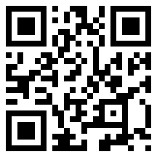

Social Security rules
01
Windfall Elimination Provision
May reduce but cannot eliminate your earned Social Security benefit.
Government Pension Offset
Reduces and may eliminate your spousal or widow/widower Social Security benefit.
Scan the QR code to review the Social Security, CalSTRS and You fact sheet at CalSTRS.com/publications.
Contact the Social Security Administration for more information.
Notes:
Another thing you will want to plan ahead for are potential reductions to any Social Security benefits you might receive.
As a CalSTRS member, you do not contribute to Social Security for your CalSTRS-covered employment. If you anticipate receiving a Social Security benefit from other employment or from a spouse, there are two government rules that can reduce your benefit or leave you with no benefit at all.
Click.
The Windfall Elimination Provision impacts your earned Social Security benefit from employment outside of CalSTRS. The Social Security Administration uses an alternate formula to calculate your benefit. This can reduce your benefit but will not eliminate it.
Click.
The Government Pension Offset impacts your spousal, widow or widower benefit. The Social Security Administration reduces your benefit by two-thirds of your CalSTRS benefit which can eliminate your benefit all together.
If you are affected by either of these offsets, they will not reduce your CalSTRS benefit. It’s important to be aware of these rules and contact the Social Security Administration for more information since the estimates on your social security statement don’t reflect these reductions.
You can also learn more by reviewing the CalSTRS, Social Security and You fact sheet on CalSTRS.com…
Click.

Slide 7
02
Section two
Online resources
Notes:
Now let’s take a look at some of the online resources available to you.
Click.

Slide 8

CalSTRS.com
02
Learn about CalSTRS and your benefits.
Download forms and publications.
Access calculators and watch videos.
Notes:
CalSTRS.com is our public website where you can learn more about us and your benefits.
You can download forms and publications, access retirement benefit calculators and even watch short educational videos to recap the information we will be covering today.
Use the white menu bar at the top of the page to easily navigate to your various resources.
Click.

Slide 9

myCalSTRS
02
Register at myCalSTRS.com and update your contact information and communication preferences.
View and update account information.
Submit forms and send messages.
Access your Retirement Progress Report.
Notes:
From CalSTRS.com you can click on the myCalSTRS login button to access your myCalSTRS account.
myCalSTRS provides online access to your CalSTRS accounts and information 24/7.
Register for an account and update your preferences for receiving information from us if you haven’t done so already. With the environment in mind, we default to electronic communication but you can always request to receive hard copies of information by mail.
With myCalSTRS you can also submit forms and send and receive secure online messages with a CalSTRS representative. The nice thing about this feature is that the electronic copies are archived in your account for future reference if you need them.
You can also access your annual Retirement Progress Report each September on your myCalSTRS account…
Click.

Slide 10
Your Retirement Progress Report
02
Use your Retirement Progress Report to review:
Membership and benefit information.
Service credit and account balances.
Employer reporting.
Review your report each fall and contact your employer regarding any discrepancies.
Notes:
Your Retirement Progress Report is your annual statement that summarizes your information for the prior school year.
It includes information about your membership and benefits, service credit and account balances and even information reported by your employer.
Beginning at age 45 you can also find estimates for your defined benefit and defined benefit supplement accounts.
Since we use information reported by your employer to calculate your benefit, it’s important to review your report each year and contact your employer directly regarding any discrepancies so they can be corrected.
Take a moment to review the actions items in section 2 of the handout, mark any necessary items.
Click.

Slide 11
03
Section three
Membership information
Notes:
Let’s talk a little bit about your membership information specifically your benefit structure.
Click.

Slide 12
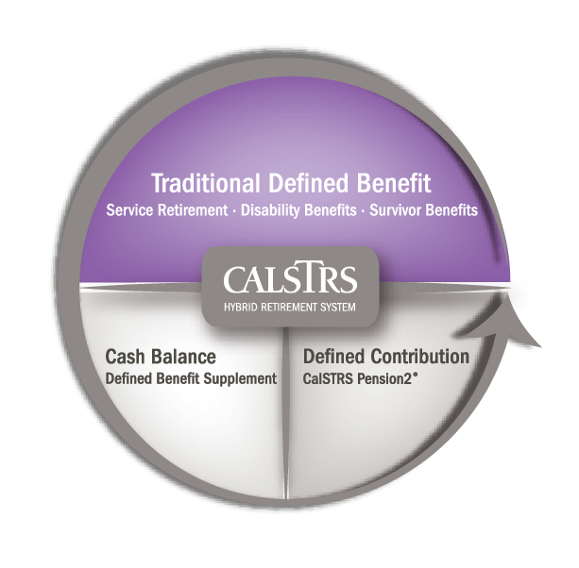
CalSTRS hybrid system
05
Membership includes:
Defined Benefit Program
Defined Benefit Supplement Program
Optional:
CalSTRS Pension2®
Notes:
Your membership includes:
-The Defined Benefit Program – which is where a majority of your retirement income will be coming from.
-The Defined Benefit Supplement Program – where money from your extra-pay assignments is routed to
The optional portion is our CalSTRS Pension2 program. This program allows for you to save extra for a secure retirement.
We’ll talk about each of these parts of the CalSTRS hybrid system as we go through the presentation.
Click.

Slide 13

Benefit structures
03
CalSTRS
2% at 60
First hired before January 1, 2013.
CalSTRS
2% at 62
First hired on or after January 1, 2013.
Fill in your benefit structure on page 1.
Verify your benefit structure on your Retirement Progress Report.
Notes:
Your benefit structure is based on the date you were first hired in a CalSTRS-covered position and determines how your retirement benefits are calculated.
After the California Public Employees’ Pension Reform Act of 2013, there are two different benefit structures:
You are a CalSTRS 2% at 60 member if you were first hired before January 1, 2013.
You are a CalSTRS 2% at 62 member if you were first hired on or after January 1, 2013.
However, please note: If you were hired after January 2013 but were a member of certain other public retirement systems within six months of becoming a CalSTRS member, you might be a CalSTRS 2% at 60 member.
If you aren’t sure of your hire date you can verify your benefit structure on your Retirement Progress Report or on the home page of your myCalSTRS account.
In section 3 of your handout there is a space for you to note down your benefit structure.
If you need to verify it on your Retirement Progress Report, check the action item in section 3 of the handout.
If you are still unsure and do not have access to your progress report, you may call our contact center Mon- Fri 8 a.m. – 5 p.m. at 1-800-228-5453.
Click.

Slide 14
04
Section four
Retirement benefits
Notes:
Next, let’s discuss eligibility requirements for Service Retirement and how your benefit is calculated.
Click.

Slide 15
Service retirement eligibility
04
Minimum requirements
Age 55 with five years of service credit.
Early
retirement
Age 50 with 30 years of service credit.
(CalSTRS 2% at 60 only)
Concurrent retirement
Age 55 with fewer than five years of service credit if retiring concurrently from certain other retirement systems.
Read the CalSTRS Member Handbook at CalSTRS.com/publications for more information.
Notes:
Click.
The minimum requirements for a service retirement benefit are age 55 with five years of service credit.
Click.
If you’re a CalSTRS 2% at 60 member, you can retire as early as age 50 with 30 years of service credit.
Click.
If you have fewer than five years of service credit you can retire at age 55 if you retire concurrently with certain other public retirement systems in California such as CalPERS.
You can read more about concurrent retirement and eligibility in the Member Handbook.
Click.

Slide 16

Service retirement formula
04
service credit $×$ age factor $×$ final compensation
$=$ monthly retirement benefit
Service credit:
Time worked and contributed.
Use the Retirement Benefit Calculator at CalSTRS.com/calculators.
Review the Understanding the Formula fact sheet and video at CalSTRS.com.
Notes:
Your retirement benefit is a guaranteed lifetime monthly benefit based on a formula and not the balance in your account.
The formula consists of three components – service credit, age factor and final compensation.
Service credit is the time you’ve worked and contributed to CalSTRS.
You accrue service credit based on the percentage of a full-time contract you work…
Click.

Slide 17
Service credit
04
Percentage of contract worked
Service
credit
Full time
75% time
50% time
1.000
0.750
0.500
Track your service credit balance on your Retirement Progress Report each fall.
Notes:
If you’re working full time, you should earn one year of service credit, half-time you would earn a half year and so on.
You can earn up to one year of service credit in a school year. We’ll talk about what happens to contributions in excess of one year a little later.
You can also receive service credit for any unused sick leave you have at retirement.
Click.

Slide 18


Service credit
04
Calculating additional service credit
unused sick leave days $÷$ number of contract days
$=$ additional service credit
Example
100 unused sick leave days $÷$ 180 contract days
$=$ 0.556 years additional service credit
Track your service credit balance on your Retirement Progress Report each fall.
Notes:
Click.
We calculate the service credit increase by dividing the number of unused sick leave days you have at retirement by the number of days in your annual contract.
Click.
For example, if you have 100 unused sick leave days at retirement and a 180-day contract, you would receive an additional .556 years of service credit in your retirement benefit. It’s important that you transfer your unused sick leave balances to your current employer if you change positions throughout your career.
Also, remember to track your service credit balance on your annual Retirement Progress Report each year and contact your employer regarding any discrepancies….
Please note: Unused sick leave time is not reflected on the RPR—that information will be certified during the retirement process.
Click.

Slide 19
Service retirement formula
04
service credit $×$ age factor $×$ final compensation
$=$ monthly retirement benefit
Service credit:
Time worked and contributed.
Age factor:
Percentage based on age at retirement.
Use the Retirement Benefit Calculator at CalSTRS.com/calculators.
Review the Understanding the Formula fact sheet and video at CalSTRS.com.
Notes:
Now let’s discuss the age factor component of the retirement formula
Your age factor is a percentage based on your age at retirement.
Click.

Slide 20
Age factor
04
Retirement age | CalSTRS 2% at 60 | CalSTRS 2% at 62
55 | 1.40% | 1.16%
56 | 1.52% | 1.28%
57 | 1.64% | 1.40%
58 | 1.76% | 1.52%
59 | 1.88% | 1.64%
60 | 2.00% | 1.76%
61 | 2.13% | 1.88%
62 | 2.27% | 2.00%
63 | 2.40% | 2.13%
64 | 2.40% | 2.27%
65 | 2.40% | 2.40%
View the complete age factor tables in the CalSTRS Member Handbook at CalSTRS.com/publications.
Career factor:
An increase of 0.20% for CalSTRS 2% at 60 members with 30 or more years of service credit.
Notes:
The standard age factor for CalSTRS 2% at 60 members is 2% when you reach age 60. The age factor gradually decreases if you retire before age 60 and gradually increases to a maximum age factor of 2.4% at age 63.
If you are under the CalSTRS 2% at 62 benefit structure you will receive the 2% age factor when you reach age 62. You will reach the maximum age factor of 2.4% at age 65.
The age factor you see on the screen is broken down in years from age 55 to age 65. The age factor is based on your age in years and months at retirement. We have provided a complete age factor table. You can access the complete age factor table in the Member Handbook…
Click.
If you’re a CalSTRS 2% at 60 member with 30 or more years of service credit at retirement, we will increase your age factor by .200 percent up to the maximum of 2.4 percent. This is known as the career factor.
Click.

Slide 21
Service retirement formula
04
service credit $×$ age factor $×$ final compensation
$=$ monthly retirement benefit
Service credit:
Time worked and contributed.
Age factor:
Percentage based on age at retirement.
Final compensation:
Highest average annual compensation earnable for 36 consecutive months.
Use the Retirement Benefit Calculator at CalSTRS.com/calculators.
Review the Understanding the Formula fact sheet and video at CalSTRS.com.
Notes:
Final compensation is the highest average annual compensation earnable for 36 consecutive months.
Keep in mind that if you’re a CalSTRS 2% at 60 member with 25 or more years of service credit, we will use a period of 12 consecutive months to calculate your final compensation.
Click.

Slide 22

Crystal’s retirement benefit calculation
Crystal is a CalSTRS 2% at 62 member who works full time.
She is 42 years old with nine years of service credit.
If she works until 62, she will have
29 years of service credit.
Notes:
Let’s work through an example. Crystal is a CalSTRS 2% at 62 member who works full time.
She is currently 42 years old with 9 years of service credit.
Crystal wants to retire at age 62 which means she still has 20 years to work and grow her service credit.
At retirement, she will have 29 years of service credit.
Click.

Slide 23

Crystal’s final compensation
04
School year | Compensation earnable | Number of months
Year A | $91,800 | 12
Year B | $90,600 | 12
Year C | $88,400 | 12
$270,800 $÷$ 36 months $=$ $7,522
Calculate Crystal’s final compensation on page 2.
Notes:
Now we need to calculate Crystal’s final compensation – the highest average annual compensation earnable for 36 consecutive months.
Keep in mind that your compensation earnable is based on your contract salary not your total earnings. If you are working part-time, your compensation earnable is based on how much you would have earned if you had been working full-time in your position.
Let’s assume the highest compensation earnable amounts during the last 36 months, or three school years, for Crystal are $91,800, $90,600 and $88,400.
Take a moment to calculate Crystal’s final compensation in section 4.
*allow time for practice calculation.
What is Crystal’s final compensation?
Click.
We add these figures together and divide by 36 months to get Crystal’s final compensation of $7,522.
Click. Now we need to calculate Crystal’s final compensation – the highest average annual compensation earnable for 36 consecutive months.
Keep in mind that your compensation earnable is based on your contract salary not your total earnings. If you are working part-time, your compensation earnable is based on how much you would have earned if you had been working full-time in your position.
Let’s assume the highest compensation earnable amounts during the last 36 months, or three school years, for Crystal are $91,800, $90,600 and $88,400.
Take a moment to calculate Crystal’s final compensation in section 4.
*allow time for practice calculation.
What is Crystal’s final compensation?
Click.
We add these figures together and divide by 36 months to get Crystal’s final compensation of $7,522.
Click.

Slide 24

Crystal’s retirement benefit
04
29 $×$ 0.020 $×$ $7,522 $=$ $4,363
Service credit
9.000 earned + 20.000 additional
by retirement
Age factor
2% at age 62
Final compensation
($91,800 + $90,600 + $88,400) $÷$ 36 months
Monthly retirement benefit
Review the Understanding the Formula fact sheet and video at CalSTRS.com.
Use the Retirement Benefits Calculator at CalSTRS.com/calculators to estimate your benefit.
Notes:
So here we have the retirement benefit formula.
Click.
We already know that Crystal has 9 years of service credit and plans to work another 20 years, giving her a total of 29 years of service credit.
Click.
Crystal is a CalSTRS 2% at 62 member, her age factor would be 2% when she retires at age 62; converted to a decimal is 0.02.
Click.
Using what we calculated on the last slide, we’ll use a final compensation of $7,522.
Click.
When we plug these figures into the formula, we get a retirement benefit of $4,363.
Your Retirement Progress Report will contain estimates based on information we have on file once you reach age 45. If you want to calculate your benefit in the interim or look at different retirement scenarios, you can use the Retirement Benefits Calculator on CalSTRS.com…
In section 4 of the handout there are action items if you need more information about eligibility, service credit, or calculating your benefit check the corresponding action items.
Click.

Slide 25


Replacement ratio
04
My CalSTRS benefit
My savings and investments
Estimate your expenses in retirement and research supplemental savings plans and other income sources.
Notes:
On average, the CalSTRS retirement benefit replaces about 50 percent of a member’s final compensation.
Financial experts recommend replacing about 80-90 percent of your income to maintain your current standard of living. You will need to rely on your savings and investments to fill the gap between your monthly retirement benefit and your retirement income goals. Start planning ahead by estimating your expenses in retirement and researching the supplemental plans and income sources available to you.
Click.

Slide 26


Replacement ratio
04
29 $×$ 0.020
Crystal’s retirement benefit
58% of final compensation
Service credit
9.000 earned + 20.000 additional by retirement
Age factor
2% at age 62
Notes:
We talk about the replacement ratio because figuring out your benefit in dollars might not be so accurate right now when you you’re many years away from retirement and we can’t predict what your salary will be.
Figuring out how much your projected benefit will replace gives you another way to determine if your benefit alone will be enough, and if not, don’t forget to add in other accounts or investments you might have. Or you can look at ways to increase your CalSTRS retirement benefit.
Let’s calculate Crystal’s replacement ratio, her service credit at retirement would be 29 years and her age factor would be 2%. We multiple those numbers.
Click.
This gives her a replacement ratio of 58%. In other words, her retirement benefit will replace about 58% of her current working salary.
You can calculate your own replacement ratio by multiplying your service credit by your age factor.
Click.

Slide 27
Increasing your monthly benefit
04
Service
credit
Work longer.
Purchase service credit.
Age
factor
Work longer.
Retire later.
Final compensation
Work at higher pay rates.
Use the calculators at CalSTRS.com/calculators.
Read the Purchase Additional Service Credit fact sheet at CalSTRS.com/publications.
Notes:
One of the things Crystal might consider is increasing her monthly benefit.
So let’s talk about some ways you can increase your monthly benefit.
You can increase your benefit by increasing any one of the three components of the formula
Click.
You can increase your service credit by working longer, purchasing permissive service credit such as unpaid medical or family leaves, sabbatical or time from an out-state-system you won’t receive a benefit from. You can also redeposit or buy back service you lost when you took a refund of your contributions.
If you’re interested in purchasing service credit, read the Purchase Additional Service Credit booklet and use the calculators on CalSTRS.com to estimate the cost of your purchase and the increase to your benefit.
Click.
You can increase your age factor by working longer or, if you stop working and don’t need to collect your benefit right away, wait to retire until you reach the maximum age factor.
Click.
Finally, you can increase your final compensation by working at higher pay rates. If you’re working in multiple positions it can be advantageous to stop working in your lower paying positions as you approach retirement in order to increase your final compensation.
Click.

Slide 28

Extra-pay assignments
04
View your account balance on myCalSTRS.
Consider working extra-pay assignments to increase your account balance.
Defined Benefit Supplement account
Member contribution rate:
  8% for CalSTRS 2% at 60 members.
  9% for CalSTRS 2% at 62 members.
Employer contribution rate is 8%.
Notes:
When we last looked at this hybrid system, I mention the Defined Benefit Supplement account.
The Defined Benefit Supplement account is a cash balance account that offers guaranteed benefits based on the balance in your account.
The Defined Benefit Supplement Program was created back in 2001. Between 2001 and 2010 we redirected a quarter of your monthly contributions to this account to give you additional income in retirement.
Click.
You also contribute to this account by working anything above one year of service credit (such as summer school, coaching, yearbook, etc.). 8 percent of your and your employers contributions for service in excess of one year go into your Defined Benefit Supplement account. If you are under the 2% at 62 benefit structure you are contributing 9%. Your account also gains a guaranteed interest rate each year.
You can find your balance for this account in your myCalSTRS account or on your Retirement Progress Report.
Click.

Slide 29
Defined Benefit Supplement distributions
04
Lump sum
Choices
Annuity
Combo
Watch the Defined Benefit Supplement video series at CalSTRS.com/videos.
Notes:
At retirement, you will have to decide how you want to receive these funds.
You can take them in either in a
Click.
lump-sum or
Click.
an annuity or
Click.
do a combination of the two.
There are several tax considerations for this account so it’s a good idea to review the Defined Benefit Supplement video series on CalSTRS.com and discuss your choices for this account with your financial representative as you near retirement.
You may want to consider rolling the Defined Benefit Supplement account funds into a qualified plan.
Click.

Slide 30
05
Section five
CalSTRS Pension2
Notes:
This brings us to the third part of the CalSTRS hybrid, CalSTRS Pension2.
Click.

Slide 31

Supplemental savings
05
403(b)
Roth 403(b)
457(b)
Roth 457(b)
Notes:
Pension2 is a voluntary defined contribution plan and offers 403(b), 457(b), Roth 403(b) and Roth 457(b) plans that often have lower fees and expenses compared to other plans.
In addition to the DBS funds you can also rollover funds from outside retirement savings accounts, consolidating them into one account.
And if you are considering this, they can provide a no cost, no obligation statement comparison between the costs you may pay elsewhere and Pension2.
If you’re interested in learning more about investing or money management, check out our Financial Awareness workshops series, which we will discuss more in a moment.
Click.

Slide 32

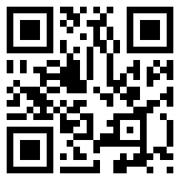

CalSTRS Pension2
05
Pension2 can take you where you want to go
Tax-deferred retirement savings.
Low and transparent costs.
No commissions, load fees or surrender charges.
Flexible investment options.
Visit Pension2.com or call 888-394-2060 for more information.
Research your employer’s plans at 403bCompare.com.
Scan the QR code to visit Pension2.com.
Notes:
Pension2 is a great way to save more for your future because you can contribute tax-deferred money, there are low and transparent costs, no commissions, load fees or surrender changes. There are also flexible investment options.
If you have additional questions about Pension2, you can visit Pension2.com by scanning that QR code or give them a call at 888-394-2060.
If you want to do some research on your own, you can visit 403bcompare.com to compare all 403b products offered in California.
In section 5 of the handout there are some actions items you may want to check.
Click

Slide 33
06
Section six
Coverage types
Notes:
In addition to your retirement benefits CalSTRS also provides disability and survivor benefits. There are two different coverage types for your disability and survivor benefits.
Click.

Slide 34
Coverage types
06
Coverage A
Member prior to October 15, 1992.
Coverage B
Member on or after October 15, 1992.
Chose coverage during special election period.
Fill in your coverage type on page 3.
Verify your coverage type on your Retirement Progress Report.
Notes:
Your coverage type determines how your disability and survivor benefits are calculated.
Click.
If you became a CalSTRS member prior to October 15, 1992, you have Coverage A.
Click.
If you became a member of CalSTRS on or after October 15, 1992, or elected the coverage during a special window period, you have Coverage B.
Fill in your Coverage Type on page 3, section 6 of your handout.
If you are not sure what your coverage type is, you can find this information in your Retirement Progress Report. Be sure to mark the action item in section 6 of the handout\ if necessary.
Click.

Slide 35
07
Section seven
One-time death benefit
Notes:
Your coverage type also determines the amount of your one-time death benefit.
Click.

Slide 36
One-time death benefit
07
Coverage A
$7,093 before or after retirement.
Coverage B
$28,372 before retirement.
$7,093 after retirement.
Fill in your one-time death benefit amount on page 3.
Complete the Recipient Designation form to name or update recipients.
Notes:
This is a one-time, lump-sum payment paid to a recipient or recipients of your choosing upon your death.
There is a spot to note your benefit amount before and after retirement on the bottom of page 3 of your handout.
Click.
If you have Coverage A, your benefit is $7,093 before or after retirement.
Click.
If you have Coverage B, your benefit is $28,372 before retirement and $7,093 after retirement.
Click.

Slide 37
One-time death benefit
07
Designate one or more recipients on myCalSTRS or by form available at CalSTRS.com.forms.
Change or update your recipients at any time.
If you die before retirement and you do not have a surviving spouse, registered domestic partner or children, your one-time death benefit recipient will receive your account balance.
Notes:
You can designate one or multiple primary and secondary recipients to receive this benefit by completing the Recipient Designation form on myCalSTRS or via the paper document.
*Please note: If you are married, your spouse must sign this form as well.
If you are not sure of who you have designated, you can view your current recipients on your Retirement Progress Report or in your myCalSTRS account. Be sure to check the action item in section 7 of the handout if you need to update your beneficiaries.
We recommend you review your recipient designation every five years or after any major life events such as marriage, divorce, or the birth or death of a loved one.
We will pay this amount to your estate upon your death if you have no recipient on file.
Click.

Slide 38
08
Section eight
Survivor benefits
Notes:
Let’s take a look at eligibility requirements and how those funds would be paid out if you passed away before retirement.
Click.

Slide 39
Survivor benefit eligibility
08
Membership
One year of service credit.
Actively contributing at time of death.
Survivors
Spouse or registered domestic partner.
Financially dependent children:
Coverage A: under age 22
Coverage B: under age 21
Fill in the age for eligible dependent children on page 4.
Read more about eligibility in the Member Handbook.
Notes:
Aside from the one-time death benefit, there are other survivor benefits your loved ones could qualify for.
Click.
Survivor Benefits are payable if you have one year of service credit and pass away while an active member.
Click.
Your eligible survivors include your spouse or registered domestic partner and financially dependent children.
Fill in the dependent child age limit on page 4 section 8 of your handout.
For Coverage A, eligible survivors include financially dependent children under age 22.
For Coverage B, eligible survivors include financially dependent children under age 21.
In some circumstances, dependent parents may qualify for a survivor benefit if you have Coverage A.
You can find more details about eligibility in the Member Handbook.
You can also view the Survivor Benefits video at CalSTRS.com to recap information we’re going over and different benefit scenarios.
Click.

Slide 40
Survivor benefit payments
08
Surviving spouse
Surviving children
Monthly benefit
Account balance
10% final compensation per child, up to 50%
View the Survivor Benefits video at CalSTRS.com/videos.
Be sure your loved ones know to notify CalSTRS of your death.
Notes:
If you have a surviving spouse their available choices depend on your coverage type and whether you have eligible children. Your spouse may be able to choose between receiving a monthly benefit or a return of your account balance.
Additionally, and in some cases, depending on the choice your spouse makes, your surviving dependent children can each receive 10% of your final compensation up to a combined total of 50%.
Read The Member Handbook for further Coverage A and B survivor benefit considerations.
Click.

Slide 41
Survivor benefit payments
08
If you die before retirement and you do not have a surviving spouse, registered domestic partner or children, your one-time death benefit recipient will receive your account balance.
Designate your one-time death benefit recipient on myCalSTRS or by form available at CalSTRS.com/forms.
Notes:
If you don’t have any eligible survivors or are otherwise not eligible for a benefit, your account balance will be paid to your one-time death benefit recipient.
Keep in mind you can track your account balances and update that one-time death benefit recipient on myCalSTRS.
It’s important that your eligible survivors know to notify CalSTRS of your passing as soon as possible so we can initiate their benefits.
Let’s take a look at a survivor benefits example.
Click.

Slide 42
Crystal’s survivor benefits
Let’s assume:
Crystal is an active member.
Crystal has no children.
Her fiancé, Raymond, is her one-time death benefit recipient.
Crystal dies before retirement.
Since Crystal has no eligible survivors, her account balance will be issued to her one-time death benefit recipient.
Notes:
Let’s assume:
Crystal is an active member with no children, her fiancé Raymond is her one-time death benefit recipient and she dies before retirement.
Click.
In this case, Crystal doesn’t have any eligible survivors so her one-time death benefit recipient, Raymond, would receive a return of her account balance
Click.

Slide 43
Crystal’s survivor benefits
Let’s assume:
Crystal is an active member.
Crystal has no children.
Her fiancé husband, Raymond, is her one-time death benefit recipient.
Crystal dies before retirement.
Crystal’s surviving spouse will receive a monthly benefit or her account balance.
Notes:
Now lets make all the same assumptions but assume Raymond and Crystal were married when she died.
Click.
In this case, Raymond would be considered a surviving spouse and could chose to receive a monthly benefit or a return of Crystal’s account balance.
Check action items in section 8 of the handout if you need more information on survivor benefits.
Click.

Slide 44
09
Section nine
Disability benefits
Notes:
Now let’s look at the disability benefits you have with CalSTRS
Click.

Slide 45
Disability eligibility basics
09
Service credit
Five years.
OR
One year if disability is due to unlawful act while working in a CalSTRS-covered position.
Medical
Permanent or continuous impairment.
Prevents you from performing usual duties or those of a comparable position.
Schedule a disability benefits planning session if needed.
Notes:
The basic eligibility requirements for a disability benefit are
Click.
five years of service credit or one year of service credit if your impairment was due to an unlawful act of bodily injury while teaching.
Click.
Your impairment must be permanent or expected to last more than 12 continuous months. It must also prevent you from performing your usual duties or those of a comparable level position.
If you should suffer an impairment and believe you may qualify for a disability benefit, contact CalSTRS as soon as possible to schedule a disability benefits planning session. A benefits specialist can prepare estimates and walk you through the application process.
Your eligibility and benefits can depend on when you apply so it’s important not to delay in initiating the process.
Click.

Slide 46


Disability benefit formula
09
50%
$$+$$
10%
final compensation
final compensation per dependent child
$$=$$
disability benefit
Read Your Disability Benefits Guide at CalSTRS.com/publications for more information about alternate calculations.
Notes:
The basic disability benefit is 50% of your final compensation plus an additional 10% per dependent child up to a combined total of 40% for your children.
Your disability benefit might be calculated differently if you work part time or if you’re a Coverage A member over age 45 with fewer than 10 years of service credit.
The Your Disability Benefits Guide provides comprehensive information on benefits for both coverage types and includes the forms you will need to apply. It’s important to read the guide and contact us if you believe you may qualify for a benefit.
In section 9 of the handout please check the actions items if you need to schedule a disability benefits planning session. You can also find more information in Your Disability Benefits Guide.
Click.

Slide 47
10
Section ten
Learn more
Notes:
Ok so we have covered all your benefits. You have a defined benefit and defined benefit supplement account. Some of you may even have a voluntary contribution plan, either Pension2 or a supplemental savings plan through your district. We have discussed how CalSTRS provides survivor and disability benefits. If you need additional information about any of these benefits, we have some great resources for you.
Click.

Slide 48
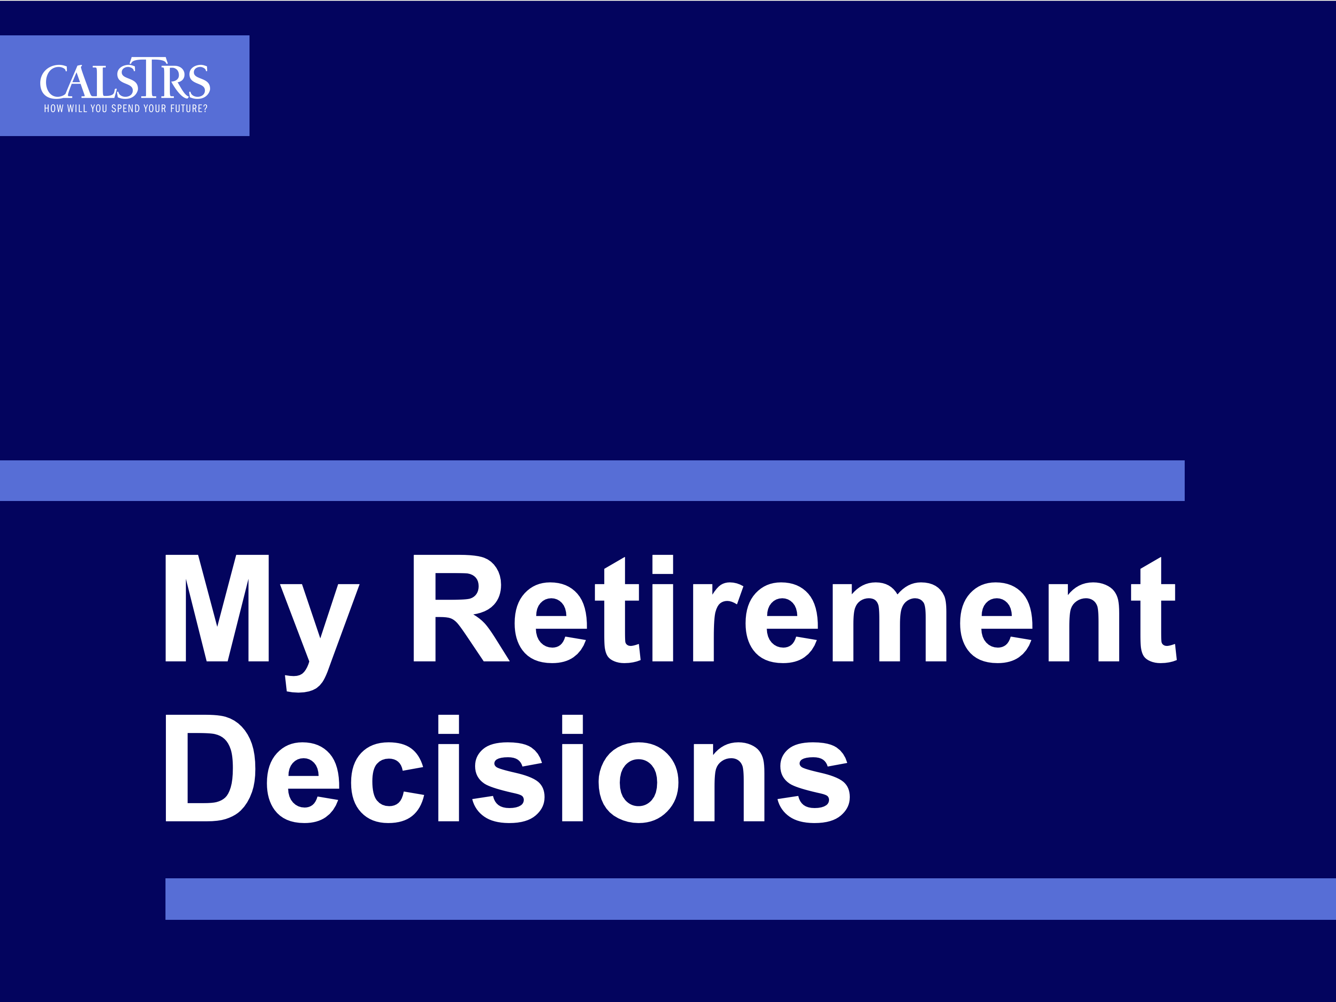
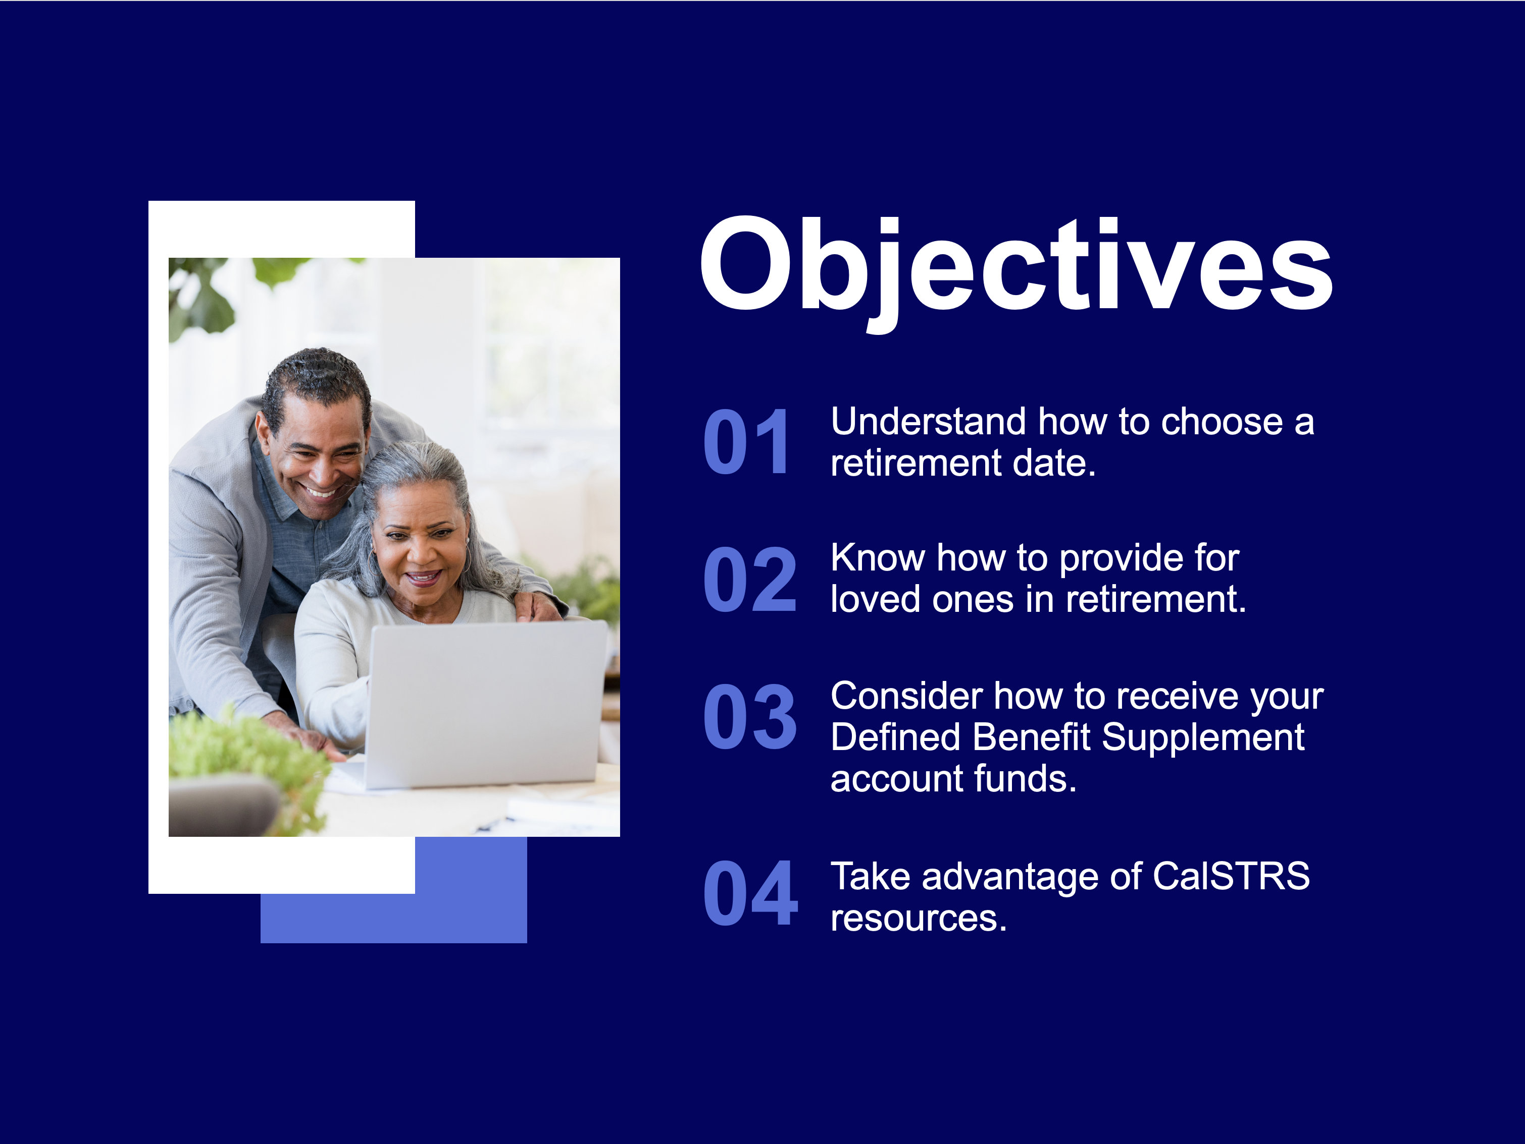
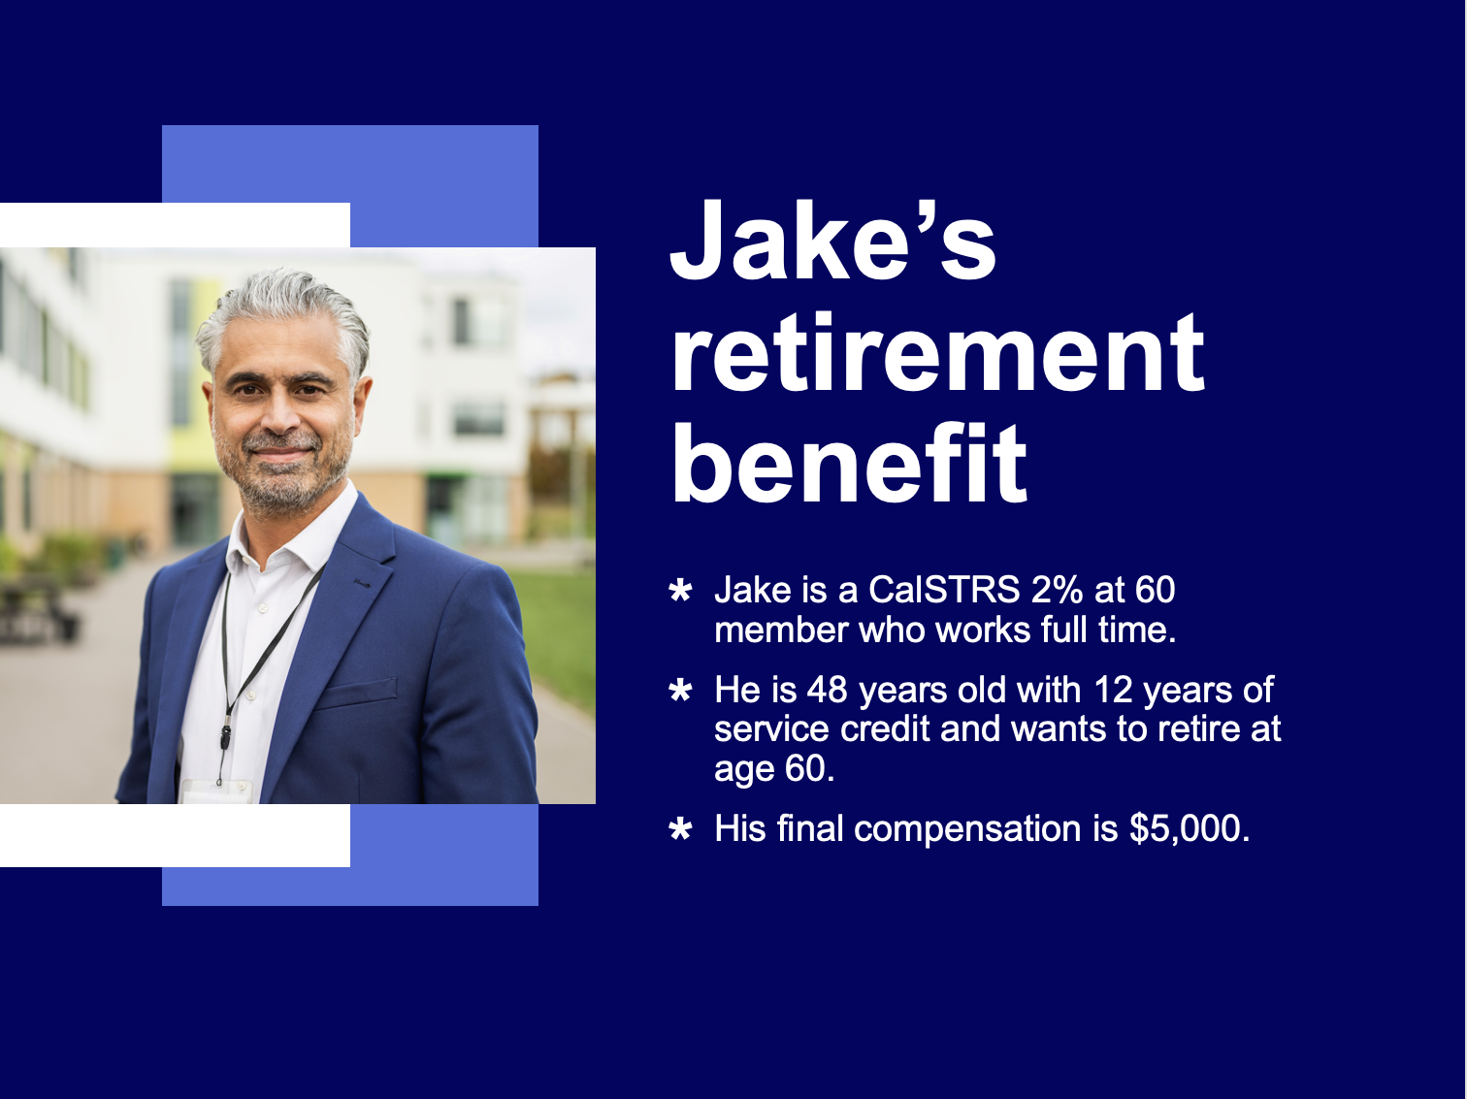
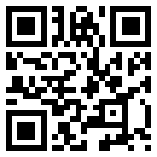
My Retirement Decisions webinar
10
Scan the QR code to view the webinar schedule and register at CalSTRS.com/webinars.
Notes:
We have some great webinars available.
In My Retirement Decisions, our third webinar in this series, you will learn more about your retirement timeline and the decisions you will face as you near the end of your career such as:
When should I retire?
Do I want to leave a lifetime monthly benefit to a loved one?
And what should I do with my Defined Benefit Supplement funds?
Click.

Slide 49



Financial Awareness webinars
10
Save for Your Future
Plan for Your Future
Budgeting basics, savings and investing, credit and debit.
Retirement lifestyle, expenses, income and obstacles.
Protect Your Future
Retirement distributions, maximizing and protecting income.
View the webinar schedule and register at CalSTRS.com/webinars.
Notes:
CalSTRS offers a financial awareness webinar series.
This isn't necessarily CalSTRS specific information, but they provide good financial planning and money management strategies.
The first webinar in the series is Save for Your Future focuses on creating budgets, saving and investing, and managing credit and debt.
Plan for Your Future focuses on reaching the retirement lifestyle you want by planning your expenses and income and how to overcome obstacles.
Protect your Future focuses on retirement distributions and maximizing and protecting your additional income sources.
You can learn more at CalSTRS.com/financial‐awareness. Also don’t forget to check CalSTRS.com/webinars to see when they are being offered.
Click.

Slide 50


Questions?
CalSTRS.com
myCalSTRS.com
Send us a secure online message using your myCalSTRS account.
800-228-5453
*Press 2 for Customer Service.
Monday–Friday
8 a.m. to 5 p.m.
Notes:
If you interested attending another workshop or webinar check the action items in section 10 of the handout. Throughout today’s presentation you have hopefully been marking all action items that you want to take care of. Keep this handout near by and remember to complete those action items you have checked off.
If you have additional questions, check out the variety of resources at CalSTRS.com. You can send and receive secure online messages with us on myCalSTRS or call us at 800-228-5453 weekdays from 8 a.m. to 5 p.m.
Thanks for attending the CalSTRS My Retirement Benefits workshop. We look forward to having you join us on future educational webinars.
I hope you all have a great rest of your day!
Click.

Slide 51
Thank you for attending!

