Slide 1
Part-time educator working multiple assignments
Notes:
Welcome to the CalSTRS Part-time Educator Working multiple assignments webinar. My name is , and I am a benefits specialist at the __________ Member Service Center/ office.
**feel free to input a personalized introduction about yourself and your background**
Before we start, I’d like to address a couple items.
There are several tools that we have made available to you that you can print or download and pull up on a separate screen. These tools can be accessed at CalSTRS.com/webinars where you signed up for today’s presentation. This presentation is packed with a lot of information and some sample calculations. These tools were made available to help with following along as well as taking notes.
If nothing else, Please be sure you have pen and paper available to take notes, I can give you a couple of minutes if you need to grab them.
As we move thorough the presentation, we encourage you to submit any questions you may have. To submit a question please use the Q & A tab that you will find at the bottom of the zoom screen.
Please do not submit any personal information OR request from us any information that is specific to your account. For your security we ask that if you do have any questions specific to your retirement account you email those through your secured myCalSTRS account or to call us at 1-800-228-5453 and speak with a CalSTRS representative.
If you find that you have questions after the webinar is complete, I urge you to log into your myCalSTRS account and send a secure online message. You can log onto myCalSTRS anytime. For your convenience you can also reach a representative by telephone Monday – Friday from 8a.m. – 5p.m.
Click.

Slide 2
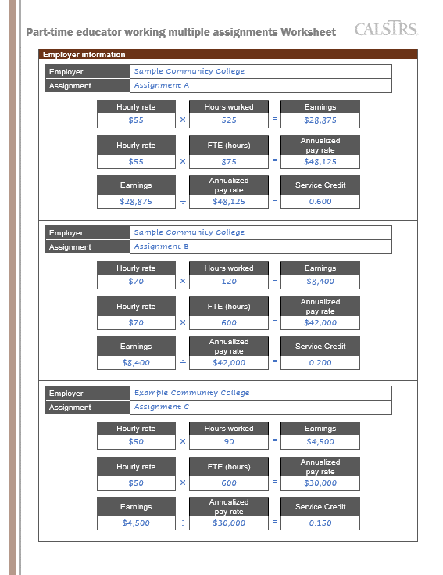
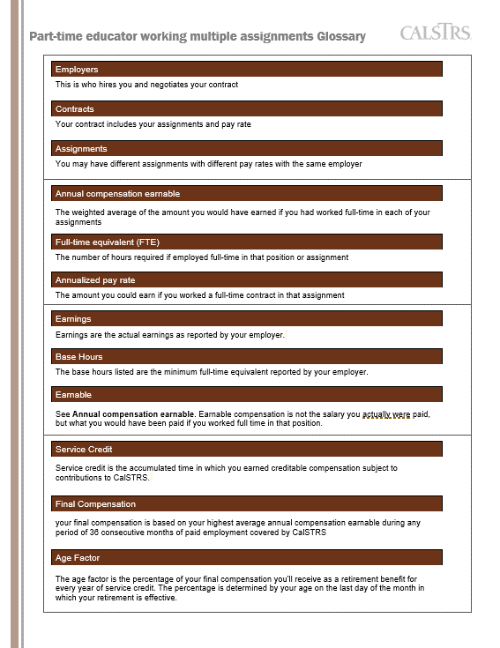
Tools for today
Presentation slides
Example worksheet
Glossary
Factsheet
All materials are available at CalSTRS.com/webinars
Notes:
I just mentioned that quite a few tools that are going to be available to help us go through today’s presentation. I am going to go over them now giving you the opportunity to download them before we jump into the actual content of today’s presentation.
Click.
You can download and print the slides.
Click.
There is also a glossary of words that we have provided. When talking about working part-time and the CalSTRS retirement formula there are several terms used and we thought it would be helpful if you understood the CalSTRS lingo.
Click.
There is a worksheet for our Sample member. In this worksheet we have pre-filled all the calculations that you will see for today’s example. We are hoping that this pre-filled worksheet will help you follow along with our sample calculations. We have also provided the same worksheet that is not pre-filled so if you want to print and work through your own numbers you can absolutely do so.
Click.
There is the Considerations for Part-time Educators factsheet. This factsheet does a good job of summarizing the topics we are going to review today; it also provides an additional sample calculation of how the Defined benefit formula is applied for those members working part-time.
Last, we have provided The benefit of a lifetime factsheet that provides a complete age factor table. I will refer to this table briefly later in today’s presentation
Remember, you can download all of these at CalSTRS.com/webinars where you signed up for today’s webinar.
Click.

Slide 3
Objectives
Determine how working multiple assignments affects your retirement.
Review sample calculations demonstrating how you can maximize your retirement benefit.
Identify resources for members working in multiple assignments.
Notes:
As the webinar is titled Part-time Educator Working multiple assignments, we are going to focus on the CalSTRS member that is working multiple assignments. More specifically the focus will be on those members that are paying into the defined benefit program.
The objectives of today’s presentation are:
Click.
To determine how working multiple assignments in the Defined Benefit program is affecting your retirement.
Click.
To review some sample calculations demonstrating how your pension is calculated and how you might maximize your monthly retirement benefit
Click.
And to identify the resources available for Part-time educators particularly those working in multiple assignments.
Click.

Slide 4
Terms
Employers
This is who hires you and negotiates your contract
Contracts
Your contract includes your assignments and pay rate
Assignments
You may have different assignments with different pay rates with the same employer
Notes:
Its obvious when you have different employers that you have different assignments, but we realize many of you have more than 1 assignment with the same employer.
In any case talking about multiple assignments can be confusing, so we want to define a couple terms up front. You can find these terms on the glossary that we provided with today’s webinar.
Click.
First is Employer or employers- your employer is who hires you and negotiates your contract.
click
Your contract includes your assignments and pay rate
Click.
And it is very important to note that you may have different assignments with different pay rates with the same employer.
click

Slide 5
Meet Daisy
Working for 3 employers
Currently age 55
Wants to retire at age 63
Notes:
I want to introduce you to Daisy. We are going to look at Daisy’s example multiple times today. Your situation may not be identical to Daisy’s but there are going to be some similar considerations.
Daisy has 3 employers
She is currently 55 years old, and she is interested in retiring by age 63.
She is just learning about her CalSTRS retirement benefits.
Click.

Slide 6
CalSTRS programs
Defined Benefit
Pension based on a formula. As a part-time educator, you may permissively elect membership at any time.
Defined Benefit Supplement
Retirement program built into the Defined Benefit where contributions from additional duties are invested.
Notes:
One of the first things that it is important to understand is that CalSTRS administers several different plans.
Click.
The Defined Benefit which is going to be the focus of today’s presentation, is a pension based on a formula.
Click.
As a member of the Defined Benefit Program, you also have an additional account called the Defined Benefit Supplement that contributions from extra duties such as summer school are invested.
Click.

Slide 7
CalSTRS programs
Cash Balance Benefit
Retirement program offered by participating districts to employees that work on a part-time or temporary basis.
Pension2®
Voluntary defined contribution plan available to all members in participating districts.
Notes:
CalSTRS also administers, the Cash Balance Benefit program which is often confused with the Defined Benefit Supplement account that I just mentioned. The Cash Balance Benefit Program is a CalSTRS retirement program offered only by participating districts to employees that work on a part-time or temporary basis. CalSTRS created this program as an alternative to social security. As a part-time educator you may have different retirement plan options and it is very important to be able to be able to identify what program or programs you are paying into. Like I mentioned previously we are going to take time today to focus on the defined benefit program and how working multiple assignments can affect your defined benefit retirement. If you are a Cash Balance participant and are working multiple assignments in the Cash Balance program know that working those assignments can only increase your retirement benefit.
Click.
CalSTRS Pension2 is a voluntary defined contribution plan available to all public-school employees by any district that offers the Pension2 program. Both members of the Defined Benefit program and participants of the Cash Balance program have access to CalSTRS Pension2.
If you are a part-time educator working for multiple employers, it is possible that you could be paying into one or more of these CalSTRS programs. To better understand your retirement benefits it is important to know exactly what programs you are paying into. The main CalSTRS Part-time Educator webinar is a great resource to help you identify what programs you are paying into.
click

Slide 8
Supplemental Savings
403(b)
457(b)
Roth 403(b)
Roth 457(b)
Visit Pension2.com for more information, videos and the “what if” and “why wait” savings calculators.
Check out your employer’s plans at 403bCompare.com.
Notes:
Pension2 offers 403(b) and 457(b) plans and the Roth versions of each.
Our Pension2 representatives are not paid on commission and can offer you nonbiased objective advice on what accounts may be a good fit for you and if it’s worth rolling over funds from your existing plan.
There are a variety of investment options.
You can chose your own investments or let us do the work for you based on your anticipated retirement date and risk tolerance.
You can learn more at Pension2.com. There you can find lots of reading material and videos to watch.
You can also research the fees and expenses of other plans offered by your employer at 403bCompare.com.
I'll now go ahead and give you some of our favorite features.
Click.

Slide 9
CalSTRS Pension2
Tax-deferred
retirement savings
Low and transparent costs
No commissions, load fees or surrender charges
Flexible investment options
Visit Pension2.com or call 888-394-2060 for more information.
Notes:
Pension2 offers the opportunity to invest your money through pre-tax payroll deductions. The tax you aren't paying then is deferred until you start making withdrawals from that account. Or you can invest post-tax money in a Roth account. Pension2 is a revenue-neutral program, so we offer low and transparent fees.
Remember in the beginning we talked about the CalSTRS vision to get you a secure retirement? With that in mind, there are no commissions, no load fees, and no surrender charges.
Pension2 offers flexible investment options. Your choice depends on your comfort in managing your retirement portfolio. Or if you have no comfort at all, we do have ready- made portfolios that you can choose from.
If you have additional questions about Pension2, you can visit Pension2.com or give them a call at 888‐394‐2060. You can also register to attend a Start Saving Now with Pension2 webinar. The dates and times are listed at CalSTRS.com/webinars.
Click.

Slide 10
What if I already have an account?
Other supplemental savings plan accounts can be rolled into Pension2
Your
Current
Account
CalSTRS
Pension2
LET US COMPARE!
Call 888-394-2060 for a statement comparison
Statement comparisons will be conducted by Voya Financial representatives working exclusively with Pension2®. Their names and photos are listed at CalSTRS.com/Trust-CalSTRS.
Notes:
If you already have a supplemental savings plan account, like another 403(b), 457(b), 401(k) or a traditional IRA, it’s possible to roll it over into the CalSTRS Pension2 program. And we can help you determine if it would be beneficial for you to do so.
CalSTRS has noncommissioned licensed advisors who are able to do a review of your current account and compare it to the CalSTRS Pension2 program to see if we’d be able to save you some more money. In order to do so, all we’d need is a copy of your latest account statement and that will help us begin the process of comparing. Since CalSTRS employees do not receive a commission, there is no incentive to get you to transfer your account, unless we’re able to help you save some more money.
If you’re interested in having your account reviewed and compared to Pension2, please call 888-394-2060.
Click.

Slide 11
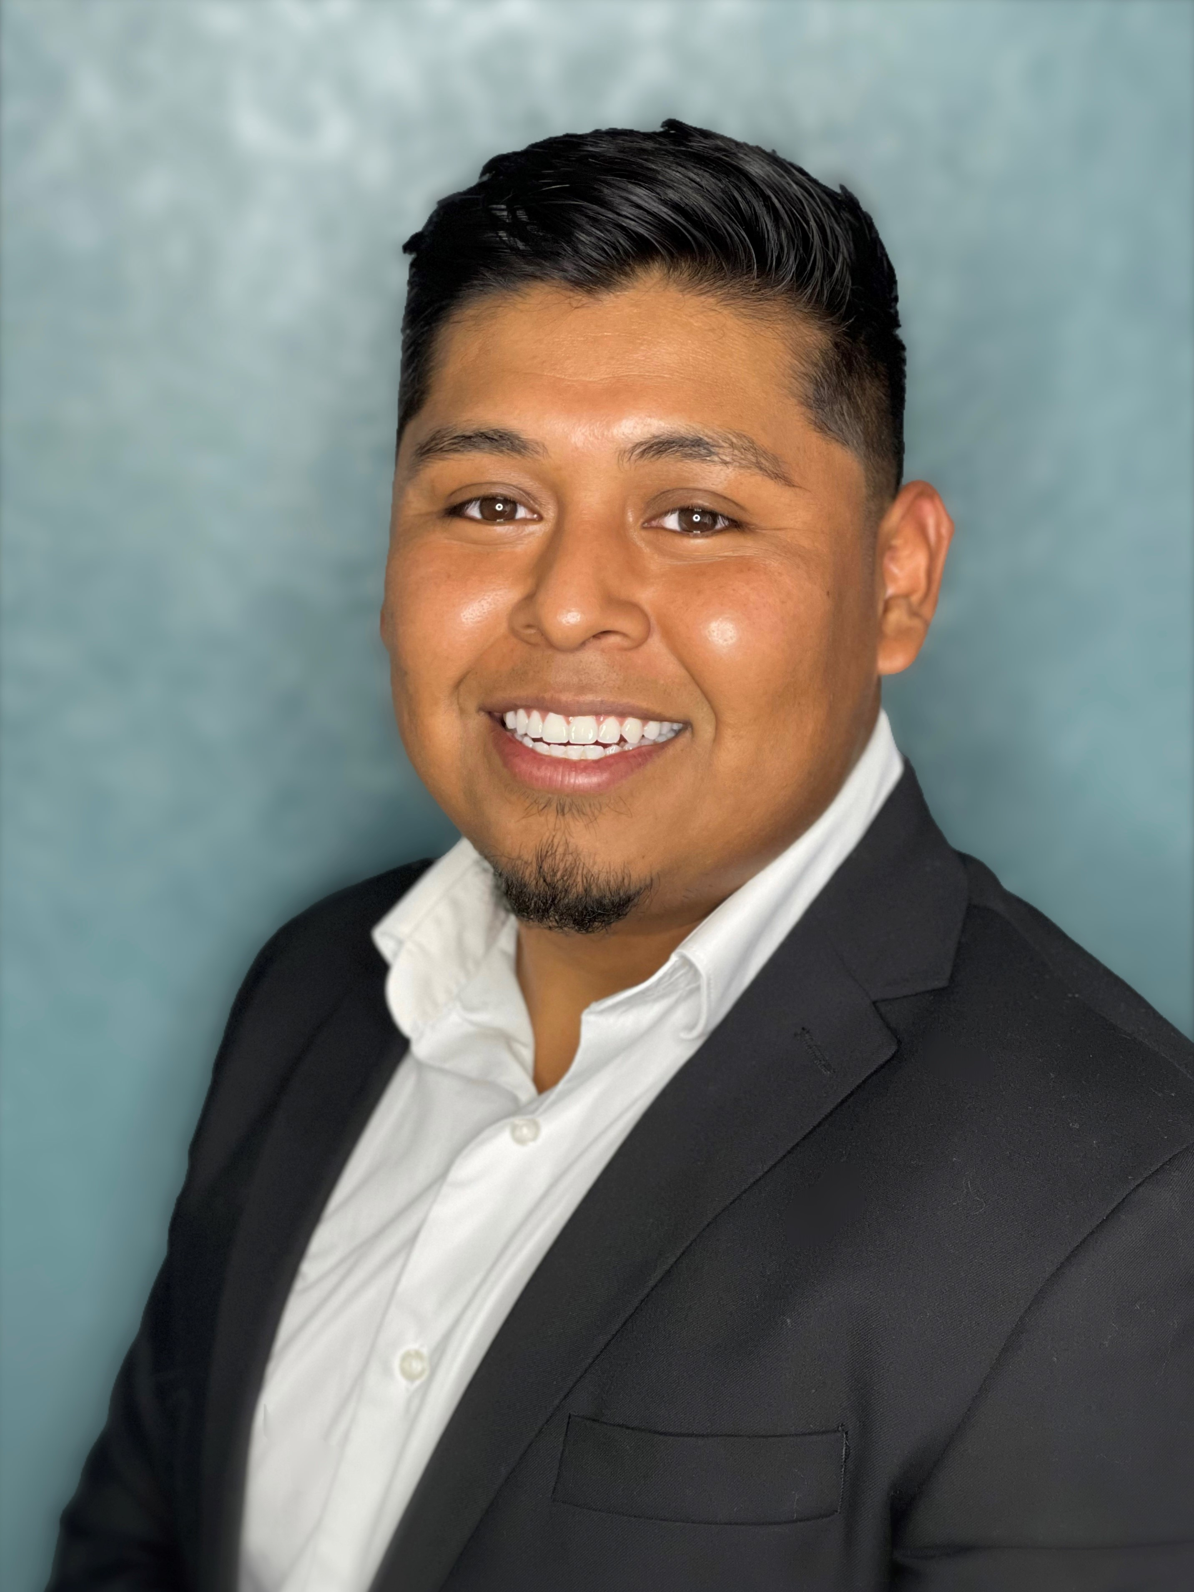
Voya Representatives for CalSTRS Pension2
Stephanie Henry
559-720-5388
Stephanie.Henry@voya.com
Central Valley:
Fresno, Kern, Kings, Madera, Tulare, San Luis Obispo, Inyo
Santiago Gonzalez
760-917-8462
Santiago.Gonzalez@voya.com
San Diego, Imperial, Riverside
Aaron Ivey
916-520-4839
Aaron.ivey@voya.com
Sacramento Region, Northern California
Ruben Rivera Jr.
425-599-1428
Ruben.riverajr@voya.com
Los Angeles, San Bernardino, Orange
Aren Yarian
818-478-0467
Aren.yarian@voya.com
Los Angeles, Ventura, Santa Barbara, San Luis Obispo
Walter Ruczynski
925-451-3079
Walter.ruczynski@voya.com
Alameda, Contra Costa, Marin, Monterey, San Benito, Santa Clara, Santa Cruz, San Francisco, San Mateo
Notes:
*ONLY READ THIS IF VOYA REP IS IN ATTENDANCE*
HYBRID
Hi (______), thank you for joining us today. I’d like to give you the opportunity to introduce yourself and how you serve our members.
VOYA REP introduces themselves….
I am very happy to be speaking with all of you today and having this opportunity to introduce not only myself, but also the team I work with.
1. Provide overview of your background and how long you’ve been in the financial services industry.
2. Discuss why you starting working w/VOYA and have a passion for finance.
3. Provide a brief explanation of what you do for our members:
Statement comparison (what it is and why it’s a good idea to have one)
Rollover Assistance
Enrollment Contributions
4. Discuss One on One Meetings
In Person, Phone, and Zoom
Meeting before (territory driven - meeting one on one at MSCs or via telephone)
During (meeting w/all areas via zoom or telephone)
After pandemic (possible mixture or return to territory?)
HYBRID
Thank you for sharing that with us and supporting members throughout California.
We will have a polling question near the end of this webinar for those who would like take part in Pension2 or request a statement comparison.
CLICK.

Slide 12
Log into myCalSTRS.com
Call us for assistance
1-800-228-5453
Monday-Friday 8 a.m. - 5 p.m.
Notes:
Another great resource to help you determine which program or programs you are paying into is myCalSTRS . You log in by going to myCalSTRS.com. If you have not previously registered for an account registration is easy.
If you ever forget your password there is a forgot password link. If you ever need more assistance, you can call our customer service line and they will help you log in after verifying your account. The number to customer service is 1(800)228-5453 and a representative will be available Monday -Friday 8am to 5pm.
While you are on the line with customer service, they can also help you identify what program or programs you are paying into.
I’ve mentioned that you could be paying into one or more CalSTRS programs. Let’s look at what each of those scenarios might look like.
Click.

Slide 13
What retirement program are you in?
Defined Benefit member
Defined Benefit member and Cash Balance Benefit participant
Cash Balance Benefit participant
Notes:
You may be working for multiple employers, and all your employers are paying into the Defined Benefit Program. If this is the case there are special considerations, you need to be aware of on how your Defined Benefit Formula will be applied. We are going to talk about those considerations at length today.
Click.
If you are a Defined Benefit member and a Cash Balance participant at retirement you will have retirement payout options from both programs. Your Defined Benefit Pension will be based on a formula and your Cash Balance payment options will be based on your Cash Balance account balance. Keep in mind that your pension can be affected by the special considerations that we are going to review today.
Click.
If you are solely a Cash Balance participant, all your employers are paying into Cash Balance. At retirement you will have multiple payout options all based on your Cash Balance account balance. If you are solely a Cash Balance Participant, today’s webinar will not have any information about the Cash Balance program however, you may still find value in today’s webinar because you may choose to become a defined benefit member at some point in your career.
To learn more about the Cash Balance program you can attend our CB webinar or read the CB booklet.
Click.

Slide 14
What retirement program is Daisy in?
Working for 3 employers
1
Defined Benefit Program
2 Assignments
A
B
2
Defined Benefit Program
1 Assignment
C
3
Cash Balance Benefit Program
1 Assignment
D
Notes:
Did you recognize Daisy?
After Daisy did some research about what programs she is paying into for employment with her 3 employers she finds that 2 of her employers are paying into the Defined Benefit Program, and 1 of her employers reporting in the defined benefit program reflected 2 assignments with different payrates. She reviewed her contract to confirm this information was correct. She also found that she is contributing to the Cash Balance Benefit Program with her 3rd employer.
While she was doing this research it was brought to her attention that she might want to consider a Consolidation of Benefits.
Click.

Slide 15
Consolidation of benefits
Cash Balance Benefit account converted into
Defined Benefit service credit
Must be an active member of the Defined Benefit Program
Must terminate all Cash Balance Benefit activity
Consolidation process can be lengthy
For more information, attend the Consolidation of Benefits webinar.
Notes:
What is consolidation of benefits and what would that mean for Daisy?
Click.
Consolidation of Benefits would convert Daisy’s Cash Balance account into Defined Benefit service credit.
Click.
In order to Consolidate Daisy must be an active member of the Defined Benefit Program which we know she is .
Click.
She must also terminate all Cash Balance activity. This does not mean that Daisy must quit her job that’s paying into Cash Balance. It means that she will stop making contributions into the Cash Balance Plan and start making contributions into the Defined Benefit program for that employer.
Click
The last thing to note about the consolidation process is that it can be lengthy. If this is something that you might be interested in it would be better to start this process sooner rather than later.
In today’s example, Daisy decides that she is not going to consolidate. This means that at retirement she will have payout choices from her Cash Balance account that will be based on her account balance, and she will also receive a benefit from her Defined Benefit account which will be a pension based on a formula.
Click.
If you have a Cash Balance account and are interested in learning more about Consolidation, please attend our Consolidation of Benefits webinar. you can sign up at Calstrs.com/webinars.
Click.

Slide 16
Defined Benefit Program membership
Any employers contributing to the Defined Benefit Program
Pension based on a formula
Special considerations
Learn more about the benefits offered in the Defined Benefit Program
Notes:
We have talked about identifying what programs you are paying into. The bulk of today’s presentation is going to be focused on the Defined Benefit Program.
Click.
This is going to include any and all employers contributing to the Defined Benefit
Click.
As I mentioned at the beginning of the presentation the Defined Benefit is a pension based on a formula. It is important to understand that formula so you can understand how your benefit is calculated
Click.
As a part-time educator working multiple assignments under the defined Benefit program there are some special considerations that are important to know about. My goal today is to make you aware of those considerations so that you can best prepare yourself for retirement and potentially make decisions today that will allow you to maximize your retirement benefit.
Click.
Since we are going to focusing on the special considerations associated with the defined benefit formula, we will not have time to explore the Defined Benefit Program at length. There are benefits associated with the Defined Benefit Program that we will not cover today. If you are a Defined Benefit member, I encourage you to continue to learn more about your benefits by attending additional webinars or reading our publications focused on the Defined Benefit program
Click.

Slide 17
What questions do you have?
Notes:
At this point I want to take a moment to answer questions regarding the information we just covered. The information we are going to cover today will be in depth and have some sample calculations so I want to make sure we are answering any questions you may have as they arise.
Please submit your questions using the Q&A feature in Zoom..
I will be pausing to answer any questions multiple times throughout today’s webinar.
As a reminder, we cannot answer specific account questions in this forum for your privacy and account security.
How do I confirm or check to see if I am working more than one assignment with my employer?
Click.

Slide 18
Defined benefit formula
service credit
Time worked and contributed up to 1.000 per year
age factor
Percentage based on age at retirement, with a maximum of 2.4%
final compensation
Highest average annual compensation earnable for 36 consecutive months
Monthly Member-Only retirement benefit
Notes:
Let’s review the formula that the defined benefit pension is based on:
Click.
First, we have Service Credit. What is Service Credit?
Service credit is the time you work and contribute to the defined benefit. Although you might work more than the equivalent of 1 service credit in a school year, you can earn up to 1.000 service credit per school year.
Click.
We multiply service credit by age factor which is a percentage based on your age at retirement. The maximum age factor a member can receive in 2.4%.
Click.
And last, we multiply service credit and age factor by final compensation. Final compensation is your highest average annual compensation earnable for 36 consecutive months.
Click.
These three components multiplied together produce the monthly member-only benefit.
As a part-time educator you should give additional consideration to 2 components of the formula.
Click.

Slide 19
Components requiring special consideration
Service credit
Time during which you earned creditable compensation and made contributions under the Defined Benefit Program
Final compensation
Highest average annual compensation earnable during any period of 36 consecutive months
Notes:
Those 2 components that require special consideration when you are working in multiple assignments are:
Click.
Service Credit which is the time you work and contribute to the defined benefit. Remember, you can earn up to 1 service credit per school year. Early on in your career working as many assignments as possible to try and earn as much service credit as possible can be a good thing. However, as you near retirement you may want to take a different approach.
Click.
The other component is Final Compensation which is your highest average annual compensation earnable for 36 consecutive months. When calculating your compensation earnable CalSTRS will use the amount you would earn if you were working full time under each assignment. You will get to see how this works later in today’s presentation.
In the next few slides, we will take a look at how each of these components are affected by working multiple assignments but first this is a good time to define a couple more terms.
Click
typically 4% determined by your local bargaining agreement

Slide 20
Terms
Annual compensation earnable
The weighted average of the amount you would have earned if you had worked full-time in each of your assignments
Full-time equivalent (FTE)
The time you would be required to perform service if employed full-time in an assignment
Annualized pay rate
The amount of annual compensation you could earn if you worked a full-time contract in that assignment
Notes:
The first term that you should have heard me say in the last few slides is annual compensation earnable. Annual compensation earnable is the weighted average of the amount you would have earned had you worked full-time in each of your assignments.
Click.
Next is Full-time equivalent or FTE. A Full-time equivalent is the number of hours required to complete a full-time contract in a given assignment.
Click.
And the last term for this segment is annualized pay rate. Annualized pay rate is the amount of annual compensation you could earn if you worked a full-time contract in a given assignment.
Remember, you an find all these terms on the glossary that was provided.
click

Slide 21
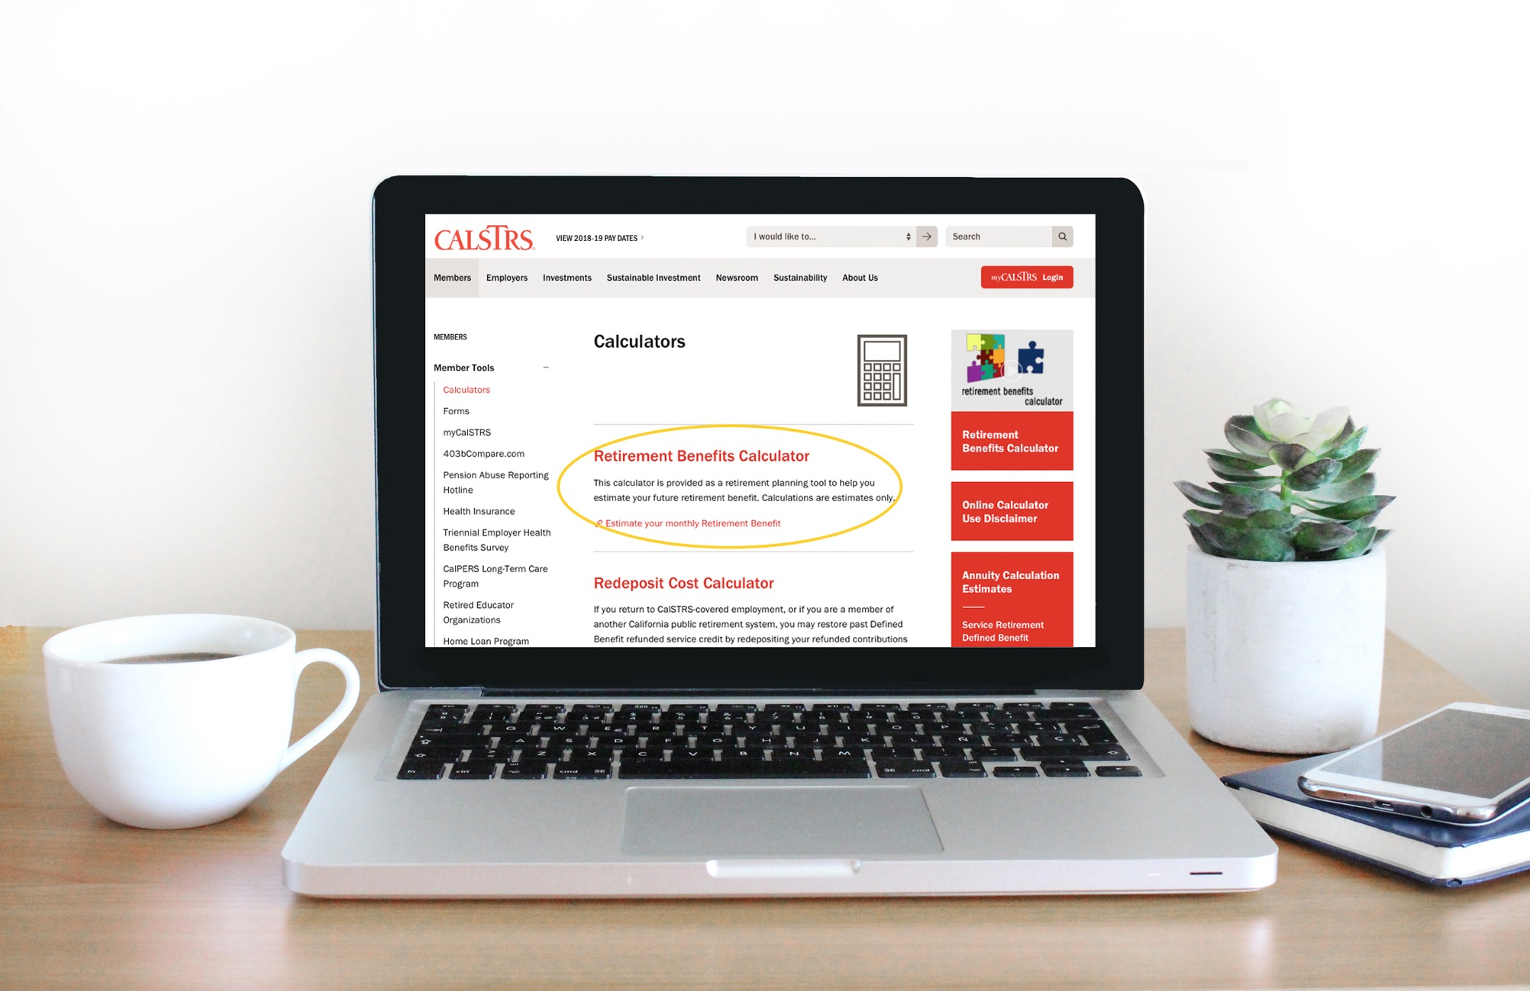
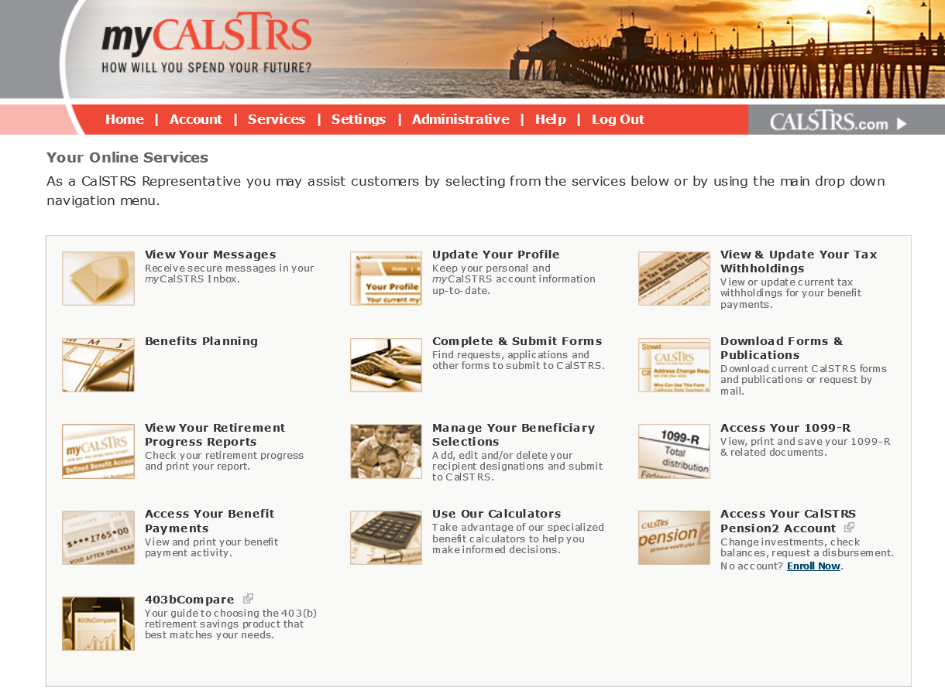
Accessing your employer details
Notes:
I previously mentioned that myCalSTRS is a good resource to determine what CalSTRS program you are paying into. MyCalSTRS is also a really good resource to identify detailed information that is reported to CalSTRS by your employers. We use this information to calculate your defined benefit pension. I am going to take the next few moments to show you where to access this information.
Once you have logged into myCalSTRs you will see a landing page that looks like what you see here on the page. Please note that your landing page might look a little different as everyone’s landing page is customized based on where they are in their career.
Click.
From the lading page you are going to click on the link labled “View Your Retirement Progress Reports”
Click.

Slide 22
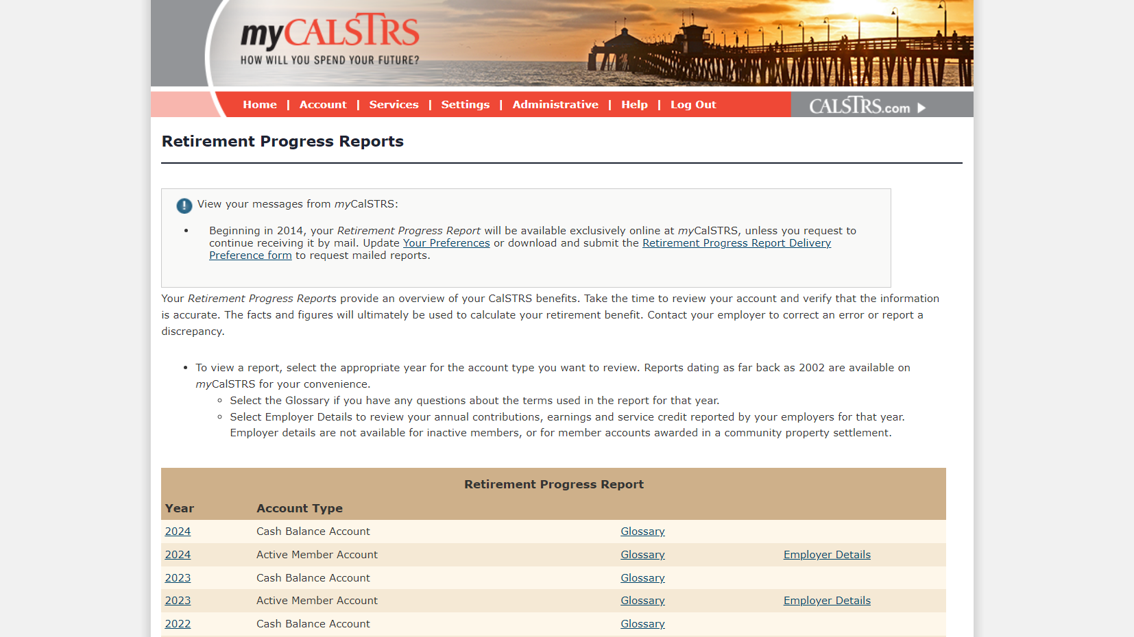
Notes:
Once you select the retirement progress report option this screen will open up. About halfway down you will see a beige bar that reads retirement progress report. You will see your reports listed here by year and account type.
This sample shows 2 account types because our sample member Daisy has money in both programs. If you only participate in one program, then you will only see that account listed here. When you see Active Member, Account know that it refers to the Defined Benefit program.
Click.
Defined Benefit members can access their employer reporting by selecting Employer Details on the far right of the screen. This link can be very helpful for part-time educators to review, especially if you are working for multiple employers because you will be able to see what each employer reported to CalSTRS for each school year.
Click.

Slide 23
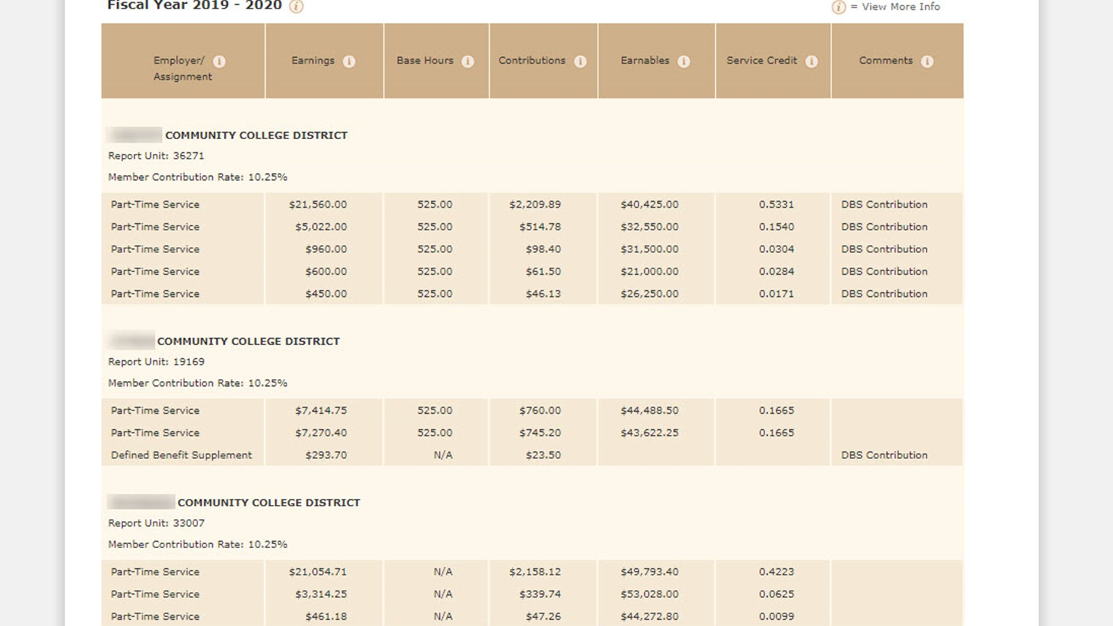
Also know as Full-time Equivalent the time you would be required to work if employed full-time in this assignment
Also known as Annual compensation Earnable which is what you would have been paid if you worked full-time in this assignment
The actual earnings you were paid for the hours you worked
Sparkle
Rose
Sphere
Notes:
When you select the employer, details screen you will see exactly what each employer is reporting. I am going to quickly review just a couple of these headings here.
Click.
First you will notice Employer. In this example you can see that this member has 3 employers.
Click.
Next to employer you can see Earnings.
This is the actual earnings you were paid for the hours you worked.
Click.
Next to earnings you will notice base hours.
Base hours are referring to Full-time equivalent. Remember, the full-time equivalent is the time you would be required to work if employed full-time in this assignment.
Click.
And the last heading I want to point out is Earnables.
Earnables are referring to Annual compensation earnable which is what you would have been paid if you worked full-time in a given assignment
Click.
It is important to review this information every year while you are actively employed and discuss any discrepancies you find with your employer so that they may be corrected.
Now let's go ahead and take the time to discuss in detail the 2 components of the formula that require special considerations.
Click.

Slide 24
Determining service credit
earnings
annualized pay rate
service credit
What you were actually paid
What you would earn if you worked a full-time load
Notes:
Let’s start with Service Credit. It is important to understand how service credit is calculated.
We divide earnings, what you were actually paid by your annualized pay rate, which is what you would have earned had you worked a full-time load in that assignment.
Once you divide your earnings by your annualized pay rate you get the service credit earned in that assignment. If you are working multiple assignments, you would calculate the service credit you earn from each and add them together to get your total service credit for the school year. Remember you can only earn up to 1 service credit in a school year.
Click.

Slide 25
Worksheet Page 1
Daisy’s service credit – Assignment A
Sparkle Community College – Assignment A
Pay rate: $55/hour
Daisy works 525 hours
Full-time equivalent is 875 hours
Notes:
Let’s go back and take a look at Daisy.
This is a good time to pull out your sample worksheet. The first page is dedicated to the employer details section. In the first box we have named her first employer Sparkle Community College and first assignment, Assignment A. You will also see her hourly pay rate, the hours Daisy works, and her full-time equivalent. Along with all the math we will be doing in the next few slides. As you follow along, you’ll see we talk about all three assignments you see there on page 1.
Daisy works in 3 assignments that pay into the Defined Benefit Program.
For the sake of this example, we are going to take an in-depth look at how service credit is calculated for one assignment which we’ve called Assignment A. Then we will also quickly calculate the service credit she will earn in her other 2 assignments which we will call Assignments B and C.
Assignment A pays $55/ hour and Daisy works 525 hours.
If Daisy were to work full time in this assignment, she would be working 875 hours. Remember this is called the Full-time equivalent.
With this information we will be able to determine how much service credit Daisy will earn from this assignment.
Click.

Slide 26
Worksheet Page 1
Daisy’s service credit – Assignment A
assignment hourly rate
actual hours worked
Daisy’s earnings
$55
525
$28,875
Step 1: Determine Daisy’s earnings.
Notes:
First, we determine Daisy’s earnings.
You can follow along here on the screen or on the sample worksheet.
This assignment pays $55/ hour, and we multiply that by the 525 hours that Daisy works to get $28,875. This is what she was actually paid.
click

Slide 27
Worksheet Page 1
Daisy’s service credit – Assignment A
assignment hourly rate
full-time equivalent hours
annualized pay rate
$55
875
$48,125
Step 2: Determine the annualized pay rate.
Notes:
Next, we want to determine her annualized pay rate. Annualized pay rate is the amount Daisy would have earned if she worked full time in this assignment.
So here we multiply the hourly pay rate of $55/ hour by this assignments Full time equivalent of 875 hours to get $48,125 which is the amount Daisy would earn if she worked a full-time load in this assignment.
Click.

Slide 28
Worksheet Page 1
Daisy’s service credit – Assignment A
Daisy’s earnings
annualized pay rate
Daisy’s service credit
$28,875
$48,125
0.600
Step 3: Determine service credit earned.
Notes:
As previously discussed, to determine service credit you divide What you were actually paid by what you would have earned if you worked full time.
In this example it is $28,875 divided by $48,125 to give a service credit amount of 0.600.
Again, this should all match the formulas you see for Assignment A on the worksheet.
Click.

Slide 29
Worksheet Page 1
Daisy’s service credit – Assignments B & C
Daisy’s earnings
annualized pay rate
Daisy’s service credit
$8,400
$42,000
0.200
B
0.150
$4,500
$30,000
C
Notes:
You would need to take the same steps and do the same calculations to determine the service credit for any other assignments you may be working in a given school year.
The detailed steps for these calculations can be seen on page 1 of the worksheet.
We determined that Daisy is earning 0.200 service credit from assignment B and 0.150 service credit from assignment C.
Click.

Slide 30
Worksheet Page 2
Daisy’s total service credit
Assignment A
Assignment B
Assignment C
total service credit
0.600
0.200
0.150
0.950
Step 4: Add service credit from each employer.
Notes:
Once you calculate the service credit you earn from each assignment add them together to get your total service credit for the school year.
We’ve provided space at the top of page 2 of the worksheet to total up your service credit. Transfer the service credit totals from page 1. For Daisy, we have done it for you. If you are using this worksheet digitally as a pdf, these numbers should have autopopulated for you. You’ll just have to add them up yourself.
Remember you can only earn up to 1.000 service credit in a school year. In this example, Daisy earns 0.950 service credit which is just below the 1 service credit maximum.
Click.

Slide 31
Service credit considerations
You can only earn up to 1.000 service credit per school year
Any unused sick leave converts to service credit at retirement
If you have a Cash Balance account consolidation could increase your Defined Benefit service credit
Meet with a CalSTRS benefit specialist
Notes:
There are a few things you should consider when thinking about service credit and its impact on your retirement benefit.
Click.
You can only earn up to 1 service credit in a school year. If you are working multiple assignments, you could be working more than the equivalent of 1 service credit. Any contributions from earnings that are above 1 service credit are going to go into the Defined Benefit Supplement account and will be matched by you employer.
When calculating your service credit, we are going to use your highest paying assignments first. Once you reach 1.000 service credit, additional contributions will be redirected into your Defined Benefit Supplement account.
Click.
Unused sick leave will be converted to Defined Benefit Service credit at retirement. Any additional service credit at retirement will have a positive impact on your retirement formula. The way unused sick leave is converted is to divide the number of unused sick leave days you have on the books by the number of contract base days you are required to work in a school year. It is possible that your employer records your unused sick leave in hours, if this is the case, you will have to convert your sick leave hours to sick leave days.
Be sure to check with your employer to verify if there is limit to how much unused sick leave you can accrue.
Click.
If you have a Cash Balance account, you may consider a Consolidation of Benefits which would essentially get rid of you cash balance account and potentially increase your Defined Benefit service credit total.
Click.
If you want to explore some scenarios specific to your situation in encourage you to meet with a CalSTRS Benefit specialist.
Click.

Slide 32
What questions do you have?
Notes:
It is time for us to answer questions regarding the information we just covered. Please submit your questions using the Q&A feature in Zoom.
As a reminder, we cannot answer specific account questions in this forum for your privacy and account security.
Click.

Slide 33
Final compensation
Based upon what you would have earned if you had worked full time
Can be affected by working multiple assignments
Higher annual compensation earnable equals a higher benefit
Notes:
We have talked about Service Credit lets now talk about Final compensation.
Before we jump into the actual calculations for Final compensation there are a few things you should know about how it is calculated.
Click.
For each assignment, when we calculate final compensation, we will always use what you would have earned if you worked full time.
Click.
Know that multiple pay rates are a weighted average. This means your lower paying assignments can lower your annual compensation earnable. Therefore, working multiple assignments as you near retirement can affect your final compensation.
Click.
And remember the higher your average compensation earnable the higher your benefit.
Click.

Slide 34
Daisy’s final compensation
Highest 36 consecutive months
Determine annual compensation earnable
Calculated using a weighted average
Notes:
Let’s talk about Daisy’s Final Compensation.
We know that Daisy’s final compensation is going to be calculated based on the 3 assignments in which she is contributing to the Defined benefit program.
She will need to determine her compensation earnable for 3 consecutive years in order to determine her Final compensation
Click.

Slide 35
Worksheet Page 2
Determining annual compensation earnable
total earnings for the year
total service credit for the year
annual compensation earnable
Total service credit earned up to 1.000
Average working salary for one year
Total of what you were actually paid
Notes:
First, we need to be able to determine your annual compensation earnable.
We do this by taking your total earnings in a given school year and divide that by the total service credit you earned in that same school year up to the 1 service credit maximum.
This will give us your Annual Compensation earnable or your average working salary for that year.
Click.

Slide 36
Worksheet Page 2
Calculating annual compensation earnable
Assignment | FTE | Annual earnings | Annualized pay rate | Service credit
A | 875 | $28,875 | $48,125 | 0.600
B | 600 | $8,400 | $42,000 | 0.200
C | 600 | +$4,500 | $30,000 | +0.150
 |  | $41,775 |  | 0.950
Step 1: Find the total annual earnings and the total service credit earned for the year.
Assumes service was performed in each month.
Notes:
Remember when we calculate final compensation, we are using a weighted average of Daisy’s multiple assignments. Let’s look at actual numbers. On the table above we see Daisy’s Annual earnings listed for each of her 3 assignments we also have the service credit she has earned in each assignment.
Click.
We add her annual earnings together, which gives us $41,775.
Click
We already added her service credit and got 0.950 service credit.
You can find both of these calculations on page 2 of the worksheet. If you’re doing this worksheet with your own details, note that both the annual earnings and service credit should have been autopopulated with the information from page 1.
Click.

Slide 37
Worksheet Page 2
Calculating annual compensation earnable
total earnings for the year
total service credit for the year
annual compensation earnable
$41,775
0.950
$43,974
Step 2: Divide the total annual earnings by the total service credit.
Assumes service performed in each month.
Employer | FTE | Annual Earnings | Annual Pay Rate | Service Credit
A | 875 | $9,625 | $48,125 | 0.200
B | 875 | $11,250 | $45,000 | 0.250
C | 600 | +$18,000 | $33,000 | +0.500
 |  | $38,875 |  | 0.950
Notes:
To calculate her annual compensation earnable
Click.
we take the total of her annual earnings $41,775
Click.
and divide that by the total of her service credit 0.950 and we get a compensation earnable for this particular year of $43,974.
When completing the worksheet, you’ll see Daisy transferred the total from Section 2 her total service credit and the total from Section 3 her total annual earnings into the spaces provided in Section 4. Both the earnings and service credit will autopopulate for you. You’ll just need to divide to get your annual compensation earnable.
Note that if you compare the annual compensation earnable calculated to the annualized pay rates of your different assignments, you will notice that you are being affected by having lower paying assignments.
Finally, we added a note here that reads "Assumes service is performed each month." When we say "each month" we are referring to the months of your contract, not of the calendar year. Daisy DID work every month of her contract, so she earned 12 months for each year, so it took 3 years to have 36 months. If she did not work during 1 or more months of her contract, she would only get credit for the months she actually worked, which would be less than 12. We would then have to pull data from additional years until we have 36 consecutive months.
Click.

Slide 38
Worksheet Page 2
Determining final compensation
Annual
compensation earnable
36
final compensation
Total must include 36 consecutive months
Total of months use for compensation earnable
Average monthly working salary
Notes:
Final Compensation is the average compensation earnable for a 3 year or 36-month period. In order to determine Final Compensation, you will need to take the total compensation earnable for 36 consecutive months and divide that number by 36. This will give you Final Compensation or your average monthly working salary.
We have provided this formula along with some notes in Section 5 located on page 2 of the worksheet.
Below that in Section 6, we provided the retirement formula. This will be the step we take after finding final compensation.
Click.

Slide 39
Worksheet Page 3
Determining final compensation
SCENARIO
1
final compensation
total annual compensation earnable for 36 months
36 months
School year | Annual Compensation earnable | Number of months
Year 1 | + $43,974 | 12
Year 2 | + $43,974 | 12
Year 3 | + $43,974 | 12
÷
$131,922
36 months
= $3,664 final compensation
Notes:
These are the 3 years we are using to calculate Daisy’s final compensation. Notice that her compensation earnable is the same for all 3 years, we are assuming that in this period Daisy works her regular schedule with no changes and no pay increases.
This can be found in Section 8 on page 3 of the worksheet.
We calculated her annual compensation earnable as $43,974, we don’t know if she will get a raise, so we will use the same earnable for all 3 years. We add 3 consecutive years together and get $131,922. We divide by 36 months, to get a final compensation of $3,664. In this example, Daisy’s final compensation that will be used in her retirement formula is $3,664.
If you take a look at Section 7 you will see that we added up her total service credit. We got her current service credit balance by looking at her Retirement Progress Report. That total along with this final compensation are used in the retirement formula to determine Daisy’s benefit.
Click.

Slide 40
What questions do you have?
Notes:
It is time for us to answer questions regarding the information we just covered. Please submit your questions using the Q&A feature in Zoom, so you can type your in your question, we are here to clarify.
As a reminder, we cannot answer specific account questions in this forum for your privacy and account security.
Is there a situation where you would only use 12 months or 1 year to determine final compensation?
Click.

Slide 41
3 scenarios
SCENARIO 1
Daisy doesn’t do anything differently. She works all three assignments at the same rates until retirement.
SCENARIO 2
Daisy drops the lowest paying assignment for one year.
SCENARIO 3
Daisy drops the two lowest paying assignments for three consecutive years.
Notes:
Remember I said working multiple assignments can impact your retirement benefit? This is because final compensation is calculated as a weighted average of the amounts you would have earned had you worked full time in each of your assignments. Because of this, your lower paying assignments can actually weigh down or lower your final compensation. Remember, the higher your final compensation the higher your retirement benefit. Let’s look at 3 different scenarios That will illustrate this point.
Click.
We have already started to look at scenario #1 and determined how Daisy’s compensation earnable and Final compensation would be calculated if she continues to work in her current assignments until retirement… See worksheet page 3 for a full breakdown.
Click.
Let’s also look at scenario 2 to see how her final compensation will be impacted if she were to drop or stop working her lowest paying assignment for just 1 year.
Click.
And scenario 3 where she will drop her 2 lower paying assignments and does this for 3 consecutive years.
Pages 4 and 5 of the worksheet are dedicated to the calculations of scenarios 2 and 3
Click.

Slide 42
Worksheet Page 3
Daisy’s final compensation
SCENARIO
1
Daisy doesn’t change a thing
Annual compensation earnable remains the same
Final compensation remains the same
Daisy’s current earnings remain the same
Notes:
When thinking about Daisy’s final compensation we want to think about what will happen if she were to stop working her lower paying assignments.
In Scenario 1 Daisy doesn’t change anything.
Her compensation earnable stays the same
Her final compensation stays the same
And her current earnings stay the same.
Click.

Slide 43
Worksheet Page 4
Daisy’s final compensation
SCENARIO
2
Daisy considers dropping her lowest paying assignment for 12 months
Annual compensation earnable will increase
Final compensation will increase
Daisy’s current earnings will decrease
Notes:
On the worksheet, page 4, you’ll find our next scenario. In scenario 2, Daisy considers dropping her lowest paying assignment for 12 months
Dropping lower paying assignments will increase compensation earnable which will increase final compensation.
Daisy will need to consider if she can afford to drop that assignment because if she isn’t working, then she isn’t bringing home that money. Her current earnings will decrease. Daisy has the option to check with her employer and ask if she can work more hours in the higher paying assignment to offset the decrease in her earnings.
Click.

Slide 44
Worksheet Page 4
Calculating annual compensation earnable
SCENARIO
2
Employer | FTE | Annual earnings | Annualized pay rate | Service credit
A | 875 | $28,875 | $48,125 | 0.600
B | 600 | $8,400 | $42,000 | 0.200
C | 600 | +$4,500 | $30,000 | +0.150
 |  | $37,275 |  | 0.800
Step 1: Find the total annual earnings and the total service credit earned for the year.
Assumes service was performed in each month.
Notes:
In this example we see Daisy drop assignment C. By doing this her earnings for the year will be lower.
Click.
When she adds the earnings for assignment A and assignment B she gets $37,275.
Click.
Her service credit for the year is also going to be lower. In this situation her service credit earned drops from the previous 0.950 to 0.800.
If you’re following along on the worksheet, you can see where we’ve put these totals on page 4, sections 10 and 11 year 3. We only put them in year 3 because that is the only year she will drop that assignment. Years 1 and 2, you’ll notice, match the numbers we used in Scenario 1 for all 3 years.
Click.

Slide 45
Worksheet Page 4
Calculating annual compensation earnable
SCENARIO
2
total earnings for the year
total service credit for the year
annual compensation earnable
$37,275
0.800
$46,594
Step 2: Divide the total annual earnings by the total service credit.
Assumes service was performed in each month.
Employer | FTE | Annual Earnings | Annual Pay Rate | Service Credit
A | 875 | $9,625 | $48,125 | 0.200
B | 875 | $11,250 | $45,000 | 0.250
C | 600 | +$18,000 | $33,000 | +0.500
 |  | $38,875 |  | 0.950
Notes:
Continuing in Section 11, year 3…. We take the total of her annual earnings $37,275
Click.
and divide that by the total of her service credit 0.800
Click.
and we get a compensation earnable for this particular year of $46,594.
Click.

Slide 46
Worksheet Page 4
Determining final compensation
SCENARIO
2
final compensation
total compensation earnable for 36 months
36 months
School year | Annual compensation earnable | Number of months
Year 1 | + $43,974 | 12
Year 2 | + $43,974 | 12
Year 3 | + $46,594 | 12
÷
$134,542
36 months
= $3,737 final compensation
Notes:
Still in Section 11, we are now looking at all 3 years.
We are going to use her initial compensation earnable of $43,974 for the first 2 years
Click.
then for the 3rd year we use her increased compensation earnable of $46,594.
Once we add the 3 earnables together we get $134,542 and divide that by 36 months giving us a higher final compensation of $3,737.
Section 12 shows where this number belongs in the retirement formula.
Click.

Slide 47
Worksheet Page 5
Daisy’s final compensation
SCENARIO
3
Daisy considers dropping her TWO lowest paying assignments for 36 months
Annual compensation earnable will increase
Final compensation will increase
Daisy’s current earnings will decrease
Notes:
Moving on to the last page, page 5. In scenario 3 Daisy is considering dropping her TWO lower assignments for 36 months. So she will only be working that highest paid assignment, A for 3 years.
Dropping lower paying assignments will increase compensation earnable which will increase final compensation.
Daisy will need to consider if she can afford to drop these assignments because if she isn’t working, then she isn’t bringing home that money. Her current earnings will decrease.
Click.

Slide 48
Worksheet Page 5
Calculating annual compensation earnable
SCENARIO
3
Assignment | FTE | Annual earnings | Annual pay rate | Service credit
A | 875 | $28,875 | $48,125 | 0.600
B | 600 | $8,400 | $42,000 | 0.200
C | 600 | +$4,500 | $30,000 | +0.150
 |  | $28,875 |  | 0.600
Step 1: Find the total annual earnings and the total service credit earned for the year.
Assumes service was performed in each month.
Notes:
In scenario 3 Daisy will drop assignments B and C her lowest paying assignments. By doing this her earnings for the year will be even lower.
Click.
In Daisy’s case she would be earning $28,875.
Click.
Her service credit for the year is also going to be lower. In this situation her service credit earned drops from the previous 0.800 to 0.600.
Because Daisy’s take home pay is dropping so significantly Daisy has decided to check with her employer to see if she can pick up more hours under assignment A.
In sections 13 and 14, you’ll see we used these totals for all 3 years.
click

Slide 49
Worksheet Page 5
Calculating annual compensation earnable
SCENARIO
3
total earnings for the year
total service credit for the year
annual compensation earnable
$28,875
0.600
$48,125
Step 2: Divide the total annual earnings by the total service credit.
Assumes service was performed in each month.
Employer | FTE | Annual Earnings | Annual Pay Rate | Service Credit
A | 875 | $9,625 | $48,125 | 0.200
B | 875 | $11,250 | $45,000 | 0.250
C | 600 | +$18,000 | $33,000 | +0.500
 |  | $38,875 |  | 0.950
Notes:
Notice when we divide her earnings of $28,875
Click.
by her service credit of 0.600,
Click.
we get a higher compensation earnable of $48,125.
In section 14 you will find these numbers were used for all three years.
Remember, when we started talking about final compensation, I explained that you will get credit for each assignment as if you would have worked full time. As you can see here Daisy’s compensation earnable is the exact same as her annual payrate for this assignment.
Click.

Slide 50
Worksheet Page 5
Determining final compensation
SCENARIO
3
final compensation
total compensation earnable for 36 months
36 months
School year | Annual compensation earnable | Number of months
Year 1 | + $48,125 | 12
Year 2 | + $48,125 | 12
Year 3 | + $48,125 | 12
÷
$144,375
36 months
= $4,010 final compensation
Notes:
In scenario 3 Daisy is dropping her 2 lower paying assignments for 3 consecutive years. When we calculate her final compensation, we are going to use her new compensation earnable of $48,125 for 3 years.
Click
We add the 3 earnables together and get $144,375 and divide that by 36 months giving us a higher final compensation of $4,010.
This is still in Section 14.
Click.

Slide 51
Final Compensation in all 3 scenarios
Scenario 1
Scenario 2
Scenario 3
$3,664
$3,737
$4,010
Notes:
As you can see Daisy’s final compensation becomes higher as she drops her lower paying assignments. We also know that in each of these situations her service credit also decreases. I want to point out that what we have calculated here is Daisy’s final compensation. This is just one component of the retirement formula. Each scenario will affect her retirement benefit differently.
Click.

Slide 52
What questions do you have?
Notes:
It is time for us to answer questions regarding the information we just covered. Please submit your questions using the Q&A feature in Zoom, so you can type your in your question, we are here to clarify.
As a reminder, we cannot answer specific account questions in this forum for your privacy and account security.
If I am working office hours at a much lower pay rate is that lowering my final compensation?
I teach for 5-6 colleges each semester and plan to retire in 3 years. Should I drop at least 2-3 of the lowest paying ones?
Click.

Slide 53
Retirement benefit
Dropping lower assignments will decrease the amount of service credit earned
Dropping lower assignments will increases your final compensation
Maximum age factor at age 63
Notes:
Remember that your Defined Benefit Retirement is based on a formula. That formula again is Service Credit x Age Factor x Final compensation.
When thinking about Daisy’s Retirement Benefit, we noticed a couple things happen.
Dropping her lower assignments decreases her service credit.
Dropping her lower assignments increases her final compensation.
And we can note that since Daisy plans to retire at age 63 she will have the maximum age factor of 2.4%. If Daisy were planning to retire any earlier than age 63 she would not be receiving the maximum age factor. For your reference we included a complete age factor table that you can download at CalSTRs.com/webinars along with the rest of the tools provided for todays presentation.
Let’s see how each of these scenarios' impacts Daisy’s Retirement Benefit.
Click.

Slide 54
Worksheet Page 3
Impact of final compensation
SCENARIO
1
service credit |  | age factor |  | final compensation |  | benefit
22.750 |  | 2.4% |  | $3,664 |  | $2,001
=
Daisy works all three assignments for her three consecutive years.
Notes:
If Daisy does nothing different and works, all 3 assignments for 3 consecutive years her service credit at retirement would be 22.750 we multiply that by the maximum age factor of 2.4% and a final compensation of $3,664.
We get a monthly retirement benefit of $2,001 a month.
You can find the math for calculating Daisy’s retirement benefit for scenario 1 on the worksheet in Section 9 on page 3.
Click.

Slide 55
Worksheet Page 4
Impact of final compensation
SCENARIO
2
service credit |  | age factor |  | final compensation |  | benefit
22.600 |  | 2.4% |  | $3,737 |  | $2,027
=
Daisy drops the lower assignment for one year.
Notes:
In scenario 2, If Daisy were to drop her lowest paying assignment for 1 year her service credit at retirement would be 22.600 we multiply that by the maximum age factor of 2.4% and a final compensation of $3,737.
We get a monthly retirement benefit of $2,027 a month. This is a $26 increase to her monthly benefit.
The math for this calculation can be found in Section 12 on page 4 of the worksheet.
Click.

Slide 56
Worksheet Page 5
Maximizing Daisy’s benefit
SCENARIO
3
SCENARIO
3
service credit |  | age factor |  | final compensation |  | benefit
21.700 |  | 2.4% |  | $4,010 |  | $2,088
=
Daisy decides to work only the highest assignment for her last three years.
Notes:
And finally, In scenario 3, if Daisy were to drop her lower 2 paying assignments for 3 consecutive years her service credit at retirement would be 21.700 we multiply that by the maximum age factor of 2.4% and a final compensation of $4,010.
We get a monthly retirement benefit of $2,088 a month. This is a $87 increase to her monthly benefit.
The math for this calculation can be found in Section 15 on page 5 of the worksheet.
Click.

Slide 57
Retirement Benefits in all 3 scenarios
Scenario 1
Scenario 2
Scenario 3
$2,001
$2,027
$2,088
Notes:
After working through this example, we see that Daisy’s Retirement Benefit is positively impacted by dropping her lower paying assignments and having a higher final compensation.
I want to note again that in scenario ‘s 2 and 3 Daisy take home pay while she is working will be decreasing.
I did mention that Daisy was going to check with her employer to see if she can work more hours under assignment A. If she can work more hours this will continue to positively impact her retirement benefit.
Click.

Slide 58
Final compensation considerations
How many working years you have left in your career
Can you afford to drop lower paying assignments
Can you work more hours in higher paying assignments
Meet with a CalSTRS benefit specialist
Notes:
There are a few things you should consider when thinking about the impact of final compensation on your retirement benefit.
Click.
How many years do you have left in your working career? In this example Daisy is 55 years old and is planning to work for the next 8 years. There are so many changes that can happen in that time frame. Know that CalSTRS will take your highest consecutive 36 months of earnings to calculate your final compensation regardless of where they are in your career.
Click.
It is also important to consider if you can afford to drop any of your lower paying assignments for any amount of time. Although, it would be great to maximize your retirement benefit we understand that these are your earnings and that it may not be possible to just drop one of your assignments. Additionally, one of your lower paying assignments could be required office hours you must provide for your students. In this case keeping that lower paying assignment is a condition of your employment.
Click.
For some of you, it may be possible for you to work more hours in you higher paying assignments. Working more hours in higher paying assignments may allow you to drop your lower paying assignments with little impact to your earnings.
Click.
As a part-time educator it is not uncommon to have other outside employment that might make it possible to drop some of these lower paying assignments. If you want to explore some scenarios specific to your current situation, I encourage you to meet with a CalSTRS benefits specialist
click

Slide 59
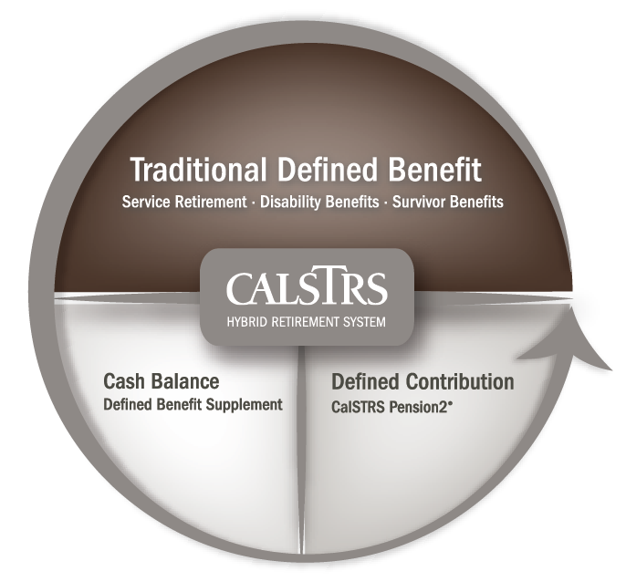
Supplement account
Defined Benefit
Supplement
account
Notes:
In the previous sections we discussed how to calculate service credit, and if you remember I said number of times that you can not earn more than 1 year of service credit in a given school year. You may be wondering what happens if you work more than 1.000 service credit.
In this case any work done above and beyond 1 service credit contributions go into the Defined Benefit supplement account. As a part-time educator you may be working for multiple employers and/or taking on multiple assignments. The service credit from those assignments may total more than 1 service credit at the end of a school year.
The Defined Benefit supplement account is an additional account built into your Defined Benefit membership. This account will provide additional income in retirement and will have payout choices based on your account balance.
So, in the beginning when I said you may choose to work as many assignments as possible to earn as much service credit as possible rest assured that if you work more than 1 service credit that contributions from that work will be building your Defined Benefit Supplement account.
Also, know that if you are working more than 1 service credit in a year that we will use your higher paying assignments first, up to the 1.000 service credit maximum when calculating your pension.
Click.

Slide 60
Build your Defined Benefit Supplement account
Earnings in excess of one year of service credit
Contributions from both you and your employer
Guaranteed annual interest rate
Notes:
This account grows from contributions from earning in excess of 1 year of service. As a part time educator working multiple assignments you may in fact be working more than the equivalent of 1 service credit.
Click.
Both you and your employer contribute to this account. So, if Daisy were to take on any additional duties that would cause her service credit to exceed 1.000 then she would be contributing to her Defined Benefit Supplement account. Her contributions would also be matched by her employer.
Click.
This account earns guaranteed annual interest that is compounded. The Teacher’s Retirement Board sets the interest rate each fiscal year. For the current year 2024-2025 that interest rate is 4.61%.
You can monitor the growth of this account on your annual Retirement Progress Report
For more information on this account including the history, how it is funded, and distribution choices visit CalSTRS.com and watch a short 3-part series of videos titled Defined Benefit Supplement Program
Click.

Slide 61
Glossary
Slides available
Worksheet
Glossary of terms
Considerations for Part-time Educators
Notes:
Remember, at the beginning of today’s presentation we did provide to you several handouts to help illustrate how your retirement benefit will be calculated if you are working multiple assignments .
The slides for today’s presentation were made available to help you follow along with all the calculations we went through. There was also a pre-filled sample worksheet provided so you could follow our sample member daisy through 3 different scenarios.
You have the glossary that you see here on the screen with CalSTRS terminology that helps with this topic.
And Lastly, there is the Considerations for Part-time Educators factsheet.
Click.

Slide 62
Considerations for part-time educators
Service credit
Final compensation
Additional example of calculations
Defined Benefit Program only
Notes:
This factsheet reviews the service credit and final compensation considerations for a part-time educator. There is also an additional example of how to calculate each and how your retirement benefit might be affected.
Click.

Slide 63
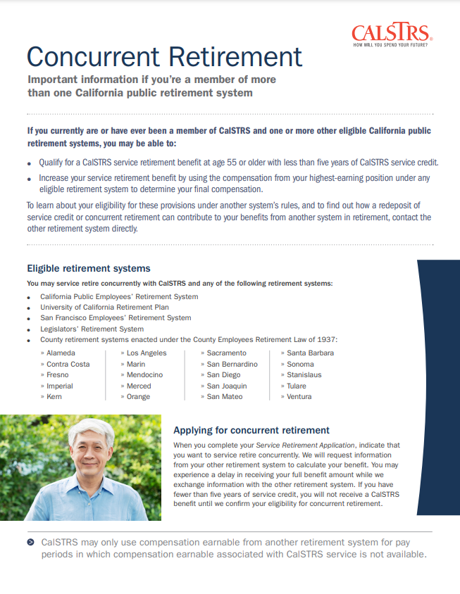
Concurrent Retirement
Member of another eligible CA public retirement system
Retire on the same day
Additional retirement benefits
Defined Benefit Program only
Notes:
We talked today about things that a part-time educator working multiple assignments should consider when those assignments are covered by CalSTRS
If you are working other assignments covered by CalPERS, the UC retirement system or any other eligible CA public retirement systems you may want to consider concurrent retirement.
Concurrent Retirement may provide additional retirement benefits if you retire from CalSTRS and any other eligible CA retirement systems on the same day.
If this applies to you, you may also want to review our concurrent retirement factsheet that you see here on the screen.
Click.

Slide 64
Additional income sources for part-time educators
Supplemental Savings with
CalSTRS Pension2
Social Security
Working after Retirement
Register for this webinar at CalSTRS.com/webinars.
Notes:
I just mentioned that it is common for part-time educators to work in employment outside of the public school system. This means that you may be relying on Additional Income Sources in Retirement. We offer a great webinar titled Additional Income Sources for Part-time educators that will take a look at a number of topics such as Supplemental Savings, Social security and working after retirement.
On average the CalSTRS retirement benefit will replace about 38% of your working income for a part-time educator. This webinar will talk about the importance of supplemental saving and how an account with CalSTRS Pension2 might help you reach your retirement income goals.
There is a common misconception that CalSTRS members do not get Social Security. This is not true; This webinar not only reviews the 2 social security offsets that CalSTRS members may be affected by. It takes and in depth look at how one might qualify for social security and helps you determine when the social security offsets apply.
Lastly, this webinar talks about working after retirement. It will review the working after retirement laws if you plan to go back to work in education or if your seeking employment outside of the public education system.
You can learn more about these additional income sources by signing up for this webinar at CalSTRS.com/webinars
Click.

Slide 65
For more information
Online resources
Benefits planning session
Attend a workshop or webinar
Part-time webpage
myCalSTRS
Retirement Progress Report
Individual benefits planning session
Additional Income Sources for Part-time Educators
Cash Balance Benefit Program
Consolidation of Benefits
calstrs.com/webinars
Notes:
If you need more information, we have several online resources. I specifically want to point out the Part-time Educator webpage, in a moment I will show you how to navigate to this page. This webpage is really the “one-stop shop” for all things a part-time educator might need.
Before I show you how to navigate to this page, I want to remind you that myCalSTRS and your annual retirement progress report are both going to be excellent online resources for you.
CalSTRS offers individual benefits planning sessions. If you would like to discuss your situation in detail and explore your options for maximizing your retirement benefit, I encourage you to schedule an individual benefits planning session when you are within 3-5 years of retirement. In this session we will provide personalized estimates and discuss your options of dropping your lower paying contracts. Remember everyone's situation is going to be different and we are here to help you identify the pro’s and con’s so that you may make the best decisions for your financial future.
There is also several webinars that were created specifically for you the part-time educator .
Click.

Slide 66
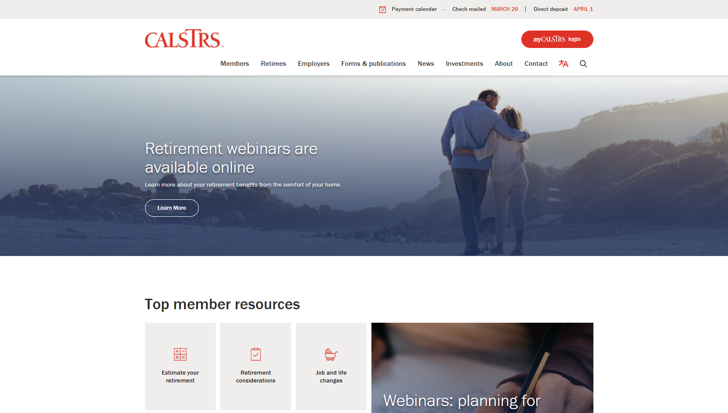
Part-time educator webpage
Notes:
Like I said I want to go ahead and show you how you can get to the Part-time Educator webpage.
Click.
From the CalSTRS.com landing page hover your mouse over “Members” from the top menu.
Click.

Slide 67
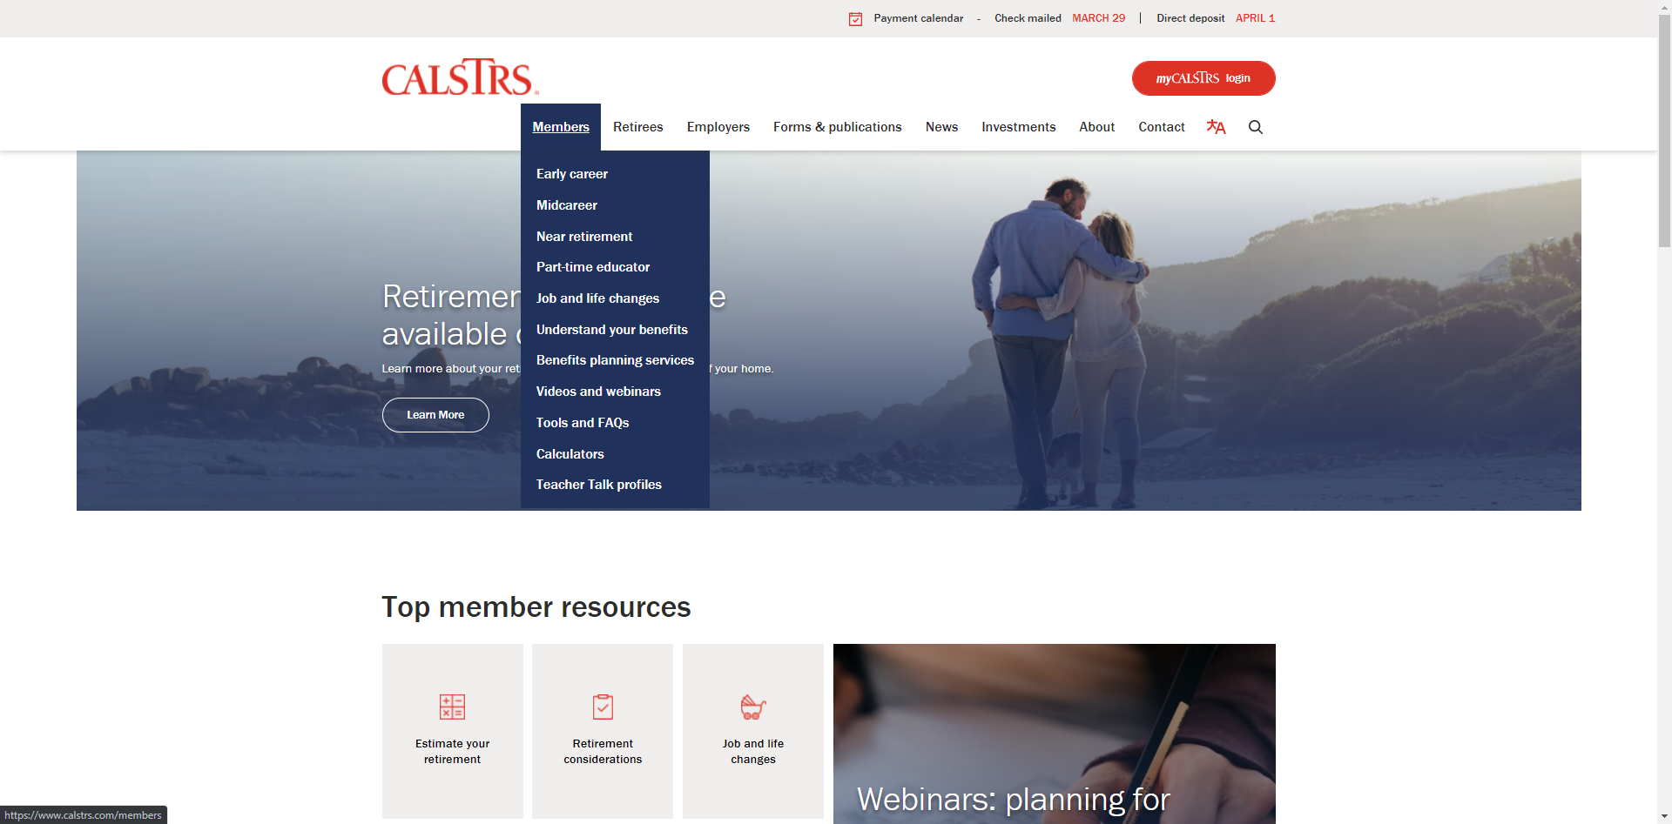
Getting Started
Notes:
From the menu that drops down,
Click.
you will select “Part-time educator”
Click.

Slide 68
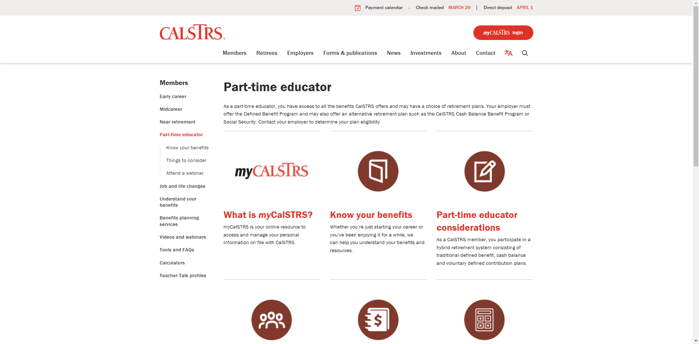
PTE page
Notes:
This will bring you to the part-time educator webpage where you can access all things part-time.
Click.

Slide 69
Questions?
CalSTRS.com
myCalSTRS
800-228-5453
*Press 2 for Customer Service.
Monday – ­Friday
8 a.m. – 5 p.m.
Notes:
Questions?

