Slide 1

CalSTRS and
Your Retirement
Notes:
Introduction:
Hello Everyone, Welcome to the “CalSTRS and Your Retirement” group session. Today we will focus on your retirement benefits and what you need to do to retire.
My name is , and I am a benefits specialist with CalSTRS.
**Feel free to give a brief introduction about yourself.**
Click.

Slide 2
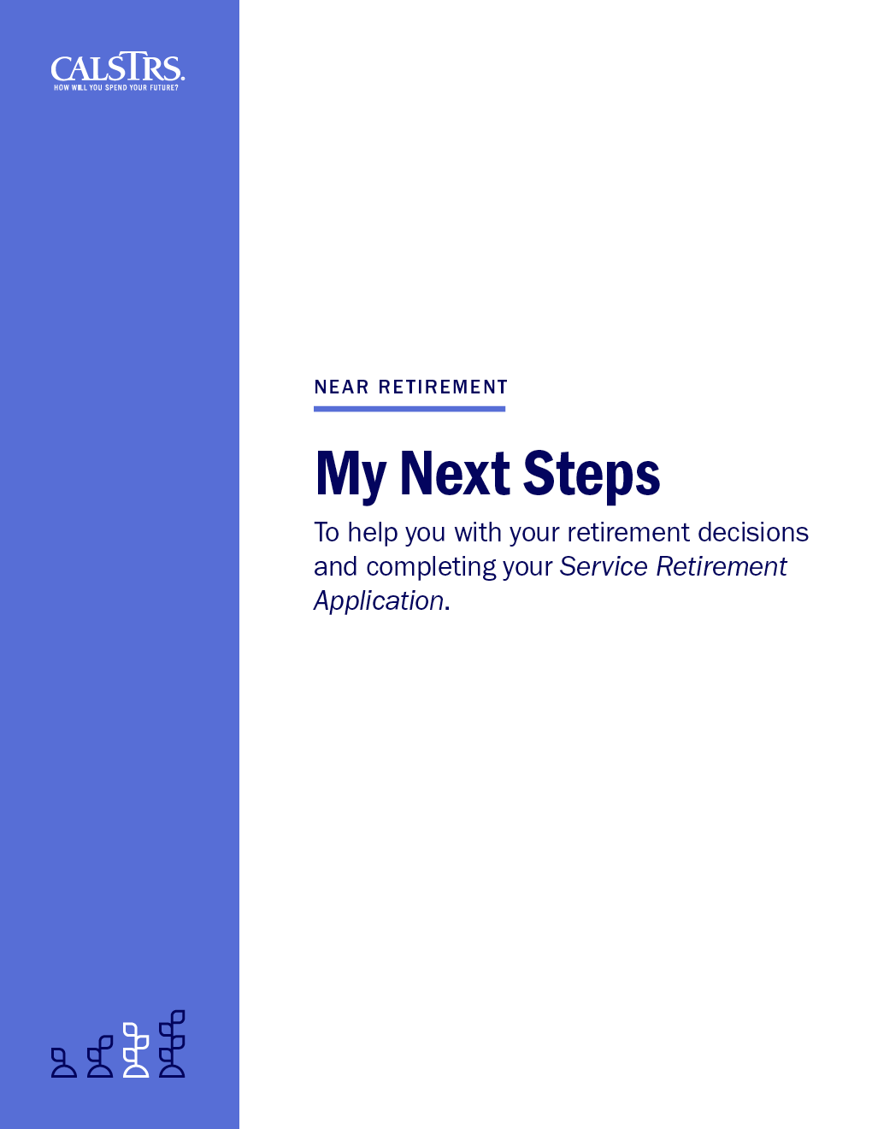

Today’s tools
My Next Steps
Interactive workbook
Guide for today’s session
Action items
Notes:
The My Next Steps booklet you received for today’s session is an important resource tool for you.
This interactive workbook will be our guide for today’s session. There will be places for you to fill in your personal information, take notes, or check off action items.
A helpful feature of this workbook is that the order mimics that of the Service Retirement Application, so any notes you take will be helpful when it is time for you apply for retirement.
Click.

Slide 3
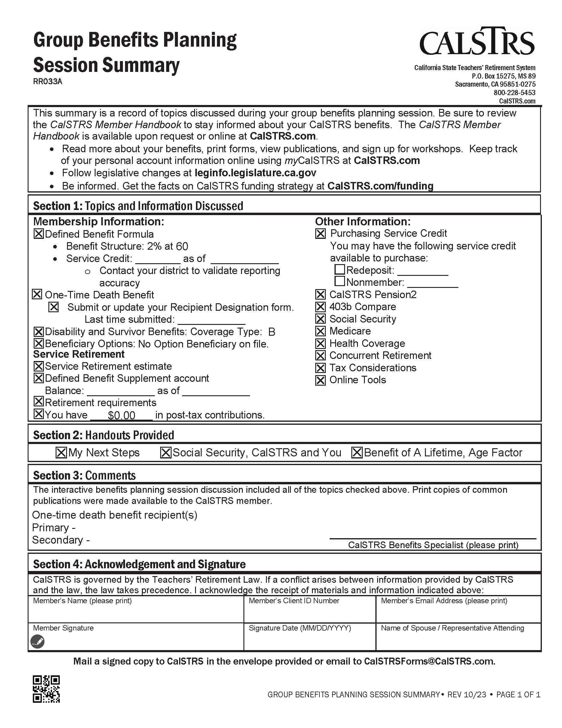
Today’s tools
Session Summary
Your personal information
Refer to throughout the session
Overview of today’s topics
Notes:
In the back pocket of the MNS booklet you will find personalized estimates and the Group Session Summary sheet. You will want to keep this handy; it has information specific to your account and I will refer to this throughout the session.
Click.

Slide 4
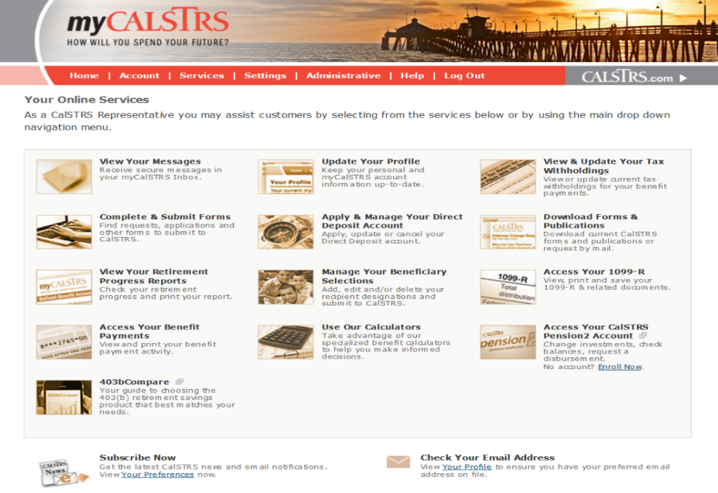
Convenient resources
View and update account information.
Submit forms and messages.
Access your Retirement Progress Report.
Notes:
CalSTRS has many convenient online resources for you.
The most important resource is your myCalSTRS account. This account provides online access to your CalSTRS accounts and information.
As we cover the sections in your My Next Steps, I will reference the many ways your myCalSTRS account is an essential online resource for you before and even after you retire.
Through secure messaging you can send and receive online messages with a CalSTRS representative.
Update your contact information and submit forms.
After you retire, you can view your pay statements and update your tax withholdings or direct deposit as necessary.
At tax time you can also access your 1099R.
Click.

Slide 5
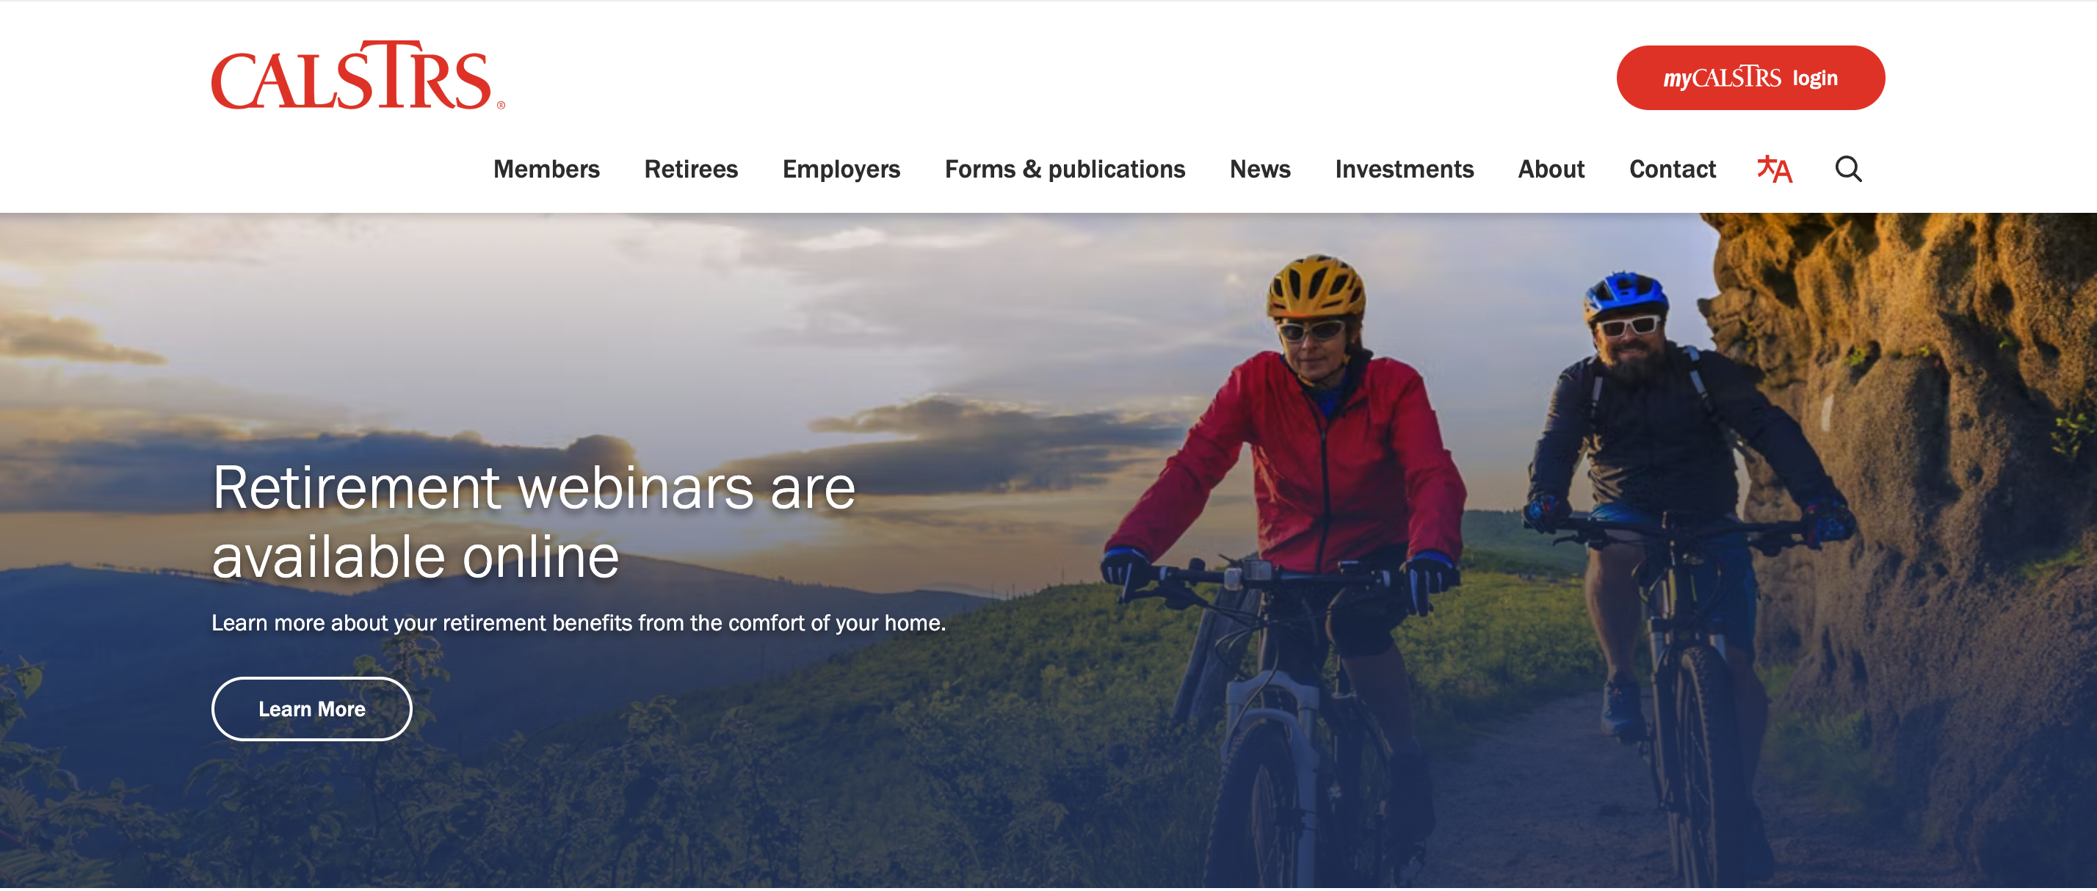
Convenient resources
Learn about
us and your benefits.
Download forms and publications.
Access calculators and watch videos.
Notes:
For more general CalSTRS information, our website, CalSTRS.com also has many useful tools for you take of advantage of:
You can use the online calculators to estimate your retirement benefit. This is especially helpful if after reviewing the estimates I generated for you, you would like to look at alternate scenarios to determine your best retirement date.
We also have calculators to help you estimate the cost of redepositing or purchasing permissive service credit.
And you can access the many educational videos available to help members better understand their CalSTRS benefits.
Click.

Slide 6
Today’s discussion
CalSTRS’ hybrid system
Retirement estimates
Providing for loved ones
Defined Benefit Supplement account
Social Security and CalSTRS
Steps toward retirement
CalSTRS resources
Notes:
Topics we will cover in today’s session.
CalSTRS administers a three-part hybrid retirement system we will take a look at all 3 parts.
Together we will review sample estimates that are similar to the personalized estimates created for you in your booklet.
We will talk about providing a lifetime benefit for a loved one.
I will explain the Defined Benefit Supplement Account.
We briefly discuss Social Security, the offsets that may affect you and give you resource information to learn more from the Social Security Administration.
We will cover the steps you need to take in order to retire.
And again throughout we will review the resources available to you.
Click.

Slide 7
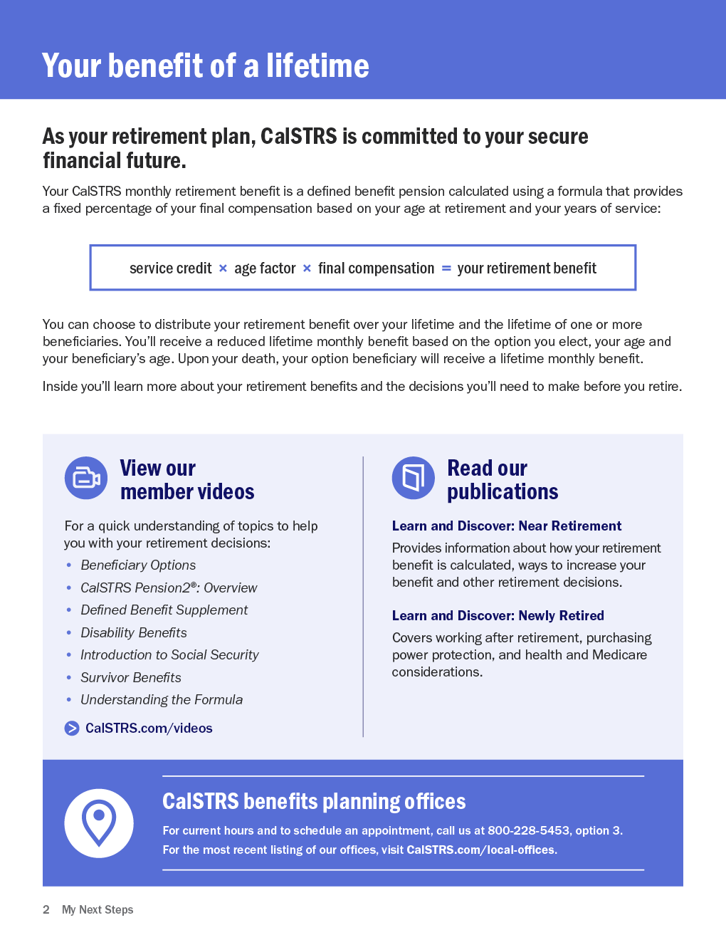
My Next Steps
Notes:
Inside the front cover of the My Next Steps booklet you will find information about your CalSTRS benefit.
Click.
At the top it says “Your Benefit of a Lifetime” because the benefit you will receive from CalSTRS is guaranteed for your lifetime. CalSTRS is a defined benefit plan, it is called a defined benefit plan because the benefit you receive in retirement is based on a set defined formula, not on the balance in your account.
You can see the formula is service credit x age factor x final compensation. When we multiply those numbers, it gives us your retirement benefit. Later when we look at your estimates, you’ll get to see how your numbers fit into this formula. Keep in mind that all the dollar amounts we look at today are gross numbers. Your income in retirement is taxable income.
Because your benefit is based on a formula and not your account balance, when the balance in your account gets to zero you will continue to receive a monthly benefit until your passing.
Click.
The bottom of the page you will see a list of some of the educational videos I referenced as a resource a moment ago. Many of the videos pertain to information we cover today. Since we do cover a lot of information, it is nice to know you can go back and watch those at your convenience. They are about 2-5 minutes long so will serve as a quick review for you.
Click.

Slide 8

CalSTRS is a hybrid retirement system.
Notes:
Like I mentioned, CalSTRS administers a hybrid retirement system.
Click.

Slide 9
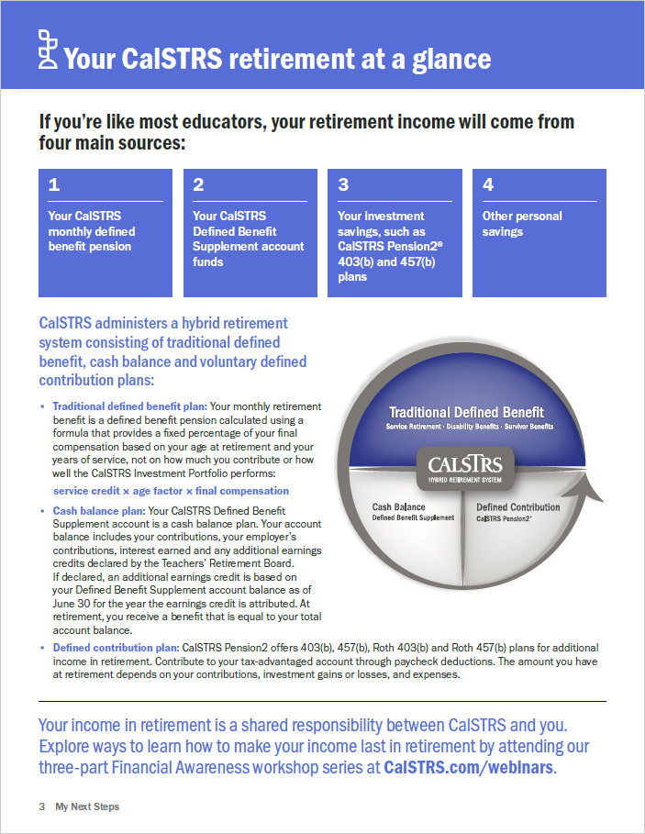
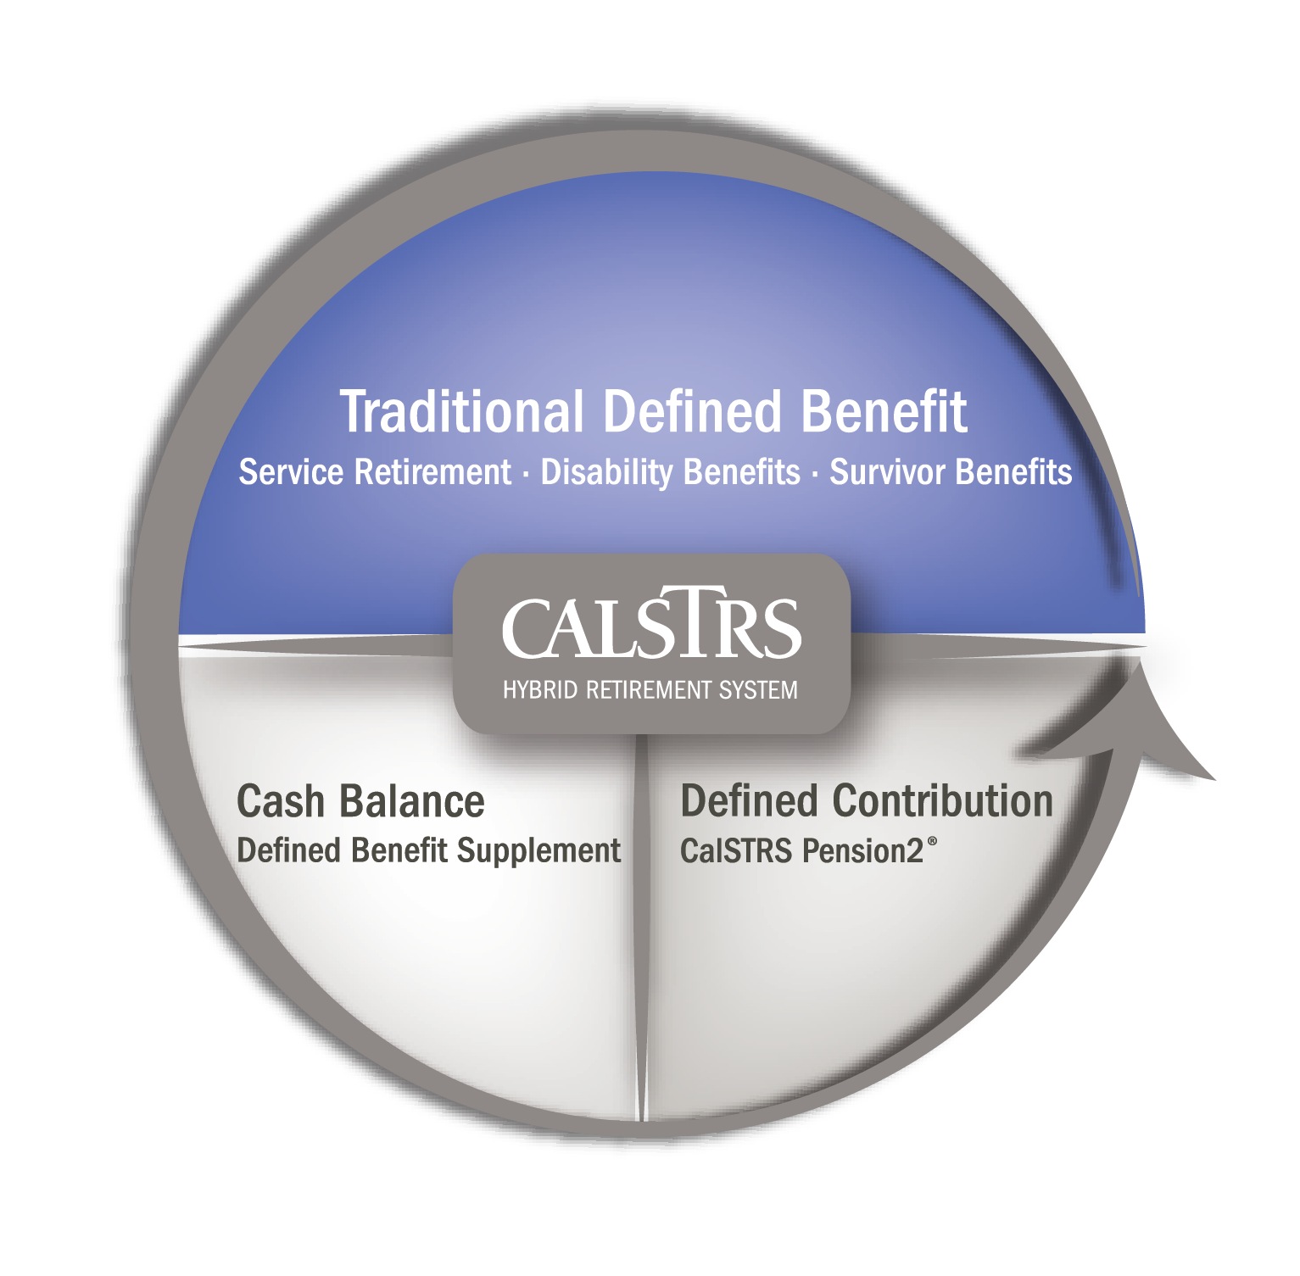
Your CalSTRS retirement at a glance
Traditional defined benefit
Defined Benefit Supplement
Defined contribution
Notes:
As you look at the next page, you’ll see this “pie chart” looking graphic. This illustrates the CalSTRS hybrid system. It consists of:
Click.
A defined benefit plan, which is the pension we just talked about. Remember it’s based on a formula and not your account balance.
Click.
Going counterclockwise, next is a cash balance account. It is known as your defined benefit supplement account. This is a second account you will draw from in retirement. Unlike your pension, this payment will depend on the cash balance of this account when you retire.
Click.
Finally, the third section is a voluntary defined contribution plan that we call Pension 2. Unlike the other 2 parts, this account is one you’d have to sign up for and set up contributions.
We will discuss each of these plans in more detail today.
Click.

Slide 10
My member information
1
SECTION
Notes:
Turn to page two in you My Next Steps booklet.
Click.

Slide 11
CalSTRS benefit structures
2% at 60
2% at 62
First hired before
January 1, 2013
First hired on or after January 1, 2013
Verify your benefit structure on your
Retirement Progress Report or your myCalSTRS account.
Notes:
It is important to know what benefit structure you fall under as part of your CalSTRS membership. Your benefit structure is based on the date you were first hired in a CalSTRS‐covered position and determines how your retirement benefits are calculated as well as how much of your earnings you contribute each paycheck.
If you aren’t sure of your hire date you can verify your benefit structure on your Session Summary page. For future reference it is also on your Retirement Progress Report and on the home page of your myCalSTRS account.
Click.

Slide 12
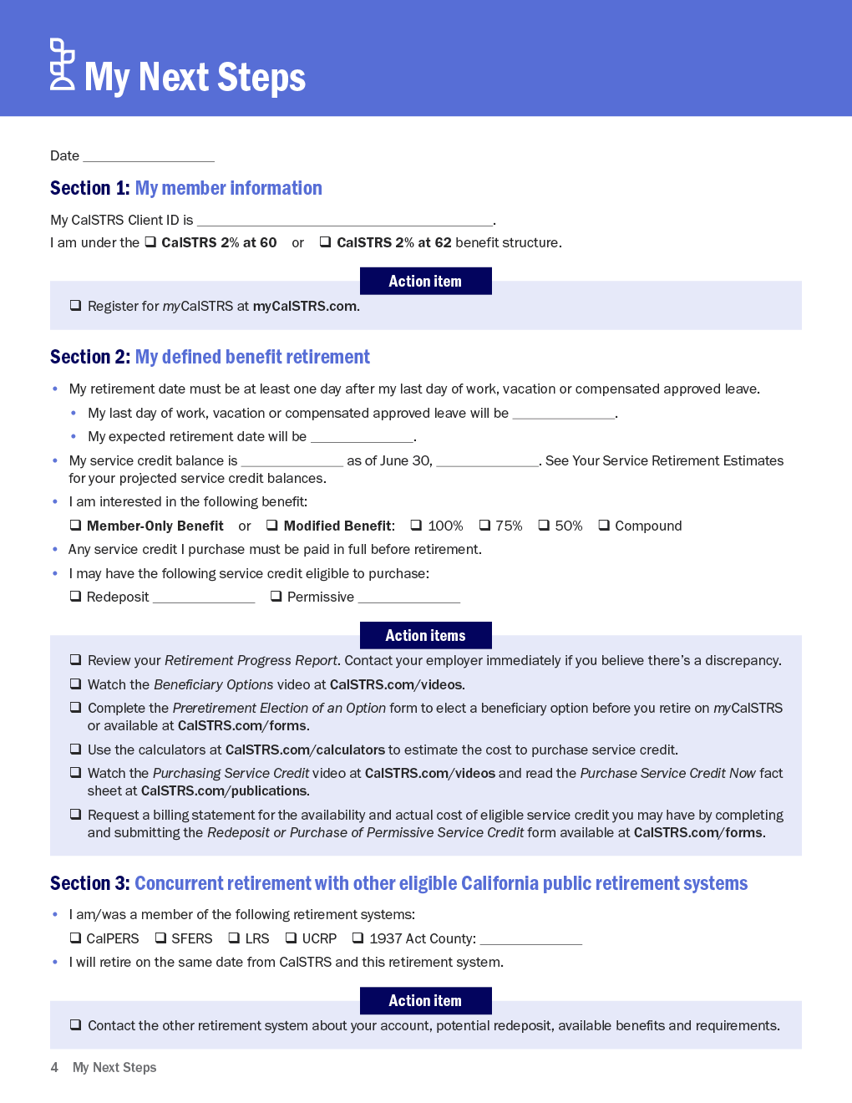
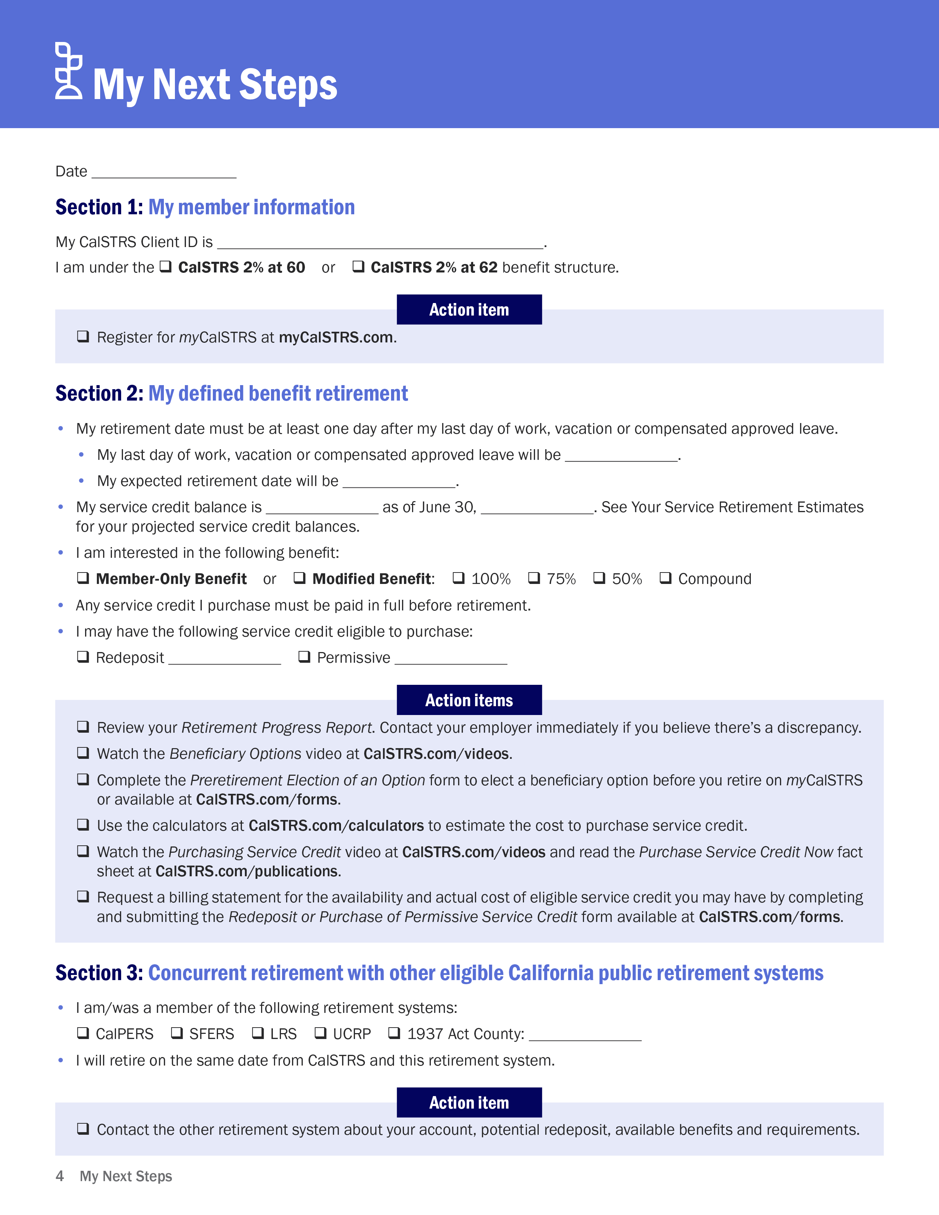
My member information
Notes:
Let’s start filling out parts of the My Next Steps, put today’s date at the top so you will have a resource point for the information given.
Click.
As a CalSTRS member you have a Client ID number that was created so you do not have to use your social security number. This number is unique to you and CalSTRS. For privacy protection we encourage you to use it when submitting forms or when contacting CalSTRS. Any correspondence you receive from CalSTRS will have this number instead. You can find your CID number at the bottom of your Group Session Summary sheet or on your personalized estimates I provided.
Here in Section 1 you can indicate which benefit structure you fall under. Again, you can find this on your Session Summary.
And if you have not already done so, your first action item is to register for a myCalSTRS account. Like I mentioned before, this is a great resource for you to keep track of your CalSTRS information.
Click.

Slide 13
My defined benefit retirement
2
SECTION
Notes:
Moving to Section 2
Click.

Slide 14
How much is my defined benefit retirement?
Notes:
Looking at the hybrid icon, you see the top half represents your traditional defined benefit plan. Again this is your guaranteed lifetime benefit based on a formula and typically represents the bulk of your retirement benefits from CalSTRS.
Click.

Slide 15



Defined benefit retirement formula
x
x
service
credit
age
factor
final compensation
= your monthly
retirement benefit*
^{*Taxable income}
Notes:
The defined benefit formula consists of three components – service credit, age factor and final compensation. We multiply them together to get your monthly retirement benefit.
Please note, any estimates we review reflect the gross amount. As you have been contributing to CalSTRS over the years, those contributions have been deducted pre-tax so when you retire your CalSTRS benefit becomes taxable income.
Let’s take a look at an example estimate to see exactly how these components determine the benefit.
Click.

Slide 16
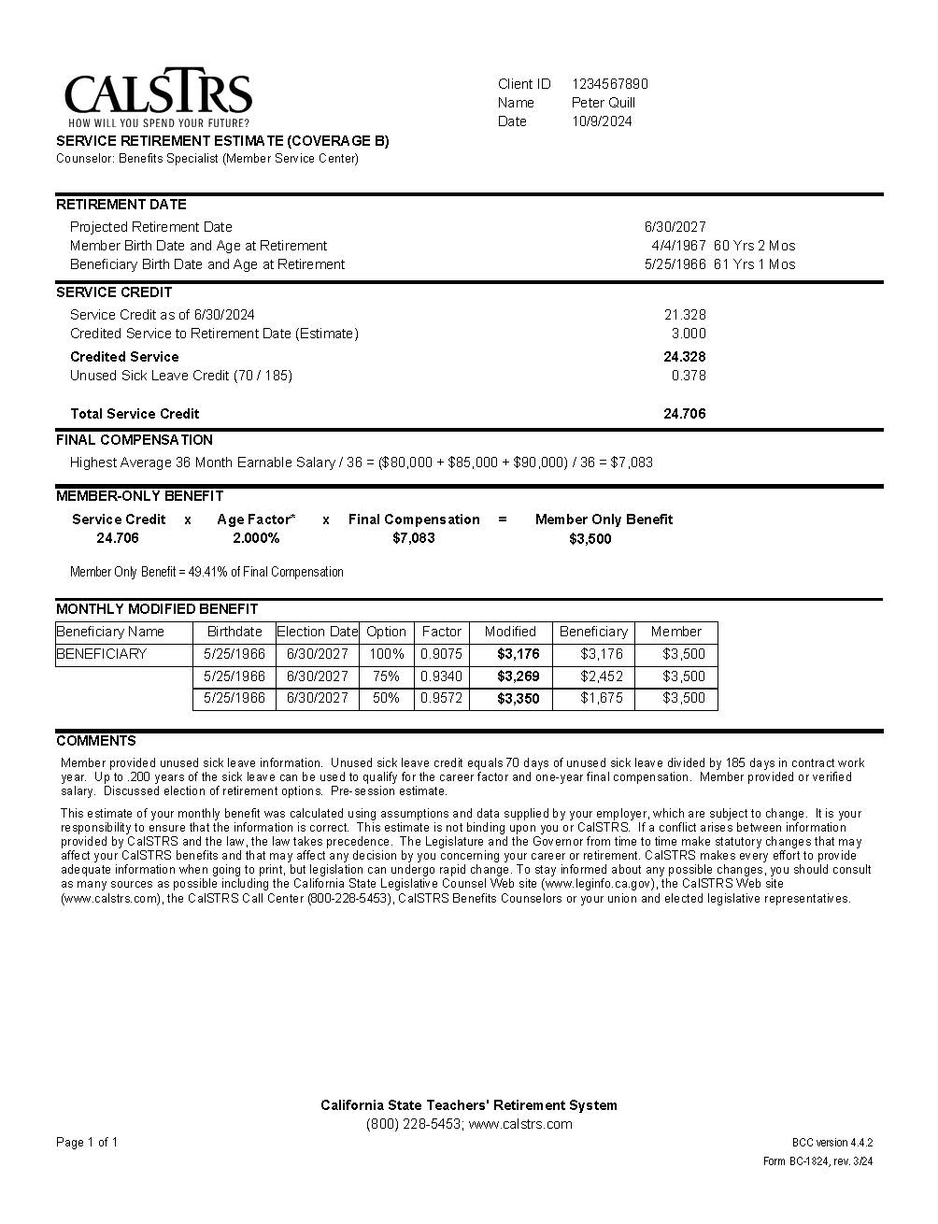
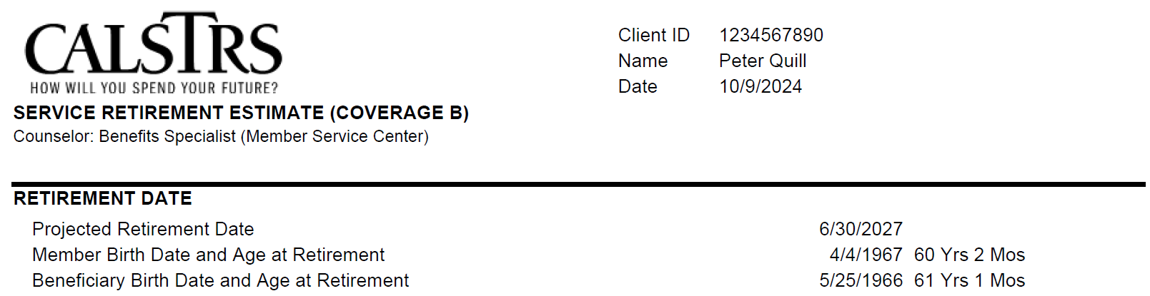
My retirement estimate
Final
Compensation
Age Factor
Client ID
Use instead of Social Security number
Coverage A or Coverage B
Disability and survivor benefits
Projected retirement date
One day after last day of work or
paid leave.
Notes:
Please pull out or open up your estimates. It should look like this but with your information. Peter is our sample member for today. I’ll review his estimates on the screen and you can follow along with your personalized estimates.
Click.
In the top right corner of the estimate, you will find your Client ID, name and the date I prepared your estimate.
At the top left corner, you will see the CalSTRS logo, Service Retirement Estimate and either Coverage A or Coverage B. The type of coverage you have determines your disability and survivor benefits. We will cover those benefits once we get to Section 6. On your personal estimates you will also see my name listed in this section.
Retirement Date information is listed next. On your estimates we default to the last day of the month, but know that the benefit information would be the same no matter when in the month you are actually retiring. The earliest you can retire is the day after your last day of paid work.
Next is the member’s date of birth and age in years and months at retirement. This is what determines the age factor.
Also, on this estimate you will see that Peter has a beneficiary date of birth listed and their age at his retirement. If you requested to see an estimate of naming an option beneficiary, then your estimates will also have a Beneficiary listed here.
Click.

Slide 17
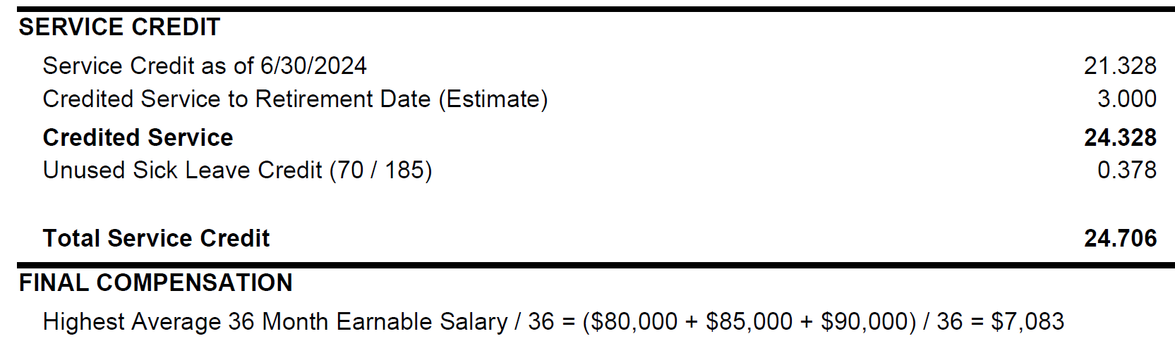
My retirement estimate
Credited service
One-year final compensation
Career factor
Final compensation
Highest average annual compensation earnable during a specific period.
CalSTRS 2% at 62 members do not qualify for benefit enhancements.
Notes:
Moving down to the next section of the estimate, let’s talk about service credit, both earned and projected.
Service credit is the time you’ve worked and contributed to CalSTRS. On the estimate you will see the Service Credit as of 6/30/2023. That’s the service credit you had at the end of the last fiscal year which is the last full year of reporting that we have.
The next line is the projected amount of service credit you will earn by your retirement date. This includes the current school year we are in right now.
Next you will notice the Credited Service line—this line is bolded. It’s bolded because the service credit total here determines what benefit enhancements you may be qualified for.
CalSTRS offers two benefit enhancements for members under the 2% at 60 benefit structure. The first one we will review pertains to final compensation.
2% @ 60 members with 25 years or more of credited service will qualify for the use of the highest 12 consecutive months of earnable salary. With less than 25 years, or if you are a 2% @ 62 member, CalSTRS uses your highest 36 consecutive months salary to calculate your final compensation. Please note however, the 12 or 36 consecutive months can be at anytime in your career.
Under Credited Service, you’ll see your unused sick leave if you provided that information when scheduling this session. Unused sick leave is converted into additional service credit when you retire. We take your unused sick leave days and divide that by the number of days in your contract. The resulting amount is how much service credit you’ll have added to your total.
When trying to reach a benefit enhancement up to .200 of that converted sick leave time can be used to qualify for the benefit enhancements.
Click.

Slide 18
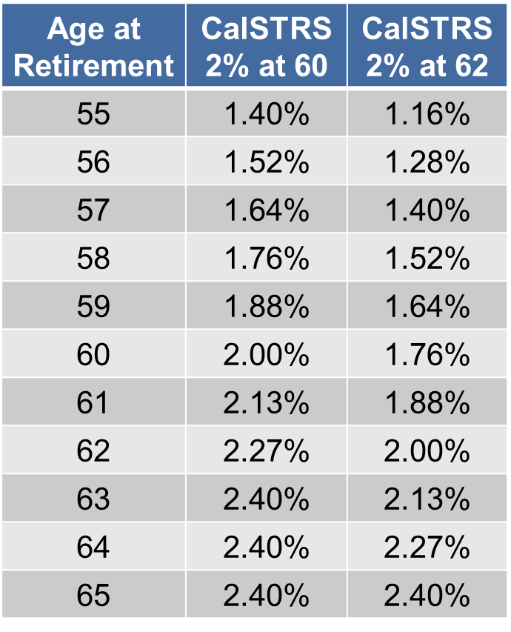
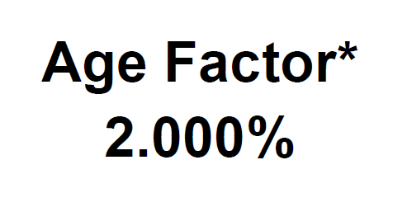
My retirement estimate
Notes:
We’ve looked at 2 parts of the retirement formula, service credit and final compensation. The third part, age factor, doesn’t have its own section but you can find it under the section titled “Member-Only Benefit” in the calculation.
Click.
Remember this is determined by your age at retirement. Peter is under the 2% at 60 benefit structure planning to retire at age 60. So his age factor is 2%.
Click.
The standard age factor for CalSTRS 2% at 60 members is 2% when you reach age 60. With a maximum age factor of 2.4% at age 63.
For 2% at 60 members, if you retire with 30 or more years of credited service, you receive the benefit enhancement called the Career Factor. Wherever you land on the age factor table a 0.2% will be added to your age factor, so essentially you get a higher age factor without having to get older to reach it. However, your total age factor will never go higher than 2.4%
Click.
If you are under the CalSTRS 2% at 62 benefit structure you will receive the 2% age factor when you reach age 62. With the maximum age factor of 2.4% at age 65.
The age factor table you see on the screen is broken down in years from age 55 to age 65. However, the age factor is based on your age in years and months at retirement. It gradually increases as you reach 2.4%. You can view the complete age factor table in the Member Handbook.
Click.

Slide 19
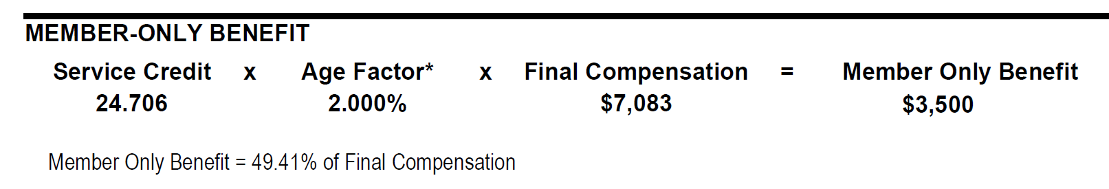
My retirement estimate
Age Factor
Percentage of final compensation compares gross incomes.
Notes:
Looking at Peter’s member-only benefit we see:
His projected service at retirement will be 27.991 years of service credit. Since Peter will be 60 at retirement, his age factor is 2.000%. And his final compensation, based on his highest 12 consecutive months, is $6250. When we multiply together, we get Peter’s monthly member-only benefit of $3,499. Remember when looking at your estimates this is a gross dollar amount.
You can increase your monthly benefit by increasing any part of the formula;
Your service credit, your age factor or your final compensation.
For instance, by working longer you will earn more service credit, getting older can increase your age factor as well as any salary increase or reaching a benefit enhancement if you are a 2% @ 60.
In smaller print under the calculation, you can see that Peter’s member-only benefit is 55.98% of his final compensation. The member only benefit of $3,499 is replacing about 56% of Peter’s highest average gross salary of $6,250.
Keep in mind when comparing your % of final compensation you are comparing gross numbers. Looking at a current pay stub you will see there are many deductions coming out of your working check now that will discontinue when you retire. For instance, you will no longer be contributing to CalSTRS, paying Medicare Tax and other supplemental savings deductions will stop.
Click.

Slide 20
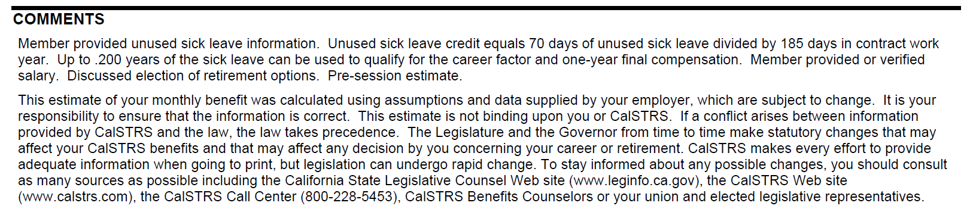
My retirement estimate
Notes:
At the bottom of the estimate is the Comments section. This is where you will find unique information about your estimate such as details about service credit purchases, option elections, projected service credit and/or final compensation.
Click.

Slide 21
I can provide a lifetime benefit to my loved ones after my death.
Notes:
Do you have someone that is dependent on your income? If so, you may want to consider leaving a lifetime benefit after your passing.
We just looked at a member-only benefit. However, there are two ways you can receive your monthly benefit in retirement. The member-only benefit or the monthly-modified benefit.
When you are eligible to retire or at retirement, you can elect an option beneficiary which would modify your monthly benefit. What that means is you can reduce what you get each month while alive knowing that when you pass your option beneficiary would continue to receive a monthly benefit for their lifetime too.
There are many reasons why someone would or would not elect an option beneficiary, it is definitely a household decision, the next few slides will give you an idea of how it works.
Click.

Slide 22
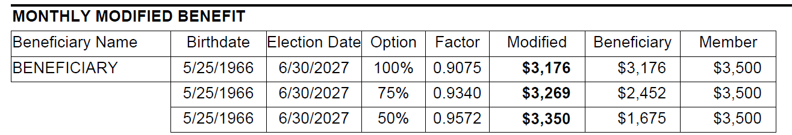
Providing for my loved ones
Notes:
Your beneficiary may be any person you choose, you may even choose multiple beneficiaries.
The option factor is an actuarial calculation based on the option you elect, your age, and your beneficiaries’ age when you make the election.
Click.
Peter has requested to see estimates that include a lifetime benefit for his spouse. If you requested option estimates, or have already elected an option, you will have this monthly modified benefit box on your estimates as well.
Click. (click through and explain the monthly modified benefit table)
First column after Beneficiary Name is Beneficiary birthdate.
Click.
Next is Election date. This is the date that you signed the paperwork to put this beneficiary on file. You may notice that this date reflects the estimated benefit effective date or a date earlier to show you the effects of putting a beneficiary on file before you are ready to retire.
Click.
Next is Option. You’ll see up to 3 different options here. This is the percentage of your benefit that you’d like to leave to your loved one.
Click.
Next is Option Factor. This number is determined by your age, your beneficiary’s age, and the date when the option was elected. We multiply this number by the member-only benefit to get your modified benefit.
Click.
The next column shows the Modified Benefit amount. This is the amount you, the member, would receive in retirement for your lifetime.
Click.
Following that is the Beneficiary column. This is the amount your named beneficiary will receive upon your passing. They will receive this benefit for their remainder of their life.
Click.
And finally is the Member column. If your beneficiary were to pass away before you, then your benefit will pop back up to your member-only benefit amount.
Click.

Slide 23


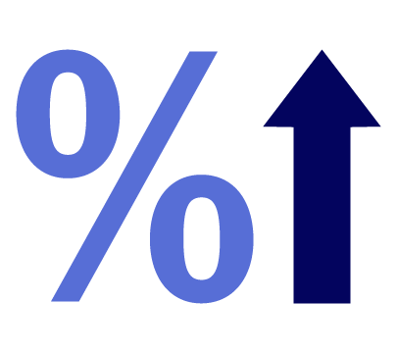
Preretirement election of an option
Advantages
Disadvantages
Secure coverage for beneficiaries if you should die before retirement.
You’ll be subject to an assessment if you change or cancel your option or if your beneficiary dies before you retire.
The assessment can reduce your future benefit.
Option factor may be higher the earlier you elect an option.
Notes:
I mentioned that your election date might be a date prior to the benefit effective date. That’s what we call a pre-retirement election of an option. You can elect a beneficiary as soon as you are eligible to retire even if you aren’t yet ready to retire.
However, there are advantages and disadvantages to pre-electing an option.
One advantage of electing an option before you retire is that you’re securing the lifetime benefit for your selected beneficiary if you should pass away before retirement.
Another advantage is that the option factor tends to be higher when elected sooner, so less is modified from your benefit the earlier you elect the option.
The disadvantage to electing an option before retirement is that if you change or cancel your option before retirement you may be subject to an assessment that can reduce your future monthly benefit. If your beneficiary dies before retirement that is also considered a cancellation.
The assessment can very, depending on the option, the ages of you and your beneficiary and the amount of time the coverage was in place.
Click.

Slide 24
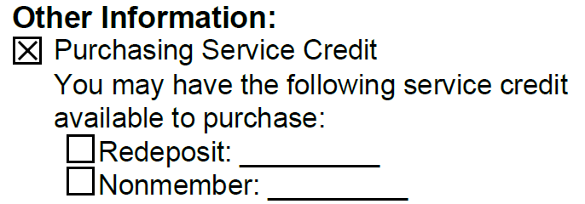
Purchasing service credit
Service Credit
You may be able to:
Redeposit withdrawn contributions.
Purchase permissive service credit.
Notes:
Now let’s explore ways to increase your benefit.
Some of you may be eligible to purchase service credit. The more service credit you have at retirement, the greater your monthly benefit will be.
There are two main types of service credit to purchase.
You can redeposit or buy back service credit you lost if you previously took a refund of your contributions.
Or you may have permissive service credit available such as non-member service which is part time or substitute service performed in the California public school system prior to becoming a member of CalSTRS
When I researched your accounts for today’s session, if I found any redeposit or non-member time available for purchase, I notated it on your Group Session Summary form.
There are also other types of permissive service credit that you may have available to purchase.
Have you ever taken maternity or paternity leave? What about a sabbatical? Did you ever teach out of state? These are some of the purchasable credits I would not have been able to see in your account.
Click.

Slide 25
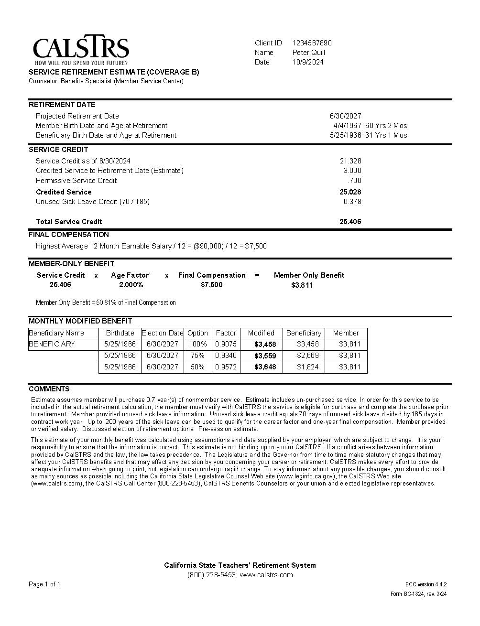
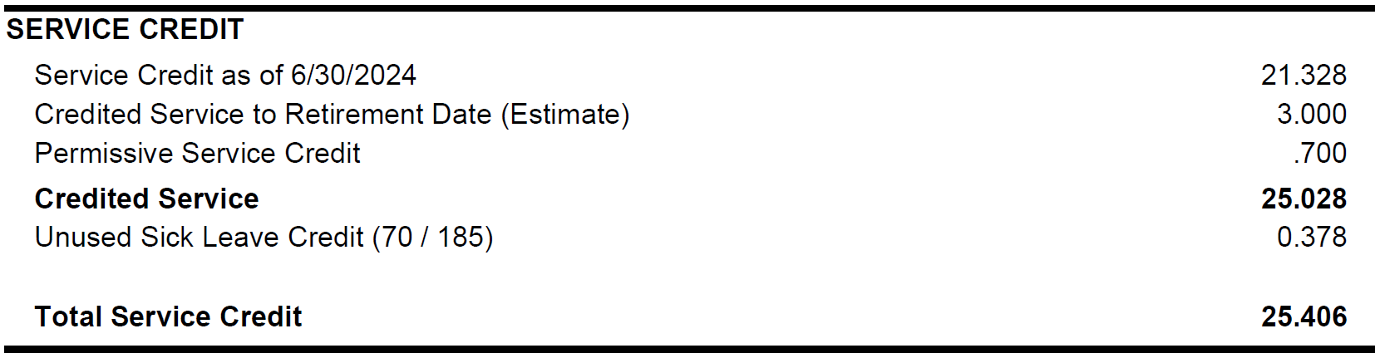
Purchasing service credit
Notes:
Looking back at the estimate, you see the Service Credit section now includes an additional line reflecting Permissive Service Credit
This increases the total service credit used in the formula to calculate the retirement benefit.
Click.

Slide 26
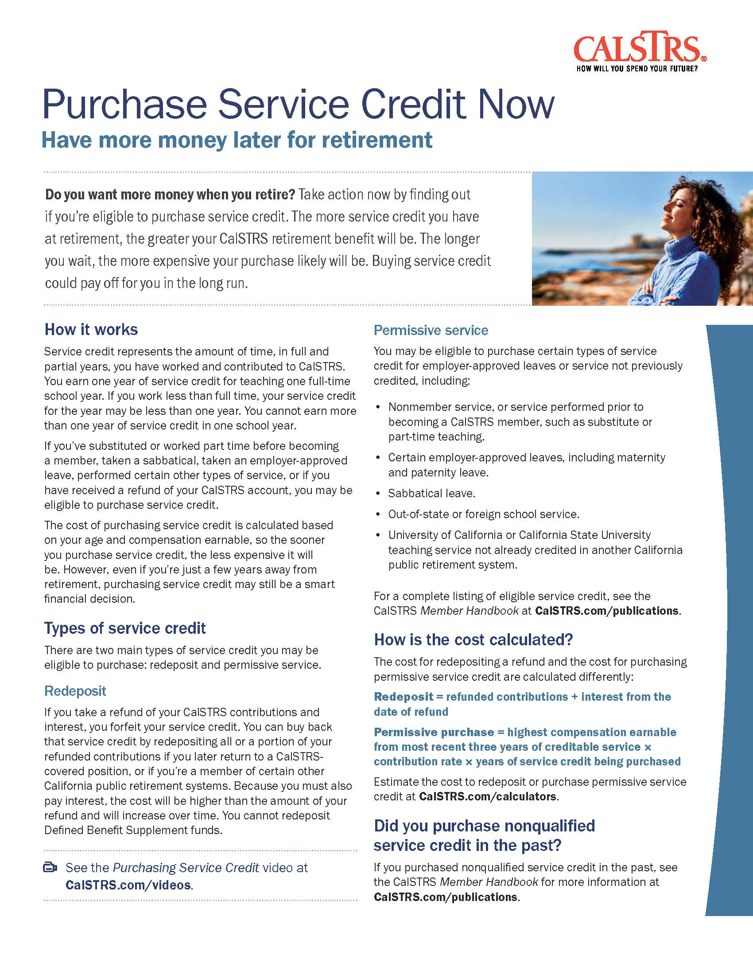



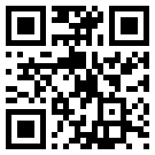
Make an informed decision
Cost to
purchase
Increase to
your benefit
Time to recover
your costs
Notes:
If you’re interested in looking into purchasing service credit, a great resource to use when examining if it is right for you is the Purchase Additional Service Credit publication.
When deciding if purchasing service credit is right for you, in addition to reviewing the potential increase to your benefit, you should also look at the costs to purchase.
You may have cost estimates in your packet, or you can use the calculators on CalSTRS.com to estimate the cost of your purchase and the increase to your benefit.
Things to consider…will the purchase get you to a benefit enhancement? Also, you can purchase a portion rather than all the permissive service credit available.
Service credit can be purchased with:
•A lump-sum rollover of pre-tax funds
•A lump-sum cash payment
•Monthly cash installments
•Monthly tax-deferred payroll deductions, if offered by your employer
Once you see what the cost of your purchase would be and how much your benefit would increase by purchasing the extra service credit, calculate how long it would take to recover your cost. You can do that by dividing the cost of buying the service credit by your monthly increase, then divide that amount by 12, for 12 months in a year. This will give you a rough estimate of how many years it would take you to see a return on your investment.
Click.

Slide 27
My defined benefit retirement
Notes:
Looking at Section 2 in your My Next Steps booklet.
The first bullet reminds you that your retirement date can be one day after your last day of work or paid leave. So, if your last day of work was June 15, your retirement date could be as early as June 16.
In the next section you can fill in your service credit balance as of June 30, 2023. You can find that information on your Group Session Summary sheet or you just saw it listed on your estimates.
The third bullet is for you to indicate or remind you of your choice of a member-only benefit or if you would like to modify your benefit. You can discuss this with your family—see what is best for your personal situation.
And If you had any purchasable service credit listed on your Session Summary, you can list it here.
Click.

Slide 28
My defined benefit retirement
Notes:
Right below, you will see a list of action items. You can check all that apply—this will serve as a reminder of what you need to do.
Be sure to review your Retirement Progress Report every year. If you ever feel there are any discrepancies with the service credit or salary information CalSTRS has on file, you should contact your employer to verify that information and if incorrect they can always re-report to CalSTRS.
Watch our Beneficiary Options video about the monthly modified benefit.
You can complete the Pre-Retirement Election of an Option form online if you would like to pre-elect before you retire.
If you are considering purchasing service credit, be sure to read the Purchase Additional Service Credit booklet and watch the Purchase Service Credit video.
Remember, you can use our online calculators to estimate the cost to purchase service credit and also estimate the increase to your benefit.
If you decide a service credit purchase makes sense, request a billing statement from myCalSTRS or CalSTRS.com. Remember, by requesting a statement you are under no obligation to purchase the service credit however any service credit you purchase must be done so before retirement.
Click.

Slide 29
Concurrent retirement with other eligible California public retirement systems
3
SECTION
Notes:
For some of you, Section 3 discusses potential sources of retirement income from other CA public pensions.
Click.

Slide 30
Concurrent retirement
Notes:
Did you ever work in a CalPERS position, any California state universities or in the UC system? If you have worked for another qualified retirement system you may be eligible for a concurrent retirement. In this section there is a list of eligible retirement systems.
A concurrent retirement means that you would receive a separate retirement benefit from both systems. The benefits of a concurrent retirement is that you don’t have to be vested in both systems to receive retirement benefits. So for instance if you are eligible to retire from CalSTRS, you would be eligible to retire concurrently with CalPERS even if you didn’t have a full five years vesting with them.
One more benefit is that both systems may be able to use the higher salaries from either system to calculate your final compensation.
Click.

Slide 31
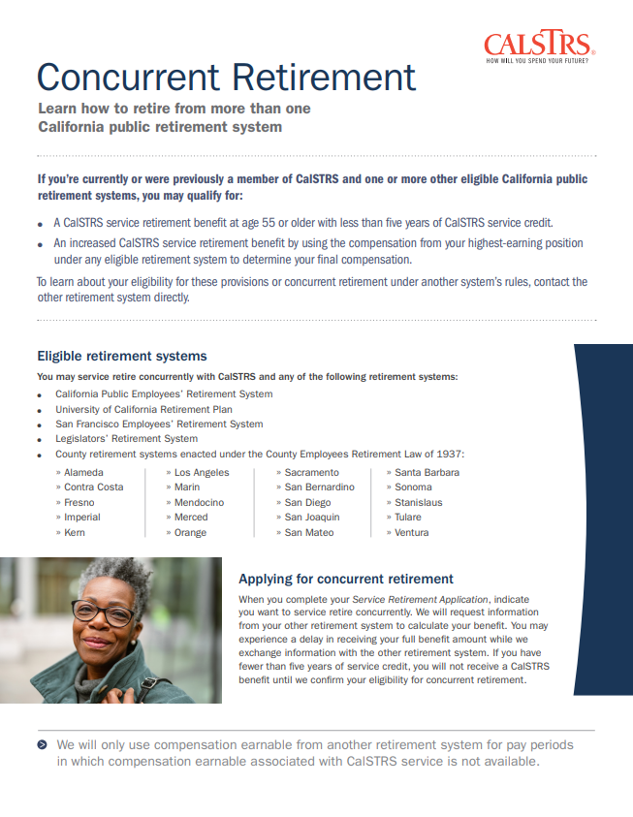
Read our Concurrent Retirement
fact sheet for more information.
Notes:
For more information, you can read our Concurrent Retirement publication. Also, you will need to contact the other retirement system to research their requirements and processes for Concurrent Retirement.
Click.

Slide 32
4
SECTION
My Defined Benefit Supplement account
Notes:
Next, section 4, your Defined Benefit Supplement Account.
Click.

Slide 33
What is the Defined Benefit Supplement account?
Notes:
The second part of the Hybrid System is your Defined Benefit Supplement account. Remember this is a cash balance account so the amount you could receive from this account depends on how much money is in there when you retire.
Click.

Slide 34
My Defined Benefit Supplement account history
2001-2010:
One quarter of Defined Benefit Program contributions redirected
Excess
earnings
Guaranteed
interest
Defined
Benefit Supplement
Notes:
The Defined Benefit Supplement (DBS) account was established in 2001. If you were a member at anytime form 2001-2010, a quarter of your Defined Benefit contributions were redirected to the DBS account. Because of that redistribution the DBS account balance was able to grow. This had no impact on your retirement benefit.
Click.
Then starting in 2002 and ongoing, any excess contributions from the work you did above and beyond 1.00 of service credit were credited to this account. For instance, if you worked extra duties, coached, or taught summer school, 8% of those contributions plus a matching 8% from your employer were credited to your DBS account. That means that for any of that extra work, you had 16% of your salary going into your account.
Click.
The third part of is this account is that from the beginning, it has been earning its own separate compounded interest. The interest rate changes each fiscal year, currently the interest rate for FY 2024-25 is 4.61%
Click.
Although the redirection of contributions discontinued in 2010, you still continue to receive 8% (for 2% @ 62 members 9%) credit from you and your employer for those extra duties as well as this account will continue to earn interest until you retire.
Click.

Slide 35

My Defined Benefit Supplement account
For your Defined Benefit Supplement account balance, refer to your
Session Summary.
Notes:
On your Session Summary, you can find your current DBS balance as of the day I prepped for this session.
Click.

Slide 36
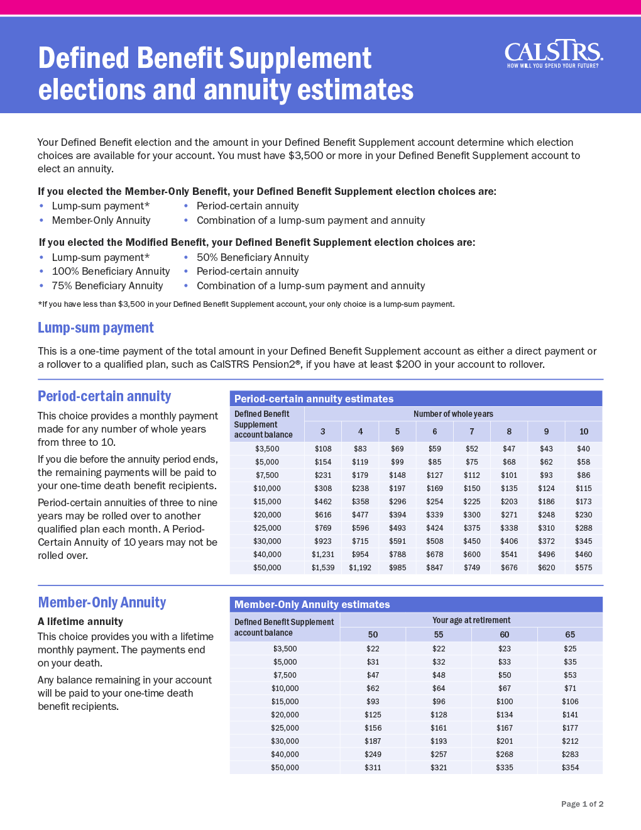
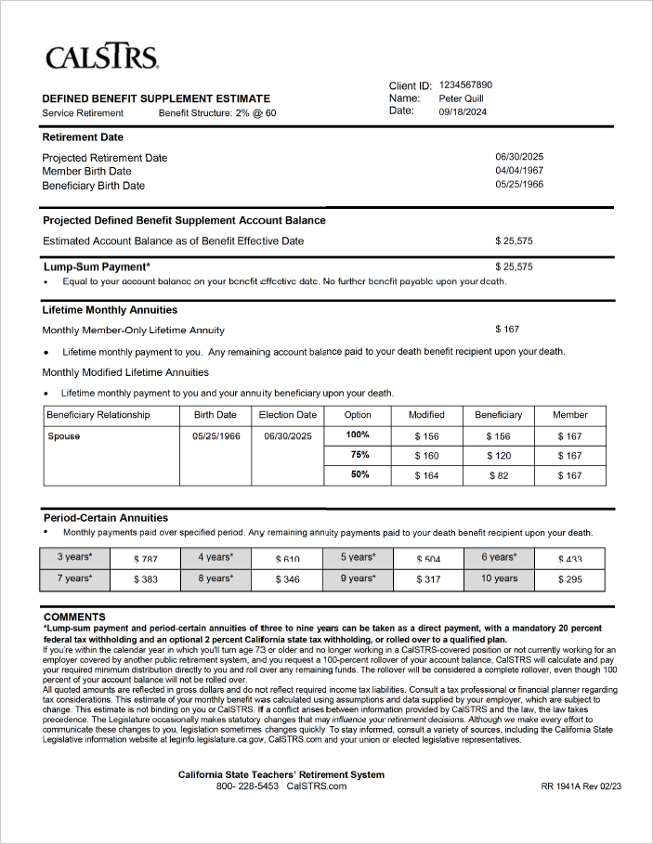
My Defined Benefit Supplement account
One year or more from retirement or less than $3,500
One year or less from retirement or more than $3,500
Notes:
In your packet, you will have one of these DBS estimates.
Click.
If your retirement date is more than 12 months out or you have less than $3,500 in your account, you will have the estimate on the left showing general information regarding payouts.
Click.
If you have at least $3,500 and you are retiring within 12 months you will have the personal estimate on the right reflecting payouts based on your account information.
Click.

Slide 37

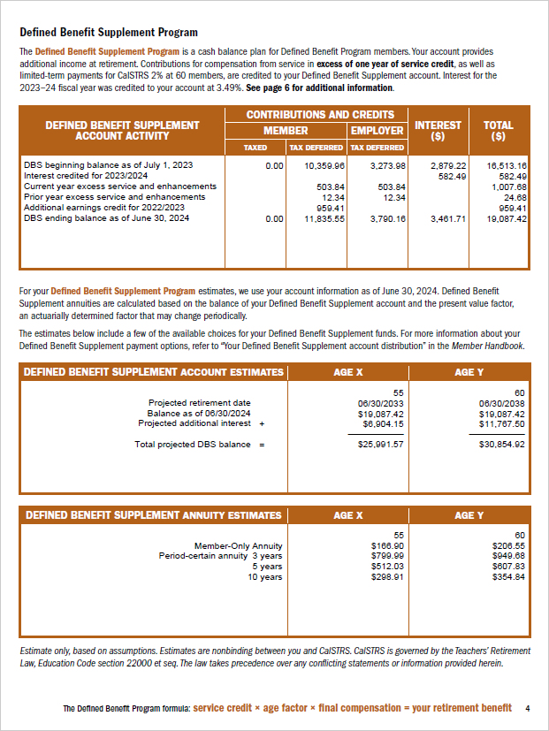
Retirement Progress Report
For estimates more specific to your account balance, review your Retirement Progress Report each year.
Notes:
Please note, an ongoing resource for you is your RPR. In September after the end of each fiscal year you receive an updated Retirement Progress Report.
Once you are 45 years old, on page 4 you can find personalized DBS estimates. This will give you an idea of what your benefit will be specific to your account balances and retirement dates for future years. The RPR also includes estimates for your DB account and lists other account specific information for all of your career
Let’s look at the payout choices using Peter as our example.
Click.

Slide 38
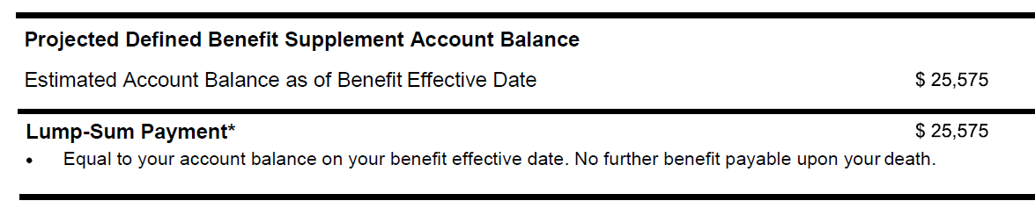
My Defined Benefit Supplement account
Lump sum
Direct payment
Rollover
Notes:
Keep in mind for the following estimate the balances and monthly benefits reflect a gross amount, this money will also be taxed when you receive it, however how it is taxed is based on how it is paid out. Regardless of the amount in your account, everyone has the option to take the balance as a lump sum at retirement.
Click.
If you choose a lump sum payment, you can have it paid directly to you or
Click.
roll it over to a qualified retirement account.
If you have it paid directly to you, CalSTRS is required by the IRS to withhold 20% for federal taxes. You can also have an optional 2% withheld for state taxes.
The key word here is withholding, at tax time you may get a refund from that withholding, or you may have to pay more depending on your other taxable income for that year.
You can roll the balance over to a tax deferred account if you would like to defer taxes at the time and continue to have potential growth. One you already have, or you can roll it over to a CalSTRS Pension2 account. Since it is tax deferred you would be taxed later down the road when you make withdrawals based on the rules for the type of account you roll the money into.
Click.

Slide 39
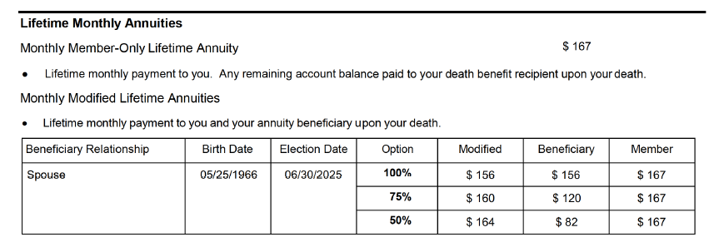
My Defined Benefit Supplement account
Lifetime monthly annuities
Member-Only Annuity
Beneficiary Annuities
(100%, 75%, 50%)
Notes:
With $3,500 or more in your account, you also have a choice to take it as an annuity. Let’s look at those choices.
A lifetime annuity would offer a guaranteed monthly payment for the rest of your life, and how you take it depends on if you elect an option for your Defined Benefit account.
Click.
If you elected the Member-Only Benefit you can choose to receive a Member-Only Annuity which would stop with your passing.
Click.
If you elected the Modified Benefit for your Defined Benefit, you could choose between a 100%, 75% or 50% beneficiary annuity. Like the DB modified benefit, you would be electing to reduce your Member-Only Annuity in exchange for providing 100%, 75% or 50% of your reduced annuity to your option beneficiary or option beneficiaries. Although both accounts must be modified if you are choosing to take this account out as a lifetime annuity, the percentages do not have to match.
If you choose an annuity, it is paid in a separate check and taxes will be withheld based on the withholding preferences that you elect on your service retirement application, and you can change those preferences at any time.
Click.

Slide 40
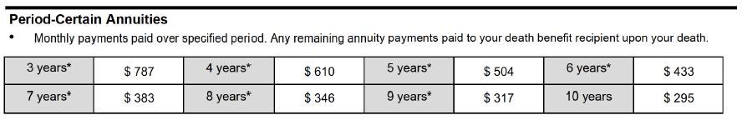
My Defined Benefit Supplement account
Period-Certain Annuity
3 Years*
4 Years*
5 Years*
6 Years*
7 Years*
8 Years*
9 Years*
10 Years
Notes:
The next choice for an annuity is the period certain annuity.
Click.
You can choose anywhere from 3 to 10 years. With this choice you would get a higher monthly benefit for a shorter period of time.
For instance, if Peter chose a 5-year period certain annuity, he would receive $504 each month for 5 years, when those 5 years were over the benefit would stop.
You’ll notice an asterisk next to 3-9 years. They are considered short term benefits by the IRS, and just like the lump sum payment, they are subject to the mandatory 20% withholding for federal and optional 2% withholding for state.
But like the lump sum payment, you could also choose to roll over each the dollar amount each month of the 3-9 year period certain annuities.
If you choose the 10-year period certain annuity, it will be paid directly to you, and you will tell us how you want the taxes withheld.
You have one more choice. You can do a combination lump sum and annuity. So as an example, Peter could take a portion of the total balance to roll-over or pay directly to him and annuitize the remaining amount. However, to do that you must leave a minimum of $3,500 in the account.
Click.

Slide 41
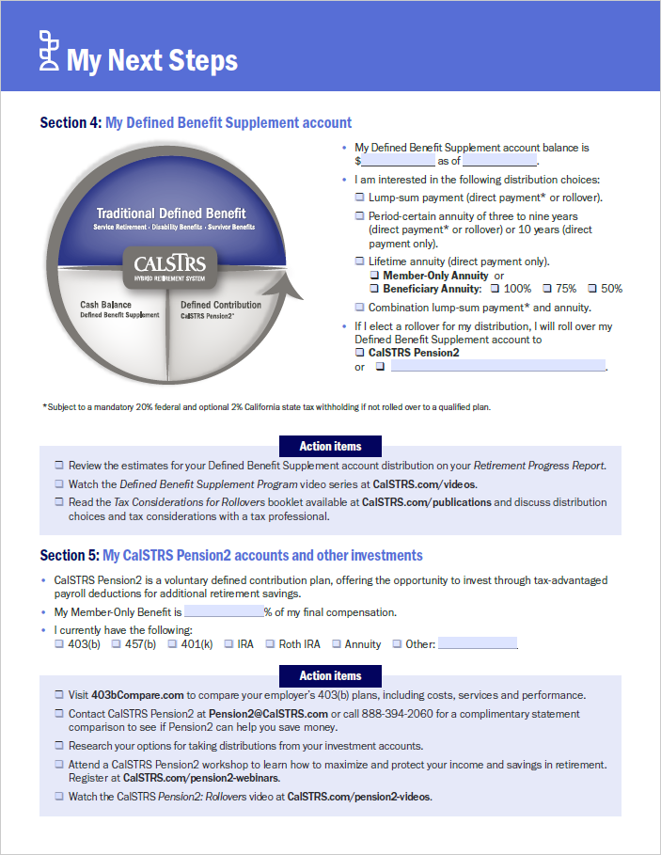
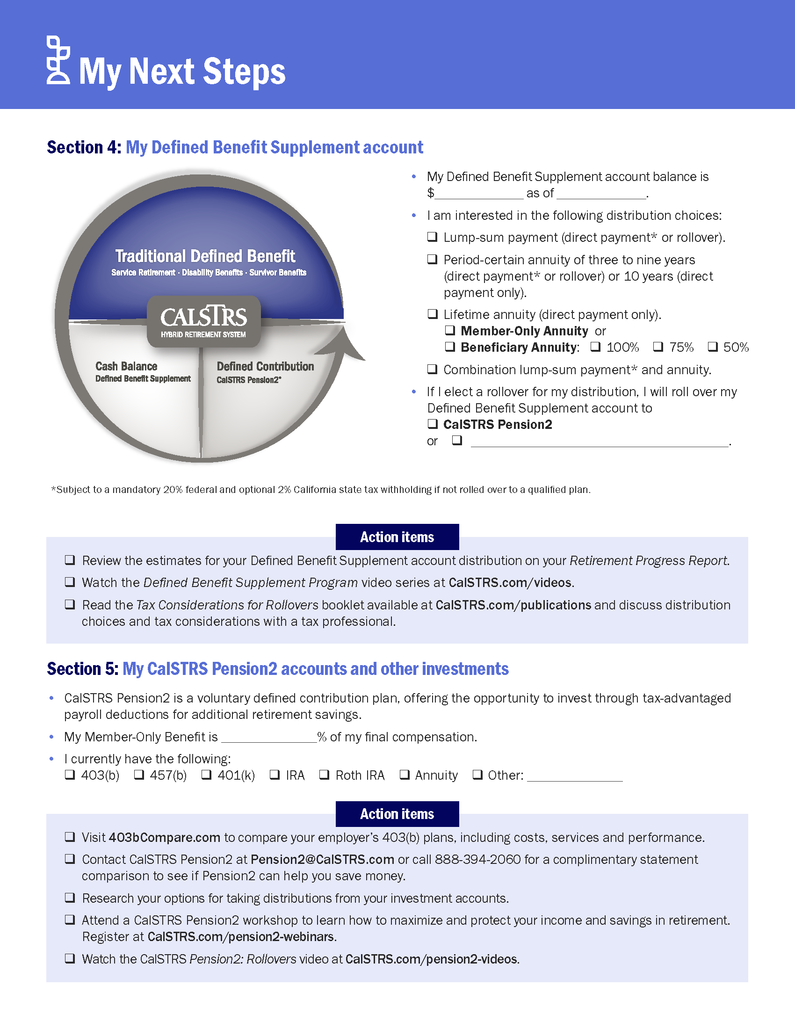
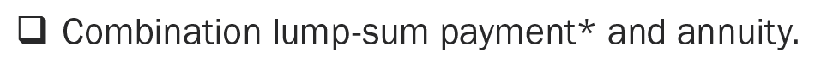
My Defined Benefit Supplement account
Notes:
In Section 4 you can record your current balance that we saw on your Group Session Summary.
Then there’s a list of all the distribution choices we just reviewed,
Click.
plus one more choice of a combination of lump-sum payment and annuity. So you can take out a portion of your account balance and annuitize the rest.
Click.
The mandatory 20% federal and optional 2% CA state tax withholding is also noted.
Rest assured this is not a decision you have to make today. In fact, CalSTRS does not need to know your payout choice until you fill out your application to retire. How you take it out is a household decision, consult with a tax professional or financial planner to determine the best choice for you.
Review Action Items
RPR
The DBS account has three educational videos to view online
Tax Considerations for Rollovers
Click.

Slide 42
My CalSTRS Pension2® accounts and other investments
5
SECTION
Notes:
We have talked about your Defined Benefit and Defined Benefit Supplement accounts. Those accounts are automatically included with your Defined Benefit membership.
Click.

Slide 43
Do I have enough to retire?
Notes:
The third part of our hybrid system is called the CalSTRS Pension2 program.
The CalSTRS Pension2 program offers supplemental savings plans for members to voluntarily contribute to help bridge the gap and replace working income in retirement.
It is important to plan for extra income in retirement. California educators tend to have higher rates of longevity in retirement. Currently the average male and female are living over 25 years after retirement. We actually have over 300 members who are over the age of 100!
Click.

Slide 44
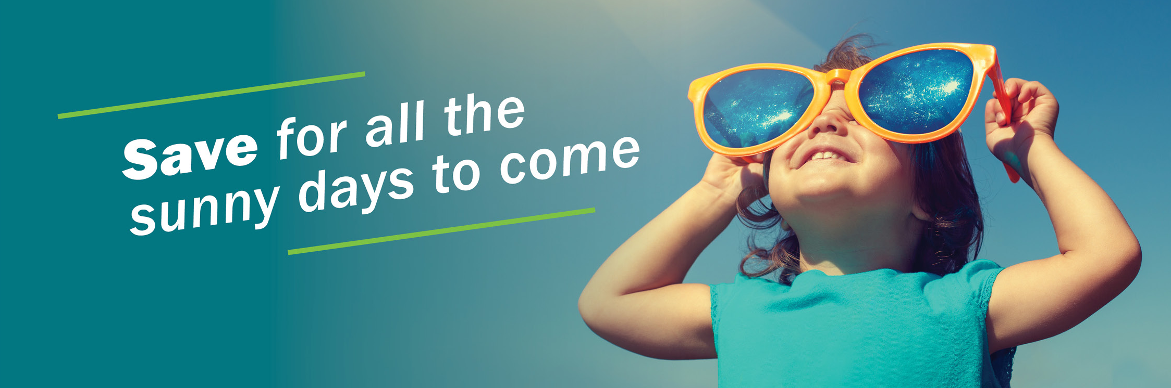
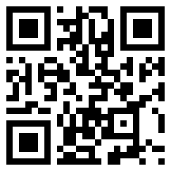
CalSTRS Pension2
Tax-deferred retirement savings.
Low and transparent costs.
No commissions, load fees or surrender charges.
Flexible investment options.
For a complimentary statement comparison, call 888-394-2060, option 2.
Notes:
So as we have been talking about sources of income, Pension2 is a convenient way for you to build up savings via pre-tax contributions to provide that additional income in retirement.
Pension2 was designed as a revenue-neutral program, meaning CalSTRS only charges what it costs to run the program. It is not for profit, it is CalSTRS staff, there are no commission fees or surrender charges. The cost is a lot lower for you than you’d find in almost any other program.
There are a variety of investment options – you can choose your own investments or let Pension2 do the work for you based on your risk tolerance and what stage of your career you are in.
Click.

Slide 45
CalSTRS Pension2
403(b)
457(b)
Roth 403(b)
Roth 457(b)
Notes:
Pension2 offers 403(b), 457(b), Roth 403(b) and Roth 457(b) plans
As stated previously, they often have lower fees and expenses compared to other plans.
So less money going to commissions means more money in your account for compounded growth.
Click.

Slide 46

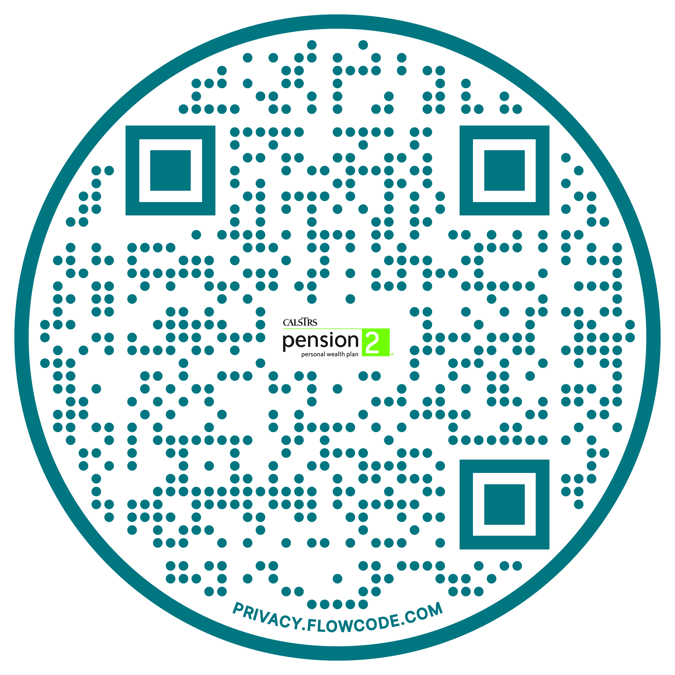
CalSTRS Pension2
Your current account
CalSTRS Pension2 account
Rollover your Defined Benefit Supplement and other supplemental savings accounts into Pension2.
Let us compare! Call 888-394-2060 for a statement comparison.
Statement comparisons are conducted by Voya financial representatives working exclusively with Pension2.
Notes:
At retirement you can roll your Defined Benefit Supplement funds into a CalSTRS Pension2 account.
Click.
Also, if you already have a supplemental savings plan it is possible to roll it over into the CalSTRS Pension2 program.
Our Pension2 representatives can help you determine if it would be beneficial to do so. Again, since CalSTRS employees do not receive a commission, there is no incentive to get you to transfer your account, unless we’re able to help you save some more money.
The QR code on the screen is for you to scan, if you are interested in setting up an appointment to get this process started or to learn more and speak with a Pension2 representative.
If you’re interested in having your account reviewed and compared to Pension2, please call 888-394-2060. Please note, statement comparisons will be conducted by Voya Financial representatives working exclusively with Pension2®.
Another video plug: You can learn more, by watching the Pension2 educational videos
Click.

Slide 47
My CalSTRS Pension2 accounts
and other investments
Refer to your Defined Benefit estimate for your percentage.
Notes:
Going back to your MNS, in Section 5 there is a place for you to enter your member-only percentage. This is the percentage that is on your Defined Benefit estimate.
Here you can check off any other investment accounts that you may already have.
You may want to visit 403bCompare.com to compare your current plans. You can also contact Pension2 to request a statement comparison.
If you would like to open a Pension2 account or you have additional questions, you can visit Pension2.com or give them a call at 888-394-2060.
*Inquire if any members are interested in talking with P2 or a hybrid specialist (half-sheet process)
Click.

Slide 48

What else does CalSTRS provide?
Notes:
Now let’s talk about the other benefits you get as a CalSTRS member.
Click.

Slide 49
6
SECTION
My disability and survivor benefits
Notes:
Disability and Survivor Benefits
Click.

Slide 50
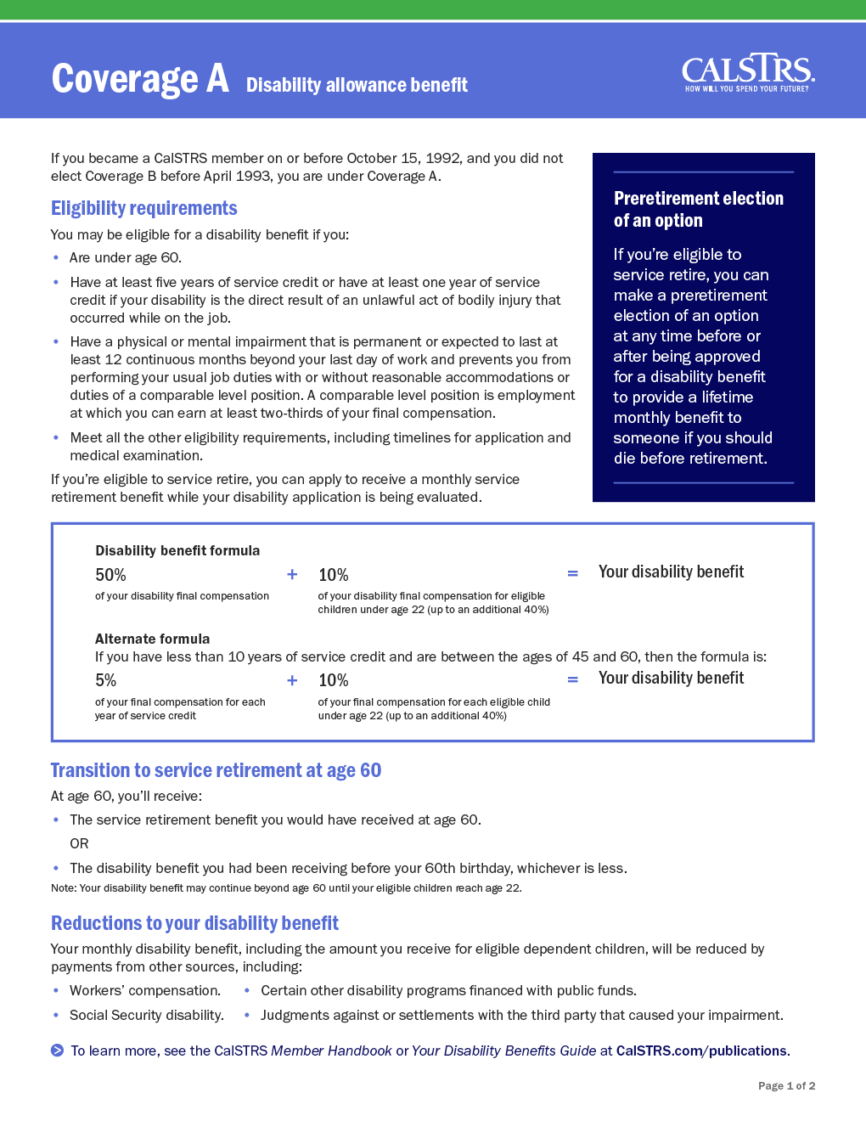
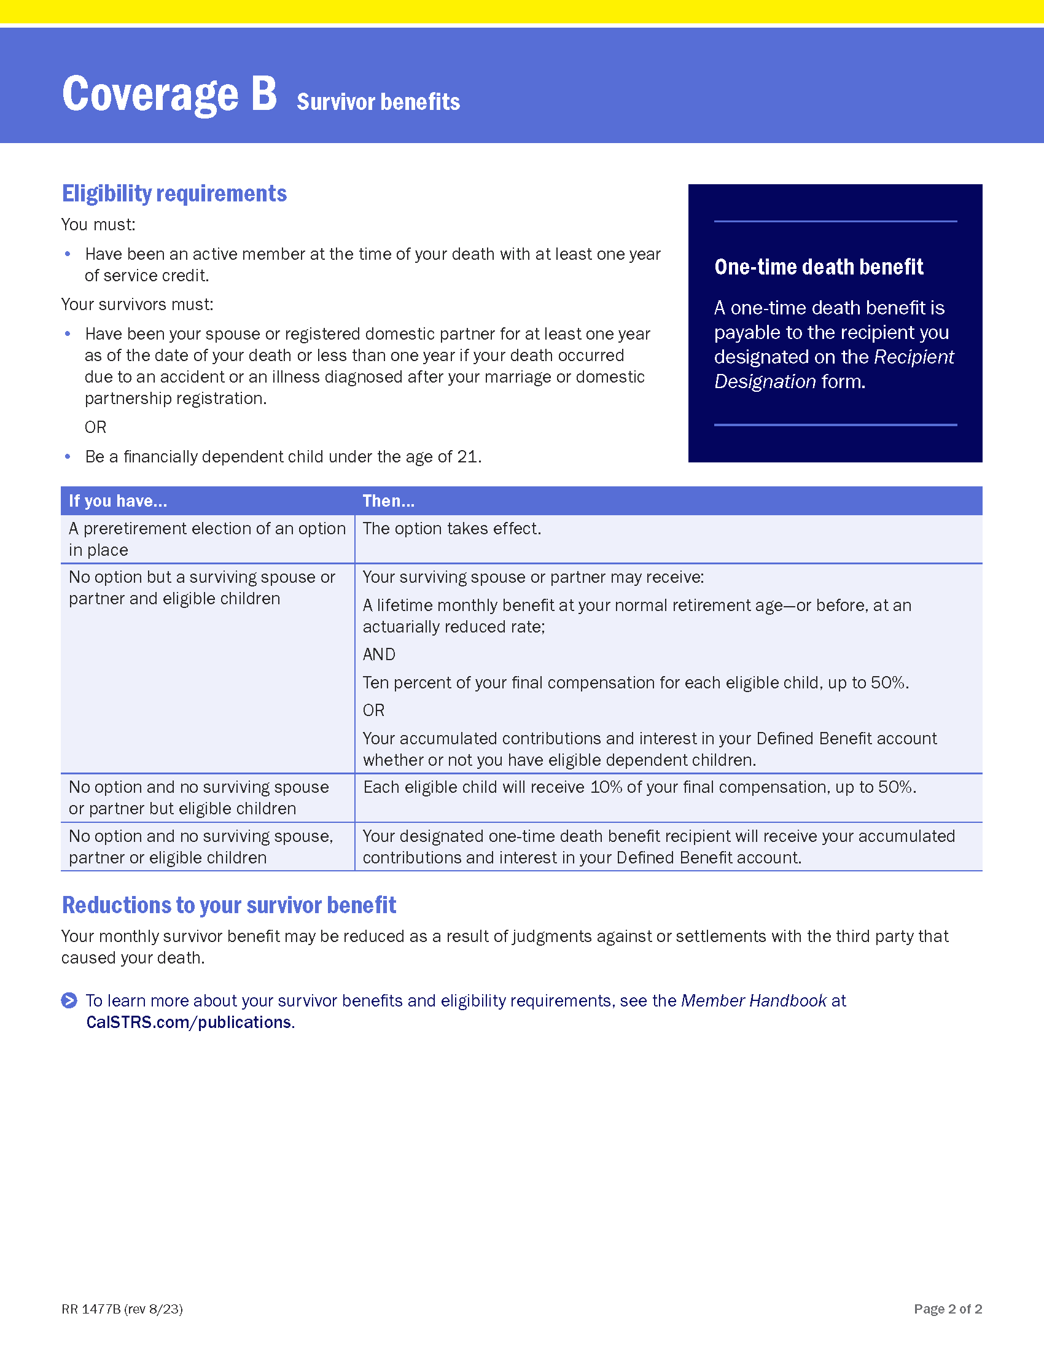
Disability and survivor benefits
Notes:
In your packet you will have a flyer regarding your Disability and Survivor benefits. Coverage A has a green stripe at the top and Coverage B has a yellow stripe.
On page 1 of the flyer, you will find information about your disability benefit. We hope all CalSTRS members will lead long, healthy working lives, but since illness and injury can interrupt careers, disability benefits are provided to Defined Benefit plan members.
This is a benefit for eligible members who have a physical or mental impairment that is expected to last 12 or more continuous months and can be substantiated with medical documentation. If approved your benefit is no longer based on the formula. In general, the basic disability benefit available under both types of coverage is 50 percent of your final compensation.
If you think you may be eligible for a disability benefit, do not hesitate to contact CalSTRS to schedule a disability benefits planning session.
On page 2 you will see you also have Survivor Benefits.
Based on your eligibility status, if you pass away before you are able to retire your spouse, children or other loved ones may be eligible for survivor benefits. On the bottom half of the page you will find a table that explains what benefits are available depending on if you have pre-elected an option or on your specific household situation. If you have no eligible survivors, the balance of your contributions and interest would be paid out to your one-time death benefit recipients.
Back to the top of page 2, you will see that all active and retired members are eligible for a one-time death benefit to whomever they designate.
Active Coverage A or Retired Member Benefit Amounts = $7,093
Active Coverage B Member Benefit Amounts = $28,372
Click.

Slide 51
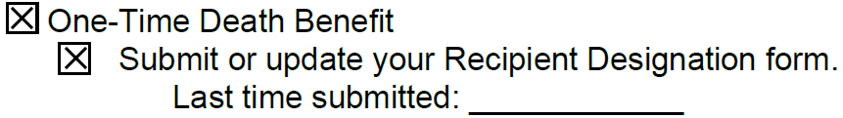
One-time death benefit
For your recipient designation information, refer to your
Session Summary.
Notes:
CalSTRS recommends that you review or update your beneficiaries every 5 years. Please know you can update or change at anytime. To find the last time you submitted your Recipient Designation form, refer to your Group Session Summary sheet.
We also recommend that you consider having both primary and secondary beneficiaries. That way if something happened to your primary, then benefits would be paid to the secondaries on file.
You can name as many primary and secondary beneficiaries as you would like. Your beneficiaries can be a person, an estate or trust, even an organization such as your favorite charity.
Click.

Slide 52
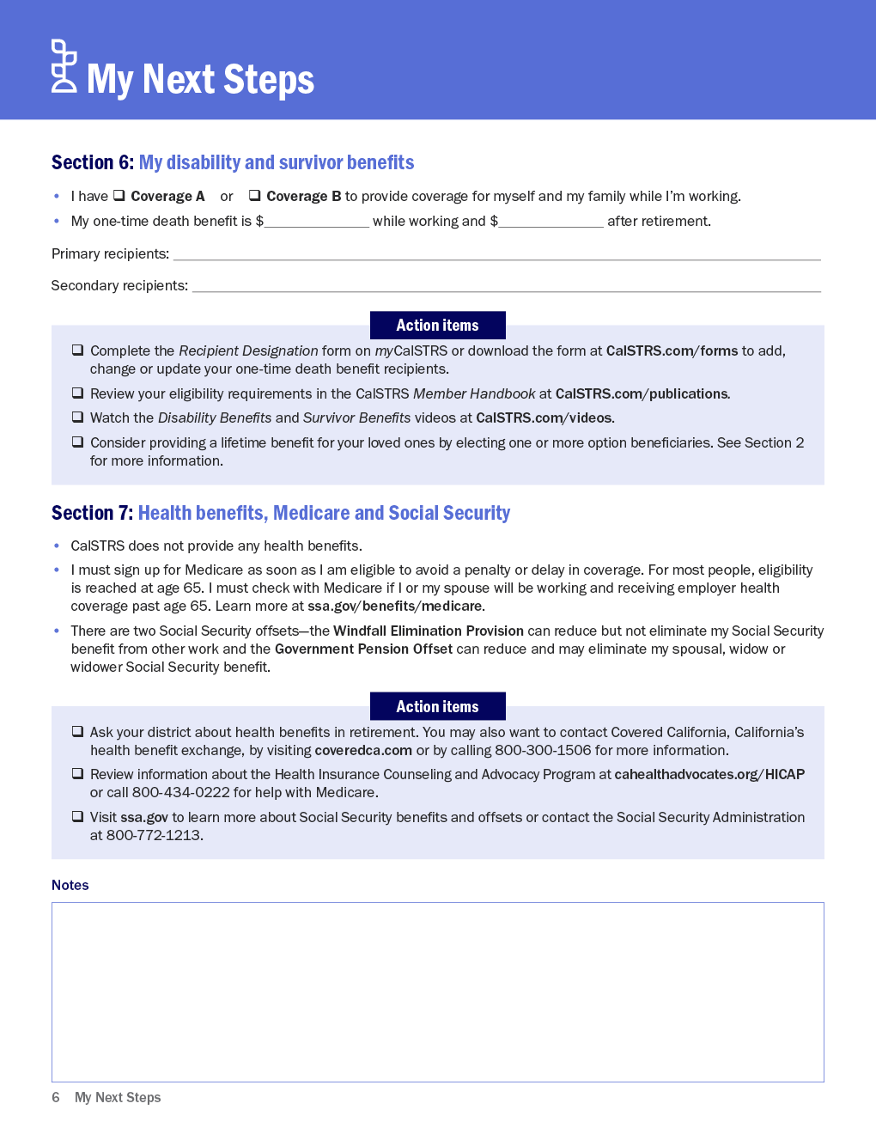
My Disability and Survivor Benefits
Notes:
Going to Section 6, you can indicate the Coverage type that you have.
You can also fill in the one-time death benefit amounts for while you are working and after retirement.
If you have Coverage A, your benefit is $7,093 before or after retirement.
If you have Coverage B, your benefit is $28,372 before retirement and $7,093 after retirement.
There is a place for you to list your primary and secondary recipients is the space provided.
If you need to update your recipients, complete the Recipient Designation form online through your myCalSTRS account.
For both Disability and Survivor Benefits, you can read more about the benefit and eligibility requirements in the Member Handbook, other online publications as well as by viewing the educational videos.
Click.

Slide 53
7
SECTION
Health benefits, Medicare and Social Security
Notes:
Section 7 covers health benefits, Medicare and Social Security.
Click.

Slide 54
Health Benefits, Medicare and Social Security
Notes:
First let’s talk about Health Benefits. CalSTRS does not provide health benefits, check with your employer to see what is available to you in retirement. At the very least your employer is required to let you continue your current plan at your own cost.
You can also shop for your own coverage through Covered California.
At age 65 or when eligible with retirement be sure to contact or sign up for Medicare.
The action steps in Section 7 gives you contact information for Covered California, HICAP, which is a healthcare advocacy group for help with Medicare.
And contact information for Social Security.
Click.

Slide 55
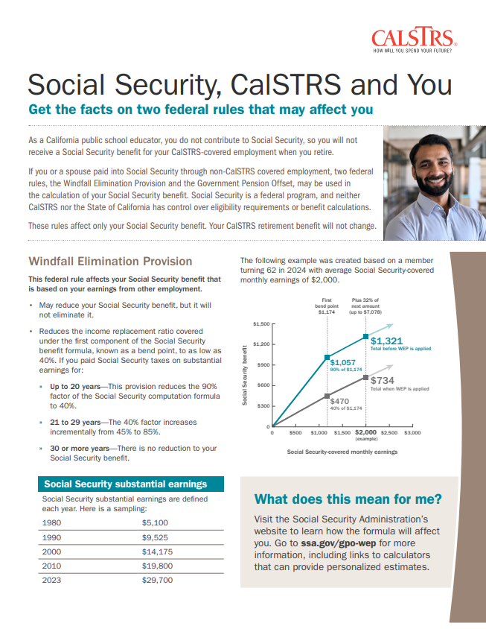
Social Security eligibility
To find out more information on how these offsets may affect you, contact Social Security directly.
ssa.gov/retirement
Notes:
Now let’s talk about Social Security offsets.
First, I would like to make sure to point out, regardless of what Social Security benefit you collect, there is no impact to your CalSTRS benefit.
And one of the most common misconception CalSTRS members have is that they will not receive a SS benefit. But that is not always true.
The Windfall Elimination Provision affects your Social Security benefit based on earnings you paid into form work other than CalSTRS covered employment. It may reduce your Social Security benefit, but it will not eliminate it. Even if you are not expecting a high dollar amount, this still would be another income stream in retirement to help replace your working income.
The Government Pension Offset rule applies to any Social Security benefit you may receive as a spouse, widow or widower, this one reduces or can eliminate those benefits. This flyer on the slide is included in your MNS booklet discusses both.
Every household is different, so there are no surprises down the road and to find out more specific information on how the offsets affect you, you should contact social security directly.
Click.

Slide 56

What do I need to do to retire?
Notes:
Click.

Slide 57
8
SECTION
My Service Retirement Application and benefit payments
Notes:
Let’s review your steps for submitting your retirement application
Click.

Slide 58
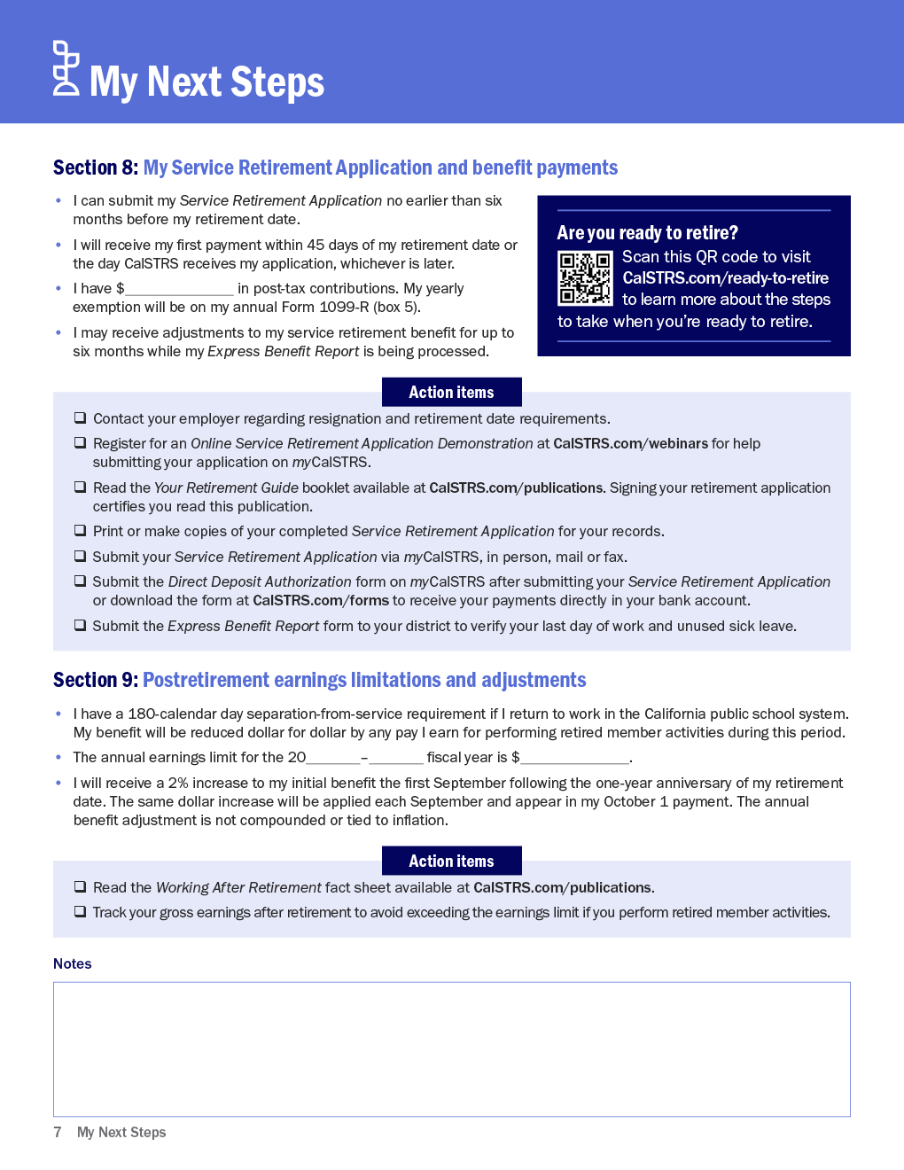
My Service Retirement Application and benefit payments
For post-tax contributions, refer to your Session Summary.
Notes:
You can complete the application as early as six months before your requested retirement date.
You will receive your first retirement payment within 45 days of your retirement date or the day CalSTRS processes your application, whichever is later.
Each year in retirement you will receive a 1099-R for tax reporting. Your Group Session Summary sheet will let you know if you have any post-tax contributions and those will also be reported on the 1099-R. (Explain post-tax contributions as need per each group)
Contact your employer regarding their resignation and retirement date requirements. This is important for verifying last day of work and also to see how your health benefits continue.
With the next few slides we will cover the rest of the Action Items in Section 8.
Click.

Slide 59

Your Retirement Guide 2024
Notes:
When you are ready to retire go to CalSTRS.com to read Your Retirement Guide, this is an informative step-by-step guide that reviews all we have discussed today and will make you comfortable with the whole process.
When you sign your application, you are stating that you have read this guide.
Click.

Slide 60
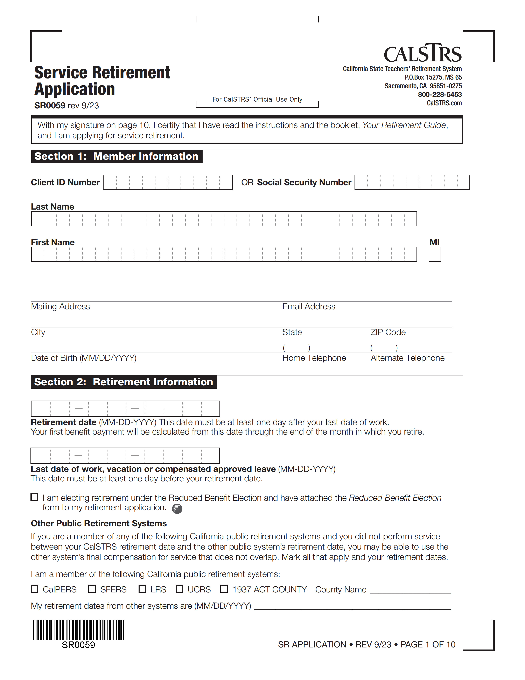
Submit the Service Retirement Application
Notes:
The quickest, and simplest way to complete your application is by using myCalSTRS.
Through your myCalSTRS account the application will pre-populate your member information and provide step-by-step guided assistance so you complete your application accurately and a copy will be saved in your account.
Since CA is a community property state, if married both you and your spouse must sign the application. You can sign electronically when submitting online.
Plus you will receive immediate confirmation when your application has been received and processed.
Click.

Slide 61
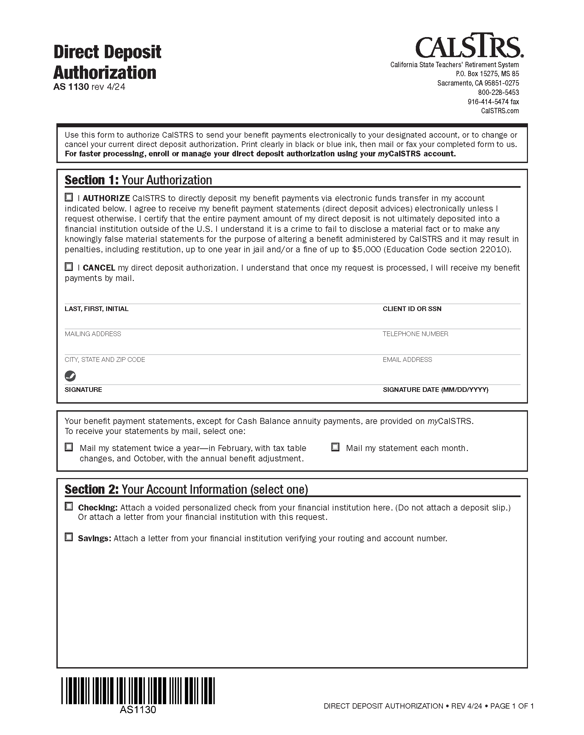
Sign up for direct deposit
Notes:
You can sign up for Direct Deposit. In this time of teleworking and especially in our current environment, signing up for direct deposit is an especially great convenience.
Click.

Slide 62
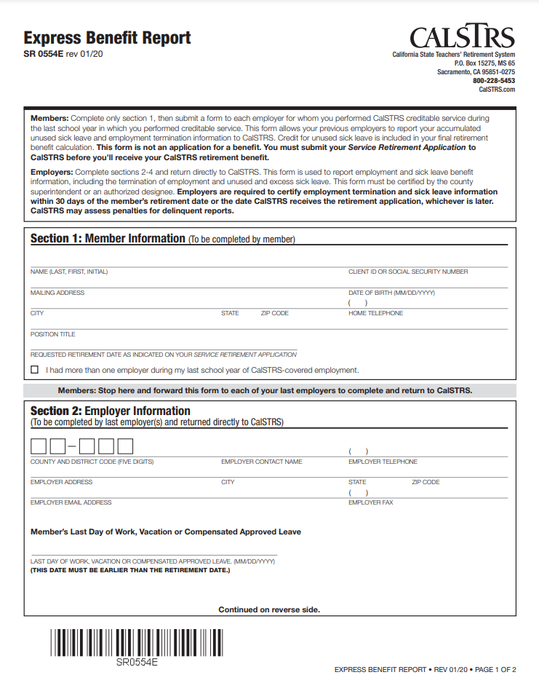
Submit an Express Benefit Report
Submit to all employers within the last year.
Verifies:
  Unused sick leave days.
  Last day of work.
Notes:
The Express Benefit form you can print on CalSTRS.com.
Fill out Section 1 then give this form to your last employer as part of your resignation process to verify your last date of employment as well as report to CalSTRS your unused sick leave balances.
Once completed your employer will mail directly to CalSTRS.
Click.

Slide 63
What happens once I retire?
Notes:
Click.

Slide 64
9
SECTION
Postretirement earnings limitations and adjustments
Notes:
Once you are retired you may be tempted to go back to work.
Whether it may be due to boredom, extra income or whatever the case may be…
Click.

Slide 65
Postretirement earnings limitations and adjustments
Earnings limit for fiscal year 2024–25:
$74,733
Notes:
You can work in retirement, however there are earnings limitations. In order to ensure separation from service, you cannot work in any CalSTRS-covered position during the first 180 calendar days of retirement. If you work within this period, your CalSTRS benefit will be reduced dollar-for-dollar by the amount you earn.
Once the 180-day waiting period is over, you can go back to work in the CA public school system, however you are subject to an annual postretirement earnings limit. If you exceed the limit, your benefit will be reduced dollar-for-dollar by the amount you earned in excess of the limit.
The earnings limit changes each fiscal year; the earnings limit is on the screen.
An important note, your only restriction to working retirement is under CalSTRS covered service, working in a private school, moving out of state and working in their public schools or simply getting a hobby job does not fall under any of the earnings limitation rules.
Click.

Slide 66

Learning doesn’t end here

Slide 67

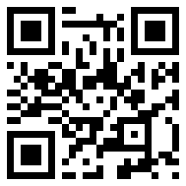
Pension2
CalSTRS.com/pension2
Notes:
More information on Pension2
Click.

Slide 68
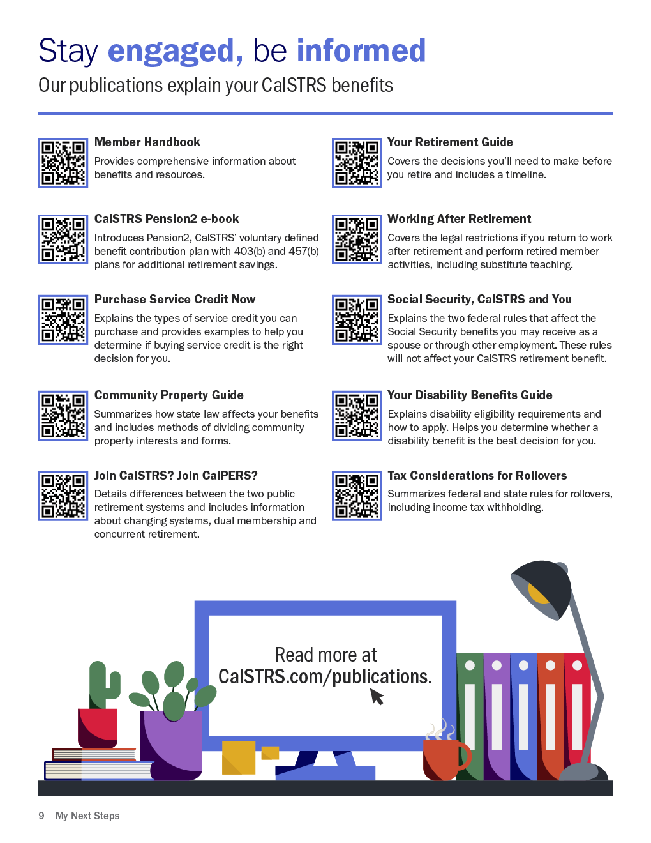
CalSTRS publications
CalSTRS.com/publications
Notes:
Here you can see a list of publications related to the information we discussed today. You can find them on CalSTRS.com, through your myCalSTRS account or even use the QR code reader to access directly.
Click.

Slide 69
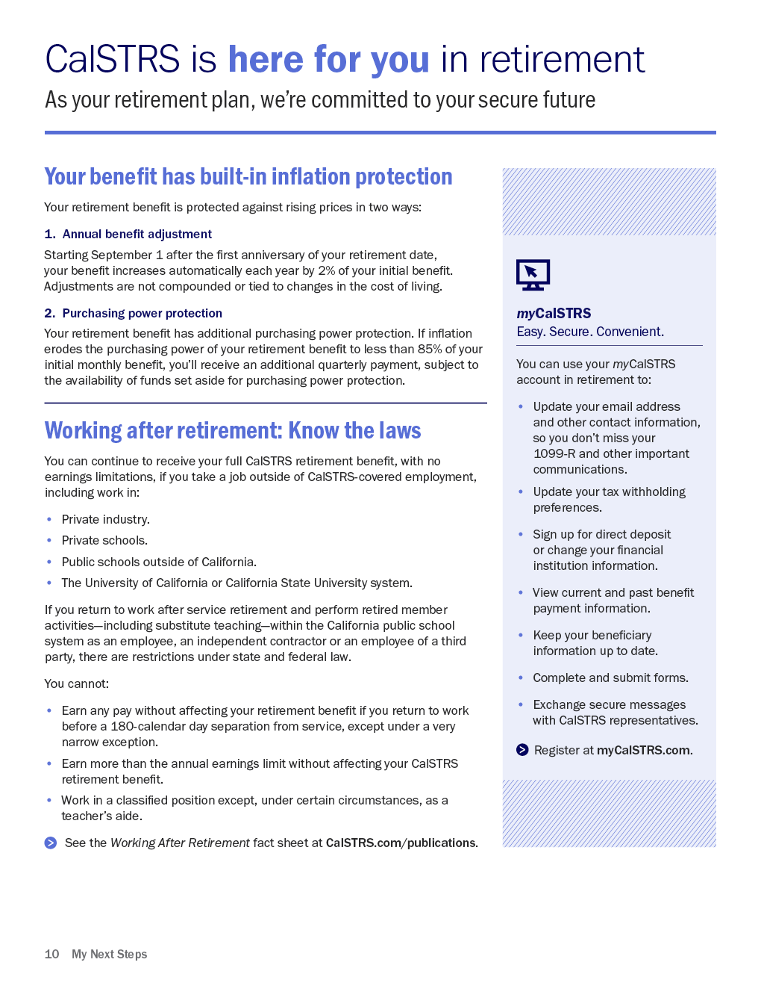
CalSTRS is here for you.
Notes:
The last page of your My Next Steps lists the many things you can do through your myCalSTRS account.
It also explains the Annual benefit adjustment and Purchasing Power Protection.
You will receive an annual benefit adjustment each September after the one- year anniversary of your retirement. This annual benefit adjustment is a non compounded increase equal to 2% of your initial retirement benefit.
Remember how I said CalSTRS members have great longevity? Purchasing power protection addresses how inflation and rising prices can erode the purchasing power of your benefit. If the purchasing power of your current benefit ever falls below 85% of your initial benefit, CalSTRS will issue you a quarterly supplemental payment to restore your benefit to the 85% of purchasing power mark.
And at the bottom of the page is reminder information regarding working in retirement.
Click.

Slide 70
Sign a copy and hand it to CalSTRS Benefits Specialist.
Keep a copy for your records.
Notes:
If you were not able to sign a copy of your session summary at check-in, you may have two copies with you. Please take a moment to sign the sheet now and you may hand it to me on your way out.
The copy you used throughout today’s session is yours to keep.
Click.

Slide 71

Questions?
Notes:
If there are any general questions, I can answer those now within the group.
If you have any personal questions, please see me after the presentation.
Click.

Slide 72





Contact us
CalSTRS.com
myCalSTRS
800-228-5453
*Press 2 for Customer Service.
Monday–Friday
8 a.m. – 5 p.m.
Notes:
As you continue researching your benefits and retirement decisions, questions may come up. Remember your resources!
CalSTRS.com offers forms, publications, educational videos, calculators and benefit information that may help answer your questions.
One of the most convenient features of myCalSTRS is our online messaging. Submit your question in writing and a written response from a CalSTRS representative will be sent and archived in your myCalSTRS account for future reference.
And as always, our Contact Center agents are available to assist you by phone.
Click.

Slide 73
Thank you for attending!
Notes:
Thank you for attending today’s session and remember to utilize your My Next Steps as your personal resource and action guide.
*if needed, hang back for any personal questions from members.

