Slide 1
I Will Retire This Year
Your Retirement Checklist and Resources
Notes:
Hi, my name is and I am a CalSTRS benefit specialist.
Today’s presentation will provide an overview of the things you will want to do as you prepare to retire this year and the resources CalSTRS offers to help you along the way as you make this important transition.
Click.

Slide 2
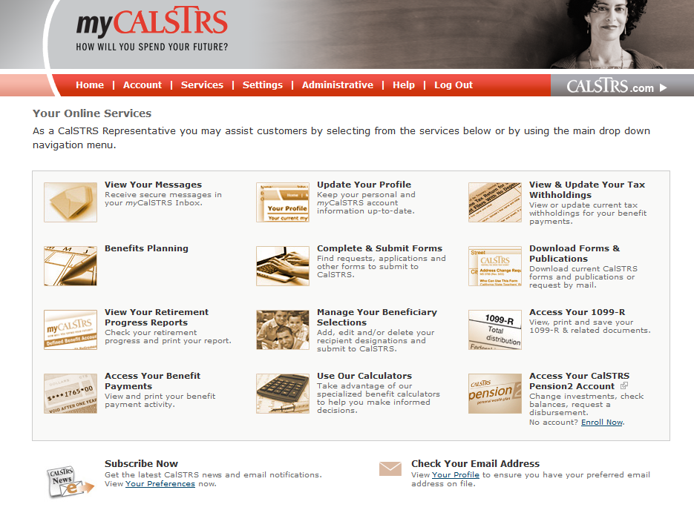
What to do:
Register for myCalSTRS
When:
Now
Visit myCalSTRS.com.
Notes:
The very first step you’ll want to take is registering for your very own myCalSTRS account.
myCalSTRS provides secure, convenient access to your CalSTRS information online, any time.
With myCalSTRS you can update your personal information, access your Retirement Progress Report, submit forms and send and receive online messages with CalSTRS representatives
Click. Once registered, review your contact information and make any necessary updates. Be sure to update your contact information with your employer as well. You can also update your delivery preferences for CalSTRS information and request to receive information by email or in the mail.
Click. Review and update your one-time death benefit recipient who will receive a one-time lump-sum payment upon your death. You can designate one or multiple primary and secondary recipients. You can even name a trust or charity if you choose. To find out more about your one-time death benefit and amount, access your Retirement Progress Report.
Click. Your Retirement Progress Report will also show your current service credit balance and Defined Benefit Supplement account balance. Via myCalSTRS you can click on the Employer Details screen to see salary information reported by your employer that CalSTRS uses to calculate your benefit. Review your report carefully and contact your employer directly regarding any discrepancies.
Click.

Slide 3
What to do:
Understand the formula
When:
Now
View Understanding the Formula video at CalSTRS.com/videos.
Service Credit
  Time worked and contributed
Age Factor
  Percentage based on age at retirement
Final Compensation
  Highest compensation earnable for 36 months
Your Retirement Benefit
Notes:
One of the most important aspects of retirement is understanding how your benefit is calculated. CalSTRS is a hybrid system that offers various programs. The bulk of your retirement comes from the Defined Benefit Program.
Your monthly benefit is a defined benefit based on a formula, not based on how much you’ve contributed or how well CalSTRS investments perform.
Click. The first piece of the formula is service credit. Service credit is the time you have worked and contributed to CalSTRS. You earn service credit based on the percentage of a full-time contract you work. You can earn a maximum of one year of service credit in a school year.
Click. The second piece of the formula is the age factor. The age factor is a percentage based on your age, in years and months, at retirement. The standard age factor is 2% at age 60 for members hired before 2013. It gradually decreases if you retire before age 60 and gradually increases to a maximum age factor of 2.4 percent at age 63.
Click. The third piece of the formula is final compensation. Final compensation is your average annual compensation earnable over 36 consecutive months. However, if you retire with more than 25 years of service credit, you qualify for a benefit enhancement which allows CalSTRS to use 12 months rather than 36.
There is a short educational video at CalSTRS.com that covers the formula including examples and more information on benefit enhancements. You can also find more information about how your benefit is calculated in the Your Retirement Guide publication.
Click.

Slide 4
What to do:
Know your Defined Benefit choices
When:
Now
View Beneficiary Options video at CalSTRS.com.
Member-Only Benefit
Modified Benefit
Receive the highest benefit
Receive a reduced benefit
Date of Death
Remaining account balance
Percentage of reduced benefit
One-Time Death Benefit Recipient
Lifetime benefit paid to option beneficiary
Notes:
The Member-Only Benefit is the highest monthly benefit available when you retire. It provides a monthly benefit for your lifetime, but the benefit stops when you die. Any contributions and interest remaining in your account at the time of your death, minus the total amount already paid to you, will be paid to your designated one-time death benefit recipients.
To provide a monthly CalSTRS benefit to your loved ones if you die after retirement, you must elect a Modified benefit which is a reduced benefit that allows you to distribute your retirement benefit over your life and the life of your option beneficiaries. After your death

Slide 5

Notes:
Member’s Member-Only Benefit is $3,192.92. The beneficiary options below are based on both the CalSTRS 2% at 60 member, and her option beneficiary being age 60 on the effective date of retirement.

Slide 6
What to do:
Know your Defined Benefit Supplement account choices
When:
Now
View the Defined Benefit Supplement video series at CalSTRS.com.
Annuity
Lump Sum
Combo
Choices
Notes:
In addition to your Defined Benefit account, you have a second account with CalSTRS called the Defined Benefit Supplement, or DBS account.
CalSTRS redirected a quarter of your monthly contributions to this account between 2001 and 2010. You still contribute to this account by working additional duties. Since you can only earn one year of service credit in a school year, any contributions in excess of that are redirected to this account. The account also gains a guaranteed interest rate each year.
You can find your DBS account balance on your Retirement Progress Report or by logging into your myCalSTRS account. You must decide what you want to do with these funds at retirement. You have three choices.
Click. The first choice is to take your entire account balance as a lump-sum payment. You can have this paid directly to you or rolled over to a qualified plan like a 403(b) or 401k.
Click. The second choice is to take an annuity. You can annuitize your account balance over a period of 3 to 10 years or for your lifetime. Period-certain annuities of three to nine years are rollover eligible.
Click. The last choice is to take a combination of a lump-sum and annuity.
You can find more information about his account and the available distribution choices and tax considerations by watching the Defined Benefit Supplemental video series at CalSTRS.com.
Click.

Slide 7


Take your entire account balance at retirement.
What to do:
Know your Defined Benefit Supplement account choices
Lump Sum
Direct
Payment
Rollover

Slide 8
Receive a separate monthly payment for your lifetime.
Your annuity beneficiary is your option beneficiary.
What to do:
Know your Defined Benefit Supplement account choices
Lifetime Monthly Annuities
Member-Only Annuity
Beneficiary Annuities
100%
75%
50%

Slide 9
Annuitize your account balance and receive a monthly benefit for a specified number of years.
What to do:
Know your Defined Benefit Supplement account choices
Period-Certain Annuities
3 Years*
4 Years*
5 Years*
6 Years*
7 Years*
8 Years*
9 Years*
10 Years

Slide 10
Take a lump-sum payment and annuitize the remaining account balance.
What to do:
Know your Defined Benefit Supplement account choices
Combination
Lump-Sum Payment
Lifetime or Period-Certain Annuity

Slide 11

What to do:
Learn about
CalSTRS Pension2
When:
Now
Visit Pension2.com for an e-book and more information or call:
888-394-2060.
403(b)
457(b)
Notes:
If you’re considering rolling over your DBS funds or those from a supplemental savings plan, research our Pension2 program.
Pension2 offers 403(b), Roth 403(b) and 457(b) accounts with low fees and expenses.
Visit Pension2.com for more information.
Click.

Slide 12
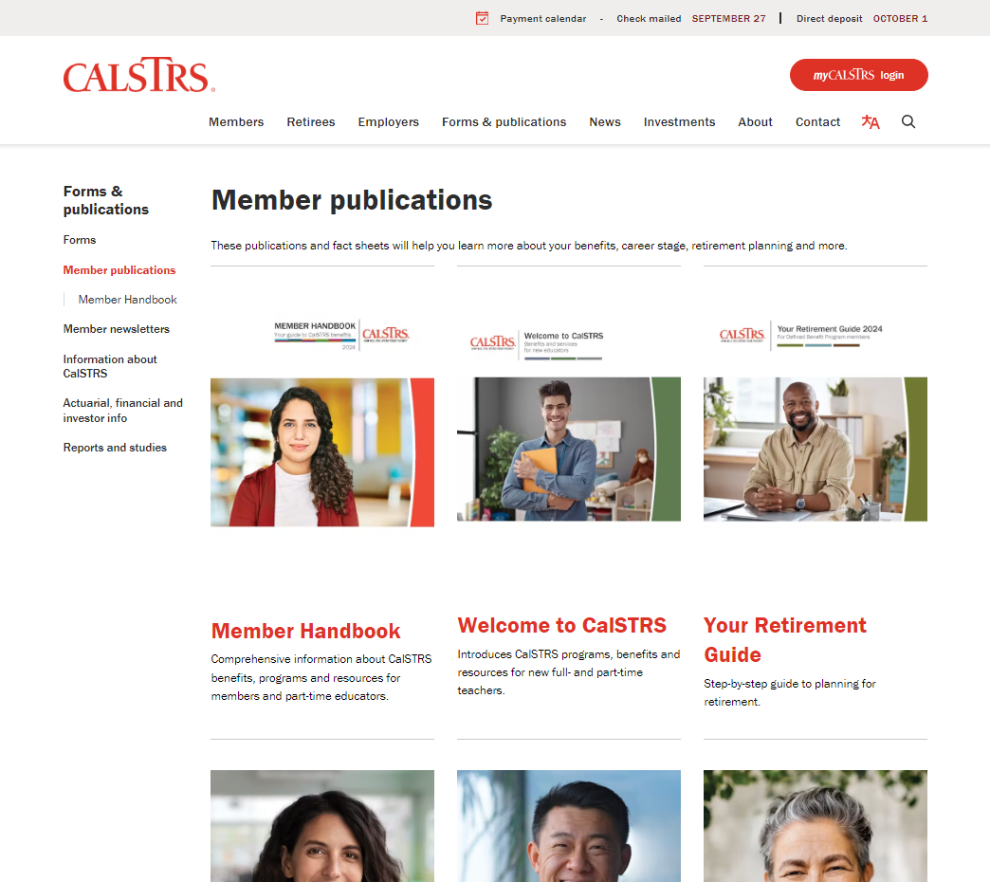
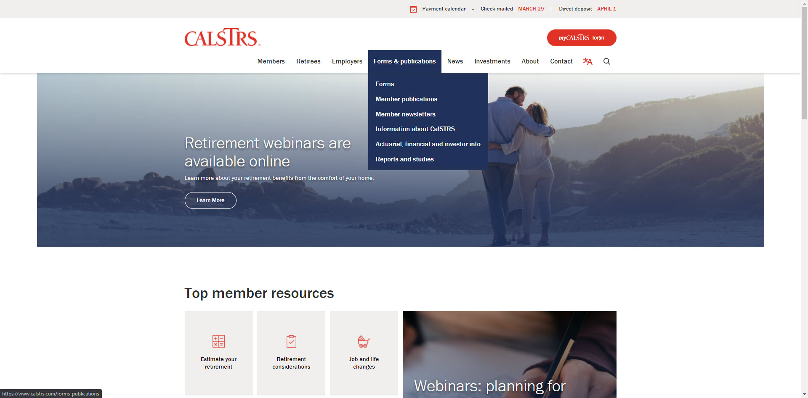
What to do:
Review Your Retirement Guide
When:
Now
Download a copy at CalSTRS.com/publications.
Notes:
Next, you’re going to want to review the Your Retirement Guide publication.
Your Retirement Guide provides information on the decisions your will need to make when you’re ready to retire.
The guide goes over how different retirement dates can impact your benefit, the different beneficiary options you can elect to leave an ongoing monthly benefit to a loved one after your death, and the various choices you have for your Defined Benefit Supplement account distribution.
Click. You can access an electronic copy of the publication by visiting CalSTRS.com and selecting the “Publications” Quick Link at the top of the page. You can also request a hard copy be mailed to you.
In addition to forms and publication, CalSTRS.com has three to five minute videos on many of the topics covered in the guide. Review these videos to help reinforce the information you read or relay the information to those involved in your decision making such as a spouse or financial adviser.
Click.

Slide 13
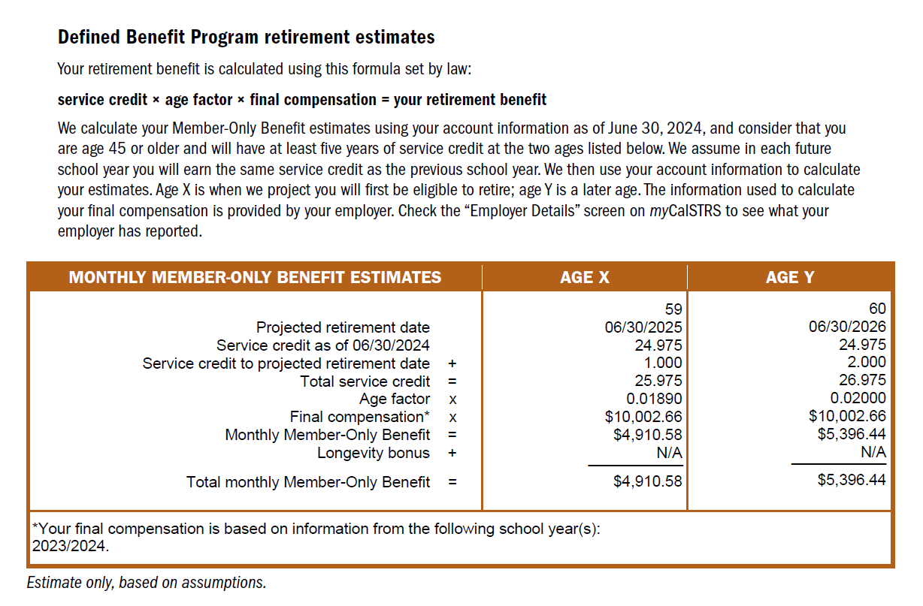
What to do:
Review your Retirement Progress Report
When:
Now
Log on to your myCalSTRS account to view your most recent report. Estimates can be found on page 2.
Notes:
If you would like to generate additional estimates to compare numbers, you may use the Retirement Benefits Calculator at CalSTRS.com/calculators to do so. The online calculator will let you see the impact different retirement dates or beneficiary options will have on your monthly benefit.
Click.

Slide 14
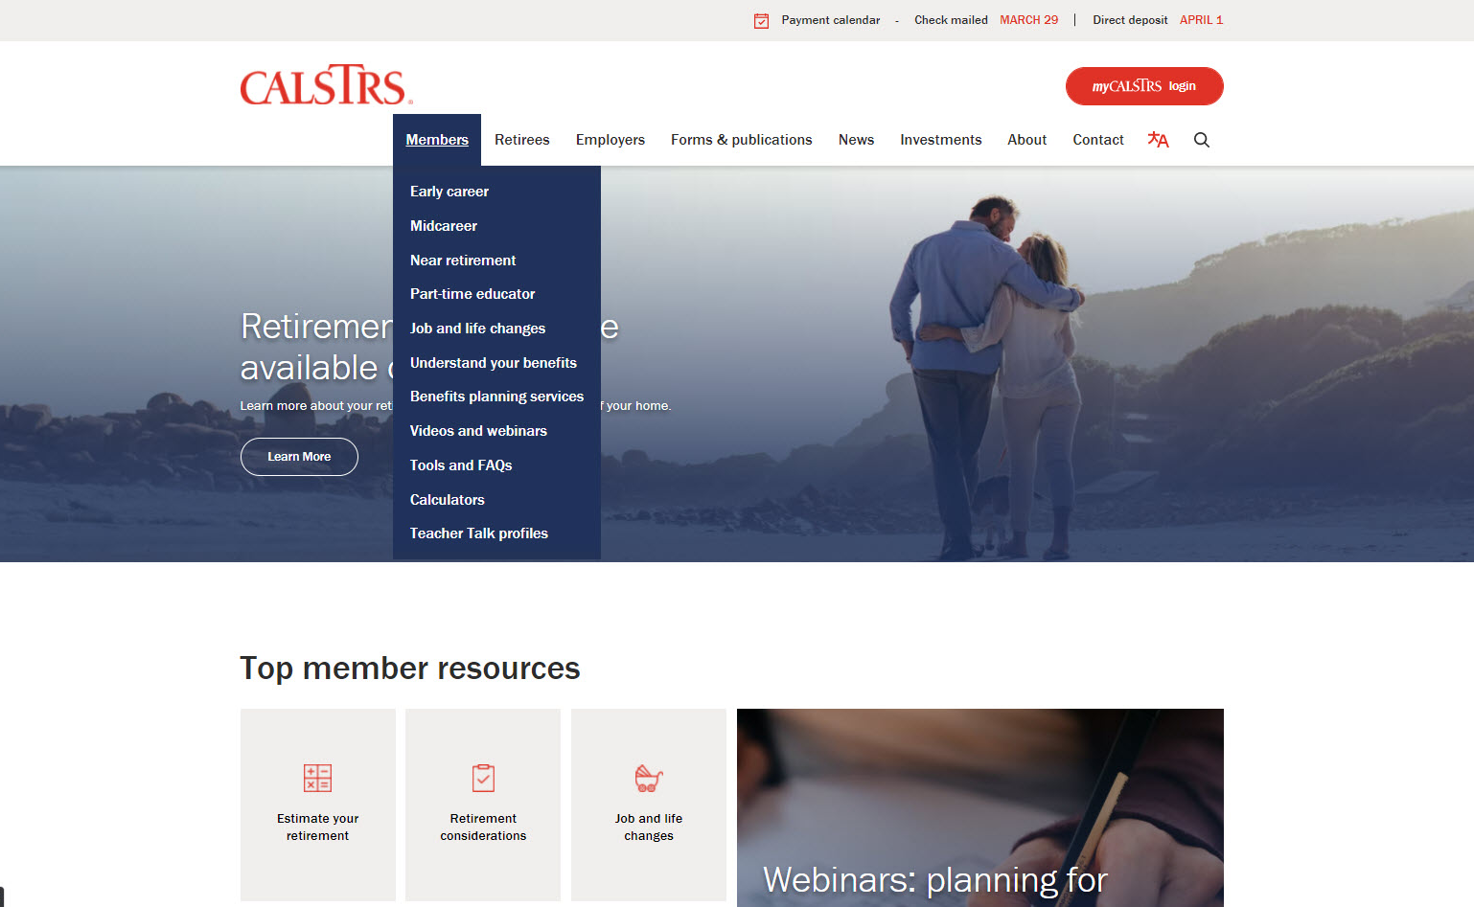
What to do:
Create a Service Retirement estimate
When:
Now
Use the Retirement Benefits Calculator at CalSTRS.com.
Notes:
There are a couple different ways you can obtain an estimate.
Your Retirement Progress Report, available on myCalSTRS, has estimates for your Defined Benefit and Defined Benefit Supplement accounts based on your service and contributions through the prior fiscal year. You’ll definitely want to review those estimates; however…
Click. You can access the online calculator by clicking the “Calculators” quick link at CalSTRS.com.
Click.

Slide 15
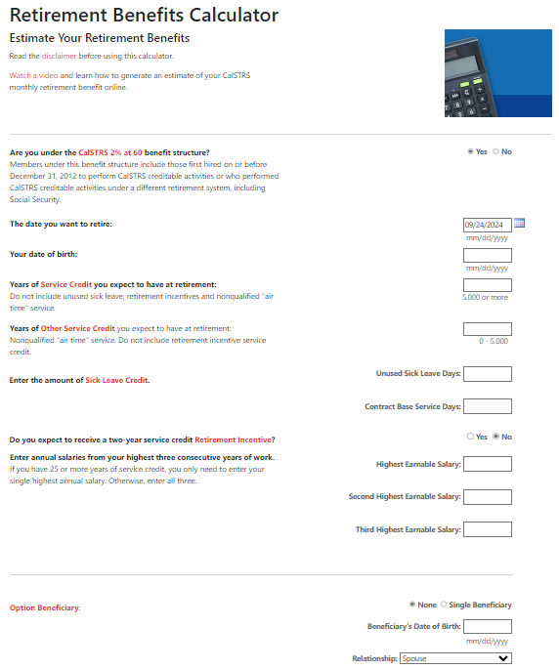
What to do:
Create a Service Retirement estimate
When:
Now
Use the Retirement Benefits Calculator at CalSTRS.com.
Notes:
If you would like to generate additional estimates to compare numbers, you may use the Retirement Benefits Calculator at CalSTRS.com/calculators to do so. The online calculator will let you see the impact different retirement dates or beneficiary options will have on your monthly benefit.
Click.

Slide 16
What to do:
Verify resignation requirements
When:
Now
Check with employer’s Human Resources for required forms and process.
Decide
Resign
Retire
Notes:
Next you’ll want to verify what requirements exist to officially resign.
Retiring with your employer is a separate process from retiring with CalSTRS. Your employer may have their own retirement date requirements and specific forms for you to complete.
Check with your employer’s Human Resources department for your district’s resignation and retirement processes.
Click.

Slide 17
What to do:
Research health benefits coverage
When:
Now
CalSTRS does not provide health benefits.
☑
Contact your employer about retiree health benefits
Shop your own coverage with Covered California
☑
Notes:
This next step is important, as well: researching different health benefits coverage.
CalSTRS does not provide health benefits coverage
Your employer is required to let you continue your current plan at your own cost. However, your employer may offer certain health benefits coverage packages to retirees.
Contact your employer’s Human Resources department for more information.
You can also shop for your own coverage through Covered California.
Click.

Slide 18
What to do:
Know the Social Security rules
When:
Now
Contact the Social
Security Administration for more information.
Windfall Elimination Provision
Reduces but cannot eliminate your earned Social Security benefit
Government Pension Offset
Reduces and may eliminate your spousal/widow(er) Social Security benefit
Notes:
Preparing to retire this year involves understanding the rules surrounding Social Security.
As a CalSTRS member, you do not contribute to Social Security for your CalSTRS-covered employment.
If you qualify for a Social Security benefit through your prior employment or a spouse, there are two government rules that may reduce your benefit or leave you with no benefit at all.
The Windfall Elimination Provision can reduce your earned Social Security benefit from employment outside of CalSTRS. Under this provision, the Social Security Administration applies an alternate calculation to your Social Security benefit. Although your benefit can be reduced, it cannot be eliminated.
The Government Pension Offset can reduce or eliminate your spousal, widow or widower benefit. The Social Security Administration will offset your Social Security benefit by two-thirds of your CalSTRS benefit which can eliminate your Social Security benefit all together.
Regardless of what Social Security benefit you collect, there is no impact to your CalSTRS benefit.
Since the estimates included on your annual Social Security statements do not take into account these government rules, contact the Social Security Administration for updated estimates.
Click.

Slide 19
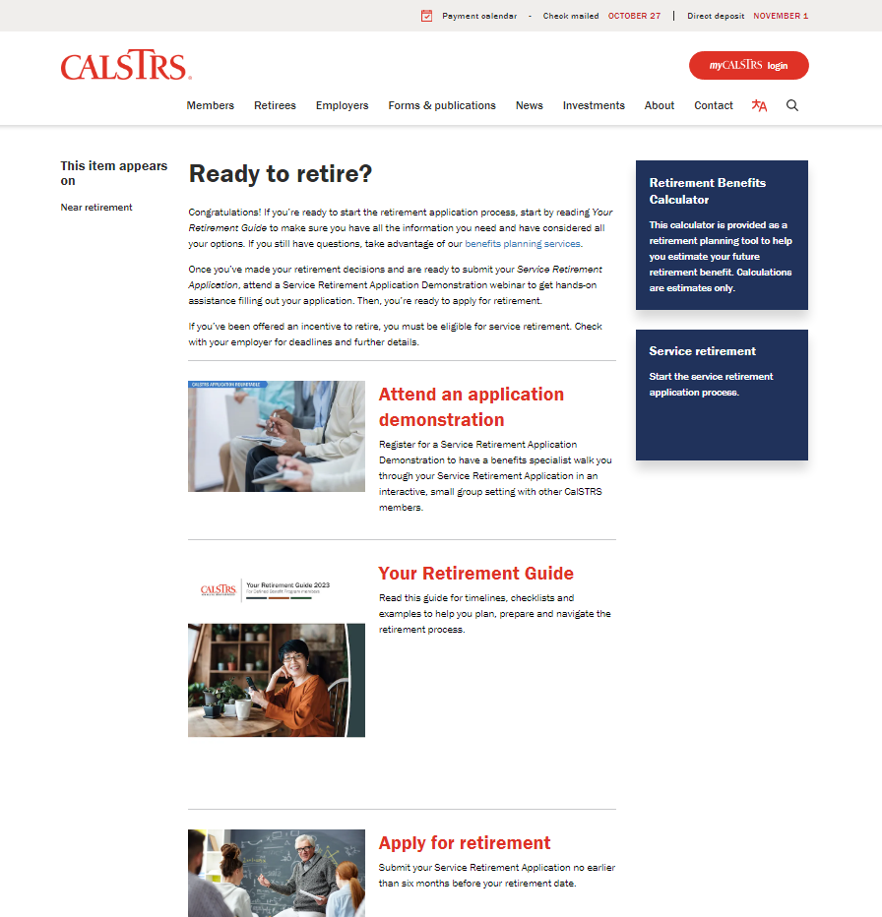
What to do:
Visit the Ready to retire? webpage
When:
Now
Easy access to the resources you need now as you prepare for retirement.
CalSTRS.com/ready-to-retire

Slide 20
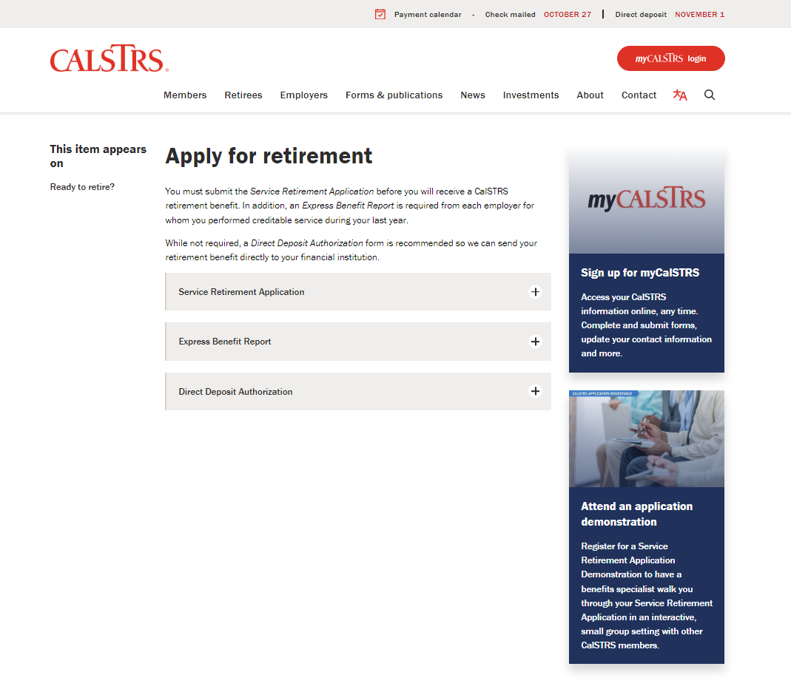
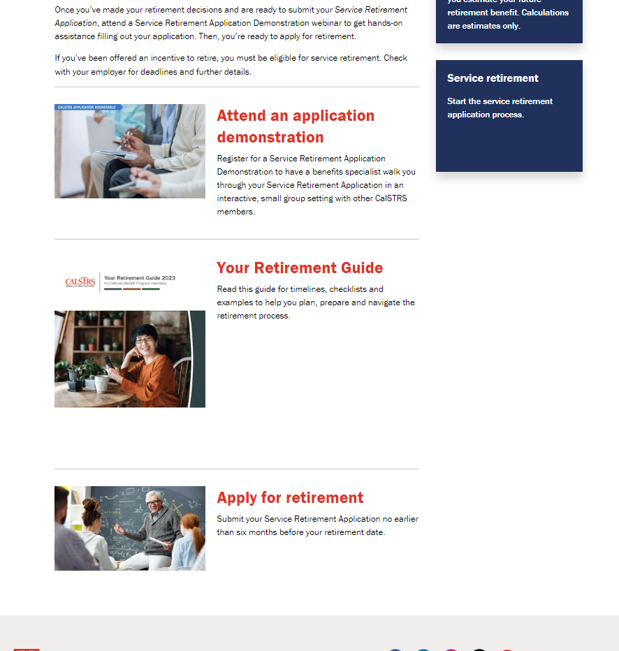
What to do:
Know what CalSTRS requires to retire
When:
Now
Service Retirement Application
Express Benefit Report
Direct Deposit Authorization (optional)

Slide 21
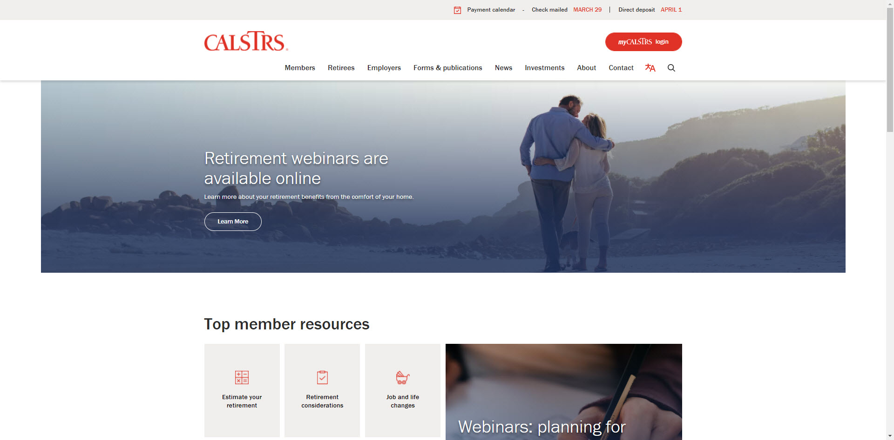
What to do:
Apply for retirement
When:
No earlier than 6 months before retirement date
Submit your application using myCalSTRS for guided assistance and faster processing.
Notes:
Once you’ve done you’re homework, you’re ready to submit your application.
You must complete the Service Retirement Application in order to receive a benefit from CalSTRS.
You can complete the application as early as six months before your requested retirement date.
If you are unable to submit your application before retirement, you can backdate your retirement date but there will be a delay in receiving your first payment.
Try to submit your application early to prevent delays and an interruption in income.
The quickest, and simplest way to complete your application is by using myCalSTRS.
Click.

Slide 22
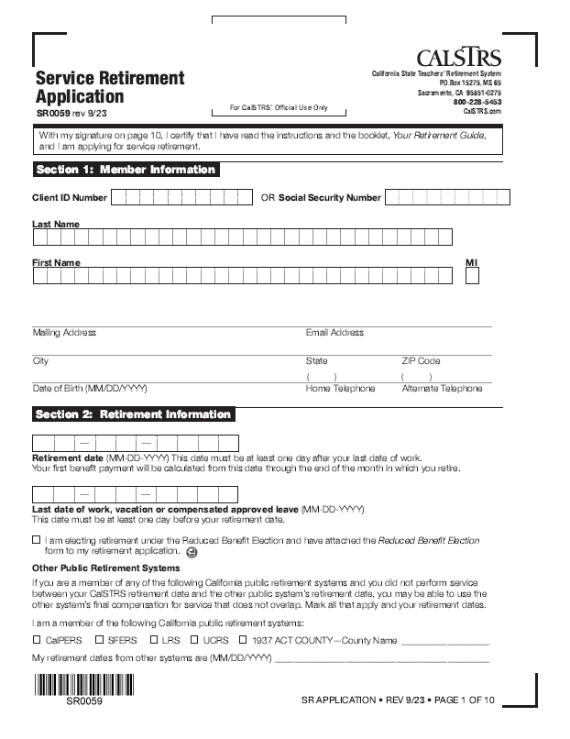
What to do:
Apply for retirement
When:
No earlier than 6 months before retirement date
Submit your application using myCalSTRS for guided assistance and faster processing.
Notes:
You can download an application or request a hard copy by mail by clicking the “Forms” quick link at CalSTRS.com.
Click.

Slide 23
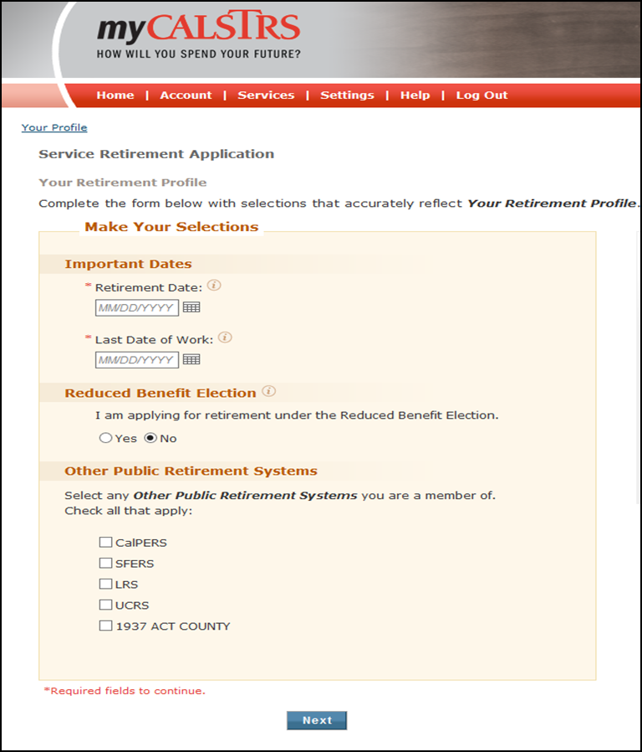
What to do:
Apply for retirement
When:
No earlier than 6 months before retirement date
Submit your application using myCalSTRS for guided assistance and faster processing.
Notes:
myCalSTRS will pre-populate your member information and provide step-by-step guided assistance so you complete your application accurately. You will receive immediate confirmation when your application has been received and processed.
You will receive your first retirement payment within 45 days of your retirement date or the day CalSTRS processes your application, whichever is later.
Click.

Slide 24
What to do:
Know how your benefit will be impacted
When:
First 180 days of retirement
Separation-from-service requirement
  Your benefit is reduced dollar for dollar for any earnings from CalSTRS-covered employment during first 180 calendar days of retirement.
Annual postretirement earnings limit
  Your benefit is reduced dollar for dollar for any earnings that exceed the annual limit.
Notes:
Once you’re retired you may be tempted to go back to work.
In order to ensure separation from service, you cannot work in any CalSTRS-covered position during the first 180 calendar days of retirement. If work within this period, your CalSTRS benefit will be reduced dollar-for-dollar by the amount you earn.
Once the 180-day waiting period is over, you are subject to an annual postretirement earnings limit. If you exceed the limit, you benefit will be reduced dollar-for-dollar by the amount you earned in excess of the limit.
The limit changes each fiscal year. The current limit is $74,733 for the 2024-2025 year.
Click.

Slide 25
What to do:
Review the Member Handbook
When:
Anytime
Annual benefit adjustment
  An increase equal to 2% of your initial retirement benefit beginning September 1 after the first anniversary of your retirement.
Purchasing power protection
  If the purchasing power of your benefit falls below 85% of the purchasing power of your initial benefit, CalSTRS will issue a supplemental benefit.
Notes:
You will receive an annual benefit adjustment each September after the one- year anniversary of your retirement.
This annual benefit adjustment is an increase equal to 2% of your initial retirement benefit.
Purchasing power protection addresses how inflation and rising prices can erode the purchasing power of your benefit.
If the purchasing power of your current benefit ever falls below 85% of the purchasing power of your initial benefit, before your annual benefit adjustments, we will issue you a supplemental benefit to restore your benefit to the 85% purchasing power mark.

Slide 26
What to do:
Attend a benefits planning session
When:
As soon as possible
Call 800-228-5453 and select option 3 for scheduling.
CalSTRS and Your Retirement
Review your benefit estimates
Explore electing an option beneficiary
Understand your retirement decisions and the application process
Learn considerations for after retirement
Notes:
CalSTRS and Your Retirement is a group benefits planning session.
A CalSTRS benefits specialist will provide personalized estimates including how electing an option would impact your benefit and review the application process and some of the other considerations we’ve touched on today.
Keep in mind these small group setting consist of no more than 10 educators. Learning in this setting allows you to benefit from the questions your peers are asking that you might not have considered or thought of yourself.
Attend a session when you’re ready to retire or interested in electing an option. In the meantime you’re Retirement Progress Report will contain personalized Defined Benefit and Defined Benefit Supplement estimates once you reach age 45. You can also use the Retirement Benefits Calculator on CalSTRS.com to generate estimates for additional scenarios.
Remember, CalSTRS.com and myCalSTRS are your greatest resources and are available to you 24/7…
Click.

Slide 27
Financial Awareness workshops
When:
Anytime
View a schedule and register at CalSTRS.com/financial-awareness.
Save for Your Future
  Budgeting basics, savings and investing, credit and debt
Plan for Your Future
  Retirement lifestyle, expenses, income and obstacles
Protect Your Future
  Retirement distributions, maximizing and protecting income
Notes:
There are three separate workshops in the series that can be beneficial at any time throughout your career.
Save for Your Future focuses on creating budgets, saving and investing, and managing credit and debt.
Plan for Your Future focuses on reaching the retirement lifestyle you want by planning your expenses and income and how to overcome obstacles.
Protect your Future focuses on retirement distributions and maximizing and protecting your additional income sources.
You can find and register for a workshop near you at CalSTRS.com/workshops.
Once you’re closer to retirement, contact your local CalSTRS office or visit myCalSTRS to schedule a CalSTRS and Your Retirement session…
Click.

Slide 28


What to do:
Access convenient resources
When:
Anytime
CalSTRS.com
myCalSTRS
800-228-5453
Monday – Friday
8 a.m. to 5 p.m.
Notes:
In conclusion, I just want to remind you of some of the resources you have available to you… especially as you begin researching your benefits and retirement decisions, we are aware questions may come up….
CalSTRS.com offers forms, publications, educational videos, calculators and benefit information that may help answer your questions.
One of the most convenient features of myCalSTRS is our online messaging. Submit your question in writing and a written response from a CalSTRS representative will be sent and archived in your myCalSTRS account for future reference.
Our Contact Center agents are available to assist you by phone Monday through Friday from 7 am to 6 pm. The phone number is 800-228-5453.
Finally, if you feel these online resources haven’t provided you with all the information you’re looking for, feel free to call and book an appointment for our CalSTRS and Your Retirement group benefits planning session. In this small group session.
Thank you.

