Slide 1

My Retirement Decisions
Notes:
Introduction:
Hello Everyone, Welcome to the “My Retirement Decisions” workshop. Today’s workshop is focused on your retirement, but more specifically considers the decisions you will have to make at retirement. My name is , and I am a benefits specialist here at CalSTRS.
**Feel free to give a brief introduction about yourself.**

Slide 2

Trust CalSTRS, not impersonators
CalSTRS authorized representatives:
Have an email address ending in @CalSTRS.com.
Can provide a CalSTRS ID badge or business card.
Do not provide refreshments at offsite events.
Will never meet at your home.
Do not sell insurance products.
Have access to your Pension2® account information.
Some Voya financial representatives work exclusively with Pension2.
Their names and photos are listed at
CalSTRS.com/trust-CalSTRS.
To verify a CalSTRS representative, contact us at 888-394-2060 or RepCheck@CalSTRS.com.
Notes:
Firstly, we’ve been receiving reports from our members believing they’ve set up an appointment or spoken with a CalSTRS representative when they have not. Only CalSTRS employees can provide you with accurate information regarding your CalSTRS Defined Benefit and Pension2 accounts. We’ve developed a checklist for you to use to ensure the person with whom your speaking is a CalSTRS employee.
Companies or individuals not affiliated with CalSTRS cannot have the CalSTRS logo on their advertisements.
Only CalSTRS employees will have an @CalSTRS.com e-mail address on their business cards. Please double-check the spelling of CalSTRS.
CalSTRS does not provide any refreshments when we come to see you at events.
CalSTRS employees will never meet you at your home.
CalSTRS is not an insurance company, so we will never try to sell you on any insurance products.
Only CalSTRS employees will have access to your CalSTRS or Pension2 account information. If you’re asked to provide a copy of your CalSTRS Retirement Progress Report or Pension2 account statement in order for someone to assess your CalSTRS accounts, they are not affiliated with CalSTRS.
CalSTRS has created a webpage at www.CalSTRS.com/Trust-CalSTRS with names and pictures of all our member-facing employees. This webpage is kept up-to-date, so you can always ensure you’re speaking with a CalSTRS employee. There are some representatives from Voya Financial with an @Voya.com e-mail address who work exclusively on the Pension2 program. Their names and photos will also be found on the CalSTRS Outreach Page.
If you scheduled an appointment or already met with someone you think may not be a CalSTRS representative, contact us at 888-394-2060 or RepCheck@CalSTRS.com to verify they are a CalSTRS representative.
Please disseminate this information to any friends or colleagues who may need it.
Click.

Slide 3

Objectives
01
Understand how to choose a retirement date.
02
Know how to provide for loved ones in retirement.
03
Consider how to receive your Defined Benefit Supplement account funds.
04
Take advantage of CalSTRS resources.
Notes:
There are many decisions you will make when you are considering retirement, so in today’s presentation we are going to cover….
Click.
Understanding how to chose a retirement date.
Click.
How to provide for loved ones in retirement.
Click.
How to distribute your Defined Benefit Supplement funds.
Click.
And the CalSTRS resources available to you.
Click.

Slide 4
01
Section one
Membership information and resources
Notes:
For those of you that have your handout in front of you we will be filling in some information here in section 1.
You will also want to pay close attention to the action items. You may check off action items as we move through each section. You will notice many action item reminders on the slides indicated by a box with a check mark next to the action item.
Click.

Slide 5


Benefit structures
01
CalSTRS
2% at 60
First hired before January 1, 2013.
CalSTRS
2% at 62
First hired on or after January 1, 2013.
Fill in your benefit structure on page 1.
Verify your benefit structure on your Retirement Progress Report.
Notes:
**specialist to draw attention to the action item.
There are 2 icons I want to draw your attention to at the bottom of this slide.
The first being the pencil. This icon signifies that there is something for you to fill out on your handout.
The next is the checkmark icon which signifies an action item that you can find on the handout. Checking an action item on the handout acts as a reminder for something you want to do after today’s presentation.
As a result of the California Public Employees' Pension Reform Act of 2013, CalSTRS has 2 benefit structures.
Your benefit structure is based on the date your were first hired in a CalSTRS‐covered position and it determines how your retirement benefit benefits are calculated.
You are a CalSTRS 2% at 60 member if you were first hired before January 1, 2013.
You are a CalSTRS 2% at 62 member if you were first hired on or after January 1, 2013.
However, please note this isn't as black and white as it may look:
If you were hired after January 2013 but were a member of certain other public retirement systems within six months of becoming a CalSTRS member, you might be a CalSTRS 2% at 60 member.
If you aren’t sure of your hire date you can verify your benefit structure on your Retirement Progress Report or on the home page of your myCalSTRS account.
Your benefit structure determines how your retirement benefit is calculated….
Click.

Slide 6


CalSTRS.com
01
Learn about CalSTRS and your benefits.
Download forms and publications.
Access calculators and watch videos.
Read the Your Retirement Guide booklet.
Notes:
Now let’s look at some of the online resources that are available to you.
CalSTRS.com is our public website where you can learn more about us and your benefits.
Under the “About Us” tab, there is a glossary to help you understand all of the terms you may hear and not understand. The retirement and investments world has a lot of terminology that you may not hear elsewhere.
You can download forms and publications. We have publications for easy reading for pretty much anything you'd like to know about CalSTRS and your membership.
You can also access retirement benefit calculators and watch short educational videos to recap the information we will be covering today. Your learning doesn't have to stop when this presentation ends.
Click.

Slide 7

myCalSTRS
01
Register at myCalSTRS.com and update your contact information and communication preferences.
View and update account information.
Submit forms and send messages.
Access your Retirement Progress Report.
Notes:
On our website you can find a link to myCalSTRS.com. myCalSTRS provides online access to your CalSTRS accounts and information 24/7. If you haven't done so already, you'll need to register for an account and update your preferences for receiving information from us.
For those of you who are not registered or just need to update your contact information please mark the action item on your handout as a reminder for you to do after today’s presentation.
With the environment in mind, we default to electronic communication but you can always request to receive hard copies of information by mail.
With myCalSTRS you can also submit forms (such as naming a recipient for your one time death benefit) and you can send and receive secure online messages with a CalSTRS representative. The nice thing about this feature is that the electronic copies are archived in your account for future reference if you need them.
You can also access your Annual Retirement Progress Report (RPR) each September on myCalSTRS…
Click.

Slide 8
Your Retirement Progress Report
01
Use your Retirement Progress Report to review:
Membership and benefit information.
Service credit and account balances.
Employer reporting.
Review your report each fall and contact your employer regarding any discrepancies.
Notes:
Your Retirement Progress Report is your annual statement that summarizes your information for the prior school year. This report is available in your myCalSTRS account each year in September
It includes information about your membership and benefits, service credit and account balances and even information reported by your employer.
Since we use information reported by your employer to calculate your benefit, it’s important to review your report each year and contact your employer directly regarding any discrepancies so they can be corrected.
Your report will include personalized estimates based on information on file beginning at age 45.
Before we move on to section 2, be sure to check any actions in section 1 of the handout that you need to take care of.
Click.

Slide 9
02
Section two
Choosing a retirement date
Notes:
In this section we will discuss things you will need to consider when choosing your retirement date.
Click.

Slide 10
Service retirement eligibility
02
Minimum requirements
Age 55 with five years of service credit.
Early
retirement
Age 50 with 30 years of service credit.
(CalSTRS 2% at 60 only)
Concurrent retirement
Age 55 with fewer than five years of service credit if retiring concurrently from certain other retirement systems.
Read the Your Retirement Guide booklet at CalSTRS.com/publications to learn more.
Notes:
The first consideration when deciding when to retire is if you are eligible.
Click.
The minimum requirements for a service retirement benefit are age 55 with five years of service credit.
Click.
If you’re a CalSTRS 2% at 60 member, you can retire as early as age 50 with 30 years of service credit.
Click.
If you have fewer than five years of service credit you can retire at age 55 if you retire concurrently with certain other public retirement systems in California such as CalPERS.
You can read more about concurrent retirement and eligibility in the Your Retirement Guide publication.
Once you’re eligible to retire, your retirement date can be as early as the day following your last day of work or paid leave…
Click.

Slide 11
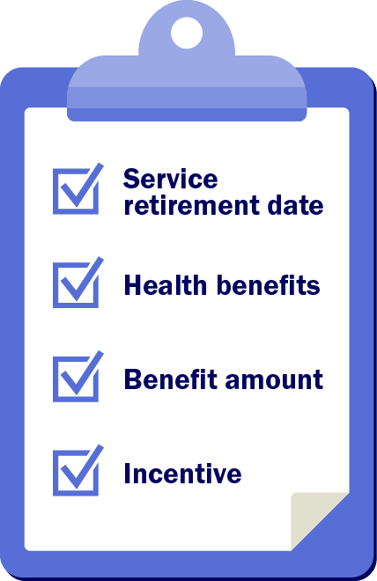
Retirement decisions
02
Check with your employer about health benefits and retirement incentives.
Verify your last day of work and retirement date with your employer.
Notes:
In addition to your service retirement date, there are several other factors that may help you determine when to retire.
CalSTRS does not offer health benefits. As an active member, your health benefits are offered through your employer. Check with your employer about what health benefit coverage is available to you in retirement so you can plan ahead for any additional costs.
Your employer may offer different retirement incentives if you retire at a certain time or within a designated period. Check with you employer about this as well.
Your retirement date can determine the amount of your retirement benefit. Let’s take a look at your retirement benefits…
In section 2 of the handout check any action items that may apply to you.
Click.

Slide 12
03
Section three
CalSTRS hybrid system
Notes:
Let’s talk about the CalSTRS retirement benefits.
Click.

Slide 13
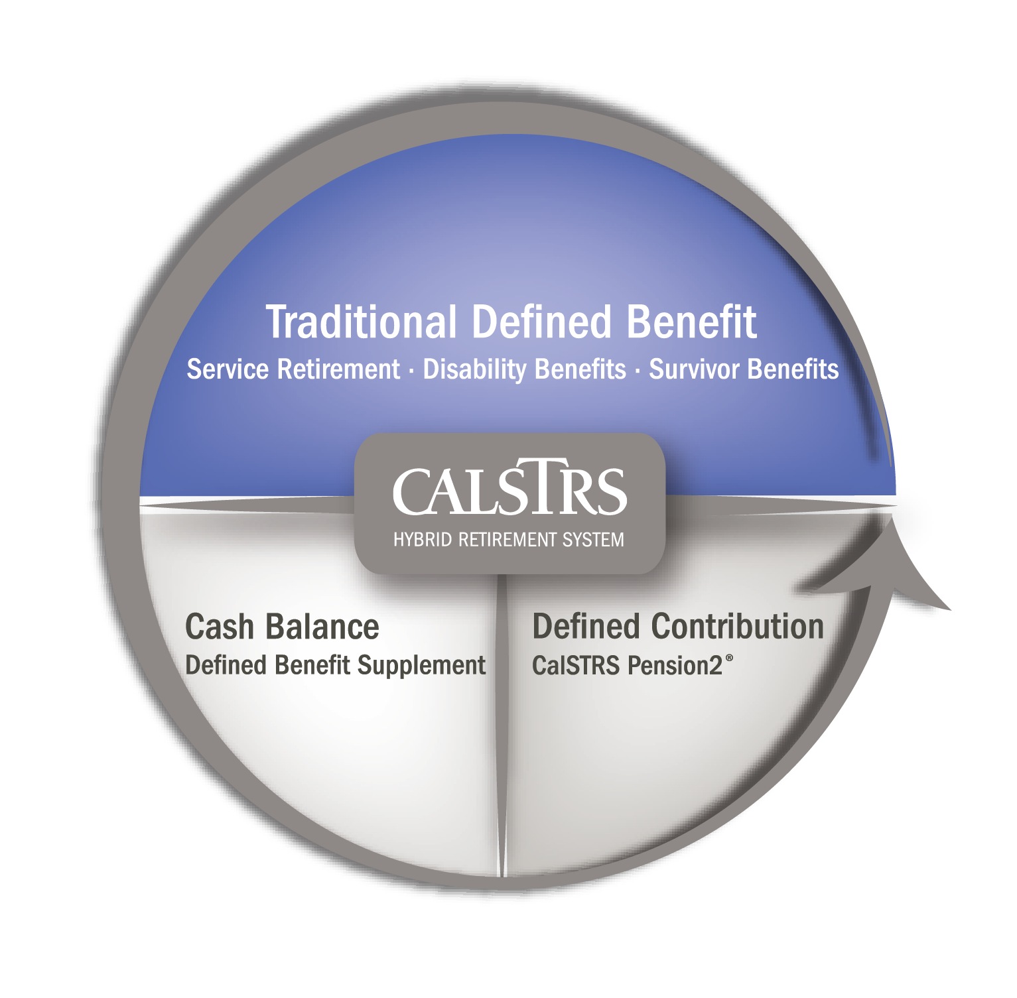
CalSTRS hybrid system
03
Membership includes:
Defined Benefit Program
Defined Benefit Supplement Program
Optional:
CalSTRS Pension2®
Notes:
Keep in mind CalSTRS is a hybrid system with three different programs.
Your membership automatically includes the Defined Benefit and the Defined Benefit Supplement programs.
Our Pension2 program is an optional program if you want to set aside additional investments for retirement.
Click.

Slide 14
04
Section four
Retirement benefit
Notes:
Let’s take a look at how your retirement benefit is determined.
Click.

Slide 15
Defined Benefit account
04
Your retirement is based on a formula set by law.
CalSTRS has two benefit structures:
  CalSTRS 2% at 60
  CalSTRS 2% at 62
Notes:
Your lifetime monthly retirement benefit comes from the Defined Benefit Program.
Click.

Slide 16

Service retirement formula
04
service credit $×$ age factor $×$ final compensation
$=$ monthly retirement benefit
Service credit:
Time worked and contributed.
Review the Understanding the Formula fact sheet and video at CalSTRS.com.
Notes:
Your Defined Benefit account will provide a guaranteed lifetime monthly benefit. That benefit is based on a formula and not on the balance in your account.
That formula is Service Credit x Age Factor x Final Compensation.
Don’t forget we have the Understanding the Formula fact sheet and video available online if you want to review this topic later.
Service Credit is the time that you’ve worked and contributed to CalSTRS
Click.

Slide 17
Service credit
04
Percentage of contract worked
Service
credit
Full time
75% time
50% time
1.000
0.750
0.500
Track your service credit balance on your Retirement Progress Report each fall.
Notes:
The amount of service credit that you earn each year is based on the percentage of a full-time contract you work. If you’re working full time you should earn one year of service credit, half-time you would earn a half year and so on.
You can earn up to one year of service credit in a school year. We’ll talk about what happens to contributions in excess of one year a little later.
Also, remember to track your service credit balance on your annual Retirement Progress Report each year and contact your employer regarding any discrepancies….
Click.

Slide 18


Service credit
04
Calculating additional service credit
unused sick leave days $÷$ number of contract days
$=$ additional service credit
Example
100 unused sick leave days $÷$ 180 contract days
$=$ 0.556 years additional service credit
Track your service credit balance on your Retirement Progress Report each fall.
Notes:
You can also receive service credit for any unused sick leave you have at retirement.
Click.
We calculate the service credit increase by dividing the number of unused sick leave days you have at retirement by the number of days in your annual contract.
Click.
For example, if you have 100 unused sick leave days at retirement and a 180-day contract, you would receive an additional .556 years of service credit in your retirement benefit. It’s important that you transfer your unused sick leave balances to your current employer if you change positions throughout your career.
Also, remember to track your service credit balance on your annual Retirement Progress Report each year and contact your employer regarding any discrepancies….
Click.

Slide 19
Service retirement formula
04
service credit $×$ age factor $×$ final compensation
$=$ monthly retirement benefit
Service credit:
Time worked and contributed.
Age factor:
Percentage based on age at retirement.
Review the Understanding the Formula fact sheet and video at CalSTRS.com.
Notes:
Your age factor is a percentage based on your age in years and months at retirement.
It represents the percent of your final compensation you will receive for each year of service credit you have at retirement…
Click.

Slide 20
Age factor
04
Retirement age | CalSTRS 2% at 60 | CalSTRS 2% at 62
55 | 1.40% | 1.16%
56 | 1.52% | 1.28%
57 | 1.64% | 1.40%
58 | 1.76% | 1.52%
59 | 1.88% | 1.64%
60 | 2.00% | 1.76%
61 | 2.13% | 1.88%
62 | 2.27% | 2.00%
63 | 2.40% | 2.13%
64 | 2.40% | 2.27%
65 | 2.40% | 2.40%
View the complete age factor tables in the CalSTRS Member Handbook at CalSTRS.com/publications.
Career factor:
An increase of 0.20% for CalSTRS 2% at 60 members with 30 or more years of service credit.
Notes:
The standard age factor for CalSTRS 2% at 60 members is 2% when you reach age 60. The age factor gradually decreases if you retire before age 60 and gradually increases to a maximum age factor of 2.4% at age 63.
If you are under the CalSTRS 2% at 62 benefit structure you will receive the 2% age factor when you reach age 62. You will reach the maximum age factor of 2.4% at age 65.
Click.
If you’re a CalSTRS 2% at 60 member with 30 or more years of service credit at retirement, we will increase your age factor by .200 percent up to the maximum of 2.4 percent. This is known as the career factor.
The age factor is based on your age in years and months at retirement. You can view the complete age factor table in the Member Handbook…
Click.

Slide 21
Service retirement formula
04
service credit $×$ age factor $×$ final compensation
$=$ monthly retirement benefit
Service credit:
Time worked and contributed.
Age factor:
Percentage based on age at retirement.
Final compensation:
Highest average annual compensation earnable for 36 consecutive months.
Review the Understanding the Formula fact sheet and video at CalSTRS.com.
Notes:
The last part of the formula is final compensation.
Your final compensation is based on your highest average annual compensation earnable for 36 consecutive months.
Click.

Slide 22

Final compensation
04
School year | Compensation earnable | Number of months
Year A | $75,000 | 12
Year B | $79,000 | 12
Year C | $83,000 | 12
$237,000 $÷$ 36 months $=$ $6,583
Total combined compensation earnable
The number of consecutive months used for the calculation
Final compensation
Notes:
In other words, to determine your final compensation we take the weighted average of your highest compensation earnable amounts over a 36 month period. Your highest compensation earnable is based on your contract salary not your earnings.
Let’s assume your highest compensation earnable amounts occurred during the last 36 months, or three school years, and are $75,000, $79,000 and $83,000.
We add these figures together and divide by 36 months to get a final compensation of $6,583.
Click.

Slide 23

Final compensation
04
One-year final compensation
Use only 12 consecutive months for CalSTRS 2% at 60 members with 25 or more years of service credit.
School year | Compensation earnable | Number of months
Year A | $75,000 | 12
Year B | $79,000 | 12
Year C | $83,000 | 12
$83,000 $÷$ 12 months $=$ $6,917
Notes:
If you’re a CalSTRS 2% at 60 member with 25 or more years of service credit, we will use a period of 12 consecutive months to calculate your final compensation. In this case we would use your highest year at $83,000.
Click.
We divide that figure by 12 months to get a final compensation of $6,917.
Click.

Slide 24

Final compensation
04
$6,917 $−$ $6,583 $=$ $333
Final compensation calculated with
12 months
Final compensation calculated with
36 months
Difference between final compensation amounts
Notes:
That’s over $300 more than the final compensation based on a three-year average.
Now let’s look at the whole picture…
Click.

Slide 25

Jake’s retirement benefit
Jake is a CalSTRS 2% at 60 member who works full time.
He is 48 years old with 12 years of service credit and wants to retire at age 60.
His final compensation is $6,583.
Notes:
Jake is a CalSTRS 2% at 60 member who works full time and wants to retire at age 60
If he currently is 48 years old with 12 years of service credit and is working full time, we can assume he will earn an additional 12 years by retirement to bring his total service credit to 24 years.
Since he wants to retire at age 60, his age factor would be 2 percent
His final compensation is $6,583 based on the three-year average we originally calculated.
Click.

Slide 26




Jake’s retirement benefit
04
24
$$×$$
0.020
$$×$$
$6,583
$$=$$
$3,160
Service credit
12.000 + 12.000 earned between ages 48 to 60
Age factor
2% at age 60
Final compensation
($75,000 + $79,000 + $83,000) $÷$ 36 months
Monthly retirement benefit
Notes:
Click.
For Jake’s service credit, we take the 12 years he has already worked and add the 12 more years he plans to work. That means that Jake can expect to have 24 years or service credit at retirement.
Click.
Jake is under the 2% at 60 benefit structure, so if he retires at age 60, his age factor will be 2% or 0.02.
Click.
We already calculated his final comp, but here is a reminder of how we got there. We added up Jake’s salary for 3 years and divided by 36 months.
Click.
When we multiply these figures together, we get a monthly benefit of $3,160. These are always gross figures—your retirement benefit is taxable income.
But what if Jake decides that $3,160 is not enough?...
Click.

Slide 27
What if Jake works longer?
Estimate Jake’s retirement benefit on page 2.
Notes:
Let’s see how Jake’s retirement benefit is affected if he works another 3 years.
Go ahead and calculate Jake’s benefit on page 2 of your handout assuming he works until age 63 in order to maximize his age factor and qualify for a one-year final compensation.
(Provide 2-3 minutes for participants to calculate halfway through check in and let them know they have about another minute)
Let’s see how you did…
Click.

Slide 28




Jake’s retirement benefit
04
27
$$×$$
0.024
$$×$$
$6,917
$$=$$
$4,482
Service credit
12.000 + 15.000 earned between ages 48 to 63
Age factor
2.4% at age 63
Final compensation
$83,000 $÷$ 12 months
Monthly retirement benefit
Use the Retirement Benefits Calculator at CalSTRS.com/calculators to estimate your benefit.
Notes:
So here we have the formula…
Click.
By working until age 63, Jake will accrue another three years of service credit. Jake will have 27 years of service credit when he retires.
Click.
As a CalSTRS 2% at 60 member, he will reach the maximum age factor of 2.4% at age 63
Click.
Lastly, you were given a one-year final compensation of $6,917. Since Jake will retire with more than 25 years of service credit and is under the CalSTRS 2% at 60 benefit structure, he will qualify for the One-Year Final Compensation enhancement
Click.
When we multiply these three figures together, we get a monthly benefit of $4,482 in retirement. By working a few more years Jake was able to increase his benefit by over $1300.
Click.

Slide 29
Increasing your monthly benefit
04
Service
credit
Work longer.
Purchase service credit.
Age
factor
Work longer.
Retire later.
Final compensation
Work at higher pay rates.
Read the Purchase Service Credit Now fact sheet at CalSTRS.com/publications.
Use the calculators at CalSTRS.com/calculators.
Notes:
You can increase your benefit by increasing any one of the three components of the formula…
Your service credit, your age factor or your final compensation.
Click.
You can increase your service credit by working longer, purchasing permissive service credit such as unpaid medical or family leaves, sabbatical or time from an out-state-system that you won’t receive a benefit from. You can also redeposit or buy back service credit you lost when you took a refund of your contributions.
If you’re interested in purchasing service credit, read the Purchase Additional Service Credit booklet and use the calculators on CalSTRS.com to estimate the cost of your purchase and the increase to your benefit.
Click.
You can increase your age factor by working longer or, if you stop working and don’t need to collect your benefit right away, wait to retire until you reach the maximum age factor.
Click.
Finally, you can increase your final compensation by working at higher pay rates. For example, If you are nearing a step increase you may be inclined to work an additional year.
Before we move on to section 5 take a look at the action items in section 4 of the handout and mark all that apply.
Click.

Slide 30
05
Section five
Defined Benefit Program decision
Notes:
Something you will need to decide before you retire is if you would like to leave a lifetime benefit to someone.
Click.

Slide 31
Defined Benefit Program decision
05
Member-Only Benefit
Highest benefit amount.
After you die, your beneficiary receives your remaining account balance.
Modified Benefit
Reduced benefit amount.
After you die, a percentage of your reduced benefit goes to your option beneficiary.
Watch the Beneficiary Options video at CalSTRS.com/videos.
Notes:
Keep in mind that so far, we have only been discussing a Member-Only Benefit.
Click.
The Member-Only Benefit is the highest benefit you can receive. It is a lifetime monthly benefit that stops when you die. After your death, your remaining account balance will be paid to your one-time death benefit recipient or your estate if you don’t have a recipient on file.
Click.
You can choose to take a reduced benefit, known as a Modified Benefit, in order to leave a lifetime monthly payment to one or more beneficiaries when you die.
You can elect to leave a beneficiary 100%, 75% or 50% of your reduced benefit. When you die, the percentage you indicated will be paid to your beneficiary or beneficiaries for their lifetime.
Click.

Slide 32
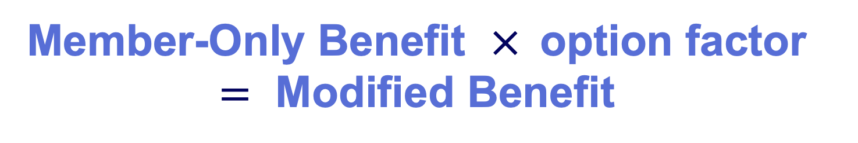
Jake’s Modified Benefit
05
Member-Only Benefit $×$option factor $=$ Modified Benefit
Watch the Beneficiary Options video at CalSTRS.com/videos.
Notes:
Your Modified Benefit is equal to your Member-Only Benefit multiplied by your Option Factor…
The option factor is an actuarial figure based on the option you elect and you and your beneficiaries’ age when you make the election.
Click.

Slide 33
Jake’s Modified Benefit
05
Option factor table
MBR age | BEN age | 100% | 75% | 50%
63 | 50 | 0.8054 | 0.8572 | 0.9036
63 | 55 | 0.8301 | 0.8776 | 0.9184
63 | 60 | 0.8572 | 0.8997 | 0.9340
63 | 65 | 0.8844 | 0.9214 | 0.9490
63 | 70 | 0.9094 | 0.9410 | 0.9621
Watch the Beneficiary Options video at CalSTRS.com/videos.
Notes:
Here is a sample of the option factors for a member at age 63 and a beneficiary from age 50 to 70.
Let’s assume at the time of election that Jake is age 63 and his spouse Jen is age 60.
Click.
If Jake chose the 75% beneficiary option, the factor would be 0.8997.
Let’s look at what Jake’s benefit would be if he elected the 75% beneficiary option.
Click.

Slide 34
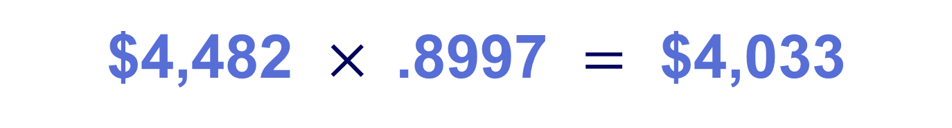
Jake’s Modified Benefit
05
$4,482 $×$.8997 $=$ $4,033
Member-Only Benefit
option factor
Modified Benefit
Watch the Beneficiary Options video at CalSTRS.com/videos.
View the Retirement Benefits Calculator at CalSTRS.com/calculators to estimate your Modified Benefit.
Notes:
Jake’s Member-Only Benefit at 63 was $4,482. We multiple this amount by the .8997 option factor listed in the table to get a Modified Benefit of $4,033.
With the 75% Beneficiary Option Jake would receive $4,033 for his lifetime and his option beneficiary, Jen, would receive 75% of that amount, or $3,024, for her lifetime after Jake’s death.
If Jen were to pass away first, Jake’s benefit would pop back up to the Member-Only Benefit since he no longer has a beneficiary…
Click.

Slide 35
Jake’s Modified Benefit
05
Member-Only Benefit
Modified Benefit
Beneficiary benefit
Notes:
The 100% and 50% beneficiary options work similarly, but your beneficiary would receive either 100% or 50% of your modified benefit.
As you can see in the chart Jake’s Modified Benefit under the 100% beneficiary option is the lowest because it provides the most coverage to Jen whereas his Modified Benefit with the 50% option is higher because we’re providing a lower benefit to Jen.
The Beneficiary Options video on CalSTRS.com reviews the information we’re discussing and may help you relay some of this information to your spouse or whoever you’re considering electing as a beneficiary.
Click.

Slide 36
Compound Option
05
Member-Only
Benefit
Learn more in the Member Handbook at CalSTRS.com/publications.
Notes:
The Compound Option allows you to elect multiple beneficiaries by modifying a portion of your Member-Only Benefit for each beneficiary…
Let’s say Jake wants to leave a lifetime benefit to each of his two children…
Click.

Slide 37


Compound Option
05
Beneficiary A
Beneficiary B
Learn more in the Member Handbook at CalSTRS.com/publications.
Notes:
He can divide his Member-Only Benefit between the two and modify it for each.
Click.

Slide 38


Compound Option
05
Beneficiary A
Member-Only
Benefit
Beneficiary B
Learn more in the Member Handbook at CalSTRS.com/publications.
Notes:
He can even choose to only modify a portion of his benefit for one or more beneficiaries and chose to keep a portion of the benefit as the unreduced Member-Only Benefit.
The Compound Option can be complex. Our online calculator cannot calculate a compound option, but you can learn more and calculate your own with worksheets in the Member Handbook or by contacting us for an estimate.
Click.

Slide 39
Preretirement election of an option
05
Advantages
Secure coverage for beneficiary if you should die before retirement.
Option factor tends to be higher the earlier you elect an option.
Disadvantages
You’ll be subject to an assessment if you change or cancel your option or if your beneficiary dies before you retire.
The assessment can reduce your future monthly benefit.
Attend a benefits planning session or obtain an estimate before electing an option.
Notes:
If you’re interested in electing an option, you can do it once your eligible to retire even if you’re still working.
This is called a Preretirement Election of an Option. There are advantages and disadvantages to doing this…
Click.
We’ll start with the Advantages. The benefit of electing your option prior to retirement is that you’re securing the lifetime benefit for your beneficiary if you pass away before retirement.
Another advantage is that the option factor could be more favorable the earlier you elect the option.
Click.
The disadvantage to electing an option before retirement is that you will be subject to an assessment that can reduce your future benefit if your change or cancel your option. If your pre-elected option beneficiary dies before you retire, that is also considered a cancelation. The assessment is based on the coverage you chose and how long it was in place.
We highly recommend attending a benefits planning session or obtaining an estimate prior to electing an option so that you are aware of the impacts to your benefit and can fully understand the coverage.
If you are considering an option beneficiary take a look at the action items in section of the handout and mark all the apply.
Click.

Slide 40
06
Section six
Defined Benefit Supplement Program choices
Notes:
The third and final decision you will have when you retire is what to do with your Defined Benefit Supplement funds…
Click.

Slide 41

Defined Benefit Supplement account
06
View your account balance on myCalSTRS.
Consider working extra-pay assignments to increase your account balance.
Defined Benefit Supplement account
Member contribution rate:
  8% for CalSTRS 2% at 60 members.
  9% for CalSTRS 2% at 62 members.
Employer contribution rate is 8%.
Notes:
Your Defined Benefit Supplement account is a cash balance account that offers guaranteed benefits based on contributions and credits.
If you were actively working between 2001-2010 CalSTRS automatically re-directed ¼ of your contributions into this account.
Click.
Beginning in 2002 if you worked in excess of 1 year of service credit, those excess contributions also went to this account
8% of your and your employer’s contributions for service in excess of one year go into this account. 2% at 62 members your contribution rate is 9%.
It also earns a guaranteed interest rate each year.
You can view your Defined Benefit Supplement account balance on myCalSTRS. You will have to tell us how you want to take these funds at retirement…
Click.

Slide 42
Defined Benefit Supplement distributions
06
Lump sum
Choices
Annuity
Combo
Review your choices and tax considerations with a tax professional.
Notes:
You have three choices.
Click.
You can take your entire balance as a lump sum.
Click.
You can annuitize your account balance.
Click.
Or you can do a combination of the two.
Click.

Slide 43

Lump-sum payment
06
Direct payment*
Account balance
Receive your entire account balance at retirement.
Rollover
There is a mandatory 20% federal tax withholding and an optional 2% state tax withholding for direct payments.
Notes:
A lump-sum payment is essentially a return of your account balance.
Click.
You can take this as a direct payment and receive a check for the balance. If you do this there is a 20% mandatory federal tax withholding and an optional 2% state tax withholding.
Keep in mind this is just a tax withholding and you may owe more or receive a refund when you file your taxes depending on your situation.
Click.
You can defer the taxes on your lump sum by rolling the funds into a qualified plan such as a 403(b), 457 or 401(k) you will not pay taxes on the funds until you take a distribution from the new account.
Click.

Slide 44
Lifetime annuity
06
Member-Only Annuity
Account balance
Receive a separate monthly payment for your lifetime.
100% Beneficiary Annuity*
75% Beneficiary Annuity*
50% Beneficiary Annuity*
*Your annuity beneficiary is your option beneficiary.
Notes:
Or you could choose to receive your account balance as a lifetime annuity.
A lifetime annuity would offer a separate monthly payment each month for the rest of your life.
The lifetime annuity you choose depends on if you elect an option for your Defined Benefit.
Click.
If you elected the Member-Only Benefit you could receive a Member-Only Annuity which would stop when you die.
Click.
If you elected the Modified Benefit for your Defined Benefit, you could choose between a 100%, 75% or 50% beneficiary annuity. Like the modified benefit, you would be electing to reduce your Member-Only Annuity in exchange for providing 100%, 75% or 50% of your reduced annuity to your option beneficiary or option beneficiaries.
If you choose a lifetime annuity taxes will be withheld based on the withholding preferences that you elect on your service retirement application. You can change these preferences at any time.
Click.

Slide 45
Period-certain annuity
06
Account balance
Receive your account balance as a separate monthly benefit for a specified number of years.
3–9 years
Can choose direct payments or rollovers.
Mandatory 20% federal tax withholding and optional 2% state tax withholding.
10 years
Direct payments only.
Can elect federal and state tax withholdings.
Notes:
You can also choose a period-certain annuity. A period certain annuity is a separate monthly payment that stops after a designated number of years. The shorter the period, the larger the monthly benefit payment. The longer the period, the smaller payment.
Click.
A period-certain annuity between three and nine years can be rolled over to a qualified plan. If you have the annuity paid directly to you, there is a 20% mandatory federal tax withholding and an optional 2% state tax withholding like the lump-sum payment.
Click.
You can also choose to receive a 10-year annuity. The 10-year annuity is taxed like regular income and cannot be rolled over.
Click.

Slide 46
Combination lump sum and annuity
06
Account balance
Receive a lump-sum payment at retirement and monthly payments for the remaining account balance.
Lump sum and lifetime annuity
Lump sum and period-certain annuity
(3–10 years)
Notes:
You can do a combination of a lump-sum and annuity
Click.
You can take part of your account balance as a lump-sum payment and annuitize the difference as either a lifetime or period-certain annuity. Please note: At least $3,500 must remain after the lump-sum payment in order to take advantage of the annuity.
As you can see there are lots of decisions and tax considerations for your Defined Benefit Supplement account. You can review the information we covered, including some examples by watching the Defined Benefit Supplement video series on CalSTRS.com. You may also want to discuss this account with your financial representative or tax advisor.
In section 6 on the handout don’t forget to check any action items that may apply to you.
Click.

Slide 47
07
Section seven
CalSTRS Pension2
Notes:
The final piece of the hybrid system is our CalSTRS Pension2 program
Click.

Slide 48

CalSTRS Pension2
07
403(b)
Roth 403(b)
457(b)
Roth 457(b)
Notes:
While you must take your Defined Benefit Supplement funds at retirement, you can roll them over into a CalSTRS Pension2 account if you want to continue to invest them.
You can also open a plan to start saving now or roll over funds from your current investments. Our Pension2 representatives are not paid on commission and can offer you nonbiased advice on what accounts may be a good fit for you and if it’s worth rolling over funds from your existing plan.
Pension2 is the third piece of our hybrid system and is completely voluntary.
Click.
Pension2 offers 403(b) and 457(b) plans and the Roth versions of each.
Click.

Slide 49



CalSTRS Pension2
07
Pension2 can take you where you want to go
Tax-deferred retirement savings.
Low and transparent costs.
No commissions, load fees or surrender charges.
Flexible investment options.
Visit Pension2.com or call 888-394-2060 for more information.
Research your employer’s plans at 403bCompare.com.
Scan the QR code to visit Pension2.com.
Notes:
Pension2 is a great way to save more for your future because you can contribute tax-deferred money, there are low and transparent costs, no commissions, load fees or surrender changes, because CalSTRS is a nonprofit organization, we want you to keep all your hard-earned money. There are also flexible investment options.
If you have additional questions about Pension2, you can visit Pension2.com or give them a call at 888-394-2060.
If you’re interested in learning more about investing or money management, check out our Financial Awareness workshops series
Before we move on remember to select any action items in section 7 of the handout that pertain to you.
There are a variety of investment options – you can choose your own investments or let us do the work for you based on your anticipated distribution date and risk tolerance.
You can learn more, watch educational videos and use a personal wellness plan calculator to estimates your account balance based on various contribution amounts at Pension2.com.
You can also research the fees and expenses of other plans offered by your employer at 403bCompare.com.
Click.

Slide 50
08
Section eight
Application process and after retirement
Notes:
Now that we’ve reviewed the decisions you will need to make, let’s look at what happens once you’re ready to retire…
Click.

Slide 51
Application process
08
Decide
Verify resignation process with your employer.
Submit the Service Retirement Application to CalSTRS no earlier than six months before retirement.
Resign
Retire
Notes:
It’s important to remember that retiring with us is a separate process than resigning with your employer. Your employer will likely have their own process, timeframes and required forms so it’s important to check on that process as well.
You must submit a Service Retirement Application to begin receiving a benefit. You can submit your application as early as six months before your retirement.
Applying online through your myCalSTRS account is quick and convenient. myCalSTRS will prepopulate your member information and walk you through the application step-by-step.
You will receive your monthly benefit within 45 days of your retirement date or when we receive your application, whichever is later.
Your Social Security benefit could be impacted by your CalSTRS benefits…
Click.

Slide 52
Social Security rules
08
Windfall Elimination Provision
May reduce but cannot eliminate your earned Social Security benefit.
Government Pension Offset
Reduces and may eliminate your spousal or widow/widower Social Security benefit.
Contact the Social Security Administration for more information.
Notes:
As a CalSTRS member, you do not contribute to Social Security for your CalSTRS-covered employment. If you anticipate receiving a Social Security benefit from other employment or from a spouse, there are two government rules that can reduce your benefit or leave you with no benefit at all.
Click.
The Windfall Elimination Provision impacts your earned Social Security benefit from employment outside of CalSTRS. The Social Security Administration uses an alternate formula to calculate your benefit. This can reduce your benefit but will not eliminate it.
Click.
The Government Pension Offset impacts your spousal, widow or widower benefit. The Social Security Administration reduces your benefit by two-thirds of your CalSTRS benefit which can eliminate your benefit all together.
It’s important to be aware of these rules and contact the Social Security Administration for more information since the estimates on your annual statement don’t reflect these reductions.
You CalSTRS retirement benefit is not impacted by Social Security. However, your CalSTRS retirement benefit could be reduced if you return to work…
Click.

Slide 53
Working after retirement
08
Separation-from-service requirement
Benefit reduced dollar for dollar for any earnings from CalSTRS-covered employment during first 180 calendar days of retirement.
Annual postretirement earnings limit
Benefit reduced dollar for dollar for earnings in excess of the annual limit.
Limit changes every fiscal year.
Track gross earnings to avoid exceeding earnings limits.
Notes:
You have a separation–from-service requirement where you cannot return to CalSTRS-covered employment for the first 180 calendar days of your retirement.
Click.
If you return to CalSTRS-covered employment within this 180-day period, your benefits will be reduced dollar for dollar by the amount that you earned.
Click.
After that 180-day waiting period, you can work in CalSTRS-covered employment up to the annual postretirement earnings limit. If you exceed the annual limit, your benefit will be reduced dollar for dollar by the excess earnings.
The limit spans each fiscal year. There is a space for you to note the current limit on your handout for reference. The limit is $74,733 for 2024/2025.
The limit only applies to CalSTRS-covered employment. If you return to work, track your gross earnings to avoid exceeding the limit.
** One other important piece of information regarding working in retirement: Members who return to CalSTRS-covered employment after the waiting period can begin contributing to a Pension2 account. **
Before we move on select all action items on the handout in section 8 that pertain to you.
Click.

Slide 54
09
Section nine
Benefit inflation protection
Notes:
Now let’s talk about protecting your benefit.
Click.

Slide 55

Annual benefit adjustment
09
$4,482 $×$ 0.02 $=$ $90
Initial benefit
2%
Annual benefit adjustment
Read the Member Handbook at CalSTRS.com/publications for more information.
Notes:
You will receive an annual benefit adjustment each September after the one-year anniversary of your retirement.
This annual benefit adjustment is an increase equal to 2% of your initial retirement benefit.
If Jake were to retire at 63 with his Member-Only Benefit of $4,482, we would multiply that amount by 2% to get an annual benefit adjustment of $90. Beginning September 1st, following his first full year of retirement, Jake’s monthly benefit would be increased by $90. He would receive that same monthly increase each September for the rest of his life.
The annual benefit adjustment is not a cost-of-living adjustment since it’s not based on inflation or compounded. One of the ways we protect your benefits from inflation is through a supplemental benefit
Click.

Slide 56



Purchasing power protection
09
85%
Price
Purchasing power
Supplemental benefit
When prices increase, your purchasing power decreases. When your purchasing power falls below 85%, you’ll receive a supplemental benefit in addition to your retirement benefit.
Read the Member Handbook at CalSTRS.com/publications for more information.
Notes:
Inflation and rising prices can erode the purchasing power of your benefit.
Your annual benefit adjustment can help alleviate some of this but might not be enough as time goes on…
If the purchasing power of your current benefit ever falls below 85% of the purchasing power of your initial benefit, before annual benefit adjustments, we will issue you a supplemental benefit to restore your benefit to the 85% purchasing power mark.
You can learn more about purchasing power protection and the calculation in the Benefit Improvement booklet on CalSTRS.com.
You can also learn more about inflation and protecting income in our Financial Awareness Workshop series…
Click.

Slide 57
10
Section ten
Learn more
Notes:
I hoped you've learned a lot about the retirement decisions you will be faced with. I'd like to share more of what we offer to help you become as educated as possible.
Click.

Slide 58



Financial Awareness webinars
10
Save for Your Future
Plan for Your Future
Budgeting basics, savings and investing, credit and debit.
Retirement lifestyle, expenses, income and obstacles.
Protect Your Future
Retirement distributions, maximizing and protecting income.
Visit CalSTRS.com/webinars to register.
Notes:
First, we have our financial awareness webinar series.
This isn't necessarily CalSTRS specific information, but they provide good financial planning and money management strategies.
The first webinar in the series is Save for Your Future focuses on creating budgets, saving and investing, and managing credit and debt.
Plan for Your Future focuses on reaching the retirement lifestyle you want by planning your expenses and income and how to overcome obstacles.
Protect your Future focuses on retirement distributions and maximizing and protecting your additional income sources.
You can learn more at CalSTRS.com/financial‐awareness. Also don’t forget to check CalSTRS.com/webinars to see when they are being offered.
Click.

Slide 59
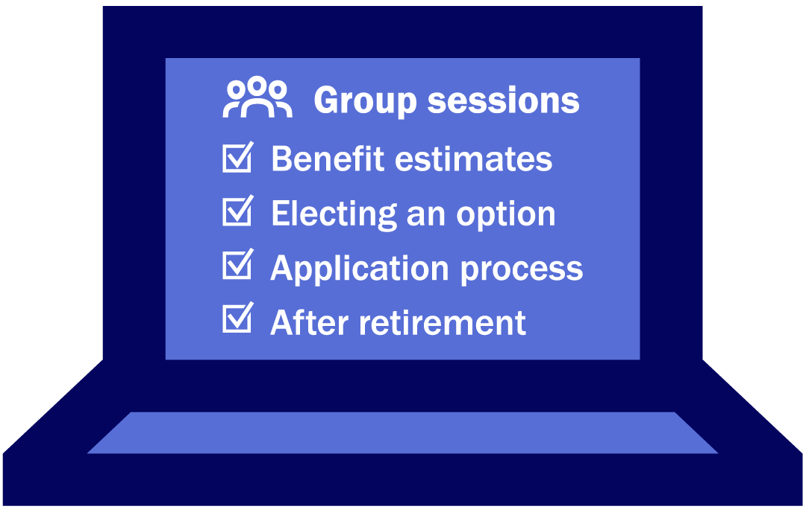
CalSTRS group sessions
10
Contact CalSTRS to schedule a CalSTRS and Your Retirement group session.
Notes:
A CalSTRS benefits specialist will provide personalized estimates including how electing an option would impact your benefit and review the application process and some of the other considerations we’ve touched on today.
Keep in mind these small group setting consist of no more than 10 educators. Learning in this setting allows you to benefit from the questions your peers are asking that you might not have considered or thought of yourself.
Attend a session when you’re ready to retire or interested in electing an option. In the meantime, you’re Retirement Progress Report will contain personalized Defined Benefit and Defined Benefit Supplement estimates once you reach age 45. You can also use the Retirement Benefits Calculator on CalSTRS.com to generate estimates for additional scenarios.
Remember, CalSTRS.com and myCalSTRS are your greatest resources and are available to you 24/7…
Click.

Slide 60


Questions?
CalSTRS.com
myCalSTRS.com
Send us a secure online message using your myCalSTRS account.
800-228-5453
*Press 2 for Customer Service.
Monday–Friday
8 a.m. to 5 p.m.
Notes:
If you interested attending another workshop or webinar, check the action items in section 10 of the handout. Throughout today’s presentation you have hopefully been marking all action items that you want to take care of. Keep this handout near by and remember to complete those action items you have checked off.
For those of you still have questions or want to learn more please visit us at CalSTRS.com. You can send and receive secure online messages with us on myCalSTRS or call us at 800‐228‐5453 weekdays from 8 a.m. to 5 p.m.
Thanks for attending the CalSTRS My Retirement Decisions workshop. We look forward to having you join us on future educational webinars.
I hope you all have a great rest of your day!
Click.

Slide 61
Thank you for attending!

