Slide 1
Notes:
Welcome participants to the “Financial Awareness Series, Plan For Your Future”.
Introduce yourself as a CalSTRS benefits specialist.
Explain the “Financial Awareness Series” (interactive, hands on, questions welcome, series of three, etc.)
Review the workshop materials, the workbook, the “flap” etc.
Cover the logistics (emergency exits, restrooms, water fountains, etc)
[click]

Slide 2
Trust , not impersonators
CalSTRS authorized representatives:
Have an email address ending in @CalSTRS.com.
Can provide a CalSTRS ID badge or business card.
Do not provide refreshments at offsite events.
Will never meet at your home.
Do not sell insurance products.
Notes:
Firstly, we’ve been receiving constant reports from our members believing they’ve set up an appointment or spoken with a CalSTRS representative when they have not. Only CalSTRS employees can provide you with accurate information regarding your CalSTRS Defined Benefit and Pension2 accounts. We’ve developed a checklist for you to use to ensure the person with whom your speaking is a CalSTRS employee.
Companies or individuals not affiliated with CalSTRS cannot have the CalSTRS logo on their advertisements.
Only CalSTRS employees will have an @CalSTRS.com e-mail address on their business cards. Please double-check the spelling of CalSTRS.
CalSTRS does not provide any refreshments when we come to see you at events.
CalSTRS employees will never meet you at your home.
CalSTRS is not an insurance company, so we will never try to sell you on any insurance products.
Click.

Slide 3
Trust , not impersonators
Have access to your CalSTRS or Pension2® account information.
Some Voya Financial representatives work exclusively with Pension2®.
Their names and photos are listed at CalSTRS.com/Trust-CalSTRS.
To verify a CalSTRS representative, contact us at 888-394-2060 or RepCheck@CalSTRS.com
Notes:
Only CalSTRS employees will have access to your CalSTRS or Pension2 account information. If you’re asked to provide a copy of your CalSTRS Retirement Progress Report or Pension2 account statement in order for someone to assess your CalSTRS accounts, they are not affiliated with CalSTRS.
CalSTRS has created a webpage at www.CalSTRS.com/Trust-CalSTRS with names and pictures of all our member-facing employees. This webpage is kept up-to-date, so you can always ensure you’re speaking with a CalSTRS employee. There are some representatives from Voya Financial with an @Voya.com e-mail address who work exclusively on the Pension2 program. Their names and photos will also be found on the CalSTRS Outreach Page.
If you scheduled an appointment or already met with someone you think may not be a CalSTRS representative, contact us at 888-394-2060 or RepCheck@CalSTRS.com to verify they are a CalSTRS representative.
Please disseminate this information to any friends or colleagues who may need it.
Click.

Slide 4
Financial Awareness Series
Save for Your Future
Budgeting Basics, Savings and Investing, Credit and Debt
Plan for Your Future
Retirement Lifestyle, Expenses, Income and Obstacles
Protect Your Future
Retirement Distributions, Maximizing and Protecting Income
Notes:
Summarize the 3-part Financial Awareness Series.
Refer them to the workbook.

Slide 5
Please Note
In today’s session, your CalSTRS benefits specialist will guide you through the basics of financial literacy and retirement planning.
All specialists have CalSTRS benefits knowledge and are your resource. We’re committed to CalSTRS’mission: Securing the financial future and sustaining the trust of California's educators.
CalSTRS benefits specialists are not financial advisers, so they cannot advise, recommend or influence your financial decisions. In addition, the information we provide is not intended to be financial advice and should not be considered financial advice.
Notes:
Explain that you are a trained benefits specialist, not a certified financial advisor.
Clarify that your role in this workshop is to help members focus and figure out their next steps in retirement planning, NOT to provide financial advice.
Read the disclaimer to the Participants.
Refer to page 2 of the workbook
[click]

Slide 6
What to Expect?
Know your retirement lifestyle
Estimate your monthly retirement expense
Identify income sources
Consider possible obstacles
Plan your next steps
Notes:
Preview of what topics will be discussed during the session.
For the younger members – Keep in mind throughout today’s discussion, the earlier you start planning and saving for retirement, the better off you probably will be in the long run. Even small increases to plan contributions when you are young can have a major effect on your plan balances at retirement. You can benefit from decades of compounded growth and save money on your tax bill at the same time.
[click]

Slide 7
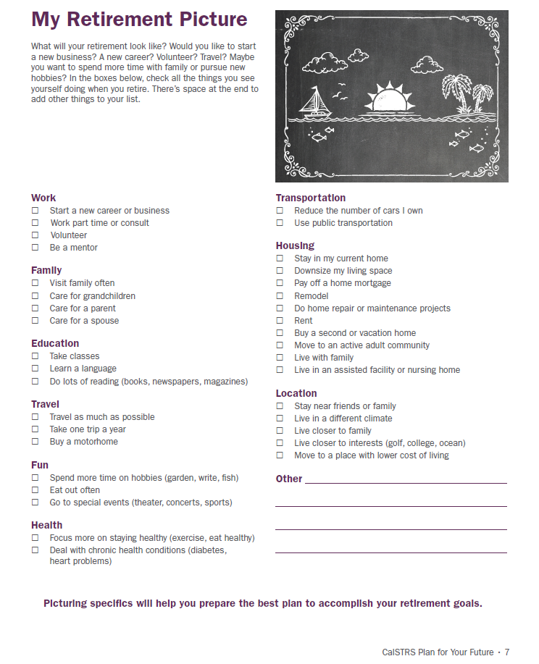
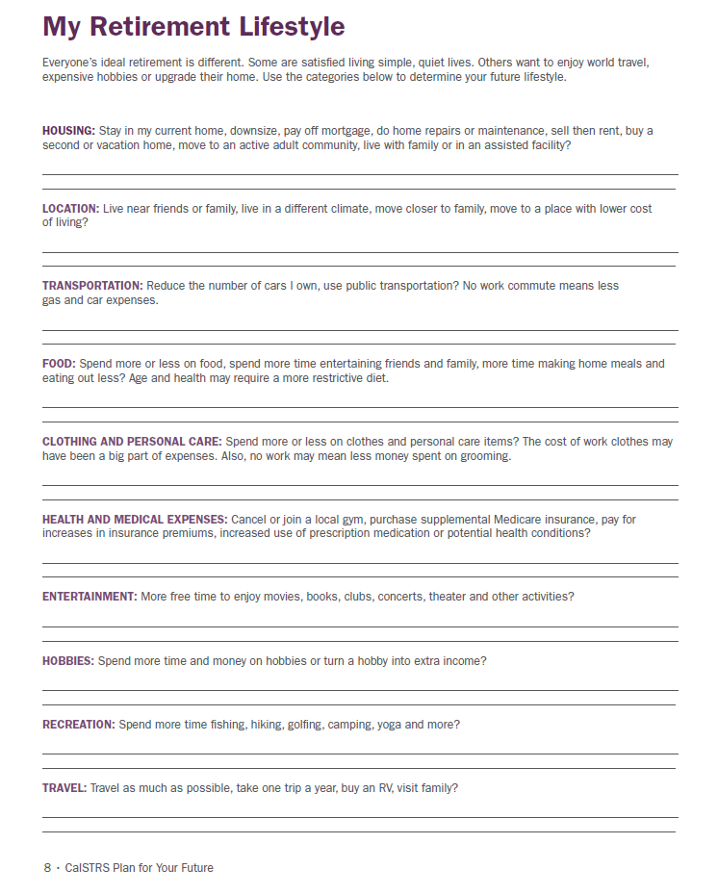
What Will Your Retirement Look Like?
#1
See workbook page 7 to complete the “My Retirement Picture” worksheet
See the “My Retirement Lifestyle” worksheet on workbook page 8 to complete at home
Notes:
Introduce the “My Retirement Picture” activity by asking member to turn to their workbooks (workbook page 7).
Ask members to start thinking about what they think or would like their retirement to look like. Ask them to review the items listed on the page and check those that apply to them.
Allow sufficient time (approximately 3-4 minutes) for members to consider their retirement plans.
Elicit responses from the participants about some of the things they are planning on doing in retirement and associated costs.
Encourage members to take a more in-depth look at their future in retirement by reviewing and completing the “My Retirement Lifestyle” activity at home (workbook page 8).
Ask participants to check the to do box 1 on the flap.
[click]

Slide 8
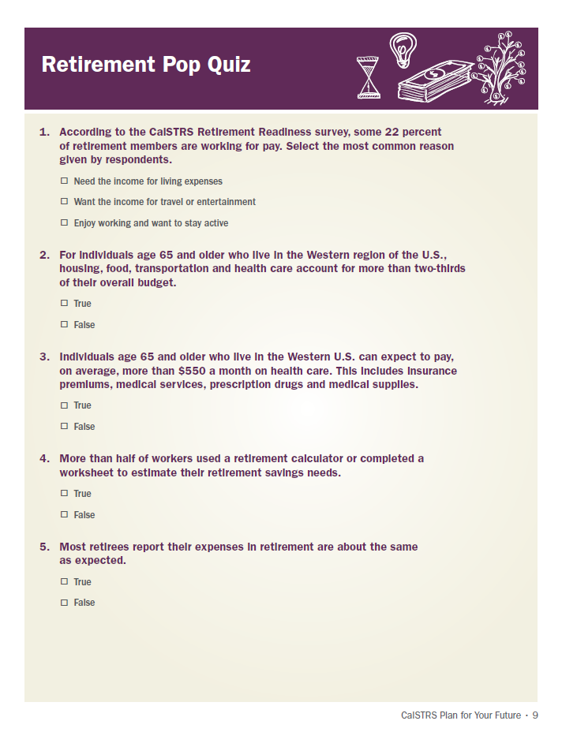
Retirement Pop Quiz
Pop Quiz! Retirement facts, figures and surprises
See workbook page 9 and take a few minutes to complete the quiz
Notes:
Encourage members to take a few minutes and test their retirement knowledge by taking the “Retirement Pop Quiz” (workbook page 9).
Allow sufficient time (approximately 3-4 minutes) for members to answer the quiz questions individually.
Provide answers to the questions and facilitate a brief discussion (workbook page 10).
Transition to Working in retirement
[click]
Working in retirement - Many people continue to work part-time in retirement because they need the money or enjoy their work. Continued employment can make up for a lack of retirement savings, allow you to afford a few retirement luxuries, and provide opportunities to socialize. Keep in mind though, you are not going to be able to work forever in retirement.
Transition to estimating monthly income.
[click]

Slide 9
Estimate Your Monthly Retirement Expenses
Estimate your retirement expenses to determine how much income you will need to retire
Start with how much you spend now and factor in the effect of inflation to estimate your future expenses
Notes:
Explain that the first step in successful retirement planning is assessing current and projecting future expenses.
[click]

Slide 10
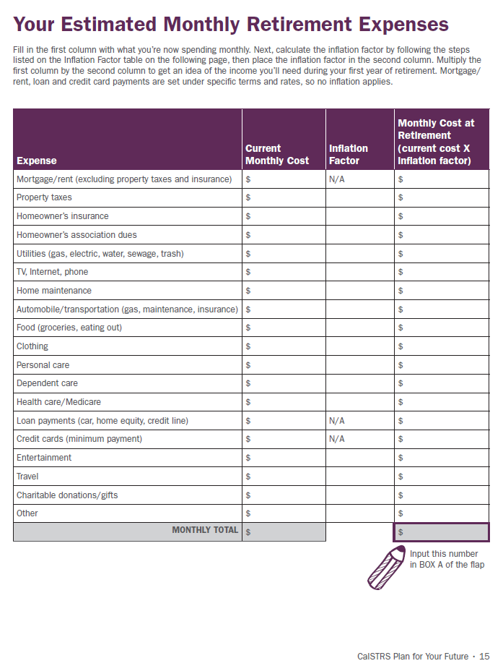
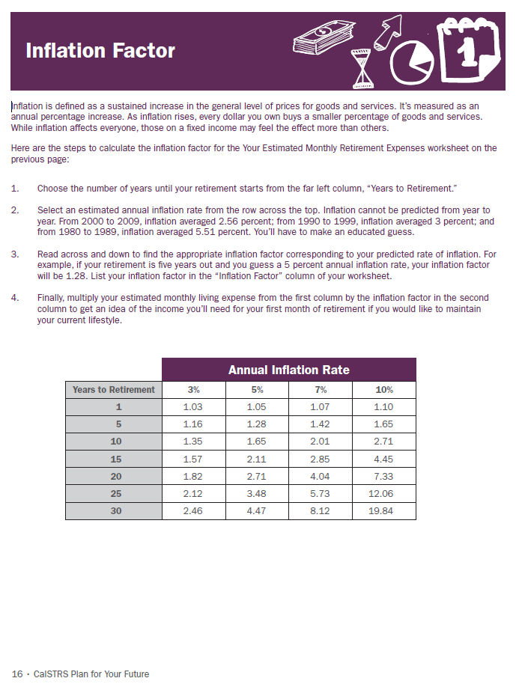
Estimate Your Monthly Retirement Expenses
Box A
See workbook page 15 to estimate your monthly retirement expenses
Use the inflation factor table on page 16 to help determine the future cost of your expenses
Notes:
Instruct participants to turn to the “Estimated Monthly Retirement Expenses” worksheet (workbook 15 & 16).
Encourage participants to consider each category listed on the worksheet and write down what they spend now, assume an inflation factor and project future expenses.
Ask participants to calculate their projected monthly total expenses and transfer that number to box A on the “flap”.
Elicit feedback from participants in terms of how helpful it was and weather it led to any surprising discoveries.
Refer participants to workbook page 18 regarding Inflation Protection. Discuss how their CalSTRS Pension has inflation protection features built into it.
[click]

Slide 11
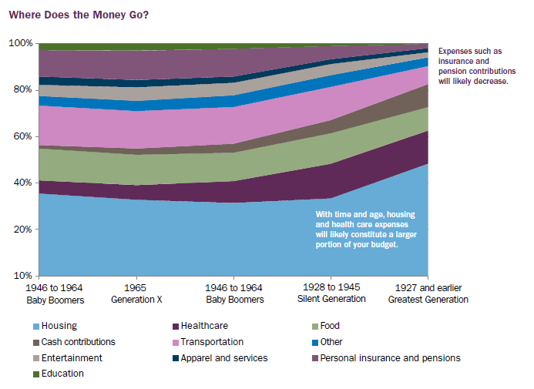
Changing Expenditures Over Time
Notes:
Explore the “Changing Expenditure Over Time” graph, focusing attention on Insurance/Pension and Health Care categories.
Refer participants to the graph in their workbook (page 19)
[click]

Slide 12
Health Care and Insurance Costs
Contact your employer about available health care options in retirement
Verify that you qualify for Medicare at 65
Contact Social Security 800-772-1213
Research your options:
Covered California 800-300-1506
Health Insurance Coverage Advocacy Program, HICAP California Health Advocates 800-434-0222
#2,3,4,5
Notes:
Encourage participants to explore potential healthcare costs.
Remind participants that Medicare is mandatory and that they should contact Social Security to verify their eligibility.
Encourage members to utilize their resources and start their research early.
Point out resource pages provided in the workbook (workbook 20-23).
Ask participants to check the to do boxes 2-5 on the flap.
[click]

Slide 13
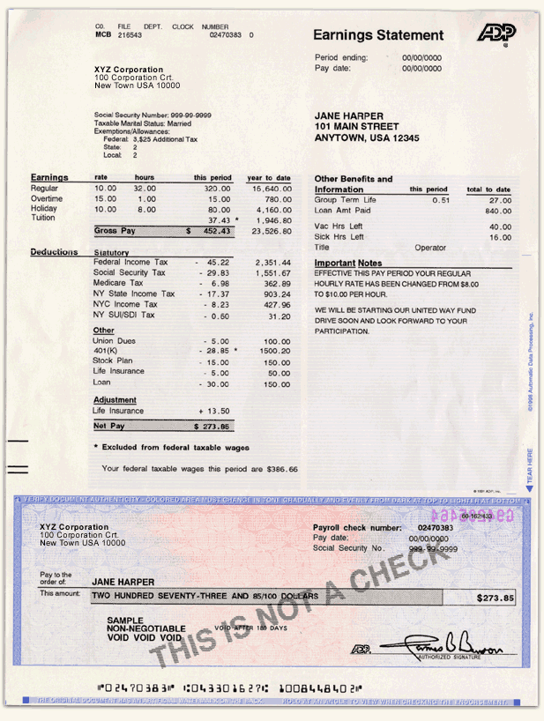
Eliminated Expenses
#6
You’ll no longer pay:
Union dues
Medicare tax
CalSTRS contributions
403(b) or 457(b) contributions
Disability insurance
Work-related expenses
Notes:
Explain that some expenses will be automatically reduced in retirement.
Encourage participants to access their paystubs and examine which of the current expenses will be eliminated after they retire.
Many deductions will cease such as your union dues, however there are opportunities to join retired union groups in retirement.
Ask participants to check the to do box 6 on the flap.
[click]

Slide 14
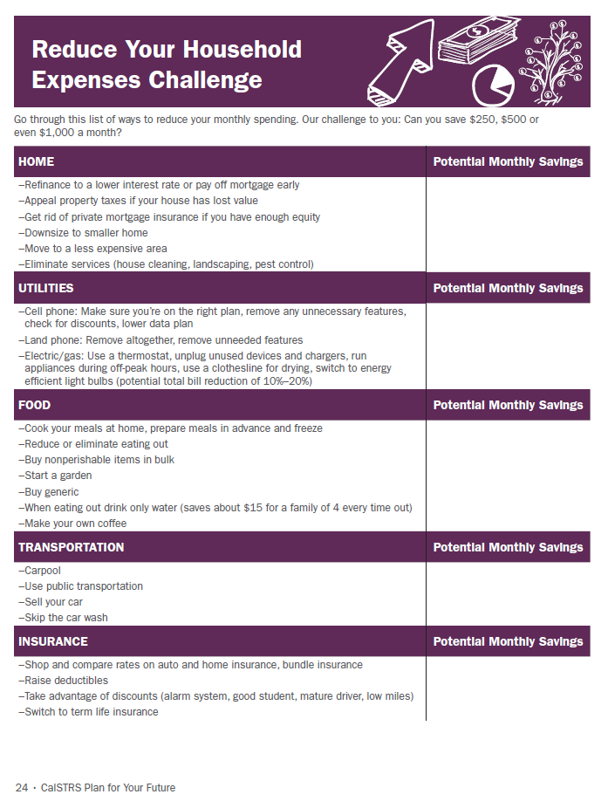
Reduce Your Household Expenses Challenge
Box B
Can you cut your spending by $250 a month? $500? $1,000?
See workbook page 24 to participate in the Reduce Your Household Challenge
Notes:
Encourage participants to participate in “The Reduce Your Expenses Challenge!” activity and try to reduce their own expenses by $250, $500 or $1, 000 per month (workbook 24-25).
Instruct participants to review the categories listed on the worksheet and write down the amounts they can reduce their expenses by in each of the categories. You may explain this in terms of “Wants v. Needs” or “Mandatory v. Discretionary Expenses.”
Allow approximately 5 minutes for participants to complete the worksheet.
Ask participants to calculate their projected monthly total expenses and transfer that number to box B on the “flap”.
Facilitate a brief group discussion.
[click]

Slide 15
Other Reduced Expenses
Sign up for Medicare on time
Take required minimum distribution on time
Take advantage of tax breaks
Notes:
Encourage members to consider the items listed on the slide as additional ways of reducing unnecessary expenses.
Transition to identifying sources of income.
[click]

Slide 16
The Gap
Watch “The Gap” video to understand how CalSTRS Pension2 can help you replace your working income in retirement
http://www.calstrs.com/the-gap
Notes:
Play the video, “the Gap” to open the discussion of income sources needed to cover potential retirement expenses. The CalSTRS hybrid plan offers three accounts to assist you in reaching your financial goals. Let’s identify your income sources.
[click]

Slide 17
Identify Your Income Sources
CalSTRS hybrid
Social Security
Additional income sources
Notes:
Preview the topics that will be discussed in this section.
[click]

Slide 18
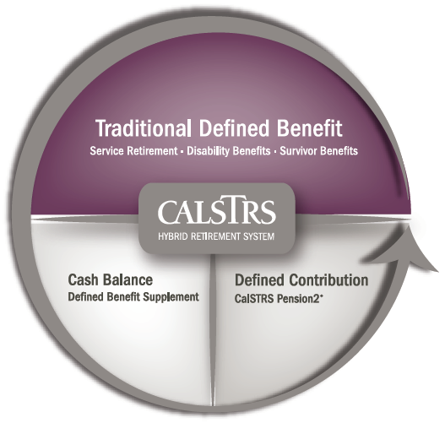
CalSTRS Hybrid
Defined Benefit
Service retirement benefit
Cash Balance
Defined Benefit Supplement account
Defined Contribution
CalSTRS Pension2
Notes:
Ask if there are any members attending that are participants in the Cash Balance Benefit Program.
Explain that CalSTRS is a hybrid retirement system.
Emphasize that members’ income in retirement is a shared responsibility between them and CalSTRS; CalSTRS benefits are just one of the available sources of income.
[click]

Slide 19
Understanding the CalSTRS Formula
https://www.calstrs.com/member-benefit-education-videos
Notes:
Introduce this video as helpful information regarding the defined benefit piece of the hybrid
Play the video, “Understanding the Formula” as a continuation of the discussion from the previous slide. Your defined benefit account is a key component in retirement planning.
Encourage participants to attend a CalSTRS benefits workshop or group session to learn more about their CalSTRS benefits and services.
Remind participants that our discussion today will remain focused on financial awareness topics.
[click]

Slide 20
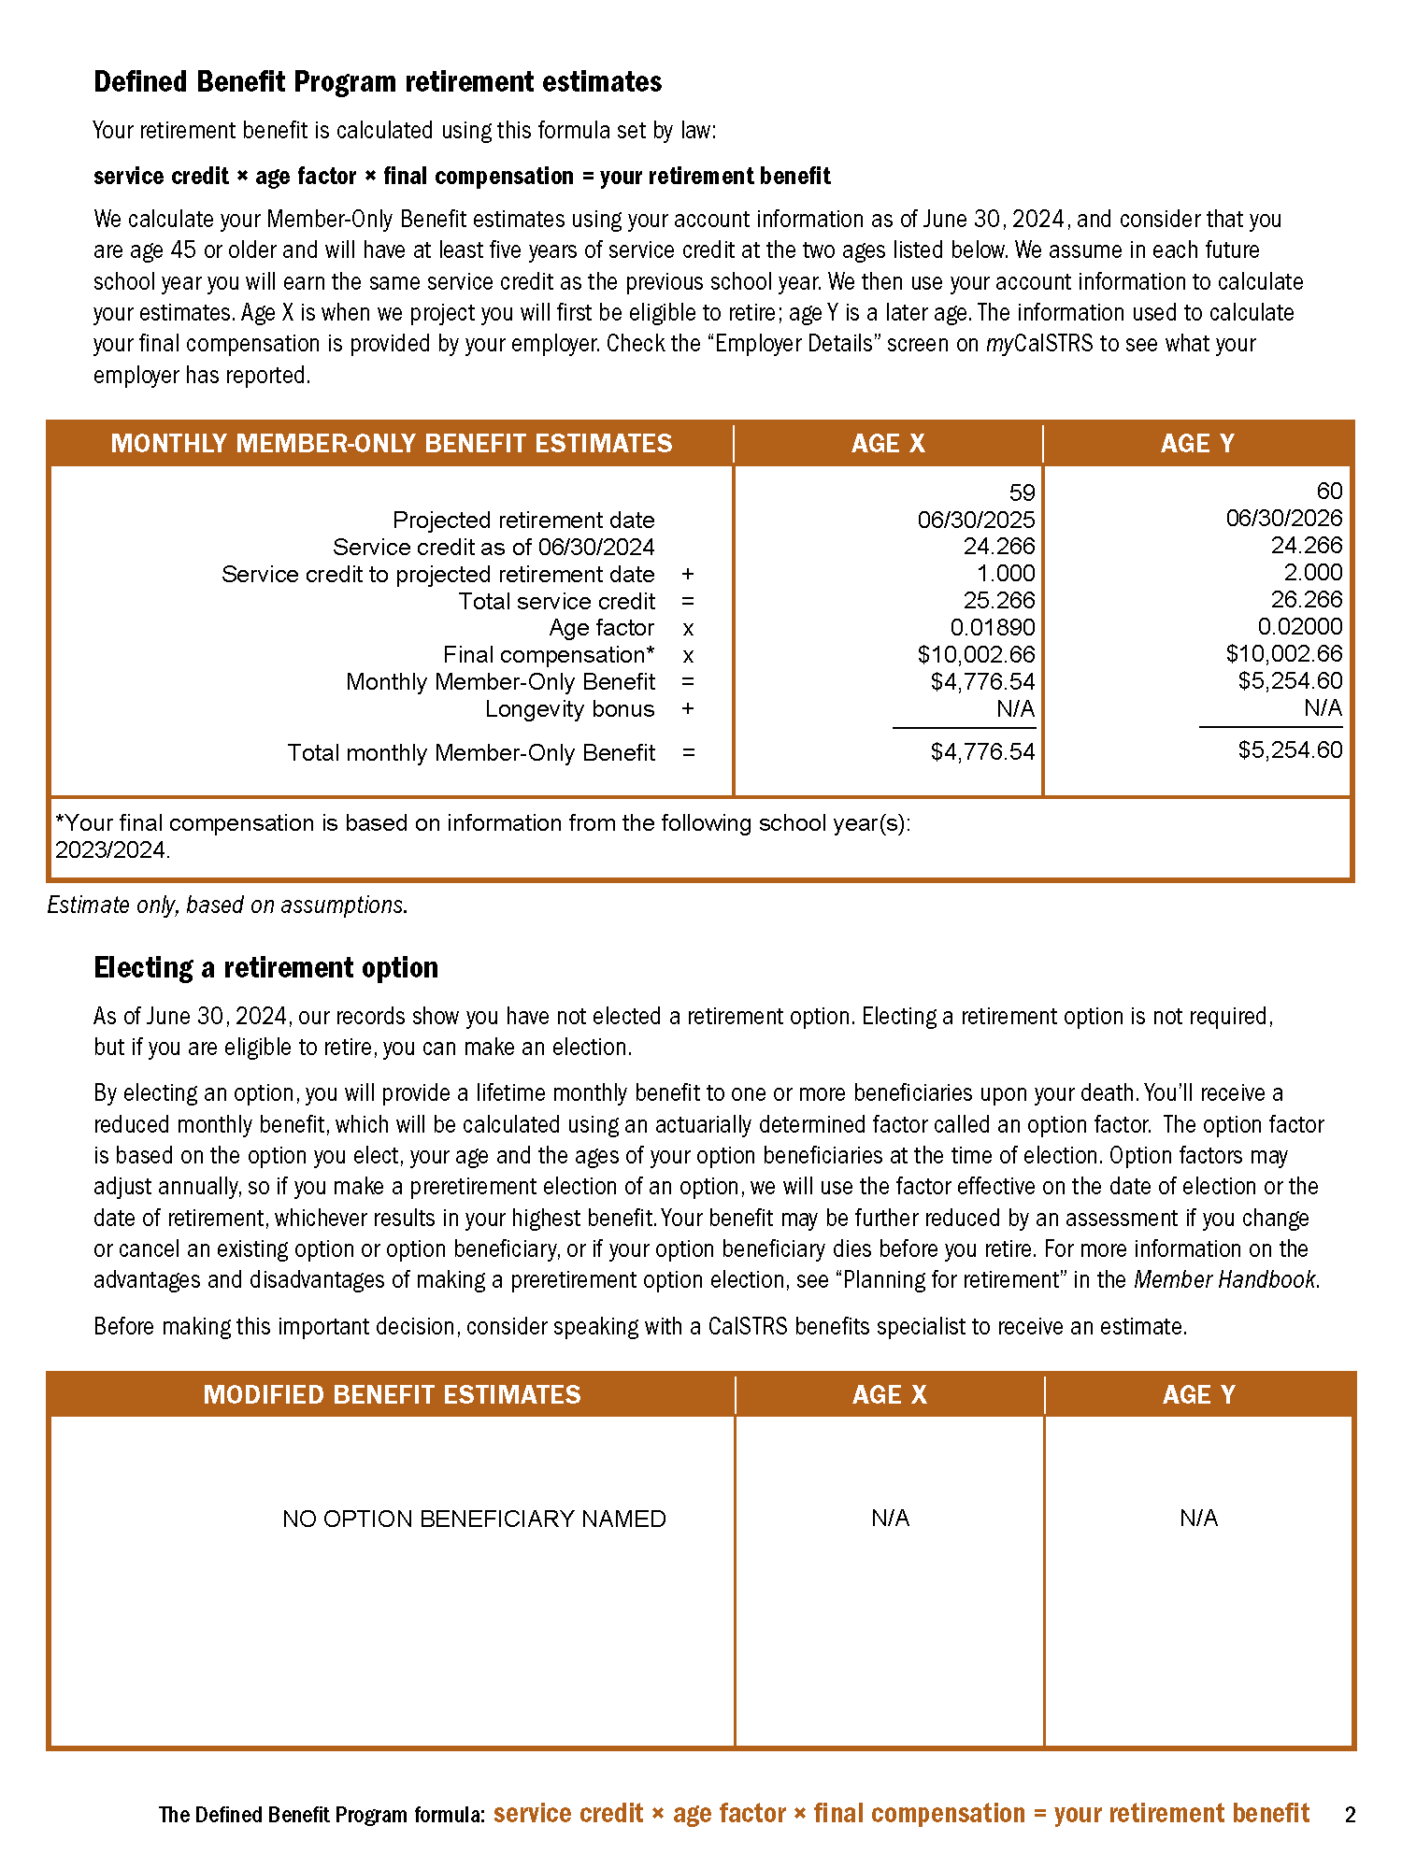
Defined Benefit Retirement Estimate
Retirement Progress Report
Box D,
#7, 8
Notes:
Explain that CalSTRS Defined Benefit retirement benefits replace, on average, about half of the members’ income while financial advisors recommend 80-90% for those who look to maintain the same lifestyle after retirement.
If there are Cash Balance participants attending, explain that this benefit will be significantly less than half of the participants income. Encourage them to schedule a benefits planning session to better understand their Cash Balance benefits. Emphasize that this workshop series is equally if not more important to them.
Discuss the concept of the gap.
Instruct participants to estimate their CalSTRS retirement benefits using their Retirement Progress Reports if available. Show members where to find this information in their RPR.
If there are Cash Balance participants attending, explain that they can find their account balance in their Cash Balance RPR. Provide a copy of the DBS annuity tables so they can estimate a potential monthly annuity based upon their account balance. Encourage them to see you after the session so you can provide additional information and resources (CB booklet and Member Handbook)
Your CalSTRS Defined benefit will be taxed as ordinary income. On your Service Retirement Application you will indicate to CalSTRS your tax withholdings; this is something you can update and change at any time throughout retirement on your myCalSTRS account. CalSTRS recommends that you contact your tax professional when determining you tax preferences.

Slide 21
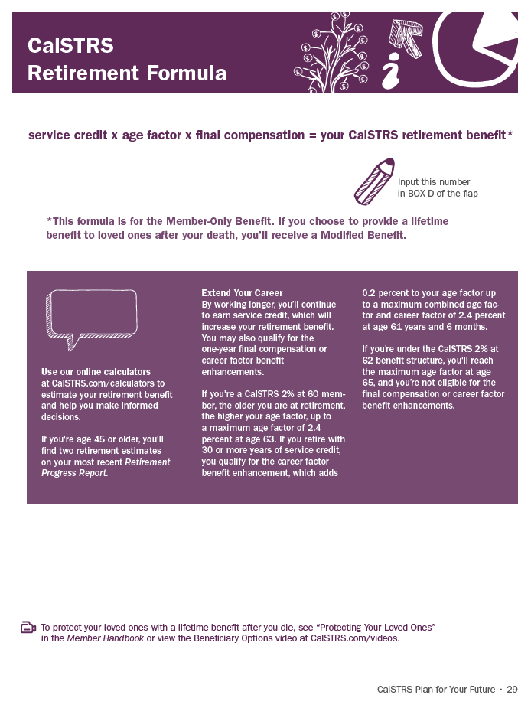
Defined Benefit Retirement Estimate
Service Credit
x
Age Factor
x
Final Compensation
=
Member Only Benefit
Notes:
Explain that those who don’t have their progress report can still estimate their CalSTRS retirement benefit by using the online calculators available on CalSTRS.com.
Refer participants to the workbook page 29.
Encourage participants to transfer that number to box D on the “flap” if they haven’t done so previously from the RPR.
If there are Cash Balance participants attending, explain that this formula does not apply to them. Encourage them to contact CalSTRS to schedule a session to discuss their Cash Balance benefit and to learn how it will fit into their income.
[click]

Slide 22
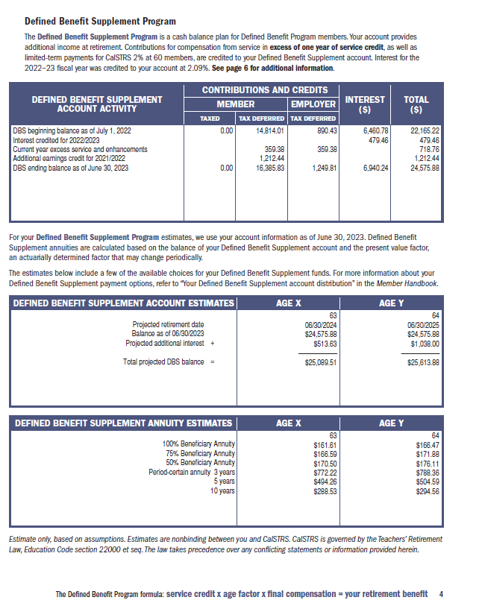
Defined Benefit Supplement Account
Box E,
#9
Notes:
· Remind the participants that another source of income provided by CalSTRS may be their Defined Benefit Supplement account.
· Point out to participants that their DBS balance and disbursement choices are available in their Retirement Progress Reports which are available on myCalSTRS.
· Briefly explain to participants that the DBS account may be taken at retirement as a monthly annuity, either for a limited number of years or for your lifetime, thus providing another monthly source of income.
· Encourage participants to discuss disbursement choices with their financial and tax professionals, as necessary.

Slide 23
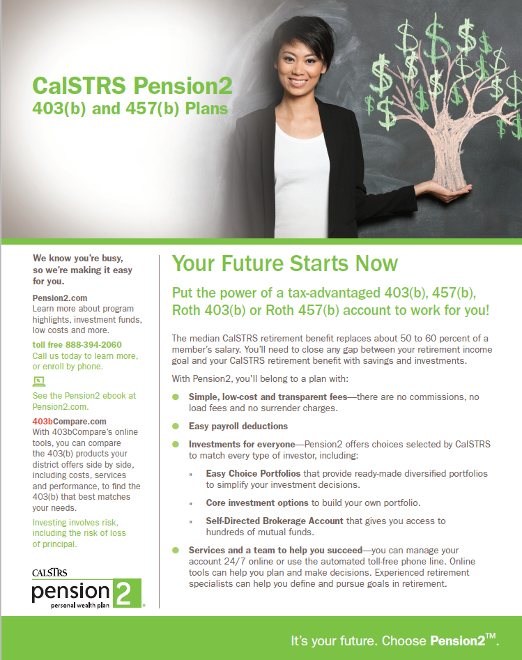
Supplemental Savings
#10
Help bridge your retirement gap
Voluntary contributions through payroll deductions
403(b), Roth 403(b), 457(b)
Notes:
Introduce Pension2 as the third component of CalSTRS as the hybrid retirement plan.
Briefly highlight the advantages of Pension2.
Tax Advantaged Contributions and Earnings – When you contribute directly to a 403(b) or 457 savings plan through payroll deductions, you defer taxes on the money you contribute. You get more savings for your contribution dollars, and your earnings grow tax-deferred.
Encourage participants to contact Pension2 with any questions and point out the contact form included in the workbook pages 31-32.
Ask participants to check the to do box 10 on the flap, if interested.

Slide 24
Social Security Facts
46 percent of active members think they will qualify for Social Security benefits
63 percent of California educators actually receive Social Security benefits
California public educators are subject to Social Security offsets
Notes:
Introduce Social Security as another potential source of income.
Discuss the Social Security facts listed on the slide.
Encourage members to take out their Social Security Statements. Those who don’t have their Social Security statement may follow along with the sample statement (workbook 33-36).
If there are Cash Balance participants attending, explain that they are subject to the offsets as well.

Slide 25
Social Security Benefit
Question #1:
How do I know if I qualify to receive a Social Security benefit?
Notes:
Inform members that as a group you will discuss a few of the most commonly asked questions regarding Social Security benefits.
Pose the question from the slide to the participants and allow time for members to volunteer their answers.
[click]

Slide 26
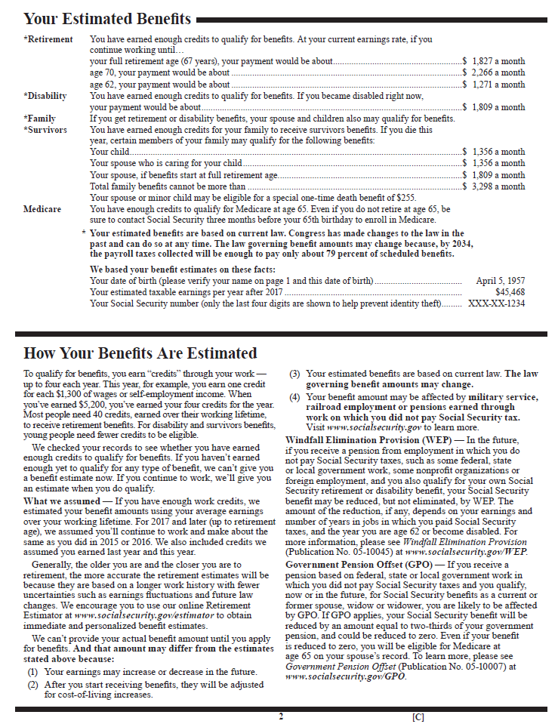
Social Security Benefit
Check page 2 of your Social Security statement
Contact Social Security at 800-772-1213
Notes:
Answer the previously posed question by expanding on the information included on the slide.
[click]

Slide 27
Social Security Benefit
Question #2:
Will my Social Security benefit be eliminated?
Notes:
Pose the question from the slide to the participants and allow time for members to volunteer their answers.
[click]

Slide 28
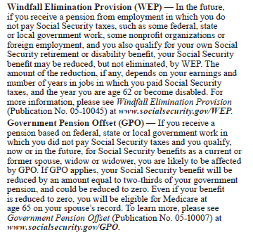
Social Security Benefit
#11
41 percent of members are affected by the Windfall Elimination Provision
26 percent of members are affected by the Government Pension Offset
Contact Social Security at 800-772-1213
Notes:
Answer the previously posed question by expanding on the information included on the slide.
Encourage members to use the WEP calculator on SSA.gov.
[click]
Direct members to the Social Security, CalSTRS and You flyer (workbook 37-38).
Ask participants to check to do box 11 on the flap.
[click]

Slide 29
Social Security Benefit
Question #3:
When should I start receiving my Social Security benefit?
Notes:
Pose the question from the slide to the participants and allow time for members to volunteer their answers.
[click]

Slide 30
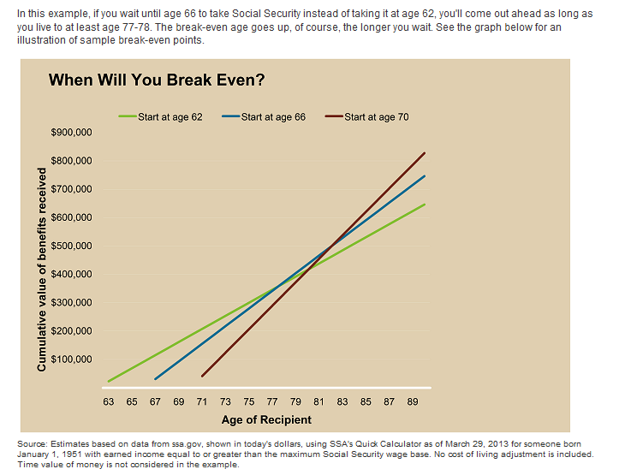
Social Security Benefit
Notes:
Answer the previously posed question by expanding on the information included on the slide. There tend to be two schools of thought – “I am going to take social security as soon as I can” or “ I am going to wait until the benefit is as high as possible before I begin to take it”. You may want to discus this break even point with your financial professional.
[click]

Slide 31
Social Security Facts
Things to consider:
Your current cash needs
Your health and family longevity
Whether you plan to work in retirement
Other retirement income sources
Your anticipated future financial needs
The amount of your future Social Security benefits
Notes:
Lead a brief discussion about the things participants should consider when deciding on the timing of their Social Security benefit.
These are things to consider to point you in the right direction. Since every household is different, for more information on when you should file for social security, ask your financial advisor.
[click]

Slide 32
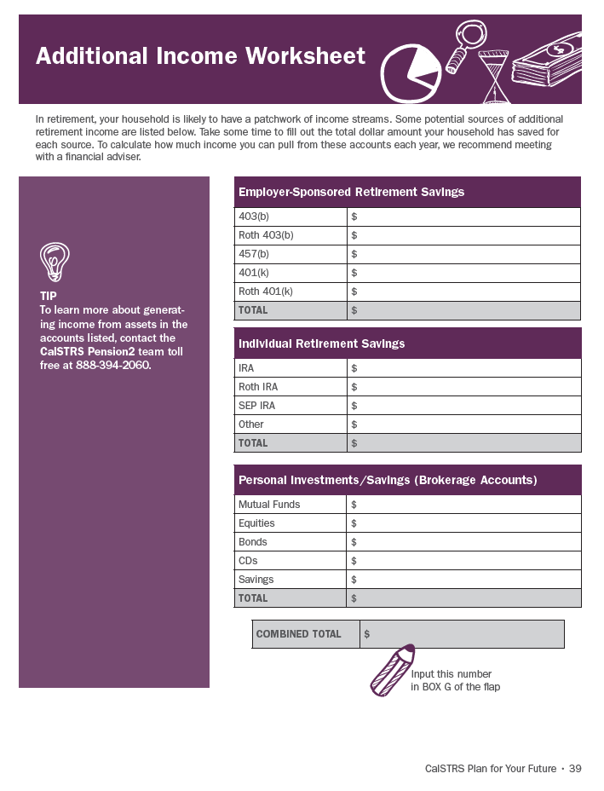
Additional Sources of Income
See workbook page 39 to list the total assets you have for each type of account
Transfer the combined total to your flap
Turn your assets into income
#12,13
Notes:
Direct participants to the “Additional Sources of Income” worksheet (workbook 39).
Encourage participants to list all their additional retirement savings accounts and transfer the combined total to box G on he “flap.”
Explain that their homework is to contact those savings plans administrators and find out how much monthly income can these accounts generate in retirement and for how long.
Also note that it may be in their best interest to speak with a tax professional or financial advisor regarding the different tax consequences and benefits of both accumulating money in these accounts and eventually withdrawing income from these accounts.
Another possible income source – Inheritance. However only a small percent of Americans expect to receive an inheritance large enough to help fund their retirement (US News and World Report)
Ask participants to check the to do box 12 & 13 on the flap.
[click]

Slide 33
Consider Possible Obstacles
Inflation
Longevity
Health care
Market risks
Notes:
Shift discussion to possible obstacles retirees often face.
Preview the topics that will be discussed in this section.
Direct participants to the “Retirement Obstacles” quiz (workbook 43).
Allow a few minutes for participants to answer the questions.
[click]

Slide 34
True or False
The highest inflation experienced in the U.S. was nearly 24 percent.
TRUE
Notes:
Facilitate the discussions by posing true or false questions to participants.
[click]
True – it happened during the Great Depression.
Discussion: currently inflation as reported on March 18, 2014 by the Bureau of Labor Statistics for the last 12 months was 1.1%. However, just because it is low now it doesn’t mean you shouldn’t plan for it being much higher at some point in your retirement.
Source: Bernholz, Peter. 2003. Monetary Regimes and Inflation. Northampton, MA: Edward Elgar Publishing.
[click]

Slide 35
Historical U.S. Inflation Rates
Percentage
The table displays historical inflation rates with annual figures from 1920 to the present. The inflation rates are calculated using the
Consumer Price Index, which is published monthly by the Bureau of Labor Statistics (BLS) of the U.S. Department of Labor.
Notes:
· Allow a moment for the participants to examine this US inflation rate chart.
Inflation can erode purchasing power. Inflation refers to the rate at which the prices of goods and services rise. Different goods and services experience rising costs at different rates, so we typically hear about the average inflation rate. The consumer price index may be the most common general measure of average inflation. Planning for inflation is important to your retirement planning since inflation can erode savings and deplete budgets. As you can see in the chart provided inflation is erratic from year to year but always there.
[click]

Slide 36
True or False
In 1980, a dollar could purchase twice as many goods as it can today.
FALSE
Notes:
Facilitate the discussions by posing true or false questions to participants.
[click]
False – costs have increased threefold since 1980
Discussion: your retirement dollars will lose value. As a counter measure, CalSTRS provides its member with a 2% non-compounded Annual Benefit Adjustment and the Purchasing Power Protection plan which guards your retirement benefit from losing more than 15% of it’s value. What about your other sources of income? Are they protected against inflation?
Source: Domestic Grosses Adjusted for Ticket Price Inflation.” Box Office Mojo. Accessed: August 20, 2010.
[click]

Slide 37
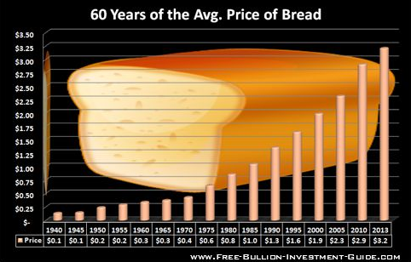
Price of Bread 1940-2013
Notes:
Allow participants a moment to examine the Bread Price Chart as an example of the average purchasing price of a 1lb. Loaf of Plain White Bread, in the United States.
Another example: think about what the cost of a postage stamp cost 20 years ago, much less than it does now. That is inflation.

Slide 38
True or False
A CalSTRS member’s average target retirement age is 65 years old.
FALSE
Notes:
Facilitate the discussions by posing true or false questions to participants.
[click]
False – it’s 61 years old.
Discussion: given what we know about life expectancies, you want to plan for a long retirement. Work with a reputable financial advisor and your tax preparer.
Source: CalSTRS Retirement Readiness Assessment 2013.
[click]

Slide 39
Average Retirement Age
Notes:
This graph is a reflection of the entire US population, not just CalSTRS members.
Point out - the fact that there’s a tendency to expect a higher retirement age than what takes place in reality. http://www.gallup.com/poll/168707/average-retirement-age-rises.aspx
Explain that this discrepancy between expectations and actual retirement age might be caused by many factors, some of which are health and family situations that may cause people to retire sooner than anticipated.

Slide 40
True or False
An average CalSTRS member may expect to be retired for 19.2 years.
FALSE
Notes:
Facilitate the discussions by posing true or false questions to participants.
[click]
False – it’s actually over 25 years, depending on gender.
[click]

Slide 41
CalSTRS Retirement
 | Male | Female
Expected Length of Retirement (years) | 25.9 | 27.9
Notes:
Discussion: according to the last experience study prepared by Milliman (2010).
Expected length of retirement (years):
Male – 25.9
Female – 27.9

Slide 42
True or False
Medicare will provide for 100 percent of my health care needs in retirement.
FALSE
Notes:
Facilitate the discussion by posing true or false questions to participants.
[click]
False– Medicare does help with medical costs, but it does not pay for everything. For many retirees this can be considered an unforeseen circumstance, especially when an unexpected /catastrophic illness occurs. Some retirees will want a supplemental policy. These can be quite expensive and annual cost increases have become the norm.

Slide 43
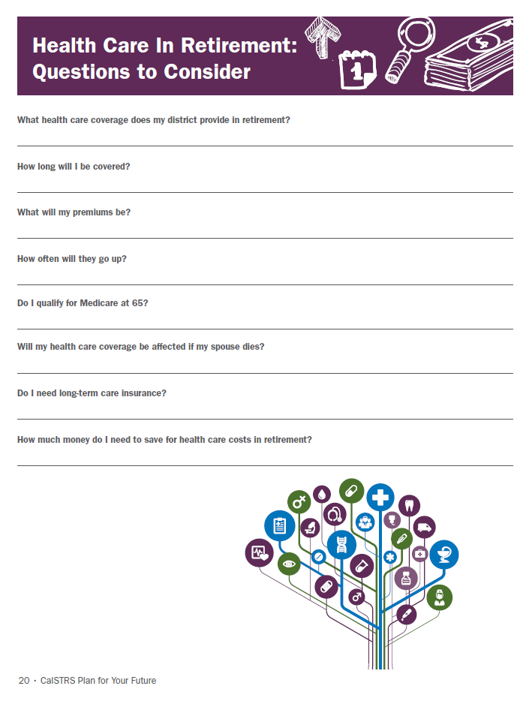
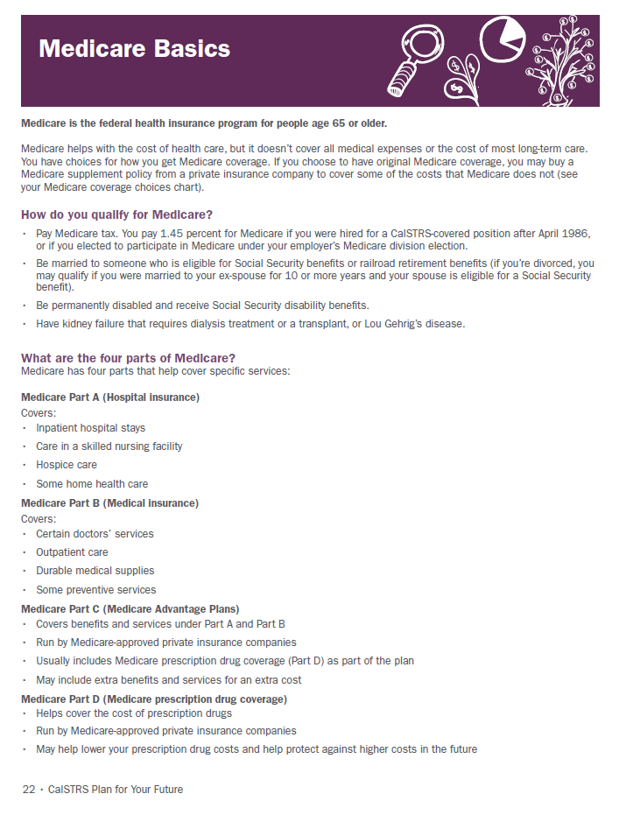
CalSTRS Retirement
Review the Medicare Basics fact sheet
Research the Questions to Consider
Notes:
Direct participants back to the workbook pages 20-23 for more information on Medicare basics, Health Insurance resources and questions to consider
Discussion: It is important to also think of other unforeseen circumstances such as: care of dependent parents, the loss of a spouse or partner and acts of nature.
[click]

Slide 44
True or False
On average, your CalSTRS retirement benefit will replace 50 percent of your working salary.
TRUE
Notes:
Facilitate the discussions by posing true or false questions to participants.
[click]
True–The average CalSTRS retirement benefit replaces about half of your working salary.
Discussion: It is important to utilize supplemental savings plans such as CalSTRS Pension2 or other 403(b), 457(b) accounts to help you offset the potential decrease in income during your retirement years.
[click]

Slide 45
True or False
Market risk cannot be eliminated from my investment portfolio.
TRUE
Notes:
Facilitate the discussions by posing true or false questions to participants.
[click]
True–The average CalSTRS retirement benefit replaces about half of your working salary.
Discussion: It is important to utilize supplemental savings plans such as CalSTRS Pension2 or other 403(b), 457(b) accounts to help you offset the potential decrease in income during your retirement years.
[click]

Slide 46
Guaranteed rate of return option for those not interested in the ups and downs of the stock market.
Contact CalSTRS Pension2 for more information.
Notes:
Discussion:
Market Risk can’t be avoided completely, however there are investment options available that provide a guaranteed rate of return and eliminate the risk of losing your principal. One such investment option is available to CalSTRS Pension2 members. If you are interested in seeking more information regarding this, please refer to page 31 of your workbook for information on how to contact the CalSTRS Pension2 team.

Slide 47
What Are Your Next Steps?
#14,15
Do the math
Review your Action Plan
Attend the two other workshops in our Financial Awareness series:
-- Save For Your Future and
-- Protect Your Future
Notes:
Instruct members to turn to the flap and calculate their income and expenses.
Add boxes A and B – result: Box C
Add boxes D, E and F – result: Box H
Transfer numbers from boxes H and C into the corresponding boxes below
Subtract value C from value H
The resulting value is either an excess (good news) or a deficit (bad news)
Encourage members to review the check list on the bottom portion of the flap and check off any action items that apply. Also, keep in mind that you may have spousal income to include in your sources of income which will help balance the household expenses.
Ask participants to check the to do boxes 14 & 15 on the flap.

