Slide 1
Retire Now or Later
Notes:
Welcome to the CalSTRS Retire Now or Later workshop. My name is , and I am a benefits specialist at the __________ Member Service Center/ office.
*Introduce yourself *
This workshop is very hands on and tech heavy so make sure you have your smart phones or tablets handy. I have provided the Wi-Fi network and password on the board.
*Pause to allow time to log into the network with password*
I have also passed out a folder containing the Retire Now or Later workbook and worksheet. Please make sure you have a pen as there will be things to fill in and a little bit of math.
This is meant to be an interactive session, so I really encourage you to ask questions at any time during the presentation.
Click.

Slide 2
Trust not impersonators
CalSTRS authorized representatives:
Have an email address ending in @CalSTRS.com.
Can provide a CalSTRS ID badge or business card.
Do not provide refreshments at offsite events.
Will never meet at your home.
Do not sell insurance products.
Notes:
Firstly, we’ve been receiving constant reports from our members believing they’ve set up an appointment or spoken with a CalSTRS representative when they have not. Only CalSTRS employees can provide you with accurate information regarding your CalSTRS Defined Benefit and Pension2 accounts. We’ve developed a checklist for you to use to ensure the person with whom you’re speaking is a CalSTRS employee.
Companies or individuals not affiliated with CalSTRS cannot have the CalSTRS logo on their advertisements.
Only CalSTRS employees will have an @CalSTRS.com e-mail address on their business cards. Please double-check the spelling of CalSTRS.
CalSTRS does not provide any refreshments when we come to see you at events.
CalSTRS employees will never meet you at your home.
CalSTRS is not an insurance company, so we will never try to sell you on any insurance products.
Click.

Slide 3
Trust not impersonators
Have access to your CalSTRS or Pension2® account information.
Some Voya Financial representatives work exclusively with Pension2®.
Their names and photos are listed at CalSTRS.com/Trust-CalSTRS.
To verify a CalSTRS representative, contact us at 888-394-2060 or RepCheck@CalSTRS.com
Notes:
Only CalSTRS employees will have access to your CalSTRS or Pension2 account information. If you’re asked to provide a copy of your CalSTRS Retirement Progress Report or Pension2 account statement in order for someone to assess your CalSTRS accounts, they are not affiliated with CalSTRS.
CalSTRS has created a webpage at www.CalSTRS.com/Trust-CalSTRS with names and pictures of all our member-facing employees. This webpage is kept up-to-date, so you can always ensure you’re speaking with a CalSTRS employee. There are some representatives from Voya Financial with an @Voya.com e-mail address who work exclusively on the Pension2 program. Their names and photos will also be found on the CalSTRS Outreach Page.
If you scheduled an appointment or already met with someone you think may not be a CalSTRS representative, contact us at 888-394-2060 or RepCheck@CalSTRS.com to verify they are a CalSTRS representative.
Please disseminate this information to any friends or colleagues who may need it.
Click.

Slide 4
Objectives
Learn to use myCalSTRS and the
Retirement Benefits Calculator.
Read and understand your Retirement Progress Report.
Determine if you can retire now or later.
Notes:
How many of you are here because you have been offered an incentive?
How many of you are here because you want to retire now?
How many of you are here because you want to hear about how you can increase your monthly benefit?
We are going to give you some tools to help you answer all of those questions. These tools are at your fingertips 24/7.
Click.
In today’s workshop you will learn how to utilize and navigate through your myCalSTRS account as well as the online calculator on CalSTRS.com.
Click.
You will develop a better understanding of your Retirement Progress Report. This report provides comparative retirement estimates.
Click.
By utilizing these tools, you will be able to decide if you can retire now or later.
Click.

Slide 5
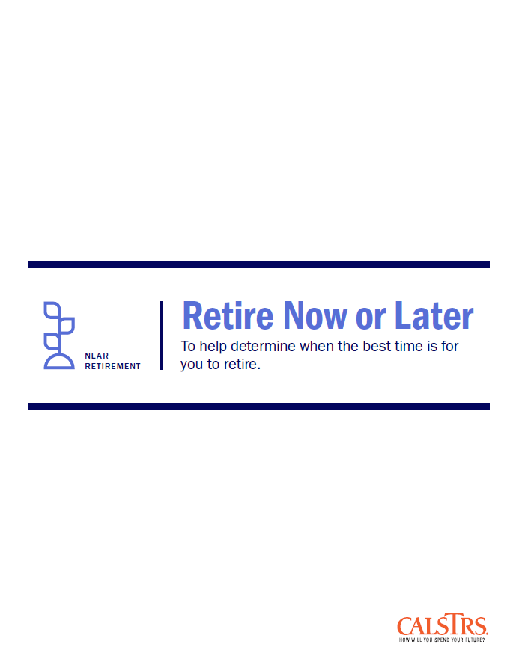
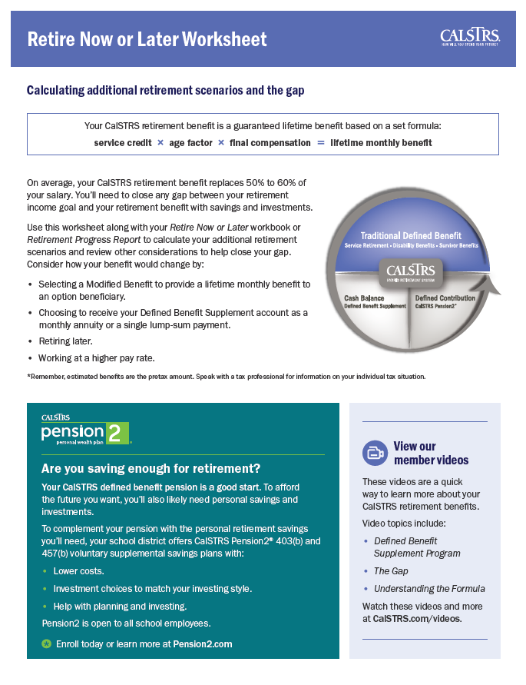
Today’s Tools
Retirement Progress Report
Now or Later Worksheet
Calculator
Now or Later Workbook
Notes:
Some of the tools you will need for today’s workshop include:
The NOL workbook I mentioned earlier – this will act as our guide and includes important notes and calculations.
Your Retirement Progress Report (RPR). If you did not bring a printed copy of your RPR, do not worry, because you will learn how to pull a copy from your myCalSTRS account.
The NOL worksheet (also in your folder) will be used later in Section 7.
You may need a calculator as there is a bit of math involved.
***If there are calculators available for members to use, you can announce that ***
Click.

Slide 6
CalSTRS hybrid retirement system
Defined Benefit
account
x final compensation = your retirement benefit
x age factor
service credit
Notes:
Your CalSTRS retirement is a hybrid retirement system comprised of 3 different pieces.
Click.
The Traditional Defined Benefit represents the main part of your retirement benefit.
This benefit is a guaranteed lifetime monthly benefit. It is based on a formula not on the balance in the account.
Does anyone know what the formula is?
That formula is:
Click.
Service credit
Click.
x age factor
Click.
x final compensation = lifetime monthly benefit.
Click.

Slide 7
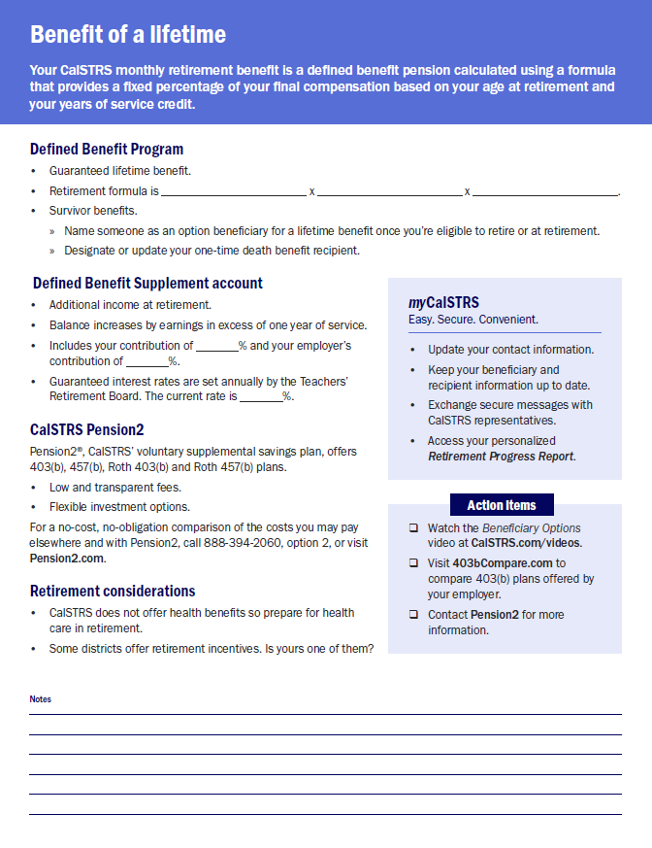
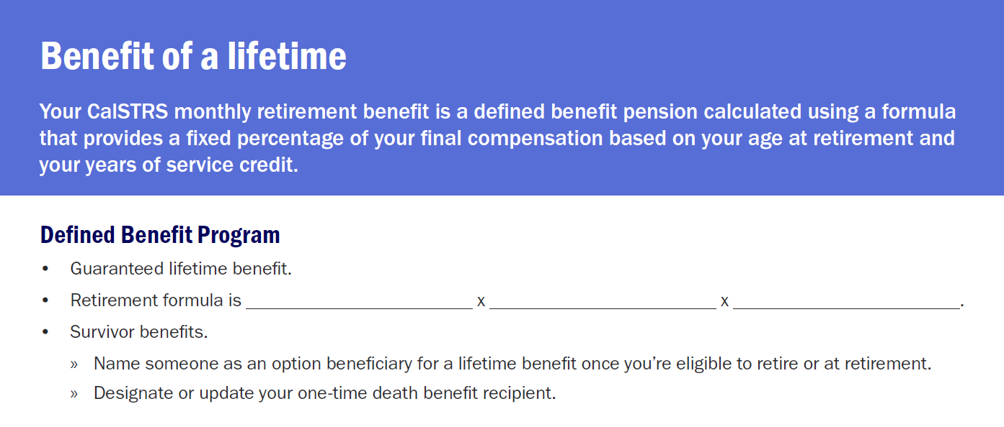
Retire Now or Later Workbook
Service Credit
Age Factor
Final Compensation
Notes:
You can write down the retirement formula on page 1 of your workbook.
Click.
***allow time to complete fill-in***
We are going to explore each of the 3 components of the formula as we go through today’s presentation.
There will be more fill-ins and sections to take notes as we cover these next few slides.
Click.

Slide 8
Protecting a loved one
Provide a lifetime benefit
for a loved one
Pre-elect once eligible to retire
Elect at retirement
One-time
death benefit
Designate a recipient today!
Notes:
How many of you are interested in providing a lifetime benefit for a loved one after your passing?
Included in the CalSTRS Defined Benefit Program are some benefits that can allow you to protect a loved one.
Click.
As a CalSTRS member you can elect to leave a lifetime monthly benefit for a loved one after your passing. The person you elect will be known to CalSTRS as your beneficiary. While retired, your benefit will be actuarily reduced based on your age and the age of your beneficiary at the time of election.
Click.
You can put this protection in place, even while you are still working. You can elect your beneficiary as soon as you meet the minimum requirements to retire from CalSTRS.
Click.
There are a few exceptions, but generally your last opportunity to leave that lifetime benefit is on your application to retire.
There are advantages as well as disadvantages in pre electing a beneficiary. For more information on when and how to elect please visit CalSTRS.com to watch our short beneficiary options video. In your workbook you will notice a link to our video page.
Click.
Also, built into your CalSTRS Defined Benefit plan is the One-Time Death Benefit. The person you name will be known to CalSTRS as your recipient. You should have a recipient designated for this benefit throughout your career and in retirement.
Click.
So if you haven’t done so, you can log on to myCalSTRS and designate somebody today.
A little later we will look at your Retirement Progress Reports and we can determine if you have designated a recipient or a beneficiary.
Click.

Slide 9
CalSTRS hybrid retirement system
Defined Benefit
Supplement
account
Notes:
We have talked about the defined benefit account.
Click.
The next part of the hybrid is the Defined Benefit Supplement (or DBS) account. Distribution from this account depends on your account balance at retirement. There are several distribution choices from this account that we will talk about when we review the retirement progress report.
Click.

Slide 10
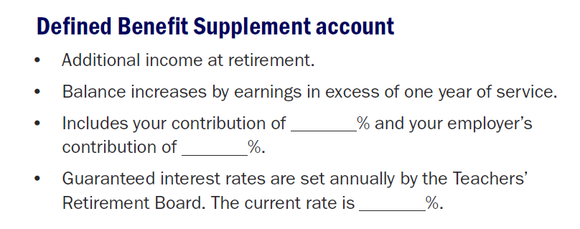
2% at 60
8%
8
2% at 62
4.61
9%
Notes:
Let’s complete the fill-ins under the Defined Benefit Supplement section.
Click.
Your contribution rate depends on when you were first hired.
For those of you that were hired on or before December 31, 2012 you are contributing 8% of your excess earnings. If you were hired on or after January 1, 2013 you’re contributing 9% of your excess earnings.
Regardless of when you were hired, your employer contributes 8%.
This account also earns guaranteed interest at a rate set annually by the teacher’s retirement board. Currently, this interest rate is: 4.61%.
Click.

Slide 11
Defined Benefit Supplement History
DBS Account | DBS Account
%
2001-2010
a quarter of Defined Benefit contributions redirected
Excess earnings
Guaranteed interest
Notes:
Click.
The Defined Benefit Supplement (DBS) account was established in 2001. If you were a member at anytime from 2001-2010, a quarter of your Defined Benefit contributions were redirected to the DBS account. Because of that redistribution, the DBS account balance was able to grow.
Click.
Then starting in 2002 and ongoing, any excess contributions from the work you did above and beyond 1.00 of service credit were credited to this account. For instance, if you worked extra duties, coached, or taught summer school, 8% of those contributions plus a matching 8% from your employer were credited to your DBS account. That means that for any of that extra work, you had 16% of your salary going into your account.
Click.
And lastly, from the beginning this account has been earning its own separate compounded interest. The interest rate changes each fiscal year.
Click.
Although the redirection of contributions discontinued in 2010, you still continue to receive 8% (for 2% @ 62 members 9%) credit from you and your employer for those extra duties and the account will continue to earn interest until you retire.
Click.

Slide 12
CalSTRS hybrid retirement system
Notes:
Those first two pieces of the hybrid are automatically included with your Defined Benefit membership.
Click.
The third piece of the hybrid is a voluntary portion. This benefit is called CalSTRS Pension2. It is a voluntary defined contribution plan. You can utilize this program to roll over the funds from your defined benefit supplement account at retirement. In addition to the DBS funds you can also rollover funds from outside retirement savings accounts, consolidating them into one account. Finally, for those of you receiving a retirement incentive and are looking for a place to invest your incentive money, Pension2 can accept those funds as well.
The advantages of investing with Pension2 include no commissions, no load fees, and no surrender charges. There are flexible investment options to match every type of investor.
CalSTRS Pension 2 offers several different accounts. They offer 403b, 457(b), roth 403(b) and roth 457(b) accounts.
They can provide no cost, no obligation comparisons between the costs you may pay elsewhere and Pension2. If you want to do some research on your own, you can visit 403bcompare.com to compare all 403b products offered in California.
Click.

Slide 13
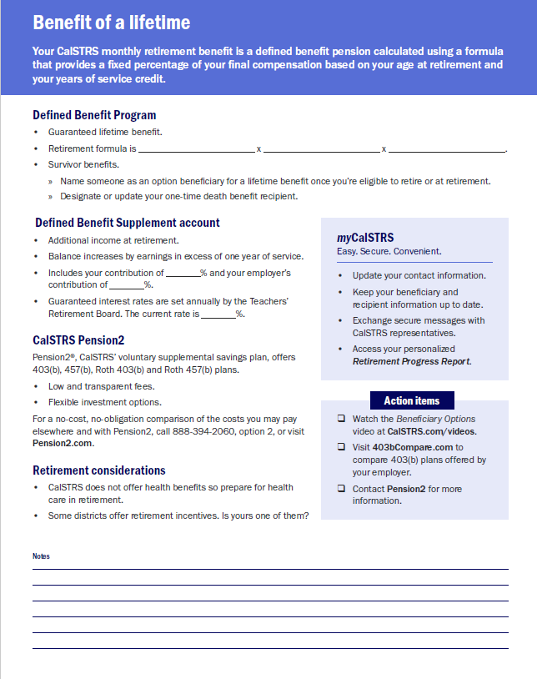
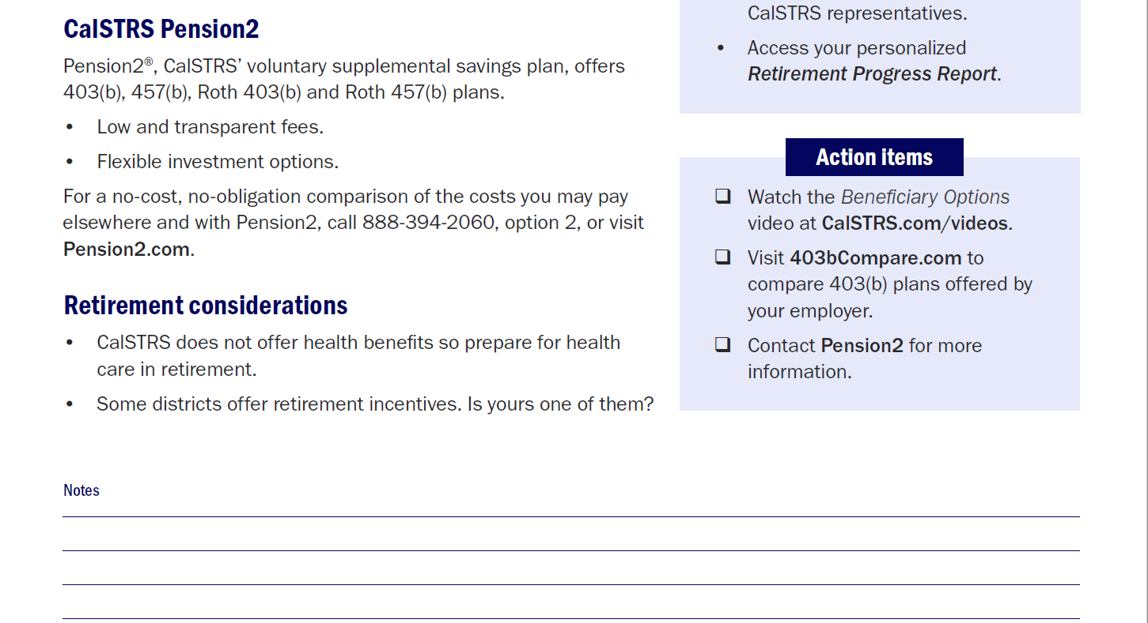
Notes:
If you are interested in opening a Pension2 account, we have provided their contact information in your workbook.
Click.
As we close out this section of the presentation, take note of the action items that are at the bottom of the page. Check mark any items that interest you as a reminder to do after this presentation.
Click.

Slide 14
Retirement considerations
Benefit
amount
Health
care
Retirement incentive
Closing
the gap
Notes:
Click.
Your CalSTRS defined benefit is the main part of your retirement. The average CalSTRS member replaces about 50% of their final compensation from their defined benefit. How much you are getting may drive your decision to retire now…or later.
Click.
You should also consider if your employer is going to provide you with health benefits in retirement. Having to pay for health benefits can be a key factor when trying to determine when to retire.
***according to ehealth in 2017 the average individual spent $440/month on health insurance.
Click.
If you are getting a retirement incentive from your employer, factor that amount into your income. Keep in mind that employers don’t always provide an incentive every year. We will go into a little more detail about how an incentive may affect your retirement.
Click.
Ultimately, if you are unable to retire this year, we will discuss different ways you can close the gap between what you will receive and what you will need by increasing your retirement income.
Click.

Slide 15
Section 1
How much will you need?
1
2
9
3
4
5
6
7
8
Notes:
On the next page in your workbook, let’s review Section 1.
How much you will need in retirement?
Click.

Slide 16
How much will you need?
Mortgage
Bills
Car payment
Health care
Other
1
2
9
3
4
5
6
7
8
Notes:
The first step in determining if you can retire is to determine your expenses in retirement. We’ve listed some examples of expenses you may want to consider.
Click.
Consider your Mortgage or rent payments. Some of you may be paying off your houses in retirement.
Click.
Don’t forget all of your miscellaneous bills such as utilities and cable.
Click.
Consider a car payment if you plan to have one.
Click.
Think about health care costs; CalSTRS does not provide health benefits in retirement so that may be an expense you are going to incur.
Click.
Also, if you have any other financial obligations that you should consider not listed here remember to include them in your calculation.
Click.

Slide 17
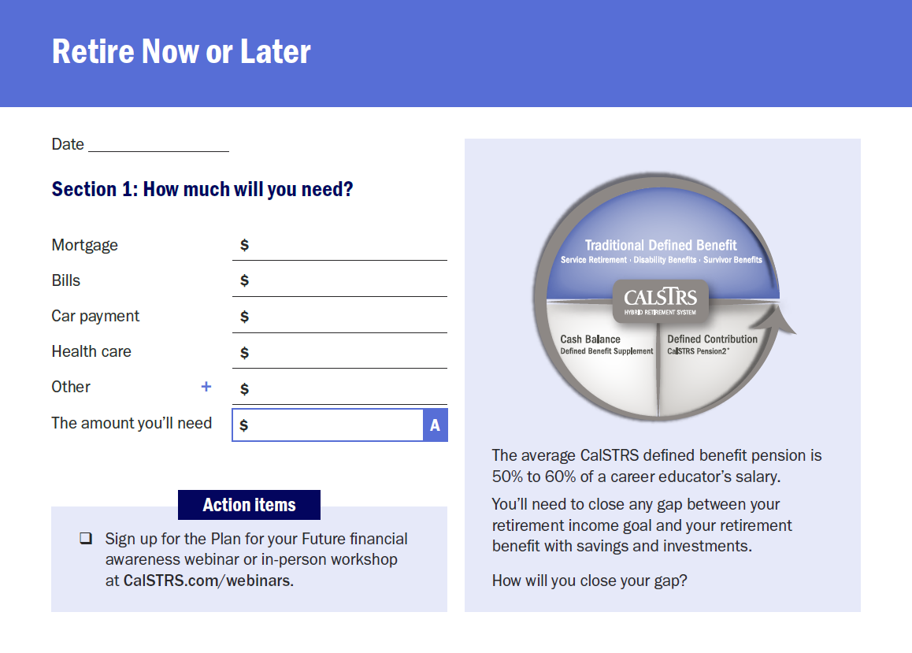
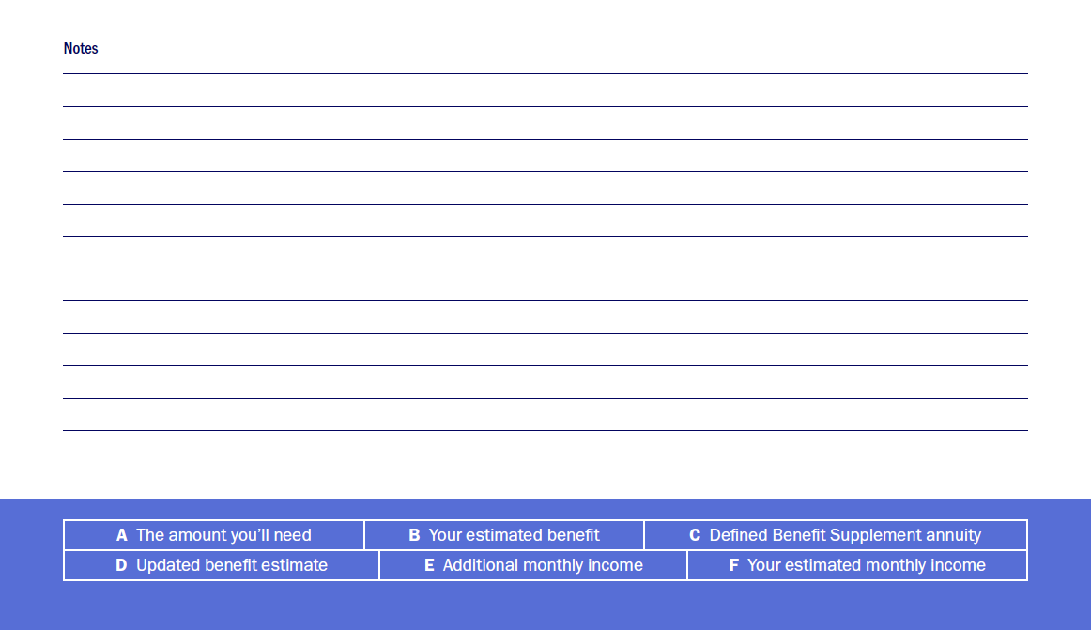
2,500
1,700
700
1,250
6,150
1
2
9
3
4
5
6
7
8
Notes:
In Section 1 of your workbook, think about your lifestyle in retirement and write down how much your expenses may be.
Click.
For this exercise I suggest that you use estimates and round up for ease of calculation. Also, in a situation like this it is better to overestimate rather than underestimate. Once you have listed your expenses, go ahead and total “The amount you’ll need” in box A.
You will use this estimated amount as your retirement income goal. This will be the basis for whether you can retire now… or later.
Click.
At the bottom of the workbook, you will notice there is a legend with letters A-F. As we move through the presentation, some sections will require a little bit of math. After this presentation, the legend will help remind you of how we did our calculations today.
For an opportunity to dig deeper into this type of budgeting, consider signing up for the Plan for Your Future workshop. Check out our website listed under the action items for more details and to sign up.
***build in time for members to fill in estimates and add together.***
Click.

Slide 18
Section 2
Retirement Progress Report
Defined Benefit Program
1
2
9
3
4
5
6
7
8
Notes:
Now that you have totaled up all of your expenses, let’s look at how you can access your Retirement Progress Report.
Click.

Slide 19
View and update your account information.
Submit forms and send secure messages.
Access your Retirement Progress Report.
1
2
9
3
4
5
6
7
8
Notes:
When you signed up for this workshop, you confirmed that you have a myCalSTRS account.
How many of you have been actively using your myCalSTRS account?
***allow for questions and interactions around this question***
Click.
My CalSTRS is good to:
View and Update your personal account information
Click.
Submit forms such as the recipient designation and send secure online messages
Click.
And access your annual Retirement Progress Report.
Click.

Slide 20
Your Retirement Progress Report
Membership and benefit information
Service credit and account balances
Employer reporting
1
2
9
3
4
5
6
7
8
Notes:
Your Retirement Progress Report (also referred to as your RPR) is an annual report that comes out every September and tracks your retirement progress. It has the information as reported by your employer through June 30 of the previous school year.
Click.
Your RPR has your most current Membership and benefit information.
Click.
Service credit totals and account balances
Click.
as well as the reporting we have received from your employer.
While you are still actively working it is very important that you check this report every year. If you notice any errors or discrepancies, we encourage you to talk with your employer right away so that the reporting can be corrected.
When you signed up for the workshop you were also encouraged to bring a printed copy of your most recent RPR. Please pull that out now.
If you did not bring a printed copy, I am going to show you how to pull up a digital copy.
Click.

Slide 21
Log in to myCalSTRS.com
1
2
9
3
4
5
6
7
8
Notes:
Let’s go ahead and take the time to login to myCalSTRS so we can take a look at your RPR.
You can see the web address here on the screen. You want to go to myCalSTRS.com
From this webpage you will be asked to put in your username and password.
Is there anyone having a hard time logging in or has forgotten their username and password? Please raise your hand and I will assist you.
***ensure that everyone has logged in and allow time for password reset.***
If you ever forget your password there is a forgot password link.
While I am doing this make sure to turn to section 2 of your workbook, we will be filling in some information shortly.
Click.

Slide 22
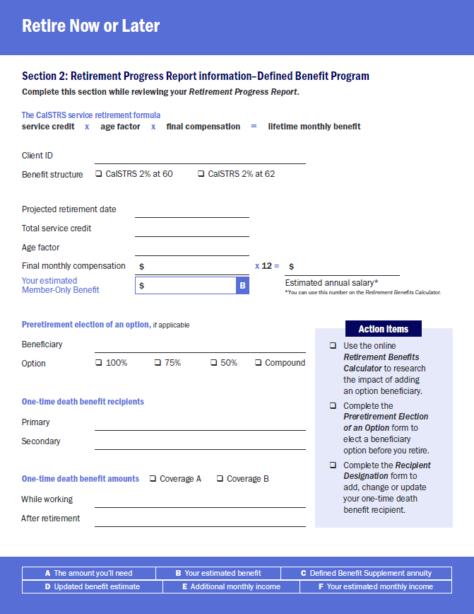
1
2
9
3
4
5
6
7
8
Notes:
Now that everyone has logged on to myCalSTRS, open up your workbook to this page here.
As we walk through the RPR together, feel free to complete the fill-ins with the pertinent information.
Click.

Slide 23
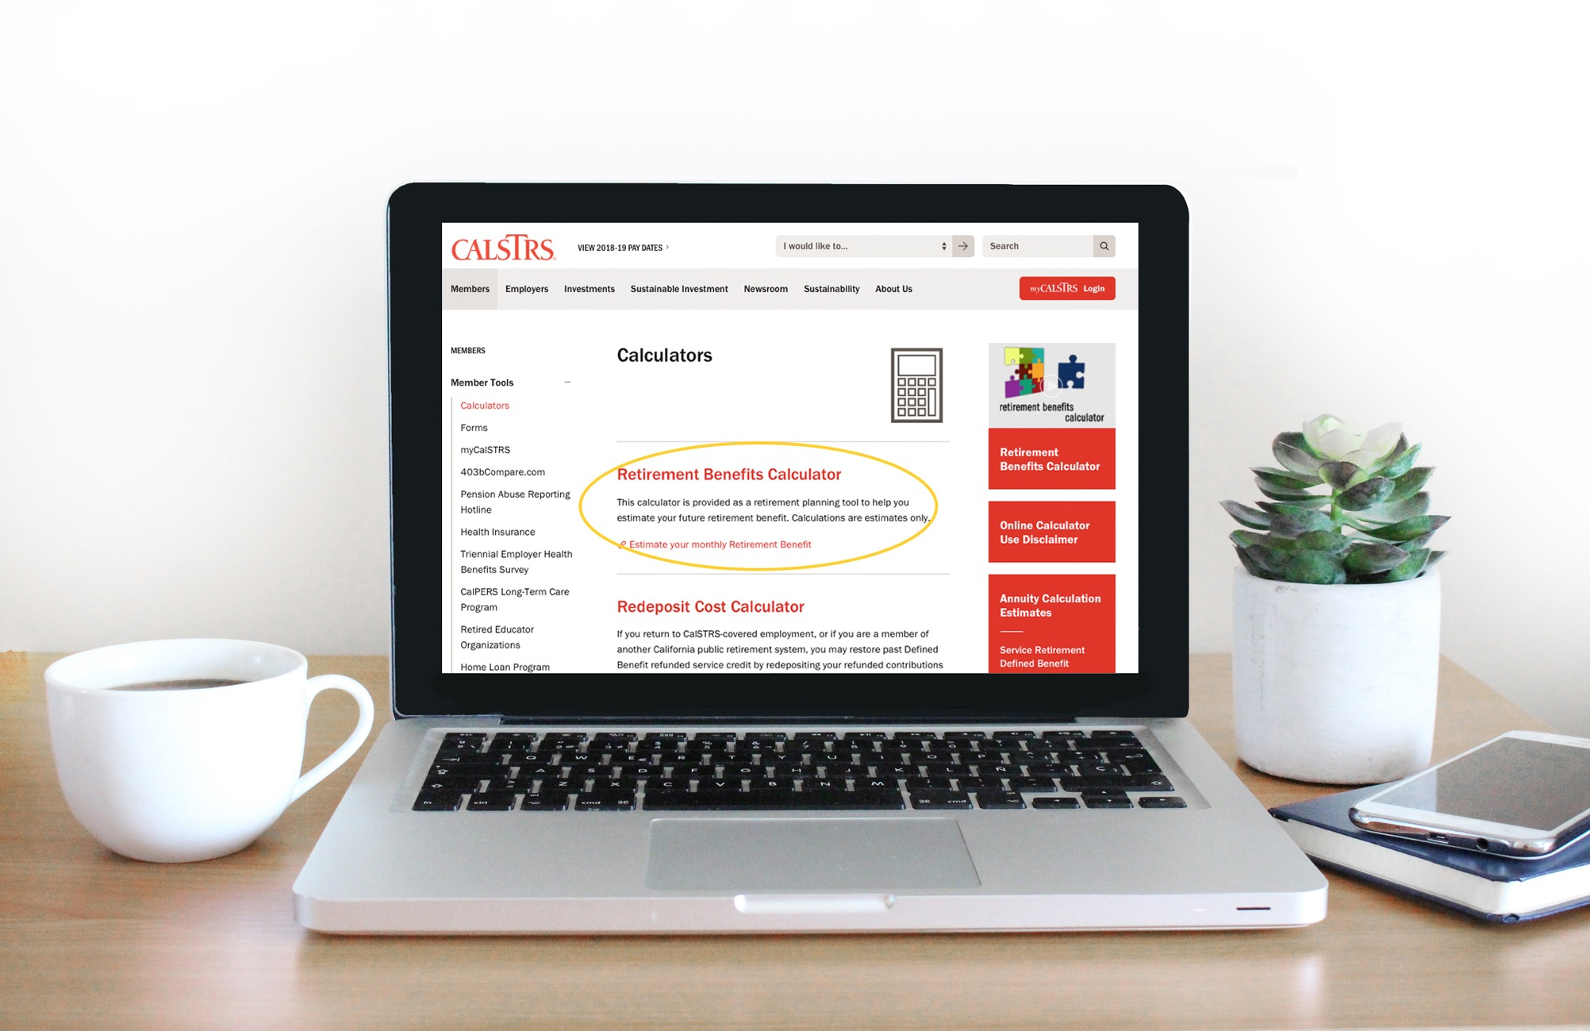
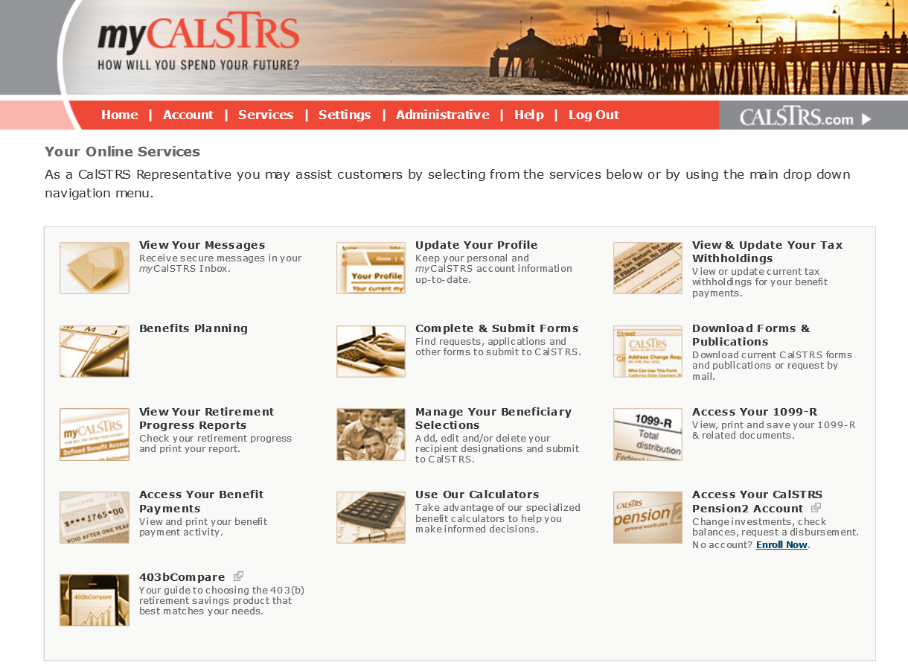
Retirement Progress Report
1
2
9
3
4
5
6
7
8
Notes:
Going back to the myCalSTRS webpage, once you have logged into to your personal myCalSTRS account you are going to see a landing page that looks similar to this.
Your icons may not be the same as mine but be aware that each person’s landing page is customized based on their situation.
Click.
The icon you are looking for is a picture that says myCalSTRS and the title will say “View Your Retirement Progress Reports”
Once you find it go ahead and click on this link.
Click.

Slide 24
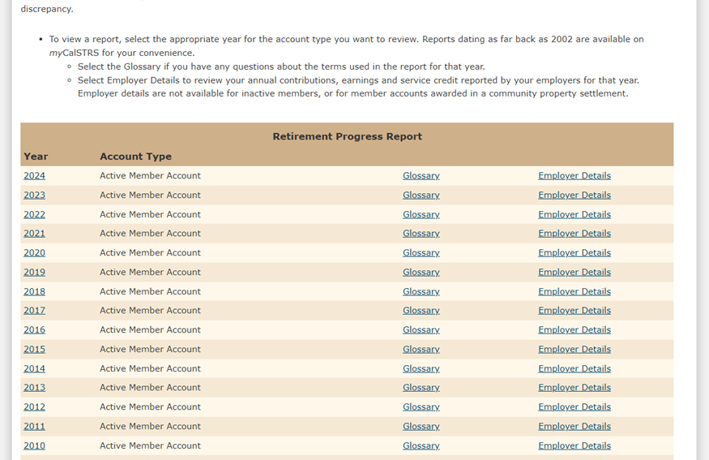
1
2
9
3
4
5
6
7
8
Notes:
On the next screen that opens about halfway down you will see a beige bar that reads Retirement Progress Report. You will see your RPRs listed here by year and account type.
For those of you that have a Cash Balance account in addition to a defined benefit account we will only be focusing on the Defined Benefit account today. For those who are not aware of what a cash balance account is, it is an alternative retirement program for part-time educators. If you have a cash balance account, please see me afterwards as this is another potential income source for you.
For the purpose of determining if you can retire now or later, please select the most recent year for your active member account.
Click.

Slide 25
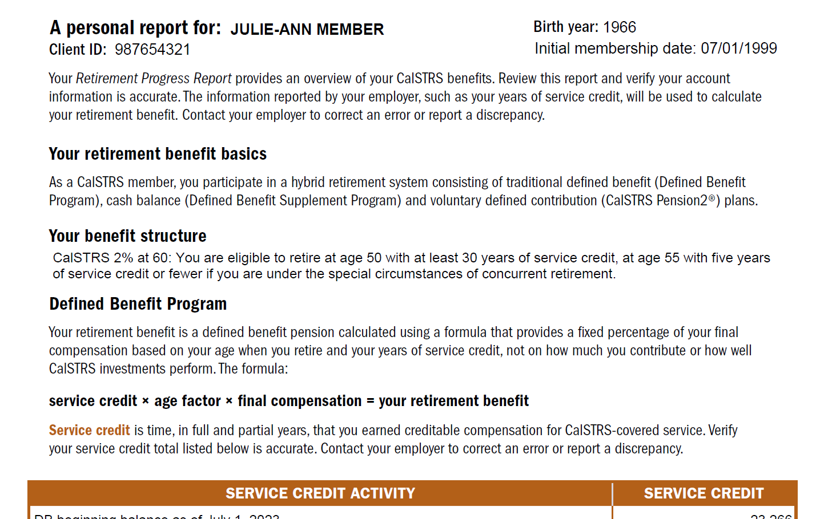
Program Information
1
2
9
3
4
5
6
7
8
Notes:
This is your retirement progress report (RPR). Your personal copy may look a little different from mine here on the screen as everyone’s individual RPR is specific to their personal and unique situation.
The first thing I want to point out is that you can find your personal information listed at the top of page 1.
Click.
Here you will see your CalSTRS client ID. The CalSTRS client ID is your CalSTRS specific identification number. When you submit any forms with CalSTRS you can use this number instead of your social security number for security purposes. Go ahead and notate this into Section 2 of your workbook.
Click.
The next thing I would like to draw attention to is your benefit structure. CalSTRS has 2 benefit structures 2%@60 and 2%@62. Please notate your respective benefit structure.
Remember your CalSTRS Defined Benefit retirement is based on a formula.
Click.
You can see that formula here:
Service credit x age factor x final compensation
Your service credit is the time that you worked and contributed to CalSTRS.
Your age factor is a percentage based on your age at retirement in years and months.
Your final compensation is the average of your highest 36 consecutive months of earnings. For those of you who are under the 2%@60 benefit structure we will use the highest 12 consecutive months of earnings if you retire with 25 years or more of service credit.
Click.

Slide 26
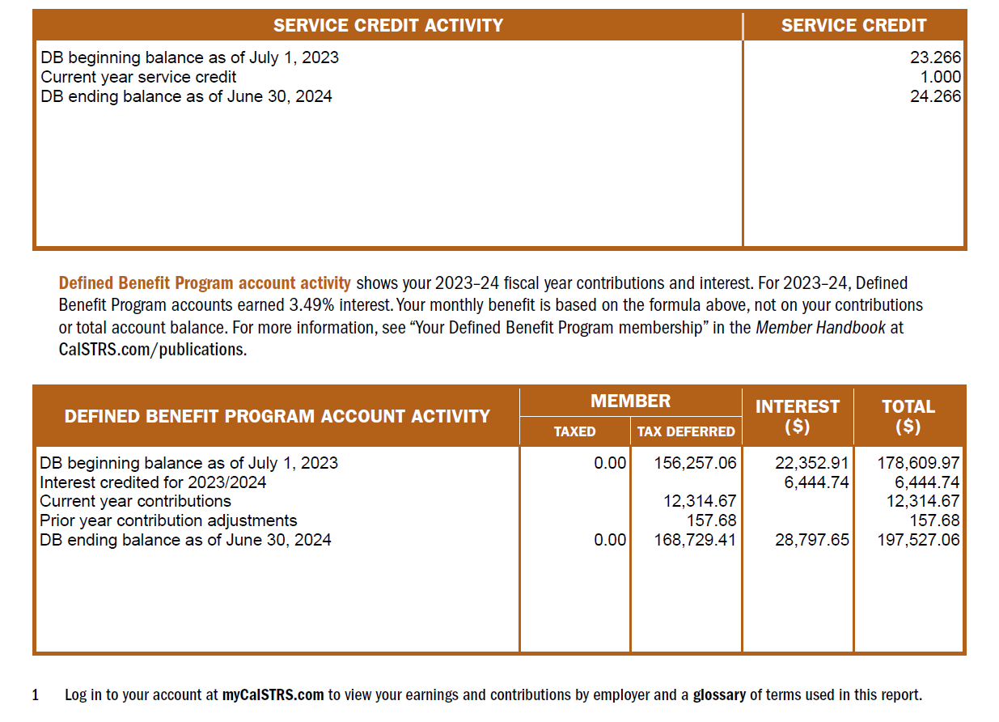
Service Credit and Contributions
1
2
9
3
4
5
6
7
8
Notes:
Click.
Last thing to note here on page 1 is the service credit balance as of the end of previous school year.
As we look down you will see your account activity.
Click.
You can see the contributions you made during the last school year as well as your account balance. Keep in mind your benefit is not based on this balance but the formula we just discussed.
Click.

Slide 27
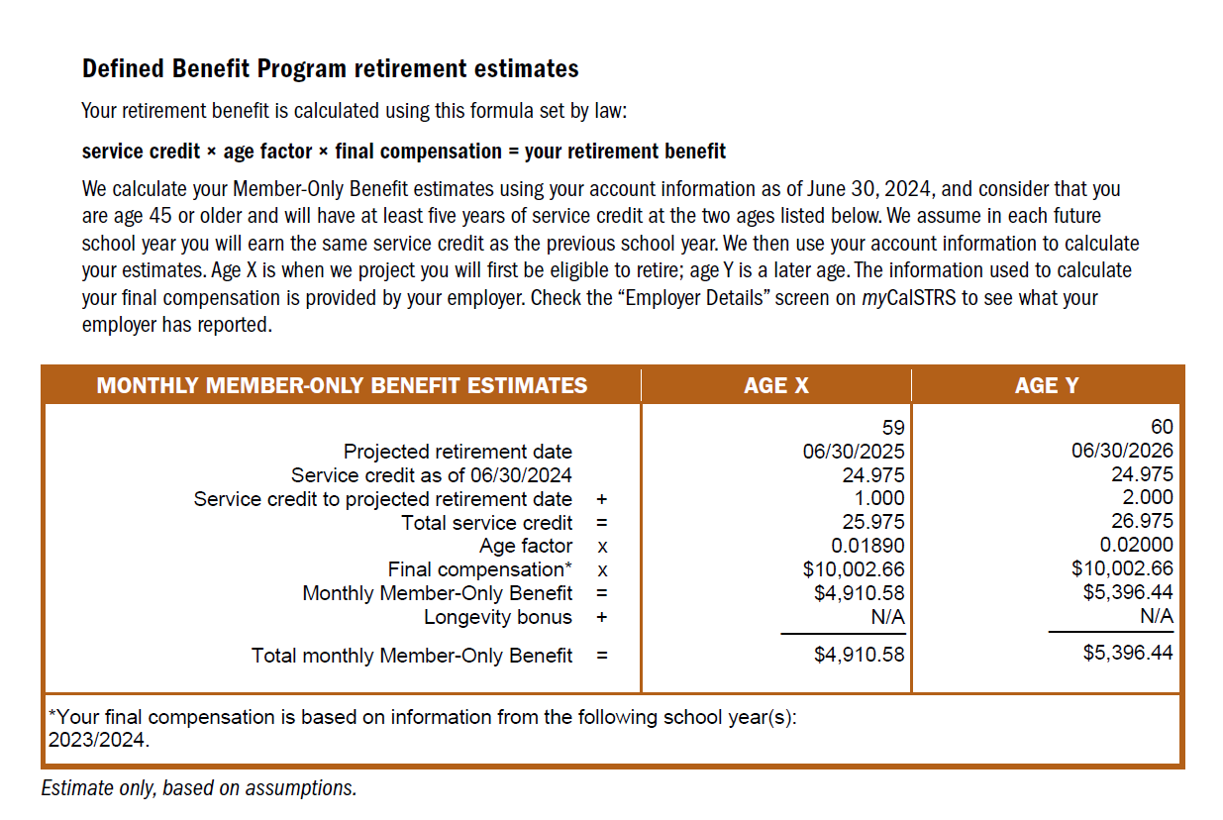
1
2
9
3
4
5
6
7
8
Notes:
On the next page, the first thing you will notice here is that there are 2 comparative retirement estimates.
As we walk through this table, feel free to notate the applicable figures into your workbook.
Click.
CalSTRS puts together 2 estimates for you to review one at age x and one at age y. You will see that age x and age y both have a projected retirement date. Go ahead and look at the projected retirement date that is closest to your retirement goal.
Click.
I am going to look at age Y.
Click.
In my example the projected retirement date for age Y is 6/30/2026.
Click.
The total service credit that you see on the RPR is the amount you are projected to have if you retire on the date listed above. CalSTRS projects service credit based on the service credit you earned last year.
Click.
Another number you should take note of is your final compensation.
Click.
At the bottom of the table you will see what years CalSTRS used to calculate your final compensation. For this member who is under the 2% @ 60 benefit structure and has more than 25 years of service credit we are basing their final compensation on their highest 12 consecutive months. If this member had less than 25 years of service credit or was under the 2%@62 benefit structure, we would have based the final compensation on their highest 36 consecutive months.
Click.
Finally, at the bottom you will see your total monthly member only benefit has been calculated for you.
Please note that these numbers are pulled from the system as of your most recent completed school year and really provide a good barometer when planning for your retirement.
Click.

Slide 28
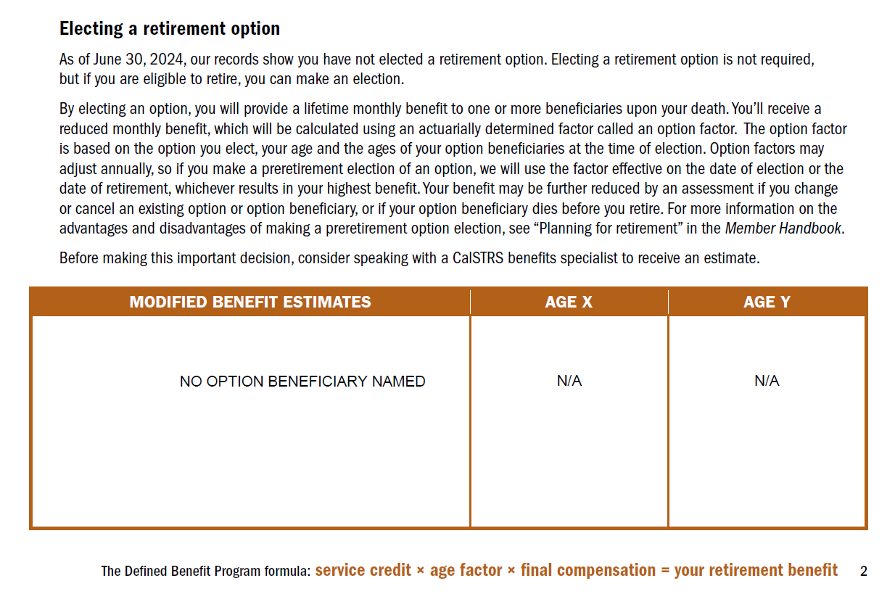
Your Option Election
1
2
9
3
4
5
6
7
8
Notes:
Some of you may have already pre-elected an option beneficiary.
If this is applicable to you, you can notate this information into the bottom half of Section 2 in your workbook.
Click.
This sample member has not elected a beneficiary yet.
For those of you that have pre-elected a beneficiary, you will have modified estimates in addition to the member only estimates.
If you already have a beneficiary on file, you should know that your expected monthly benefit is your modified benefit estimate rather than the member-only benefit.
If you are interested in electing an option beneficiary, you can use the online calculator to estimate how your benefit will be affected. We will see this later in today’s presentation.
If you want more information on electing a beneficiary visit CalSTRS.com and watch the beneficiary options video. If you decide you would like to put that option in place now you will need to complete the Preretirement Election of an Option form.
Click.

Slide 29
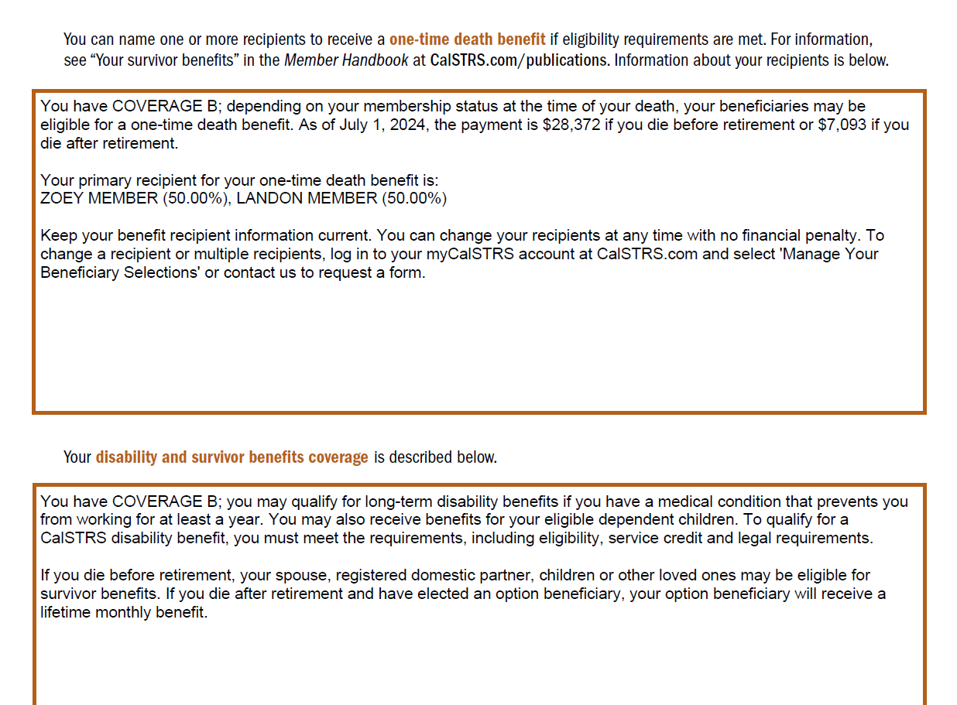
One-Time Death Benefit
1
2
9
3
4
5
6
7
8
Notes:
As you continue going through your RPR you will then see information on the One Time Death Benefit.
Click.
This is a one-time lump sum payment payable to whomever you have listed as your recipient upon your passing. This can be a person, a trust or even an organization.
In this section of your RPR you can see the amount of the one-time death benefit and if you have designated your recipient their name or names will be listed here.
Click.
For this member their one-time death benefit is… **read amounts from screen**
Click.
and they have named 2 primary recipients, Zoey Member and Landon Member. Remember this is something you always want to have up to date and on file with CalSTRS regardless of what stage you are in, in your career. If you do not have a recipient named, you can submit a recipient designation form or update this information on myCalSTRS.
Go ahead and take some time to notate this part of your RPR into the bottom portion of Section 2, and review the action items.
Click.

Slide 30
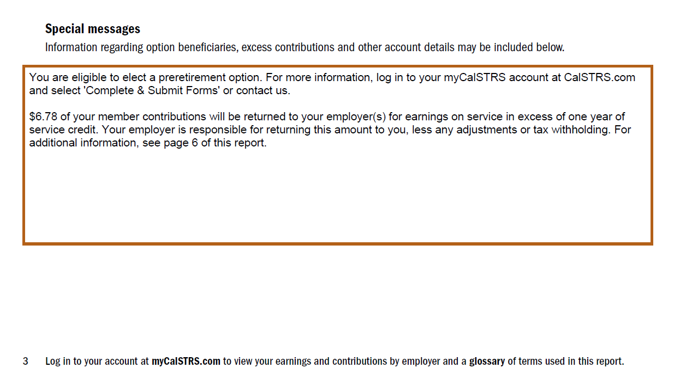
Special Messages
1
2
9
3
4
5
6
7
8
Notes:
Next you will see special messages.
In this section we notate any messages that pertain to your unique situation such as:
Click.
your eligibility for a pre-retirement election of an option or any excess earnings if you worked more than your 1 year contract.
Click.

Slide 31
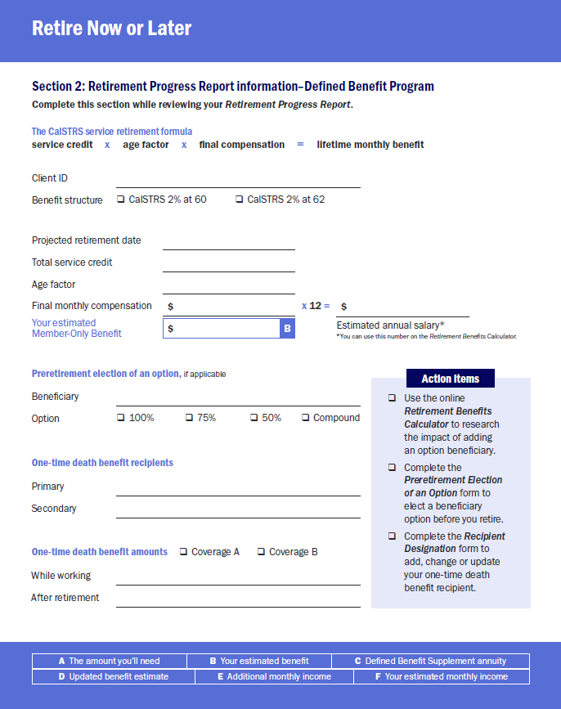
987654321
06/30/2026
26.266
0.02000
10,003
120,036
5,255
Zoey Member, Landon Member
$28,372
$7,093
1
2
9
3
4
5
6
7
8
Notes:
We just completed section 2.
If you were filling out this section as you followed along, you should have something that looks like this.
Click. (add animation – arrow points to x12 spot)
Later in this workshop, we are going to use the online Retirement Benefits Calculator. Go ahead and take your final compensation figure and multiply it by 12. Notate that number so we can use it later.
We are not done with the RPR just yet – we will cover the remaining pages in the next section.
Before we move on, does anyone need more time to complete this section?
***allow time to catch-up as needed***
Click.

Slide 32
Section 3
Retirement Progress Report
Defined Benefit Supplement Program
1
2
9
3
4
5
6
7
8
Notes:
As you continue to go through your RPR you will see the Defined Benefit Supplement Account.
Click.

Slide 33
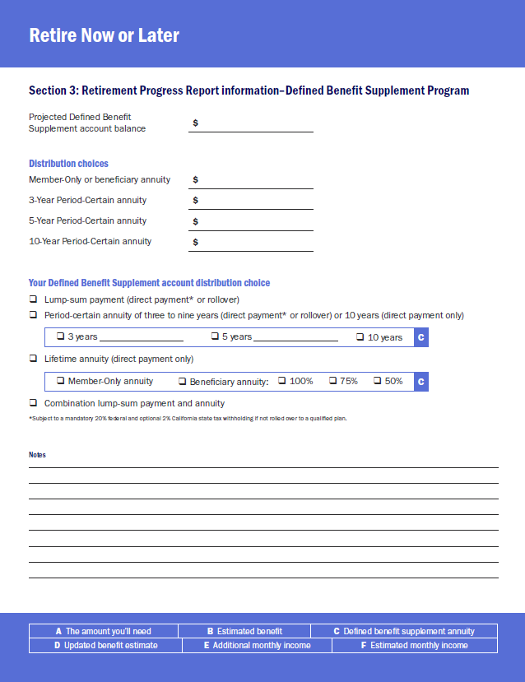
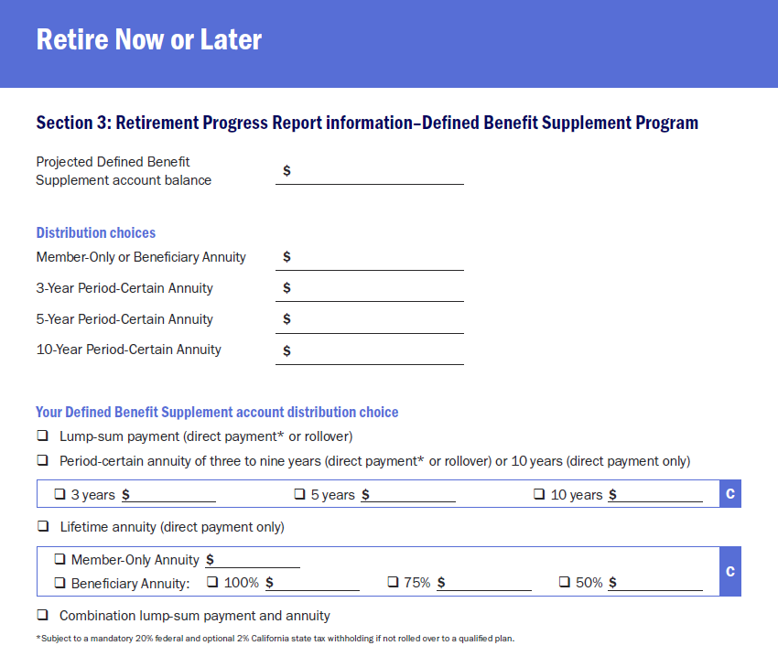
1
2
9
3
4
5
6
7
8
Notes:
Go to Section 3 of your workbook as we review this next part.
Click.

Slide 34
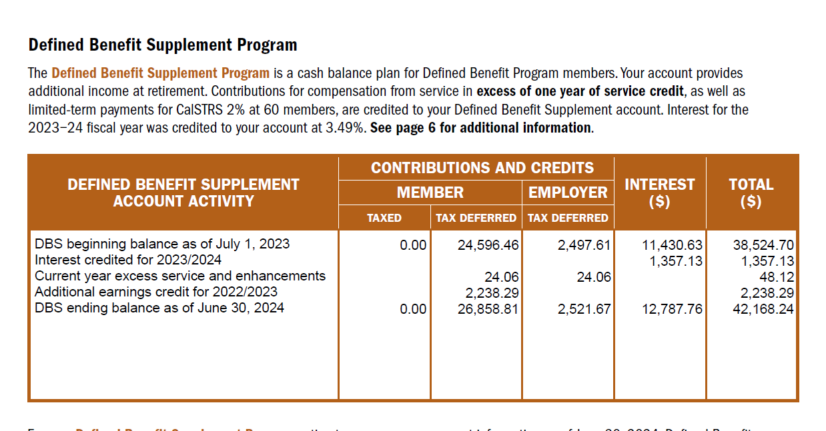
DBS Account Activity
1
2
9
3
4
5
6
7
8
Notes:
On your RPR, locate the Defined Benefit Supplement Program.
Click.
Remember the hybrid we previously discussed. This is the second portion of that hybrid system. This benefit is based on your account balance.
Click.
Under Defined benefit supplement account activity, you will find your account balance as of the end of last school year.
Click.

Slide 35
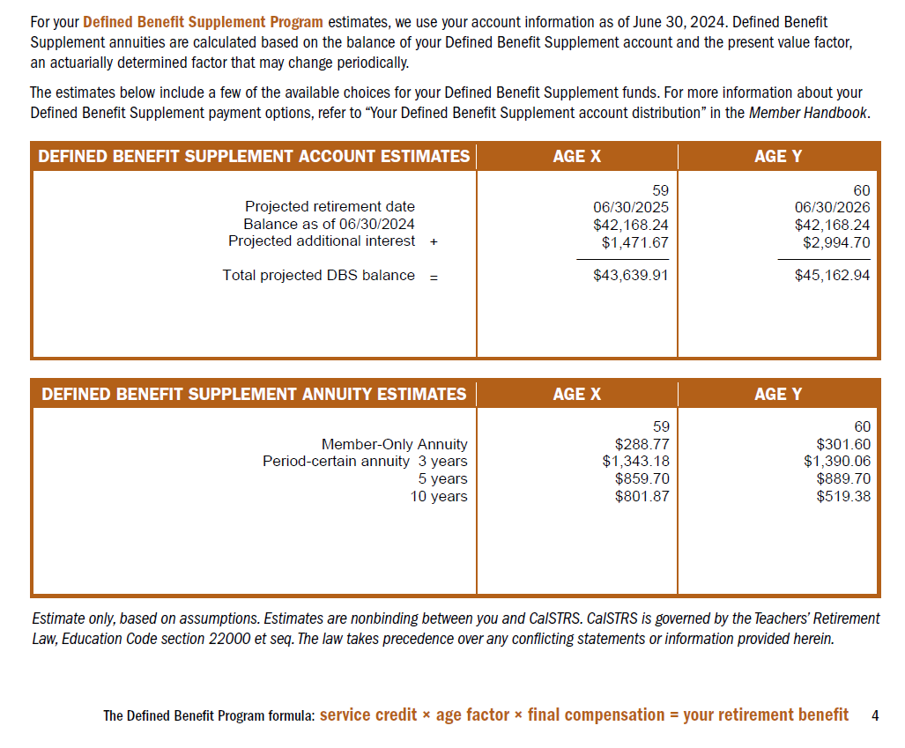
DBS estimate
1
2
9
3
4
5
6
7
8
Notes:
You will see the same age x and age y that you saw when we were talking about the defined benefit account. Continue to focus on the age you previously choose.
Click.
I had selected age Y, so I am going to look at this column.
Let’s take note of the projected DBS balance at the selected age.
Click.
For me that is $45,162.94. Keep in mind that CalSTRS is only projecting the interest that this account will earn until the projected retirement date. If you are working extra duties this balance will be higher on your retirement date.
When you retire, you have the choice to take a lump sum or an annuity. If you choose a lump sum you can choose a direct payment, or the funds can be rolled over to a qualifying retirement account. For a direct payment CalSTRS is required to withhold 20% for federal taxes and there is a 2% state tax withholding that is optional. If you roll the funds over to a qualifying retirement account, you defer the taxes until you start taking a distribution from that account.
Click.
If you don’t want a lump-sum you can choose an annuity. You could choose a lifetime annuity so you would receive a monthly amount for the rest of your life. The RPR may provide an estimate for a member only annuity or a beneficiary annuity.
Click.
Because my member has not yet elected an option beneficiary, we only see a Member-Only Annuity. If they had an option beneficiary on file, the RPR would also give estimates for a modified benefit. If you choose a lifetime annuity, taxes will be withheld based on the withholding preferences that you elect on your service retirement application. You can change these preferences at any time.
Click.
Instead of a lifetime annuity, you can choose a period-certain annuity for a period of 3-10 years. Although, the RPR only provides estimates for 3, 5, and 10 years, in reality you can choose any number of years from 3-10. Please review the DBS Annuity Calculation fact sheet for your convenience.
If you choose any time period between 3-9 years each monthly payment would be subject to a 20% federal withholding and an optional 2% state withholding unless you rollover the funds to a tax deferred retirement account. The ten-year period certain annuity is not rollover eligible and taxes will be withheld the same as a lifetime annuity, meaning you will tell us how you want those taxes withheld.
Take a close note of your DBS distribution choices listed in this section of the RPR. Go ahead and notate all of these choices into your workbook.
Click.
For our sample member, I’m going to choose the Member-Only Annuity for my calculations today.
So I will select the Lifetime annuity and then member-only annuity and write that figure down in my workbook.
Keep in mind that you do not have to decide this today however, you will need to make this decision on your retirement application. These notes in our workbook will serve us later in our calculations, so feel free to select a distribution just for the demonstration today.
We have covered the estimate information you are going to need to use the online calculator. There is a lot more information in your RPR, please take the time to review it thoroughly after this workshop.
Click.

Slide 36
45,163
302
1390
890
519
302
1
2
9
3
4
5
6
7
8
Notes:
We just completed section 3.
Click.
If you were filling out this section as you followed along, you should have something that looks like this.
Please keep in mind that I used rounded figures for ease of calculation.
Again, the DBS distribution choice is not locked in and we are just using these figures today for estimate purposes.
Now that we have looked at the RPR and we have an idea of what Julie Ann’s retirement benefit will look like let’s calculate her gap.
Click.

Slide 37
Section 4
Calculating the Gap
1
2
9
3
4
5
6
7
8
Notes:
Let’s determine whether you have a gap. The gap is the difference between how much you are going to need in retirement and your estimated benefit amount. By determining what your gap is you can make an informed decision on when you can retire.
Click.

Slide 38
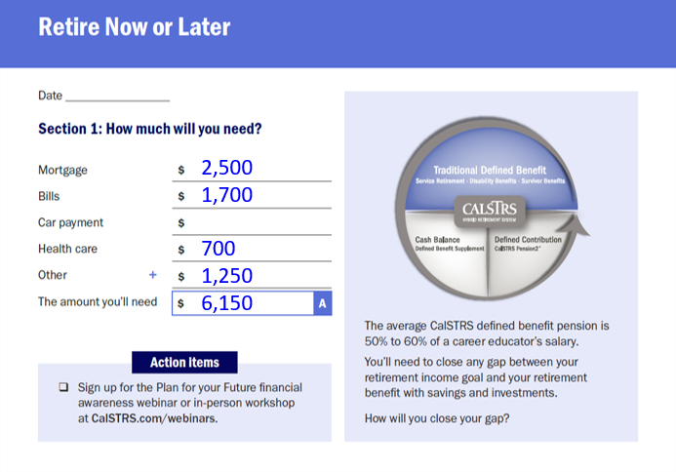
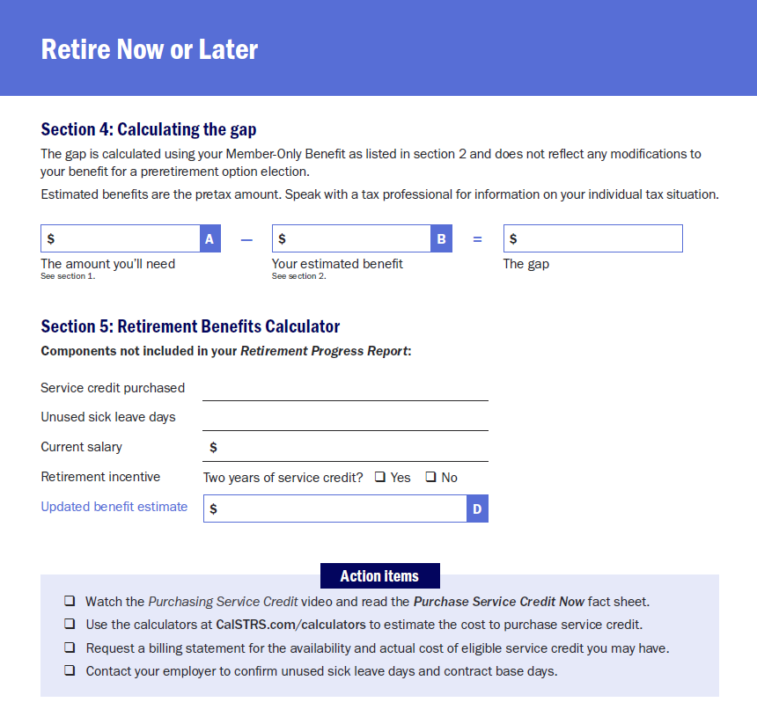
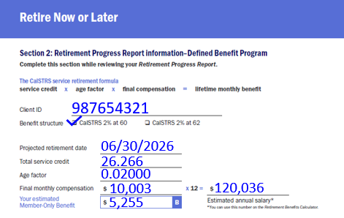
6,150
895
Calculate your gap again after taxes
5,255
1
2
9
3
4
5
6
7
8
Notes:
We will be working in Section 4.
Pull your estimated total from Section 1 and enter the “Amount you’ll need” in box A.
Click.
Then from Section 2, take “Your estimated benefit” and plug that number in box B.
Click.
Let’s do some quick math and subtract the 2 to determine your Gap.
***build in time for educators to do the math.***
Click.
If your result is a negative number that means you will have a surplus of retirement income. If this is the case, I would recommend you revisit your bills and what you will need in retirement just to double check you have accounted for all foreseeable expenses in retirement.
If you calculated a positive number, that number is your gap. Having a gap is not only normal it is expected because your pension from CalSTRS is only a portion of your income in retirement.
Click.
Estimated benefits are pre-tax amounts and your actual figures will vary once taxes are applied to these figures. Remember to speak with a tax professional about your individual tax situation.
Click.
Consider coming back to this page after today’s workshop, and re-calculate your gap when you have a better picture of your actual retirement benefit with taxes applied.
Click.

Slide 39
Section 5
Retirement Benefits Calculator
1
2
9
3
4
5
6
7
8
Notes:
Is your gap a little bigger than you expected? Don’t worry there are other things that may not be included.
Let’s look at Section 5 of the workbook to identify some of those missing elements. As any of these pertain to you take note in this section of the workbook.
Click.

Slide 40
What’s not included on your RPR?
Service credit purchase
Unused sick leave
Current or future year salary amounts
Incentive
1
2
9
3
4
5
6
7
8
Notes:
Some elements not listed on your RPR that should also be considered include:
Click.
Any service credit purchases that you are currently making or plan to make. Service credit purchases that were completed prior to the end of the previous school year are already included in your service credit total. For more information on the types of service credit that you may be able to purchase visit CalSTRS.com and watch the Purchasing Service Credit video or download the publication titled Purchasing Additional Service Credit.
Click.
The RPR also does not include any unused sick leave you may have. The unused SL days convert to additional service credit. We calculate this by unused sick leave days divided by your contract base days. Keep in mind that the unused sick leave listed on your pay stub may be reported in hours and CalSTRS uses the number of days. You will need to convert the number of hours into days by dividing the hours you have by the number of hours you are required to work in a day.
Click.
The next piece not included is your current year salary. If you have had any pay raises effective this year or are expecting pay raises in the future, this can increase your benefit.
Click.
Your district may offer you a retirement incentive. If that incentive is the 2-year service credit retirement incentive note that in this section of the workbook. If it is a cash incentive, we will address that in the next section.
Click.

Slide 41
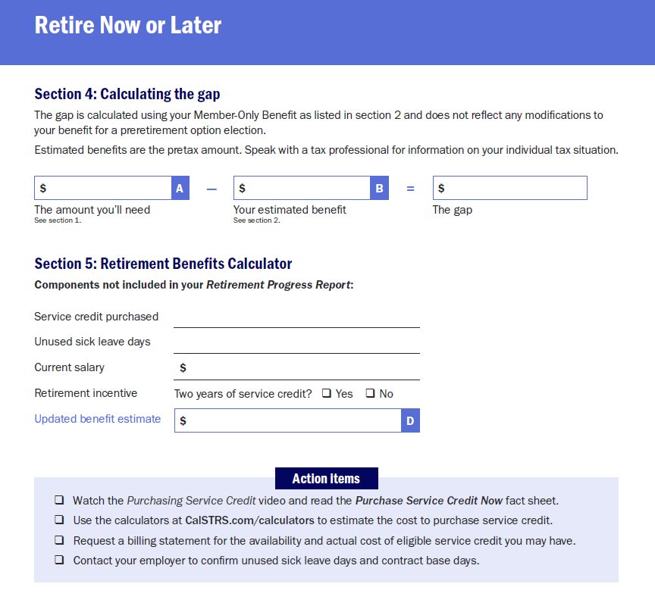
6,150
5,255
895
0
126 sick days / 185 contract days
126,033.52
1
2
9
3
4
5
6
7
8
Notes:
In the workbook, there is space for you to jot down these elements not on your RPR. Let’s complete this section to help prepare us for the online calculator.
Click.
Our sample member, Julie-Ann, currently has no service credit to purchase.
She has 126 unused sick leave days and185 base contract days.
And has a higher salary this year, she is going to be receiving a 5% raise.
There was no retirement incentive, so that part will be blank for her.
Once we plug all of these elements into the online calculator, we will determine your “Updated benefit estimate” for box D.
***allow time for members to complete fill-ins***
Click.

Slide 42
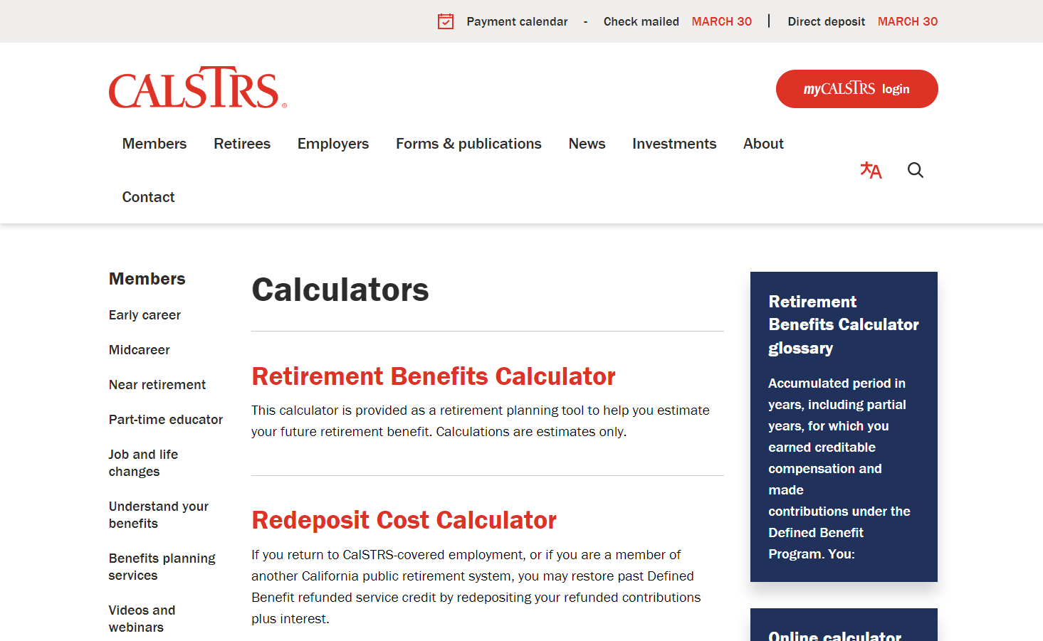
Retirement Benefits Calculator
1
2
9
3
4
5
6
7
8
Notes:
How many of you think your estimated benefits might be higher that what we looked at in the RPR?
The Retirement Benefits Calculator is a great tool you can use to explore your possible retirement scenarios.
You can find this calculator at CalSTRS.com. Just click on Members from the top banner, then calculators, and then select the first option which is the Retirement Benefits Calculator.
Go ahead and click on the header to open up the online calculator.
***Move to live calculator & walk members through the calculator. Use the “Live Demo Calculator – Sample Sheet” to help you walk through the calculator using our sample member. Have members notate their member-only (or modified benefit) amount into Section 5 as the “Updated benefit estimate” labeled box D on next slide.***
Click.

Slide 43
6,150
5,255
895
0
126 sick days / 185 contract days
126,033.52
5,660.37
1
2
9
3
4
5
6
7
8
Notes:
Going back to Section 5 of the workbook, we will enter the new “Updated benefit estimate” into box D.
Click. (add animation)
My updated retirement benefit is about $5,660.
Click.

Slide 44
Section 6
Additional Income
1
2
9
3
4
5
6
7
8
Notes:
Go ahead and keep your calculator on the screen we will have time to try different scenarios in a moment.
Many of you may have outside sources of retirement income.
Click.

Slide 45
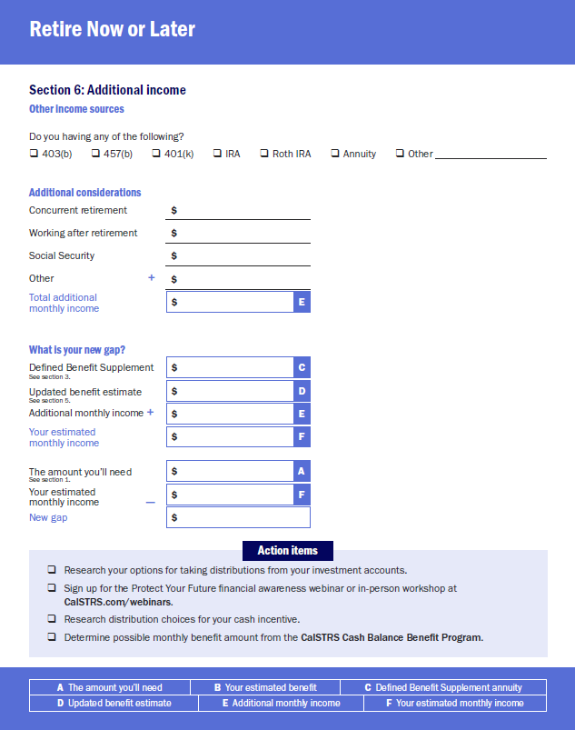
Additional income
Additional Income
1
2
9
3
4
5
6
7
8
Notes:
Looking at Section 6 of the workbook this can include accounts such as 403(b), 457(b), IRAs and other qualified retirement accounts. If you have any of these accounts mark the appropriate box.
After you leave this presentation, this should be a reminder for you to do some research into these accounts and their distribution choices as these outside accounts contribute to your retirement picture.
CalSTRS also offers a 3-part financial awareness series for various stages in your career. To learn more about completing your retirement picture you may be interested in the workshop, Protect Your Future.
Click.

Slide 46
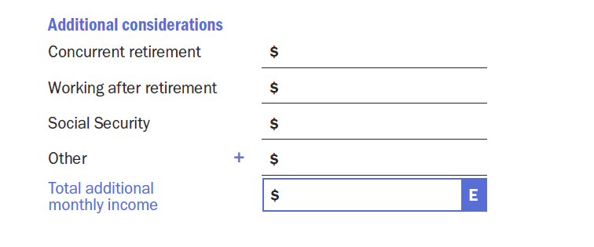
Additional considerations
1
2
9
3
4
5
6
7
8
Notes:
Ok now let’s talk about some additional considerations that can help you close the gap.
We are going to be working in the middle section.
Consider any monthly income in this section that you expect to receive from the following sources:
Click.
If you are a member of any other California Public Retirement Systems, such as CalPERS you may be eligible to concurrently retire. In your workbook, notate the estimated monthly income you are expecting from the other retirement system (first line).
Click.
Some of you may have plans to work in retirement. If this is the case, write down the estimated monthly income you plan to earn in retirement (2nd line).
Click.
Although you don’t pay into social security as an educator you may have other employment that qualifies you for this benefit. Some of you may qualify for a social security benefit. If so, go ahead and enter your estimated monthly amount here (3rd line).
Click.
Is your employer offering a cash retirement incentive? If so, that amount of cash should be considered with your retirement income. Talk to your employer about distribution options for your incentive. In some cases, you may want to rollover your incentive funds into a retirement savings account. The CalSTRS Pension2 program is an option if you are interested in rolling over any of your funds or consolidating accounts under one roof.
I previously mentioned CalSTRS Cash Balance Program. If you are a participant in this program, be sure to research your distribution choices for this account as well.
These are just a few examples of other additional retirement funding sources.
Click.
Go ahead and add the additional income sources you’ve listed and enter the “Total additional monthly income” into box E.
Click.

Slide 47
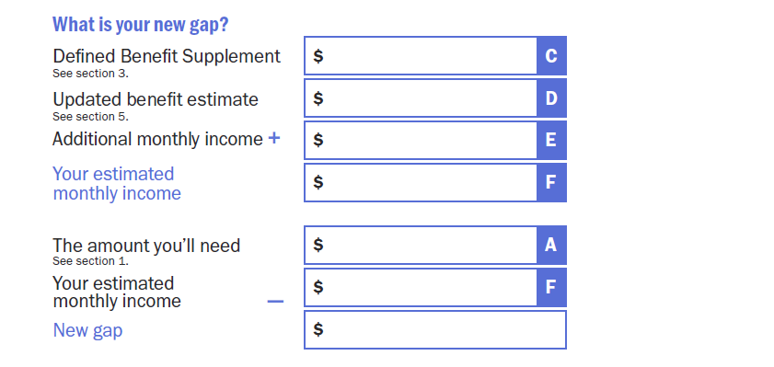
What is your NEW gap?
302
5,660
5,962
6,150
5,962
188
1
2
9
3
4
5
6
7
8
Notes:
Let’s calculate your new gap.
Look back at Section 3 for your choices with the DBS account. If you are considering a monthly annuity enter the estimated amount for that monthly benefit in box C.
Click.
Next, copy over your “Updated benefit estimate” from Section 5 into box D.
Click.
We looked at your “Additional monthly income” just a few minutes ago. If this is applicable to you, then copy that amount into box E. I have none, so my box E will be blank.
I’ll give you a moment to add these figures together and notate “Your NEW estimated monthly income” into box F.
Click.
***give 5 minutes to calculate***
With that lets go ahead and calculate your New Gap:
First, carry down “Your estimated monthly income” for box F.
Click.
Next, grab “The amount you’ll need” from Section 1 and add that into box A.
Click.
Subtract to calculate and determine your New gap.
Click.
If you have any of the additional income sources that we just spoke about, then your new gap should be lower. If you still find that it is not low enough there are still a few ways you can close your gap.
Click.

Slide 48
Section 7
Close the gap by increasing your monthly benefit
1
2
9
3
4
5
6
7
8
Notes:
You can also look to increase your monthly benefit by increasing any component of the of the 3-part equation.
Click.

Slide 49
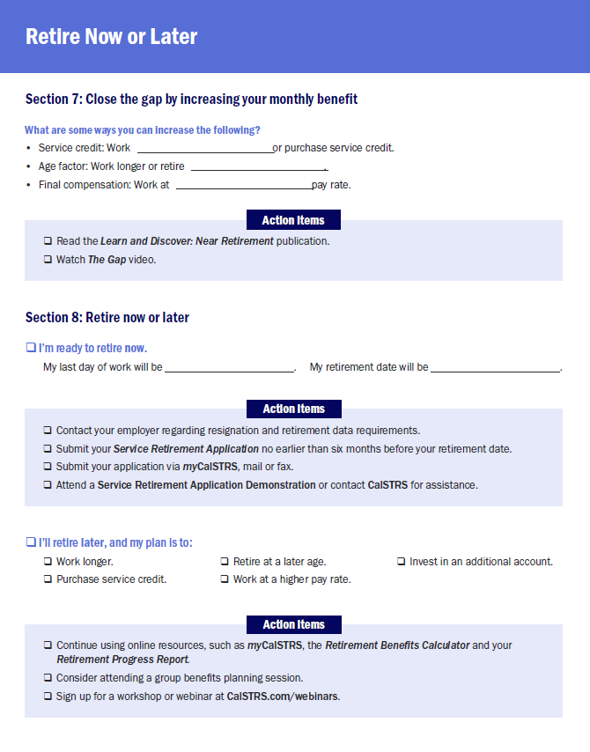
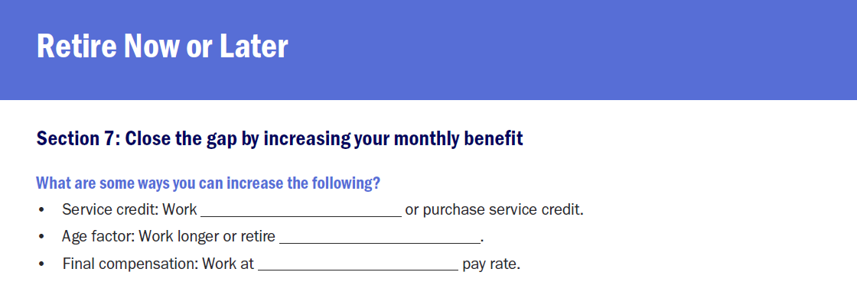
Increasing your monthly benefit
Longer
Later
Higher
1
2
9
3
4
5
6
7
8
Notes:
In section 7 of the workbook please fill in the blanks as we go through each component of the formula.
Click.
Your service credit can be increased by working longer or making a service credit purchase if you are eligible to do so.
Click.
Your age factor can be increased by working longer and/or retiring later. Remember that the age factor is a percentage determined by your age in years and months on the last day of the month in which your retirement is effective. The maximum age factor you can have is 2.4%
If you want help determining your age factor, we have age factor tables for you to refer to.
Click.
The last component of the formula is final compensation and you can increase that by working at higher pay rates. For example, if you are nearing a step increase you may be inclined to work an additional year.
Let’s look at my example to see how just working 1 more year could increase your benefit.
Click.

Slide 50
Retirement Benefits Calculator
1
2
9
3
4
5
6
7
8
Notes:
I am going to quickly show you the addition of 1 year to my benefit. Don’t worry you will get time to play around and input numbers with your own benefit.
**Go back to the calculator webpage & make changes to the online calculator***
We are only going to change 2 things. The date we want to retire from 6/30/2025 to 6/30/2026. You will notice that I will be a year older so my age factor will increase.
Because I will be working another year, we will add 1 year to our years of service credit from 26.266 to 27.266.
Everything else remains the same so we scroll down and select calculate.
Your new estimate will populate on the screen.
In my case you can see that my estimated benefit went from $5034 to $5568.
Click.

Slide 51
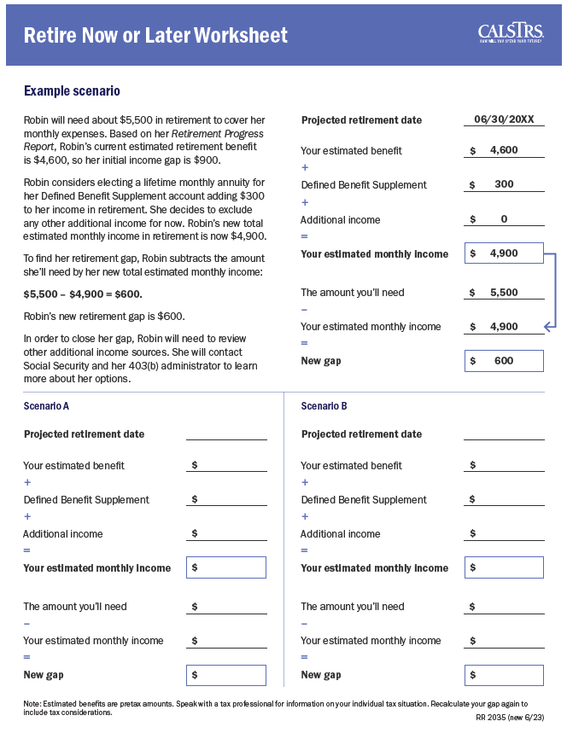
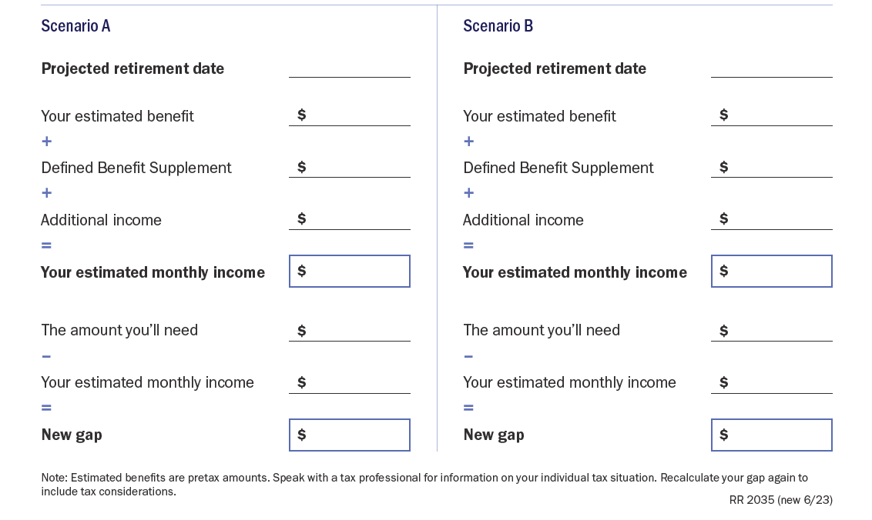
1
2
9
3
4
5
6
7
8
Notes:
On the NOL worksheet (also provided in your folder), you can play around with different Projected Retirement Dates as well as calculate your new Gap. The scenarios are formatted to follow the same calculations we did earlier in Section 6.
At this point you can take some time to do some additional calculations. If you have any questions, I’m here to answer them.
***allow up to 15 minutes to calculate – depending on the room.***
Click.

Slide 52
Section 8
Retire Now or Later
1
2
9
3
4
5
6
7
8
Notes:
Now that we have calculated and discussed different considerations for multiple retirement scenarios, let’s look at section 8 of the workbook.
Click.

Slide 53
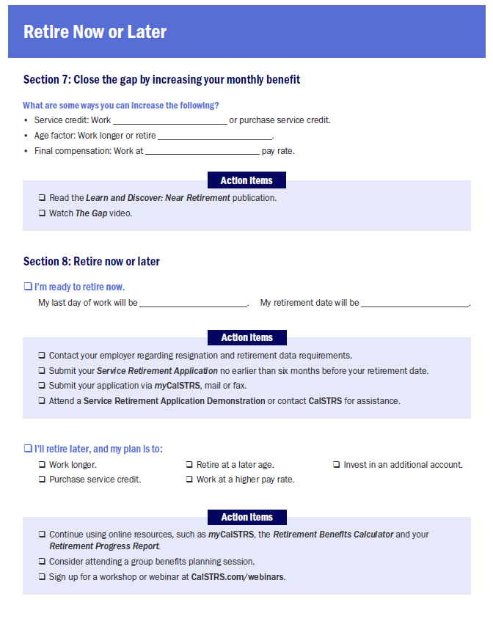
I’m ready to retire now
6/9/2025
6/10/2025
I’ll retire later
1
2
9
3
4
5
6
7
8
Notes:
So, are you ready to Retire NOW
Click.
or LATER?
Click.
Check off one of the boxes and we will review the action items for each path.
***give time to reflect and check off “retire now” or “retire later”***
Let’s say that you are ready to retire now.
Click.
Go ahead and write down your last day of work and your retirement date with CalSTRS.
Click.
Your retirement date with CalSTRS must be at least one day after your last day of work, vacation, or compensated approved leave.
There are a couple of things for you to do to prepare for retirement. Let’s look at your action items:
Click.
You will need to verify your district’s resignation process, and resign with your district according to their process.
You can submit your service retirement application with CalSTRS no earlier than 6 months before your retirement date.
Consider attending an Application Roundtable for assistance with completion of your Service Retirement Application or visit your local MSC and get help at the front counter.
Click.

Slide 54
I’ll retire later
Notes:
For those of you who are planning to work a little longer, CalSTRS has some great resources for you to take advantage of.
Click.
Continue to use the online resources we reviewed today.
Consider attending a group benefits planning session.
And attend a workshop or webinar to learn more about your retirement system.
Click.
Istock ID 1091229366

Slide 55
Retirement requirements
With CalSTRS
Submit your Service Retirement Application via myCalSTRS, in person, mail or fax.
Submit the Direct Deposit Authorization form.
Submit the Express Benefit Report to your employer to verify sick leave amount and your last day of work.
With your district
Verify retirement date requirements.
Resign with your district.
Discuss options for health care.
1
2
9
3
4
5
6
7
8
Notes:
Whenever you decide to retire, please keep in mind that you will need to “retire” from both CalSTRS and your employer.
Click.
You can see here the things specific to CalSTRS
Click.
and the things specific to your employer.
This table is a reminder of some of the steps you will need to take when applying for retirement.
You can review a full retirement checklist in the CalSTRS Your Retirement Guide Publication.
Click.

Slide 56
Section 9
Postretirement Considerations
1
2
9
3
4
5
6
7
8
Notes:
In retirement there are some things for you to consider.
Those things are:
- If you plan on working in retirement
- Your annual benefit adjustment
- And Social security
Let’s go ahead and look at these considerations in Section 9.
Click.

Slide 57
Working after retirement
Separation-from-service requirement
Benefit reduced dollar for dollar by the amount you earn in CalSTRS-covered employment during first 180 calendar days of retirement.
24-25
74,733
Annual Postretirement Earnings Limit
Benefit reduced dollar for dollar for earnings in excess of the annual limit.
Earnings limit changes every fiscal year.
1
2
9
3
4
5
6
7
8
Notes:
You can work in retirement, however there are earnings limitations.
Click.
There is a 180-calendar day separation from service requirement. During this time, the earnings limit is set at zero dollars for any pay that could be earned from a CalSTRS-covered employer. That means that if you work within this period, your CalSTRS benefit will be reduced dollar-for-dollar by the amount you earn.
Click.
Once the 180-day waiting period is over, you can go back to work in the CA public school system, however you are subject to an annual postretirement earnings limit. If you exceed the limit, your benefit will be reduced dollar-for-dollar by the amount you earned in excess of the limit.
Click.
There should be a space for you to notate the earnings limit.
Keep in mind that the earnings limit changes every year.
If your district is offering a retirement incentive be sure to check with your employer to see if there are any restrictions that apply to working after retirement.
Click.

Slide 58
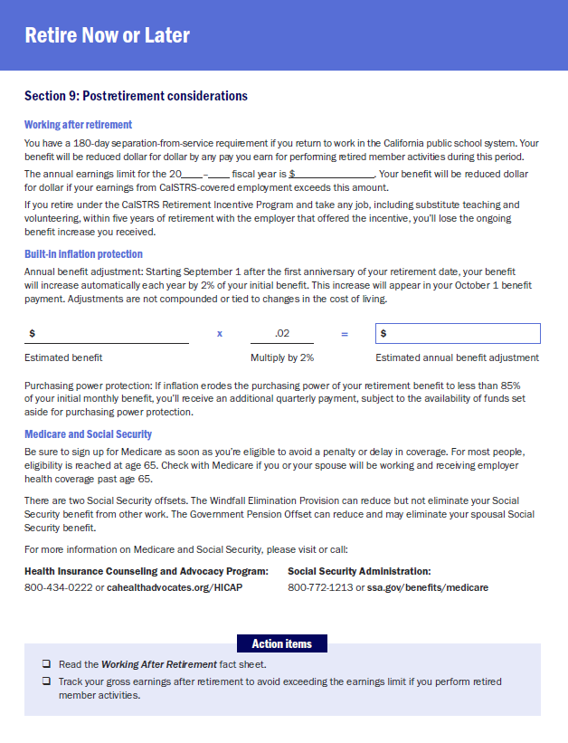
Initial benefit
$5,660
$113
Annual increase
Not tied to inflation
Not compounded
Protected by law
1
2
9
3
4
5
6
7
8
Notes:
On September 1st following your one year anniversary of retirement, you will get your first annual benefit adjustment.
The Annual benefit adjustment is 2% of your initial benefit.
This is not compounded and not tied to inflation. So, you will receive the same dollar amount increase every year.
In the workbook let’s calculate your annual benefit adjustment.
Choose the estimated benefit for the retirement date that you are considering.
Simply multiply your estimated monthly benefit by 0.02 to get your estimated annual benefit adjustment.
Click.
My estimated monthly benefit is $5034
Click.
when I multiply by 0.02 I get $101
So what means is that I will get a $101 monthly increase every year after I have been retired for a year.
For EX: If we take that initial benefit of $5034 and add in the annual benefit adjustment of $101, my new monthly benefit would be $5135.
Click.

Slide 59
Purchasing power
85% Purchasing power
Supplemental benefit
☑
View the Member Handbook for more information.
1
2
9
3
4
5
6
7
8
Notes:
While the annual benefit adjustment is not based on inflation, CalSTRS does provide built in inflation protection.
Click.
If inflation erodes the purchasing power of your retirement benefit to less than 85% of your initial monthly benefit,
Click.
you’ll receive an additional quarterly payment, subject to the availability of funds set aside for purchasing power protection.
Click.
If you want more information on this protection you can refer to the member handbook.
Click.

Slide 60
Medicare
Sign up on time
Must sign up as soon as you’re eligible.
Need assistance?
Contact HICAP at 1(800) 434-0222.
1
2
9
3
4
5
6
7
8
Notes:
Now let’s talk about Medicare.
Click.
This is just a reminder to sign up on time. Generally you become eligible for Medicare at age 65. Check with Medicare if you or your spouse will be working and receiving employer health coverage past age 65.
Click.
The Medicare process can be confusing.
In the workbook you will find the contact information for HICAP - (Health Insurance Counseling and Advocacy Program). It is a not for profit organization that can help you with the Medicare process.
Click.

Slide 61
Social Security
Windfall Elimination Provision
May reduce but cannot eliminate your
Social Security benefit.
Government Pension Offset
Reduces and may eliminate your spousal, widow or widower Social Security benefit.
Contact the Social Security Administration for more information.
800-772-1213 or ssa.gov
Notes:
There are, however, 2 offsets that could affect your social security benefit if you are expecting one.
Click.
The first is the Windfall Elimination Provision.
This states that if you are expecting a social security benefit based on your own earnings that social security may reduce your benefit but not eliminate it.
Click.
For those of you who might be expecting a spousal benefit from social security your benefit may be affected by the Government Pension Offset.
This offset reduces and may even eliminate your spousal benefit.
Click.
For more information contact social security directly.
Click.

Slide 62
For more information
Online resources
Attend a group session
myCalSTRS
Retirement Progress Report
Online calculators
CalSTRS and Your Retirement
Financial Awareness Series
Attend a workshop or webinar
Save for Your Future
Plan for Your Future
Protect Your Future
www.calstrs.com/workshops
www.calstrs.com/webinars
Notes:
Hopefully after today’s webinar you feel more comfortable using your online resources. Remember you can access myCalSTRS, your RPR, and the online calculators 24 hours a day 7 days a week.
Remember to review your RPR every year to ensure reporting accuracy and view updated estimates.
In today’s workshop we gave you a high-level overview of your benefits. For those of you who would like more detailed information about your retirement benefits, contact CalSTRS to attend a CalSTRS and Your group session.
CalSTRS offers the Financial Awareness Series Workshops. This series is about strengthening financial literacy and becoming savvier with your finances.
You can sign up for any CalSTRS workshop or webinar at CalSTRS.com/webinars.
Click.

Slide 63
888-394-2060
Pension2.com
Notes:
If you are planning to work a few more years… remember Pension2?
Pension2 is a CalSTRS program that offers retirement accounts at low costs for additional retirement savings. Reach out to one of our Pension2 representatives to open an account.
If you are receiving a retirement incentive and are considering investing those funds into a CalSTRS Pension2 account, you can find more information about Pension2 on the back page of your workbook.
Click.

Slide 64
Questions?
CalSTRS.com
myCalSTRS
800-228-5453
*Press 2 for Customer Service
M-F 8 a.m. – 5 p.m.
Notes:
Questions?
istock photo ID: 947648828

