Slide 1
Paper Service Retirement Application Demonstration

Slide 2
Trust , not impersonators.
CalSTRS authorized representatives:
Have an email address ending in @CalSTRS.com.
Can provide a CalSTRS ID badge or business card.
Do not provide refreshments at offsite events.
Will never meet at your home.
Do not sell insurance products.
Notes:
Firstly, we’ve been receiving constant reports from our members believing they’ve set up an appointment or spoken with a CalSTRS representative when they have not. Only CalSTRS employees can provide you with accurate information regarding your CalSTRS Defined Benefit and Pension2 accounts. We’ve developed a checklist for you to use to ensure the person with whom your speaking is a CalSTRS employee.
Companies or individuals not affiliated with CalSTRS cannot have the CalSTRS logo on their advertisements.
Only CalSTRS employees will have an @CalSTRS.com e-mail address on their business cards. Please double-check the spelling of CalSTRS.
CalSTRS does not provide any refreshments when we come to see you at events.
CalSTRS employees will never meet you at your home.
CalSTRS is not an insurance company, so we will never try to sell you on any insurance products.
Click.

Slide 3
Trust , not impersonators.
CalSTRS authorized representatives:
Have access to your CalSTRS or Pension2® account information.
Some Voya Financial representatives work exclusively with Pension2®. Their names and photos are listed at CalSTRS.com/Trust-CalSTRS.
To verify a CalSTRS representative, contact us at 888-394-2060 or RepCheck@CalSTRS.com
Notes:
Only CalSTRS employees will have access to your CalSTRS or Pension2 account information. If you’re asked to provide a copy of your CalSTRS Retirement Progress Report or Pension2 account statement in order for someone to assess your CalSTRS accounts, they are not affiliated with CalSTRS.
CalSTRS has created a webpage at www.CalSTRS.com/Trust-CalSTRS with names and pictures of all our member-facing employees. This webpage is kept up-to-date, so you can always ensure you’re speaking with a CalSTRS employee. There are some representatives from Voya Financial with an @Voya.com e-mail address who work exclusively on the Pension2 program. Their names and photos will also be found on the CalSTRS Outreach Page.
If you scheduled an appointment or already met with someone you think may not be a CalSTRS representative, contact us at 888-394-2060 or RepCheck@CalSTRS.com to verify they are a CalSTRS representative.
Please disseminate this information to any friends or colleagues who may need it.
Click.

Slide 4
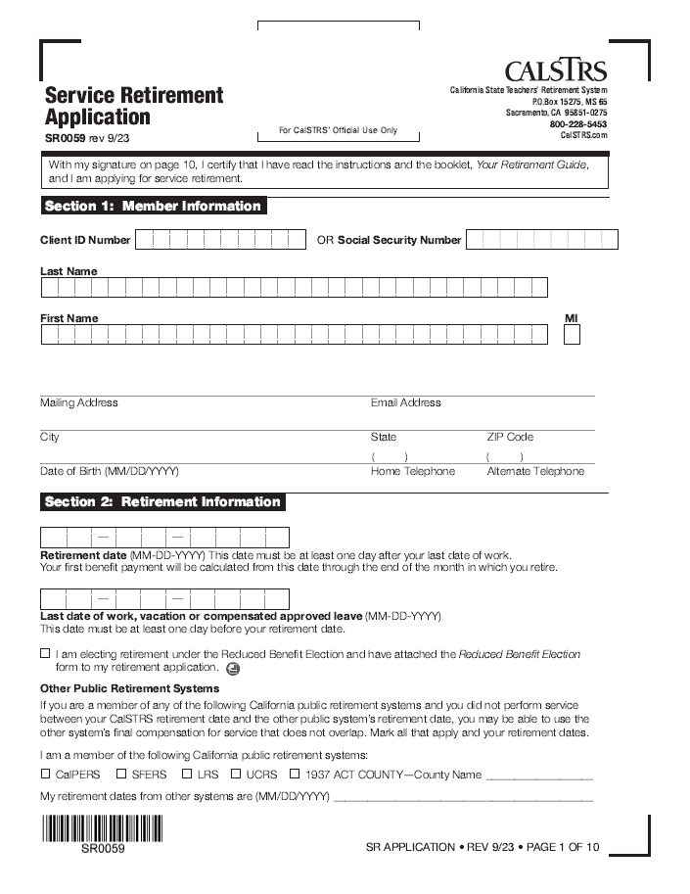
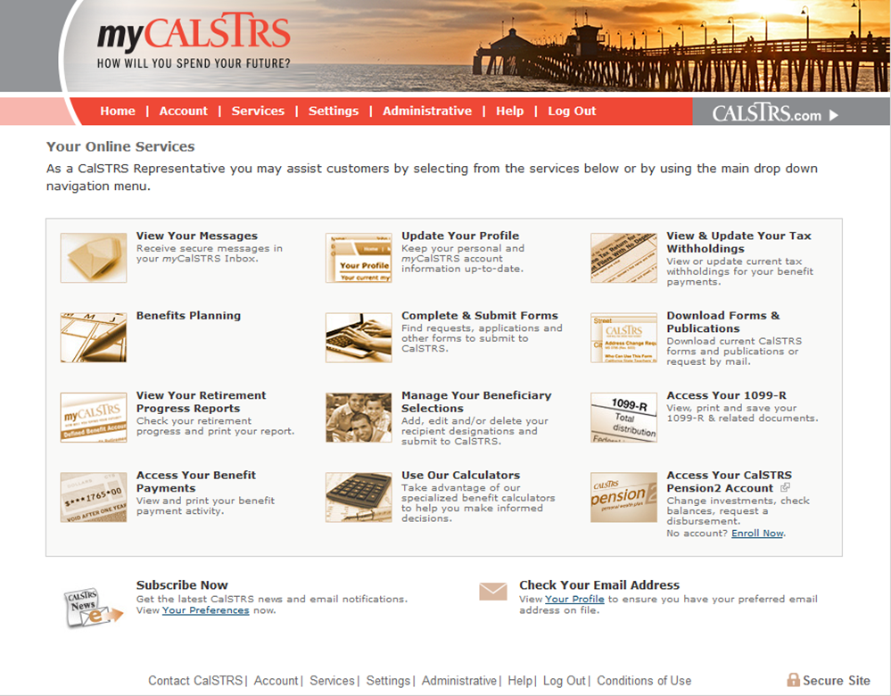
Applying for Service Retirement
Online using your myCalSTRS account
Hard copy forms
Notes:
Explain that members can apply for Service Retirement online, using their myCalSTRS accounts, or in paper, using hard-copy forms. Today’s session will focus on filling out hard –copy forms.

Slide 5
Read Your CalSTRS Retirement Guide
Your Decisions
Checklists
Instructions
Notes:
Inform members that the retirement guide is their main resource during the service retirement process. Explain the guide encompasses all the information needed regarding their retirement choices, timelines, instructions and the application process.
The guide may be found online at www.calstrs.com. Make several hard copies available during the session.

Slide 6
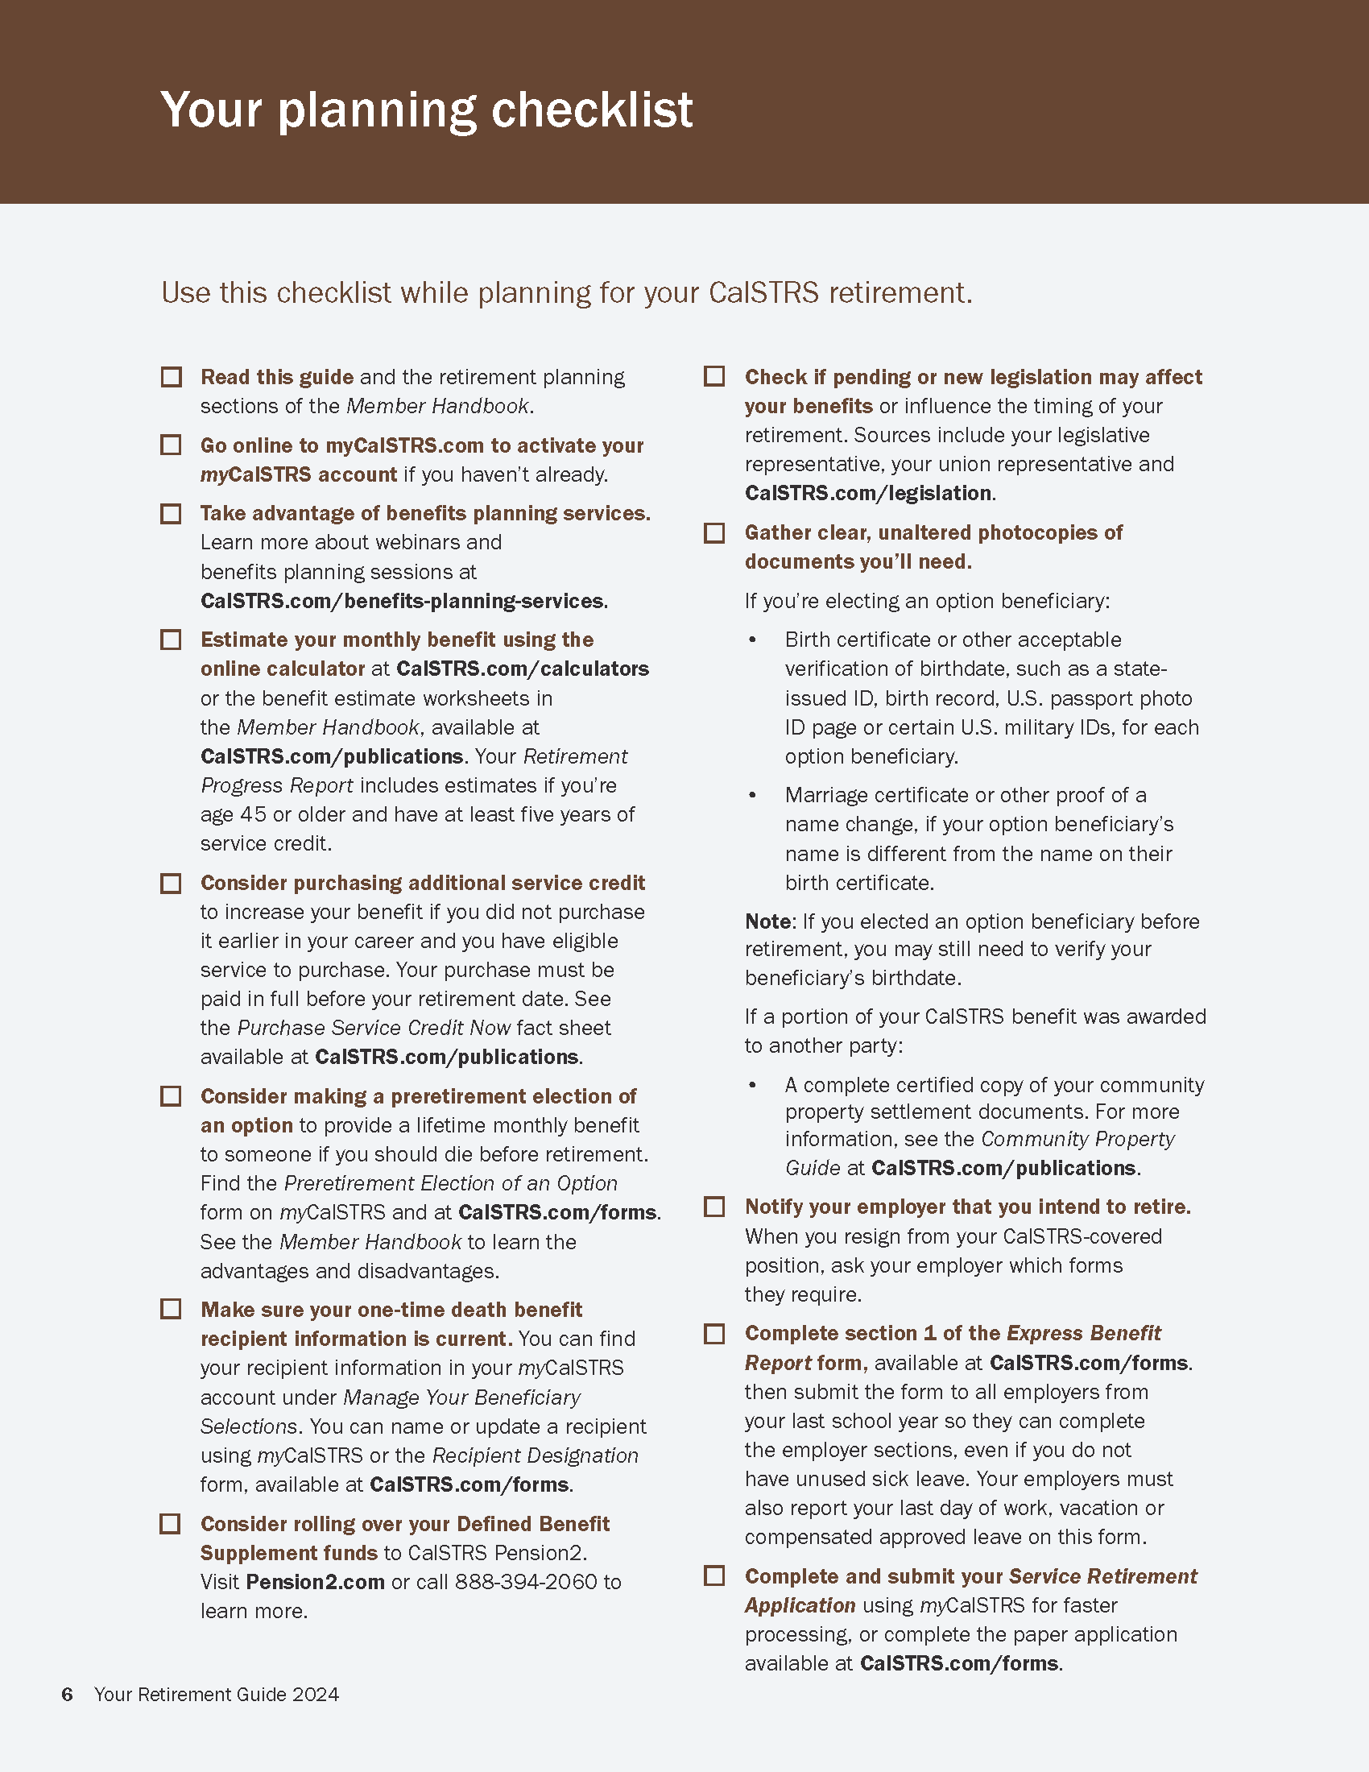
Plan For Your CalSTRS Retirement
Read Retirement Guide
Open a myCalSTRS account
Complete and submit your application
Notify Your Employer
Notes:
Point out the planning checklist and stress the importance of reading the entire guide.

Slide 7
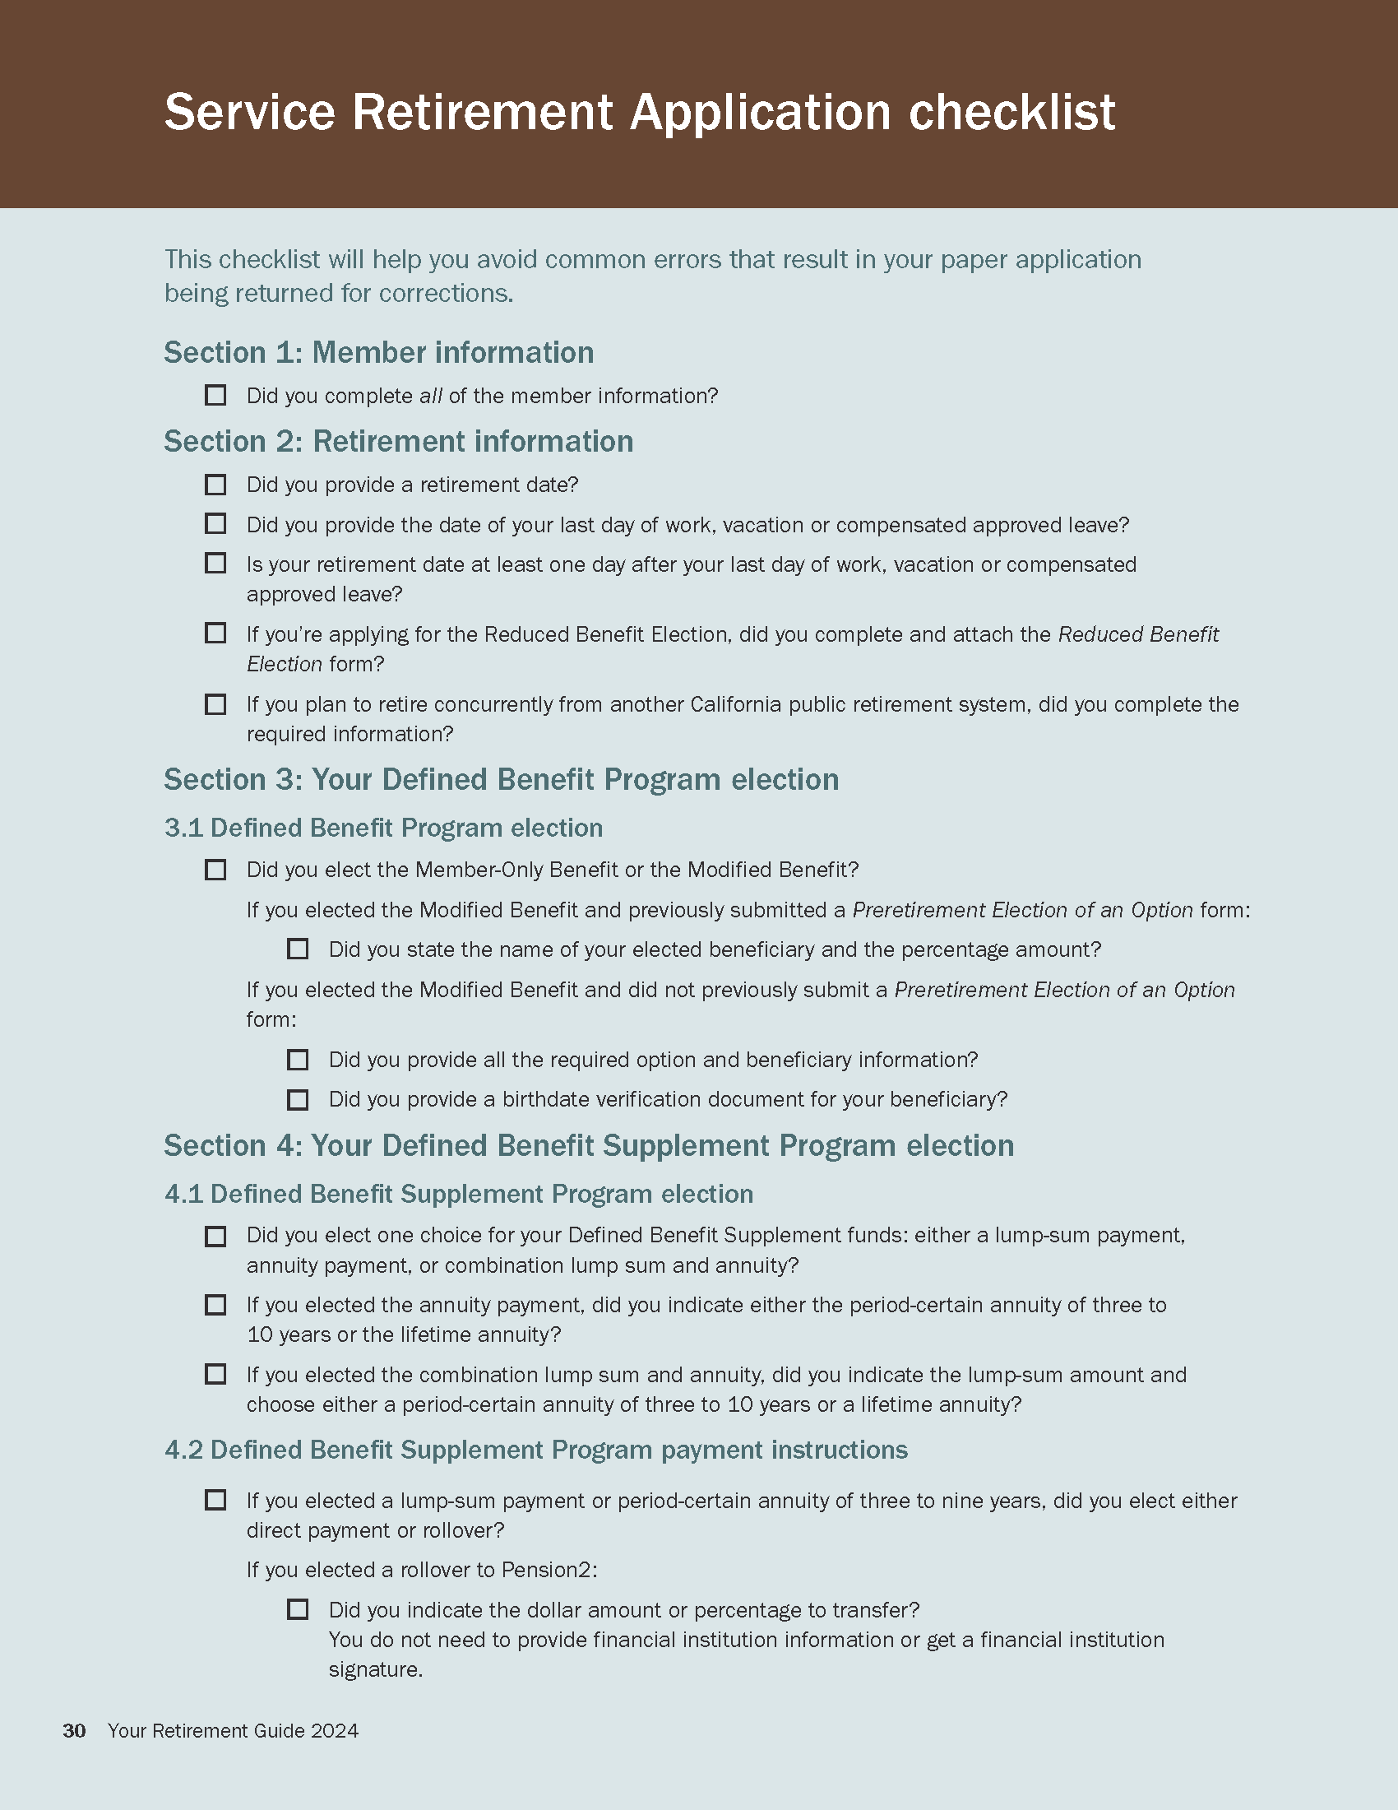
Application
Checklist
Your tool to ensure
completion
Avoid common errors
Remember to
sign & date
Notes:
Point out the application checklist – this will help members avoid common mistakes while filling out their application.

Slide 8
Service Retirement Application
Blue or Black ink
Initial Corrections
Personal Information
Retirement Date
Last Date of Work
Reduced Benefit
Election
Concurrent Retirement
One day past your last day of work
Check only if you wish to participate
Must retire on the same date
from both systems, if applicable
Notes:
Provide a review of each section of page 1 of the application.

Slide 9
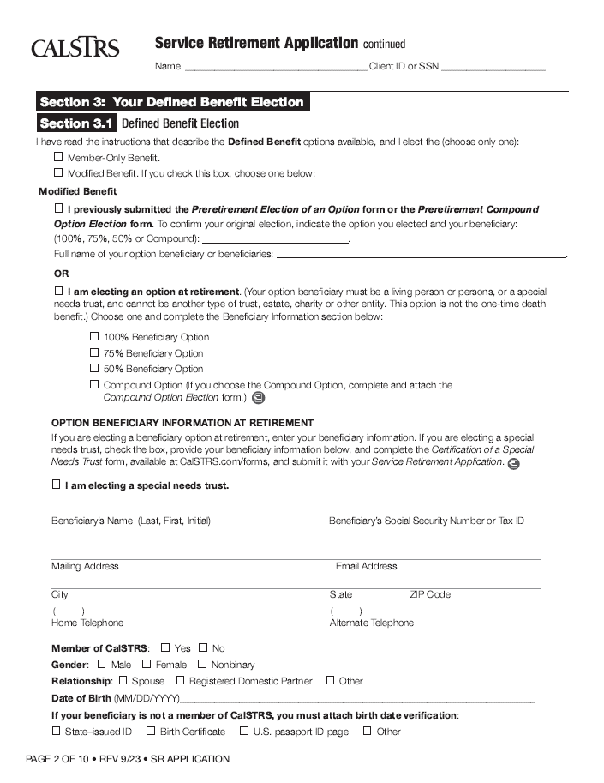
Defined Benefit Election
Member-Only
or
Modified option
1. Pre-elected
2. At retirement*
*Attach birth date verification
Check one
1
2
Notes:
Provide a review of each section of page 2 of the application.

Slide 10
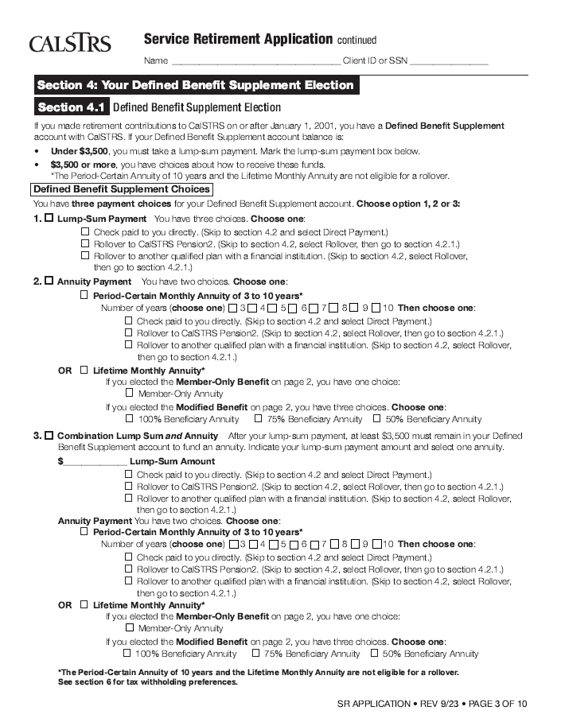
Defined Benefit Supplement Election
1. Lump Sum
Direct payment
Rollover
2. Annuity payment
Lifetime
Period certain
3. Combination
1
2
3
Notes:
Provide a review of each section of page 3 of the application. Go over the DBS payout choices in detail, if necessary.

Slide 11
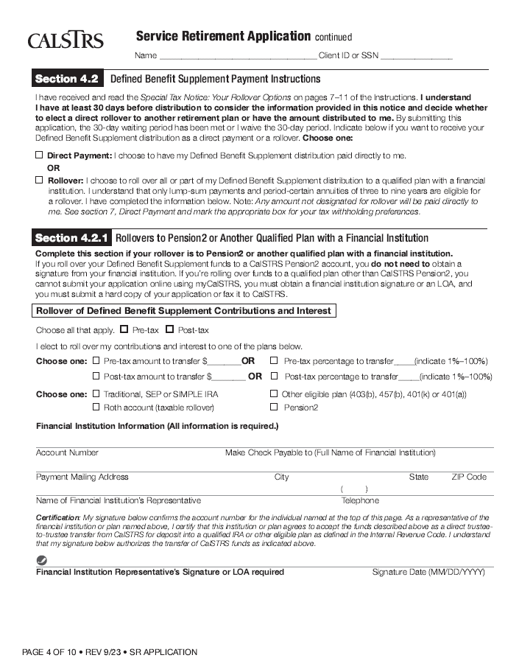
Lump Sum or 3-9 Year Period Certain Annuity
Direct payment
20% federal tax
2% state tax*
Rollover
*optional
Notes:
Provide a review of each section of page 4 of the application.

Slide 12
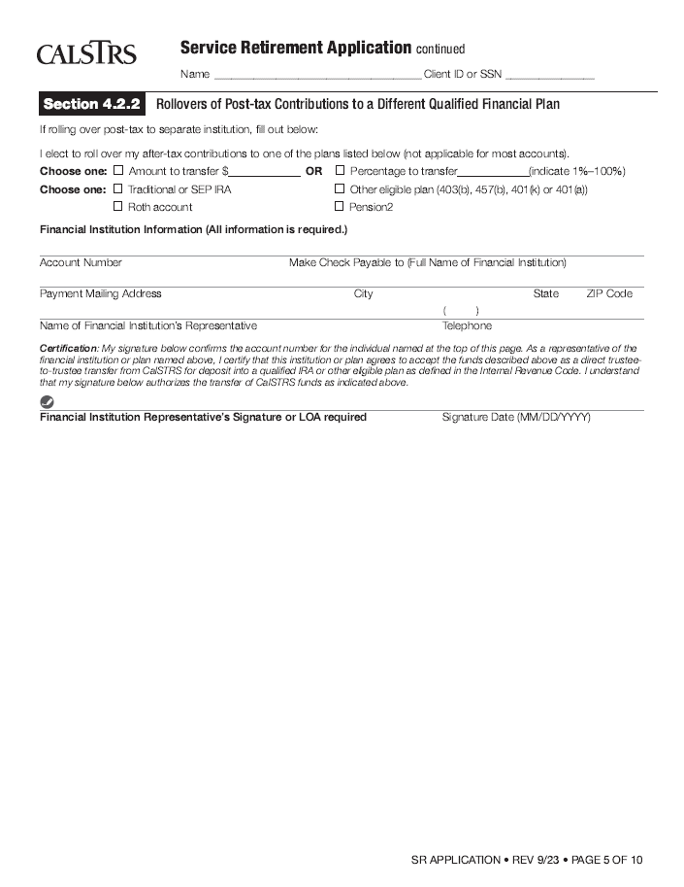
Lump Sum or 3-9 Year Period Certain Annuity
Direct payment
20% federal tax
2% state tax*
Rollover
Verify information
Qualified plan
Obtain necessary signatures
*optional
Notes:
Provide a review of each section of page 5 of the application.

Slide 13
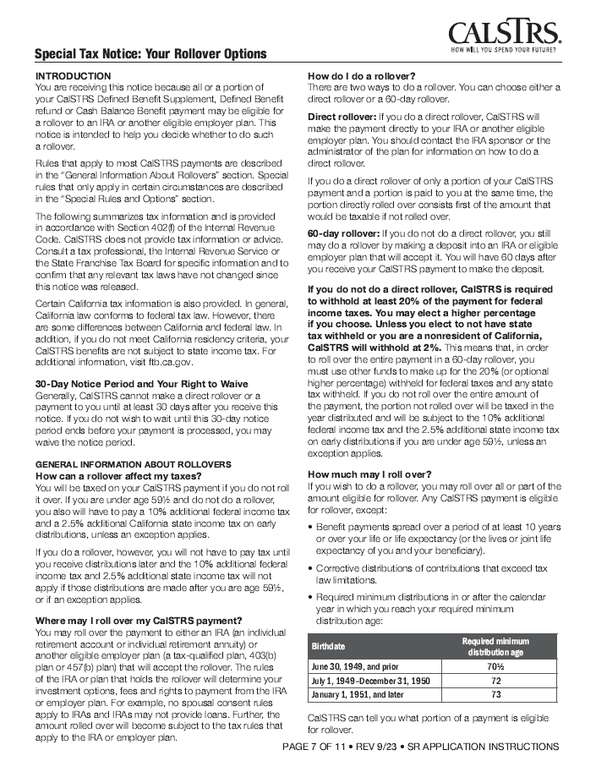
Tax Considerations For Rollovers
Consult your rollover decision
with a tax professional.
Notes:
Point out page 7 of the instructions will outline the tax considerations for those who are considering a DBS rollover.

Slide 14
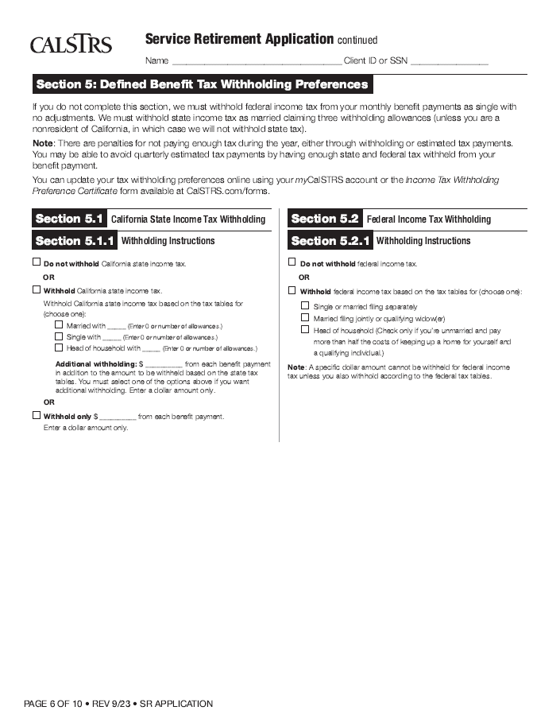
Income Tax Withholding
Preference
Taxable income
Withhold or not?
Update On-line*
* Use your myCalSTRS account to change your tax withholding preference
Consult with your tax professional
Notes:
Provide a review of each section of page 6 of the application. If a member has not elected a federal withholding, the default is now Single with no adjustments, and they will receive a Tax Election 2023 Template letter.

Slide 15
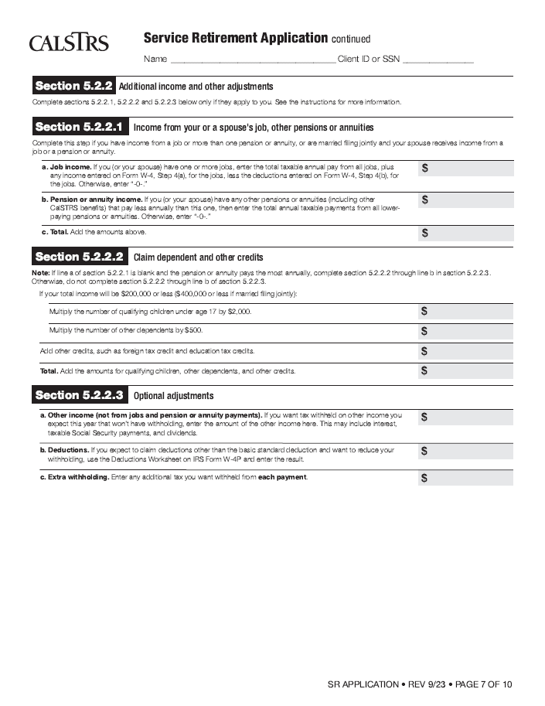
Additional Income Tax Withholding Preference
Only complete if applicable
Update On-line*
* Use your myCalSTRS account to change your tax withholding preference
Consult with your tax professional
Notes:
Provide a review of each section of page 7 of the application. There are detailed instructions and an examples in the instructions for these sections. You can also consult with a tax professional for assistance

Slide 16
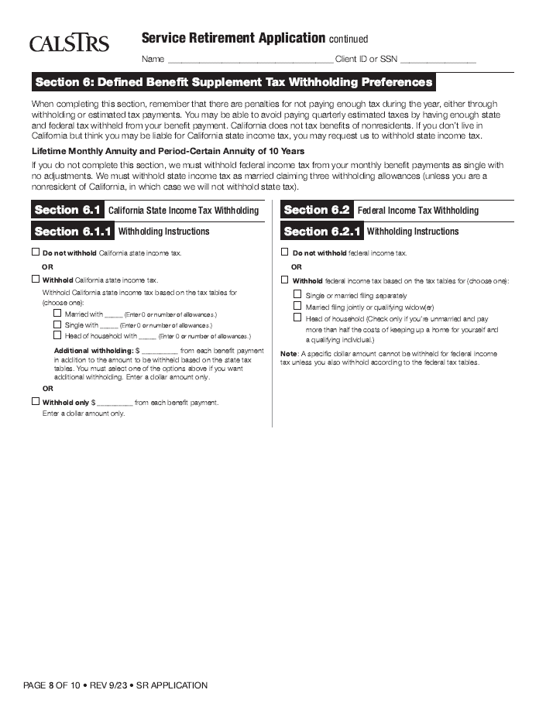
Tax Withholding Preferences (DBS)
Direct Payment
Lump sum
3-9 year period certain
Annuity payments
Lifetime
10-year period certain
Consult with your tax professional
Notes:
Provide a review of each section of page 8 of the application.

Slide 17
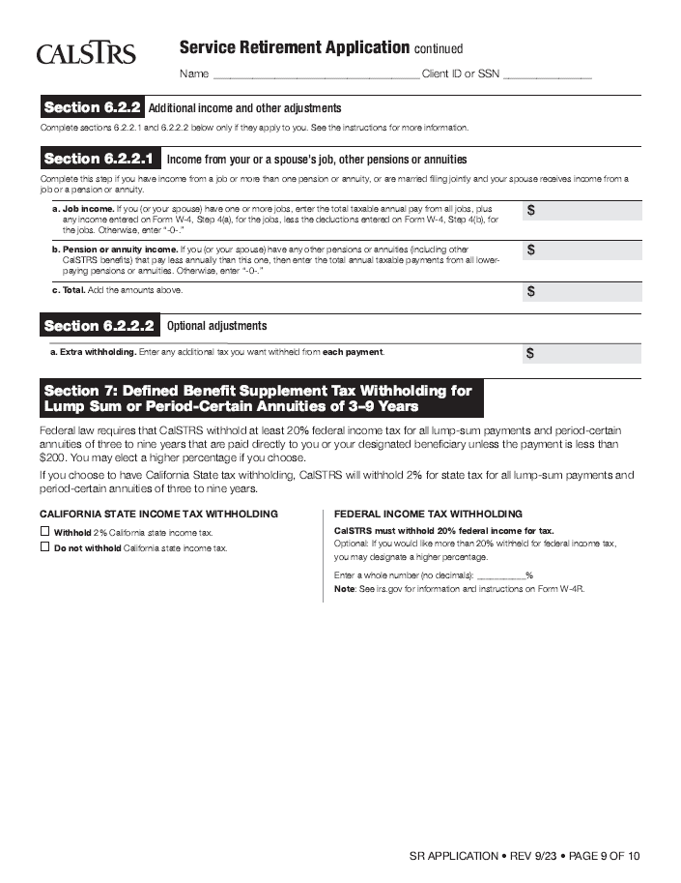
Additional Income Tax Withholding Preference
Only complete if applicable
Consult with your tax professional
Notes:
Provide a review of each section of page 9 of the application.

Slide 18
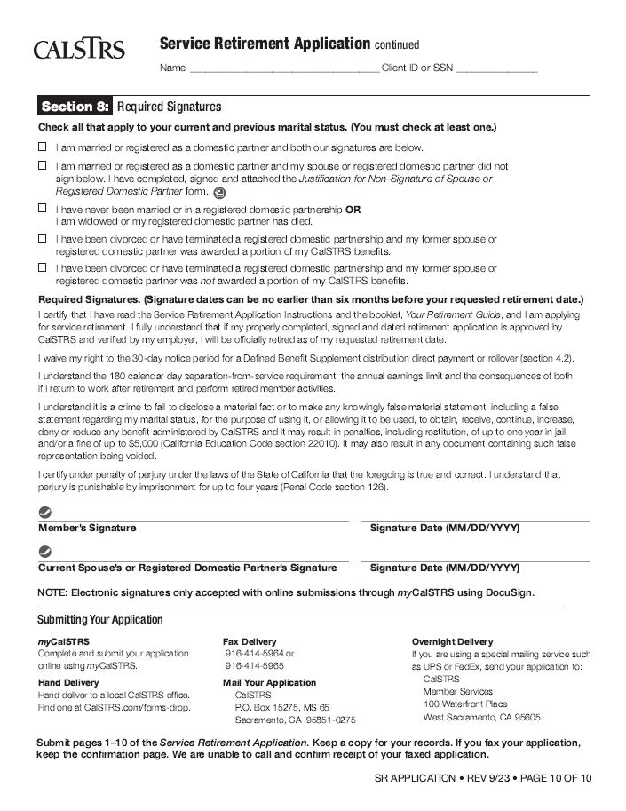
Signature and Submission
Marital status
Date and Signature(s)
Member
Spouse/Partner*
Submission
In person
Mail
Fax
*if applicable
Don’t forget to sign and date your application
X
X
Notes:
Provide a review of each section of page one of the application.
Emphasize the importance of dates and signatures, both member’s and spouse’s/partner’s, if applicable.

Slide 19
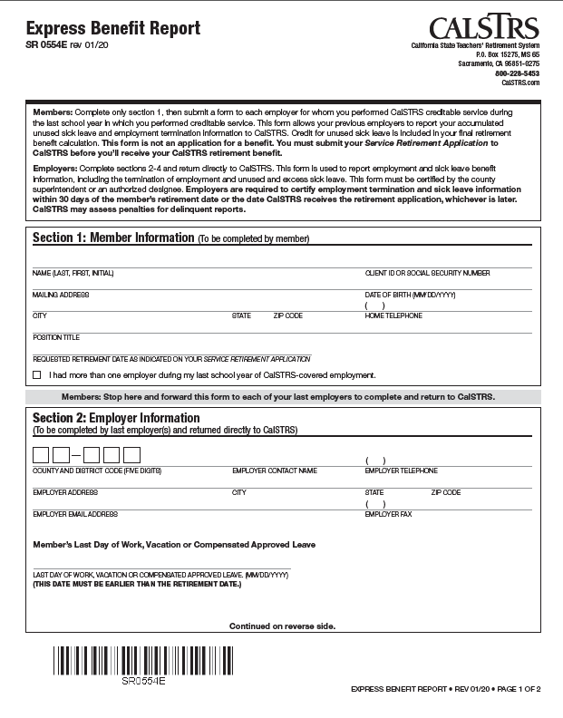
Express Benefit Report
Member
Section 1 only
Employer
Sections 2-4
Last date of paid employment
Unused sick leave
Member completes section 1 only
Notes:
Explain the purpose and importance of the Express Benefit Report. Review the form, focusing mainly on section 1.

Slide 20
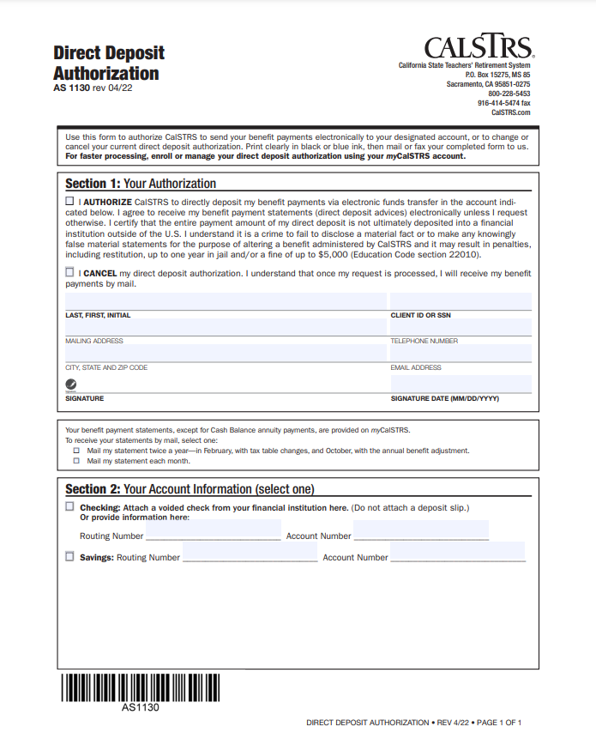
Direct Deposit Form
Fill out all sections and sign
Attach voided personal check
Submit with application
Notes:
Explain the benefit of establishing direct deposit. Review all sections of the Direct Deposit form.

Slide 21
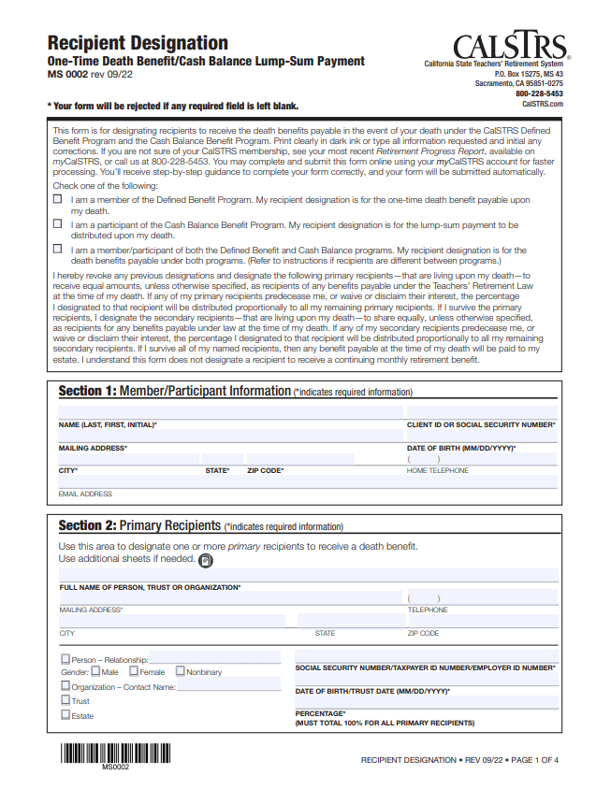
Recipient Designation Form*
One-time Death Benefit
While Active
Coverage A - $7,093
Coverage B - $28,372
When Retired
Both - $ 7,093
* Update every 5 years
Notes:
Discuss the importance of the Recipient Designation form just as you would during an individual interview.

Slide 22
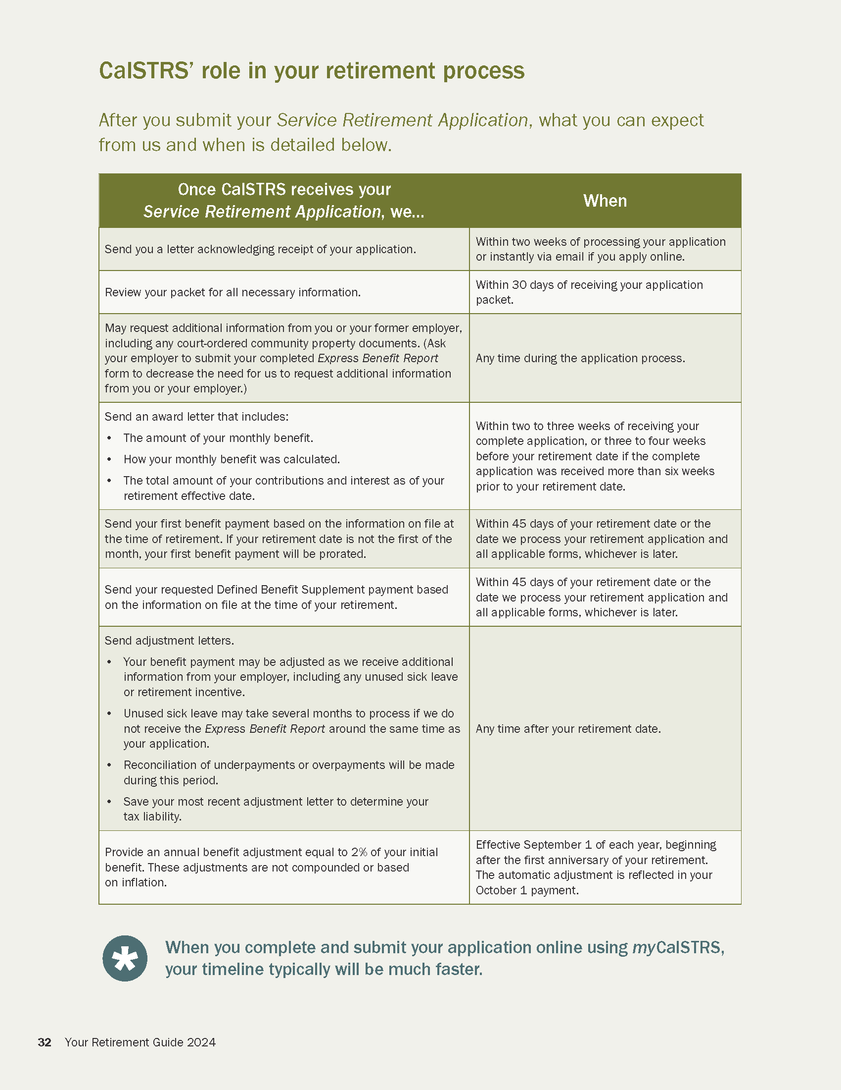
What’s Next ?
Acknowledgement
Benefit letter
Initial payment within 45 days:
retirement date
receipt of application
Adjustment letters
Notes:
Point out CalSTRS’ role in Your Retirement Process in the Retirement Guide. Discuss the process and indicated what members can expect to happen after they submit their Service Retirement applications.

Slide 23
Post Retirement Benefits
Annual Benefit Adjustment
Purchasing Power Protection
Notes:
Discuss post-retirement benefits that CalSTRS provides to its members and encourage members to establish direct deposit.

Slide 24
Earnings Limitations After Retirement
$0 earnings limit for first six months after retirement
2024/2025 earnings limit is $74,733
Earnings limit is set each July 1st
No limit for work outside of California Public Schools
Cannot contribute to Cash Balance
Notes:
Discuss post-retirement earnings limitations.

Slide 25
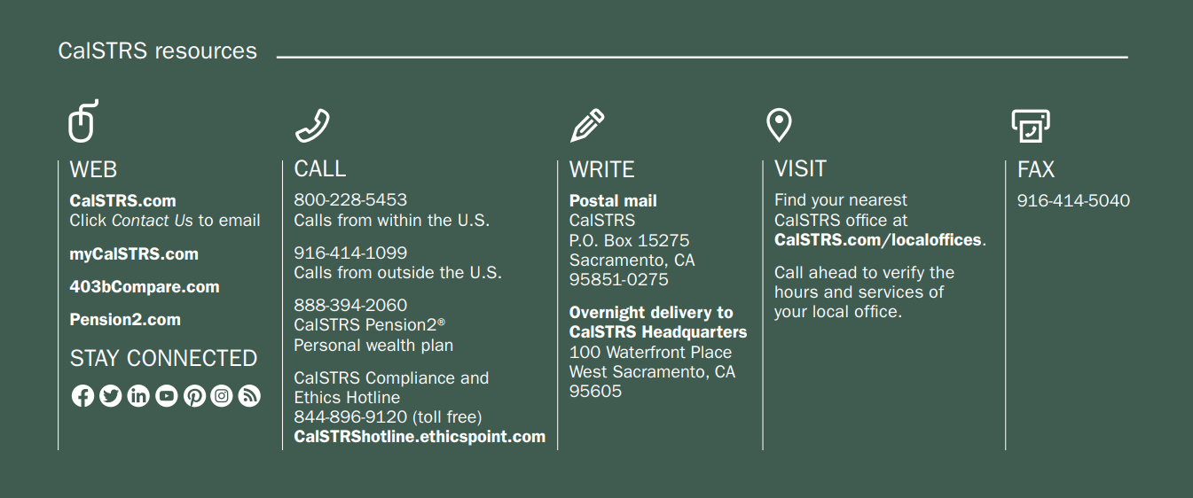
Your CalSTRS Resources
Notes:
Briefly explain that CalSTRS is there for members in retirement and go over the resources available to members.

Slide 26
myCalSTRS
Secure Messaging
Annual Statements
Address Change
Beneficiary Elections
Tax Withholding Changes
Notes:
26
Emphasize the importance and benefits of establishing a myCalSTRS account.

Slide 27
Thank you for attending
Enjoy your retirement
Notes:
End the session.

